Slide 1

FY23 DCA Dashboard Program
Transfer Decision Dashboard
Interstate Compact for Adult Offender Supervision

Slide 2
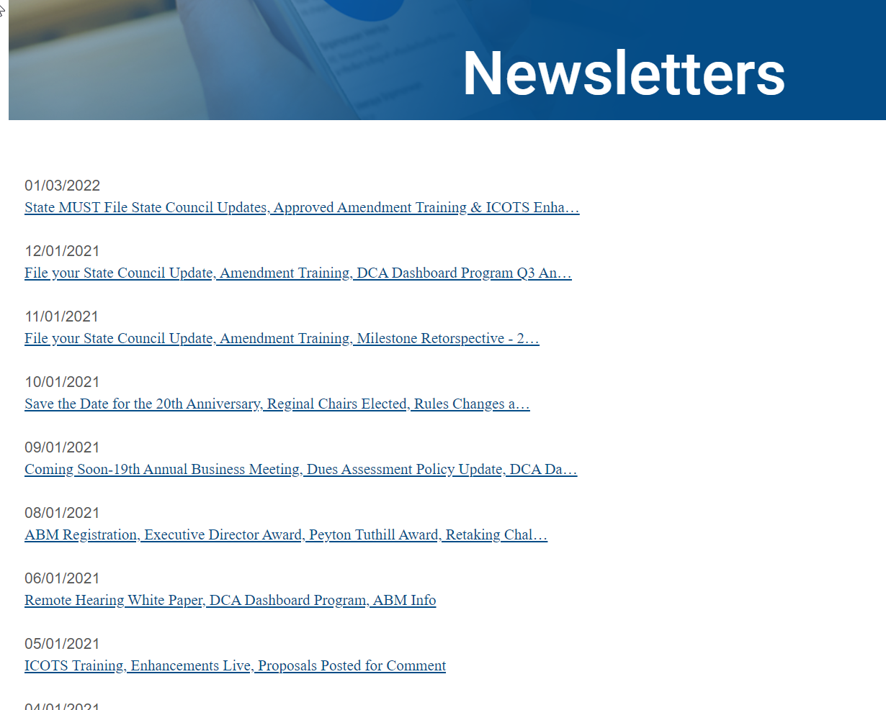

Don’t Miss Important Information!
https://www.interstatecompact.org/newsletters
October less than 20%
Open Rate ☹
Notes:
October announced UCCI Study results, documentary release, presentations, new chairs, new committees

Slide 3
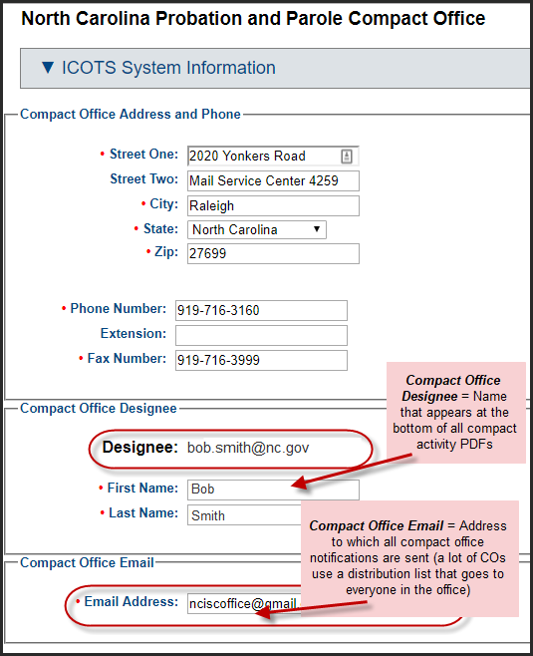
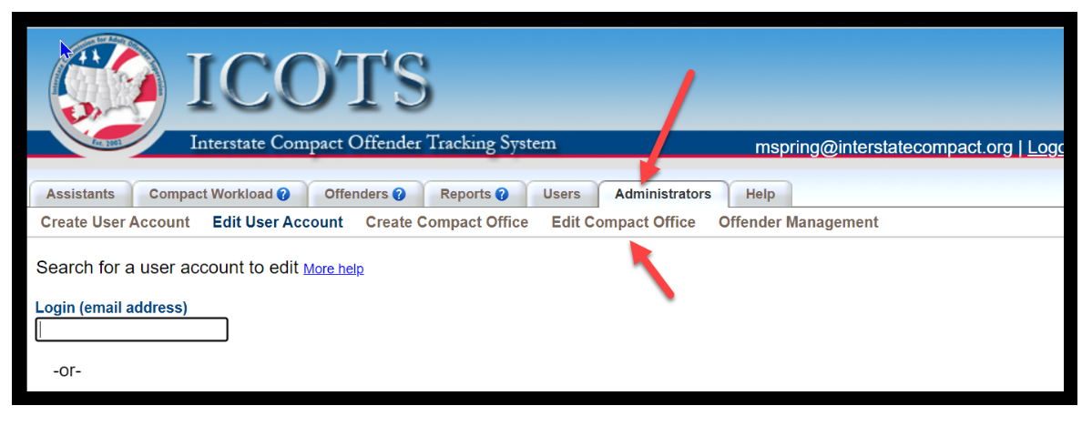
Edit Compact Office
  Change designee
  Update compact office email address for general notifications
  Update address & phone for compact office
https://support.interstatecompact.org/hc/en-us/articles/7707923338775-Managing-Compact-Office-Emails-ICOTS-PDFs-Public-Web-Portal-Information

Slide 4
Presentation Objectives
Today you will learn about:
FY22 Transfer Assessment Results & Methods
Verification Tips
Transfer Decision Dashboard Demos
  Decision Summaries
  Outgoing Case Analysis
  Incoming Case Analysis

Slide 5

FY22 Transfer Assessment Purposes
Promote offender success, effective tracking, efficient transfer processes, and adherence to ICAOS Rules 3.101, 3.101-1, 3.101-2, and 3.104.
Review the extent of change following the 2016 assessment.
  Initiated based on reports of ‘invalid denials’
  Resulted in changes to Rule 3.101-2 & ICOTS
Identify potential common factors impeding present-day acceptance rates.
Help states gain an understanding of dashboard reports.
Notes:
Assessment focus was to review state procedures from both incoming and outgoing.
How are states handling difficult cases
Are there new factors impeding acceptance rates so was a comparison to FY15 discretionary assessment

Slide 6

Transfer Assessment FY22
Purpose to promote offender success, effective tracking, efficient transfer processes, and adherence to ICAOS Rules 3.101, 3.101-1, 3.101-2, and 3.104.
Review included:
  Acceptance Rates compared to FY15:
    Data shows minimal improvement
    Unverified data remains #1 reason for rejection
  Thorough review of cases initially rejected, subsequently accepted:
    How can we get it right the first time? Improve efficiency
  Top 10 sending/receiving state
    Improve relationships with states your state does most business
Notes:
Assessment focus was to review state procedures from both incoming and outgoing.
How are states handling difficult cases
Are there new factors impeding acceptance rates so was a comparison to FY15 discretionary assessment

Slide 7
FY22 Assessment Results
Reasons for Rejection | FY2015 Discretionary | April, FY2021 Mandatory & Discretionary
Invalid/Unverified Plan | 79.6% | 72.1%
Offender in Receiving State w/out Permission | 3.9% | 4.3%
Non-qualifying Misdemeanor | 2.4% | 0.7%
Offender Changed Mind | 2.6% | 5.7%
Absconded during Investigation | 0.9% | 2.3%
Incomplete Request |  | 2.9%
No Longer Eligible for Transfer |  | 2.3%
Non-compliant Behavior / Pending Charges | 0.7% | 2.8%
Other | 9.8% | 7.1%
Sending state should WITHDRAW case, instead of requesting denial
Not a valid reason for denial; Sending state determines ‘substantial compliance’
Many identified in the assessment, pending charges were in the RECEIVING STATE
Notes:
Consistent with fy15. Most issues exist due to failure of the sending state to properly verify plan of supervision.

Slide 8
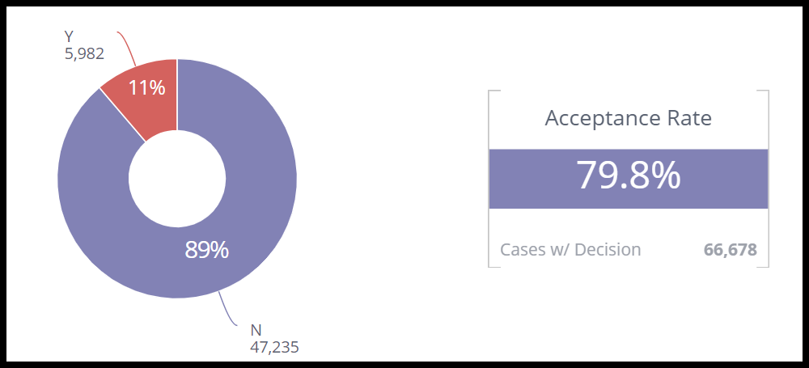
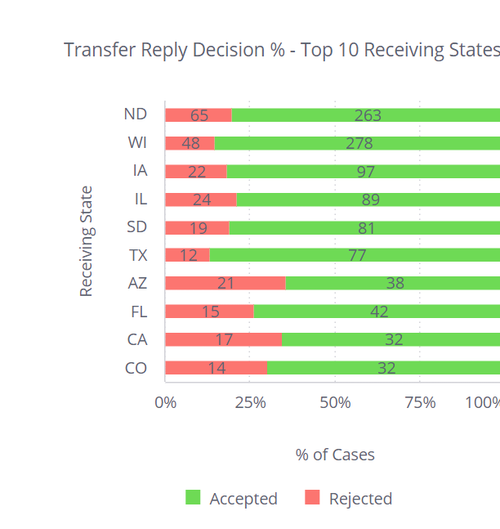
State Self-Assessments
Improve Efficiencies for Cases initially rejected and subsequently accepted (counted as Accepted) How can we get it right the first time?
Focus on ‘Top Ten’ states with whom you do business
Notes:
Clarify cases ‘rejected then accepted, are counted as ‘accepted’
Getting it right the first time prevents delays, improves efficiencies
Share data
‘Top ten’: make it a goal to improve with top ten if struggling
Are there rejection trends with particular states or when transferring to certain regions in the receiving state?

Slide 9
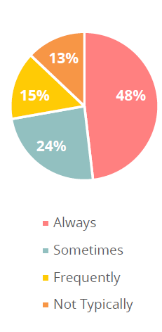
State Self-Assessments
For OUTGOING Transfers
Does your compact office follow-up to ensure transfer justifications are verified through specific or defined procedures before transmission of a transfer request?
Notes:
Shows most states rely on users to understand what it means to ‘verify’ a plan of supervision when requesting transfer.
Poll: What methods does your compact office employ to ensure transfers justifications are verified prior to transmission?
A: Require written explanation from the officer on how the plan was verified
Compact Staff calls the individual transferring as well as the sponsor
Our compact office does not ensure transfer justifications are verified

Slide 10

Documenting a Valid Plan of Supervision
Top reason for rejection:
Investigation reveals the home situation was not as described
2
Valid Plan
Terms & conditions of supervision
Residence
Employment/Means of Support
  Landlord issues, simple address verification, inaccurate information from client, sponsor/host.
  Does the sponsor understand and know what their role is and the plan of supervision?
Notes:
Having a valid plan and how that is verified and documented is so important to ensure a transfer is accepted and accepted in an efficient manner.
The #1 reason we see why cases are rejected is that the investigation revealed the information provided by the sending state was inaccurate or not verified.
Also, cooperation of the sponsor is vital so we want to ensure they understand the compact process and their expectations.
Common conditions resulting in rejections if sponsor is not aware ahead of time may include no guns in the home, alcohol, unannounced visits.
How long has sponsor known offender?
What makes the plan valid? (how can conditions be met, means of support, etc.)
Illustrate the offender is in substantial compliance; if there are pending charge, explain why offender is still eligible
Reason; why do they need/want to live in the other state? Residency, support, job, stability
#1 reason transfers are rejected due to investigation revealing the home situation was not as described. Landlord issues, simple address verification, inaccurate information from client, sponsor/host. Do more vetting on the front end less rejections; does the sponsor know what it means? Understand conditions: guns in the home, alcohol, unannounced visits. Conditions may be added by receiving state
Sponsor Relationship how long known (non family)
Substantial compliance-pending charges/warrants/detainers
Reason: illustrating they meet the reason qualification/documentation

Slide 11
Documenting a Valid Plan of Supervision
2
How are conditions of supervision going to be met?
What is the means of support? How did you verify this?
If the sponsor is a non-family member, what is the relationship?
Reason for transfer should illustrate reason qualification and include any supporting documentation. Why does the client want to live (or why do they live) in the receiving state?
Valid Plan
Terms & conditions of supervision
Residence
Employment/Means of Support
Notes:
Having a valid plan and how that is verified and documented is so important to ensure a transfer is accepted and accepted in an efficient manner.
The #1 reason we see why cases are rejected is that the investigation revealed the information provided by the sending state was inaccurate or not verified.
Also, cooperation of the sponsor is vital so we want to ensure they understand the compact process and their expectations.
Common conditions resulting in rejections if sponsor is not aware ahead of time may include no guns in the home, alcohol, unannounced visits.
How long has sponsor known offender?
What makes the plan valid? (how can conditions be met, means of support, etc.)
Illustrate the offender is in substantial compliance; if there are pending charge, explain why offender is still eligible
Reason; why do they need/want to live in the other state? Residency, support, job, stability
#1 reason transfers are rejected due to investigation revealing the home situation was not as described. Landlord issues, simple address verification, inaccurate information from client, sponsor/host. Do more vetting on the front end less rejections; does the sponsor know what it means? Understand conditions: guns in the home, alcohol, unannounced visits. Conditions may be added by receiving state
Sponsor Relationship how long known (non family)
Substantial compliance-pending charges/warrants/detainers
Reason: illustrating they meet the reason qualification/documentation

Slide 12
Improving Transfer Documentation Promotes Supervision Success!
Increases efficiency of the transfer process
Creates Good Business Records
Promotes compliance
Sets good examples for other users
Ensures the best plan for a client to be successful on supervision
Notes:
Good documentation does what…..

Slide 13
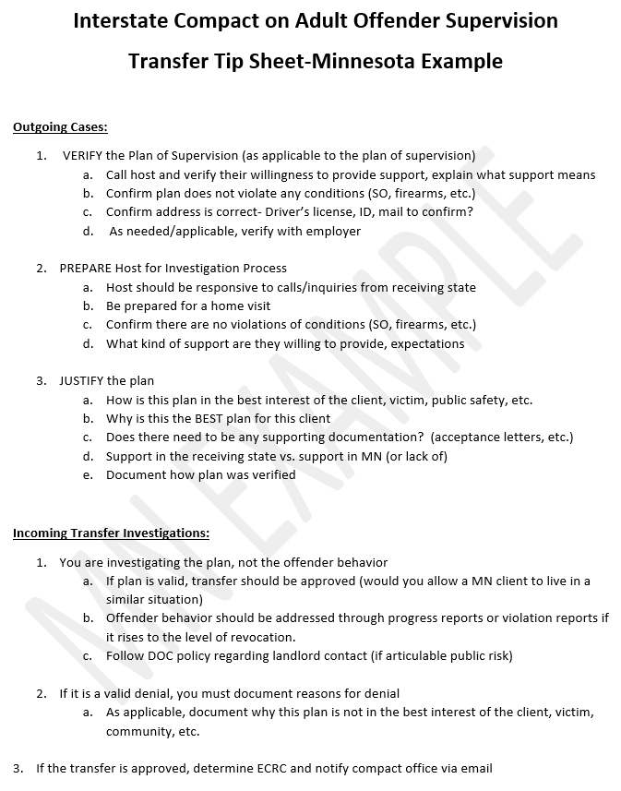
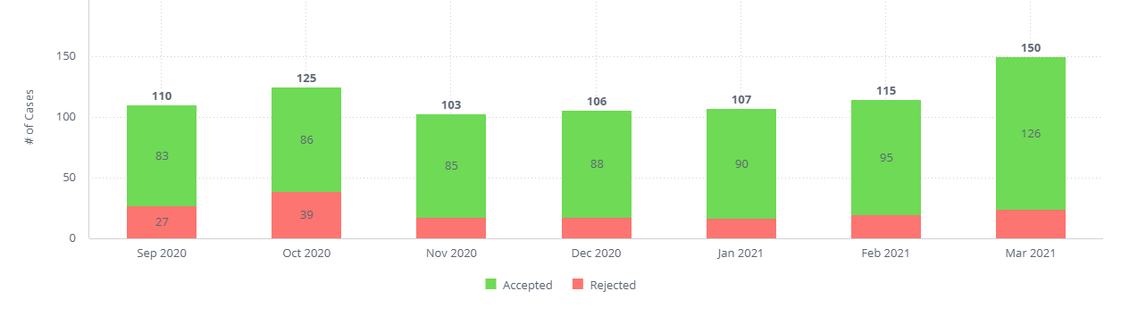
Minnesota implemented use of tip sheet
Notes:
Here is the result of that. So seems simple, but definitely increased the rate of acceptances which at the end of the day not only ensures efficiency but also decreases the chances for rejections.

Slide 14
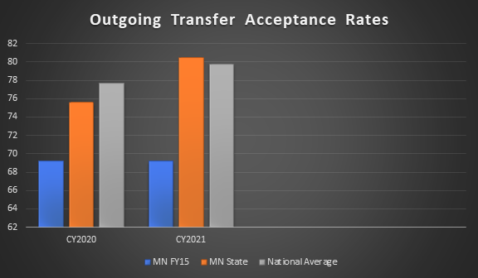

Slide 15
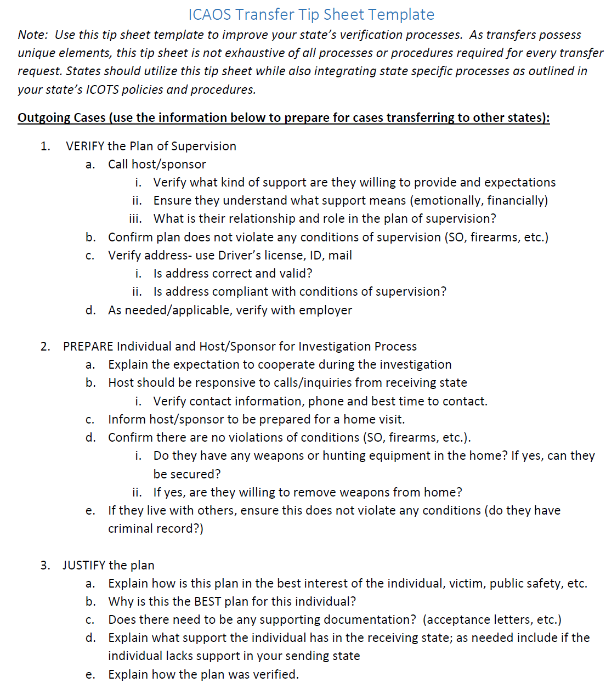

New Tip Sheet Template
https://support.interstatecompact.org/hc/article_attachments/9634362070807
Notes:
Poll:
Does your state use a tip sheet to assist with ensuring proper verification?
Yes
No

Slide 16
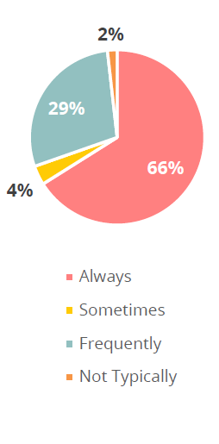
State Self-Assessments
For INCOMING Transfers
Do transfer decisions consider the purposes of the compact?

Slide 17

What is the impact of the decision on the client?
Good plan versus best plan
Will a rejection merely delay the process?
Would the decision be different for an in-state client?
Does the decision directly punish the Client?
Is this a blanket rejection versus a specific one to a proposed plan?
For example, rejections merely because the sponsor is the fiancé/ non-family

Slide 18

Questionable Rejections……
Any type of Blanket Rejection
Dual Supervision (also on supervision in the receiving state)
Federal Probation
Detainer Releases
Pending Charges/Non-compliant Behavior
Rejected based on circumstances allowed for your own state clients

Slide 19
Crime committed while living in sending state w/ girlfriend. No other family/support exists in sending state; Relationship ended and subject moved to the receiving state to be supported by daughter prior to sentencing; June 2022
Sentenced Sept 2022; reporting instructions approved to live with daughter
During investigation daughter decides subject may no longer reside with her and now subject is homeless living in a shelter
Subject is completely disabled (severe medical issues & awaiting heart surgery) no transportation and lives off social security; Due to his move from the sending state (now non-resident status), he would not be eligible for services in sending state immediately
Son (who also lives in receiving state) assists with basic needs (driving to Dr. appts etc.) and emotional support but not amenable to allowing the subject to reside with him
Notes:
Poll: How would you/your state handle this incoming case?
Immediately reject, requiring return due to the subject being homeless
Send out to field for investigation
Elevate to DCA to discuss case, find out additional details and strategize on the best course of action

Slide 20
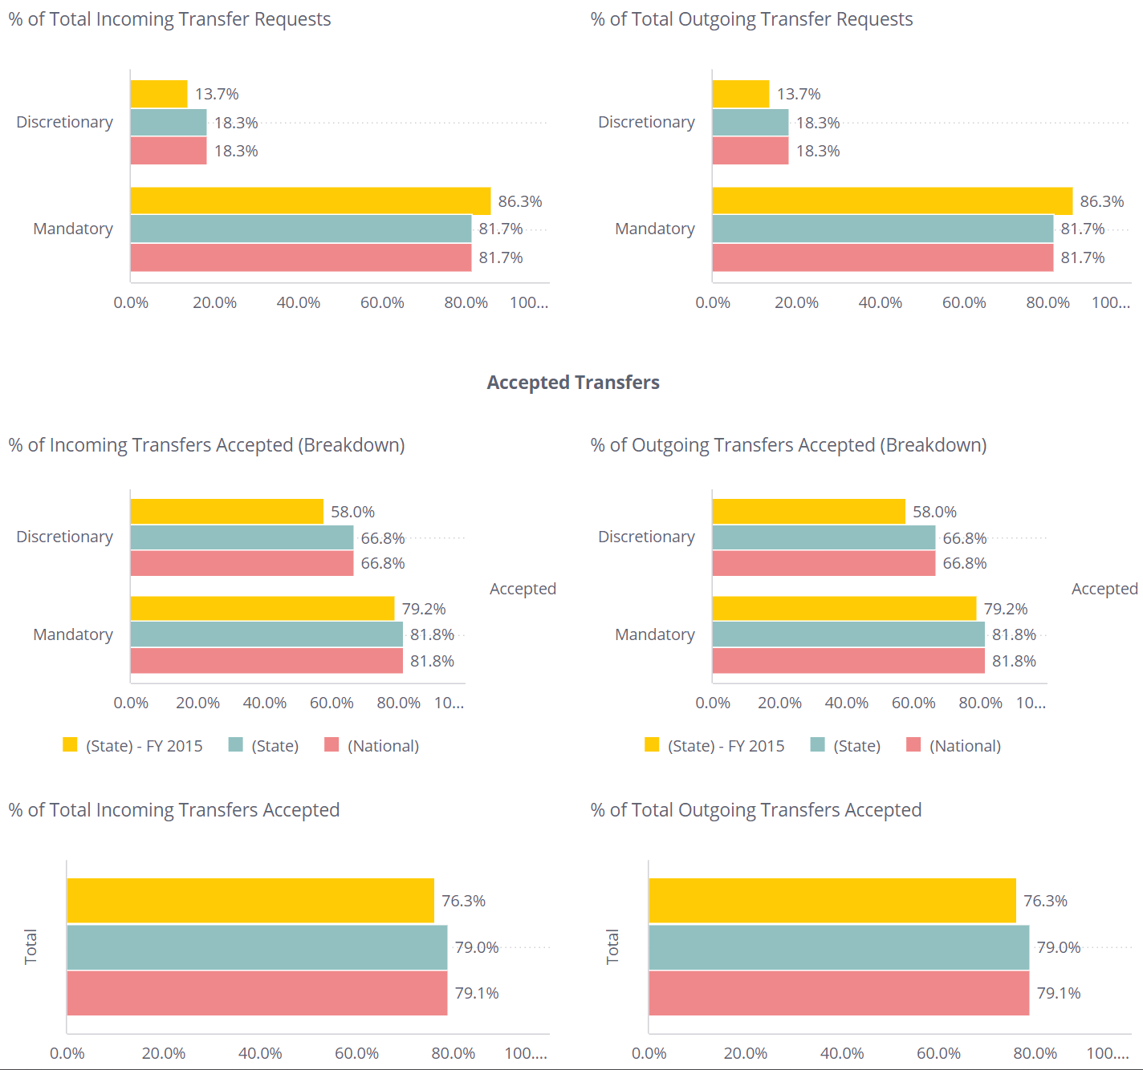
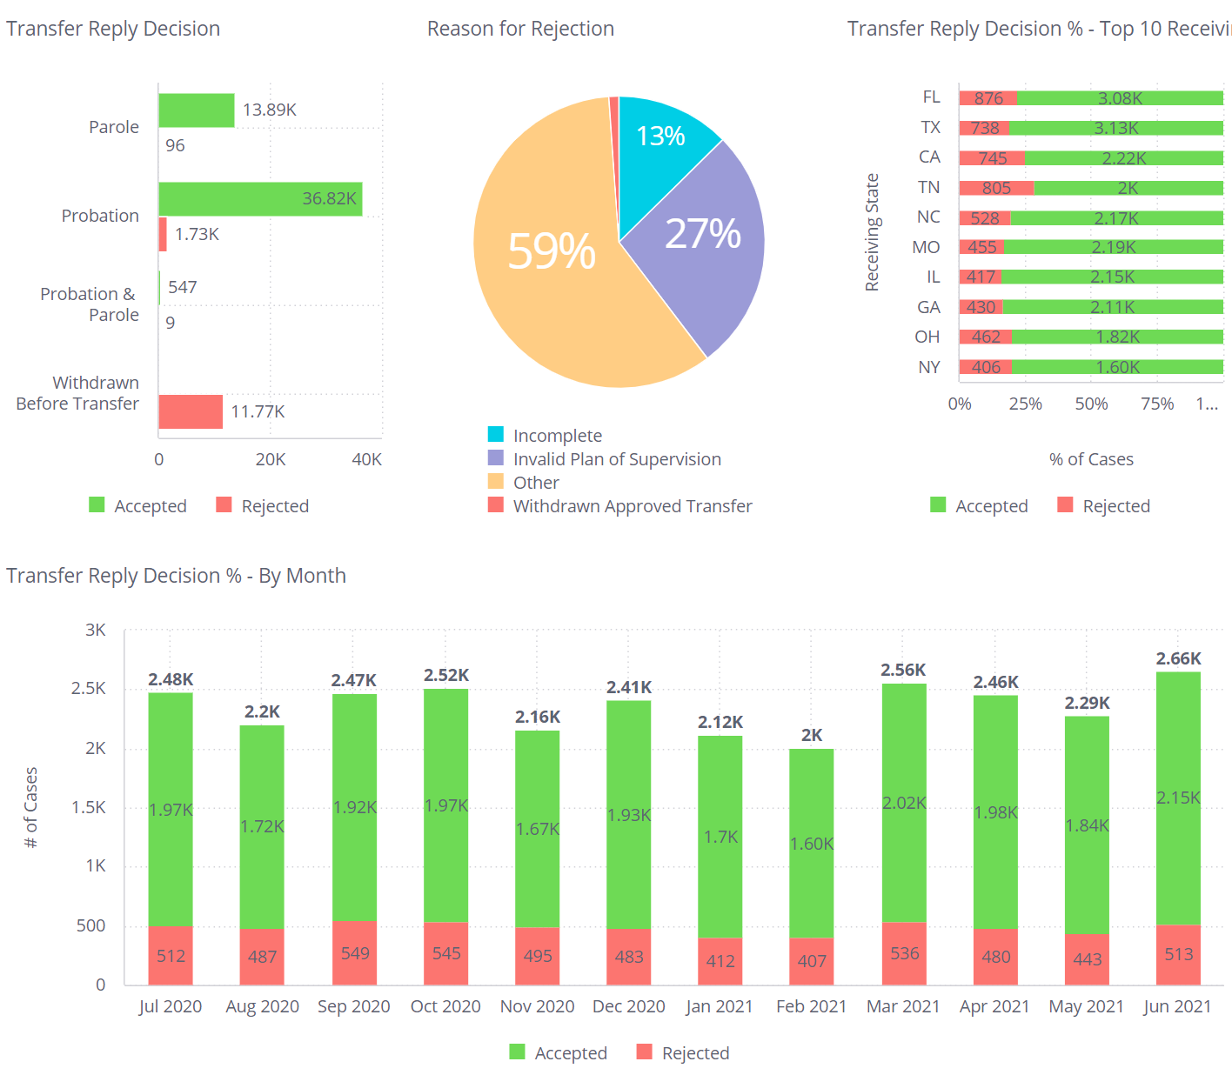
Transfer Decision Reports Analysis
Supervision Type
Race
Gender
Agent
Agency
Compact Staff Reviewer
Sex Offender
Justification/Rejection
Notes:
Report Demo

Slide 21
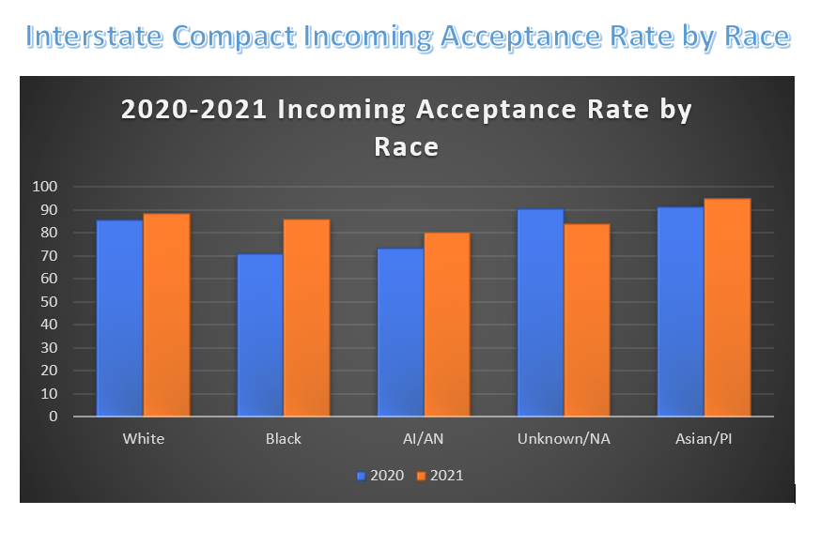
Minnesota’s Assessment of Racial Equity

Slide 22
How Can Your State Improve Transfer Processes…..
Assessment Results
Meet
Tools
Use in trainings
  Measure Successes
  Areas for Improvement
Border Meetings
Top Ten Sending/Receiving
  Learn & Share info on laws
Tip Sheets for Users
New Documentary
New UCCI Study
Review Priorities
Elevate
Focus on Purposes
Enhance Compact Office Review for OUTGOING documentation
Audit Staff
  Ensure users have a clear channel to elevate issues to compact office
  Keep Commissioner apprised
  Request Assistance
  What is the right decision for:
    Individual Transferring
      Rehabilitation
      Effective Supervision & Tracking
    Public Safety
    Victim's Rights/Safety
Notes:
New documentary and UCCI study highlight both strengths and weaknesses in ISC business
Related to transfers delays in transfer when sponsor is non-family; one subject had to get married before RS would accept. Nothing else in plan changed
UCCI bad contact information for clients posed challenges for client interviews, communication should be improved; what can we do now, what should commission consider technology wise to make better.
Can only control what goes out of your state; DCAs, your name is on every transfer going out of your state
Learn and Share: Highlight Midwest, IA sex offender laws, DUI laws

Slide 23
Technical & Training Assistance AP 1-2008
Request Requirements
Commissioner request to Executive Director
Description of Need
Number of recipients
Desired Outcome/Objective
Proposed Delivery
Transfer Decision Biannual Emails begin January 2023
% of Cases Initially Rejected, then Accepted
https://www.interstatecompact.org/policies/01-2008

Slide 24
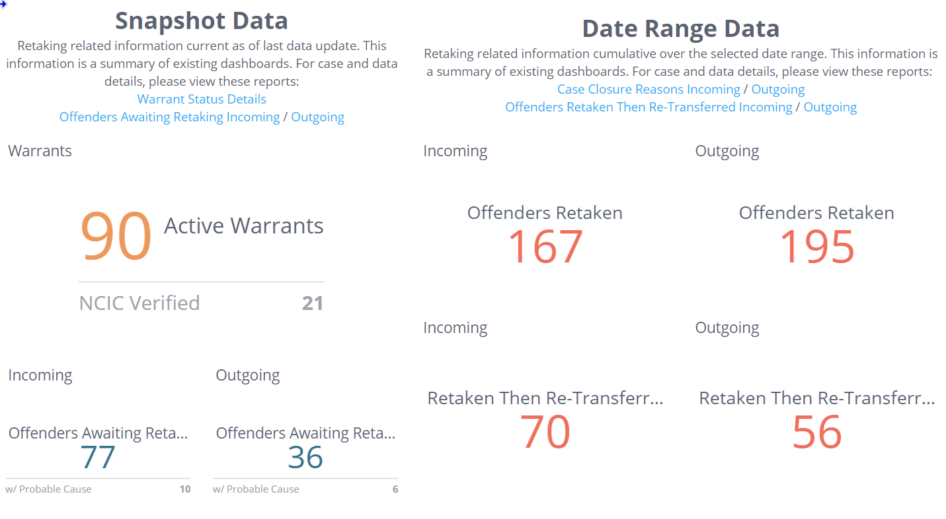
NEW Retaking Management Dashboard
https://dash2.interstatecompact.org/app/main#/dashboards/6308eb628fe71a2884fb9ab6
Notes:
New emails also starting in January 2023
Will be part of the next DCA dashboard training early 2023 focusing on warrant tracking
Discussions at ABM centered on absconders and alternatives to retaking. What actually occurs in these cases where a retaking occurred and a retransfer.

Slide 25
Thank You
Interstate Compact for Adult Offender Supervision

