Slide 1
Warrant Management Dashboard Training July 2022
Interstate Commission for Adult Offender Supervision

Slide 2
Presentation Objectives
Today you will learn about:
Warrant Status FAQ’s
New Warrant Management Dashboard
FY23 Compliance Audit Preparations
ABM Registration OPEN!

Slide 3
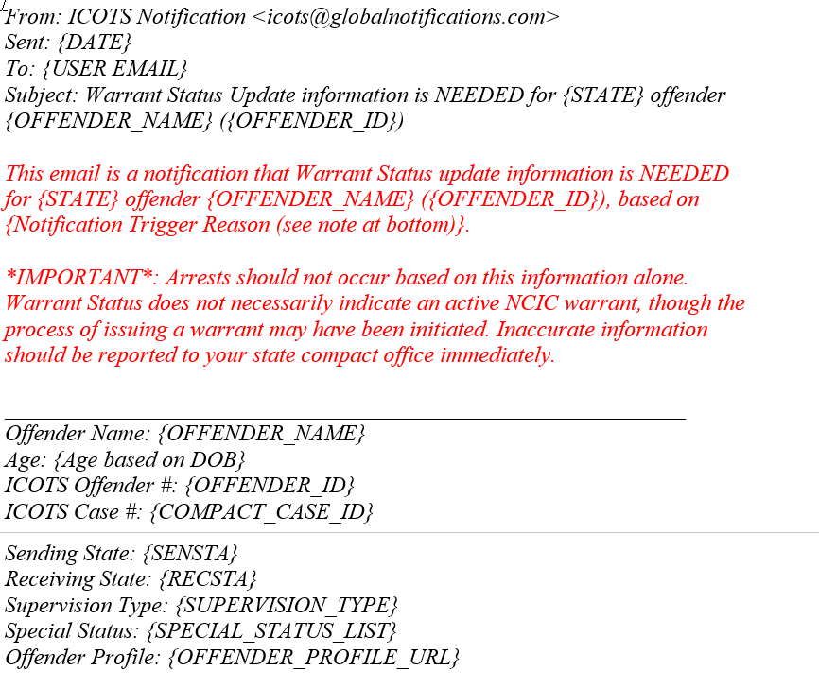
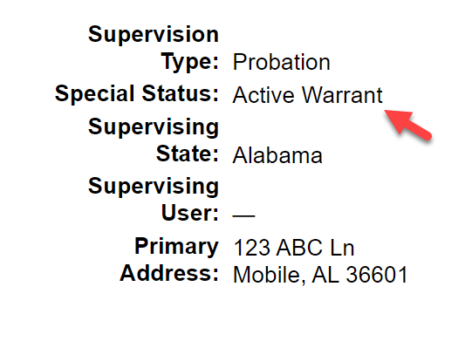
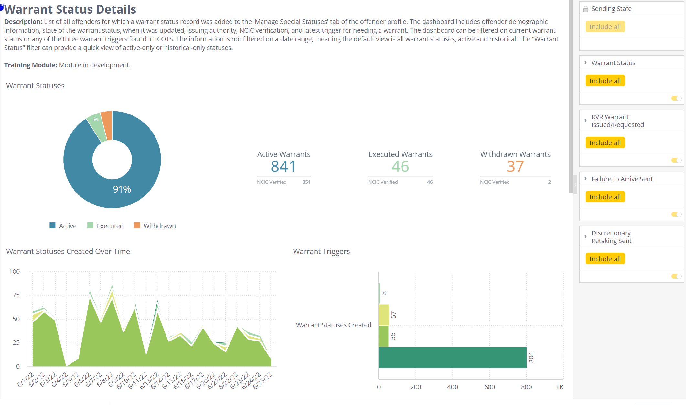
Warrant Status
New Special Status
Email Notifications
Data Export
Triggered by ICOTS activities

Slide 4
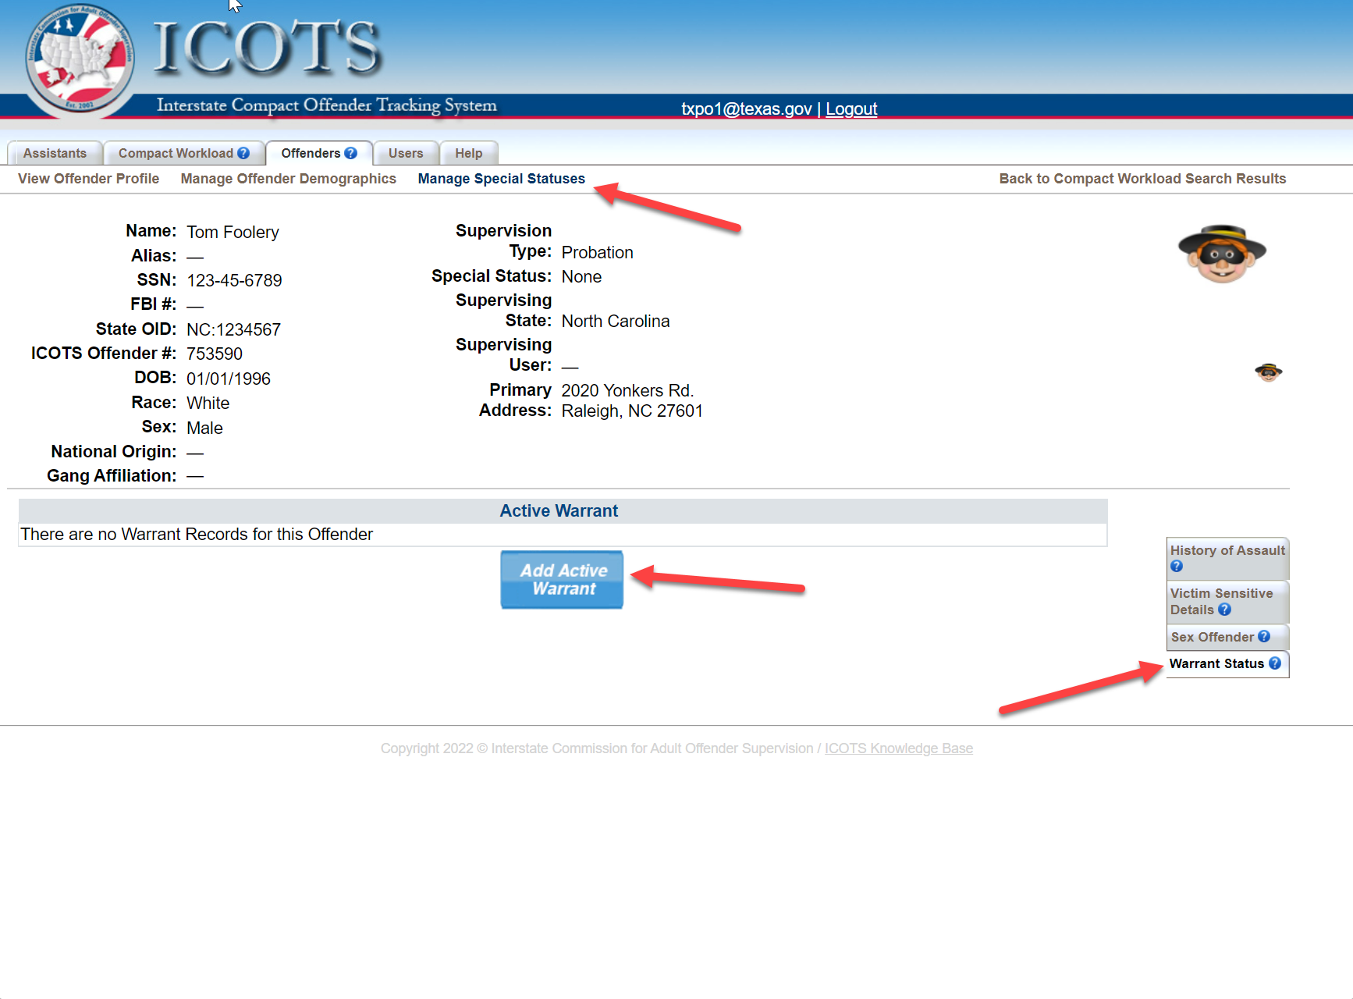

Slide 6
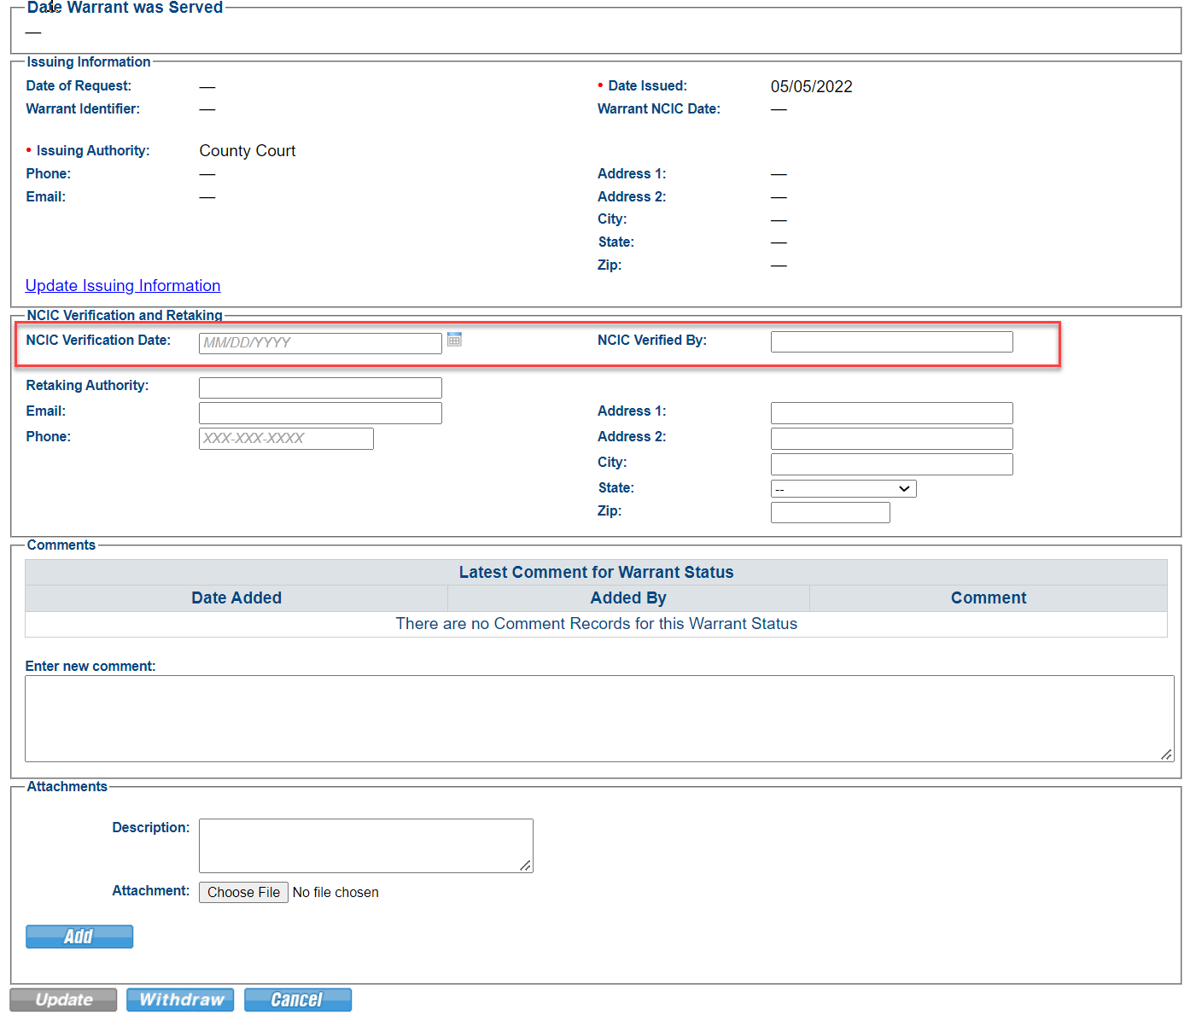
Enter verification date AFTER confirming warrant is compact compliant
No geographic limits
No bond
Entered into NCIC

Slide 7
Warrant Status Workflow
Add/Update Warrant Status records anytime via the Offender profile
ICOTS will prompt the user (via email notifications) to add warrant records upon submission of:
Failure to Arrive;
Mandatory Retaking (via Violation Report) w/Sending state
response of ‘Warrant Issued/Requested;’ or
New Discretionary Retaking
‘Warrant Status Update Needed’ email notifications sent @ 5, 10, 15, and 30 days
Warrant Status record historical and emails stop after indicating warrant is ‘withdrawn’ or ‘served’
See article for details
Notes:
Email stop triggers noted in article
https://support.interstatecompact.org/hc/en-us/articles/6280328669847-Warrant-Status-Special-Status

Slide 8
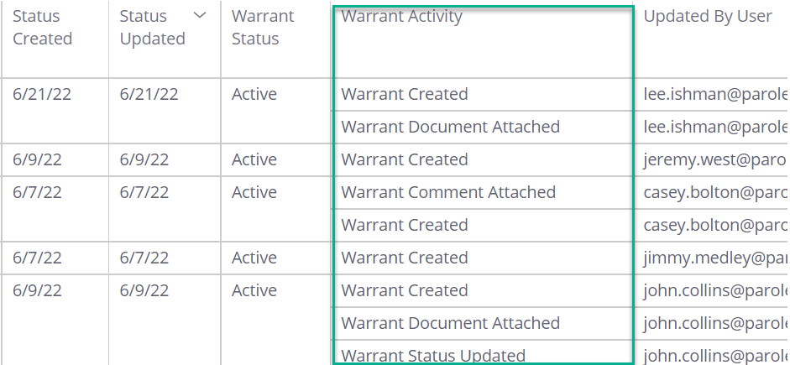
New Warrant Management Dashboard
Shows records for ALL TIME
In screen filters allow filter by warrant status (active, withdrawn, executed) and initiating activity type
Export and filter for specific timeframe data
Warrant creation & update records
https://dash2.interstatecompact.org/app/main%23/dashboards/62b489d64ecdd92ae0ab27cf

Slide 9
Report Demo

Slide 10
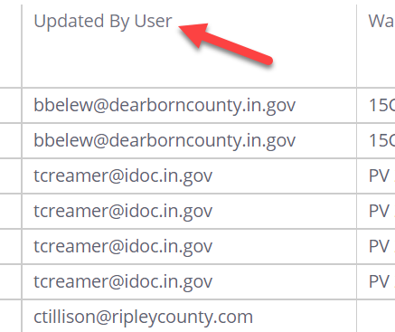
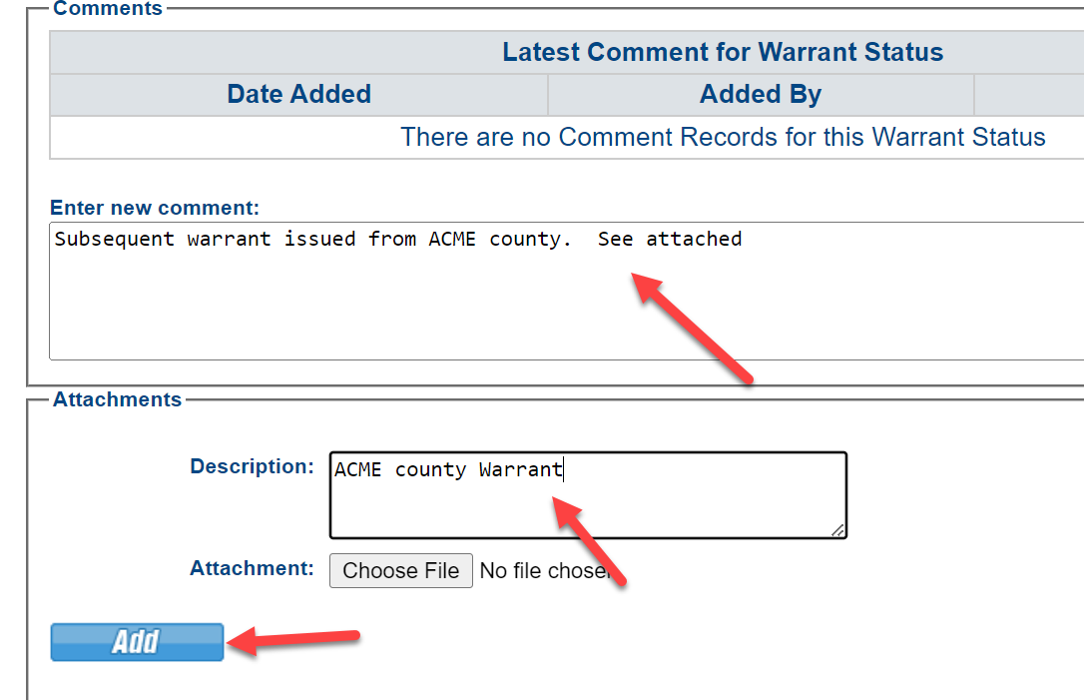
Warrant Report Limitations
∙
No ability to sort by supervision type
Export to filter by user email address
∙
Only 1 warrant record active at any given time
Note additional warrants in comments

Slide 11
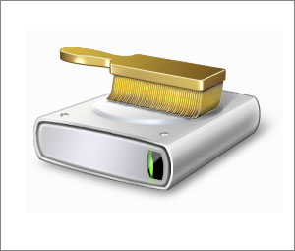
FY23 Compliance Audit
Data Integrity Audit Covering:
Demographic data
Photos
Junk/Duplicate Offender Cleanup
Rejected Case Clean-up
Rejected 60+ days
Awaiting Retaking Clean-up
https://support.interstatecompact.org/hc/en-us/articles/5744894888087-FY23-ICAOS-Compliance-Audit
Notes:
All from past audits or highlighted in this year’s DCA Dashboard Program.
Go to article for details

Slide 12
Prepare for discussions at ABM!!
ABM Registration now open!
How is your state utilizing the ‘tolling’ feature?
Review tolled cases
FY22 Rejection Assessment
What did your state learn or change?
Drug Laws
What is the impact of decriminalization on supervision?
Past, Present & Future of ICAOS theme
Debut of documentary & UCCI Compact Study

Slide 13
Thank You
Interstate Compact for Adult Offender Supervision

