Slide 1
2021 Approved Rule Amendments & ICOTS Enhancements Part II May 2022
Interstate Commission for Adult Offender Supervision
Notes:
2022 Approved ICOTS Enhancements • New Warrant Status: • Offender Profile • Email Notifications • New Discretionary Retaking Activity Offender Management Enhancement • New restrictions to improve process management FY23 Compliance Audit Planning New Dashboard (Tolled ICOTS Cases) & New CAR Data

Slide 2
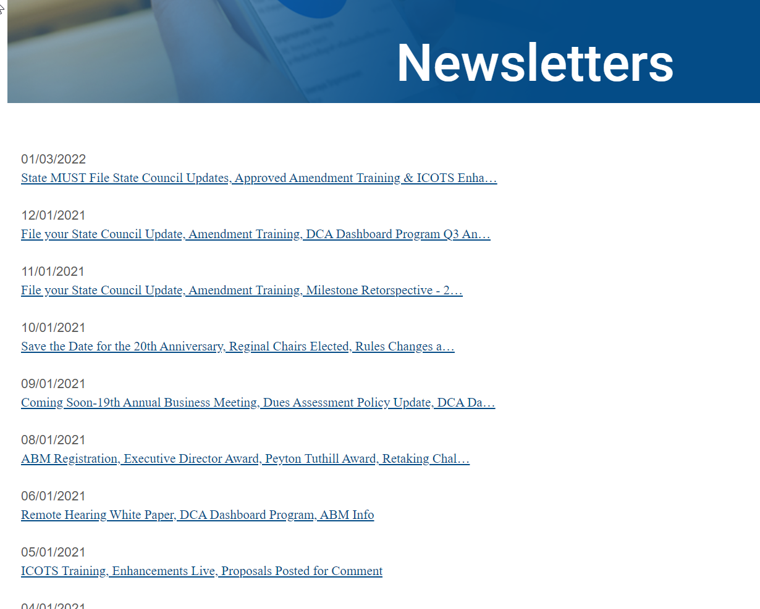
Don’t Miss Important Information!
https://www.interstatecompact.org/newsletters
<40% Commission Open Rate ☹

Slide 3
Presentation Objectives
Today you will learn about:
FY22 Approved Rule & ICOTS Enhancements
New Warrant Status
New Discretionary Retaking Activity
New Offender Management Restrictions
FY23 Compliance Audit Preparations
Dashboard News
New Tolling Dashboard
New CAR data
Notes:
2022 Approved ICOTS Enhancements • New Warrant Status: • Offender Profile • Email Notifications • New Discretionary Retaking Activity Offender Management Enhancement • New restrictions to improve process management FY23 Compliance Audit Planning New Dashboard (Tolled ICOTS Cases) & New CAR Data

Slide 4
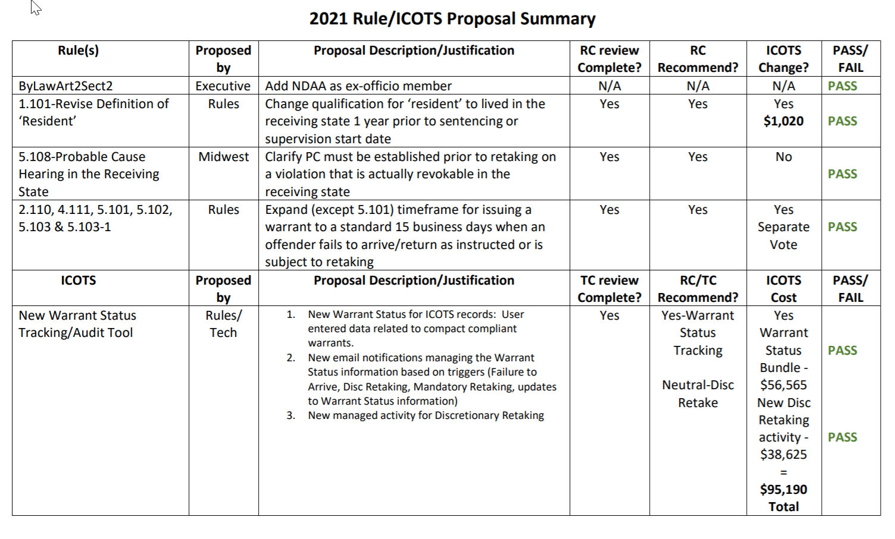
April 1, 2022 Rule Implementation
&
June 1, 2022 ICOTS Implementation
See Support Article for Q & A https://support.interstatecompact.org/hc/en-us/articles/4411705662615-2021-Rule-Amendments-ICOTS-Enhancements
4
Notes:
Rule implementation appeared smooth. No questions or concerns reported to national office since the December training.
If no additional questions on the rules, we can focus on the ICOTS enhancements

Slide 5
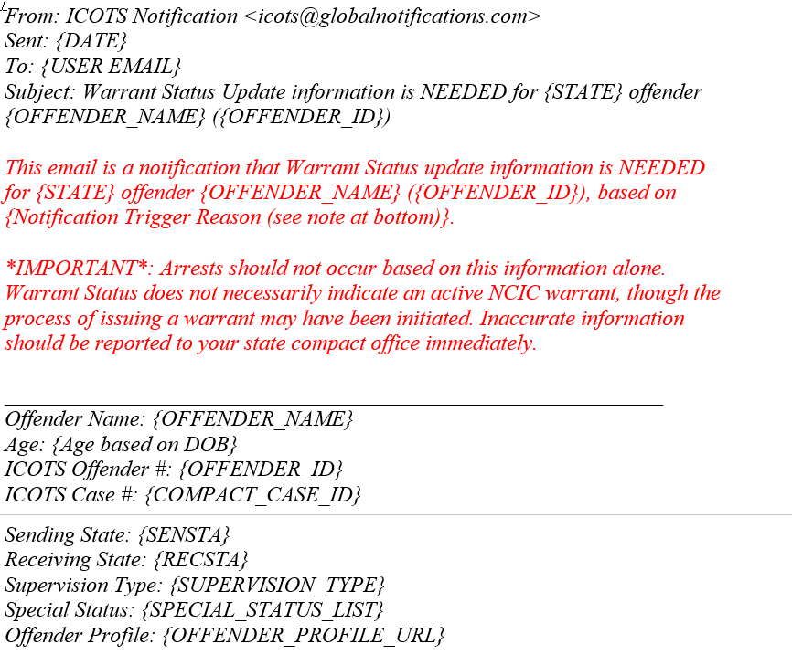
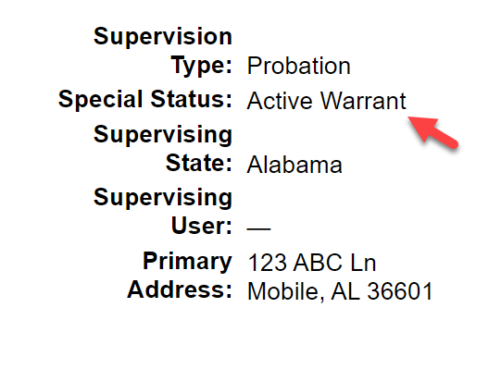
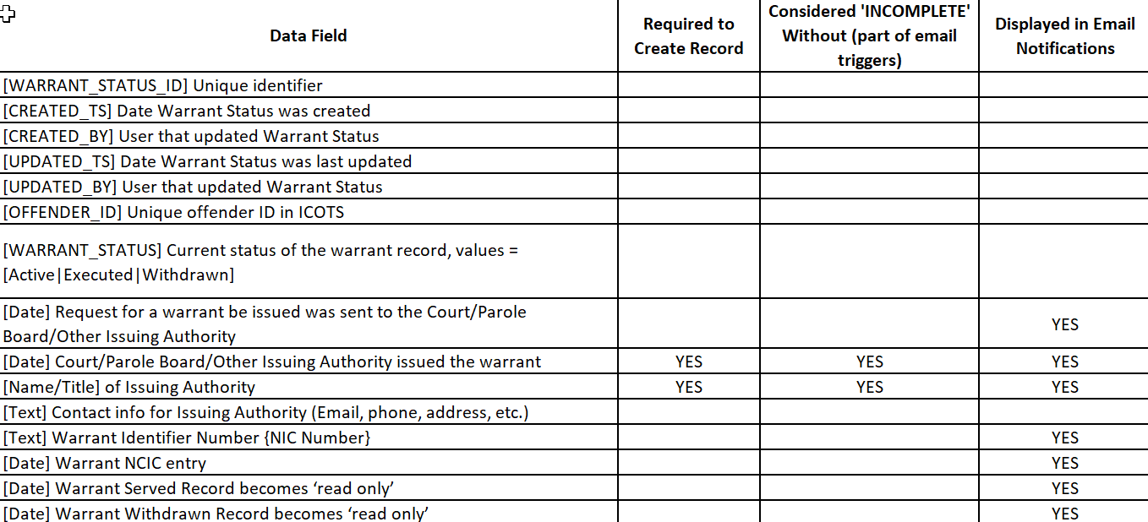
Warrant Status Bundle: $56,565
New Special Status
Email Notifications
Data Export
Triggered by ICOTS activities/action and missing warrant data (e.g. NCIC verification)

Slide 6
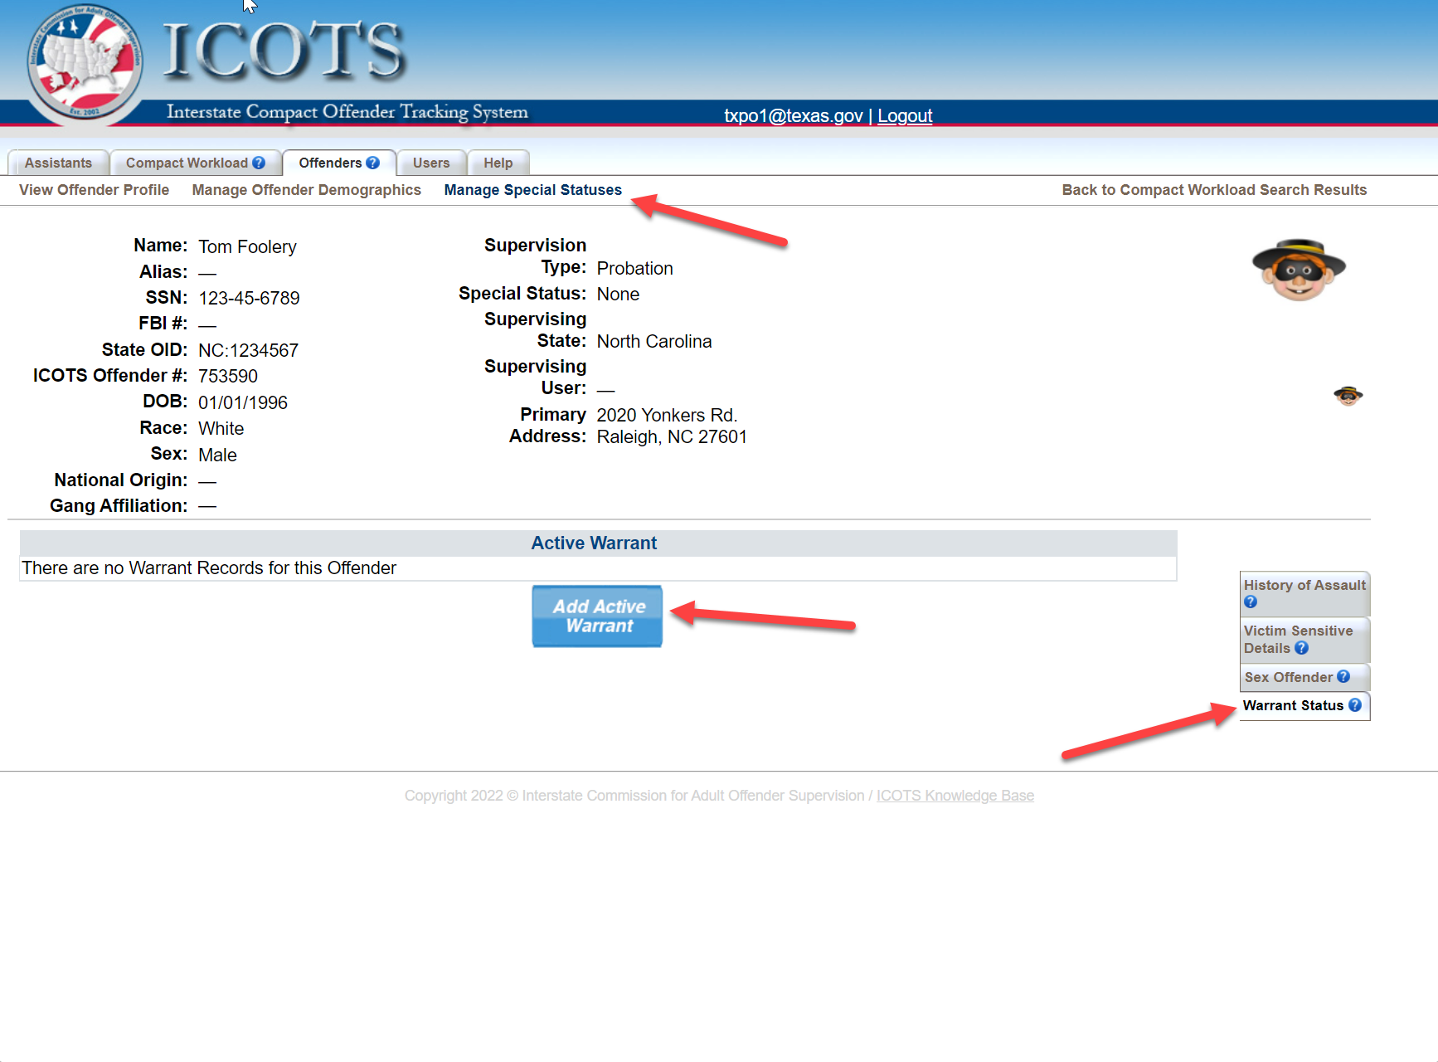
Notes:
New Warrant Status
Demo in PREP

Slide 8
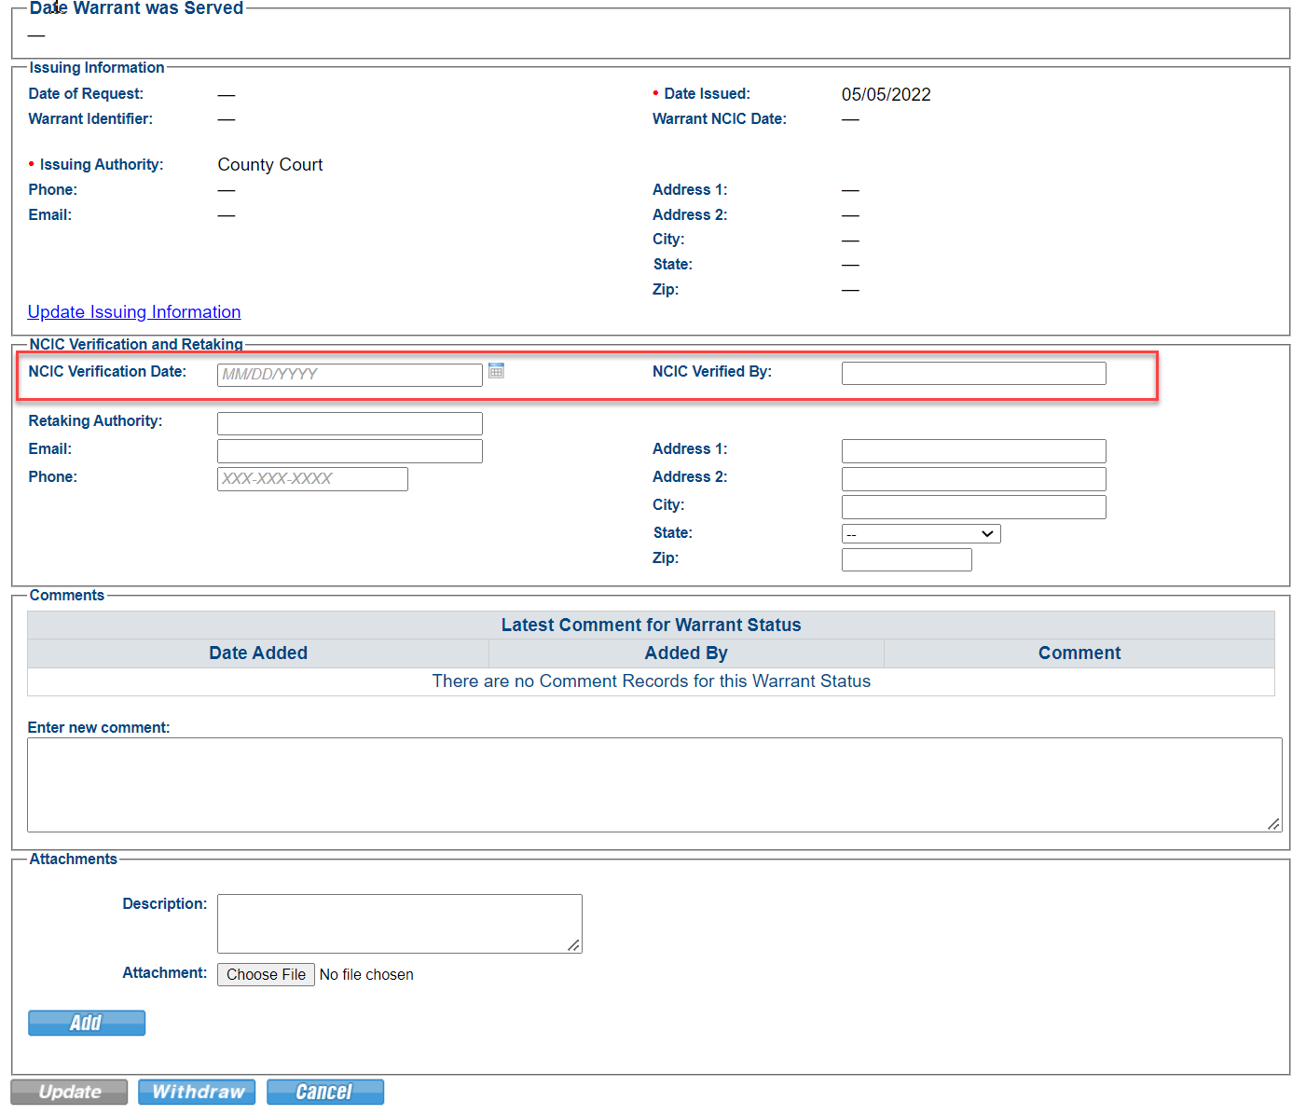
Enter verification date AFTER confirming warrant is compact compliant
No geographic limits
No bond
Entered into NCIC

Slide 9
Warrant Status Bundle: Workflow
Add/Update Warrant Status records anytime via the Offender profile
ICOTS will prompt the user (via email notifications) to add warrant records upon submission of:
Failure to Arrive;
Mandatory Retaking (via Violation Report) w/Sending state
response of ‘Warrant Issued/Requested;’ or
New Discretionary Retaking
‘Warrant Status Update Needed’ email notifications sent when required fields are blank:
Warrant issuing authority
NCIC verification date
Warrant Status record historical after indicating warrant is ‘withdrawn’ or ‘served’
Notes:
Statuses associated with profile, not specific cases

Slide 10
Warrant Status Functionality
∙
Allows for multiple entries by various users with a time/date audit trail of ICOTS user entry data.
∙
Warrant data can be added to any active or historical record (e.g. absconder cases may be closed when entering warrant information)
∙
Sending state-assigned PO, supervisors, and compact office can enter warrant status data (Compact Office does NOT need to reassign case)
∙
Clear audit trail of who, what, and when an entry is made.

Slide 11
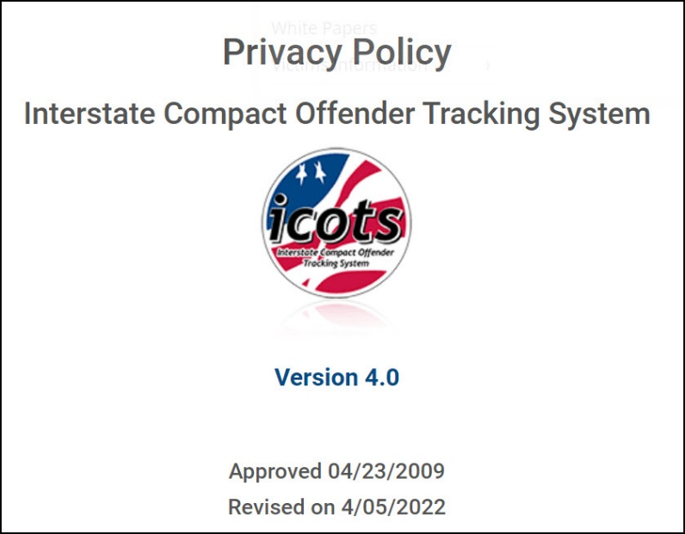
Warrant Status Expectations for States
Make training a priority. Procedures to obtain compact compliant warrants varies by state. System only as good as the data.
Self-audit regularly to ensure ICOTS privacy policy compliant data entry.
Ensure users know that ICOTS/ICAOS does not confirm active/compliant warrants. States will need to verify. Disclaimer included in screens & email notifications

Slide 12
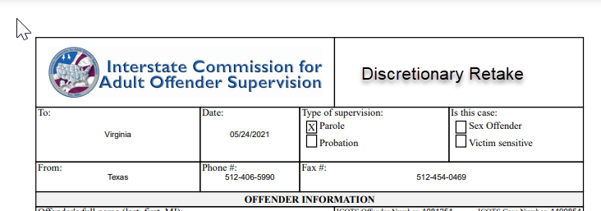
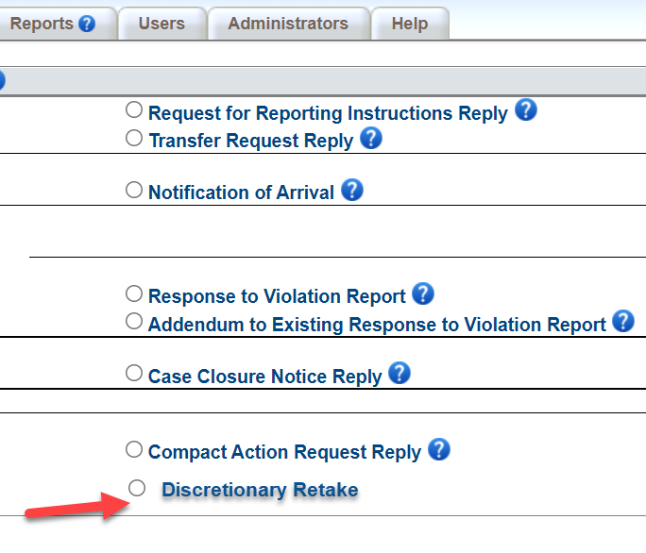
Discretionary Retaking Activity: $38,625
Communicates Sending State’s intent to Retake under Rule 5.101 (b) ‘retake an offender via warrant’
Mirrors Progress Report workflow, except sending state transmits:
PO->Supervisor->Compact Office.
When transmitted to the Receiving State, the activity will become final except for the assigned user’s ability to withdraw
Compliments the New Warrant Status Enhancement as a trigger for email notifications to instruct the user to enter a ‘Warrant Status Record”
Notes:
This process will not apply to offenders ordered to return in-lieu-of-retaking under Rule 5.101 (a) or 5.103 (b). Rather, those offenders will use the existing return reporting instruction procedure.

Slide 13
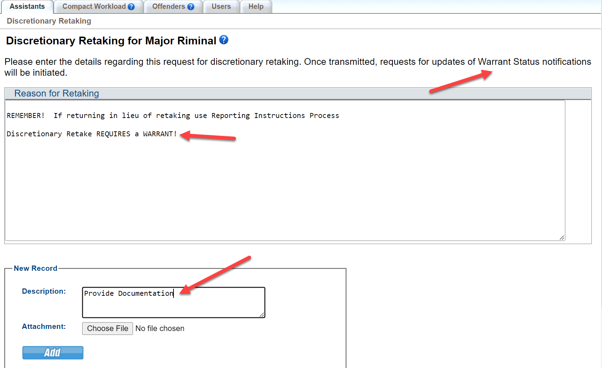

Slide 14
Discretionary Retake Activity Considerations
Tracks frequency Rule 5.101 (b) is invoked
Communicates ‘reason’ sending state invoked retaking
Captures compliance data for notifying receiving state within 15 business days of warrant issuance
Prompts users to enter a ‘warrant status record’ if not entered previously

Slide 15
NEW Offender Management Restrictions
Delete: One-time batch delete 19,000 offenders
Merge: Both offender profiles historical only
Move: No reassignment of the ‘supervising user’ pending move
Other: Remove the "Back" button from the confirmation screen
Merge, Move and Other to be implemented Mid-Late June
Notes:
Delete occurred summer 2021

Slide 16
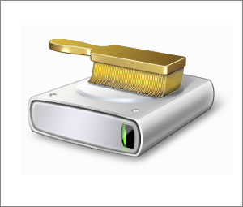
FY23 Compliance Audit
Data Integrity Audit Covering:
Demographic data
Photos
Junk/Duplicate Offender Cleanup
Rejected Case Clean-up
Rejected 60+ days
Awaiting Retaking Clean-up
https://support.interstatecompact.org/hc/en-us/articles/5744894888087-FY23-ICAOS-Compliance-Audit
Notes:
All from past audits or highlighted in this year’s DCA Dashboard Program.
Go to article for details

Slide 17
ICOTS Privacy Policy v4 AP 6-2009
Data entry & sharing
Data integrity timeframes
Report errors 5 business days
Creation of duplicates, junk offenders, other data entry errors
Act on errors (State Administrators) 30 calendar days.
Move, merge, delete including:
Pending requests from other states
Utilize reports to act on junk/dup profiles CREATED BY YOUR STATE!
Data Cleanup = opportunity to stress Privacy Policy user responsibilities
https://www.interstatecompact.org/policies/icots-privacy-06-2009
How are states addressing data errors with users to prevent future dups/junk profiles?
Notes:
Are not new requirements. Analysis shows states have not been enforcing PP requirements.

Slide 18
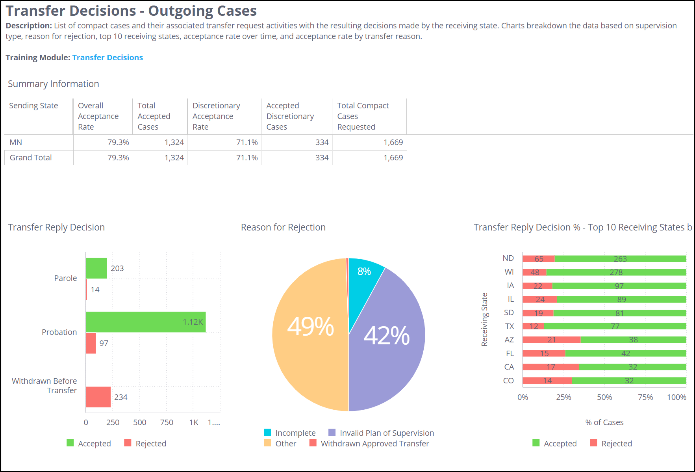
FY23 DCA Dashboard Program
Focus on 2 Areas:
Transfer Decision Dashboard
Training Fall 2022
Utilized for FY22 Assessment/ABM sessions
Identify areas for improving acceptance rates
Warrant Tracking Dashboard
Training Winter 2023
Dashboard to launch Fall 2022
https://www.interstatecompact.org/icaos-dashboards
https://support.interstatecompact.org/hc/en-us/sections/1500001041362-DCA-Compact-Staff-Dashboard-Program-and-Best-Practices
Notes:
Transfer Decision to focus on various uses the report can be used for.
There will be 2 sessions at the ABM on the assessment so we expect to learn more on practical ways states can use this report.
Ensure racial equality for compact cases
Audit users and staff. Do certain users see more rejections. Why? Is there a trend with certain states rejecting more than other state? What details are your users including in the justification and does that directly correlate to rejection.
Staff, is your staff doing their job in reviewing outgoing transfer documentation. What more can be done. Does your state send deficient transfers out versus send back to the field. For example, when I did my review I came across cases where the justification merely stated ‘is a resident per the compact.’ To me that is unacceptable.

Slide 19
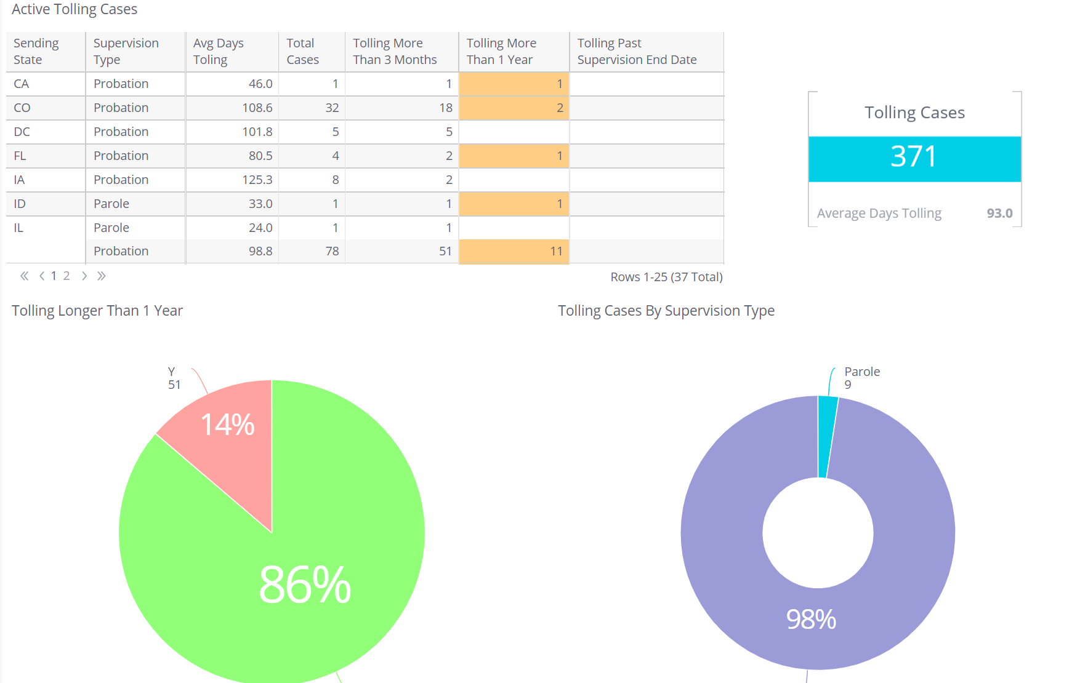
New Tolling Dashboard
Legal concerns raised over misuse of ‘tolling’ feature
Rules Committee directed new Workgroup to Investigate
Data analysis
Identify & confirm issues
Possible solutions/best practices
DCA Institute Session Planned
Is feature used in accordance your state’s legal authority?
Providing proper documentation & clarifications in ICOTS?
https://support.interstatecompact.org/hc/en-us/articles/4419732848663-What-is-the-tolling-feature-used-in-ICOTS-

Slide 20
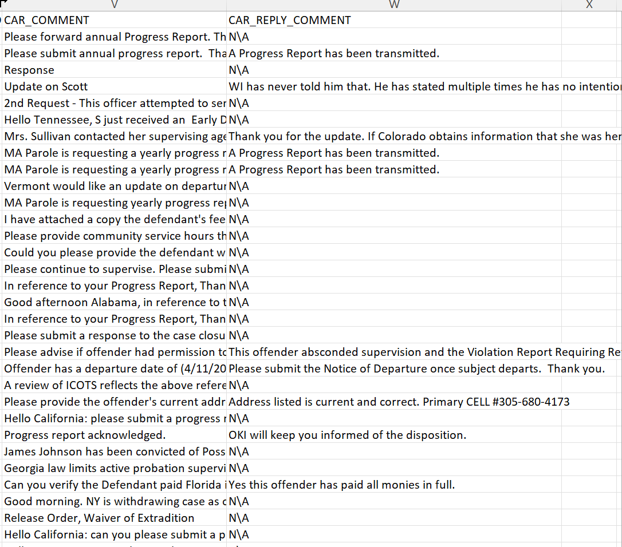
New Compact Action Request Data
Export CAR comments to excel
Provides audit tool to ensure
Users respond;
Appropriate communication;
Violation data is not sent using CAR’s

Slide 21
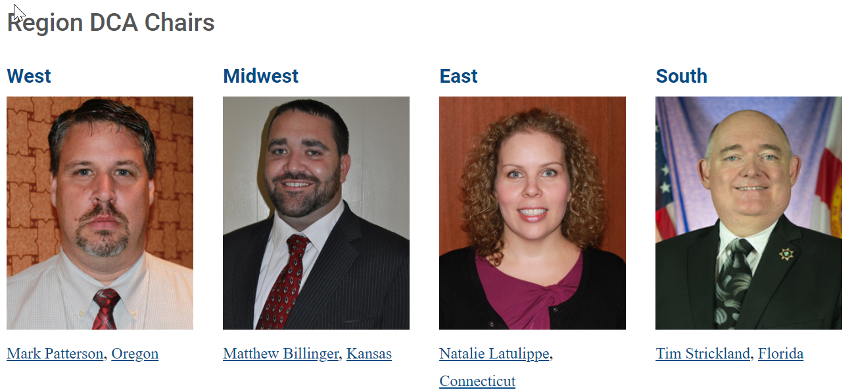
DCA Region Chairs
Communicate your topic suggestions to your region chair for upcoming training &/or DCA Region Meeting!

Slide 22
Thank You
Interstate Compact for Adult Offender Supervision

