Slide 1

ICAOS Rules Training
Interstate Compact for Adult Offender Supervision
Presented by:
Notes:
1

Slide 2
Today you will learn about:
  Overview of the Compact
  Eligibility for Transfer
  Transfer Process/Investigation
  Supervision in the Receiving State
  Closing a Compact Case
  Reporting Violations Requiring Retaking
  Probable Cause Hearing Requirements
  ICAOS Resources & Training Tools
Presentation Objectives
Notes:
2

Slide 3
Overview of the Compact
Purpose, Authority, and Implications for Non-Compliance

Slide 4

Purpose of ICAOS
Promote Public Safety
Protect the Rights of Victims
Ensure Effective Supervision &
Rehabilitation
Control/Track Movement of Supervised Individuals
Notes:
Always important to highlight purposes of compact. No decisions or actions should be made that do not support these.
Promote Public Safety
Protect Victim’s rights
Ensure supervision techniques are consistent with instate supervised individuals and in line with best practices of the supervising state; this includes same access to supervision, sanctions, and services
Through databases supported by each national office, we are tracking and controlling movement of supervised individuals as they cross state lines
4

Slide 5

ICAOS Functions
ICAOS regulates how supervised individuals are:
  Transferred from one state to another
  Supervised while on Compact supervision
  Returned to a sending state when supervision is not successful
Notes:
5

Slide 6



Authority of an Interstate Compact
Authorized
Binding
Supersedes
The Compact is authorized by the US Constitution & Crime Control Act
The Compact is binding upon all state authorities & citizens
The Compact rules supersedes conflicting state law
‹#›

Slide 7

Implications of Non-Compliance
It is incumbent upon prosecutors, judges and other state officials to understand the requirements of the Compact and its rules, as well as the consequences of non-compliance.
Failure of state judicial or executive branch officials to comply with the Compact and its rules results in the state defaulting on its obligations under the Compact and could lead the Commission to take corrective or punitive action, including suit in federal court for injunctive relief.
Notes:
Explaining the consequences is important for stakeholder resisting compliance with compact requirements
7

Slide 8
Eligibility for Transfer

Slide 9

Why supervised individuals transfer
  ALL Transfers Require:
    Valid plan of supervision;
    Justification; and
    Reason
  Most supervised individuals are residents/have resident family-best chance for success!
Did you know?
115,000 active transferred individuals
60,000 cases transferring annually
Notes:
9

Slide 10
ICAOS Creates Circumstances to Promote Successful Supervision
Ensure Effective Supervision & Rehabilitation
Positive Relationships & Family Support
Life Stability
Means of Support & Employment
Resources/Programs
There is no “right” of convicted persons to travel across state lines or to serve one’s sentence in a particular state. See, Jones v. Harris, 452 U.S. 412 (1981); Meachum v. Fano, 427 U.S. 215 (1976)
Convicted persons have no right to control where they live; the right is extinguished for the balance of their sentence. Williams v. Wisconsin, 336 F.3d 576 (7th Cir. 2003), Pelland v. RI,317 F. Supp. 2d 26 (2004)
Notes:
Through ICAOS individuals on supervision provide opportunity for support and stability
10

Slide 11
Cycle of a Compact Case
Step 1: Determine Eligibility & Reason for Transfer!
Transfer Request
Transfer Reply
Notice of
Departure
Case Closure
Supervision in the Receiving State
Notice of Arrival
Notes:
11

Slide 12

What Triggers the ICAOS
Supervised
Individual
Supervision
Relocate
Adult who commits a criminal offense (all felonies & specific misdemeanants)
  Subject to ‘supervision’; and
  Released to the community under the jurisdiction of:
    Courts
    Paroling Authorities
    Corrections
    Other Criminal Justice Agencies
2 Distinct criteria:
    Oversight exercised by a controlling authority, which includes:
      Courts
      Paroling Authorities
      Corrections
      Other Criminal Justice Agencies
    Required to monitor regulations or conditions, other than monetary
+
+
Supervised individual intends to remain in another state for more than 45 consecutive days
‹#›
Notes:
Note eligibility for deferred sentenced supervised individuals
Furloughed and preparole
12

Slide 13
Eligible Misdemeanants
Person incurred direct or threatened physical or psychological harm.
Sentence = 1+ years of supervision
AND
Instant Offense Includes
One or More
Use or possession of a firearm involved.
2nd or subsequent conviction of driving while impaired by drugs or alcohol
Sex offense requiring registration in the sending state
Notes:
13

Slide 14
Transferring Supervision

Slide 15

Requirements for Transfer
1
2
3
4
Time Remaining on Supervision
A minimum of 90 calendar days remaining on supervision
Valid Plan
  Terms & conditions of supervision
  Residence
  Employment/ Means of Support
Substantial Compliance
No initiation of revocation proceedings by Sending State
Justification & Reason
  Resident
  Family
  Employment
  Military Orders
  Discretionary/ Correctional Sense
Notes:
Other eligibility criteria for transfer must illustrate that relocating to another state is supervised individual’s best chance for success. supervised individuals must have a good plan, not be in violation status in the sending state and most have ties to the receiving state as being a resident (living in that state prior to committing their offense) or have family support.
As clearly stated in case law, no convicted person has a right to server his or her sentence in another state.
It’s imperative supervised individual’s understand this when allowed to transfer and that the compact is established to provide a legal mechanism for the supervised individual to live and be supervised in a receiving state, not be an obstacle.
15

Slide 16
Mandatory vs. Discretionary Transfers
All Transfers should illustrate:
  Successful Completion of Supervision
  Public Safety
  Rehabilitation of Supervised Individuals
  Protect Rights of Victims
Mandatory
  Discretionary
Receiving State must accept supervision if:
  Mandatory criteria transfer is met; and
  Information is verified; and
  Plan is valid; and
    Acceptable for an in-state supervised individual
  Required documentation is provided
Receiving state may accept or reject supervision in a manner consistent with the purpose of the compact
  Sending state must justify “WHY”
  Rejections must include specific reasons for rejection
Notes:
16

Slide 17
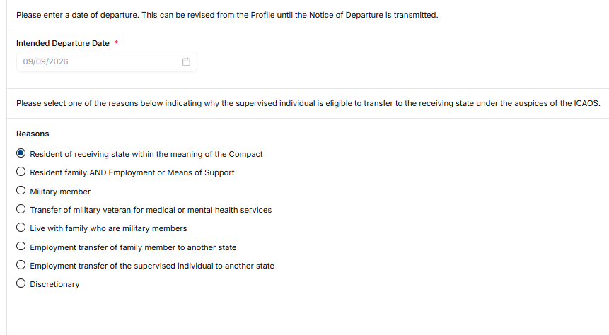
Reason for Transfer
Departure Date can be managed from the supervised individual’s profile.
Ensure that the appropriate reason is selected and any additional documentation requirements are included
Notes:
17

Slide 18
Top Reasons for Transfer
Resident of the Receiving State
Has Supportive Resident Family
  Parent, grandparent, aunt, uncle, adult child, adult sibling, spouse, legal guardian, or step-parent;
  Lived in the receiving state for at least 180 days; and
  Transfer must explain how family will support the supervised individual.
Lived in the receiving state for 1 year prior to either:
  Supervision start date; or
  Sentencing date
Notes:
18

Slide 19

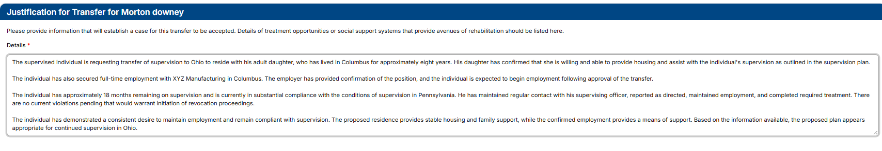
Justification for Transfer
Detailed VERIFIED justifications!!!
  Why is the supervised individual going to be more successful in the Receiving State?
  Describe support system
  Means of support
  Living situation
  Use clear, concise language; no abbreviations
Notes:
19

Slide 20
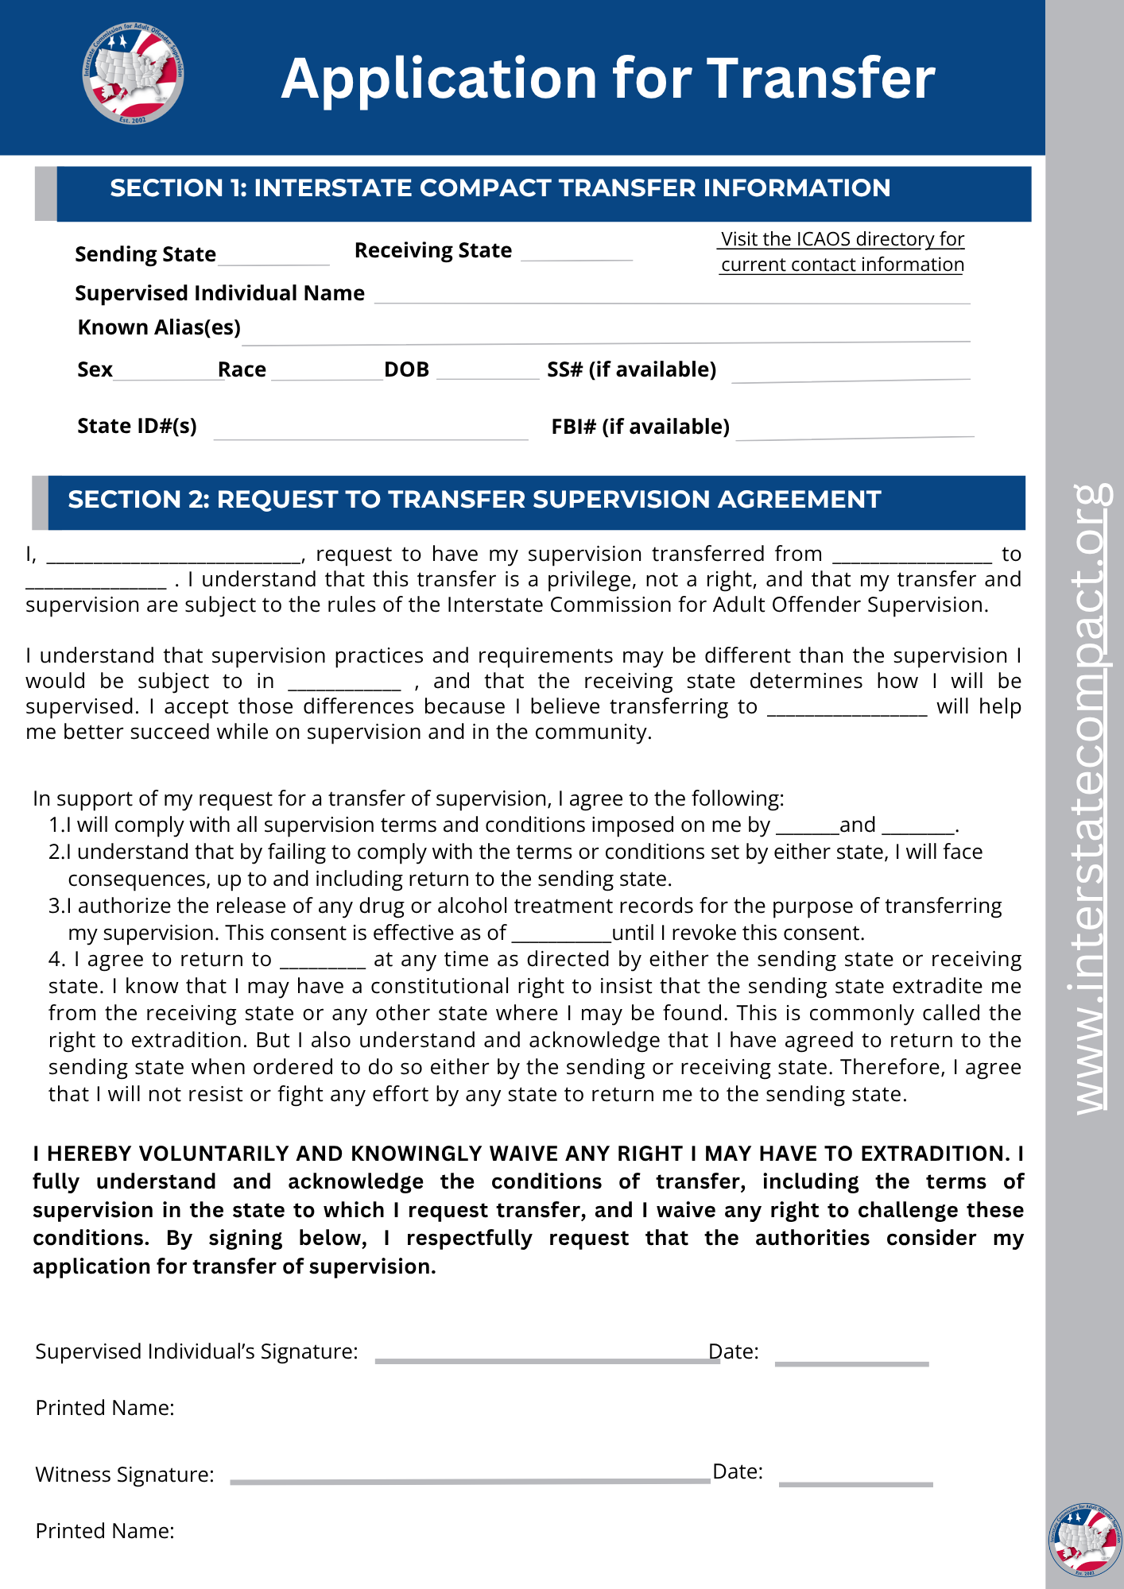
Required Attachments
Copy of signed Application for Transfer
Instant Offense DETAILS
Photo
Conditions of Supervision
Financial Obligations (order by Court)
Supervision history (only if currently on supervision for more than 30 calendar days)
PSI (if it exists or is not prohibited for distribution)
If Applicable: Sex offender registration requirements Orders of restriction Known protective orders Known gang affiliation Prison discipline and mental health history of last 2 years
Notes:
20

Slide 21
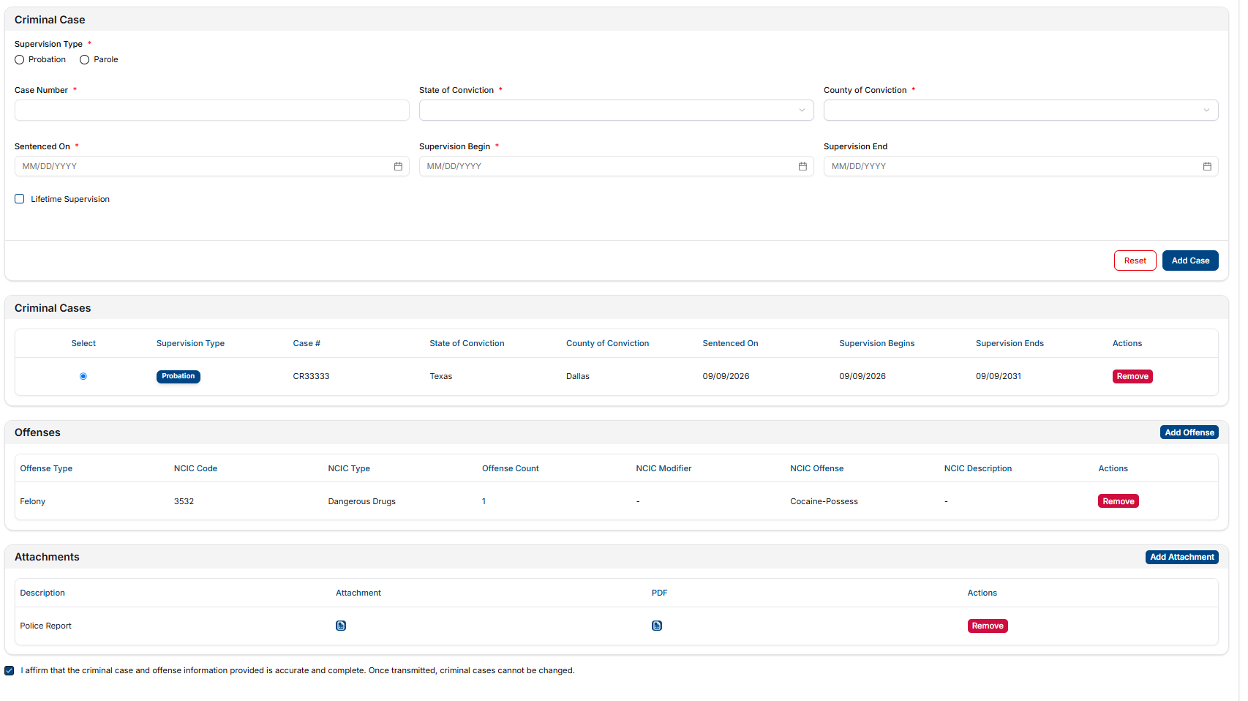
Offense Details
  Add criminal case information
  Add offenses to case- Enter NCIC code or use drop-down
  Attach details of offense- Narrative, Police Report, etc.
Notes:
21

Slide 22
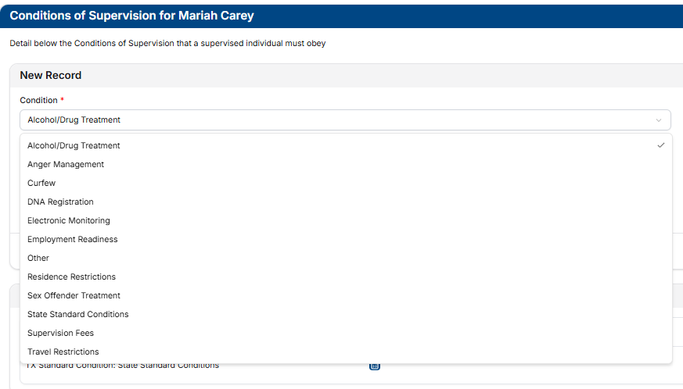
Conditions of Supervision
Provide the Receiving State with the individual’s conditions of supervision for review. There may be conditions that they cannot comply with that will have to be communicated to the Sending State.
Notes:
22

Slide 23
Sex Offenders
3 Types per ICAOS Definition
Additional Transfer Requirements
Following acceptance
  Registered in the sending state
  Required to register in the sending state
  Subject to sex offender terms and conditions in the sending state
If Available:
  Assessment Information
  Victim Information
    Demographics
    Statement
  Supervision or Treatment plan - current or recommended
If requested (and available,) provide to the receiving state within 30 days
  Risk Needs Score
  Information related to PRIOR sex offenses
  Other documents to assist in supervision
Notes:
23

Slide 24
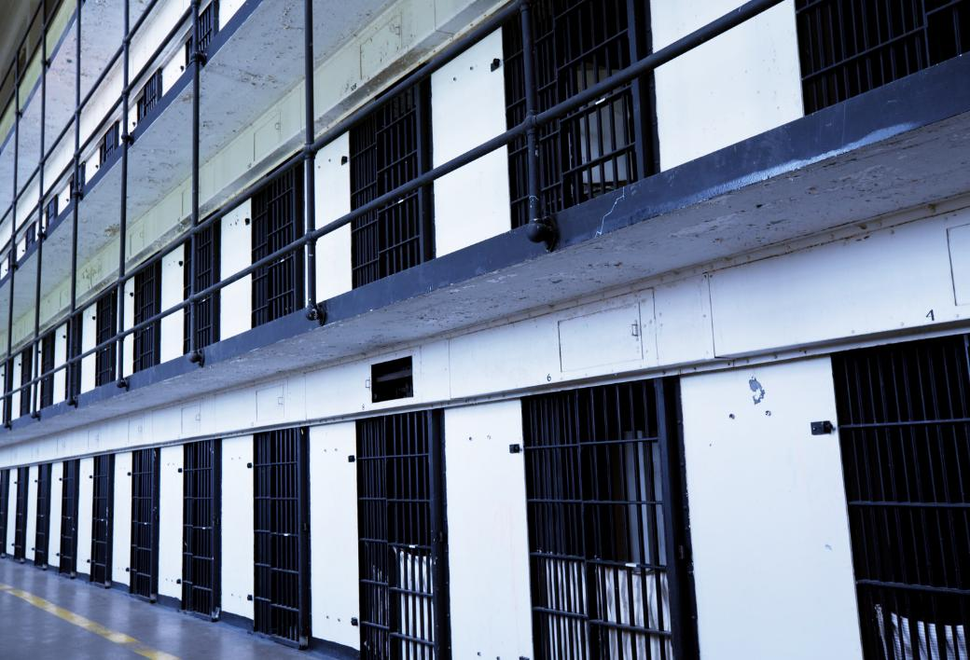
Pre-Release Transfer
Submit request within 120 calendar days prior to release date
Sending state shall notify receiving state if:
  the planned release date changes, or
  if release date has been withdrawn or denied
Notes:
24

Slide 25
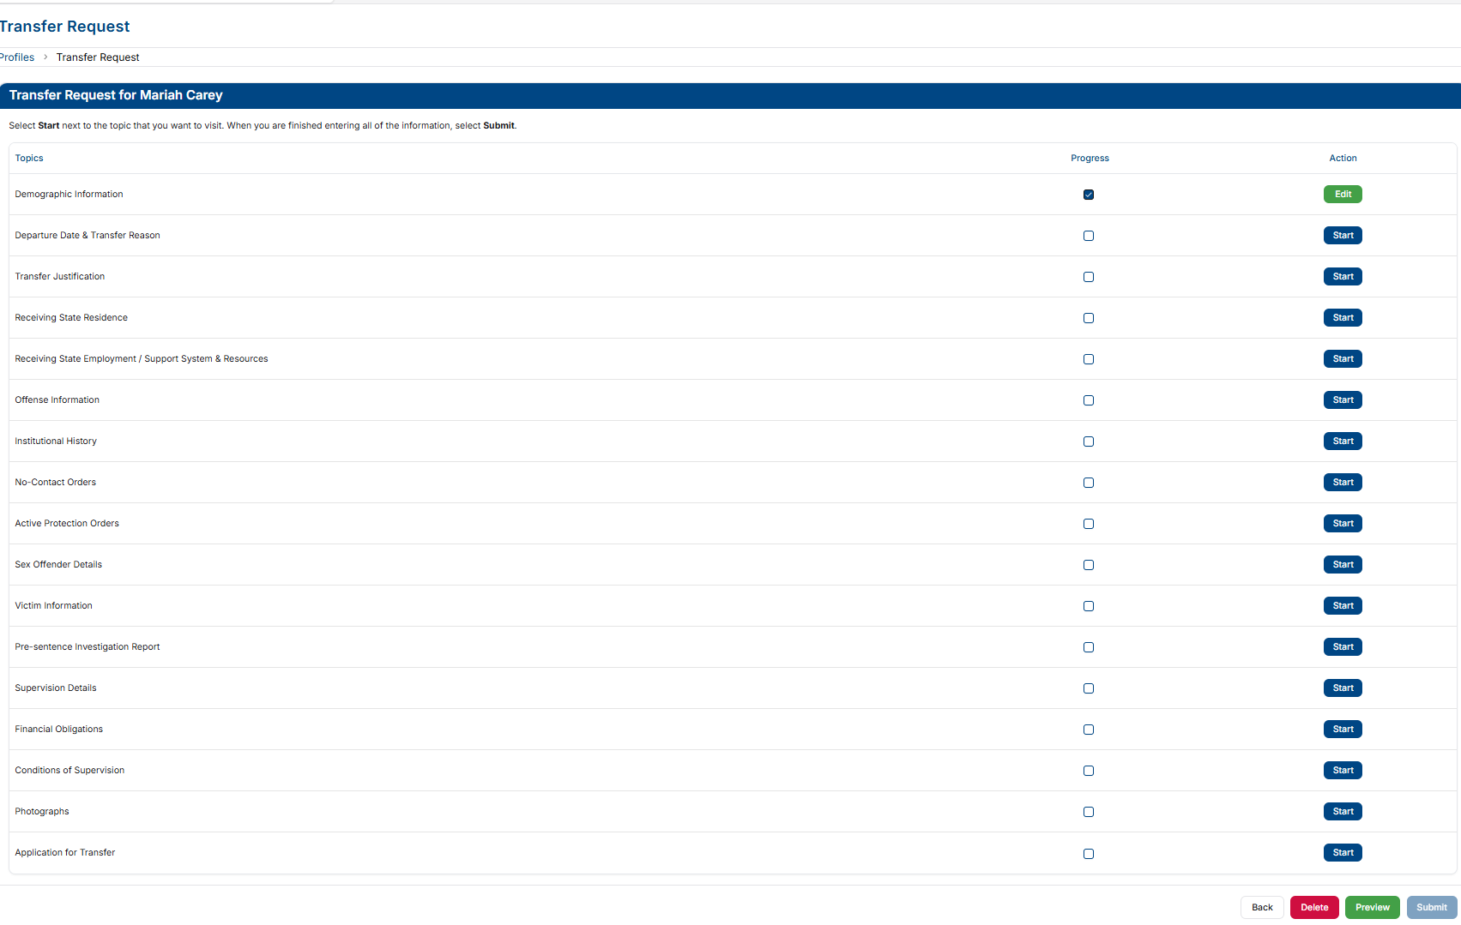
Submission of a Transfer Request
Last Chance to Delete!
Notes:
25

Slide 26
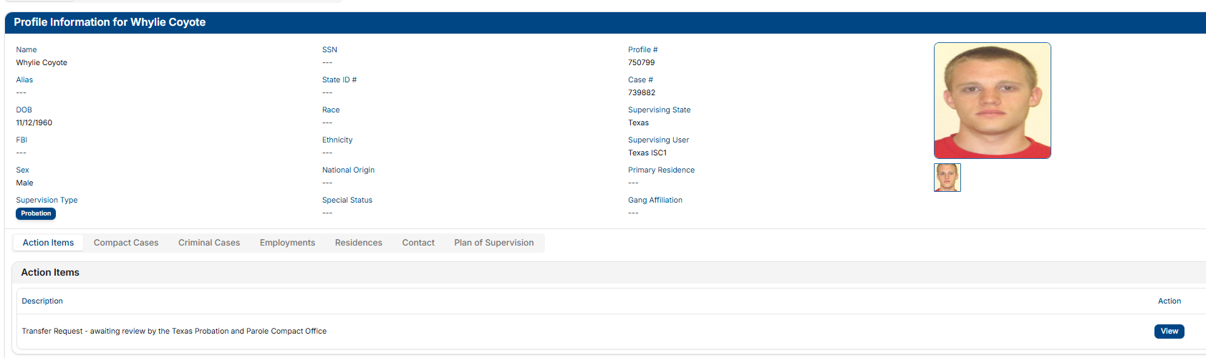
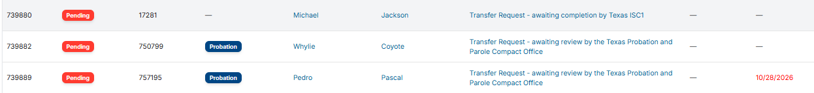
Check Status of Transfer Request
  Compact Workload
  Individual’s Profile (Action Items)
Notes:
26

Slide 27

Investigation Period
  Up to 45 days
No Travel Prior to Acceptance
Reporting Instructions Exceptions:
  Living in Receiving State at the time of Sentencing
  Military Members/Veterans Receiving Treatment/Employment Transfer
  Supervised Individuals Released from Incarceration in the Receiving State
  Other verified Emergency Situations (both states must agree)
  OTHER: Daily travel (border) allowed for medical/employment ONLY must return daily and notify of travel via INSITE
Notes:
Ris Provides temporary permission for supervised individual to be in a receiving state during the investigation.
27

Slide 28

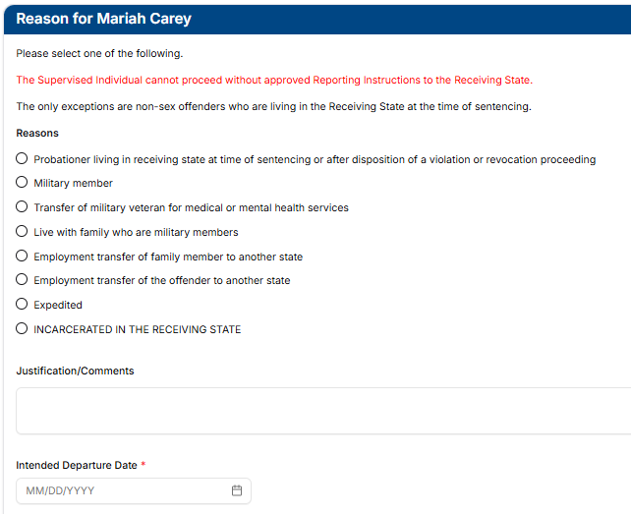
Reporting Instructions
Provides permission for a supervised individual to be in the receiving state PRIOR to acceptance
Qualifying for mandatory reporting instructions does NOT automatically qualify as a mandatory transfer.
Notes:
28

Slide 29

Living in Receiving State vs. Compact Definition of Resident
Living in Receiving State
RI REASON
Resident
TRANSFER REASON
Lives in the receiving state when sentenced to probation in the sending state and needs to go home after sentencing or sentenced remotely
Lived in receiving state for 1 year (continuously and immediately) prior to supervision start date or sentencing date
Notes:
29

Slide 30
Requests must be submitted within 10 business days of:
  initial sentencing date,
  date of the disposition of a violation or revocation proceeding, or
  release date from incarceration to supervision, if this occurs within 90 days of the sentence
TIP: Submit Transfer Request prior to release. If approved, request for reporting instructions is not necessary
ONLY reason for reporting instructions in which a travel permit may be issued (non-sex offenders) prior to reply from a receiving state
  Be sure to inform supervised individual of the
  Reporting Instructions when received!!!
Reporting Instructions
Living in the Receiving State at the Time of Sentencing
Notes:
30

Slide 31
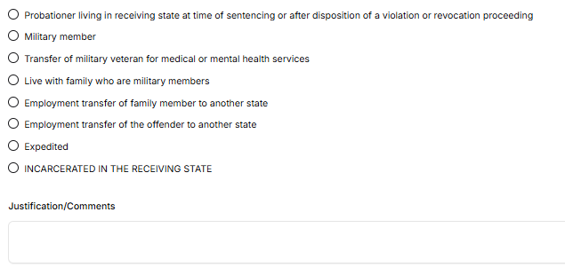
Reporting Instructions Documentation Requirements
Verify residency PRIOR to issuing a travel permit
ALWAYS JUSTIFY!
Military orders
Approval/Referral
Employer documentation stating the transfer is directed by employer to maintain employment (NOT for new job opportunities/promotions)
Any other emergency reason- Both states MUST agree
Incarceration information
Sex Offender Requirements
  Narrative of the instant offense (circumstances, type, severity, and any charge reduction)
  Conditions of supervision
  Orders restricting contact with victims or others
  Victim information (name, sex, age, relationship), if available and legally permissible
  Judgment and sentencing documents related to the sex offense, if available
Notes:
LIRS: Provide documentation
31

Slide 32

Reporting Instruction Timeframe Requirements
Receiving State
Sending State
Respond to Reporting Instructions Requests
    2 business days
    Sex Offenders: 5 business days
Send Transfer Request Timely!
    15 business days
    7 business days after approved expedited reporting instructions
Notes:
32

Slide 33
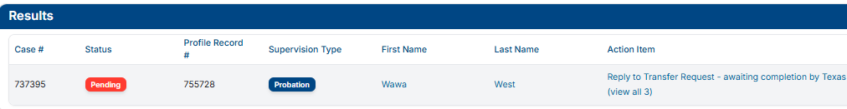
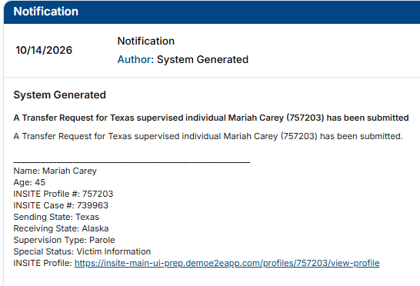
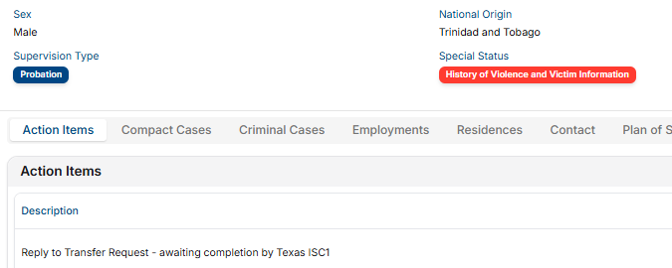
Transfer Reply
Access activity from Notifications, Compact Workload, or Profile
Notes:
33

Slide 34
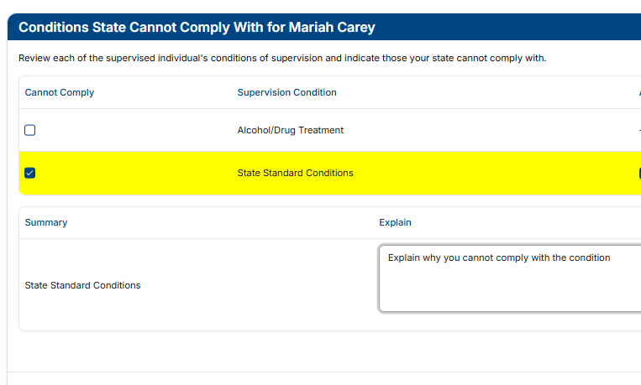
Transfer Reply
Provide details as to why a condition cannot be imposed
Inability to enforce a condition is NOT a valid reason for rejecting a transfer
Sending state authorities decide whether condition can be removed
Notes:
34

Slide 35
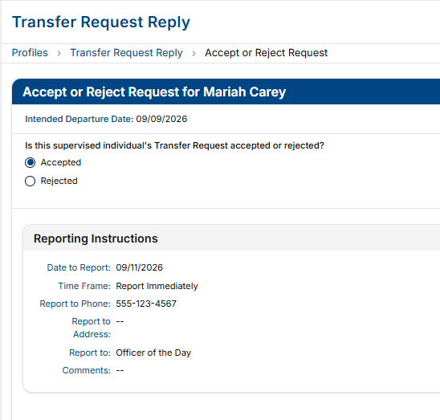
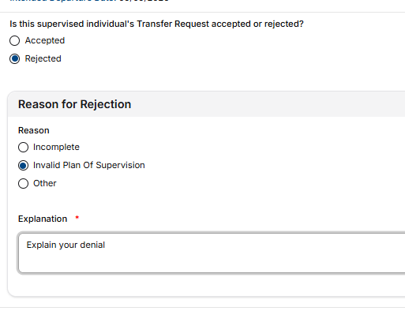
Transfer Reply
Acceptance
Valid for 120 Calendar Days
Rejection
Be specific! Reason for rejection must be consistent with the purpose of the compact articulating why plan would not be approved if convicted in your state
Notes:
35

Slide 36

Invalid Transfer Rejections
  Individuals with disabilities (Rule 2.108)
  Individuals with pending charges (obtained before or during investigation period; AO 8-2005)
  Undocumented immigrant (AO 13-2006)
  Section 8 housing (AO 2-2007)
  Discretionary Cases without addressing the justification (3.101-2)
Notes:
36

Slide 37
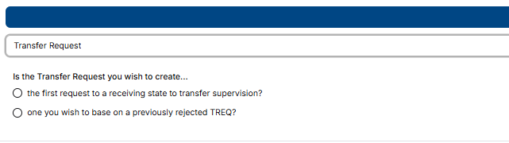
Resubmission AFTER Rejection
If a transfer is rejected, you can create a new transfer based on the rejected request.
Supervised individuals in the receiving state with approved reporting instructions may remain there if a new Transfer Request is submitted within 15 business days
Notes:
37

Slide 38


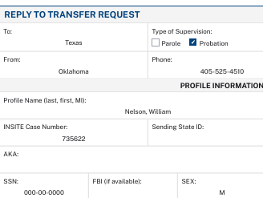
Transfer Approval
Receiving State’s Compact Office Transmits Reply
    Notification is generated to sending state users
      Compact Office, PO Supervisor & PO
    Activity History (Profile) reflects the decision of the Transfer Reply
    Sending state should be sure to review the PDF and attachments for details
After approval, the Receiving State may request additional items needed for supervision via transfer reply or a communication.
The Sending State must send requested information within 30 calendar days.
See Rule 3.107
Notes:
38

Slide 39

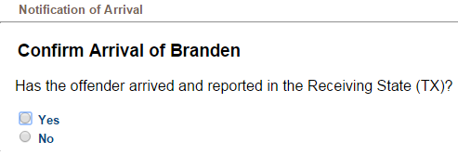
Tracking Movement-Notices of Departure/Arrival
Sending State
Receiving State
Notice of Departure Due when supervised individual departs
*A NOD shall not be submitted more than 5 business days prior to departure
Failed to arrive as instructed? Warrant may be required
(NOFA triggers warrant status needed notifications)
Notice of Arrival
Due when supervised individual arrives and reports as instructed
(must be within 5 business days of departure)
Officer becomes the ‘supervising user’ in INSITE
Rules 3.104-1 & 4.105
Notes:
39

Slide 40
Victim’s Rights
Victim’s Right to be Heard
Victim Notification
  Victims can contact Sending State’s compact office
  Victims have 15 business days after notification of transfer to give input
    Receiving state shall continue to investigate
    Victim’s Comment ALWAYS Confidential
Victim notification shall be initiated:
  In accordance with the sending state’s laws and procedures
  Within 1 business day of either:
    Issuance of Reporting Instructions; or
    Acceptance of a Transfer Request
Notes:
40

Slide 41
Supervision in the Recieving State

Slide 42



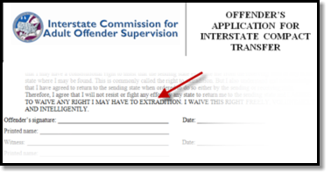
Compact Supervision Elements
Duration
Conditions
Waiver
Sentencing Authority in the Sending State determines duration of Supervision
Supervised individual agrees to conditions imposed by BOTH Sending & Receiving States
Supervised individual applying for transfer WAIVE rights for extradition
Notes:
As a precondition to transfer supervision, ALL supervised individuals must sign the supervised individual application for transfer agreeing to waive extradition from any state. This is EXTREMELY IMPORTANT as it replaces the need for an extradition hearing in the Receiving State and the need for a Governor's warrant by the Sending State in order to apprehend an supervised individual.
This form clearly states, “…I will not resist or fight any effort by any state to return me to the sending
state and I AGREE TO WAIVE ANY RIGHT I MAY HAVE TO EXTRADITION. I WAIVE THIS RIGHT FREELY,
VOLUNTARILY AND INTELLIGENTLY.”
42

Slide 43
Compact Supervision in a Receiving State
Supervise individuals transferred under the interstate compact in a manner consistent with the supervision and risk level of similarly sentenced individuals in the receiving state.
‘Participation in the ICAOS ensures not only the controlled movement of supervised individuals under community supervision, but also that out-of-state supervised individuals will be given the same resources and supervision provided to similar in-state supervised individuals including the use of incentives, corrective actions, graduated responses and other supervision techniques’
Notes:
Once allowed to transfer, receiving states have to provide supervision consistently in how they would supervised an supervised individual sentenced in the receiving state. Although most states fulfill this requirement well under the compact requirements, it can be a training issue for stakeholders involved in supervision decisions or rehabilitation programs.
43

Slide 44

Requirements During Supervision
Progress Reports
Registration
Fees
  Regular supervision updates
    Requests for PRs from sending state (via specialized CAR) must be sent within 30 calendar days
  Notify when adding or updating conditions
  Inform of compliant AND non-compliant behavior
  Receiving states required to assist the sending state
    E.g., DNA Testing
Sending States
  May impose an application fee
  May not charge supervision fees after transfer
  Responsible for collecting all financial obligations (e.g., court costs, restitution, child support)
Receiving States
  May impose supervision fees after acceptance
  Fees must be consistent with those charged to in-state supervised individuals
https://www.interstatecompact.org/resources/fees
Notes:
44

Slide 45
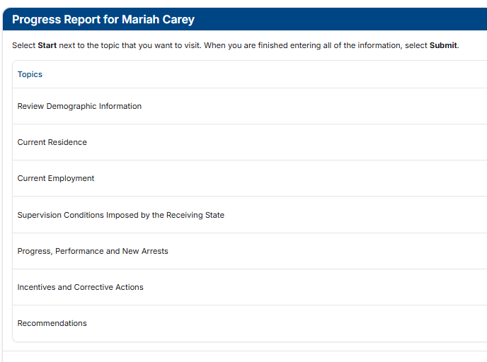
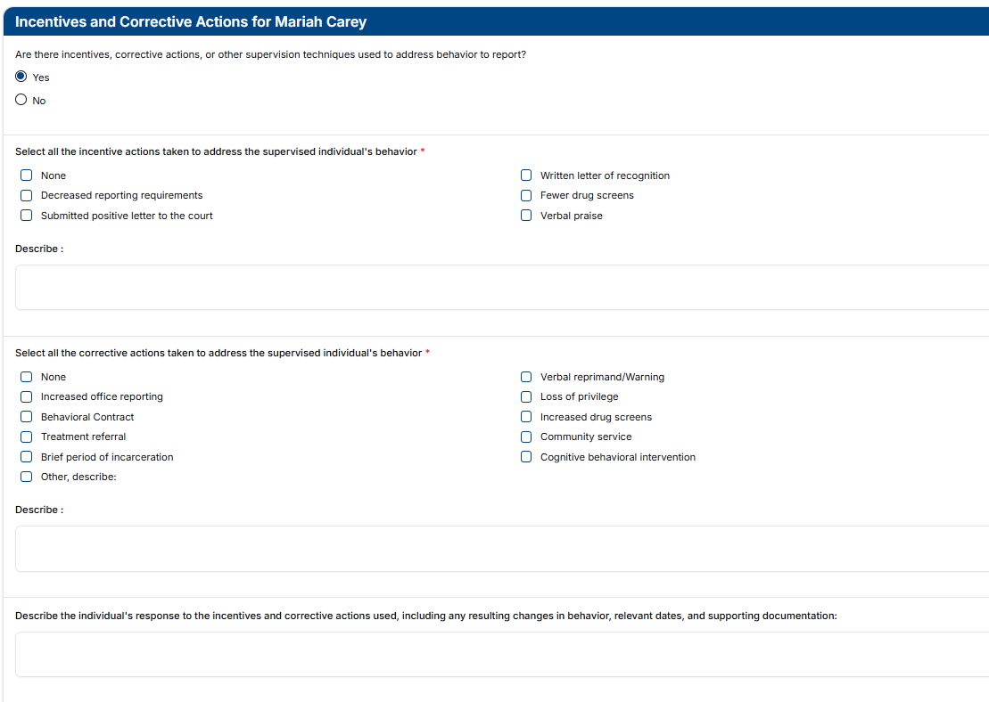
Progress Reports
Keep the Sending State informed!
  Supervision Update
  Ability to add new conditions imposed
  Documentation on compliant & non-compliant behavior that DOES NOT require retaking
  Report New Arrest
Notes:
45

Slide 46
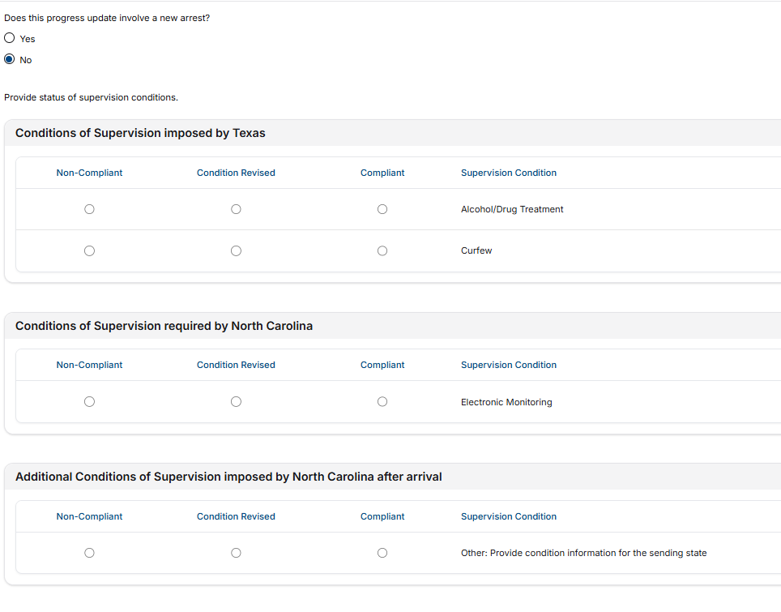
Progress Report Status of Conditions
  Report compliance or noncompliance with supervision conditions
  Attach any supporting documentation
Notes:
47

Slide 47
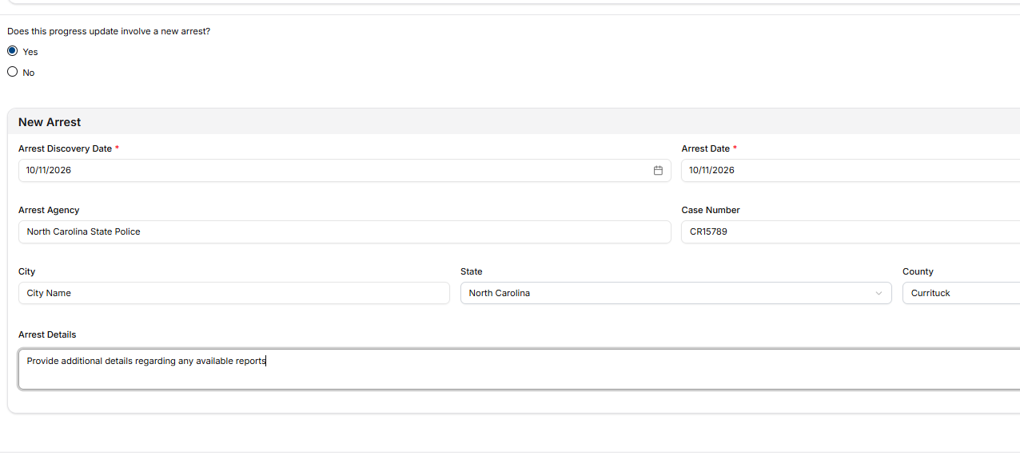
Provide arrest details and upload supporting documentation (e.g., police reports, witness statements, etc.)
Report New Arrest
Notes:
If reporting on both send 2 progress reports
48

Slide 48
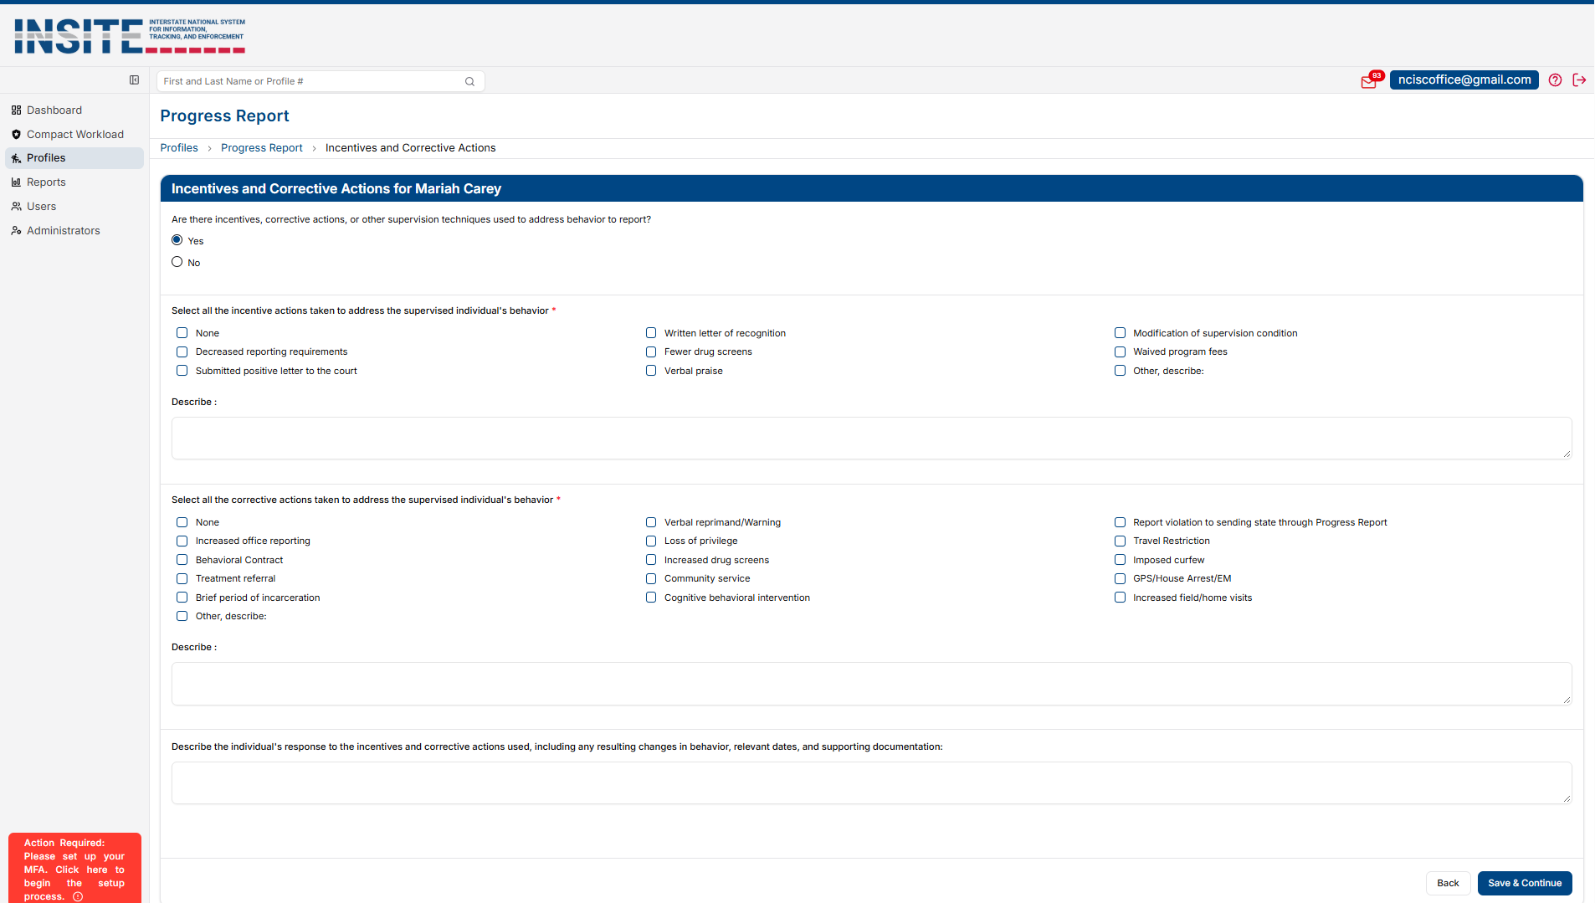
Progress Report Incentives & Sanctions
Don’t forget to include OUTCOMES/RESPONSES for corrective actions imposed!!
Notes:
49

Slide 49
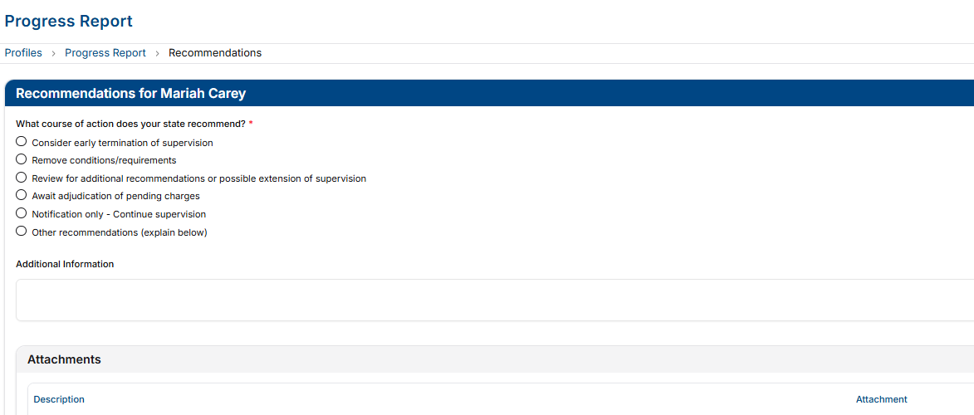
Progress Report Recommendations
Notes:
50

Slide 50
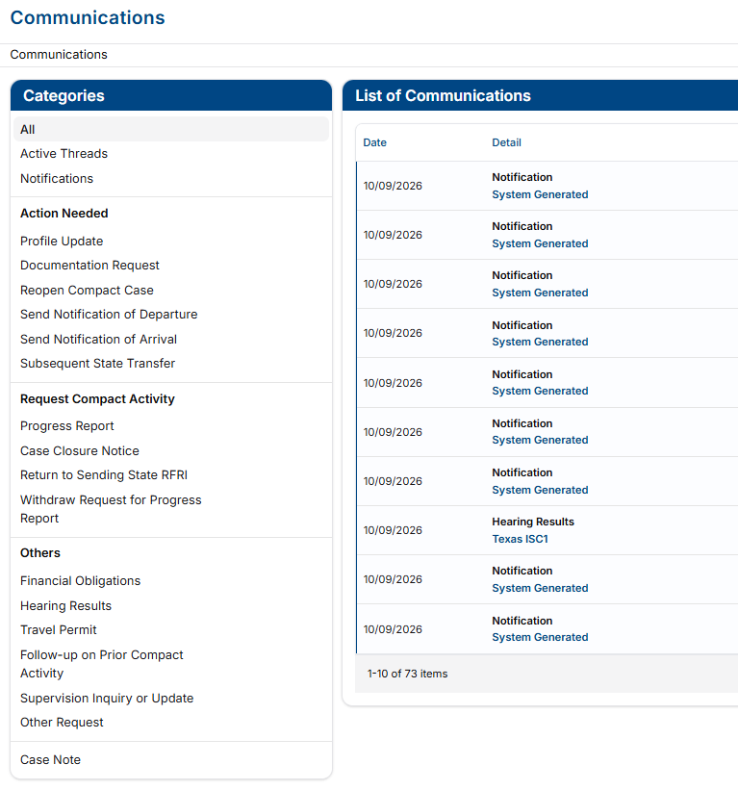
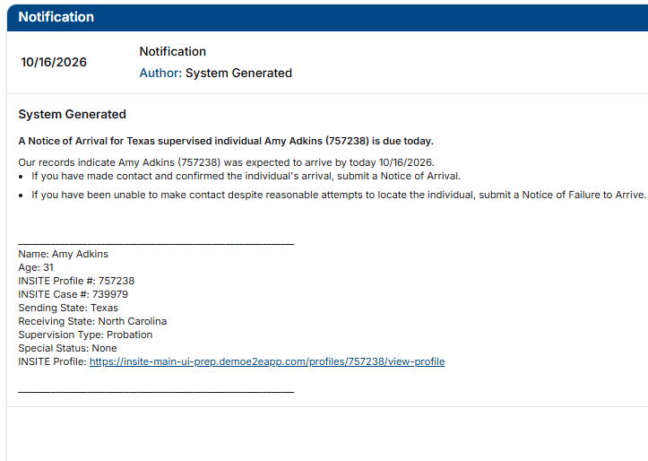
Communications
Purpose
  Used for nonstandard or supplemental communication
  Automatically generates another state
User Access
  Available to Sending and Receiving State users after assignment
Specialized Request Types
  Action Needed
  Requesting Compact Activities
  Other
  Communications Center also houses system notifications so users can access all in one location within INSITE
Notes:
51

Slide 51

Returning to the Sending State
Requires Return Reporting Instructions Request
Transferee’s Request
After Rejection
In Lieu of Retaking
ALWAYS provide reason for return
  Applies to supervised individuals in Receiving State with Reporting Instructions
  DO NOT request return reporting instructions if appropriate for supervised individual to remain pending review of an alternate plan
  ONLY allowed for:
    Discretionary return invoked by a sending state, OR
    Return in lieu of retaking for ‘behavior requiring retaking’ (Rule 5.103)
This Photo by Unknown Author is licensed under CC BY-SA
Notes:
52

Slide 52
Workflow for ALL Returns
Receiving State
Sending State
Request Return RIs: Provide Reason!
NOD & CCN upon departure
Supervisory Authority Ends
Respond to RI Request
2 business Days
NOA confirms arrival
Failed to arrive? Issue Warrant
CCN Response
CASE CLOSED
Notes:
53

Slide 53
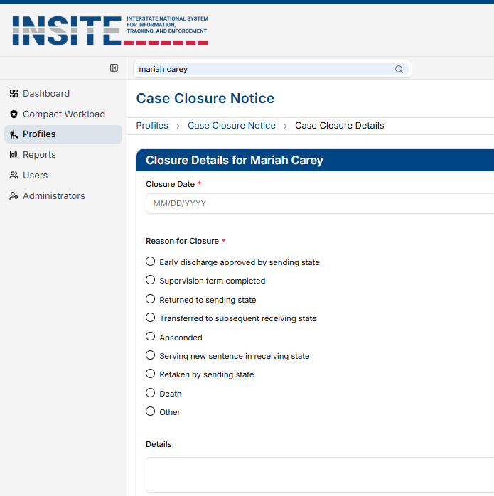
Case Closure
  Date supervision is discharged
  Notice to Sending State of absconding from the Receiving State
    OVR must be submitted prior to closure
  Notice to Sending State of incarceration (180 days or longer), including:
    Judgment and sentencing documents
    Supervised individual’s location
  Notification of death
  Return to Sending State
    Case may not be closed during retaking
  Transferred to a subsequent state
    Rule 4.112
The sending state must submit a case closure reply within 10 business days of receipt.
Notes:
54

Slide 54
Warrants, Discretionary Retaking &
Reporting Violations Requiring Retaking

Slide 55
Retaking Definition
Retaking – means the act of a sending state physically removing or causing to have a supervised individual removed, from a Receiving State.
Sending State:
    Issue Compact compliant ‘warrant’
    Incur cost of Retaking Supervised Individual
Receiving State:
    Incur cost to incarcerate pending retake
    May require establishing PC
Supervised individuals subject to retaking shall not be entitled to bond/release conditions pending retaking Rule 5.105
Notes:
56

Slide 56
Warrant Definition
Warrant – means a written order of the court or authorities of a sending or receiving state or other body of competent jurisdiction which is made on behalf of the state, or United States, issued pursuant to statute and/or rule and which commands law enforcement to arrest a supervised individual. The warrant shall be entered in the National Crime Information Center (NCIC) Wanted Person File with a nationwide pick-up radius with no bond amount set.
Warrants are required when:
  A supervised individual fails to arrive as instructed
  Receiving State requires retaking as supervision is no longer feasible and the supervised individual:
    is reported as an absconder; or
    is subject to mandatory retaking for behavior requiring retaking (exception exists to allow return in lieu of retaking See Rule 5.103); or
    commits a new felony or violent crime
  Sending State discretionarily retakes
Notes:
57

Slide 57
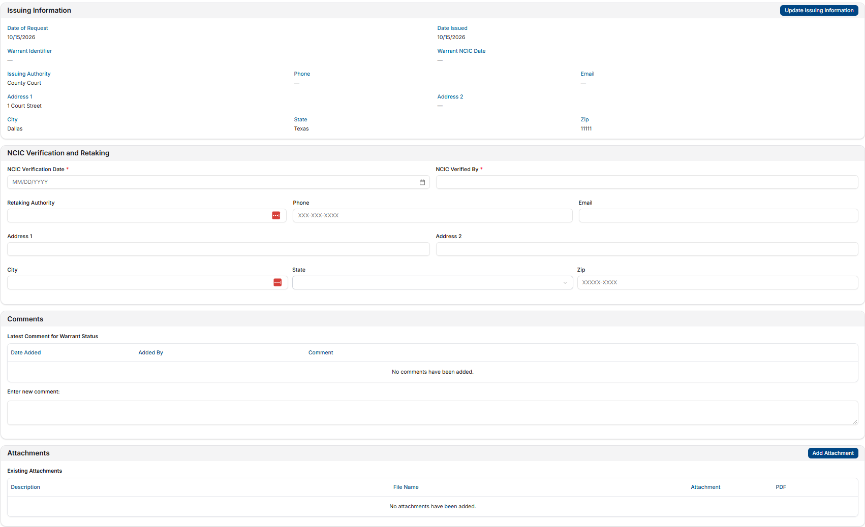
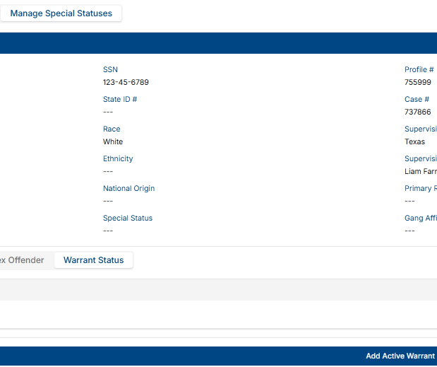
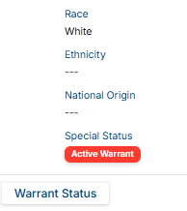
Warrant Status
Enter verification date AFTER confirming warrant is compact compliant
  No geographic limits
  No bond
  Entered into NCIC
All warrants issued by a sending state in accordance with ICAOS rules must be entered into INSITE.
Notes:
58

Slide 58
Discretionary Retaking & Mandatory Retaking
Discretionary
Retaking
Mandatory
Retaking
  Initiated by the Sending State (typically courts or parole boards)
  Requires notification via Discretionary Retaking Activity
  Warrant required- submit within 15 business days of warrant issuance
  Do not use Discretionary Retaking Activity for return in lieu of retaking
  Warrant must be entered into INSITE
  Initiated by the Receiving State for:
    Revocable behavior
    New felony or violent crime
    Absconding
  Documentation must show corrective efforts were exhausted and revocation would occur
  Probable cause (waiver or hearing) may be required unless the violation is a new crime conviction
Notes:
59

Slide 59
Behavior Requiring Retaking
Behavior would rise to the level of revocation in the Receiving State
Violation Report
Progress Report
Act or pattern of Non-Compliant Behavior
Non-Compliant Behavior
RETAKING
Unsuccessful Supervision Documented
Address Behavior & Report to Sending State
Would Request Revocation of Supervision
Would Apply Sanctions OR Corrective Actions
Notes:
60

Slide 60

  Court/Parole Board in your jurisdiction revokes SUPERVISION for similar behavior
    Extending/modifying supervision term is NOT revocation
Revocation - means the course of action by a court, sentencing authority or paroling authority to rescind a supervised individual’s supervision term and impose a jail or prison sentence due to an act or pattern of behavior that could not be successfully addressed through documented corrective actions or graduated responses in the community.
  Exhausted options to address non-compliant behavior
  Revocation of SUPERVISION would be likely for instate similar supervised individual
  Revocation is NOT simply reporting a condition violation to the court.
Notes:
Absconder apprehended, but sending state could not pick up or transport-
Receiving state agreed to resume supervision until such a time as sending state could make arrangements
61

Slide 61
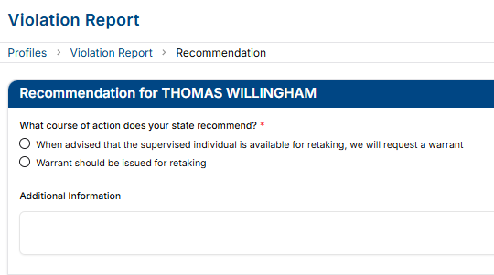
Violation Report Requiring Retaking
  Reports “behavior requiring retaking”
  Recommends revocation of supervision
  Enforces retaking rules
  Manages retaking
    All communication regarding violations via Violation Reports & Violation Addendums
While states may select “When advised that the individual is available for retaking, we will request a warrant,” best practice is to submit a Violation Report Requiring Retaking once the supervised individual is formally available.
Notes:
62

Slide 62
Violation Report Responsibilities
Receiving State
Sending State
  Submit within 30 calendar days of determination that supervision is no longer viable
  Include supporting documentation:
    Police and toxicology reports
    Preliminary findings
    Infraction details/status
  Incentives or sanctions applied and responses
  Verify the supervised individual’s availability status is accurate
Respond within 10 business days
Notes:
63

Slide 63

Violation Report Considerations
1
2
3
4
The sending state is only going to know what you tell them.
Use the same detail if reporting to your own authorities.
Specifics on how the behavior would result in revocation of supervision.
State how and why the option of working with the individual (e.g. intervention)has been exhausted.
  Violation reported is revocable behavior
  “violation would rise to level of revocation because…”
  Reported timely
  Requiring return/retake
  Availability status accurate
  Ensure no pending charges exist
  Supporting documentation included
  “Story” provided on why supervision is not successful
  Review supervised individual profile to ensure consistency/accuracy
Notes:
64

Slide 64
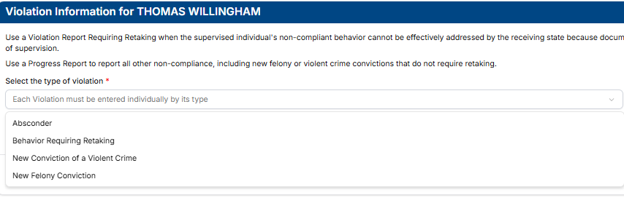
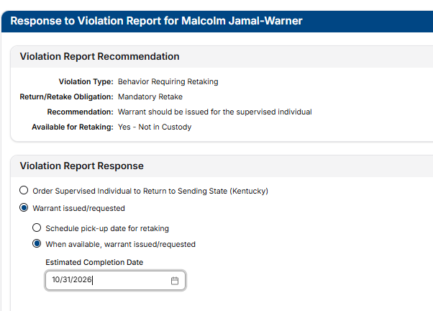
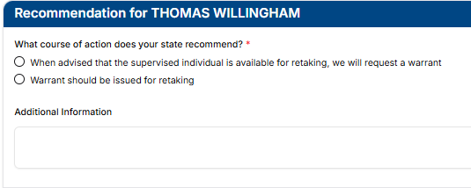
Receiving State
Sending State
Be sure to use addendums for ALL subsequent violation correspondence
Notes:
65

Slide 65
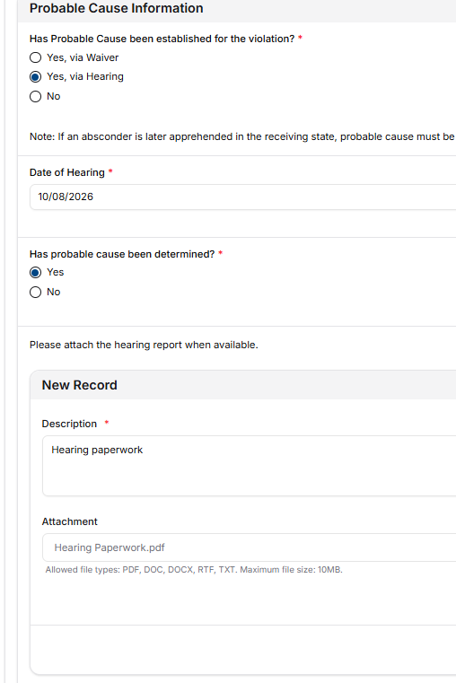
Violation Reports Probable Cause Status
Probable Cause Status
When there is a possibility of revocation of supervision once retaken/returned to the sending state, the supervised individual has a RIGHT to a PC hearing near where the alleged violations occurred prior to retaking
Not required if violation is new conviction
Although not required without request from sending state, establishing PC should be expected prior to retaking
Additional PC Training in next section
Waiver must include admission of a violation that would result in pursuance of revocation of supervision in YOUR STATE.
Hearing Reports must comply with Rule 5.108 and hearing officer must conclude there is probable cause of a violation that would result in pursuance of revocation of supervision in YOUR STATE.
Update/Add PC information anytime via Addendum to Violation Report

Slide 66
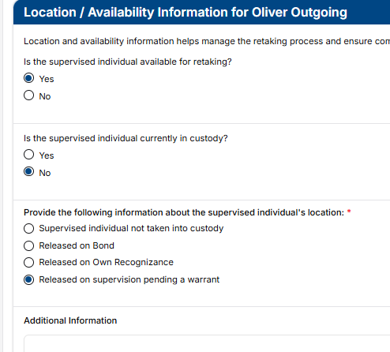
Violation Reports Location & Availability
When is a supervised individual available for retaking?
When there is nothing holding the supervised individual in the Receiving State.
A supervised individual is NOT available if there are pending Violent Crime or Felony Charges unless states (stakeholders) mutually agree. See Rule 5.101-1
Update Location information anytime via Addendum to Violation Report
Notes:
67

Slide 67
Abscond – means:
a. Supervision personnel are unable to establish contact or locate the supervised individual; and
b. The supervised individual took action to make themselves unavailable for supervision and failed to comply with reporting requirements.
Absconders
Receiving State
Sending State
Supervised individual not located after investigation period:
  Attempt to locate the individual at their last known residence
  Contact employer and/or school, if applicable
  Contact service providers or community agencies
  Contact known family members and collateral contacts
  Conduct record and database checks to assist in locating the individual
Submit Violation Report (Detailing Investigation) and Case Closure
Issue Warrant within 15 business days
Enter Warrant Details on supervised individual Profile
Notes:
68

Slide 68
Begin Investigation
30-Day Investigation
Exceptions
If absconding is suspected, make reasonable efforts to locate the individual.
After conducting investigation, submit absconding OVR and CCN.
Documentation is key!
New serious offense, flight/escape, monitoring tampering, or history of violence/escalating risk.
01
02
03
The 30-day investigation starts when absconding is suspected and efforts begin.
Document the start date in the narrative of the violation report.
Detail all investigative efforts during the 30 days.
Submit the violation report after 30 days, unless extenuating circumstances exist.
Warrant Issued
Detainer
Within 15 business days of receiving the OVR for an absconder, a warrant shall be issued
If apprehended within the receiving state, a detainer shall be filed with the holding facility
04
05
Rule 4.109-2 Absconding Violation

Slide 69
Warrant Requirement
1
Violation Report Requiring Retaking
=
WARRANT
ONLY Exception: after report of ‘Behavior Requiring Retaking,’ Sending state can order the return of the supervised individual (via reporting instructions) in lieu of retaking
2
Warrant must be Compact Compliant (within 15 business days of OVR receipt)
  No Bond
  Nationwide
  Entered into NCIC
3
Details of Warrant must be entered in INSITE on the supervised individual’s Profile
Notes:
69

Slide 70
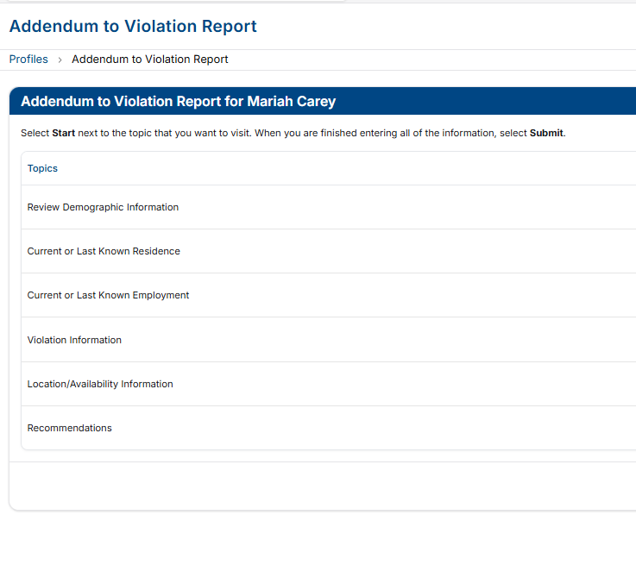
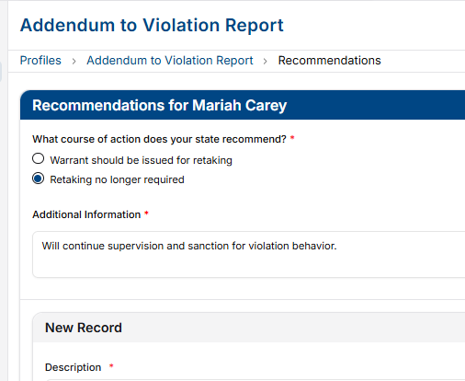
Manage Retaking via Violation Report Addendums
Cases must remain open in INSITE until retaking occurs!!
Previously reported absconder(subject to retaking) apprehended in the Receiving State?
Reopen case to provide documentation and communication via addendums
  e.g., location status, availability, etc.
  If states mutually agree to continue supervision upon apprehension, an addendum indicating retaking no longer required shall be completed
Ensure accurate/updated information is provided timely
Notes:
70

Slide 71

5.101-2 Discretionary Process for Violation Disposition
  Allows electronic or in-person proceedings for new convictions or violations leading to incarceration or out-of-state supervision
  Requires approval from the sending state and consent from the supervised individual
  Sending State must notify the Receiving State and share results within 10 business days
  No Retake Required: If sentence fully satisfies the violation or is supervision-only (Rules 5.102, 5.103, 5.103-1)
  Retake Required: If sentence includes incarceration and only partially satisfies original incarceration
Notes:
Given the complexity of managing violations and retaking supervised individuals across state lines, this rule aims to ensure violations are addressed appropriately and without delay. It accounts for factors such as the severity of the violation and whether it is connected to a new crime conviction, violation, revocation resulting in incarceration, or a new term of supervision.
With the rise of remote sentencing and the emphasis on swift and certain supervision, the updated language clarifies that the sending state may use remote hearings to address violations while simultaneously managing a sentence of incarceration or supervision.

Slide 72
Probable Cause
Rule 5.108
Reference ICAOS Hearing Officer Guide
https://www.interstatecompact.org/hearing-officers-guide

Slide 73
US Supreme Court Cases & Rule 5.108
Morrisey vs. Brewer 408 U.S. 471 (1972) (parole)
Gagnon vs. Scarpelli 411 U.S. 778 (1973) (probation)
Why is this important to Compact supervised individuals?
  Geographical concerns (violations committed outside of Sending State)
  Without PC, violations may be barred from consideration for revocation (Sending State)
  Supervised individuals are ENTITLED when revocation is possible (once transfer is granted, it cannot be arbitrarily rescinded)
Probable Cause & Interstate Compact
Notes:
72

Slide 74
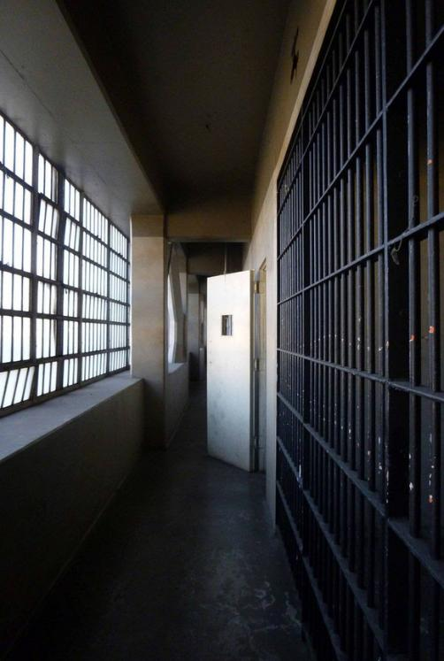
Revocation vs Retaking
Revocation
Retaking
Sending State rescinds supervised release and incarcerates the supervised individual
    Requires PC be established near where alleged violations occurred
Process to remove or cause a supervised individual to be removed from the Receiving State
    Mandatory: Receiving State invokes based on ‘revocable’ non-compliant behavior
    Discretionary: Sending State may initiate retaking for ANY reason (unless pending felony or violent charges exist)
This Photo by Unknown Author is licensed under CC BY-NC-ND
Notes:
73

Slide 75

Purpose of Probable Cause
Test Merit of Violation
  Provides evidence the supervised individual likely violated his or her conditions of supervision
  Ensure violation meets definition of ‘Behavior Requiring Retaking’
  Receiving States should not arbitrarily revoke relocation once granted
Creates a Record
  To be used in possible subsequent revocation hearing
  Who, What, When & Where??
Notes:
74

Slide 76
NOT Entitled to a PC Hearing
Entitled to a PC Hearing
  No possibility that violations committed in Receiving State will be used in revocation proceedings in the sending state
    e.g., supervised individual simply returning to resume supervision in Sending State
  Violation is based on new conviction
    Conviction is proof the supervised individual committed the violation
    Rule 5.102
  Custodial detention based on violations
    Initiated by either the receiving/sending state
    Justifies detention
  Violations committed in Receiving State may form basis for revocation of supervision
    PC creates record for sending state and substantiates the violations
  Absconder apprehended in the receiving state unless states mutually agree to continue supervision
Notes:
75

Slide 77
Reasons Probable Cause is Required
Justify Custodial Detention
Violations to be Used in Revocation Proceedings
Previously Reported Absconder
Preliminary hearing to justify detention
  Sanctioning, not retaking or revocation
May or may not meet requirements of Rule 5.108 (varies state to state due to internal policies)
Retaking for violations
  creates record for sending state
  substantiates the violations
Ensures certain due process RIGHTS are afforded to the supervised individual prior to revocation hearing
Confirms validity of previous Violation Report
Warrant & Detainer must remain in place!
Reopen INSITE case to provide PC documentation
Not required if states mutually agree to continue supervision under 5.103-1
Notes:
76

Slide 78

Informing the Supervised Individual
  Provide written notice of the alleged violation(s)
  Supervised individual decides to
    proceed with hearing; or
    waive their right to a hearing, provided the waiver includes an admission of a revocable violation
Probable Cause Hearing
Waive right to hearing
Notes:
77

Slide 79

Supervised Individual Rights
Disclosure of non-privileged/non-confidential evidence
Opportunity to be heard
  in person, present witnesses, evidence, etc.
Opportunity to confront and cross-examine adverse witnesses
  unless the hearing officer determines that a risk of harm to a witness exists
Notes:
78

Slide 80

Elements of the Hearing
Shall be conducted within 30 calendar days of a request made by a sending state unless postponement is granted by a hearing officer
Conducted by neutral and detached person
Close proximity to where alleged violations occurred
Administrative hearing
  Fact finding, no determination of guilt
  Level of due process is usually less than a revocation hearing
Notes:
78

Slide 81

Reporting Requirements
Send within 10 business days after the hearing
Must include:
  Date, time, location of the hearing
  Who was present (who testified/who did not)
  The alleged violations of conditions and the hearing officer’s finding on each violation
  Clear & concise WRITTEN summary of ALL testimony
  What evidence was used in decision?
Notes:
78

Slide 82

Waiving PC Hearing
1
Supervised individual is apprised of his or her rights to hearing
2
Supervised individual does not contest retaking and aware of the facts supporting retaking
Signed admission to one or more revocable violations
Admission must be of sufficient gravity to justify revocation in the Receiving State
3
Notes:
79

Slide 83
Upload PC Documentation
Upload Probable Cause documentation when reporting the violation or later via Addendum to Violation Report
Notes:
80

Slide 84
PC NOT Established | PC NOT Established
Receiving State | Sending State
Notify the sending state to vacate the warrant | Vacate Sending State’s warrant
Vacate the Receiving State’s warrant
If in custody, release the individual back to supervision within 24 hours of the hearing
Continue Supervision
After the PC Hearing
PC Established | PC Established
Receiving State | Sending State
May hold the individual in custody pending decision from the sending state | Confirm decision to retake within 15 business days of receipt of the report
The individual does not become available for retaking until the results of the PC hearing are submitted to the sending state. | SHALL retake individual within 30 calendar days once in custody solely held on the sending state’s warrant and PC hearing results received.
Notes:
81

Slide 85

Contact the ICAOS National Office
Email
icaos@interstatecompact.org
Phone
859.721.1050
Website
www.interstatecompact.org
Office
3070 Lake Crest Circle
Suite 400-264
Lexington, KY 40513
Notes:
82

