Slide 1

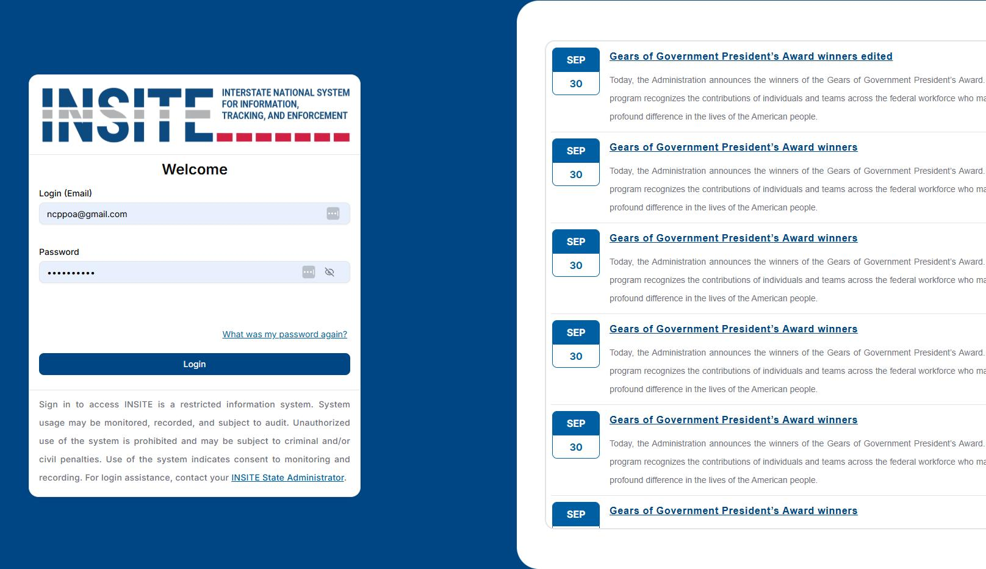

A BETTER WAY TO WORK

Slide 2
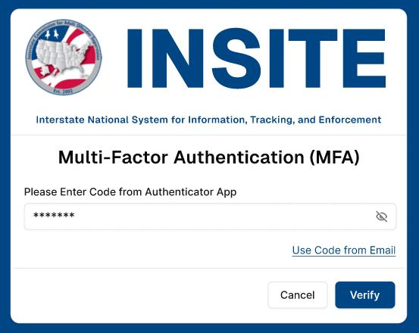
MULTI-FACTOR AUTHENTICATION

Slide 3
WHY MFA?
  Protects Sensitive Information
  Prevents Unauthorized Access
  Supports Public Safety
  Meets Federal Requirements

Slide 4
LOGIN & NEWS

Slide 5

WHAT YOU’LL FIND IN NEWS
  System Maintenance
  Releases & Enhancements
  Service Interruptions
  Training Opportunities
  Educational Resources
  Events & Reminders

Slide 6
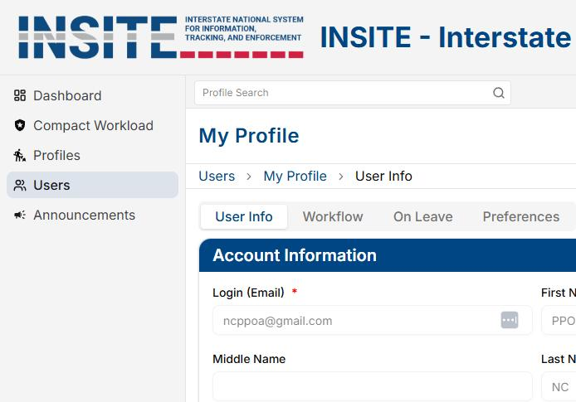
USER PROFILE

Slide 7
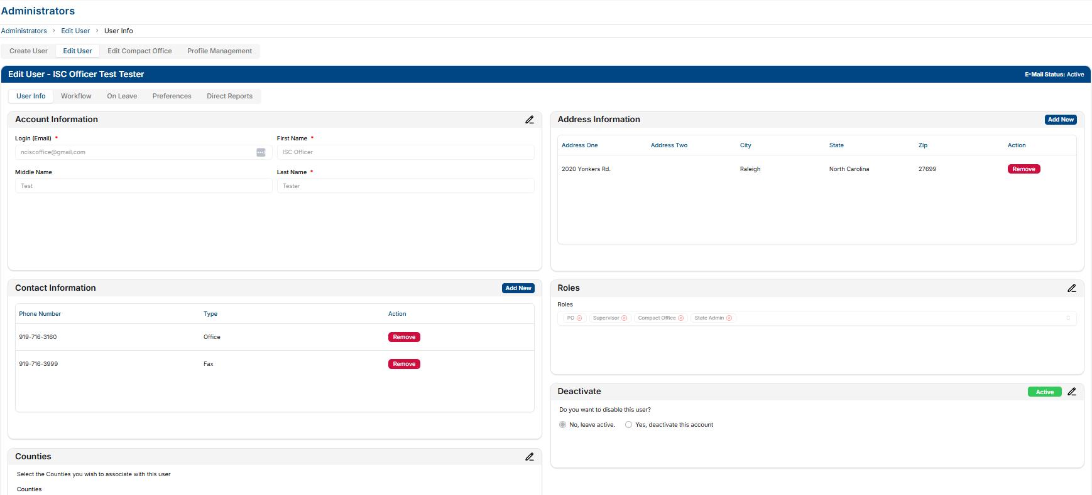
USER INFO & DEACTIVATION

Slide 8

SIMPLIFIED USER ADMINISTRATION
  Same look & feel for End Users
  Simplified deactivation process for compact Staff
  Automatic removal of User Roles which was often times overlooked in ICOTS

Slide 9
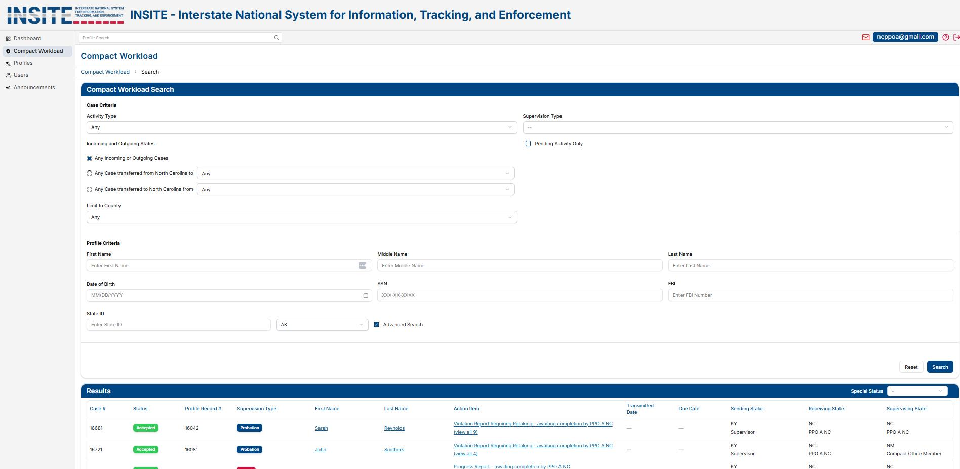
COMPACT WORKLOAD

Slide 10
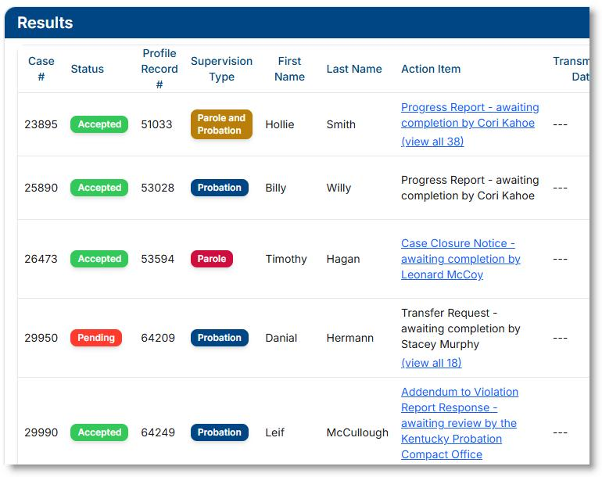
COMPACT WORKLOAD RESULTS

Slide 11

IMPROVED SEARCH FUNCTIONALITY
  Profile Search on every screen for quicker access
  More intuitive search results that highlight key matches
  Search results on the bottom of screens to allow for abilty to change search criteria instantly
  Color coded information to quickly see type and status of cases

Slide 12
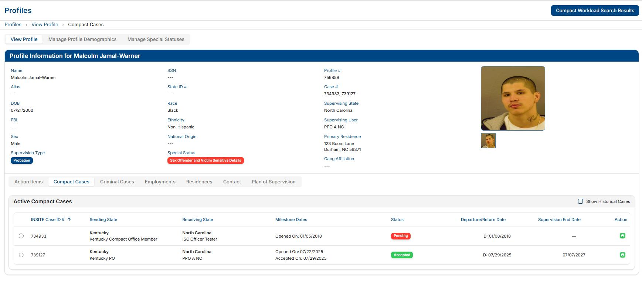
SUPERVISED INDIVDUAL PROFILE

Slide 13
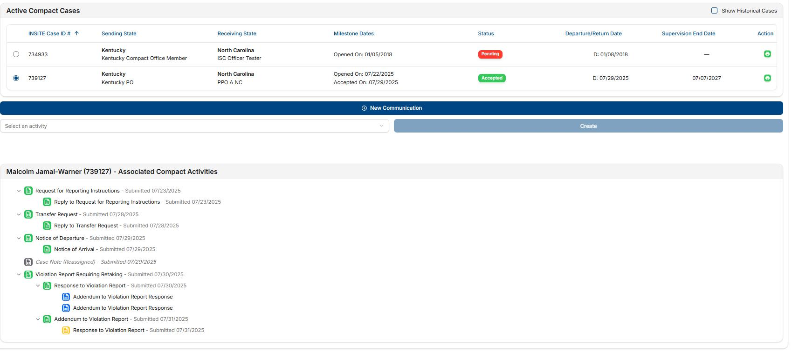
SUPERVISED INDIVIDUAL PROFILE

Slide 14

PROFILE MODERNIZATION
  Language updated to reflect “Supervised Individual” instead of “Offender”
  Updated NCIC codes
  Contact information located in one section to streamline information
  Ethnicity now shown on profile
  “Violation History” removed as this info is available elsewhere on the profile

Slide 15
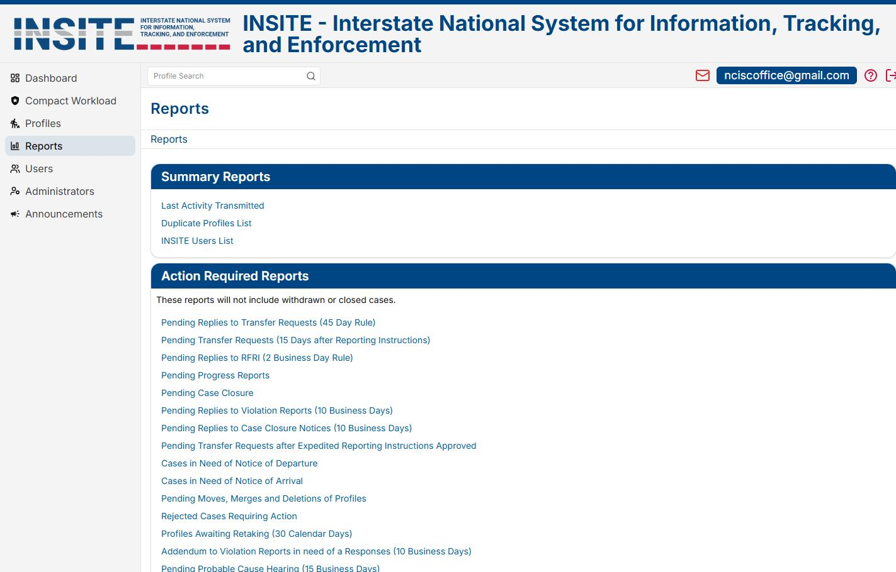
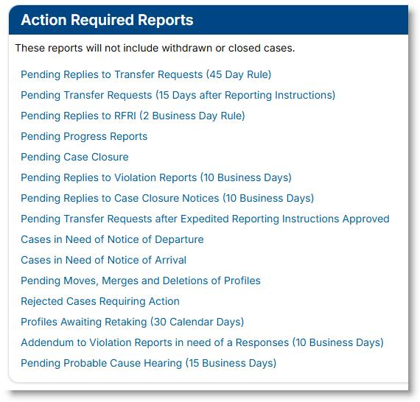
REPORTS

Slide 16
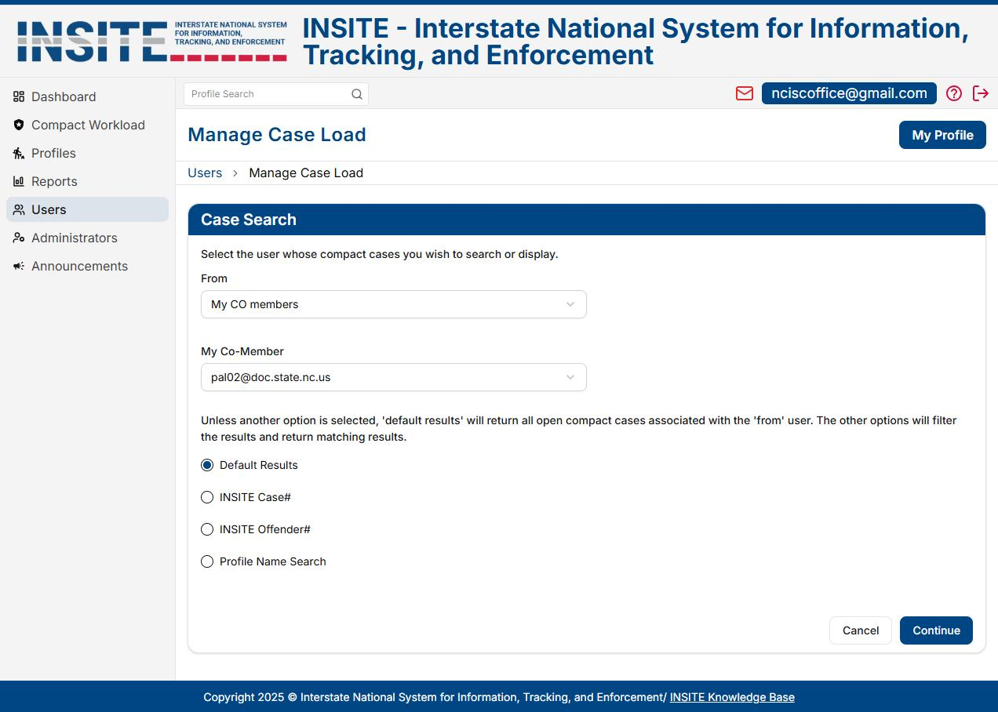
USER ADMINISTRATION

Slide 17
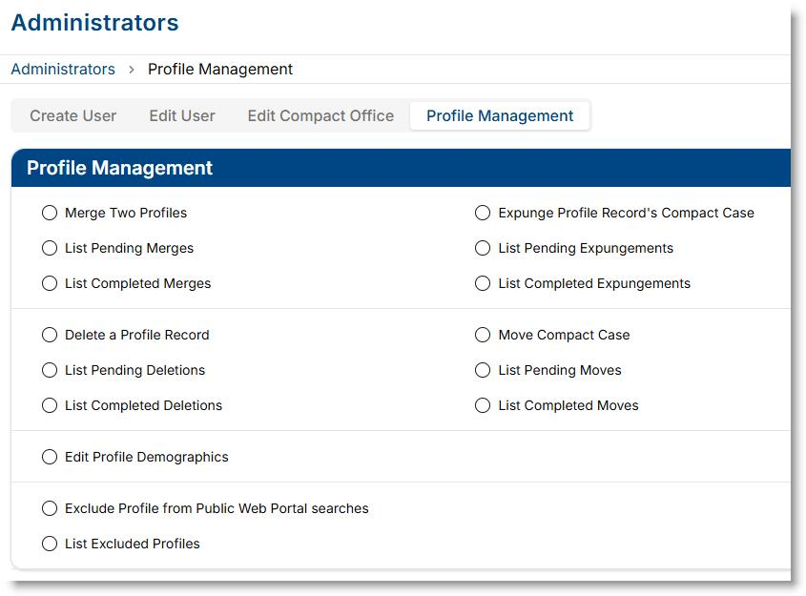
PROFILE MANAGEMENT

Slide 18
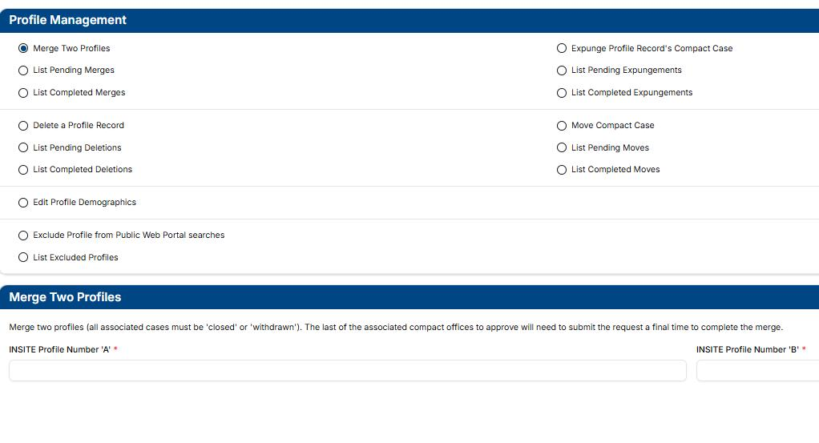
PROFILE MANAGEMENT
CLEARER DIRECTION BUILT INTO THE SYSTEM

Slide 19

IMPROVED MANAGEMENT OF PROCESSES
  “Overdue” reports replaced by “Pending” reports for more proactive case management
  Overdue reports remain available in the ICAOS Dashboard Reports
  New “Last Transmitted Activity” report makes it easier to monitor case progress
  National Office approval removed from moves/merges/deletes/expungements for faster processing by states

Slide 20
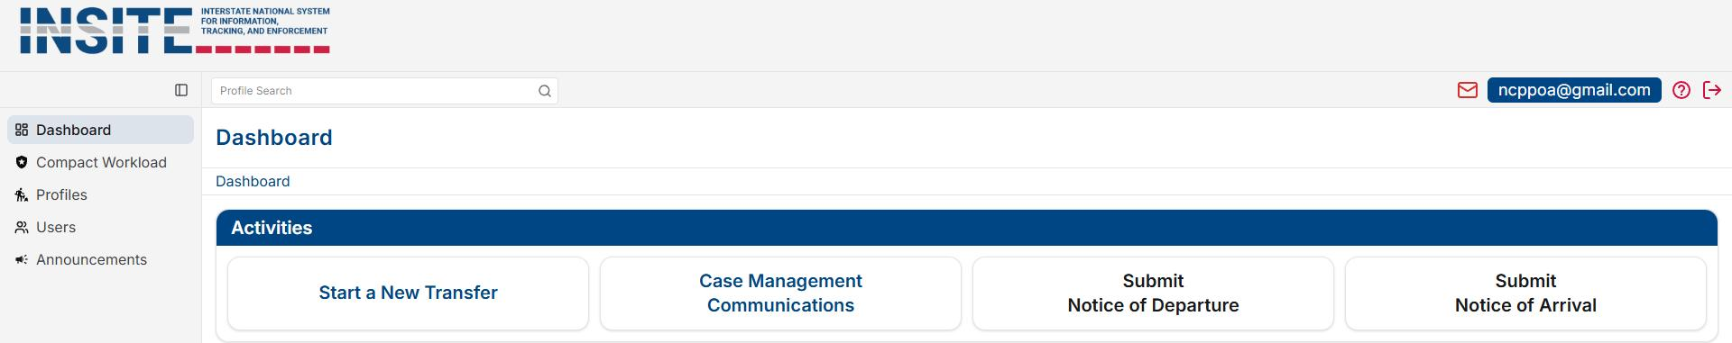
DASHBOARD

Slide 21

QUICK ACCESS TO COMMON PROCESSES
  Replaces “Assistants” tab which could be confusing and overwhelming for users
  Common tasks located on “Dashboard” as a starting point for users
    Start a New Transfer
    Case Management Communications
    Submit Notice of Departure
    Submit Notice of Arrival
  Encourages majority of workflow processes to occur fron the Individual’s Profile

Slide 22
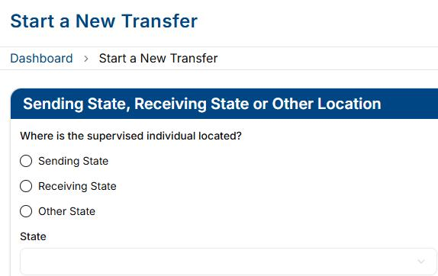
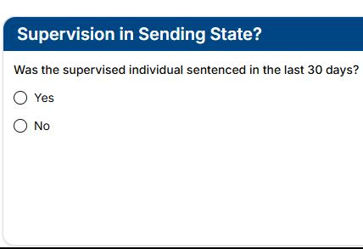
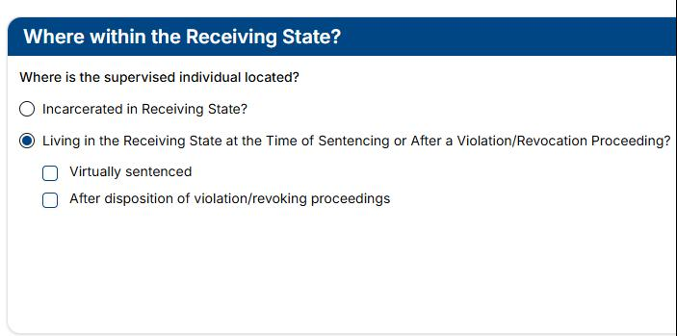
PRE-TRANSFER QUESTIONS

Slide 23

PRE-TRANSFER QUESTIONS
  Takes the guesswork out of which process to start by answering a few simple questions
  Provides more accurate information to the receiving state on where an individual is actually located at the time of the request
  Includes questions on virtual sentencing and if the individual was living in the receiving state at the time of violation or revocation proceedings which was unavailable in ICOTS

Slide 24
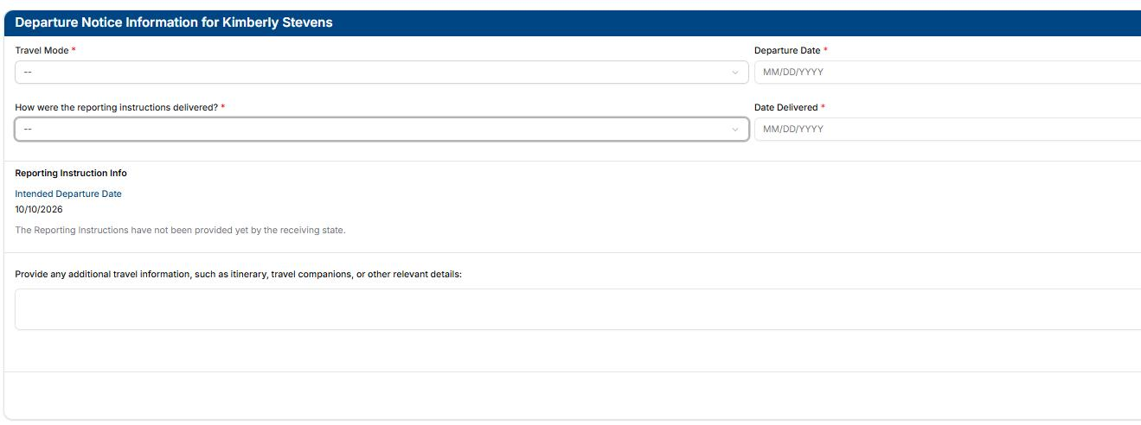
NOTICE OF DEPARTURE
No Process Changes

Slide 25

NOTICE OF DEPARTURE
  Clearer language added to instruct users to provide travel information (itinerary, travel companions, etc.)
  Space to include how reporting instructions have been or will be given to the supervised individual
*Overall NOD process remains the same*

Slide 26
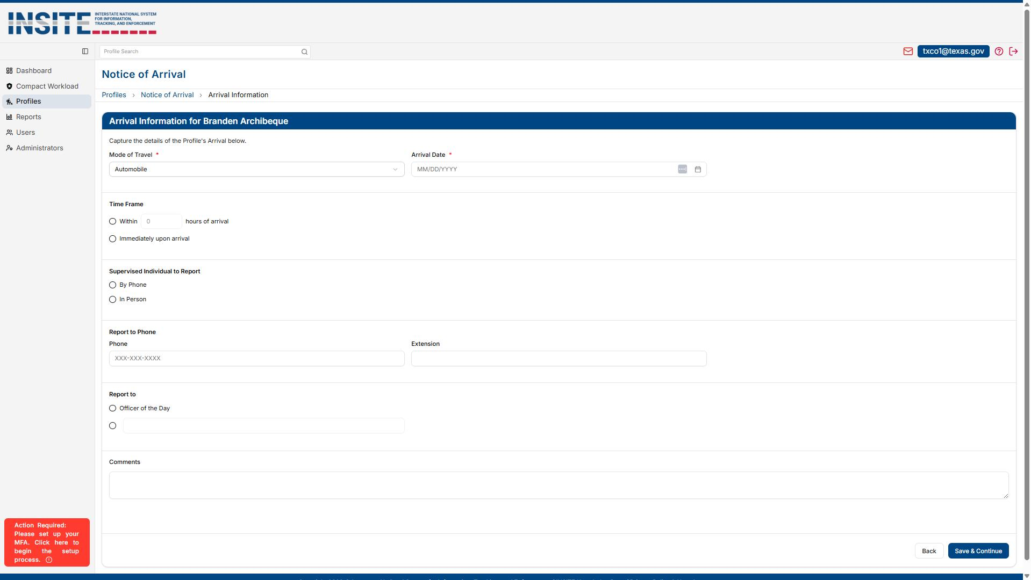
NOTICE OF ARRIVAL
No Process Changes

Slide 27
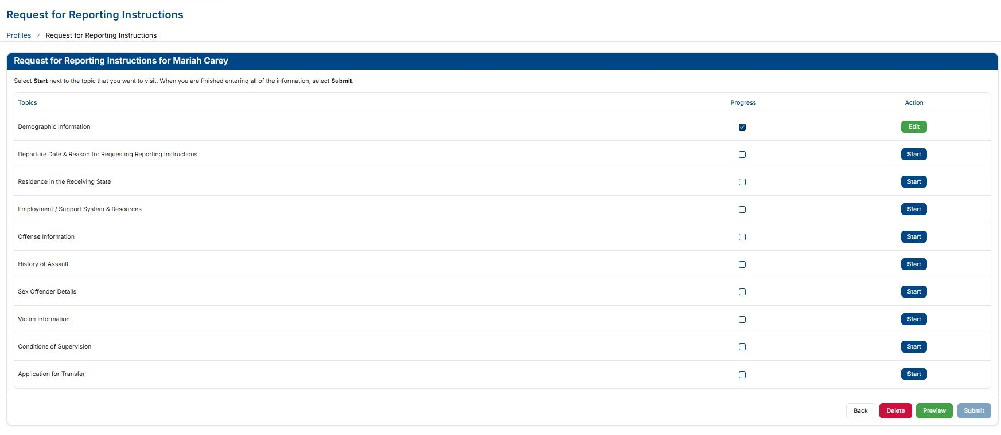
REQUEST FOR REPORTING INSTRUCTIONS
No Process Changes

Slide 28
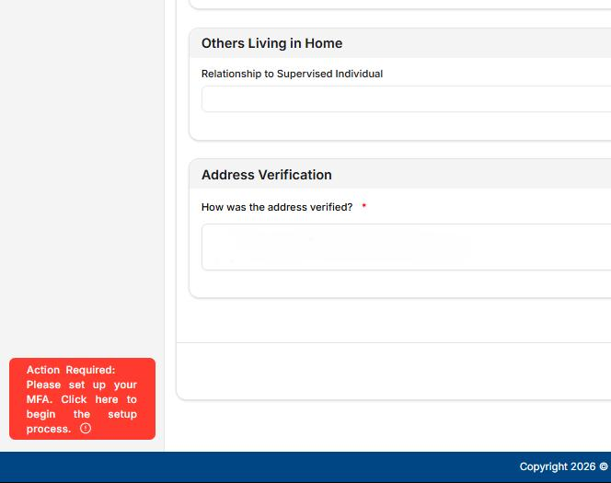
REQUEST FOR REPORTING INSTRUCTIONS
& TRANSFER REQUESTS
  Create a new case from an existing closed case
  Updated NCIC codes
  New residence verification fields
  Identify others residing at proposed residence
  Phone number required
  Support system and resources required for all transfers

Slide 29

UPDATED TERMINOLOGY
  VICTIM SENSITIVE DETAILS → VICTIM INFORMATION
  CONTACT RESTRICTIONS → NO-CONTACT ORDERS
  PROTECTIVE ORDERS → ACTIVE PROTECTION ORDERS
  SUPERVISION HISTORY → SUPERVISION DETAILS

Slide 30
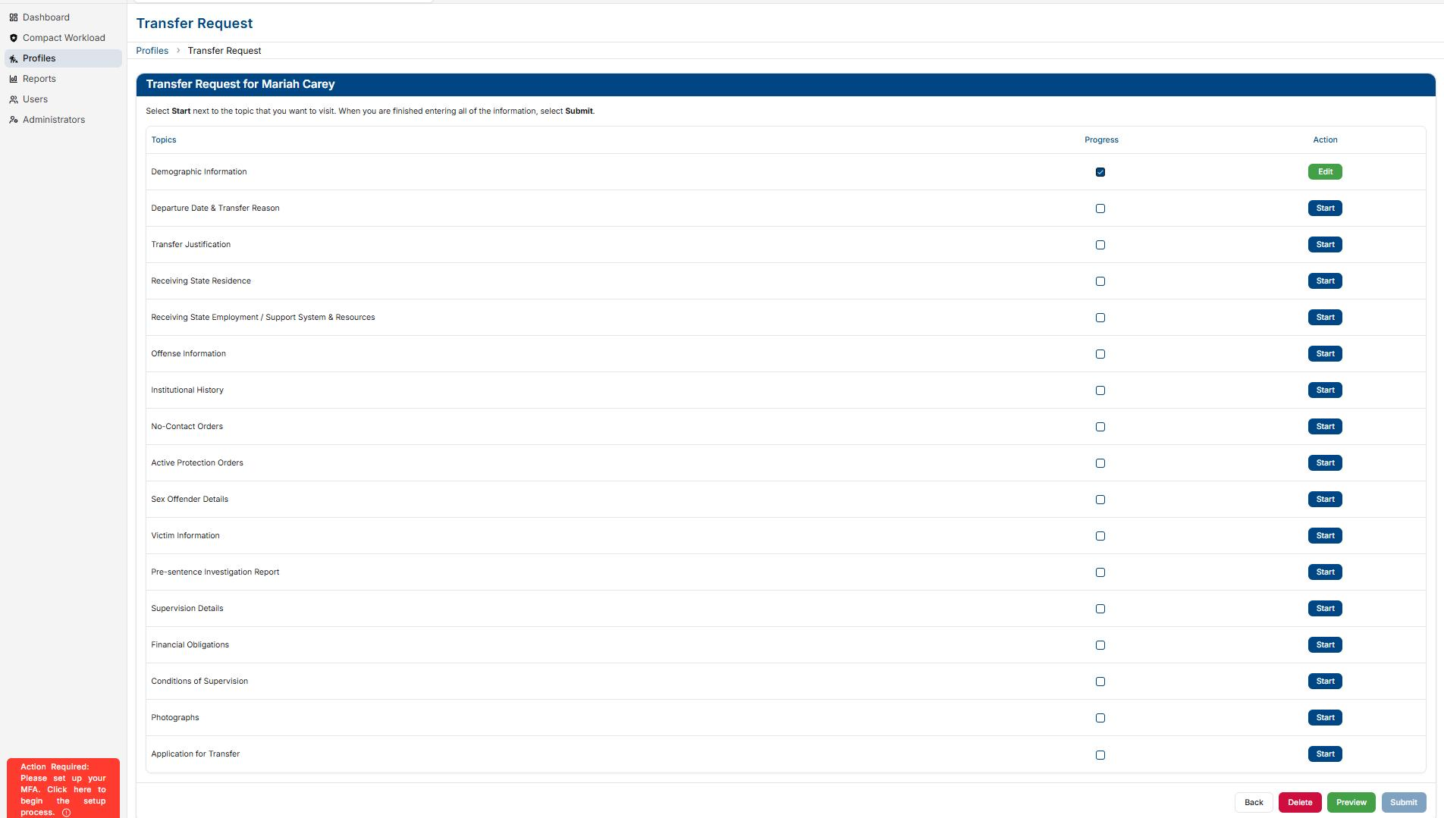
TRANSFER REQUEST
No Process Changes

Slide 31
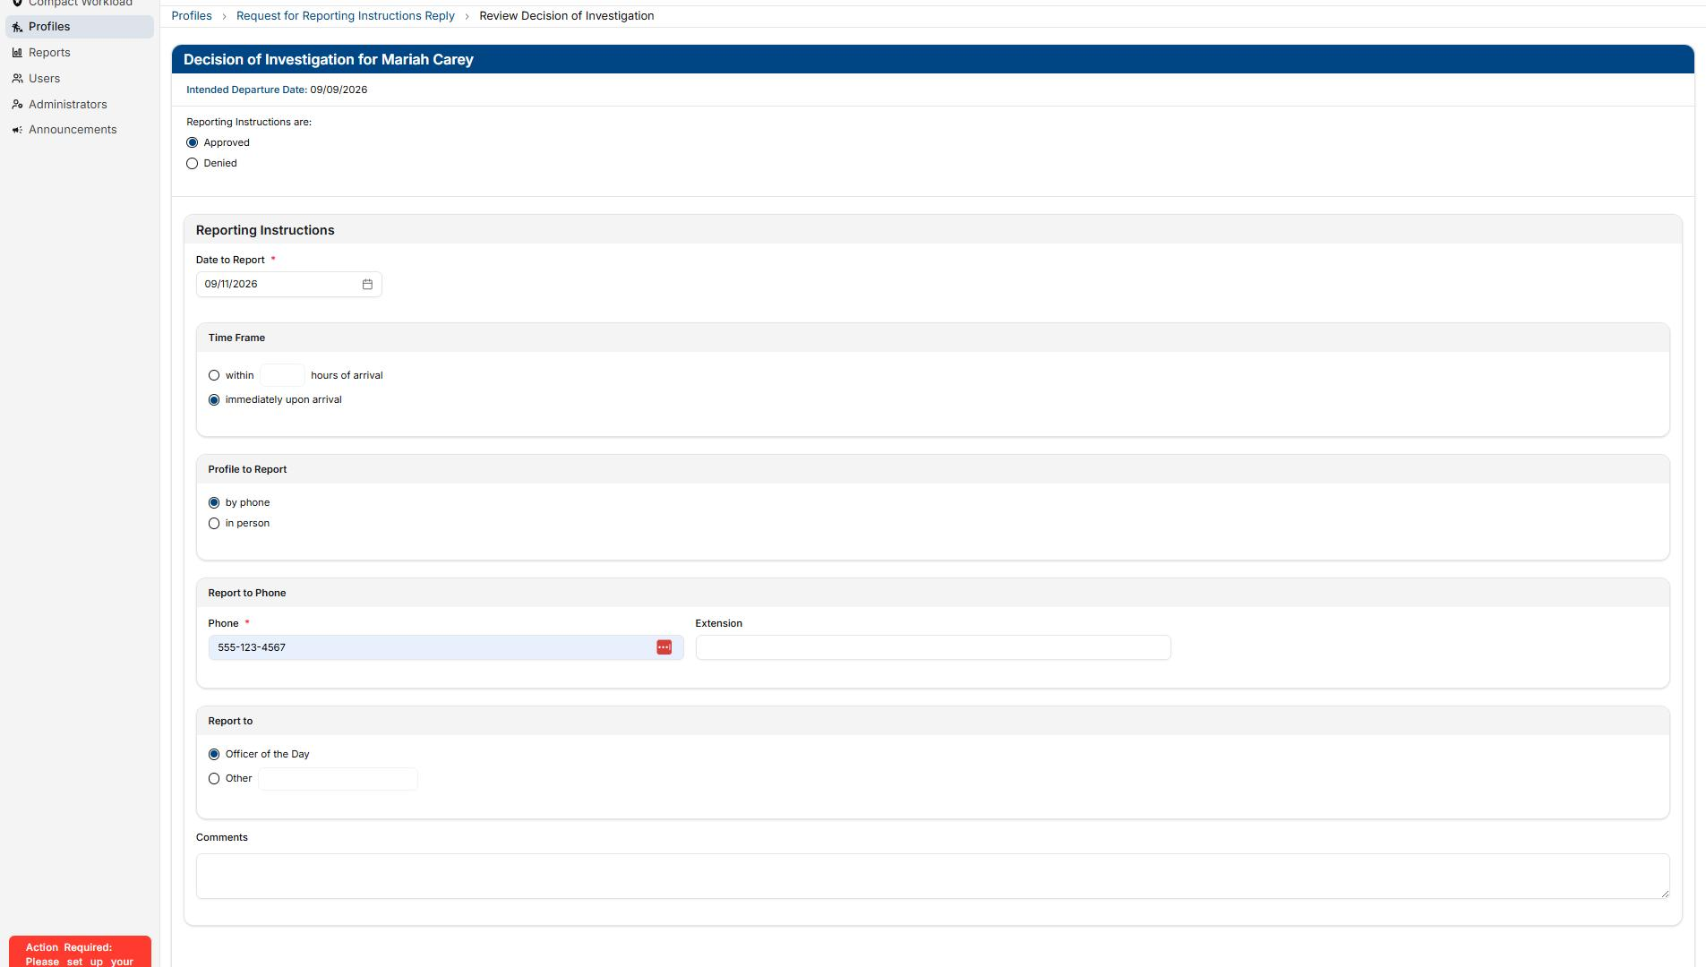
RFRI REPLY
No Process Changes

Slide 32
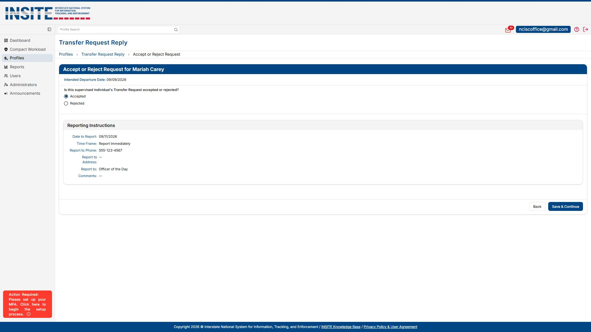
TRANSFER REPLY
No Process Changes

Slide 33
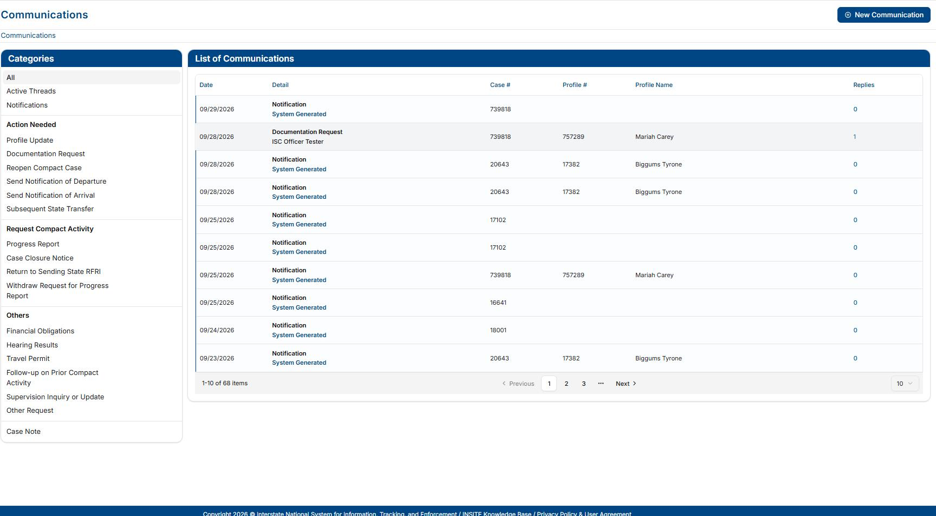
COMMUNICATIONS & NOTIFICATIONS

Slide 34
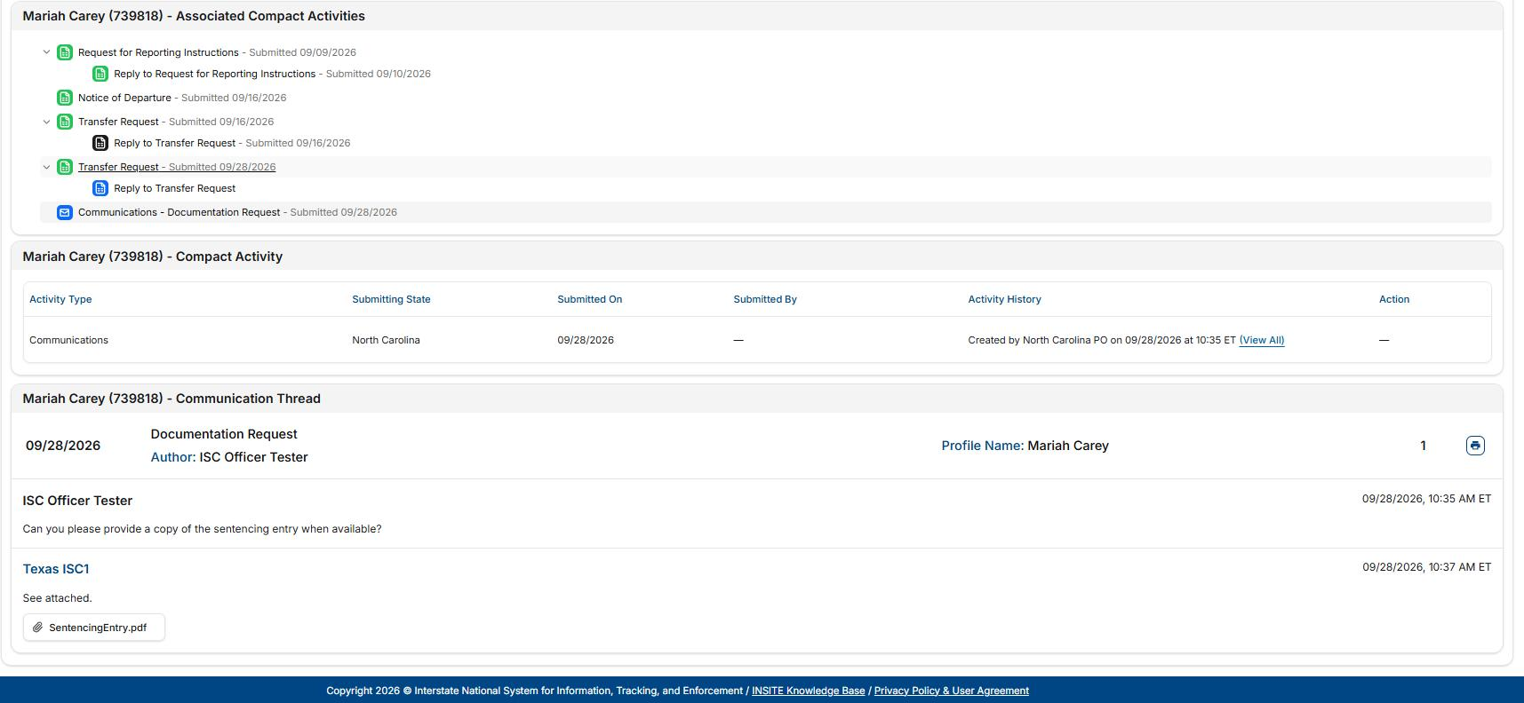
COMMUNICATIONS
  Replaces Compact Action Requests
  Clear direction on what the receiving user needs to do with clearer specializations
  No longer getting lost in old Compact Action Requests or responding to the incorrect one
  Nested coversations to keep information all in one place (after November 2nd launch)
  Historical record on individual’s profile

Slide 35
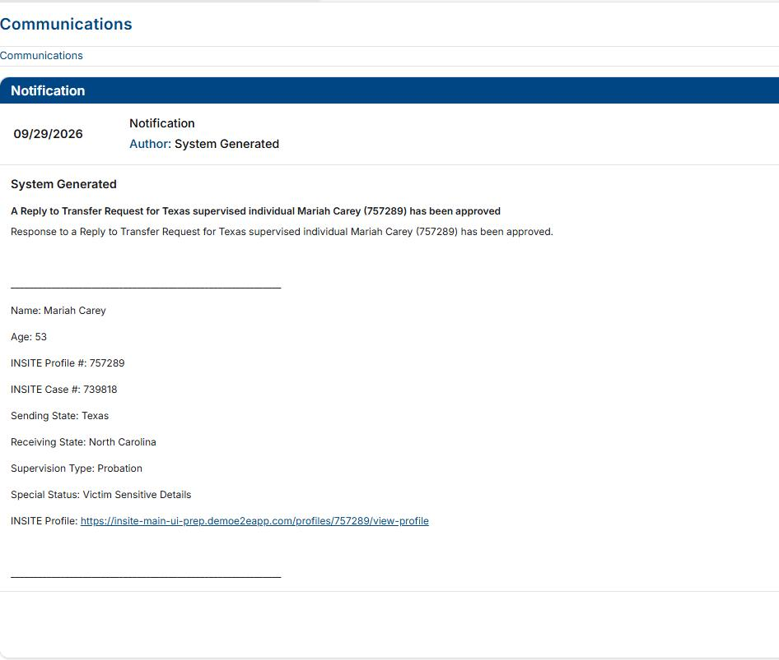
NOTIFICATIONS
  Replicates current ICOTS notification emails
  Does NOT replace email notifications but provides the same information directly into INSITE
  Will show as “System Generated” notification in your Communications section
  Quick glance as a to-list for end users

Slide 36
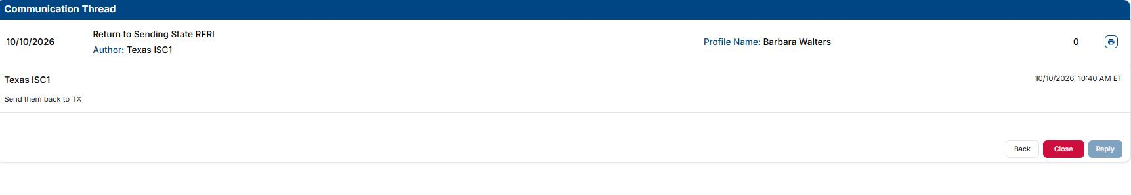
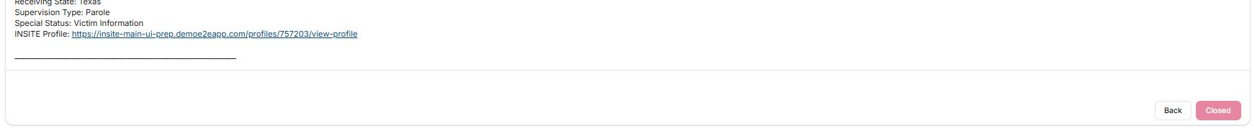
CLOSING COMMUNICATIONS & NOTIFICATIONS
  Communications should be closed after reponse has been received and all information has been provided
  System Generated Notifications will automatically closed when viewed for 2 seconds or more

Slide 37
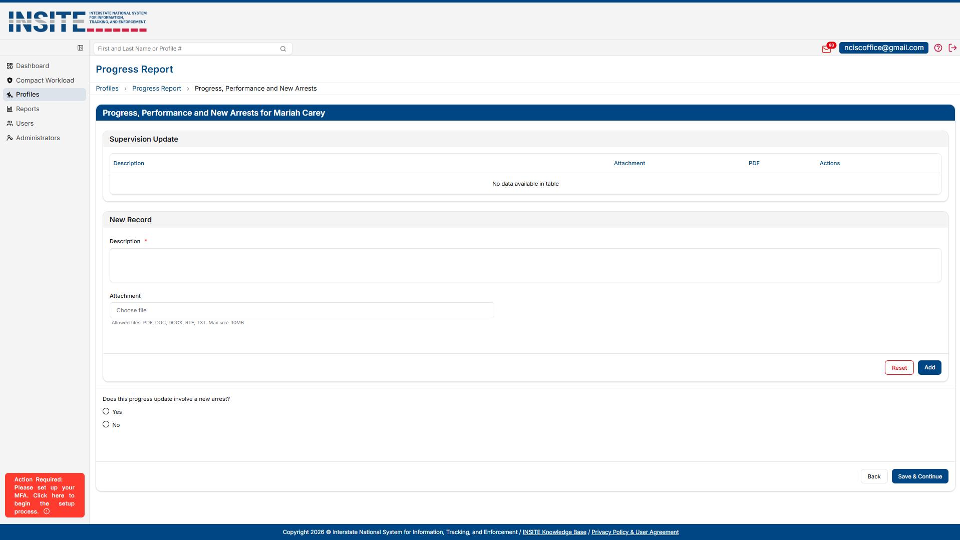
PROGRESS REPORT

Slide 38
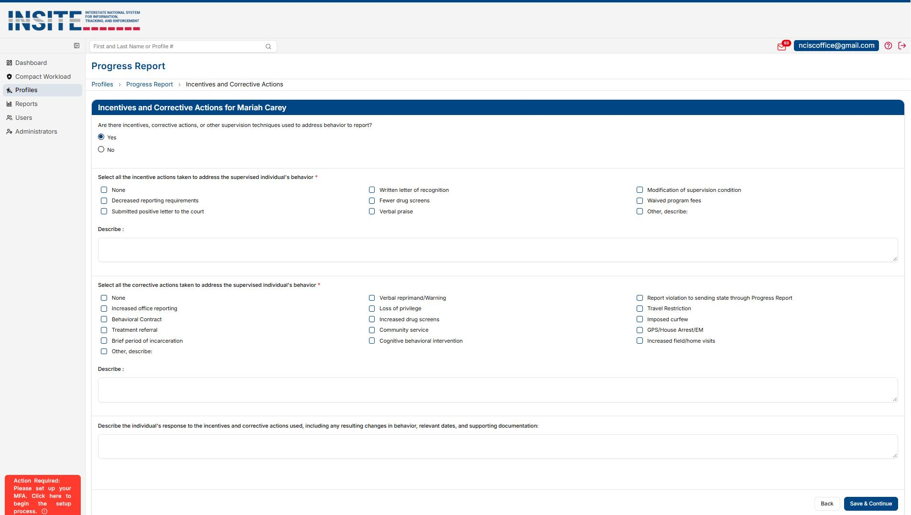
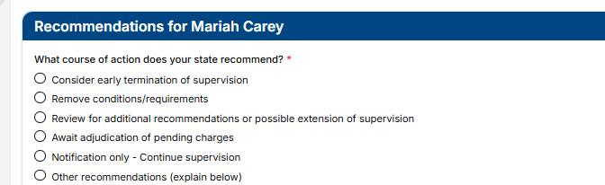
PROGRESS REPORT
  "Progress, Performance & Attitude" renamed to "Progress, Performance & New Arrests"
  Receiving State Conditions & Incentives/Corrective Actions now display regardless of user responses
  Recommendations section updated for improved clarity

Slide 39
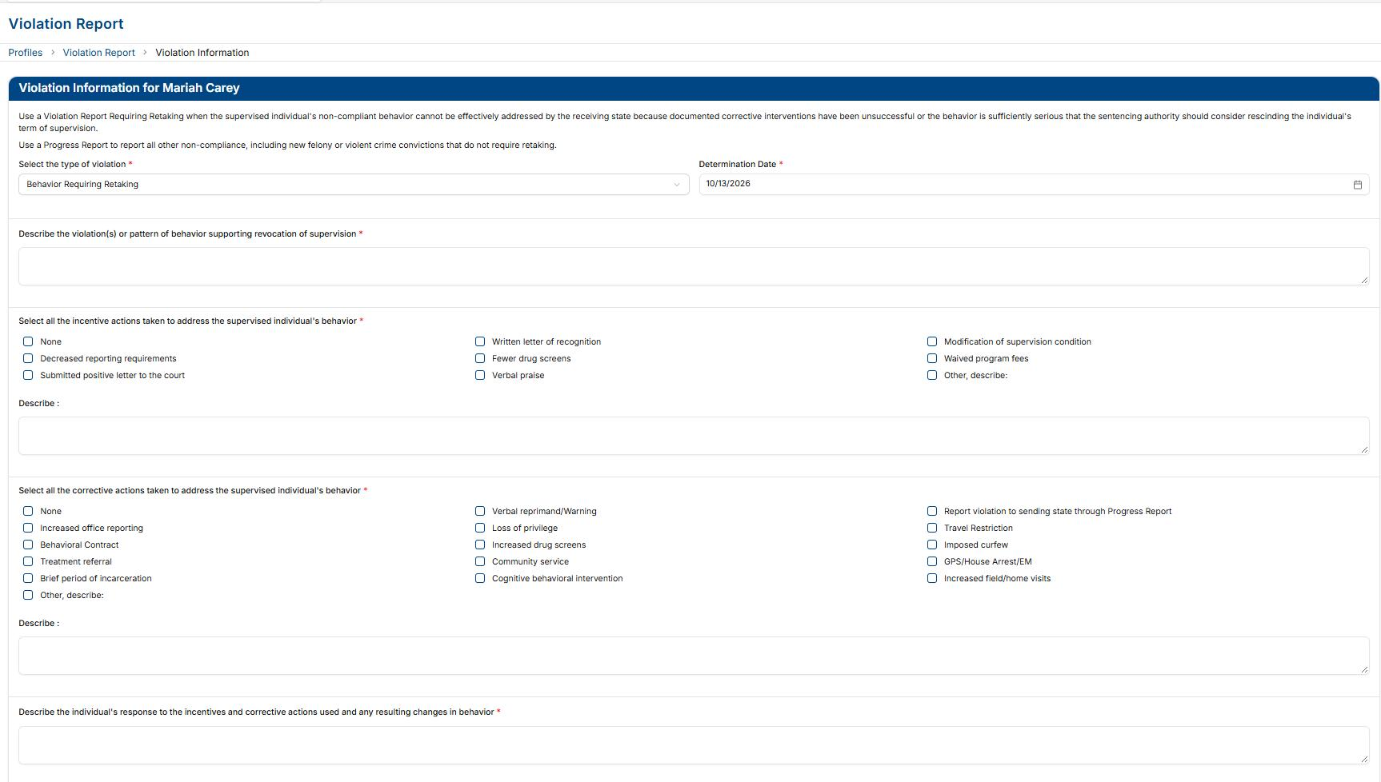
VIOLATION REPORT

Slide 40
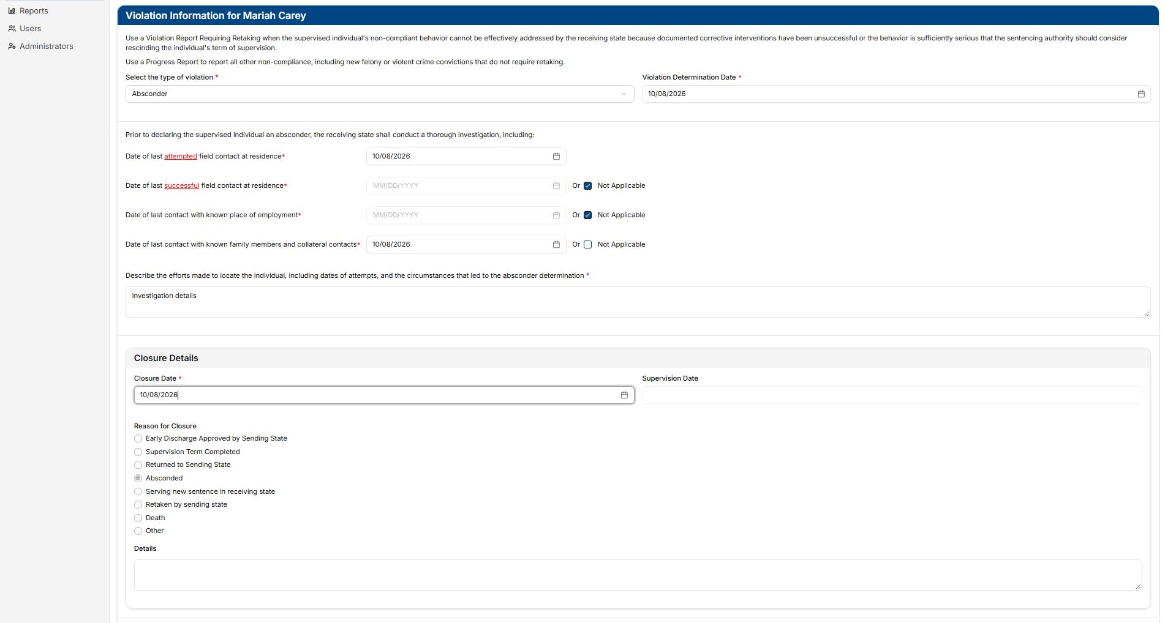
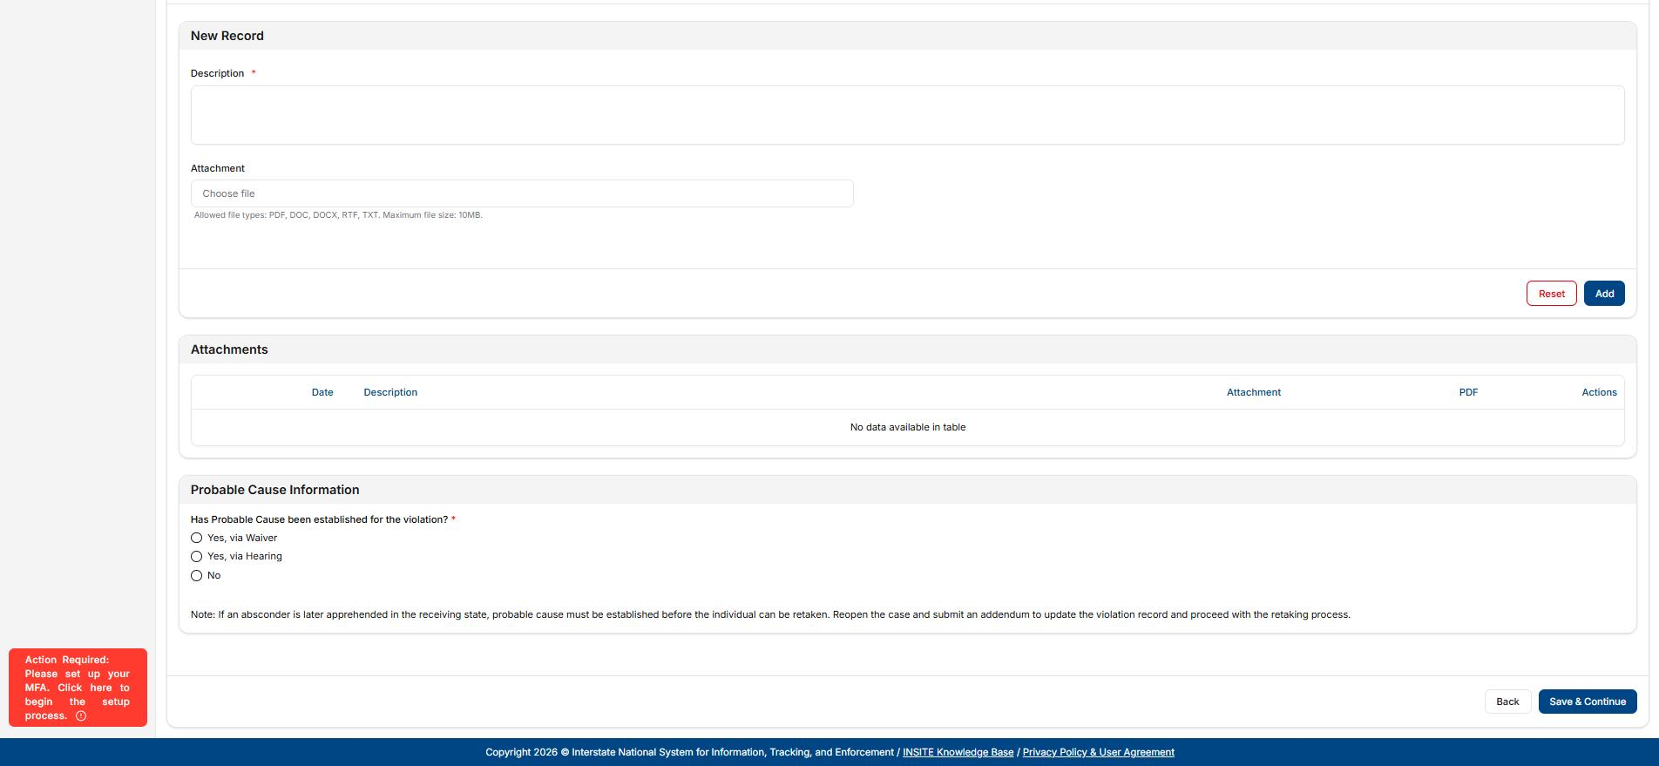
VIOLATION REPORT
  Determination Date replaces prior discovery or determination language to provide consistency
  Clearer directions provided to assist end users

Slide 41
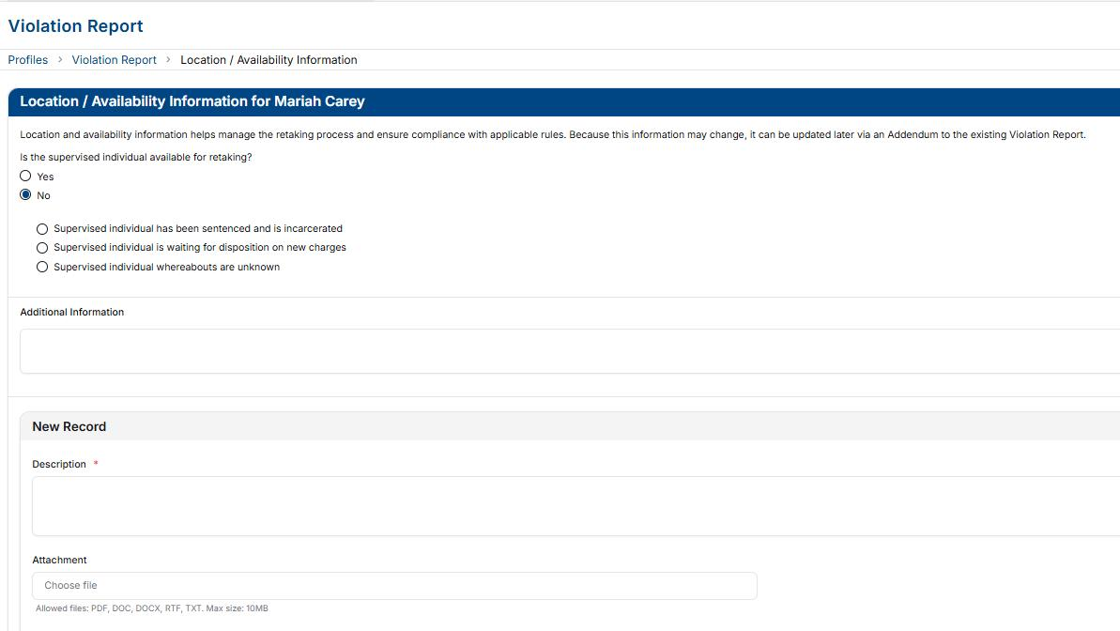
VIOLATION REPORT
Clearer Language

Slide 42
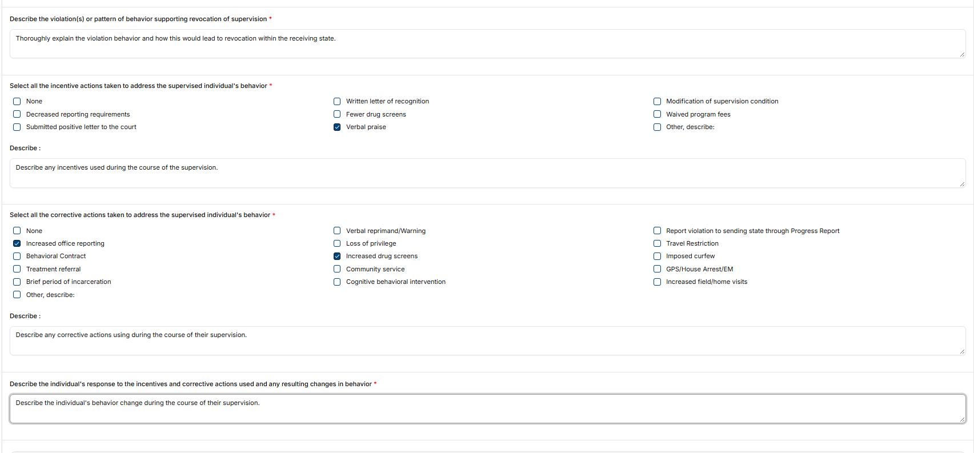
VIOLATION REPORT
After November 2nd-
Incentives/Corrective Actions on EVERY Violation Report

Slide 43
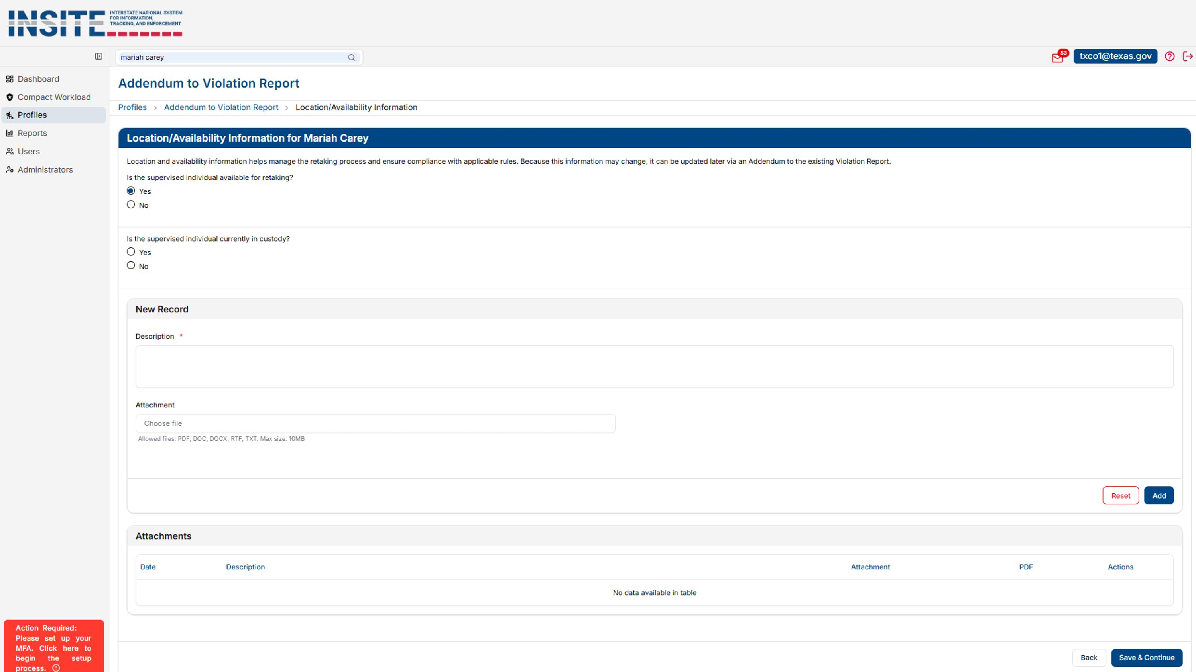
ADDENDUM TO A VIOLATION REPORT
No Process Changes

Slide 44
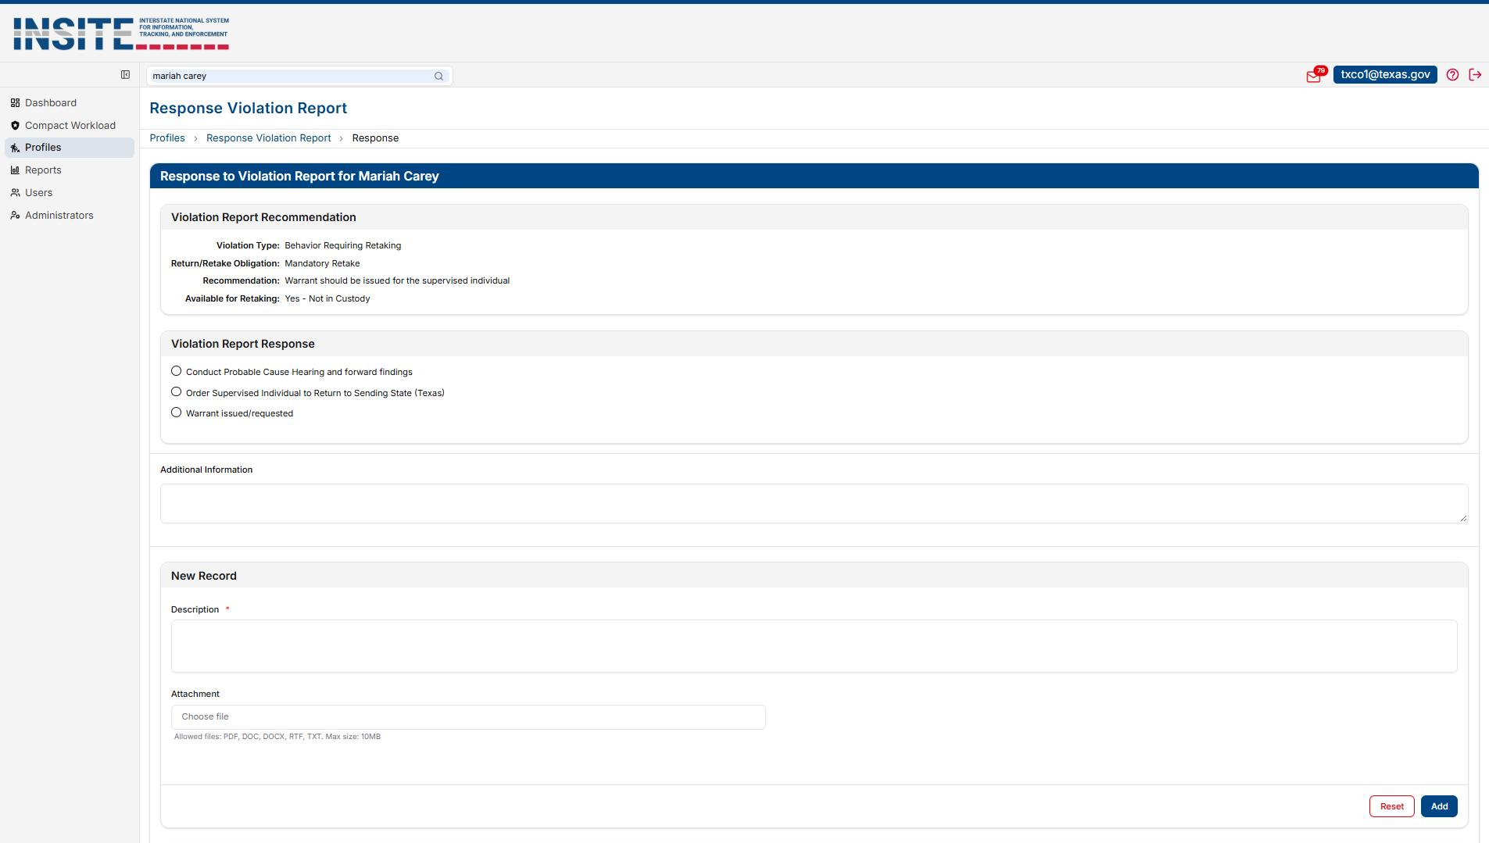
VIOLATION REPORT RESPONSE
No Process Changes

Slide 45
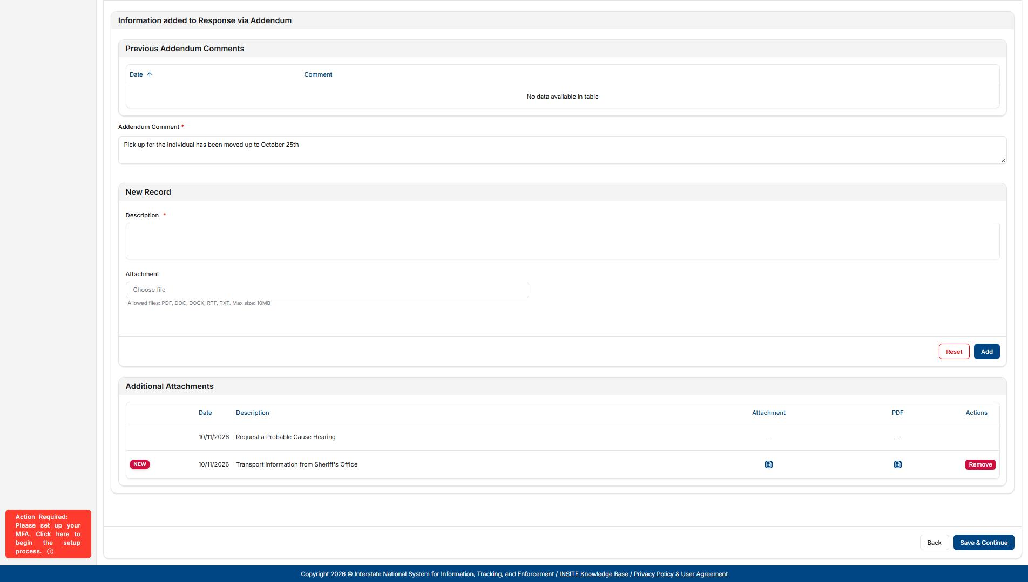
ADDENDUM TO A VIOLATION REPORT RESPONSE
No Process Changes

Slide 46
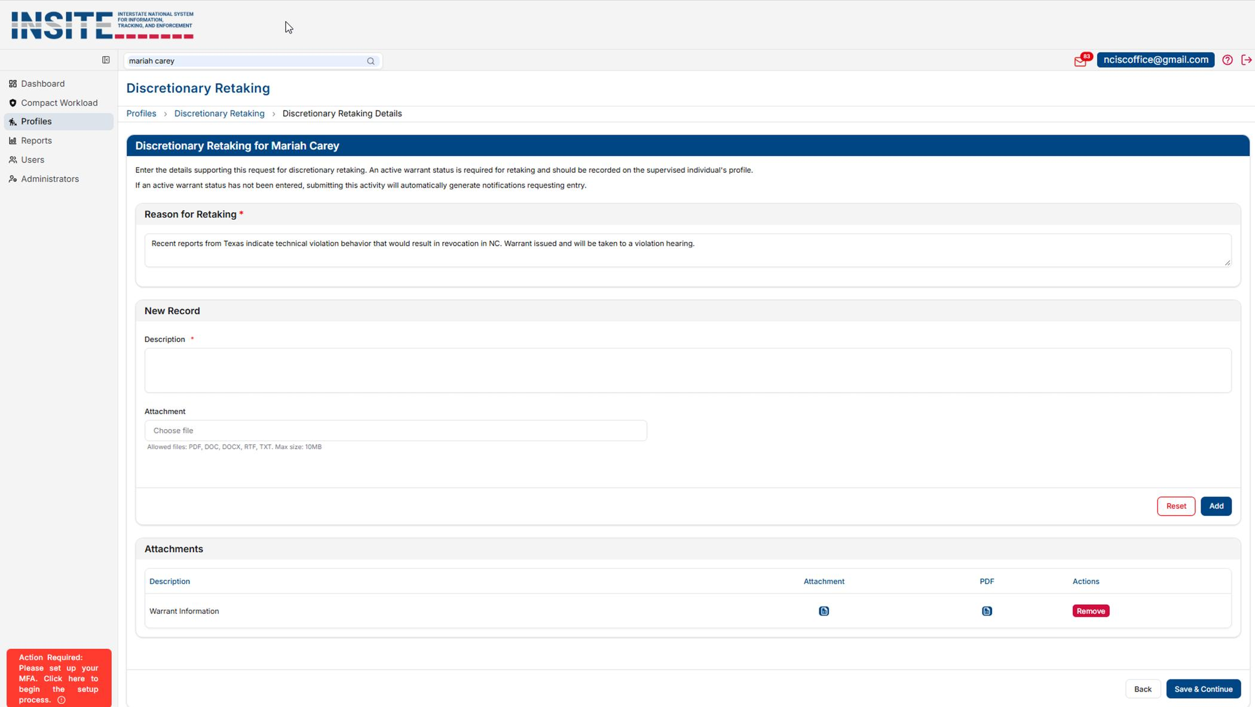
DISCRETIONARY RETAKING & RETURNS
DISCRETIONARY RETAKING
  Overall process has not changed
  Language has been updated to improved guidance on the process and warrant status requirements

Slide 47
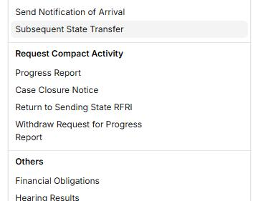
DISCRETIONARY RETAKING & RETURNS
DISCRETIONARY RETURNS
  MOVED THE PROCESS TO THE COMMUNICATIONS SECTION FOR EASIER ACCESS
  Generate under Return to Sending State RFRI

Slide 48
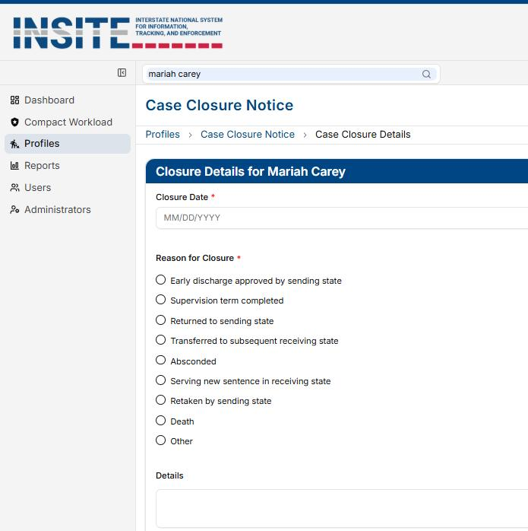
CASE CLOSURE NOTICE
  Overall process has not changed
  Updated Closure Reason Descriptions for clarity
  New option for Subsequent State Transfers

Slide 49
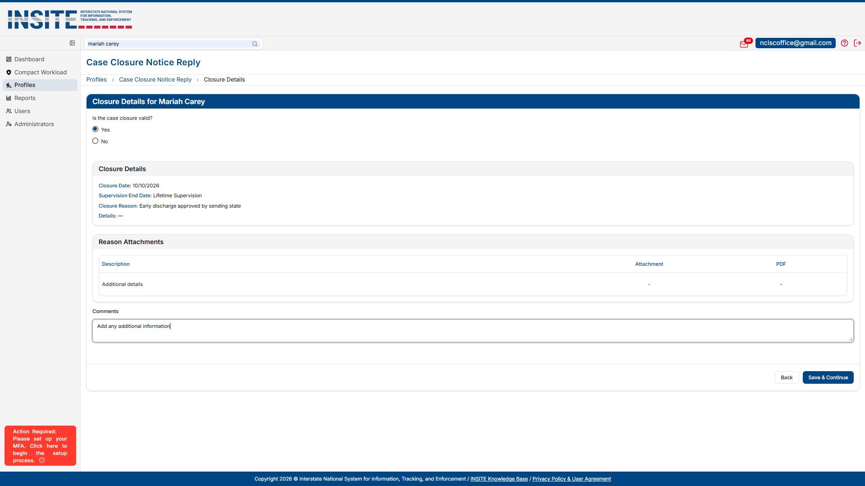
CASE CLOSURE NOTICE RESPONSE
No Process Changes

Slide 50
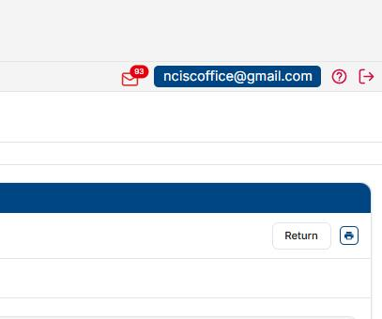
GENERATING PDFS IN INSITE
Click the Printer Icon

