Slide 1

Successful Supervision Through Interstate Compact
Interstate Compact for Adult Offender Supervision
Presented by:
Mindy Spring, ICAOS Training Coordinator (National Office)
Notes:
Who has been involved in a transfer? Who knows nothing about IC?

Slide 2
Presentation Objectives
Today you will learn about:
Overview of the Compact Process
How Compact Focuses on Offender Rehabilitation and Successful Supervision
Example Strategies Implemented by States
Notes:
Review what the interstate compact is, its purpose and authority
Hope to simplify and reinforce importance of good verification and documentation.
Commission recently assessed transfers for all member states and will be working in the next year to improve and set measures. We have learned so far that the lack of front end verification is the #1 reason a transfer gets rejected and have some simple examples to share today that through data, shows are effective.

Slide 3
Interstate Compact for Adult Offender Supervision
ICAOS regulates how offenders are:
Transferred from one state to another
Supervised while on Compact Supervision
Returned to a sending state when supervision is not successful
Notes:
The compact (formal agreement of all 50 state and 3 US territories including PR, District of Columbia and Virgin Islands) provides a mechanism for individuals on probation and parole to be supervised in another state other than the one they were sentenced in or served prison time.
The compact provides a transfer process, supervision expectations of the supervising state as well as recognizes successful supervision may not always occur so if the client violates to the extent supervision would be revoked in a receiving state, a process exists for returning a client to the sending state.
As we advance through the presentation, think about these 3 areas and how all of these topics are achieved through cooperation and communication between the two states.
What information would you need to approve or investigate a home plan?
What information is needed for supervision? And
When should a justice involved individual be reincarcerated for violations and what information is needed to go through such a process

Slide 4



Authority of an Interstate Compact
Authorized
Binding
Supersedes
The Compact is authorized by US Constitution & Crime Control Act
The Compact is binding upon all state authorities & citizens
The Compact rules supersedes conflicting state law
Notes:
ICAOS operates with Congressional consent that derives from the Crime Control Act from 1934
Each member state enacted the compact through legislation. And compact rules adopted by the commission supersede any conflicting state laws..

Slide 5
Implications of Non-Compliance
It is incumbent upon prosecutors, judges and other state officials to understand the requirements of the Compact and its rules, as well as the consequences of non-compliance.
Failure of state judicial or executive branch officials to comply with the Compact and its rules results in the state defaulting on its obligations under the Compact and could lead the Commission to take corrective or punitive action, including suit in federal court for injunctive relief.
5
Notes:
Despite that, states and the commission are regularly training its stakeholders on the interstate requirements as even courts are required to comply with the rules.
It is important to note that Failure of state judicial or executive branch officials to comply with the Compact and its rules results in the state defaulting on its obligations under the Compact and could lead the Commission to take corrective action.

Slide 6
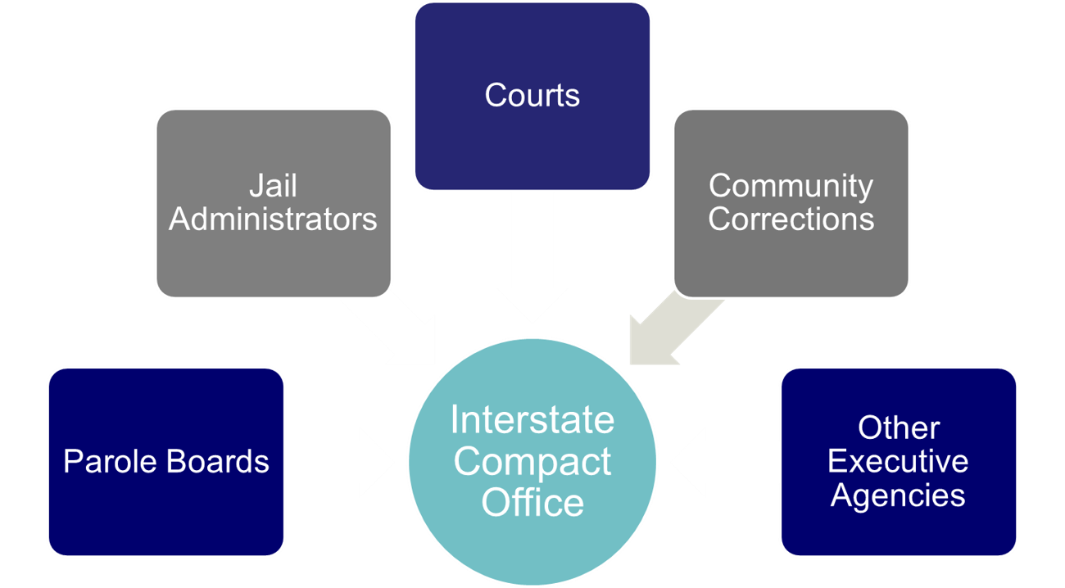
Interstate Compact Offices
Administers the Compact
Point of contact for case specific questions
Conducts training
Resolves issues with other states
Ensures rule compliance
Develops & recommends in-state ISC operating procedures to State Council
Interstate Compact Office
Notes:
Each state has a compact office that manages compact activities and is a training resource for your state. Anytime you have a question about compact or perhaps an issue with anything compact related, elevate to them. We provide a directory on the ICAOS website

Slide 7




Purpose of ICAOS
Protect the Rights of Victims
Promote Public Safety
Ensure Effective Supervision &
Rehabilitation
Control/Track Movement of Offenders
Notes:
Always important to highlight 4 major purposes of compact. No decisions or actions should be made that do not support these.
Promote Public Safety
Protect Victim’s rights
Ensure supervision techniques are consistent with instate offenders and in line with best practices of the supervising state; this includes same access to supervision, sanctions, and services
Through databases supported by each national office, we are tracking and controlling movement of offenders as they cross state lines

Slide 8
ICAOS Creates Circumstances to
Promote Successful Supervision
Ensure Effective Supervision & Rehabilitation
Positive Relationships & Family Support
Life Stability
Means of Support & Employment
Resources/Programs
Notes:
Today we are going to really focus on the goal and purpose of effective supervision and what provides the best chances for success.
We want to ensure justice involved individuals have access to positive relationships, resources, stability and means of support.
So in consideration of the compact, these elements are in another state so documenting and explaining how these elements exist more in another state, we will later show how the explanations are so important to ensure a transfer is accepted and accepted more efficiently.

Slide 9
What Triggers the ICAOS?
Offender
Supervision
Relocate
Adult who commits a criminal offense (all felonies & specific misdemeanants)
Subject to ‘supervision’; and
Released to the community under the jurisdiction of:
  Courts
  Paroling Authorities
  Corrections
  Other Criminal Justice Agencies
2 Distinct criteria:
  Oversight exercised by a controlling authority, which includes:
    Courts
    Paroling Authorities
    Corrections
    Other Criminal Justice Agencies
  Required to monitor regulations or conditions, other than monetary
Offender means to remain in another state for more than 45 consecutive days in any 12 month period.
+
+
Notes:
Eligibility as not everyone on probation or parole is required to transfer
1st has to be guilty of a criminal offense, subject to supervision which is defined as being subject to non(monetary) conditions requiring monitoring. In addition, the compact rules do not govern temporary travel but any transfer in which the individual intends to be in the other state for at least 45 days

Slide 10

What Requirements for Transfer?
1
2
3
4
Time Remaining on Supervision
>= 90 calendar days or an indefinite period of supervision remaining
Valid Plan
Terms & conditions of supervision
Residence
Employment/Means of Support
Substantial Compliance
No initiation of revocation proceedings by Sending State
Justification/Reason
Resident
Family
Employment
Military Orders
Discretionary/ Correctional Sense
Notes:
Other eligibility criteria for transfer must illustrate that relocating to another state is offender’s best chance for success. Offenders must have at least 90 days remaining on supervision term, a good plan, not be in violation status in the sending state and most have ties to the receiving state as being a resident (living in that state prior to committing their offense) or have family support. But any transfer can be accepted under a discretionary reason so long as the transfer makes sense.
As clearly stated in case law, no convicted person has a right to server his or her sentence in another state so this all starts with the sending state verifying the best chances for success exist in another state. I also want to stress it’s imperative clients understand this when allowed to transfer and are expected to cooperate with the investigation process.

Slide 11
What is a Valid Plan of Supervision?
#1 reason for rejection due to investigation revealing the home situation was not as described.
E.g. Landlord issues, simple address verification, inaccurate information from client, sponsor/host.
Does the sponsor understand and know what their role is and the plan of supervision?
How are conditions of supervision going to be met?
What is the means of support? How did you verify this?
If Sponsor is non-family, what is the relationship?
Reason for transfer should illustrate reason qualification and include any supporting documentation. Why does the client want to live (or why do they live) in the receiving state?
2
Valid Plan
Terms & conditions of supervision
Residence
Employment/Means of Support
Notes:
Having a valid plan and how that is verified and documented is so important to ensure a transfer is accepted and accepted in an efficient manner.
The #1 reason we see why cases are rejected is that the investigation revealed the information provided by the sending state was inaccurate or not verified.
Also, cooperation of the sponsor is vital so we want to ensure they understand the compact process and their expectations.
Common conditions resulting in rejections if sponsor is not aware ahead of time may include no guns in the home, alcohol, unannounced visits.
How long has sponsor known offender?
What makes the plan valid? (how can conditions be met, means of support, etc.)
Illustrate the offender is in substantial compliance; if there are pending charge, explain why offender is still eligible
Reason; why do they need/want to live in the other state? Residency, support, job, stability
#1 reason transfers are rejected due to investigation revealing the home situation was not as described. Landlord issues, simple address verification, inaccurate information from client, sponsor/host. Do more vetting on the front end less rejections; does the sponsor know what it means? Understand conditions: guns in the home, alcohol, unannounced visits. Conditions may be added by receiving state
Sponsor Relationship how long known (non family)
Substantial compliance-pending charges/warrants/detainers
Reason: illustrating they meet the reason qualification/documentation

Slide 12

What does it mean to be in ‘substantial compliance’?
Sending State determines whether in ‘substantial compliance’
Pending charges, warrants, detainers? THINK if sending state is not pursuing revocation of supervision based on the charges/warrant, the client is in ‘substantial compliance’ and eligible for transfer
3
2
Substantial Compliance
No initiation of revocation proceedings by Sending State
Notes:
Sending state determines whether the client is in substantial compliance. So even with pending charges, if sending state is not pursing revocation, the client can be determined to be in substantial compliance. A lot of invalid rejections we saw in the assessment this year, the clients pending charges were actually in the receiving state.
Substantial compliance-pending charges/warrants/detainers
Reason: illustrating they meet the reason qualification/documentation

Slide 13
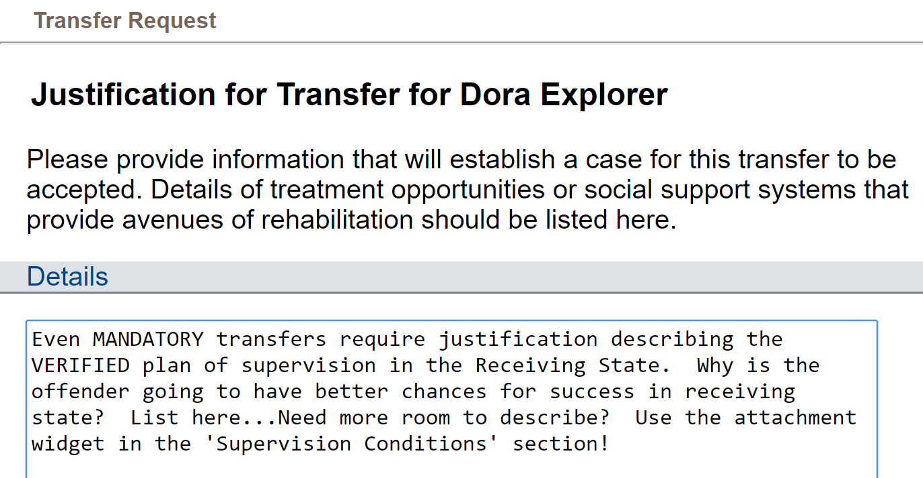

Justification for Transfer
Detailed VERIFIED justifications!!!
Why is the offender going to be more successful in the Receiving State?
Describe support system
Means of support
Living situation
Use clear, concise language; no abbreviations
Notes:
Justify, justify, justify!
This should be a detailed explanation of why the supervision should be transferred. This is required for ALL transfers, not just discretionary

Slide 14
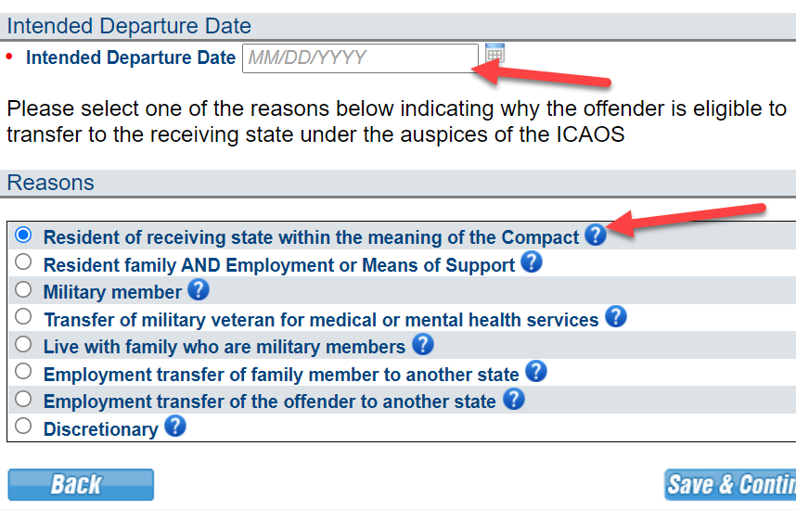
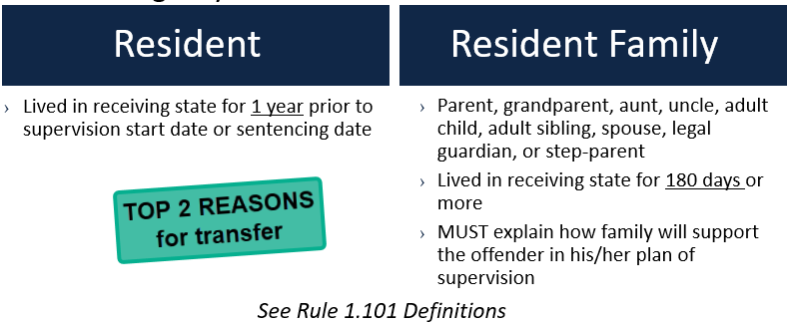
Reason for Transfer
Departure Date can be managed from the offender’s profile.
Use the help points to ensure appropriate reason is selected and any additional documentation requirements
Notes:
As noted in earlier slide most clients transferring are either residents of a receiving state or have family support. These reasons are defined here and note for ICOTS users, these references exist within the system to remind of those definitions.

Slide 15
Mandatory versus Discretionary Transfers
All Transfers should illustrate
Successful Completion of Supervision
Public Safety
Rehabilitation of Offenders
Protect Rights of Victims
Mandatory
Discretionary
Receiving State must accept supervision if:
Mandatory criteria transfer is met; and
Information is verified; and
Plan is valid; and
  Acceptable for in state offender
Required documentation is provided
Receiving state may accept or reject supervision in a manner consistent with the purpose of the compact
Sending state must justify “WHY”
Rejections must include specific reasons for rejection
Notes:
What is a mandatory transfer versus a discretionary?
If documentation and reason show the client meets mandatory criteria, the receiving state is required to accept supervision.
For discretionary transfers that doesn’t mean a receiving state can reject for any reason. Decisions must show they are made in line with the purposes of the compact and be detailed addressing the justification provided by the sending state

Slide 16
What percentage of Compact cases are Mandatory versus Discretionary?
94%/6%
87%/13%
62%/38%
50%/50%

Slide 17
Reason for Transfer of Active Compact Cases
January 2022
87% Mandatory - 13% Discretionary

Slide 18
% of cases initially rejected, but subsequently accepted?
Transfer efficiency gains are possible!
2%
6%
11%
24%
Notes:
Poll percentage of transfer initially rejected and subsequently accepted. This illustrates efficiency gains are possible if sending states can do a better job getting it right the first time.

Slide 19
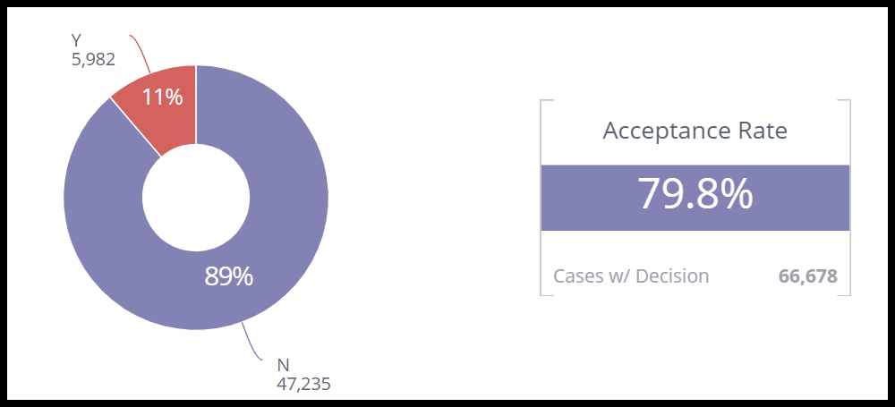
% consistent year to year
Commission focus on improving efficiency
Based on data from 12/1/2020 – 11/30/2021
Notes:
In addition to overall rejection and acceptance rates, our assessment this year looked at these cases and what factors are slowing down the transfer process when a valid plan exists in the receiving state.
This percentage has stayed consistent since 2010 and looking to improve. For example, these cases commonly are due to being incomplete (specifically due to lack of offense details a requirement of a transfer request.) or again unverified or inaccurate information.

Slide 20

Transfer Tips
Show your work, who did you call, when did you speak with them and summarize the conversation
Is the plan acceptable for in state client? Describe why.
Why is this the best plan for the client (physically and mentally)?
Notes:
Here are a couple tips and elements that should be documented in transfers to ensure transfers are accepted.

Slide 21
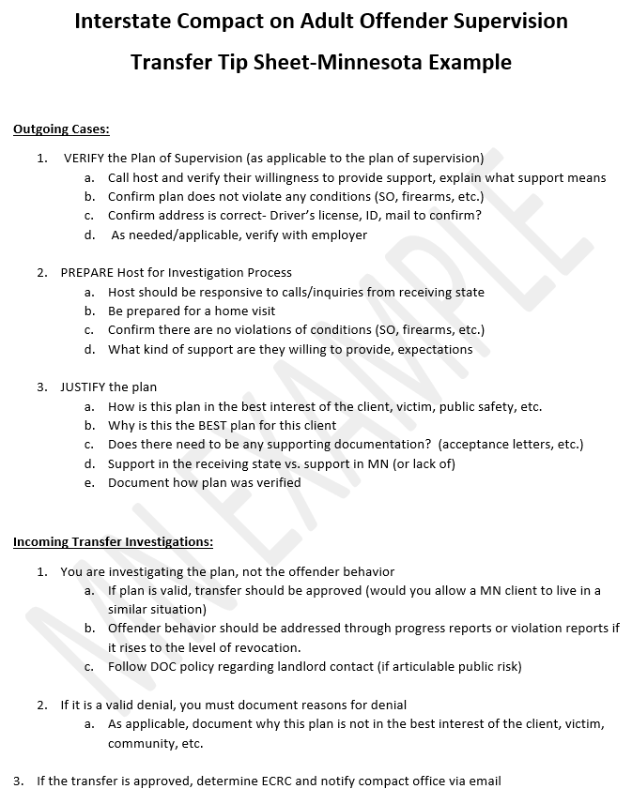
Notes:
One state in particular, MN implemented those tips after participating in our assessment. A tip sheet was distributed to their ICOTS users and compact staff were trained to do a better job screening outgoing transfers.

Slide 22
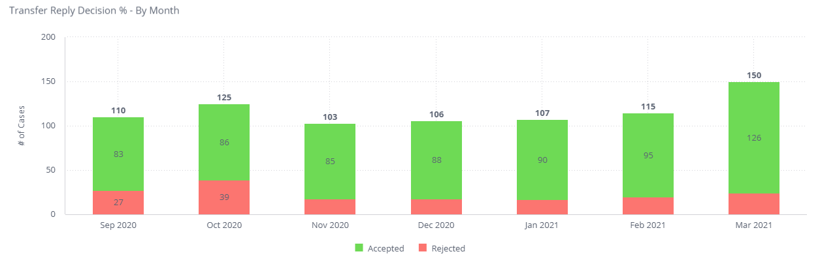
Minnesota implemented use of tip sheet
Notes:
Here is the result of that. So seems simple, but definitely increased the rate of acceptances which at the end of the day not only ensures efficiency but also decreases the chances for rejections.

Slide 23

Compact Supervision in a Receiving State
Supervision standard consistent with similar offenders sentenced in the Receiving State
Same programs, incentives, sanctions/interventions
‘Participation in the ICAOS ensures not only the controlled movement of offenders under community supervision, but also that out-of-state offenders will be given the same resources and supervision provided to similar in-state offenders including the use of incentives, corrective actions, graduated responses and other supervision techniques’
Notes:
Shifting to after the transfer is accepted, what are the expectations of the receiving state as a supervising agent.
Once allowed to transfer, receiving states have to provide supervision consistently in how they would supervised an offender sentenced in the receiving state. Although most states fulfill this requirement well under the compact requirements, it can be a training issue for stakeholders involved in supervision decisions or rehabilitation programs.

Slide 24

Supervision Goals
Less offenders returning to institution for formal revocation
  Strategies to address non-compliant behavior
  Exhaust alternatives to revocation while the offender is supervised in the receiving state
Ensure retaking is initiated ONLY when it MAKES SENSE!
  Retaking isn’t guaranteed to be permanent
  Retaking costs $$
  Documentation should support revocation
Notes:
Ask who uses EBP…should be all
Offenders transfer for purposes of successful supervision. This means that they are Residents and/or supportive environment exists in the Receiving State, Family, employment, etc.
Use of Evidenced Based Practices (graduated response/sanctions/access to programs) should be the same for compact clients so in practice how you respond to behavior whether good or bad is the same as your own states client
Promote positive/compliant behavior
Particularly over the last 5 years or so, the commission has put a lot of effort into ensuring states comply with this requirement exhausting all efforts to correct behavior before requiring retake. We have seen a vast decrease in retaking requests and even more with pandemic due to transport issues, jail space and other obstacles. The last 2 years have definitely brought to light too the importance of state communication and cooperation to ensure we are protecting the public with these challenges
Use examples: While rules may require retake, how the sending state plans to handle violation should be a consideration.
Does viable supervision plan still exist.
Offenders usually live in the receiving state. If always resided in your state, they will always reside in your state. Violation doesn’t mean they won’t come back. Don’t you want offenders to have best opportunity to succeed in your community??

Slide 25
Common Challenges
Compact Supervision in a Receiving State
Differences in Supervision
States’ responses to behavior and path revocation vary across jurisdictions
Recognizing another state’s documentation
Stakeholder Involvement
Ensure sanctions are exhausted before requiring retaking
  If offender is retaken, it means receiving state would revoke
Actions and documentation provided by another state
Ensure compliance: warrants, timeframes, costs
New pending charges = Offender not available for retaking (unless key stakeholders in both states agree due to public safety concerns)
Notes:
On the flip side, it is also a challenge for states recognizing another state’s documentation and the path to revocation may be different in a receiving state versus a sending state.
The commission has published legal white papers on several issues related to these challenges. Many highlight the responsibility for states to educate its stakeholders and involve relevant stakeholders when decisions are made.
So anytime you are presented with challenges related to a compact case, particularly around retaking whether you are the sending or receiving state, get your compact office involved.
While numerous courts have held that convicted persons do not have a right to relocate from one state to another (as discussed in earlier slide,) courts have also
recognized that once relocation is granted states should not lightly or arbitrarily revoke the relocation.
Although retaking does not guarantee an offender will be revoked once retaken and back in the sending state, that is the intent if the level of noncompliance is reached while under supervision in the receiving state so states must ensure sufficient documentation and communication to ensure proper decisions and actions are made when responding to violation situations.

Slide 26

Effective Communication Reminders
Other state only knows what is in ICOTS
Remember rules are requirements for ALL states to follow and minimum as to what is required
  Always do more; things may look different state to state
Be clear and concise
  Do not use abbreviations
Elevate to compact office
Notes:
Documentation and what you share in ICOTS should be comprehensive, so always think above the rule requirement.
In addition to training, I also have assisted in audits and assessments using ICOTS data. I see all the time CARs with no response. Be sure if you encounter this to get your compact office to assist. They need to know about the issue to ensure it is addressed by the other state.

Slide 27

Tools & Training
  ICAOS Quick Reference Guides: Relate to your own instate processes
    Courts
    Jails
    Transport/Extradition Teams
    Probationer/Parolee: Work WITH individuals transferring. Understanding of the process & cooperation promotes acceptances.
  Stakeholder Training: Keep Collaborative
    How can Compact assist?
    How can Stakeholder assist Compact?
Notes:
Tools and resources are important to ensure we relate compact requirements in our states to existing processes.
Does everyone need to know every rule and requirement? No, we want to keep simple and relate to what may already exist.
Several states create QRGs for their stakeholders and individuals going through the transfer process.
One thing we saw with COVID is the increase in remote sentencing which may be here to stay in many states due to the cost savings and logistics or in person hearings. For compact offenders that means they may never physically be in the sending state and are already in the receiving state when sentenced.
One state quickly saw challenges in getting paperwork from the courts to probation resulting in delays or gaps in supervision. This state worked with their state council representative to establish a process implemented with their state court administrators to streamline this internal communication to ensure these cases are transferred efficiently through the compact.
Another state hosts a monthly forum with their line staff to ensure areas of concern from the field are addressed.
QRG to extradition teams explaining the responsibilities of both SS and RS
For judges, we have a few states that host ‘lunch and learns’ including someone from their AG office to assist in the presentations. A few have gotten creative to hold these virtually, ordering in lunch for the attendees.
A new initiative the national training committee is working on this year is to provide simpler resources for those transferring and their families on the commissions website. Being with the commission for 18 years now and for that time involved in training, how training is delivered is always evolving. First started, we didn’t have ICOTS and training was somewhat of a mess not knowing how processes were really being done. since ICOTS implementation 2008, we have learned so much on the need for practical training tools and always working to improve what we provide to assist states and ensure they know their responsibilities to manage compact business in their states.
This year as we commence 20 years of the Commission, we have several projects too underway to better learn more about the impact of our business from outside lenses. 1 is a study being done by UC and a documentary where a few actual individuals who went through the interstate compact will be highlighted

Slide 28
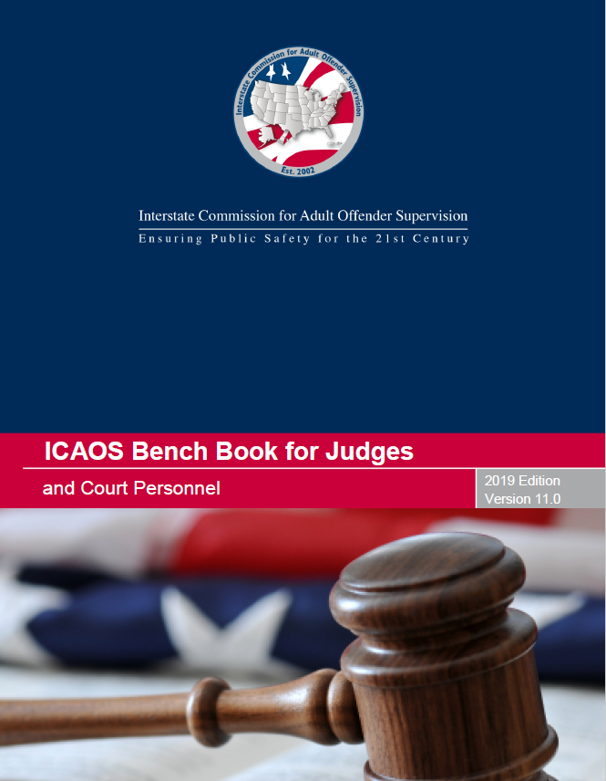

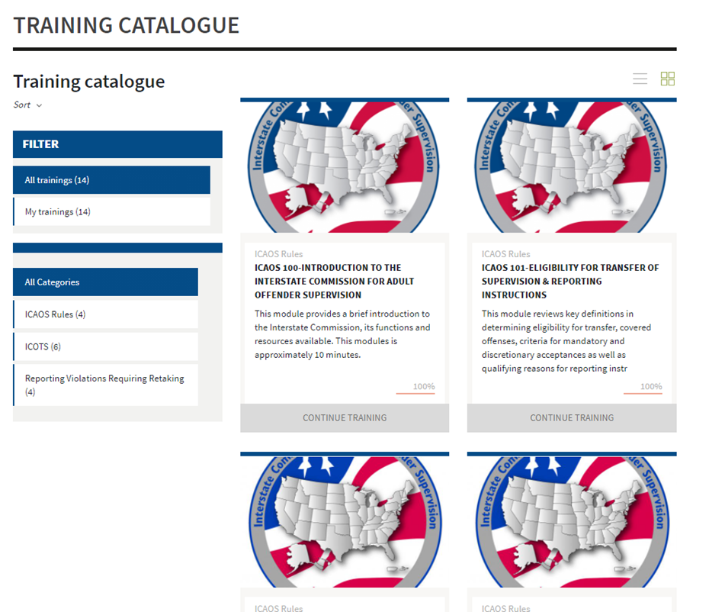
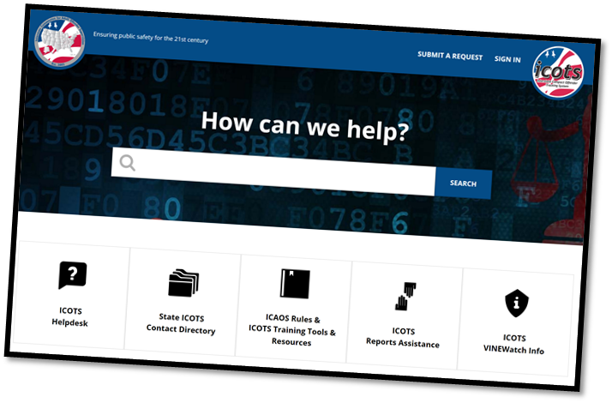
Contact the ICAOS National Office
Email
icaos@interstatecompact.org
Phone
859.721.1050
Website
www.interstatecompact.org
https://www.interstatecompact.org/core-search
https://www.interstatecompact.org/bench-book
https://support.interstatecompact.org/hc/en-us
Office
3070 Lake Crest Circle
Suite 400-264
Lexington, KY 40513

Slide 29

Questions and/or Suggestions?

