Slide 1
2021 Approved Rule Amendments & ICOTS Enhancements
Interstate Commission for Adult Offender Supervision
Notes:
Presenters: Suzanne Brooks, Mindy Spring & Tracy Hudrlik
Housekeeping: Keep yourself muted when not speaking, but feel free to ask questions via the chat or hand raise feature.

Slide 2
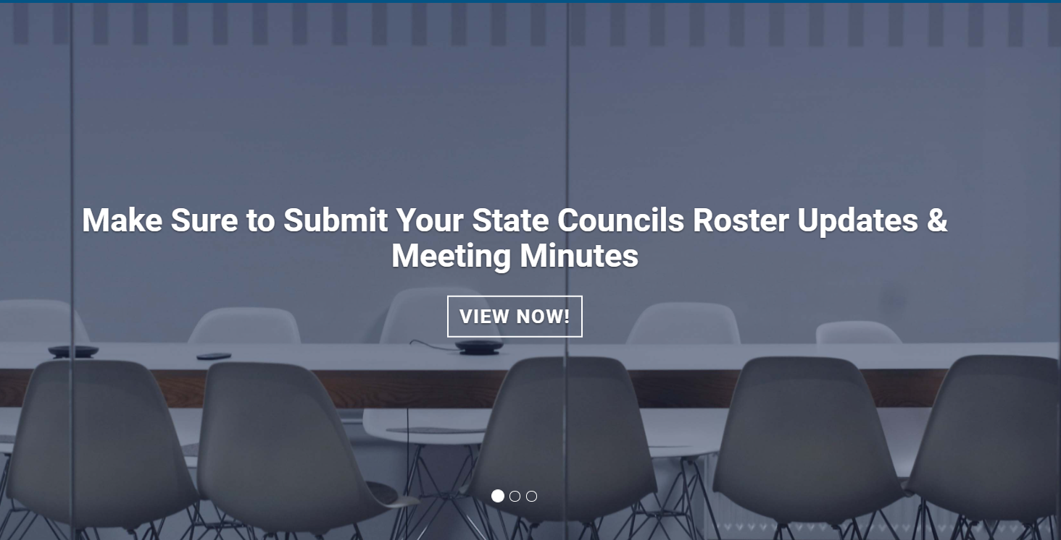
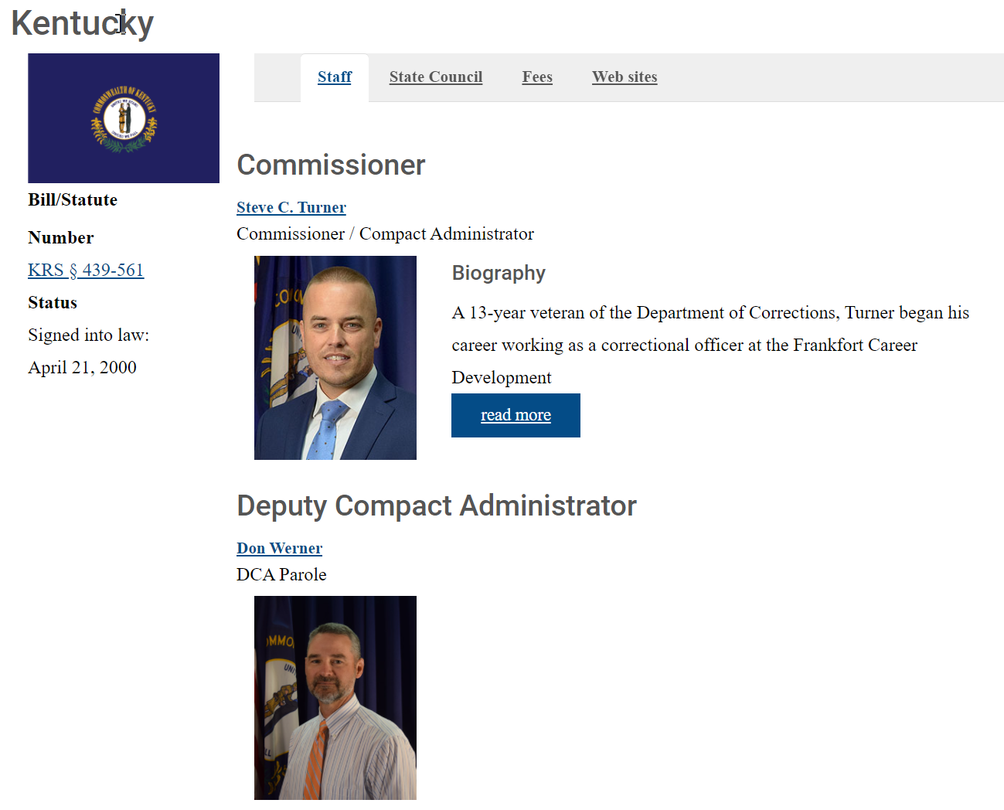
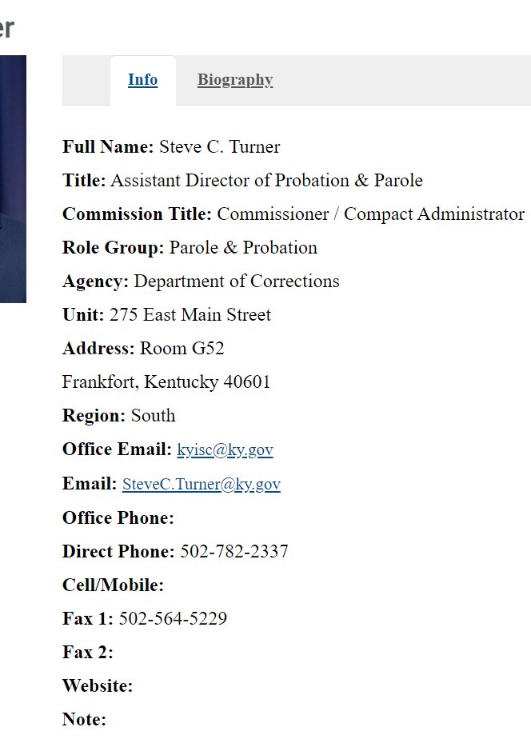
Directory Information Up-to-Date??

Slide 3
Presentation Objectives
Today you will learn about:
ICAOS Rule Amendments
Practical impact & considerations for states
ICOTS Enhancement for Warrant Tracking
Warrant Status Bundle
New Discretionary Retaking Activity

Slide 4
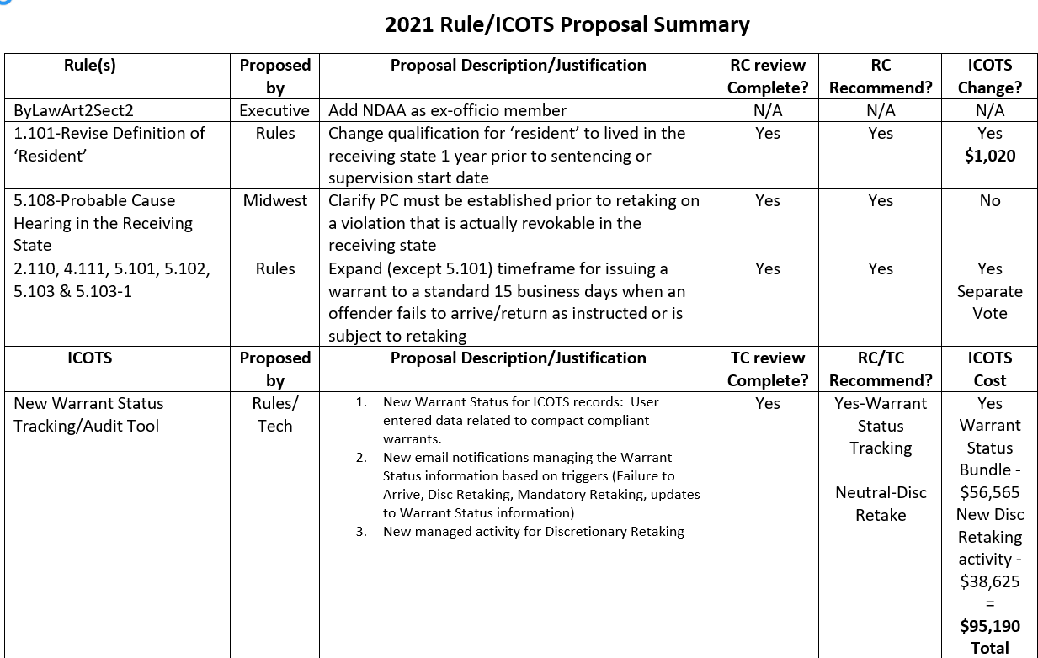
April 1, 2022
Effective Date for Rule Proposals & ICOTS Enhancements
4

Slide 5
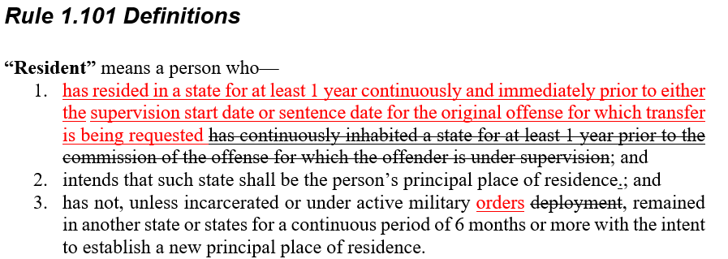
Rule 1.101 ‘Resident’ Definition
Current definition is:
Restrictive
Commonly misapplied
Causes delays/denials
Qualifying reason remains tied to commission of offense for which a transfer is requested
Individuals who have resided in the receiving state for an extended time between commission of the offense and placement on supervision, will qualify as ‘resident’ under this revised definition
ICOTS Change: Remove Definitions from Transfer and Transfer Reply PDFs $1,020

Slide 6
Rule 1.101 ‘Resident’ Definition
∙
Need for ICOTS user & Stakeholder training on new criteria for mandatory transfer
Implications for Approving
Definition of ‘Resident’
∙
Anticipate increase in eligible offenders for transfer under ‘resident’ reason
∙
Anticipate improved acceptance rates for ‘resident’ due to common misapplication under current definition
∙
Considers where the offender lived immediately prior to EITHER the supervision start date or sentence date, rather than where offender lived prior to committing the offense.
Notes:
more may qualify for mandatory transfer as a ‘resident’, that does not necessarily mean more offenders will be transferred. Instead, many who would qualify under the new definition are having to be transferred as resident family or discretionary and when current ‘resident’ is misapplied, it results in delays and due to rejections.

Slide 7
Rule 5.108 (b) & (f)
Probable Cause Hearing in the Receiving State
Rule 5.108 (b) Additional language clarifies the waiver must include admission of a revocable violation.
ICAOS Benchbook for Judges: “the intent of the rule is that the offender must admit guilt to a violation that would result in revocation.”
ICOTS Change: NONE
Notes:
Distinct revocation of supervision from revocation of sentence.

Slide 8
Rule 5.108 (b) & (f)
Probable Cause Hearing in the Receiving State
Rule 5.108 (f) Ensures PC hearing reports meet proper criteria illustrating probable cause for a ‘revocable’ violation.
ICAOS Benchbook for Judges: “officials in the receiving state must show through documentation that the offender has engaged in behavior requiring retaking.”
ICOTS Change: NONE

Slide 9
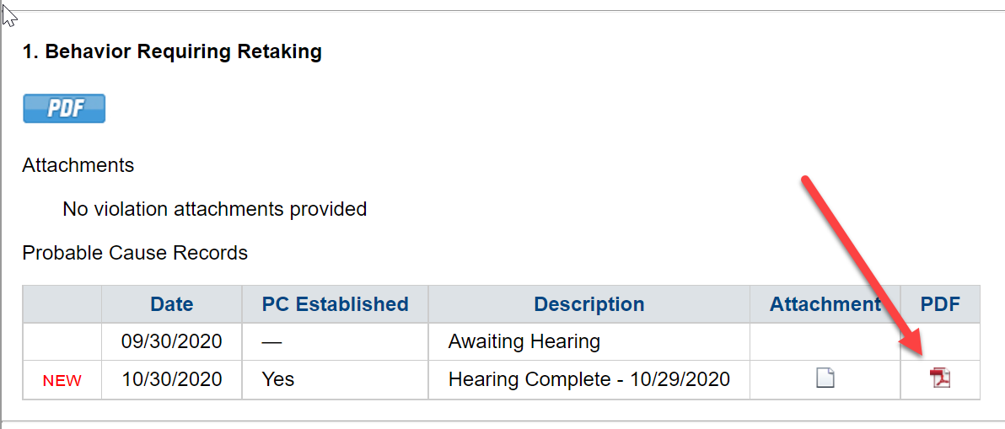
5.108 (b) & (f)
Probable Cause Hearing in the Receiving State
∙
Clarifies the intent of the Rule consistent with training, ICAOS Hearing Officer’s Guide & ICAOS Benchbook
Implications for Approving
Rule 5.108
∙
Ensure documentation illustrates the offender engaged in revocable behavior
PC Waivers
PC Hearing Results

Slide 10
Rules 2.110, 4.111, 5.101, 5.102, 5.103 & 5.103-1 15 Business Day Standard for Issuing Compact Warrants
Summary of Rules
Rules 2.110, 4.111& 5.103 | Offender does not return as ordered (Expands timeframe from 10 to 15 business days)
Rules 5.101 | Offender does not return as ordered (Reduces timeframe from 30 calendar to 15 business days)
Rule 5.102 | Creates timeframe to issue warrant after invoking mandatory retaking for new felony or violent crime conviction
Rule 5.103-1 | Expands timeframe from ‘upon receipt’ to 15 business days

Slide 11
Rules 2.110, 4.111, 5.101, 5.102, 5.103 & 5.103-1 15 Business Day Standard for Issuing Compact Warrants
Implications for 15 Business Day Standard
Standard timeframe to improve stakeholder training
Streamlines audit standards for new ‘Warrant Status’ ICOTS enhancement

Slide 12
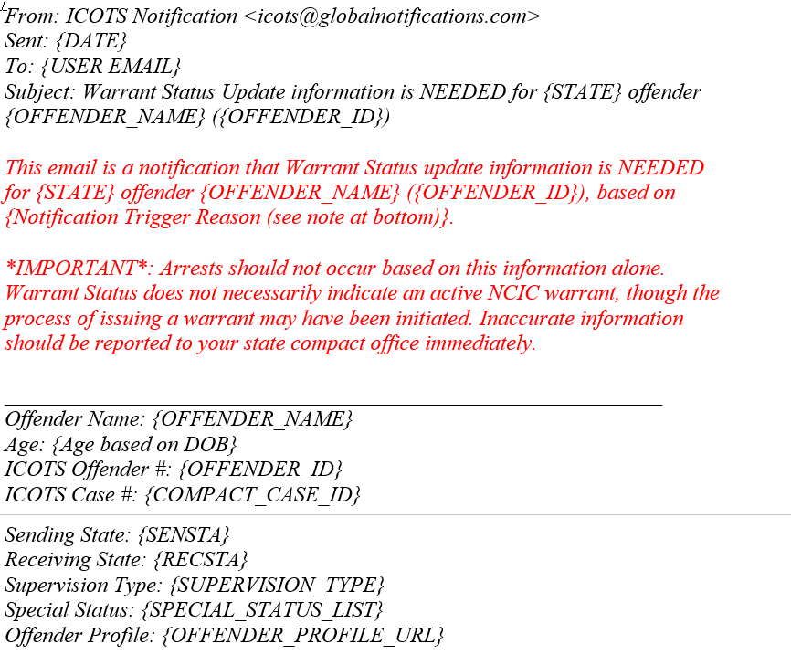
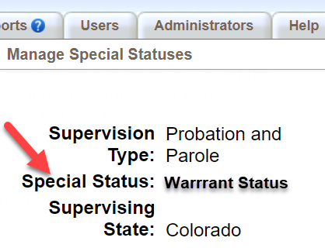
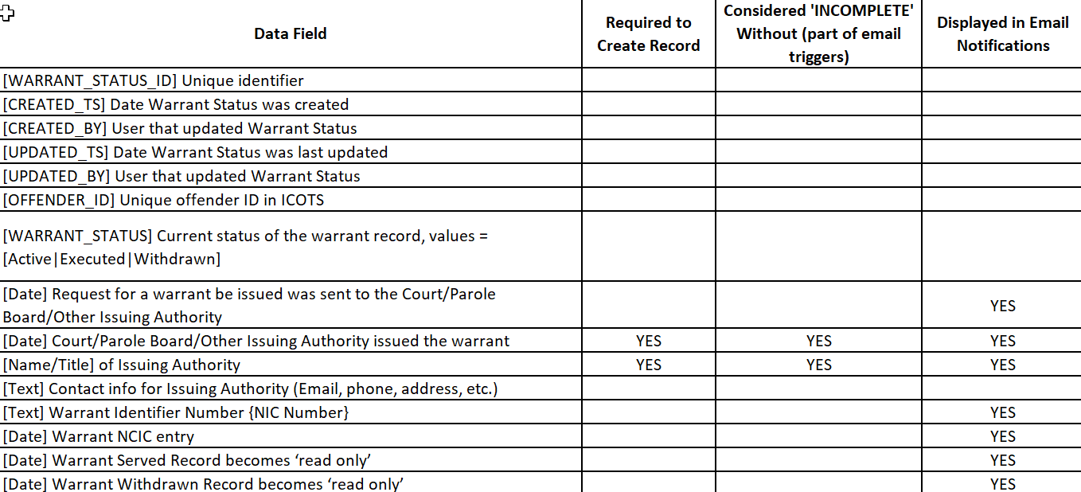
Warrant Status Bundle: $56,565
New Special Status
Email Notifications
Data Export
Triggered by ICOTS activities/action and missing warrant data (e.g. NCIC verification)

Slide 13
Warrant Status Bundle: Workflow
Add Warrant Status records anytime via the Offender profile
ICOTS will prompt the user (via email notifications) to add warrant records upon submission of:
Failure to Arrive;
Mandatory Retaking (via Violation Report) w/Sending state
response of ‘Warrant Issued/Requested;’ or
New Discretionary Retaking
‘Warrant Status Update Needed’ notifications sent when required fields are blank:
Warrant issuing authority
NCIC verification date
Warrant Status record historical after indicating warrant is ‘withdrawn’ or ‘served’
Notes:
Statuses associated with profile, not specific cases

Slide 14
Warrant Status Functionality
∙
Allows for multiple entries by various users with a time/date audit trail of ICOTS user entry data.
∙
Warrant data can be added to any active or historical record (e.g. absconder cases may be closed when entering warrant information)
∙
Sending state-assigned PO, supervisors, and compact office can enter warrant status data (Compact Office does NOT need to reassign case)
∙
Clear audit trail of who, what, and when an entry is made.

Slide 15
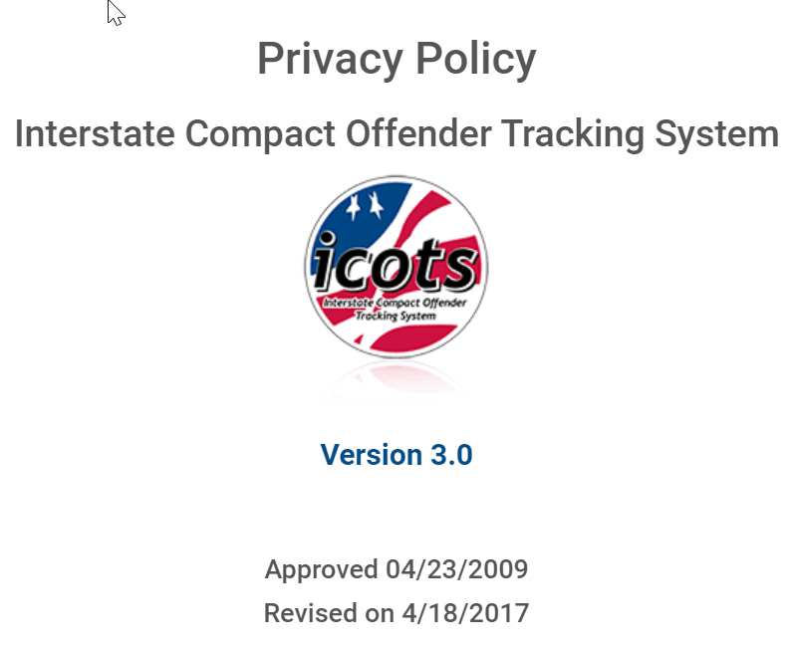
Warrant Status Expectations for States
Make training a priority. Procedures to obtain compact compliant warrants varies by state. System only as good as the data.
Self-audit regularly to ensure ICOTS privacy policy compliant data entry.
Ensure users know that ICOTS/ICAOS does not confirm active/compliant warrants. States will need to verify. Disclaimer included in screens & email notifications

Slide 16
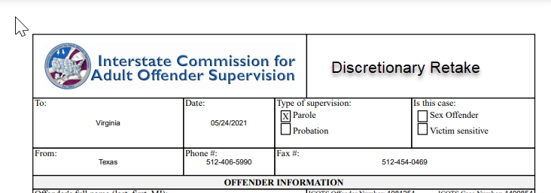
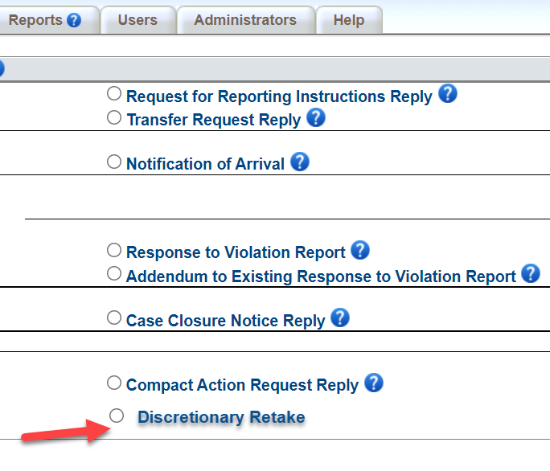
Discretionary Retaking Activity: $38,625
Communicates Sending State’s intent to Retake under Rule 5.101 (b) ‘retake an offender via warrant’
Mirrors Progress Report workflow, except sending state transmits:
PO->Supervisor->Compact Office.
When transmitted to the Receiving State, the activity will become final except for the assigned user’s ability to withdraw
Compliments the New Warrant Status Enhancement as a trigger for email notifications to instruct the user to enter a ‘Warrant Status Record”
Notes:
This process will not apply to offenders ordered to return in-lieu-of-retaking under Rule 5.101 (a) or 5.103 (b). Rather, those offenders will use the existing return reporting instruction procedure.

Slide 17
Discretionary Retake Activity Considerations
Tracks frequency Rule 5.101 (b) is invoked
Communicates ‘reason’ sending state invoked retaking
Captures compliance data for notifying receiving state within 15 business days of warrant issuance
Prompts users to enter a ‘warrant status record’ if not entered previously

Slide 18
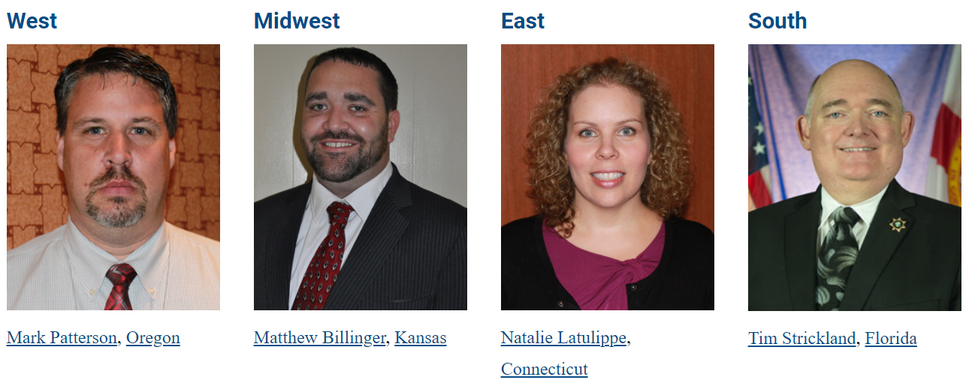
Share Your State’s Implementation Plans!
Share implementation plans @ upcoming DCA Region Meetings!
AGENDA
ICOTS Enhancement Implementation Plans

Slide 19
Thank You
Interstate Compact for Adult Offender Supervision

