Slide 1
FY22 DCA Dashboard Program
Q1 Offender Management
Interstate Compact for Adult Offender Supervision

Slide 2
Presentation Objectives
Today you will learn about:
Helpdesk & Hard Bounce Reminder
DCA Dashboard Program Overview
Q1: Offender Management
Goals
Actions
Expectations
Notes:
Region chair elections

Slide 3
Helpdesk Reminder
INSTRUCT users to call Compact Office for Assistance
Only DCAs and Appointed Compact staff are authorized to submit tickets to ICOTS helpdesk after troubleshooting
Articles on support site are PUBLIC and UNDERUTILIZED
Provide Screen Shots, browser info, etc.
Nearly all reported ‘errors’ are user created
Notes:
Tickets coming in from end users and through the direct email are on the rise. We have 5 staff and no one is full time for ICOTS support. When ICOTS was launched, the Commission decided to have states be responsible for level 1 support instead of hiring additional national staff. Never direct an end user to contact the national office for assistance. All assistance must go through compact staff designated to assist with ICOTS, training or whatever the issue is.
Use the support site. We get questions over and over on training items that can easily be looked up via the search in ICAOS support. Establish standards for your users when requesting assistance. Details of the issue, screen shots, what browser they were using, what their IT has done to assist, etc.

Slide 4
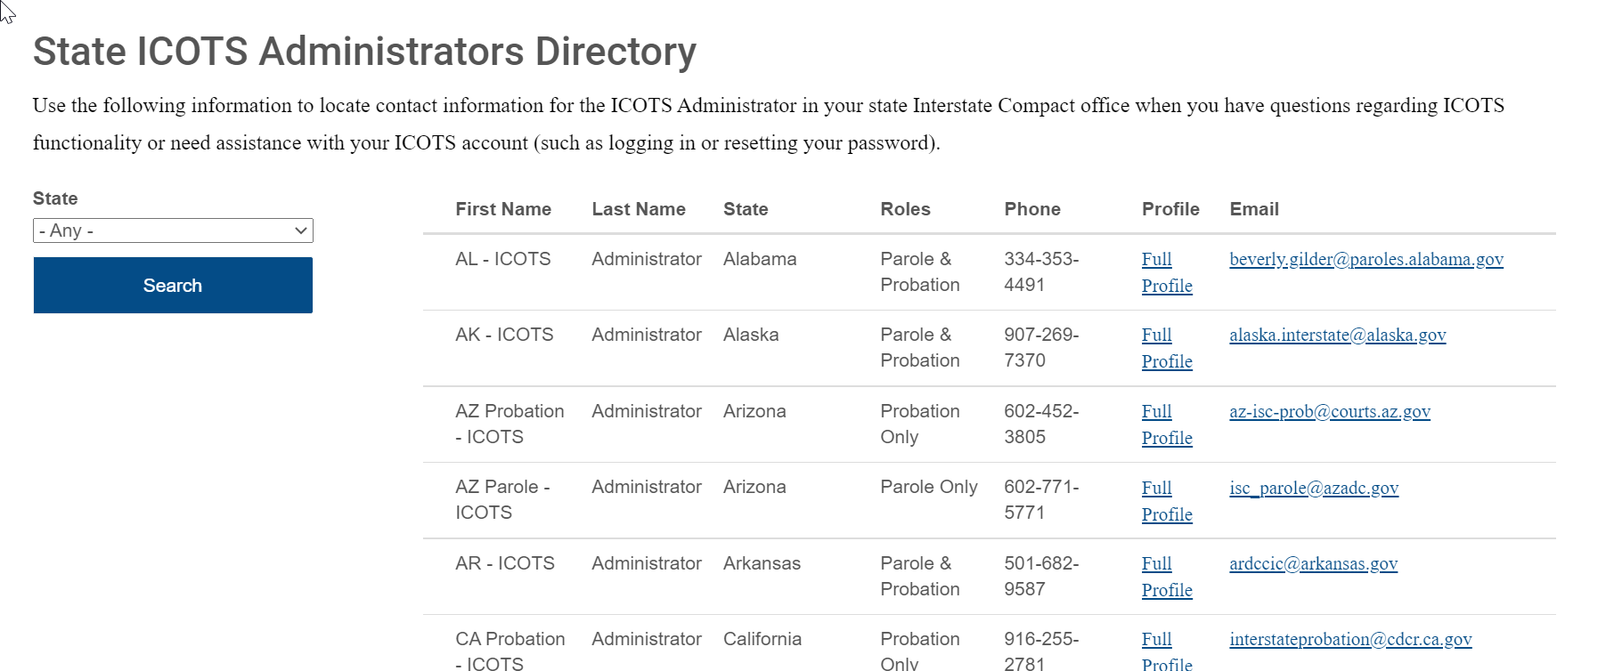
State Helpdesk/Administrator Directory
https://www.interstatecompact.org/icots-directory-search
Is your state’s information correct?

Slide 5
Troubleshooting Steps for ICOTS Email Issues
Check with your state compact office and ensure your ICOTS account is setup correctly. Then send a test email by entering your (or the user experiencing the issue) email address via ‘what is my password’ from the ICOTS login screen.
Ensure the addresses icots@globalnotifications.com and pm_bounces@pm-bounces.globalnotifications.com are set as a “Safe Sender”. Be sure to check that emails are not going to a junk mail folder. (See article for more information)https://support.interstatecompact.org/hc/en-us/articles/224743927-Not-Receiving-A-Password-Reset-Email
Did the email fail to deliver, is a Hard Bounce suspected? Your state’s ICOTS administrator must provide the national office with the steps you have taken to address this issue, as well as provide contact information for the individual that provides support for your state’s email domain (this is not typically IT support). (See article for more information) https://support.interstatecompact.org/hc/en-us/articles/1500002092561-ICOTS-Emails-Not-Reaching-Some-Users
If the email is a confirmed hard bounce, your state’s ICOTS administrator must ensure that hard bounce notifications to ICOTS emails have been suppressed by your state’s email domain administrator. Please note, users must have access to emails to utilize ICOTS. Ongoing issues may be escalated to the Commissioner for resolution.
Notes:
Article to send out to user experiencing email issues

Slide 6
ICOTS Email Bounces
Increasing Incidents! Planning for Commissioner Escalation!!
Receiving mail server software causes the hard bounce issue
Helpdesk ticket request must include:
ADMINISTRATOR contact info
Not Tech Support
DETAILED action taken by administrator
Expectation & CONFIRMATION administrator is aware of required action to be taken by them to prevent future hard bounces once Appriss reactivates account
Notes:
Receiving tickets w/o including State admin. Same states failing to provide admin or confirming proper action. Admins refusing to suppress hard bounces must be escalated. These are preventable and take a lot of resources
Email Bounces
Users
A number of states continue to submit the occasional ticket where a user or group of users has stopped receiving any email notifications from ICOTS. There are typically two underlying causes to this issue:Internal software used to limit spam or junk mail is rejecting emails from ICOTS or placing them in a quarantine folder.
An internal mail server is sending a “hard bounce” message to the ICOTS mail server, effectively telling it that the email address doesn’t exist and future emails should be disabled.
In both instances, states will need to take action to reinstate ICOTS notifications for the user. In the case of ICOTS emails being marked as spam, resolving the issue could be as simple as locating the emails in the spam folder, but could also require the user’s IT department to check their email logs to see where the notifications are being blocked. This knowledge base article will help IT departments make sure ICOTS emails aren’t flagged as junk mail: https://support.interstatecompact.org/hc/en-us/articles/224743927-Not-Receiving-A-Password-Reset-Email In the case of “hard bounce” notifications, the national office can send those specific emails to Appriss to check if they’ve been deactivated. Once reactivated, the user’s IT department will have to take action to ensure those hard bounce notifications are not sent again. Here are the steps to take if a user in your state s not receiving email notifications from ICOTS:Determine whether the emails are not being blocked by a spam filter. This usually requires reaching out to the department in charge of administrating your email service.
If you’re sure the spam filter is not blocking emails, send the specific email addresses not getting notifications to the helpdesk: https://support.interstatecompact.org/hc/en-us/requests/new
Provide email contact information for the person or department in charge of administrating the email for your domain. Once provided, the national office can forward the issue to Appriss.
Appriss will be able to determine whether notifications stopped due to a hard bounce message. They will reactivate it and, if the deactivation occurred within the past 30 days, send email logs showing when and how the deactivation occurred.
*MOST IMPORTANT* – The department or agency responsible for administrating email for that user(s) must take steps to ensure hard bounce notifications are not sent by their email servers for messages coming from ICOTS. Otherwise, this issue will continue to occur.
While the issue is occurring on the state’s side, the national office is happy to assist in diagnosing the problem.

Slide 7
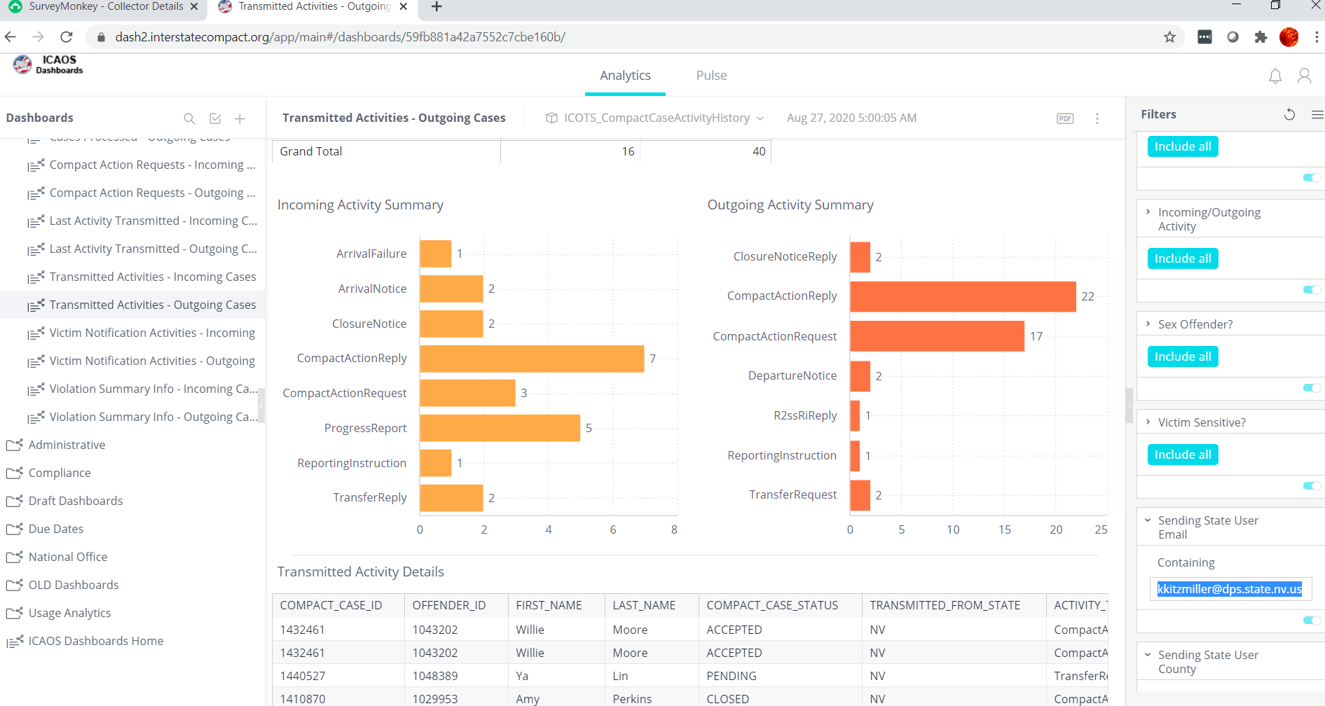
FY22 DCA Dashboard Program
Objectives:
Improve Data Integrity and Accuracy
Improve Report Capabilities
Share Best Practices
DCA Mentoring Opportunity
Expectations for Report Uses:
Manipulating data elements
Self-auditing practices
Practical uses – using the reports day-to-day
Determine Needs for ICAOS Formal Auditing/Corrective Action
https://www.interstatecompact.org/icaos-dashboards
https://support.interstatecompact.org/hc/en-us/articles/360062756533-DCA-Compact-Staff-Dashboard-Program-FY22
Notes:
Compliance expectations go beyond adhering to timeframes and the 6 automated standards.
States should be regularly using the reports to improve compact processes, ensure CLEAN data and identify areas for training needs, etc.

Slide 8
FY22: Q1 Offender Management
What is Offender Management?
What Offender Management Issues Exist?
What Objectives does Your State Need to Focus on?

Slide 9
Article Review & Demo
Notes:
Go to Article
https://support.interstatecompact.org/hc/en-us/articles/1500006065481
Pull Dup report
Show how to review each profile, determine steps, particularly for MOVE; delete when nothing is transmitted
Go through pending items
Pull Junk offender report (note we wil be adding a new element) nothing transmitted soon.

Slide 10
Offender Management Initiatives
Per Privacy Policy States MUST have established P&P for reporting and managing Dup and Junk Records
National Office
Who manages & How do users report duplicates/junk records to your state?
Frequency of Processing/Cleansing of ICOTS data
Training requirements for State Admin access
Regular review of instruction articles & training
Identifying user behavior not in compliance w/ PP and reporting to states
Newly approved Enhancement:
Purge Junk Records (Phase 1)
Set Restrictions for Offender Management Functions to decrease user created errors
Notes:
Ask whether states have a designated person?
Do they have these procedures published for their users?
Do states define what a junk or dup record is?
What are states’ timeframes set for processing?

Slide 11
DCA Region Chairs
Communicate your topic suggestions to your region chair for upcoming training &/or DCA Region Meeting!

Slide 12
Thank You
Interstate Compact for Adult Offender Supervision

