Slide 1

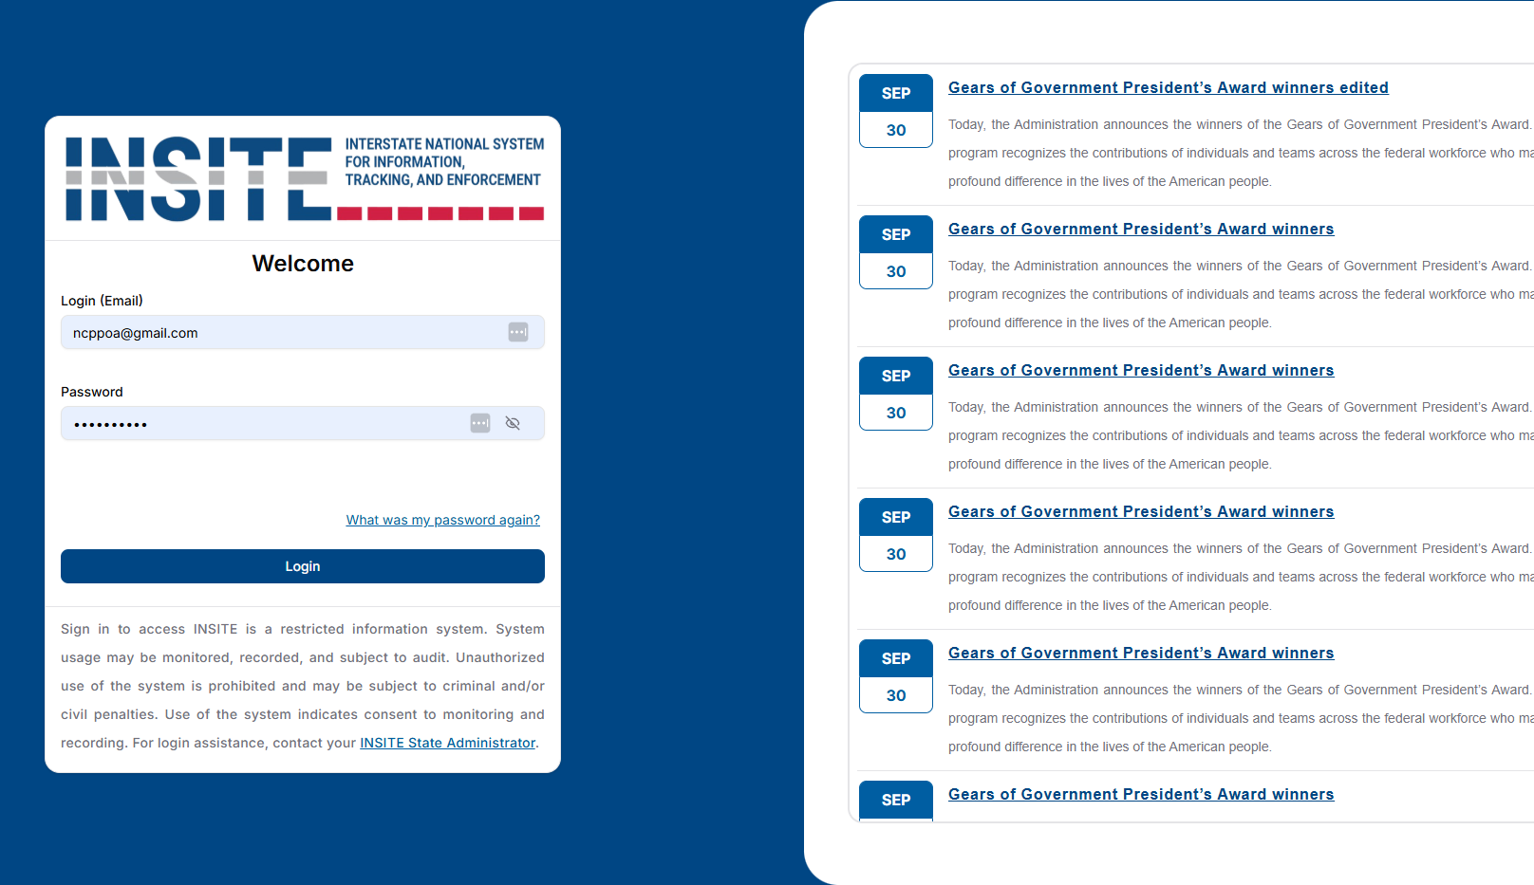

A BETTER WAY TO WORK

Slide 2
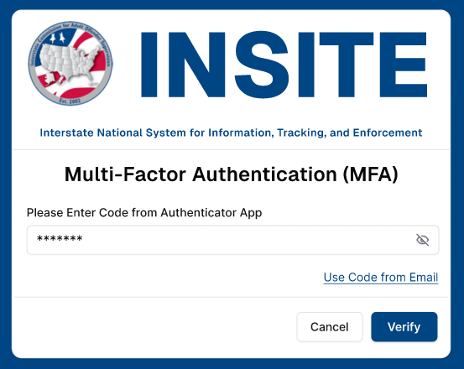
MULTI-FACTOR AUTHENTICATION

Slide 3
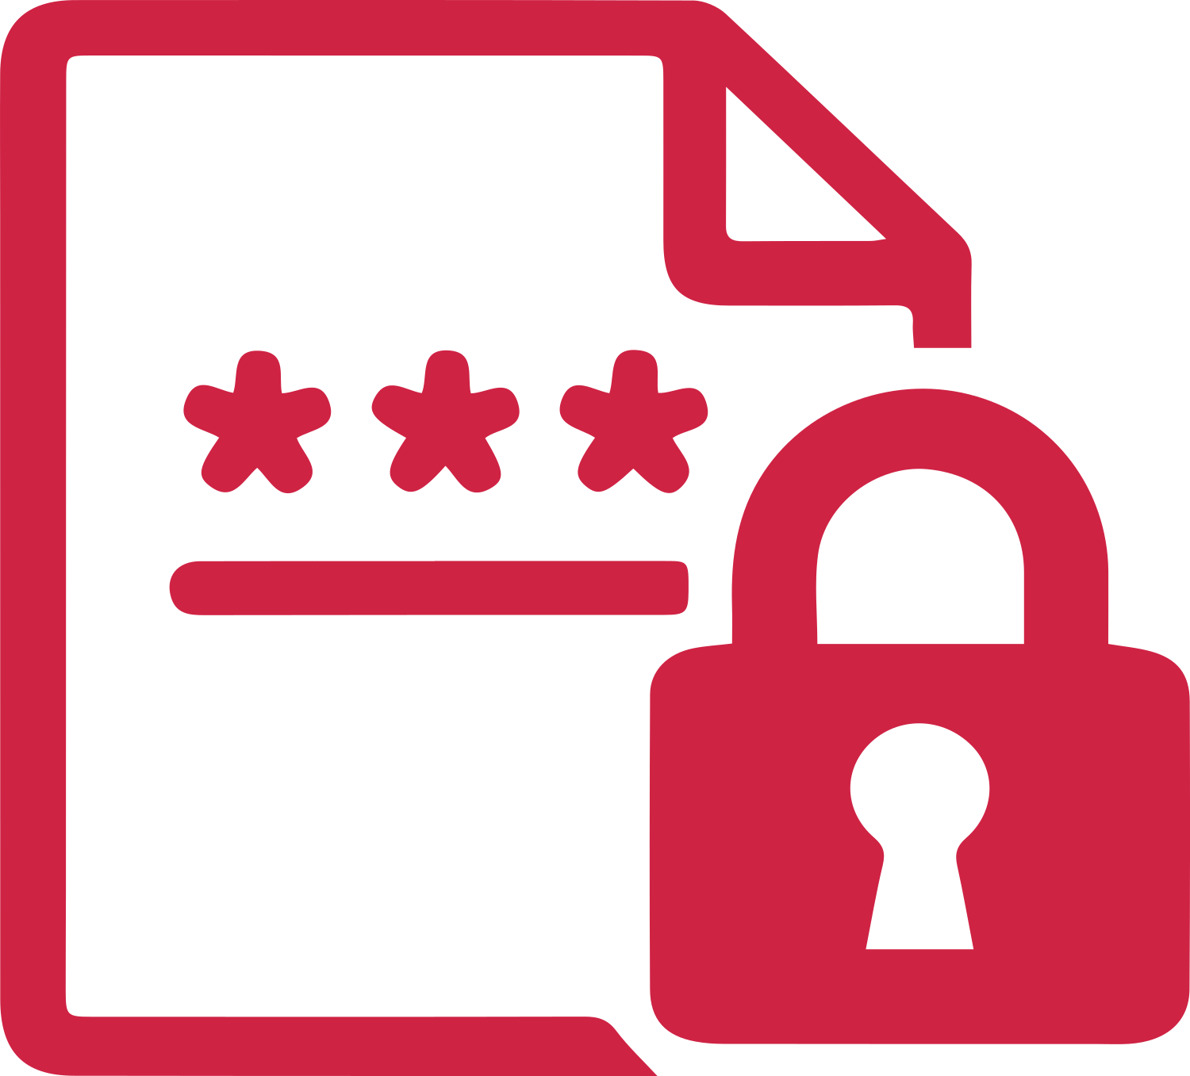


WHY MFA?
  Protects Sensitive Information
  Prevents Unauthorized Access
  Supports Public Safety
  Meets Federal Requirements

Slide 4
LOGIN & NEWS

Slide 5

WHAT YOU’LL FIND IN NEWS
  System Maintenance
  Releases & Enhancements
  Service Interruptions
  Training Opportunities
  Educational Resources
  Events & Reminders

Slide 6
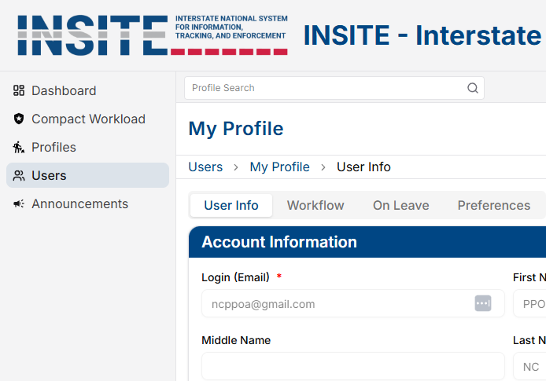
USER PROFILE

Slide 7
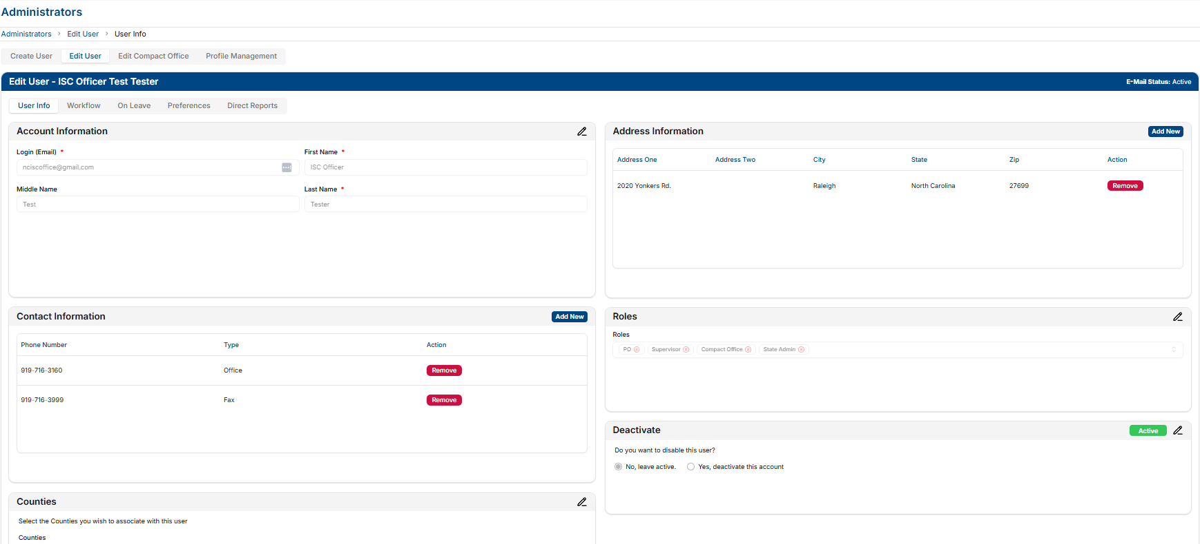
USER INFO & DEACTIVATION

Slide 8

SIMPLIFIED USER ADMINISTRATION
  Same look & feel for End Users
  Simplified deactivation process for compact Staff
  Automatic removal of User Roles which was often times overlooked in ICOTS

Slide 9
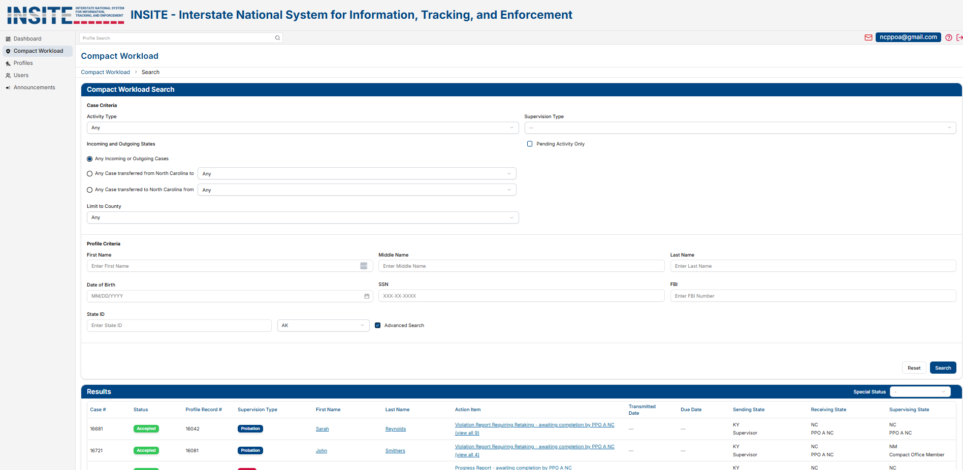
COMPACT WORKLOAD

Slide 10
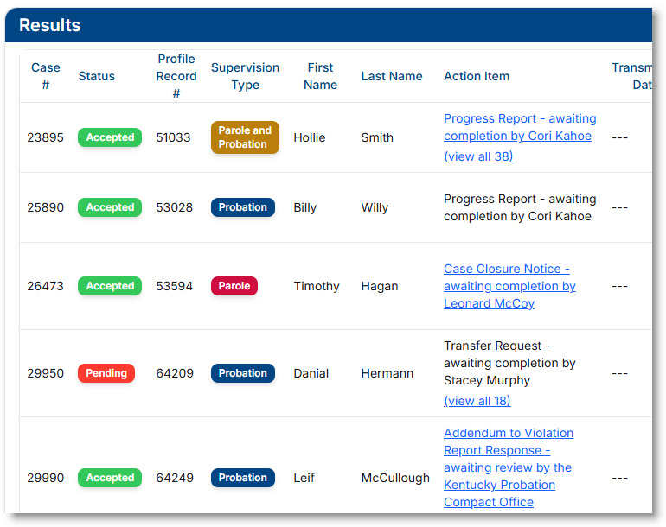
COMPACT WORKLOAD RESULTS

Slide 11

IMPROVED SEARCH FUNCTIONALITY
  Profile Search on every screen for quicker access
  More intuitive search results that highlight key matches
  Search results on the bottom of screens to allow for abilty to change search criteria instantly
  Color coded information to quickly see type and status of cases

Slide 12
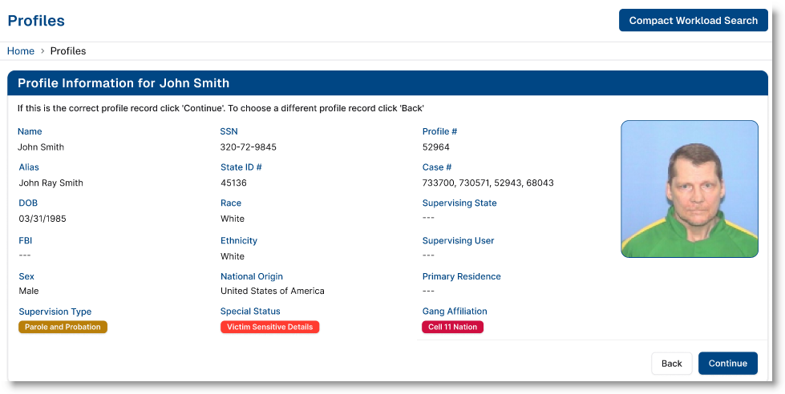
SUPERVISED INDIVIDUAL PROFILE

Slide 13
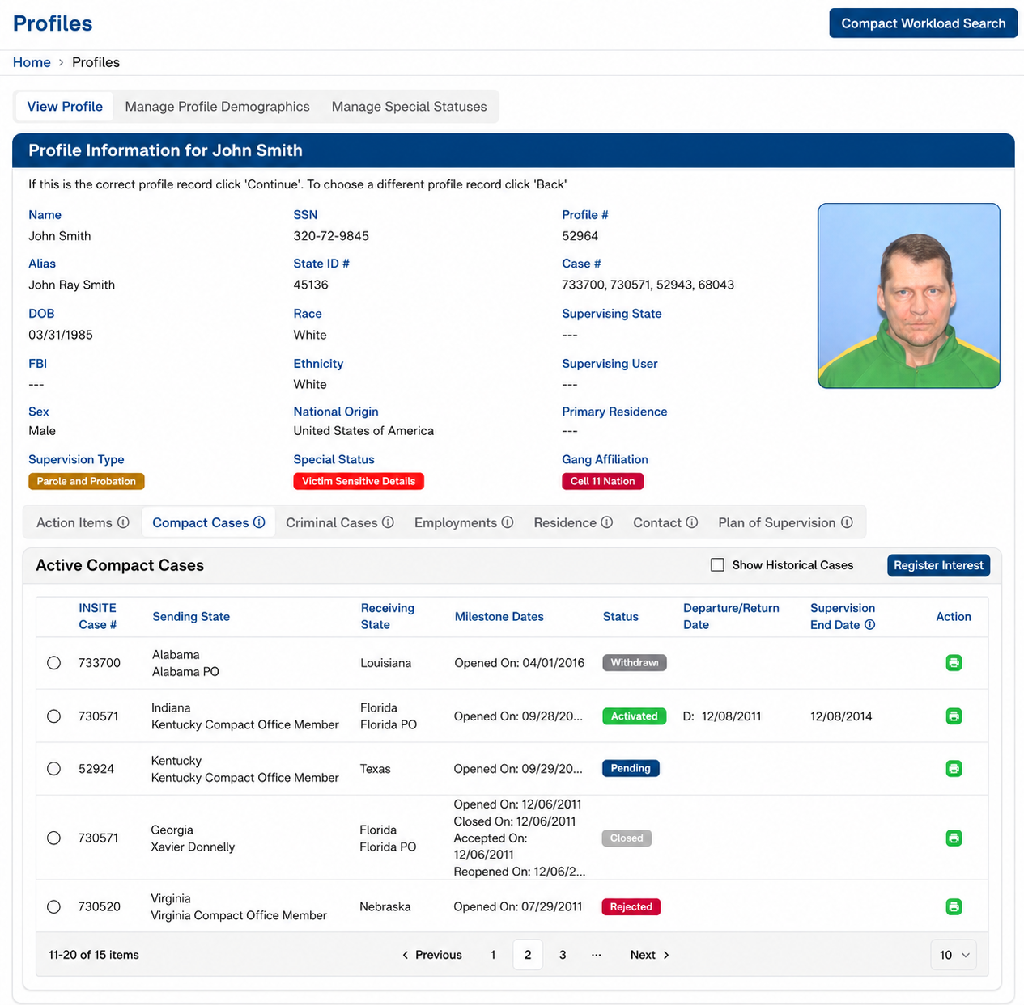
SUPERVISED INDIVDUAL PROFILE

Slide 14

PROFILE MODERNIZATION
  Language updated to reflect “Supervised Individual” instead of “Offender”
  Updated NCIC codes
  Contact information located in one section to streamline information
  Ethnicity now shown on profile
  “Violation History” removed as this info is available elsewhere on the profile

Slide 15
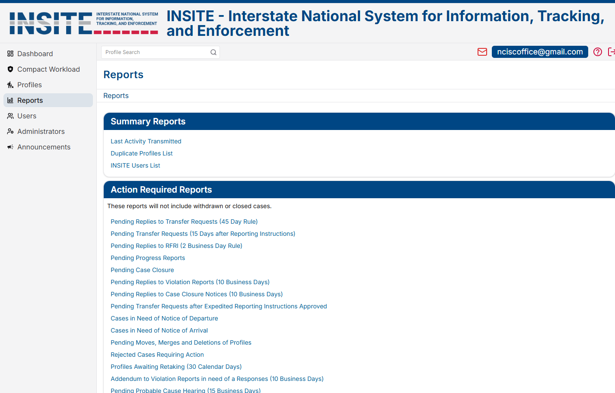
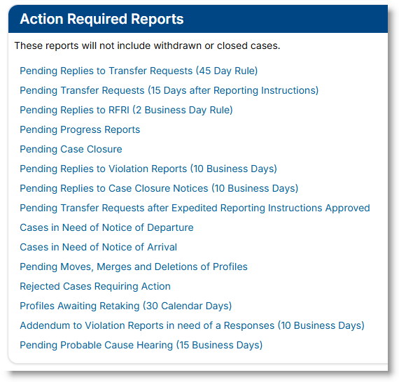
REPORTS

Slide 16
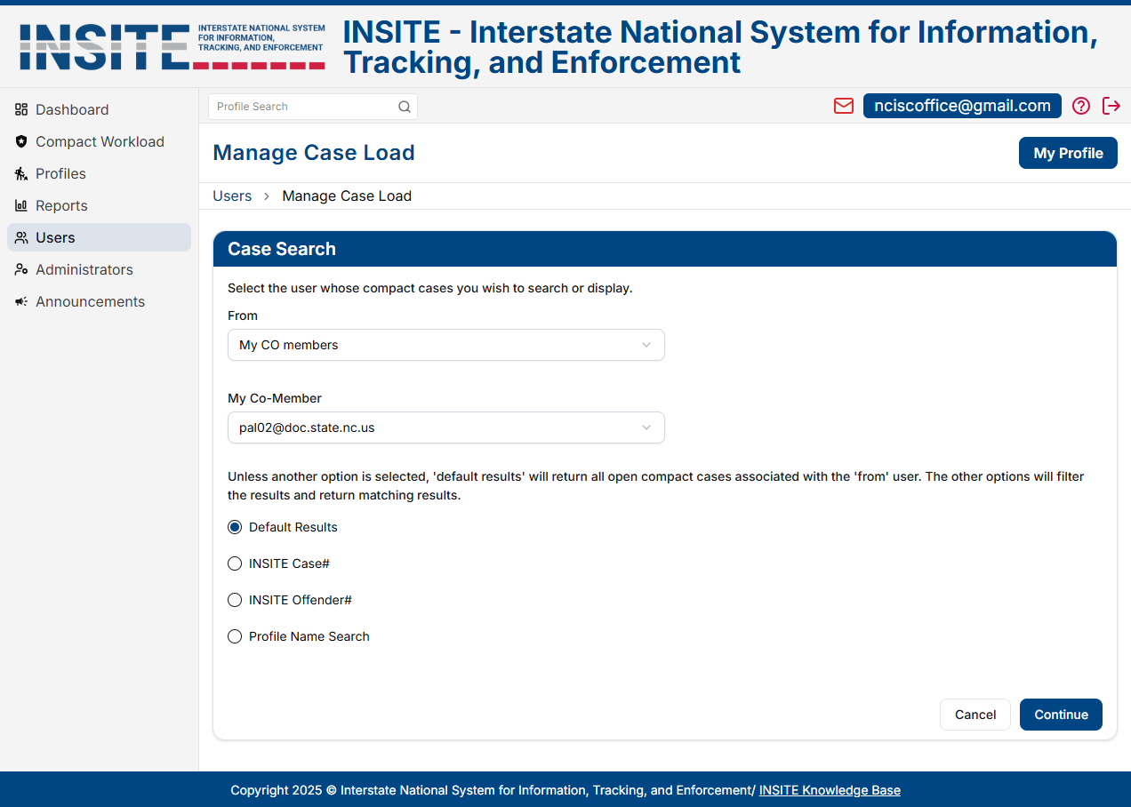
USER ADMINISTRATION

Slide 17
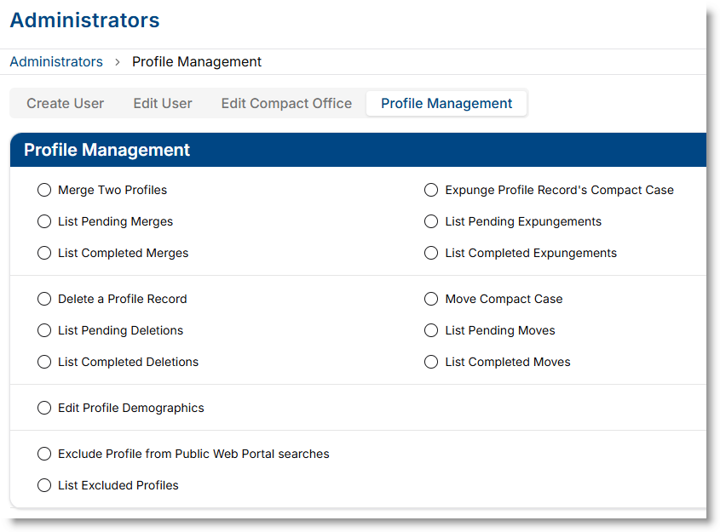
PROFILE MANAGEMENT

Slide 18

IMPROVED MANAGEMENT OF PROCESSES
  “Overdue” reports replaced by “Pending” reports for more proactive case management
  Overdue reports remain available in the ICAOS Dashboard Reports
  New “Last Transmitted Activity” report makes it easier to monitor case progress
  National Office approval removed from moves/merges/deletes/expungements for faster processing by states

Slide 19
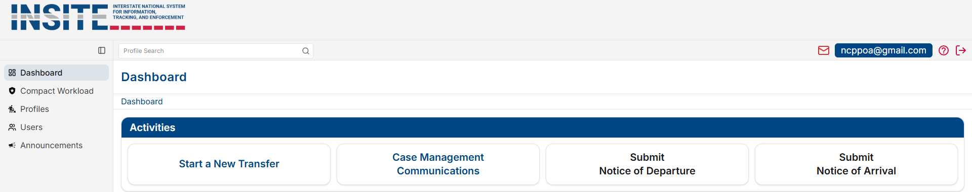
DASHBOARD

Slide 20

QUICK ACCESS TO COMMON PROCESSES
  Replaces “Assistants” tab which could be confusing and overwhelming for users
  Common tasks located on “Dashboard” as a starting point for users
    Start a New Transfer
    Case Management Communications
    Submit Notice of Departure
    Submit Notice of Arrival
  Encourages majority of workflow processes to occur fron the Individual’s Profile

Slide 21
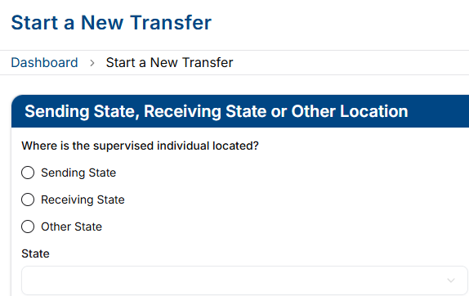
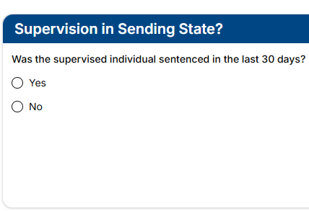
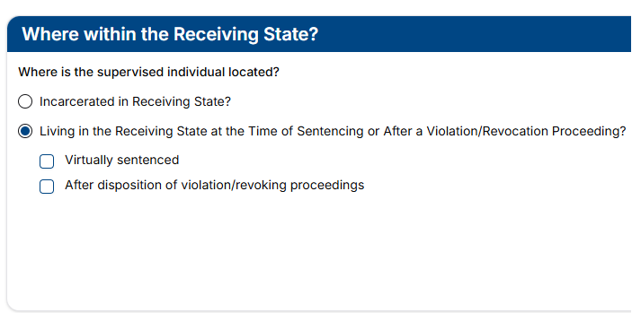
PRE-TRANSFER QUESTIONS

Slide 22

PRE-TRANSFER QUESTIONS
  Takes the guesswork out of which process to start by answering a few simple questions
  Provides more accurate information to the receiving state on where an individual is actually located at the time of the request
  Includes questions on virtual sentencing and if the individual was living in the receiving state at the time of violation or revocation proceedings which was unavailable in ICOTS

