Slide 1

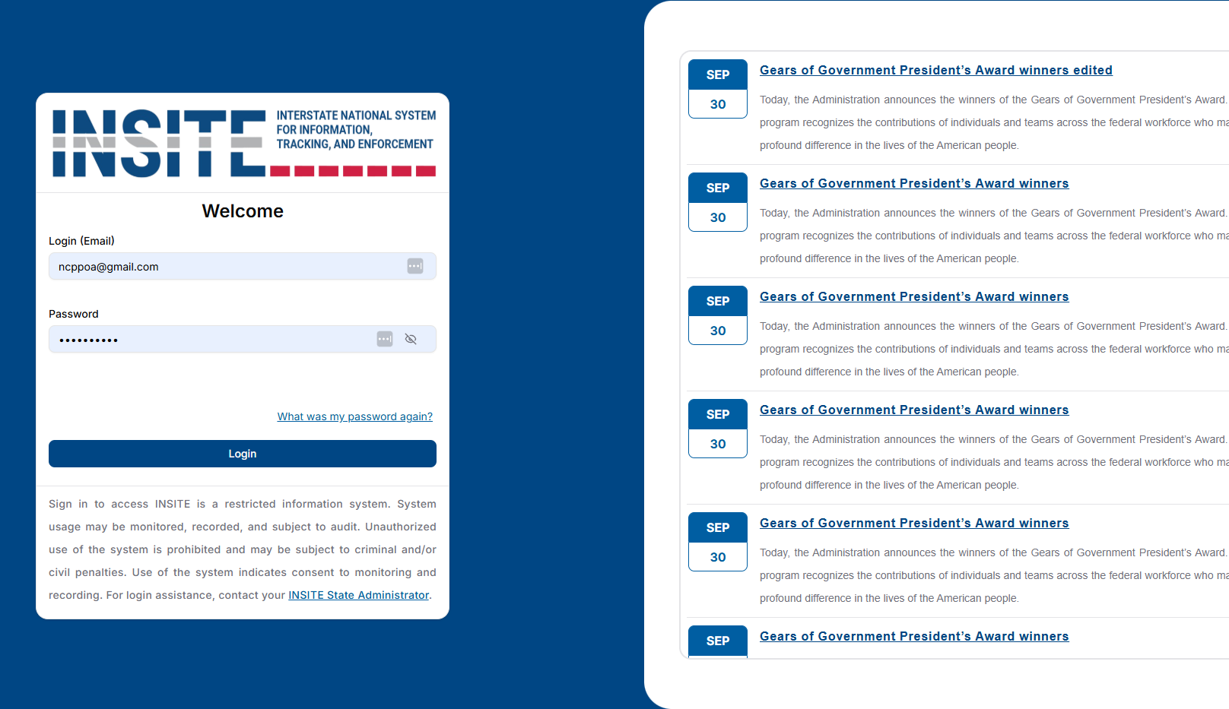

A BETTER WAY TO WORK

Slide 2
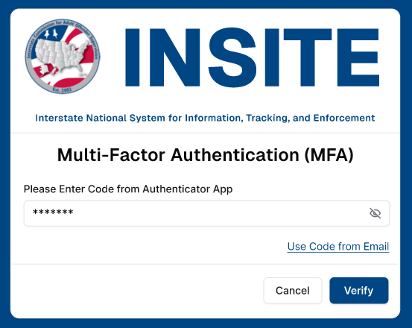
MULTI-FACTOR AUTHENTICATION

Slide 3
LOGIN & NEWS

Slide 4
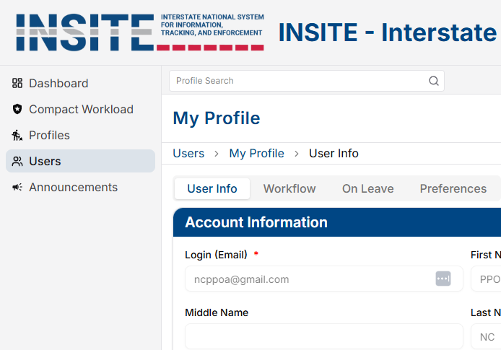
USER PROFILE

Slide 5
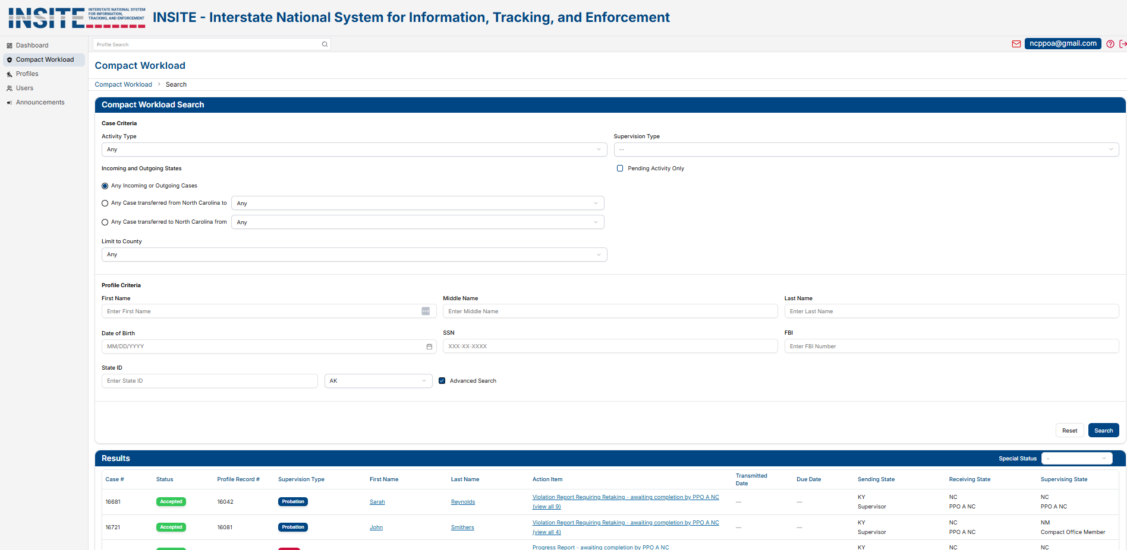
COMPACT WORKLOAD

Slide 6
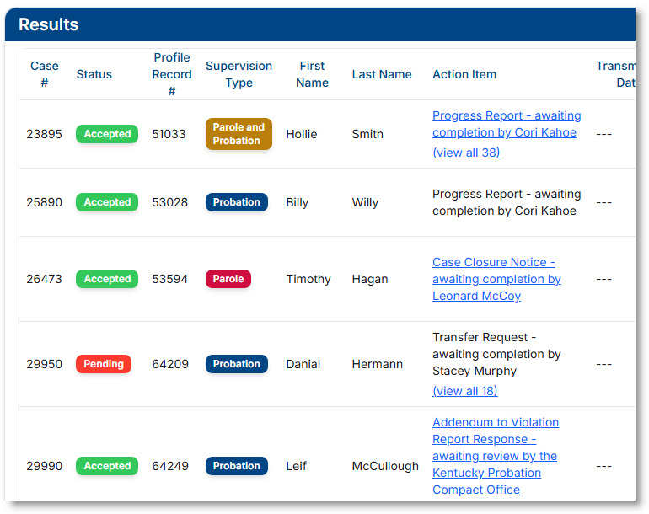
COMPACT WORKLOAD RESULTS

Slide 7
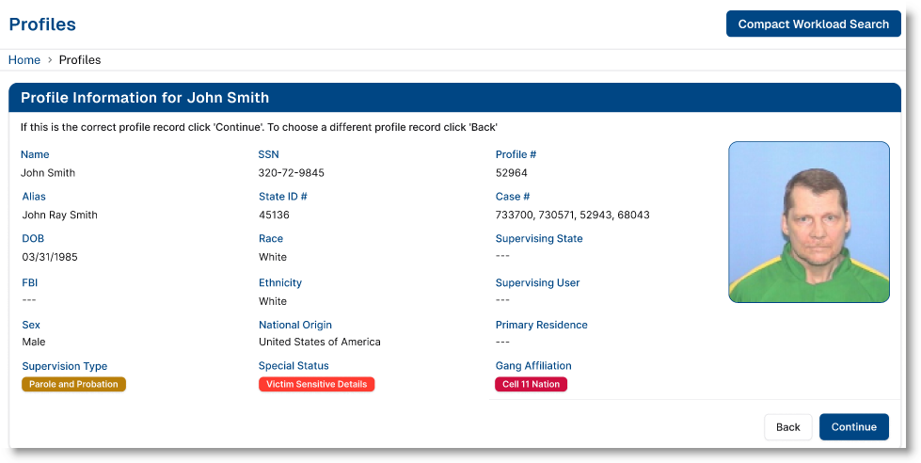
SUPERVISED INDIVIDUAL PROFILE

Slide 8
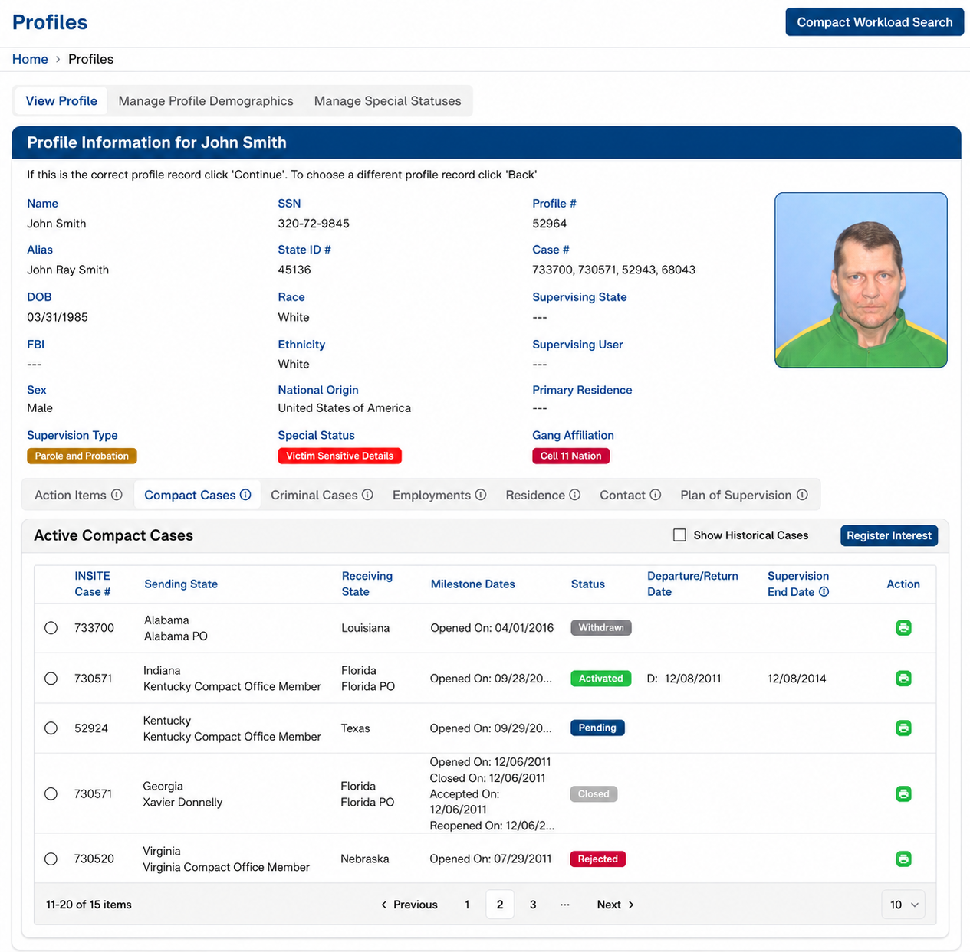
SUPERVISED INDIVDUAL PROFILE

Slide 9
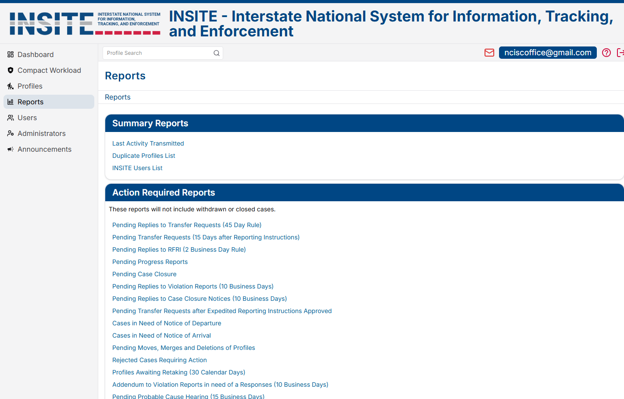
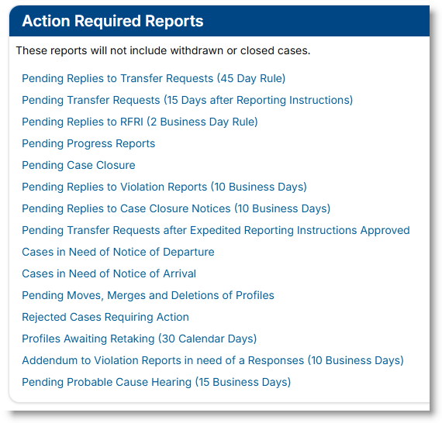
REPORTS

Slide 10
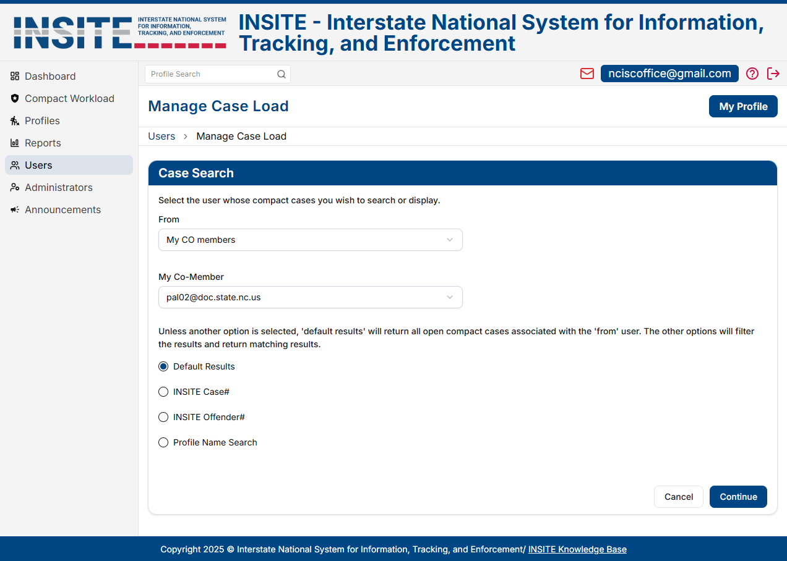
USER ADMINISTRATION

Slide 11
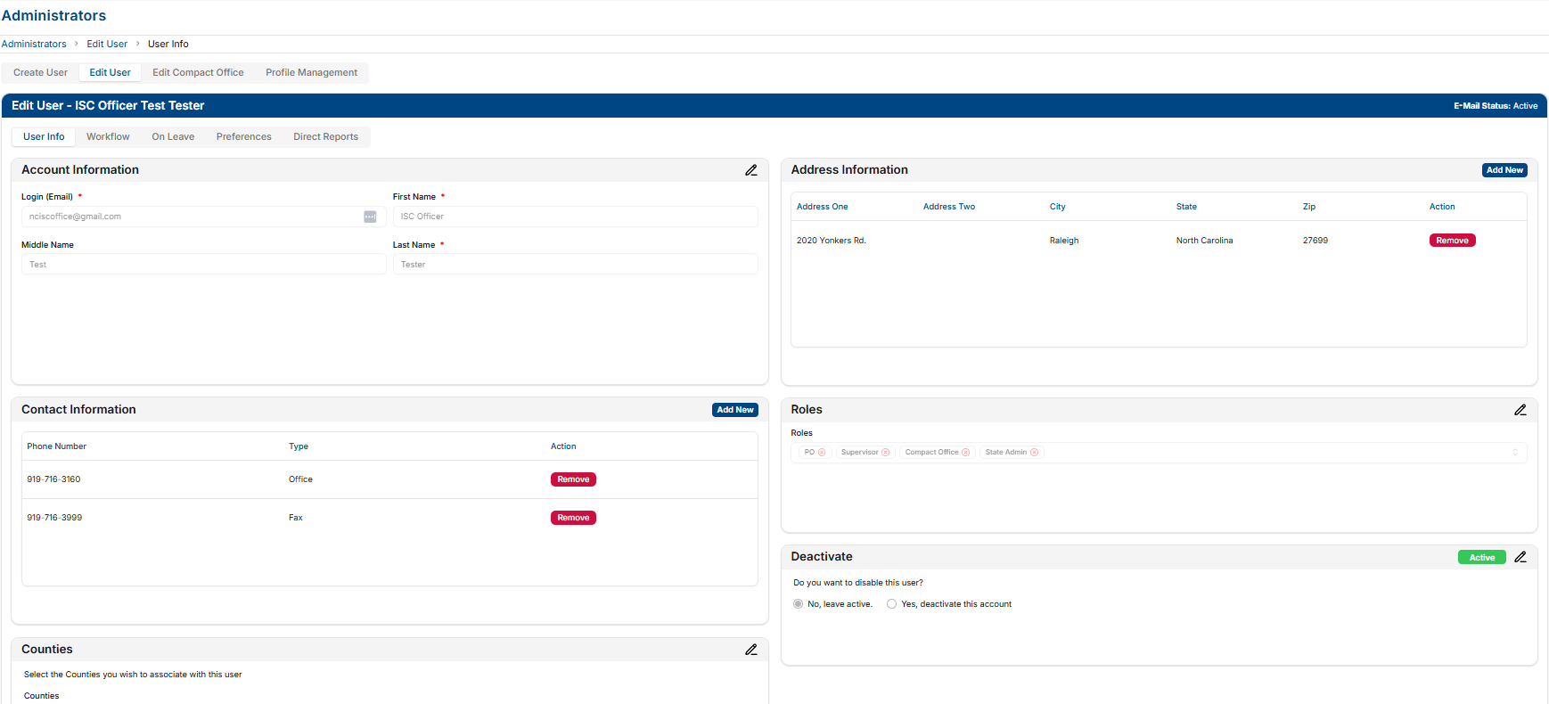
USER INFO & DEACTIVATION

Slide 12
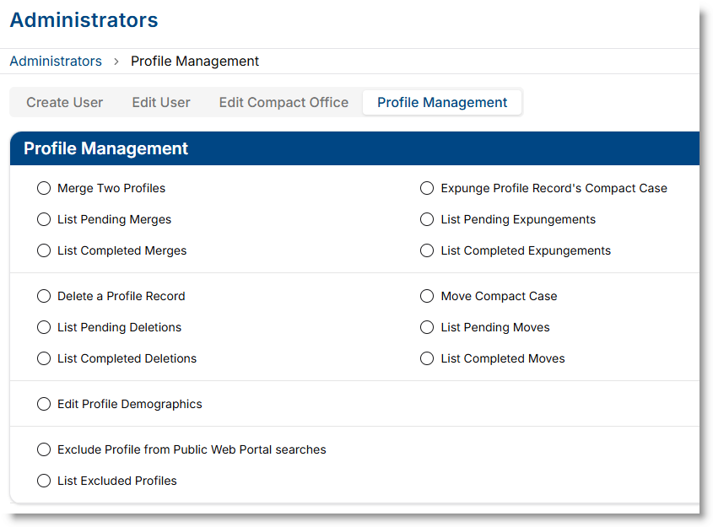
PROFILE MANAGEMENT

Slide 13
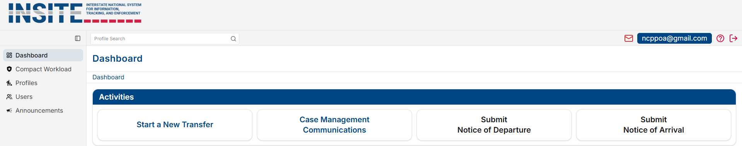
DASHBOARD

