Slide 1

ICAOS Stakeholder Training
Interstate Commission for Adult Offender Supervision (ICAOS)

Slide 2

Training Objectives
  What is ICAOS?
  Purpose
  Authority
  Implications
  Rule Making Authority
  Compliance Enforcement
  Role of State Compact Office
  Available Resources
Notes:
Overview of the authority of the interstate commission for adult offender supervision, purpose and functions of the ICAOS as well as resources available.

Slide 3

ICAOS Considerations
  Transferred from one state to another
  Supervised while under Interstate Compact supervision
  Returned to a sending state when a supervised individual violates
Notes:
ICAOS governs how supervised individuals released on supervision, are transferred and supervised over state lines and returned to a sending state when in violation.

Slide 4
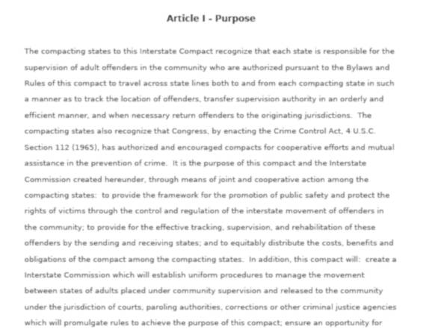

Adoption of the Compact
https://interstatecompact.org/compact-statute
Notes:
Enacted in 2002, the Interstate Commission for Adult Offender Supervision is a national governing body which oversees the day-to-day operations of the Interstate Compact for Adult Offender Supervision. The Compact is a formal agreement between member states to control the movement of certain adult offenders subject to community supervision. Today all 50 states and the territories of the District of Columbia, Puerto Rico and the US Virgin Islands are members of the Compact. In becoming a member to the Compact, each state passed similar legislation requiring all agencies within that state to enforce and effectuate the ICAOS Rules in accordance with the purposes for the ICAOS.

Slide 5

Purposes of the Compact
  Promote Public Safety
  Protect the Rights of Victims
  Effective Supervision/Rehabilitation
  Control Movement of Supervised Individuals
  Provide for Effective Tracking
Notes:
The ICAOS functions through cooperation and communication which consists of sharing offender information as individuals on supervision relocate to another state. The key purposes of the ICAOS are to promote public safety, protect victim’s rights, effectively supervise offenders while controlling and tracking movement across state lines.

Slide 6

Authority of the Compact
  Article I, Section 10, Clause 3 of the U.S. Constitution – the “Compact Clause
  The Crime Control Act of 1934
  Congressional consent ‘transforms’ the compact and authorized rules into a “law of the United States” Texas vs. New Mexico, 482 U.S. 124 (1987).
  Cuyler vs. Adams, 449 U.S. 433 (1981). Compact rules supersede any state laws in conflict with them.
Notes:
The ICAOS is based on congressional consent granted under the Crime Control Act of 1934, which provides, “The consent of Congress is hereby given to any two or more States to enter into agreements or compacts for cooperative effort and mutual assistance in the prevention of crime and in the enforcement of their respective criminal laws and policies, and to establish such agencies, joint or otherwise, as they may deem desirable for making effective such agreements and compacts.” **Because ICAOS has received congressional consent, it is federal law and supersedes any conflicting state laws.

Slide 7

Transfer of Supervision is a Privilege
  There is no “right” of convicted persons to travel across state lines or to serve one’s sentence in a particular state. See, Jones v. Harris, 452 U.S. 412 (1981); Meachum v. Fano, 427 U.S. 215 (1976)
  Convicted persons have no right to control where they live; the right is extinguished for the balance of their sentence. Williams v. Wisconsin, 336 F.3d 576 (7th Cir. 2003), Pelland v. RI,317 F. Supp. 2d 26 (2004)
Notes:
As far as implications for supervision individuals, initiation of a transfer is always at the discretion of the sentencing state. There is no constitutional right for any convicted person to travel or transfer supervision to another state. Interstate transfers are considered a privilege and should only be considered when it appears the offender would be more successful supervised in another state

Slide 8

Compliance Enforcement
  Compliance Audits
  Sanctions for Non-Compliance
    Remedial Training
    Imposition of Fines
    Legal Action in Federal Court
Notes:
**The Commission possesses significant enforcement authority regarding non-compliant states which can include requiring remedial training, mediation or arbitration, imposing monetary fines, suspending or terminating a non-compliant state from the Compact or seeking relief in federal court, most commonly by obtaining an injunction to curtail state action or compel compliance.
Grounds for seeking redress include, but are not limited to, a state’s failure to perform obligations imposed by the terms of the Compact, the Interstate Commission’s bylaws or any promulgated rule of the Commission. To date, the Commission has prevailed in several enforcement actions against states to address non-compliance including allowing eligible offenders to relocate outside of the compact, failure to retake a compact offender when required by the rules and delinquent payment of dues.

Slide 9

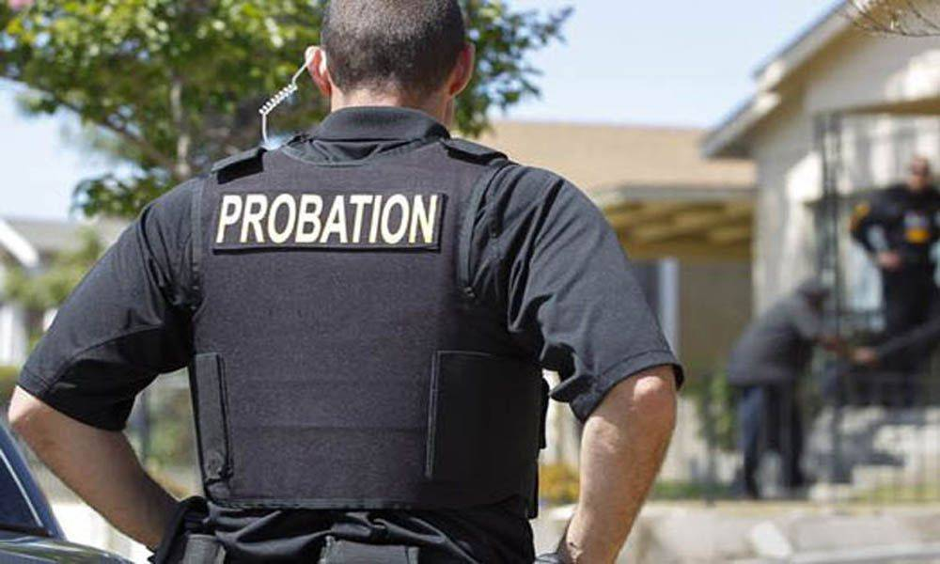
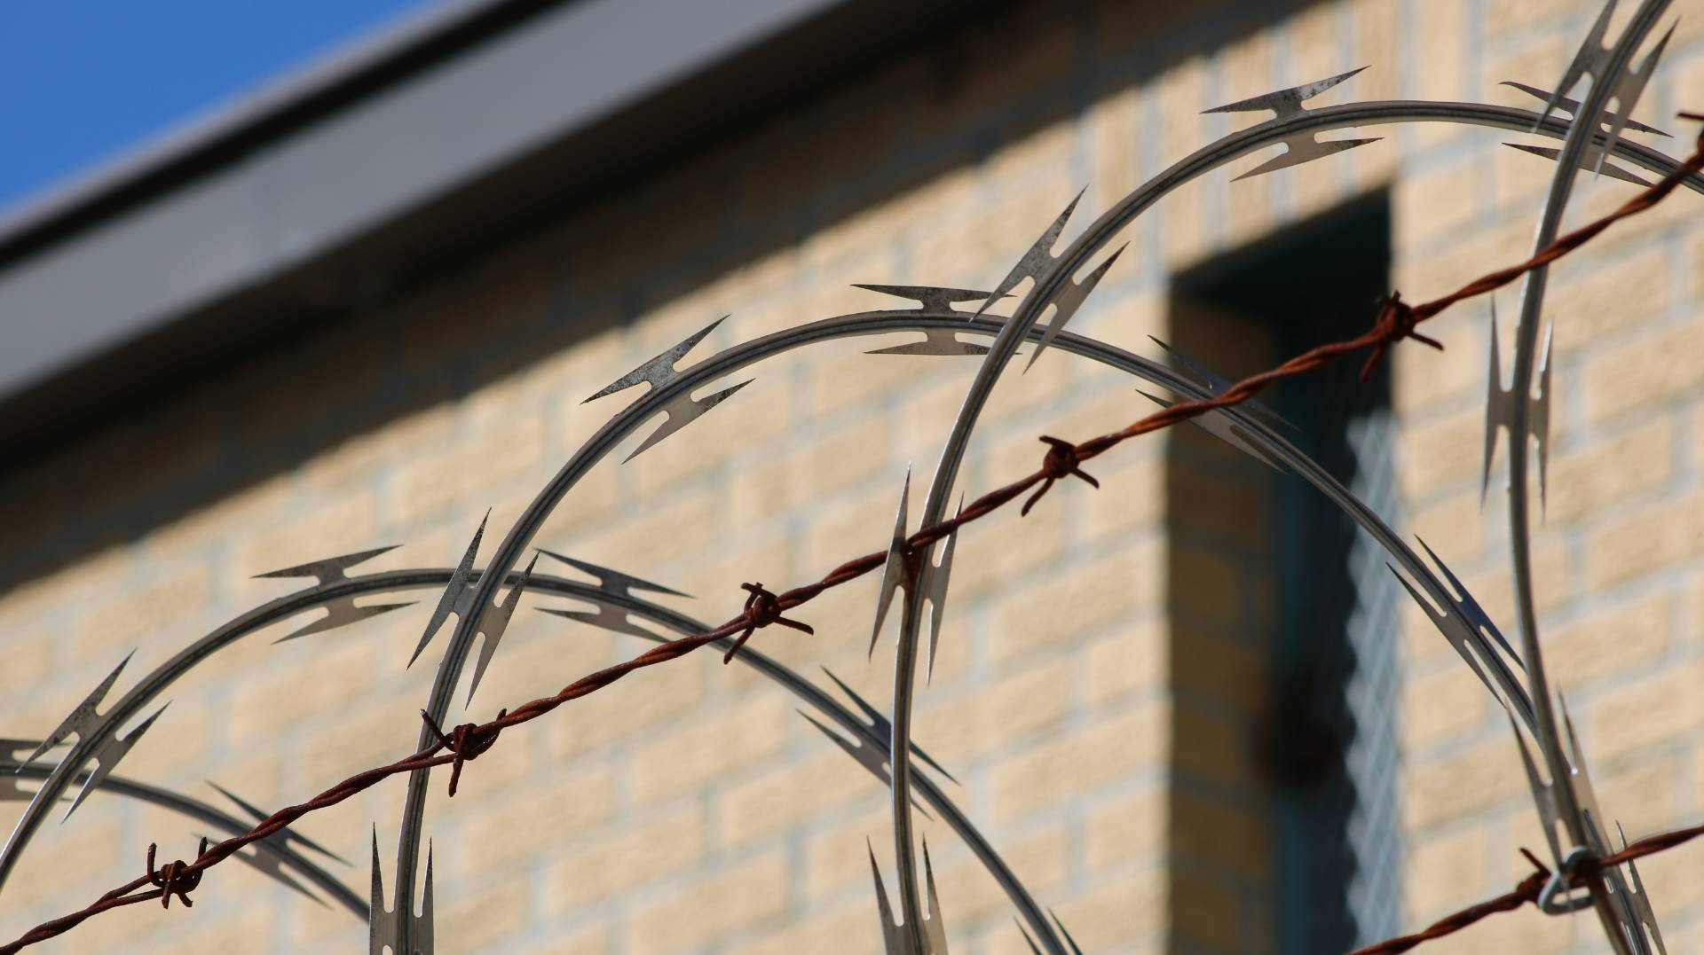
Implications of the Compact
Notes:
All jurisdictions including the courts, parole boards, community corrections and other criminal justice agencies are subject to ICAOS rules and required to enforce the Compact as indicated in each state’s statute. The rules are essentially a framework for member states to follow when transferring supervision responsibilities for offenders, determining how offenders are supervised over state lines and returning offenders when in violation. Effective communication and sharing of offender information are key components to interstate compact business between states as well as between agencies within a state.

Slide 10

Role of the State Compact Office
  Processes & reviews compact transfers and activities
  Training Resource
    Field officers, Prosecutors, Judges, Jails & Parole Boards
  Resolves issues with other states
  Ensures compliance with ICAOS rules
  Develops & recommends in-state standards and operating procedures
    State Council
Notes:
Each state’s compact office serves as a resource center for all agencies involved with Compact offenders. The interstate compact office can confirm whether or not an offender is an interstate compact offender, answer questions regarding the interstate compact as well as assist when issues arise. State compact offices work with other state compact offices to resolve issues, ensure compliance with the rules as well as work with state council members to develop policy and procedures related to compact business within their state. The compact office can also ensure involvement of a probation or parole officer when necessary.

Slide 11

Collaboration
Judge
Counsel
Supervision Officer
Interstate Compact Office
Notes:
When it is known at sentencing that an individual lives or plans to live out of state, it is important that judges, prosecuting attorneys, supervising officers and the offender are aware and consider the interstate compact requirements. The interstate compact office can provide assistance and resources when needed.

Slide 12

Supervised Individual
  Adult who commits a criminal offense
  Subject to supervision
  Released to the community under jurisdiction of:
    Courts
    Paroling authorities
  Meets eligibility requirements
Relocate
  Remain in another state for more than 45 consecutive days
    Includes treatment where the stay exceeds 45 days
    Corrections
    Other criminal justice agencies
No state shall permit a supervised individual who is eligible for transfer to relocate to another state except as provided by these rules
Supervision
(at least 90 days remaining)
2 distinct criteria:
  Oversight exercised by controlling authority which includes Courts, Parole Boards. etc.
  Required to monitor regulations or conditions, other than monetary

Slide 13

Eligible Offenses
Felonies
  All felons subject to “supervision
Misdemeanants- Rule 2.105
  Sentence of 1 year or more of “supervision” & instant offense includes at least 1 of the following:
  Person incurred direct or threatened physical or psychological harm
  Use or possession of a firearm
  2nd or subsequent conviction of driving while impaired by drugs or alcohol
  Sex offense requiring registration in the sending state
Deferred Sentences- Rule 2.106
  Waived right to trial?
  Entered a guilty/no contest plea?
  Court accepted the plea?
Notes:
Eligibility criteria also requires that the offender has committed an eligible offense. This includes all Felons and certain misdemeanant offenders as outlined in Rule 2.105.
Eligible misdemeanants have a sentence of at least 1 year of supervision and the instant offense includes one or more of the following: 1.) An offense in which a person incurred direct or threatened physical or psychological harm; 2.) An offense that involves the use or possession of a firearm; 3.) A second or subsequent misdemeanor conviction of driving while impaired by drugs or alcohol; and 4.) A sexual offense that requires the offender to resister as a sex offender in the sending state.
Rule 2.106 states that offenders subject to “deferred sentences” are subject to the Compact Rules. This type of sentencing can be applied differently across jurisdictions. While Compact eligibility criteria does not include cases that do not carry guilt and revocation implications, it does apply to cases where an offender is considered guilty during the period of time they were under supervision.

Slide 14

Transfer Requirements
  Request at the discretion of the sending state
    No supervised individual has right to transfer
  90+ days of supervision remaining
  Substantial compliance
  Valid plan of supervision
  Reason for transfer
  Justification
Notes:
Request to transfer supervision responsibilities is always at the discretion of the sending state. Offenders do not have the right to transfer. Qualifications for all transfers require the offender have at least 90 days of supervision remaining at the time the request is made, is considered to be in substantial compliance, has a valid plan of supervision and has a reason for transfer that is justified. Review the definitions by clicking on the red boxes on the right of the screen before advancing to the next slide.
Substantial compliance means an offender is sufficiently in compliance with the terms and conditions of his or her supervision so as not to result in the initiation of revocation of supervision proceedings by the sending state.
Only the sending state determines if an offender is in substantial compliance.
Plan of Supervision means the terms under which an offender will be supervised, including proposed residence, proposed employment or viable means of support and the terms and conditions of supervision.

Slide 15

Reason for Transfer
Mandatory
Resident/Resident Family (Majority of transfers)
Other Mandatory (Less common transfer reasons)
  Military Member/Live with Military Family Military Veteran Receiving Treatment
  Employment Transfers (at direction of employer)
Discretionary
Common Reasons: Treatment/School/New Employment opportunities; other verified means of support
Notes:
Qualifications for transfer and reasons for transfer determine whether the acceptance by the receiving state is Mandatory or Discretionary. Remember, offenders do not have the right to transfer and the sending state determines whether to submit a request and application to a receiving state. Mandatory acceptance indicates that if transfer criteria is met and the offender is transferring under one of the 7 mandatory reasons for transfer, the receiving state must accept supervision. All other requests are considered discretionary. Nearly all mandatory requests are submitted for offenders qualifying as either a resident of the receiving state per the compact’s definition or having resident family willing and able to assist the offender in the receiving state.

Slide 16

Reporting Instructions
Rule 3.104
No Travel Prior to Acceptance
Reporting Instruction Exceptions
  Living in the receiving state at the time of sentencing/disposition of violation or revocation proceeding
  Expedited (other emergencies)-Both states must agree
  Military orders
  Employer directed transfer to maintain employment
  Veteran services
  Released from incarceration in the receiving state
Notes:
Certain offenders qualify for reporting instructions. Reporting instructions provide permission for the offender to be in the receiving state during the investigation of the transfer request. Upon receipt of a request for reporting instructions in the receiving state, replies for reporting instructions are due within 2 business days except for sex offenders. The receiving state has 5 business days to respond to reporting instruction requests for sex offenders and may be denied if the residence is not compliant with policies or laws.

Slide 17
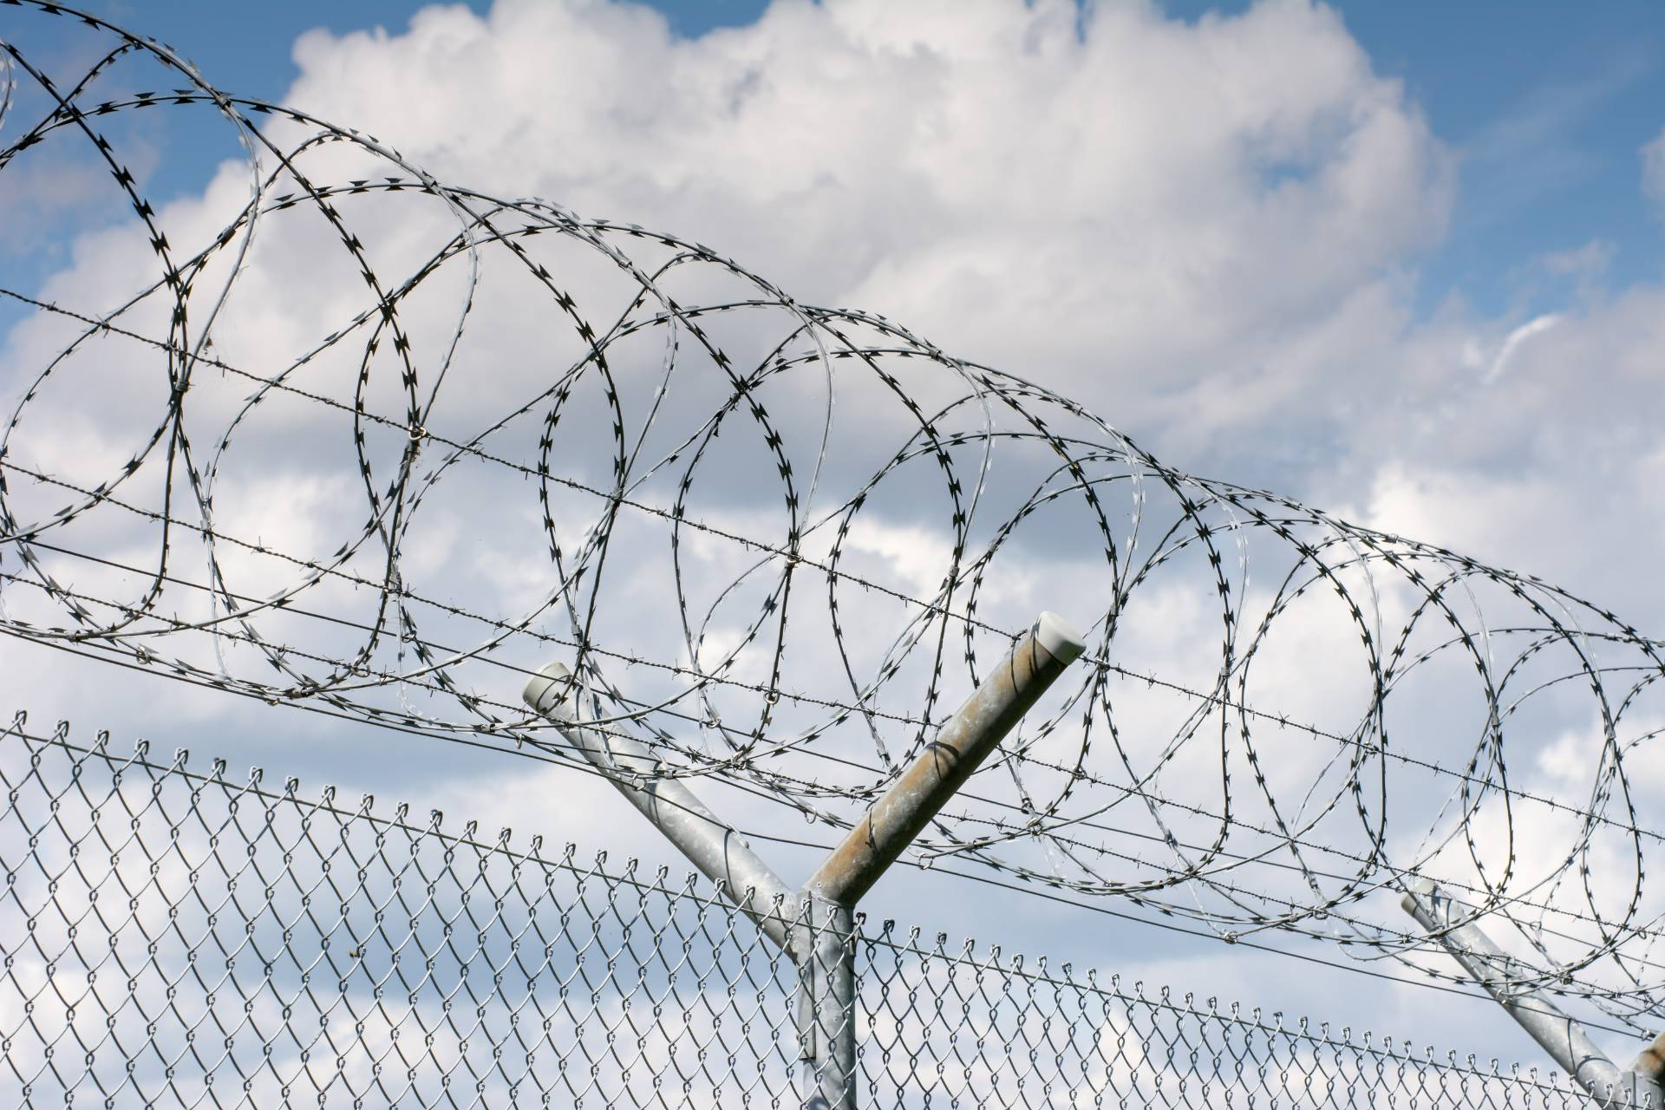
Pre-Release Transfer
Submit within 120 days prior to release
Notify Receiving State if:
  Release date changes
  Release date withdrawn or denied
Rule 3.105
Notes:
Interstate Compact transfers of supervision require an acceptance from the receiving state prior to an offender traveling or relocating. **For incarcerated offenders requesting to relocate upon release, applications can be submitted within 120 days prior to the planned release date. If the release date changes or is withdrawn, the sending state is required to notify a receiving state immediately.

Slide 18
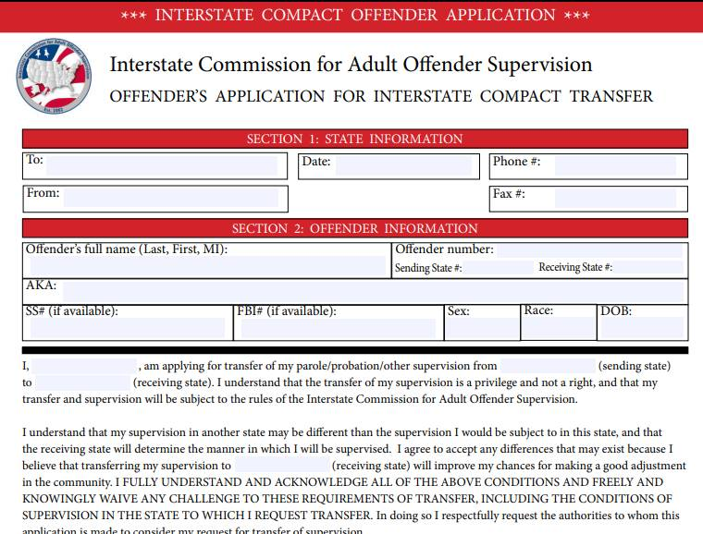
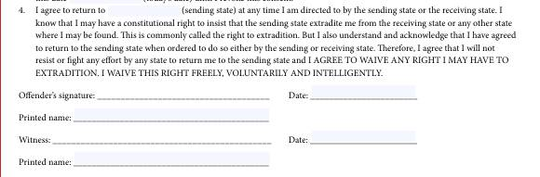
Waiver of Extradition
Application for Transfer
  Supervised individual signs prior to leaving the sending state
  Extradition hearings not required
Notes:
**As a precondition to transfer supervision, ALL offenders must sign the offender application for transfer agreeing to waive extradition from any state. This is EXTREMELY IMPORTANT as it replaces the need for an extradition hearing in the Receiving State and the need for a Governor's warrant by the Sending State in order to apprehend an offender.
This form clearly states, “…I will not resist or fight any effort by any state to return me to the sending
state and I AGREE TO WAIVE ANY RIGHT I MAY HAVE TO EXTRADITION. I WAIVE THIS RIGHT FREELY,
VOLUNTARILY AND INTELLIGENTLY.”

Slide 19



Supervision
Sending State
Receiving State
Term of Supervision
Rule 4.102
Conditions
Rule 4.103
Degree of Supervision
Rule 4.101
Notes:
Conditions: As part of application for transfer, supervised individuals agree to comply with the terms and conditions that have been placed on them by both the sending and receiving state
Degree: Receiving state to supervise compact individuals consistent with in-state supervised individuals
INCLUDING programs, sanction/interventions
EXCEPT extend supervision or revoke
Courts involved in supervision decision for in-state case? Then they should be for compact cases as well

Slide 20

Warrant
Warrants must be issued within 15 business days
  Written order commanding law enforcement to arrest an offender
  SHALL be entered in the NCIC Wanted Person File
  National pick-up radius
  No bail or other release condition
Rule 1.101
Notes:
All Warrants issued for Compact individuals must be entered in the National Crime Information Center Wanted Person File with a national pick-up radius.

Slide 21

Authority to Arrest & Detain
A supervised individual in violation of the terms and conditions of supervision may be taken into custody or continued in custody by the receiving state
  Only if you have the authority to arrest in-state individuals without a warrant from the Court
Rule 4.109-1
Notes:
In supervising an out-of-state case, the receiving state acts as an agent for the sending state when an offender violates his or her terms or conditions of supervision or when the sending state initiates retaking of the offender. Upon execution of the interstate warrant by the receiving state, the individual must be held in custody until he or she is retaken by the sending state. ICAOS Rule 4.109-1 clarifies the statutory authority to arrest and detain an out-of-state case. However, state officials should note this rule does not extend warrantless arrest powers to an official who does not domestically have the power to arrest an offender without a warrant.

Slide 22

Retaking
  Requires Warrant & Detainer
  Discretion of the Sending State OR Required upon request of Receiving State for non-compliance with a recommendation for a warrant and revocation of supervision
  Supervised individual charged with a new crime cannot be retaken until:
    Charges have been dismissed
    Sentence has been satisfied
    Supervised individual is released to supervision for the new offense
UNLESS sending and receiving state mutually agree to retake/return
Rule 5.101 & 5.101-1
Notes:
When an offender is transferred and then returned to a sending state, this is referred to as retaking under the compact rules and definitions. An offender can only be returned to a sending state under the compact if that offender initially left the sending state through a compact transfer. Compact offenders agree to waive extradition from any state prior to transferring.
Whether the sending state or the receiving state can initiate retaking is dependent on an offender’s status.
A sending state may, in its discretion, retake an offender transferred to another state at any time unless that offender is charged with a new crime in the receiving state.
If the offender has been charged with a subsequent criminal offense in the receiving state, the offender shall not be retaken without the consent of the receiving state, or until criminal charges have been dismissed, sentence has been satisfied or the offender has been released to supervision for the subsequent offense.
A receiving state may request retaking upon notification to the sending state that an offender committed a violation and such violation would result in a request for revocation if that offender was originally sentenced in the receiving state. In many instances, the sending state is required to issue a warrant in a timely manner and file a detainer once in custody. Mandatory retaking situations require that the offender be removed from the receiving state within 30 calendar days once the decision to retake is made and the offender is considered ‘available’, meaning no pending charges or anything else is holding the offender in the receiving state.
‘Behavior requiring retaking’ means the offenders has engaged in an act or pattern of non-compliance with conditions of supervision that could not be successfully addressed through the use of documented corrective action or graduated responses and would result in a request for revocation of supervision in the receiving state, if committed by a similar offender sentenced in the receiving state. In most instances the sending state retakes the offender via warrant, however Rule 5.103 provides the option for a sending state to order the return of the offender in lieu of retaking.
Receiving states may also request retaking after a conviction of a felony or violent crime per Rule 5.102. For these instances, the sending state must retake the offender after either the offender has completed the term of incarceration for the new conviction or is placed under supervision for the new crime. Once the offender is available for retaking, the sending state issues a warrant and once the offender is in custody files a detainer with the holding facility.
Absconders apprehended in the receiving state on the sending state’s warrant must also be retaken. Abscond means to be absent from the offender’s approved place of residence or employment and avoiding supervision. For absconders, the sending state issues a warrant upon receipt of a violation report containing the receiving state’s confirmation the offender is not at his or her residence, employment and is not located via contact with any known family members or collateral contacts. The retaking process outlined in Rule 5.103-1 is initiated if and when the offender is apprehended in the receiving state on the sending state’s warrant.

Slide 23
Retaking Obligations
Sending State
  Cost of retaking
  Retake within 30 days
  Establish authority of officers
  Identify the supervised individual
    Ensure no detainers against the individual exist
    Ensure no extradition proceedings are pending
Receiving State
  Cost of detaining
  No bail or release conditions allowed for the supervised individual
  Conduct a probable cause hearing if requested
Rules 5.105, 5.106, & 5.108
Notes:
Each state’s obligations during the retaking process are outlined in Chapter 5 of the ICAOS rules. The sending state is responsible for all costs associated with retaking the offender and must retake offenders within 30 calendar days of the offender considered to be ‘available’ for retaking. Available means there is nothing holding the offender in the receiving state, specifically, no pending charges.
As for the receiving state, all costs associated with detaining the offender awaiting retaking are the responsibility of the receiving state. Offenders subject to retaking are not entitled to bail or other release conditions and may be afforded the opportunity for a probable cause hearing in the receiving state if requested by a sending state.

Slide 24
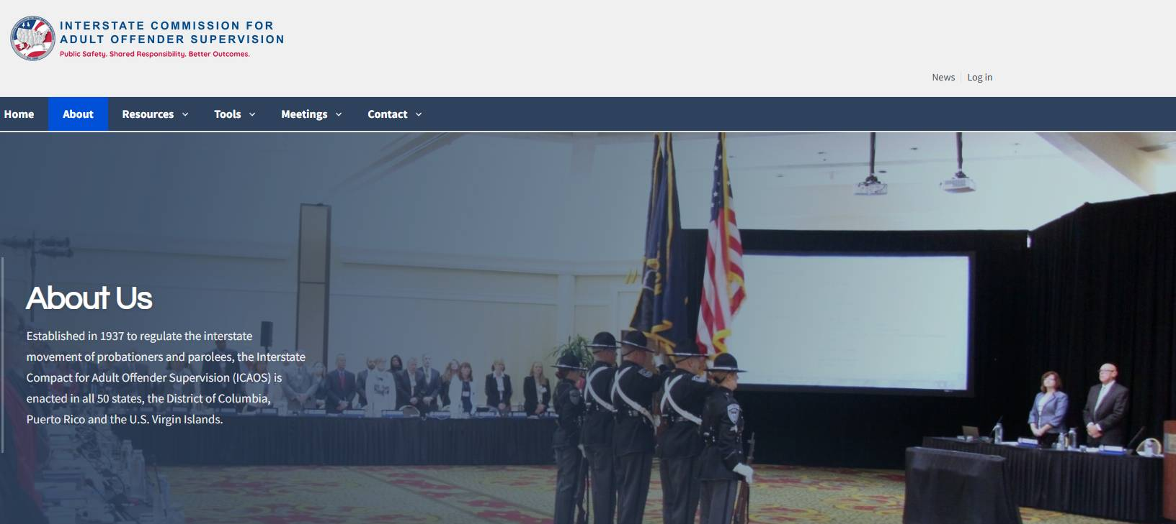
ICAOS Website
interstatecompact.org
Notes:
The ICAOS national office hosts a website providing resources to professionals responsible for administrating the interstate compact within their state, a directory of all interstate compact offices as well as general information for offenders and their families to better understand the compact.

Slide 25

White Papers
Why Your State Can be Sanctioned Upon Violation of the Compact or the ICAOS Rules
  Neither judges, prosecutors nor other state officials can immunize a state from liability which results from their actions arising under the terms of an interstate compact to which the state has bound itself by legislative enactment of the compact. See Alabama v. North Carolina, 560 U.S._ _, 130 S.Ct. 2295, 176 L.Ed.2d 1070 (June 1, 2010), also Texas v. New Mexico, 462 U.S. 554, 564 (1983)
Discharge of Sentences in Lieu of Retaking is a Violation of the Compact and the ICAOS Rules
  Empathizes that once retaking is initiated, states have an obligation to follow through with such requirement regardless of the term remaining on the offender’s supervision
https://interstatecompact.org/white-papers
Notes:
Two white papers published by the Commission are of particular interest to Judges, attorneys and other state officials. The first white paper discusses common misconceptions regarding the rules and authority of the compact which have led to violations of the compact. These misconceptions include courts allowing offenders to be in another state beyond 45 calendar days to participate in treatment, school or work without transferring via the Interstate Compact, issuance of warrants by sending states without including all 53 states and territories as well as dismissal or quashing of warrants prior to the execution of the warrant or return of the offender to the sending state. The second white paper further discusses a sending state’s obligations during the retaking process and highlights that regardless of the term of supervision the offender has left to serve, a sending state cannot discharge the offender’s remaining sentence to avoid retaking.

Slide 26

Contact the ICAOS National Office
Email
icaos@interstatecompact.org
Phone
859.721.1050
Website
www.interstatecompact.org
Address
3070 Lake Crest Circle
Suite 400-264
Lexington, KY 40513

Slide 27
Questions?

