Slide 1





Probable Cause Hearings
Rule 5.108 Probable Cause Hearings in the Receiving State
Training for Court Personnel, Jail Staff, Hearing Officers

Slide 2

Goals and Objectives
  Equip stakeholders with a clear understanding of their duties, communication expectations, and required documentation throughout the probable cause process.
  Identify the updates to Rule 5.108, especially procedural changes, timelines, and clarifications connected to Rule 5.103, and understand how they impact hearings and retaking.
  Enable stakeholders to follow a compliant, step-by-step probable cause hearing process, ensuring the supervised individual’s rights are upheld and all hearings meet ICAOS standards.
  Promote effective communication between states, reduce common breakdowns, and reinforce the importance of accurate documentation, timely notifications, and consistent rule compliance.

Slide 3


Why Probable Cause is Important
In Morrissey and Gagnon, the US Supreme Court established a two-step process for revocation proceedings.
  A preliminary hearing to determine the appropriateness of the individual's detention due to suspected violations of conditions of supervision.
  A proceeding to consider the merits of the actual revocation of supervised release.
The purpose of a due process hearing in the receiving state is to ensure fairness and prevent arbitrary detention or revocation. The hearing reviews the facts of alleged violations, validating the violations, and creates an official record for the sending state’s revocation process.

Slide 4


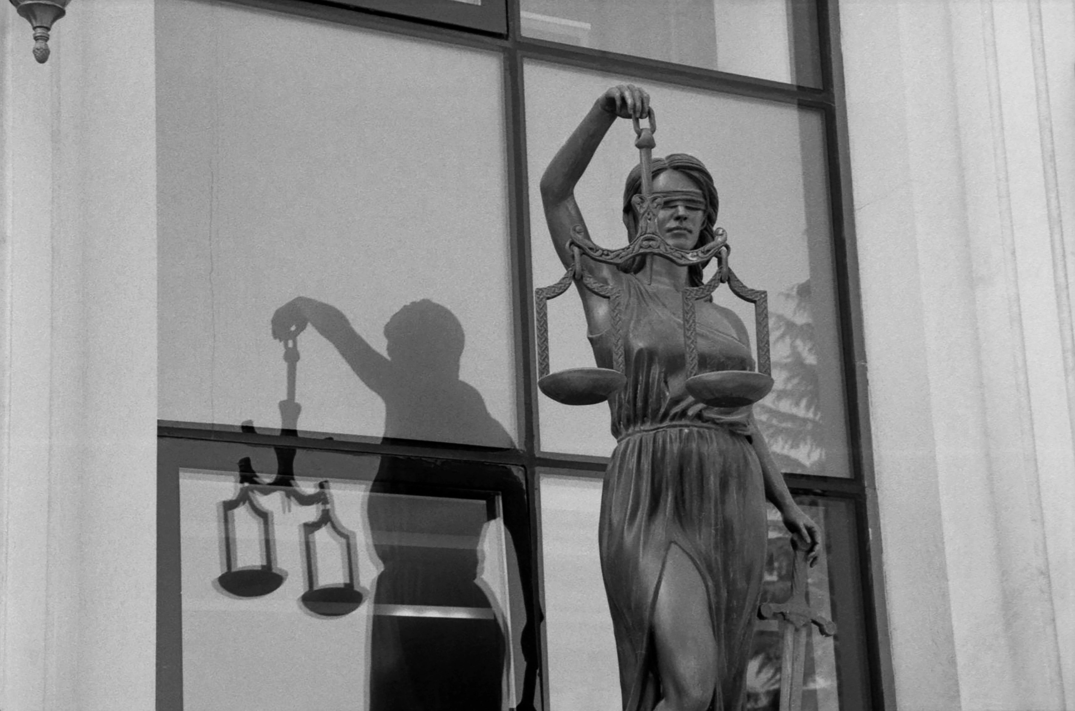
When a Supervised Individual Is Entitled to a Probable Cause Hearing
  In custody in the receiving state due to supervision violations or a sending state request
  Alleged violations could lead to revocation, and distance prevents adequate defense (witnesses/evidence)
  Reported as an absconder and apprehended on the sending state’s warrant

Slide 5

New
Convictions
Waivers
Supervised individuals can choose to waive their probable cause hearing if there is an admission to 1 or more violations that would result in the pursuance of revocation
If the supervised individual has a conviction for a new criminal offense, the judgement shall be deemed conclusive proof that the supervised individual may be retaken
Revocation
The course of action by a court, sentencing authority or paroling authority to rescind a supervised individual’s supervision term and impose a jail or prison sentence due to an act or pattern of behavior that could not be successfully addressed through documented corrective actions or graduated responses in the community

Slide 6


Supervised Individual Rights
  Hearing must occur in or near the place of the violation
  Receiving state must hold hearing within 30 calendar days (unless continuances are granted)
  Written notice of violations
  Evidence disclosure
  Opportunity to be heard, present evidence/witnesses
  Confront/cross-examine witnesses (unless safety risk)

Slide 7




Hearing Officer Requirements
The receiving state must send the hearing officer’s report within 10 business days of the hearing to the sending state.
Must include:
  Date/time/location of hearing
  Parties present
  Alleged violations
  Finding on EACH violation
  Summary of testimony & evidence
All evidence must be forwarded to sending state.
The hearing must be conducted by a neutral, independent person and held near the location and in a timely manner relative to the alleged violations.

Slide 8
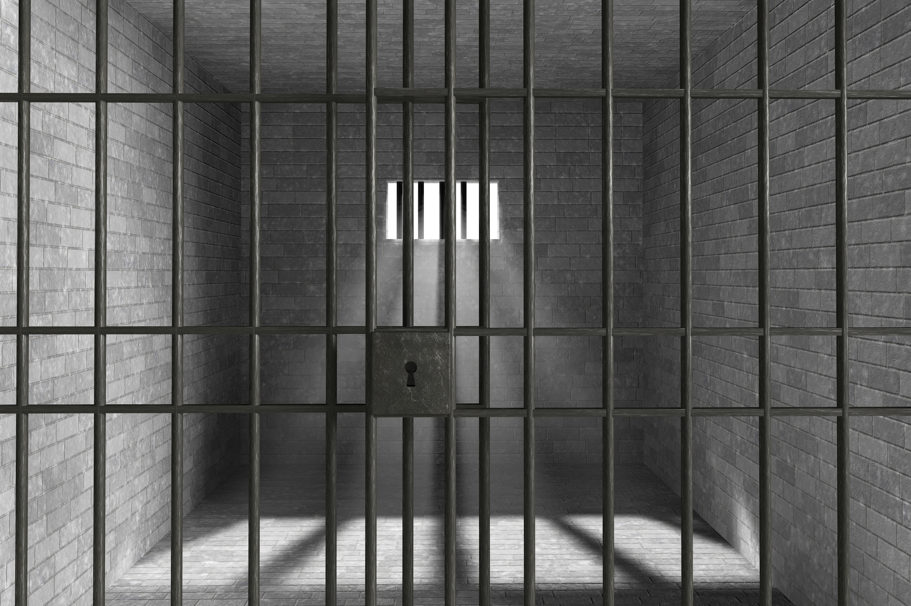
Probable Cause Established | Probable Cause NOT Established
Receiving state may hold in custody | Continue supervision if not in custody
Sending state will notify the receiving state on their decision to retake within 15 business days of receiving hearing officer’s report | Notify the sending state to vacate the warrant, and continue supervision upon release if in custody on sending state’s warrant
The supervised individual becomes available for retaking upon report being submitted to sending state | Vacate detainer/warrant by receiving state and release back to supervision within 24 hours of the hearing if in custody

Slide 9




What’s new for 2026
  30-day timeframe for conducting a Probable Cause Hearing once requested by the sending state (unless continuances are granted)
  Documentation of the alleged violations and the hearing officer’s finding on each violation will be included in the report sent to the sending state
  Timeframes for retaking will begin once the results of the Probable Cause Hearing are submitted to the sending state
  Absconders arrested in the receiving state must have probable cause established prior to retaking if they have been gone for more than 30 days or if states do not mutually agree to continue supervision

Slide 10




Why Amend the Rule?
  Protect Due Process: Prevent individuals from being held too long without a timely hearing.
  Ensure Timeliness: Establish a 30-day deadline so hearings occur promptly and consistently across states.
  Reduce Arbitrary Detention: Stop situations where people are held on warrants for months while waiting for a probable cause hearing.
  Promote Uniform Standards: Align practices across all states so transferred individuals receive the same protections.
  Improve Revocation Decisions: Require clearer findings and better reports so sending states have accurate information.
  Resolve Rule Conflicts: Clarify when an individual is available for retake to prevent confusion between rules and avoid premature transfers.

Slide 11
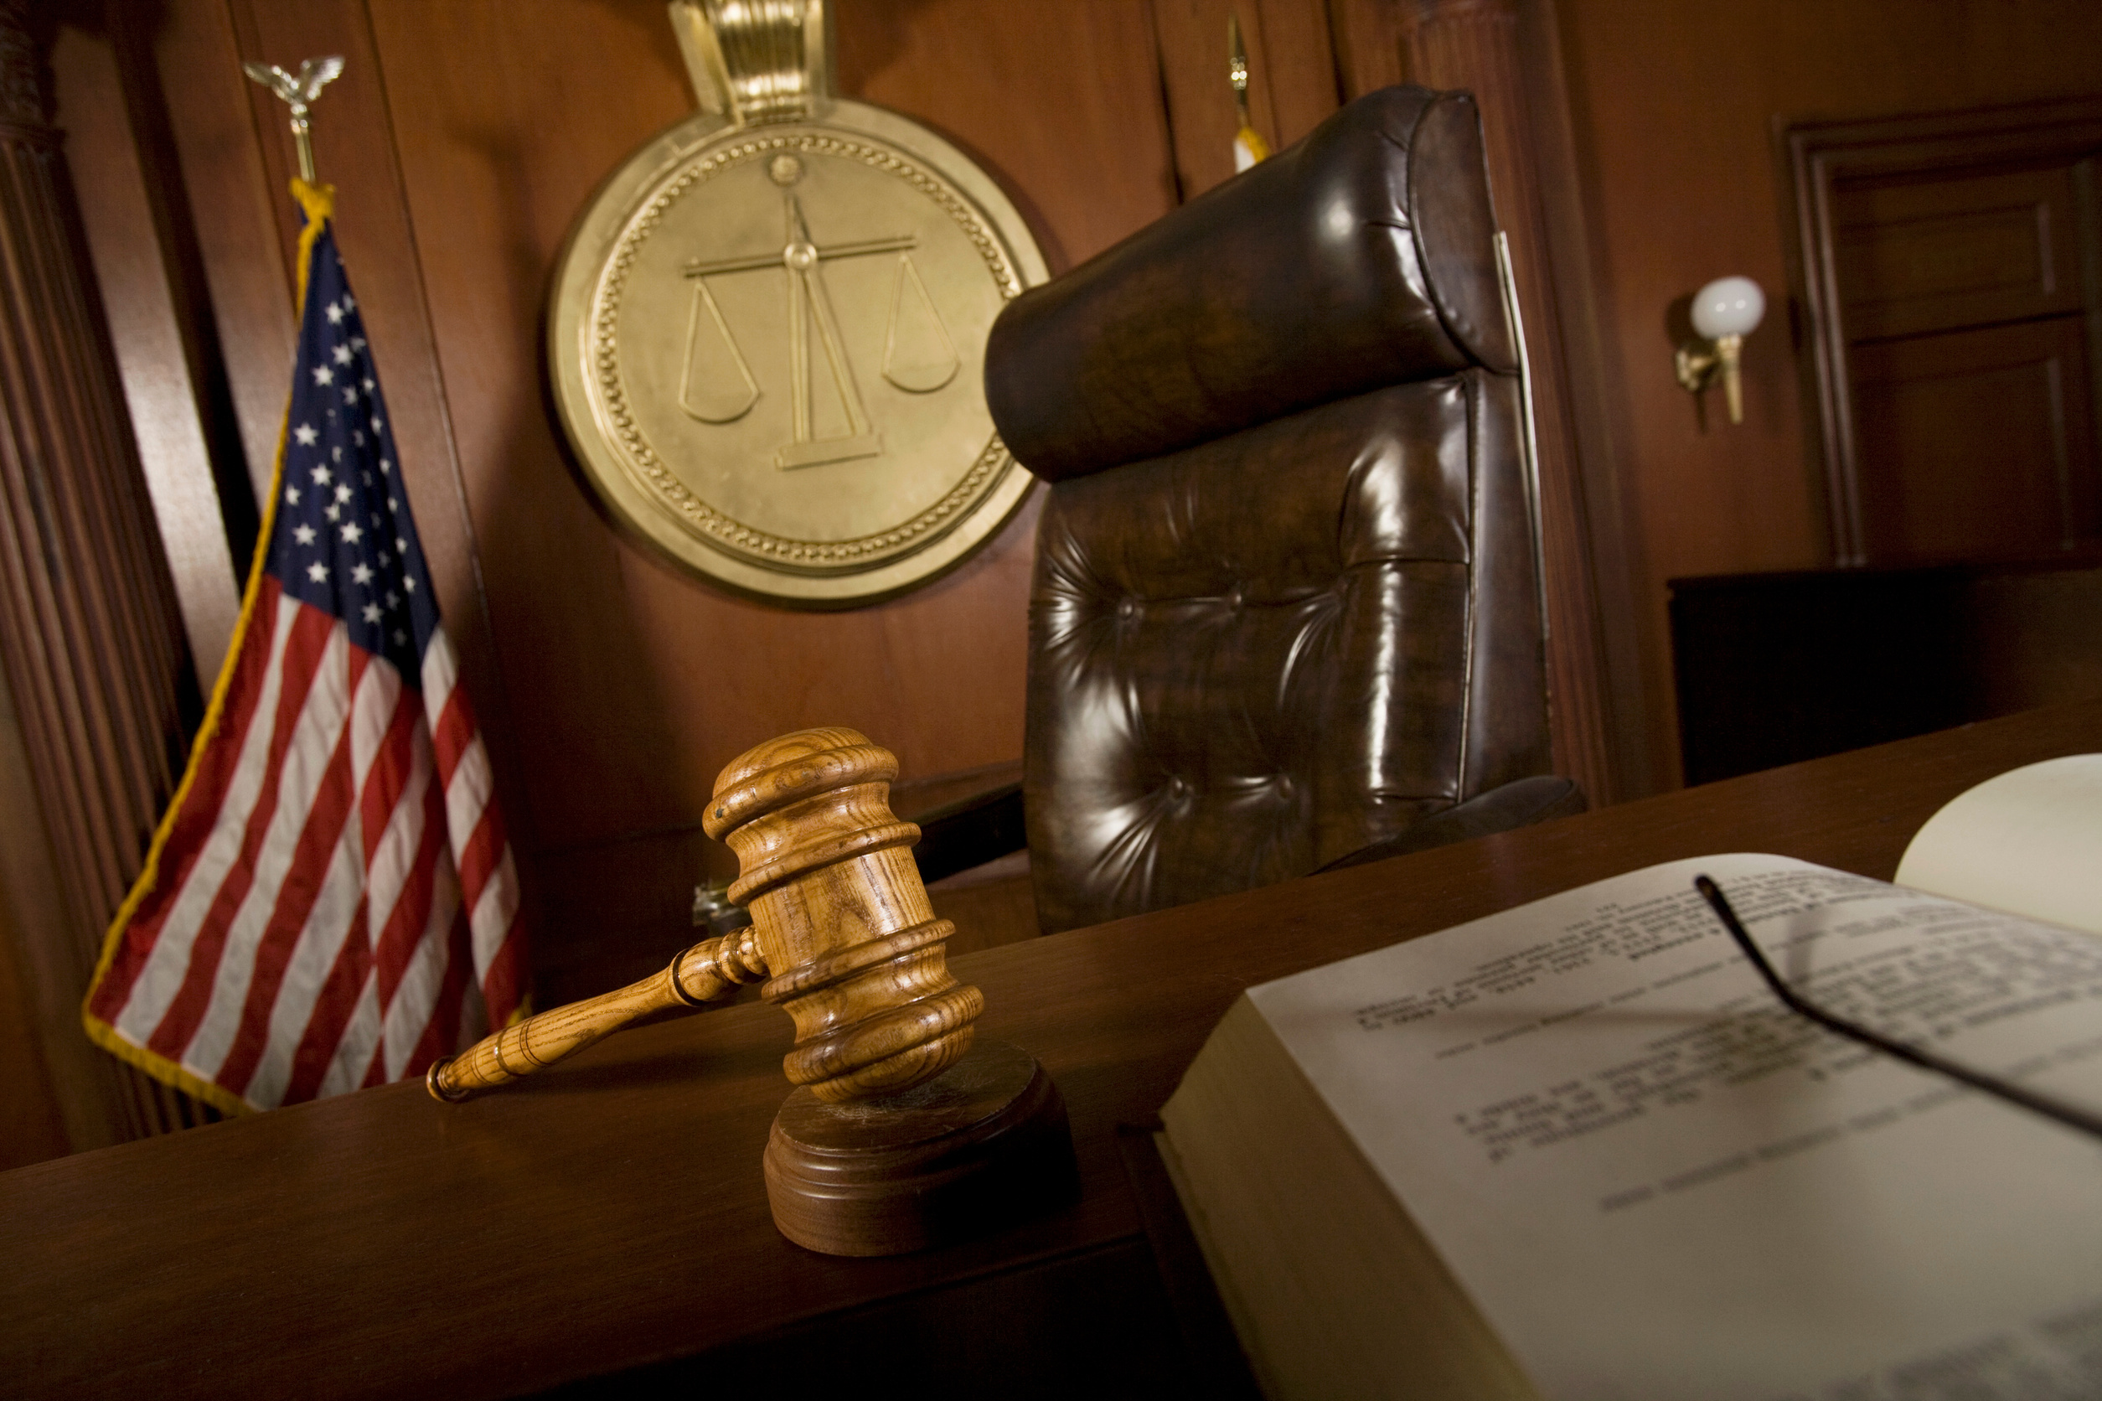
Impact on Stakeholders
Court Personnel and Hearing Officers
  Time constraints for hearings unless continuance are granted
  More thorough documentation on findings for all alleged violations
  Potential for increased Probable Cause Hearings due to requirements on absconders
Jail Personnel
  Availability for retake will not begin until after the results of the Probable Cause Hearing are submitted to the sending state
  The receiving state shall be responsible for the cost of detaining the supervised individual pending retaking by the sending state

Slide 12

Questions?

