Slide 1
Presented by:
Suzanne Brooks (OH), Tracy Hudrlik (MN),
Matt Billinger (KS), Natalie Latulippe (CT)
Moderator: Joselyn López (WI)
DCA Empowerment
Interstate Commission for Adult Offender Supervision
Notes:
Welcome & Introductions
Housekeeping: Attendees muted; Question & Answer period at end with Q & A posted after the training on ICAOS site. Interactions during session

Slide 2
Presentation Objectives
In this webinar you will learn about:
Role of Commission, Commissioner & DCA
Importance of communication to work out issues
Enforcing the Compact in your own state
Resources available to assist with difficult conversations

Slide 3
Compact Roles Explained
Notes:
Matt

Slide 4
Purpose of ICAOS
Protect the Rights of Victims
Promote Public Safety
Ensure Effective Supervision &
Rehabilitation
Control/Track Movement of Offenders
Notes:
Always important to highlight purposes of compact. No decisions or actions should be made that do not support these.
Promote Public Safety
Protect Victim’s rights
Ensure supervision techniques are consistent with instate offenders and in line with best practices of the supervising state; this includes same access to supervision, sanctions, and services
Through databases supported by each national office, we are tracking and controlling movement of offenders as they cross state lines

Slide 5
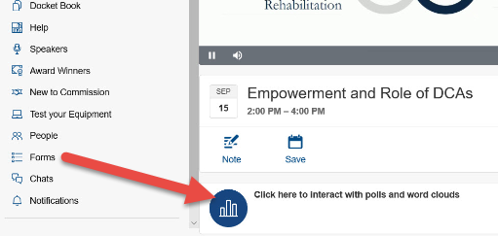
In 3 words describe the role of a Deputy Compact Administrator

Slide 6
Role of Commission, Commissioner & DCA
Commission
Commissioner
DCA
Promulgate rules & enforce compliance to achieve the purpose of the compact
Represent state in Commission
Ensure adequate resources, work w/ state officials to enact policy/legislation change
Manages day to day
Coordinates activities & act as resources for stakeholders
Ensure compliance
Communicate needs to Commissioner
Notes:
Commission made of up commissioners from all states functions through action of majority vote of commissioners. DCAs have an important role to move issues ‘up the chain’ when unable to resolve an issue or when the issue is one the commission itself should consider or take action on.
Today’s session is intended to illustrate the importance of each role and these processes
Providing an understanding of what the DCA and Commissioner role constitutes (need to tie in Commission itself to address how noncompliance, disputes are handled and require commissioner involvement; states simply can’t come on a training and say a state does this and this happens all the time without also illustrating what they’ve done to resolve the issue)

Slide 7
What is a DCA?
Manage
Resource
Cooperate
Ensure your state is compliant
Administrate ICOTS Users & Compact Office Staff
Manage Workflow
Establish procedures to ensure compact fits into supervision requirements
Act as resource and main point of contact for all stakeholders (supervising agencies, courts, jails, etc.
Keep Commissioner apprised of compact related issues & ask for assistance when needed
Communicate and work out issues with other states
Participate in trainings & discussions
Resolve conflict with internal stakeholders & other states
Notes:
Role of you, the DCA
Ensure that your state remains in compliance with day to day activities within the compact
Act as a resource to your supervision agencies, courts, jails, etc.
Manage the workflow of interstate compact activities
Acts as the main point of contact for interstate matters
Commissioner by statute is responsible for interstate matters, moving up the chain is necessary regardless how you feel your relationship is or your commissioners knowledge of compact

Slide 8
Commissioner Role
∙
Ensure Compact statute requirements are met: Attend meetings/vote, functioning state council, due are paid
∙
Ensure adequate resources for compact office: staffing levels, technology, training opportunities, policies & practices align with ICAOS rules
∙
Secure necessary relationships for optimal compact operations: stakeholders, informed on field operations, propose policy/legislative changes
∙
Resolve conflict unable to be resolved by DCA: internally, with other states, ask for assistance when necessary & file complaints
Notes:
Role of the Commissioner
Represent the state as a voting member in the commission
Ensure that the state council function in an effective manner
Ensure the compact office has adequate resources and staff
Ensure that organizations policies and practices align with ICAOS rules
Work with officials to change policy, propose legislation when necessary to best comply with compact requirements and/or to streamline compact with your state’s supervision policy’s and requirements
Assist DCA to ensure training needs are met with stakeholders
Step in when DCAs are unable to resolve conflict or issues internally and with other states.

Slide 9
Importance of Commissioner/DCA Relationship
DCA should:
Commissioner should:
Keep the commissioner informed of the workflow and compliance of the ICAOS operations.
Elevate non-compliance issues that cannot be resolved to the commissioner
Create communication opportunities
Relay problems/concerns to state council or agency leaders to reach resolution
Be mindful of the compliance of its state & ICAOS rules
Notes:
The importance of the Commissioner and DCA relationship
DCA…
… should keep the commissioner informed of the workflow and compliance of the ICAOS operations.
… should elevate non-compliance issues that cannot be resolved to the commissioner
The commissioner
…should create opportunities that allow for effective communications with the DCA
…relay problems or concerns to the state council or agency leaders to reach resolution
…should be mindful of the compliance of its state in the ICAOS rules

Slide 10
In 3 words or less, what is the top challenge of a Deputy Compact Administrator?

Slide 11
Interstate Compact Offices
Administers the Compact
Point of contact for case specific questions
Conducts training
Resolves issues with other states
Ensures rule compliance
Develops & recommends in-state ISC operating procedures to State Council
Interstate Compact Office
Notes:
Compact offices have an important role in ensuring compact success.

Slide 12
Resolve by Communication
Notes:
Tracy
Best practi
Objective: Encourage DCA to communicate and work together to resolve issues.
DCA’s answer poll question:
How often do you talk to your border state/biggest customer DCA’s?
More than I talk to my significant other, they are my other co-workers
They are on my top ten speed dial
I only communicate via email, no need to pick up the phone
Only when I have to- Ugh
Wait, who is the DCA in that state again?
Why do I have good communication or why don’t I have good communication? (participants to think about why they have positive or not so positive relationships with other states.)
Why Building that Relationship is SOOO important:
External-You are going to need each other- There isn’t a state out there that hasn’t made a mistake or needed another state to help them solve a problem and that relationship can go a LONG way in working it out. We are all in this together.
External=Provide an Example of working it out:
Obtaining PC for a state when violation report not submitted, both states worked through their perspective authorities, legal counsel and came up with a process through regular communication and brainstorming
Internal- Challenge internal thoughts/feelings- What do your staff feel/believe about a neighboring state? Do not fall into the “always” and “never” that agents/officers can sometimes feel. Every state is doing their best. If there are issues then we address them directly, not in general terms. Also Data doesn’t lie- look to dashboards to provide info to your staff:
“my state always takes discretionary cases.” -what does dashboard indicate?
“That state never takes discretionary cases.”- again, what does dashboard indicate and also what are reasons- are we providing enough detail/justification? Are your officers verifying plans? If a rejection disputes your state’s justification, the problem may be in your processes
Ways to Build that relationship
Learn how the other state operates:
What is their authority, the court’s authority, violation matrix, etc.
Example, some agents/officers can issue warrants, some only the court can, etc.
Ask questions- “Can you tell me how your state handles this…..”
Look at a situation from the other state’s perspective or the client perspective:
Example: receiving state indicates not a valid plan of supervision, sending state feels it is best option
Provide the whole story- documentation is key- we often learn a great deal more information when speaking to one another than what was relayed in ICOTS record-constant reminder to staff as well.
Always be open and honest, if your state messed up, own it and fix it and move on ☺ No pointing fingers
Communication Strategies
DCA Region Meetings
Can discuss issues in open forum-EX. COVID increased meetings
Keep neighboring states apprised of changes to law/policies in states
Opportunity to ask how other states are handling similar issues
Regions can agree on how to proceed
EX: Midwest region not returning/denying for change of address prior to removal from application form
Border Meetings
Is it possible to have a meeting between states?
Large meetings where agents can meet face to face and states can have open dialogue- processes and procedures, question/answer, scenario
Small meeting of leadership in a specific area-large city that crosses state lines for example
Even tri-state meetings if appropriate
Standing touchpoints
Are you in an area where there is constant contact- What about a weekly touchpoint with that state? Can review ongoing cases together –much like an internal staffing, but with your outstate partners.
Phone a Friend- ask another DCA (not the sending/receiving state DCA) how they would handle a case
Don’t have to name other State (just looking for another perspective)
Gives you an unbiased perspective/thoughts
At our next face to face ABM- seek new
Final poll question- Name one thing I can put into action to increase communication- (take aways)
ces for ‘working together’

Slide 13
As Deputy Compact Administrator for your state, how often do you talk to your border state(s)/biggest customer(s)?

Slide 14
Know Expectations
Work Together &
Stay Connected
Public Safety #1
Prevent absconders
Always provides good documentation & communication in ICOTS
Elevate when warranted
Notes:
Top sending and receiving states (active cases report)
Make sure the focus is on your state’s documentation when reviewing, not on another state. Challenge your own user before challenging the other state.
Every state operates differently so must ensure documentation is thorough and easily understood. Can’t expect another state to translate and when clear, there is less possibility something is misunderstood
Issues must be elevated.

Slide 15
Good Communication & Positive Relationships
Why do I have….
Why don’t I have….
Investigate and do not assume my state is in the right.
Good listener/responsive
Willingness to compromise
Ask questions
Understanding/recognizing the differences in supervision practices
Do not like confrontation
Inflexible
Unavailable/unresponsive
Notes:
Why do I have good communication or why don’t I have good communication? (participants to think about why they have positive or not so positive relationships with other states.)
Slide 14… I’m still thinking on this one. 😊 One of the struggles that we have had with other states is in reference to our EM/GPS policy so maybe “supervision practices” could be something on the negative side.

Slide 16
Importance of Positive Relationships
External
Internal
You are going to need each other
Challenge thoughts/feelings
Don’t fall into the ‘Always’ & ‘Never’ about other states
Understand Perspective
Always THINK Purpose of the Compact….
Data doesn’t lie-Invalid rejection: Are your officers verifying plans/providing sufficient detail? Are staff reviewing?
Notes:
Why Building that Relationship is SOOO important:
External-You are going to need each other- There isn’t a state out there that hasn’t made a mistake or needed another state to help them solve a problem and that relationship can go a LONG way in working it out. We are all in this together.
External-Although you may not agree, you should Understand perspective
External=Provide an Example of working it out:
Obtaining PC for a state when violation report not submitted, both states worked through their perspective authorities, legal counsel and came up with a process through regular communication and brainstorming
Internal- Challenge internal thoughts/feelings- What do your staff feel/believe about a neighboring state? Do not fall into the “always” and “never” that agents/officers can sometimes feel. Every state is doing their best. If there are issues then we address them directly, not in general terms. Also Data doesn’t lie- look to dashboards to provide info to your staff:
“my state always takes discretionary cases.” -what does dashboard indicate?
“That state never takes discretionary cases.”- again, what does dashboard indicate and also what are reasons- are we providing enough detail/justification? Are your officers verifying plans? If a rejection disputes your state’s justification, the problem may be in your processes

Slide 17
Relationship Building
1
2
3
4
Learn How Other States Operate
What is their authority, the court’s authority, violation matrix, etc.
Example, some agents/officers can issue warrants, some only the court can
Ask Questions!
“Can you tell me how your state handles this….”
Look at situation from other state’s perspective or offender’s perspective
Documentation
Provide whole story
ALWAYS review the offender profile
Suggest/Implement ways to be more clear
Open & Honest
Own it & fix it!
No finger pointing!
Notes:
Ways to Build that relationship
Learn how the other state operates:
What is their authority, the court’s authority, violation matrix, etc.
Example, some agents/officers can issue warrants, some only the court can, etc.
Ask questions- “Can you tell me how your state handles this…..”
Look at a situation from the other state’s perspective or the client perspective:
Example: receiving state indicates not a valid plan of supervision, sending state feels it is best option
Provide the whole story- documentation is key- we often learn a great deal more information when speaking to one another than what was relayed in ICOTS record-constant reminder to staff as well.
Always be open and honest, if your state messed up, own it and fix it and move on ☺ No pointing fingers

Slide 18
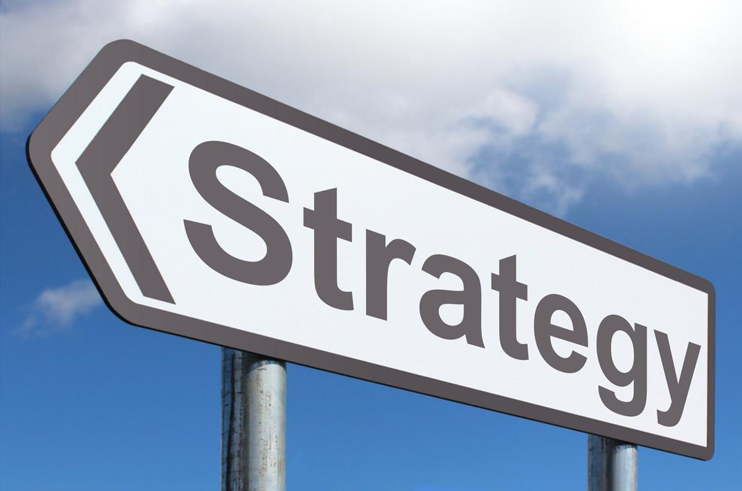
Communication Opportunities & Strategies
DCA Region Meeting
Border Meeting
Take Initiative
Apprise other states of law/policy changes
Poll on how states handle….
Consensus building
Meet face to face
Open Dialogue
Weekly Status to review ongoing cases/issues
Suggest improvements
Constant problem solving
Phone a Friend
Seek New DCAs
Get outside unbiased feedback and perspective
Next ABM meet all new DCAs
Notes:
Communication Strategies
DCA Region Meetings
Can discuss issues in open forum-EX. COVID increased meetings
Keep neighboring states apprised of changes to law/policies in states
Opportunity to ask how other states are handling similar issues
Regions can agree on how to proceed
EX: Midwest region not returning/denying for change of address prior to removal from application form
Regional DCA meetings
Highlight the importance of these meetings especially during COVID 19
Was beneficial to understand what states were experiencing in reference to transfers and extraditions and restrictions imposed
Provided an avenue for DCAs to discuss the overall status of COVID 19 in their states and how it was impacting field operations (i.e. Staff being restricted from field work)
Brought DCAs together to talk through how they could work together while adhering to state imposed restrictions while maintaining public safety and complying with compact rules and regulations
Allows DCA to get a better understanding of the challenges and successes within their regions
Creates opportunity for relationship building between DCAs that engage with one another on a regular basis
Empowers DCAs, in the absence of Commissioners, during regional meetings, to make decisions and strengthen communication
Border Meetings
Is it possible to have a meeting between states?
Large meetings where agents can meet face to face and states can have open dialogue- processes and procedures, question/answer, scenario
Small meeting of leadership in a specific area-large city that crosses state lines for example
Even tri-state meetings if appropriate
Standing touchpoints
Are you in an area where there is constant contact- What about a weekly touchpoint with that state? Can review ongoing cases together –much like an internal staffing, but with your outstate partners.
Phone a Friend- ask another DCA (not the sending/receiving state DCA) how they would handle a case
Don’t have to name other State (just looking for another perspective)
Gives you an unbiased perspective/thoughts
At our next face to face ABM- seek new

Slide 19
Name one thing my state can put into action to increase/improve communication with other states

Slide 20
Enforcing Compact
Notes:
Natalie
Keep your goal on point! Your responsible for YOUR STATE, not to control compact operations when other states ‘do it differently’ Best practices for ‘working together’ is coming up

Slide 21
In resolving issues/working with resistant stakeholders, has your knowledge of your state’s statute helped you?

Slide 22
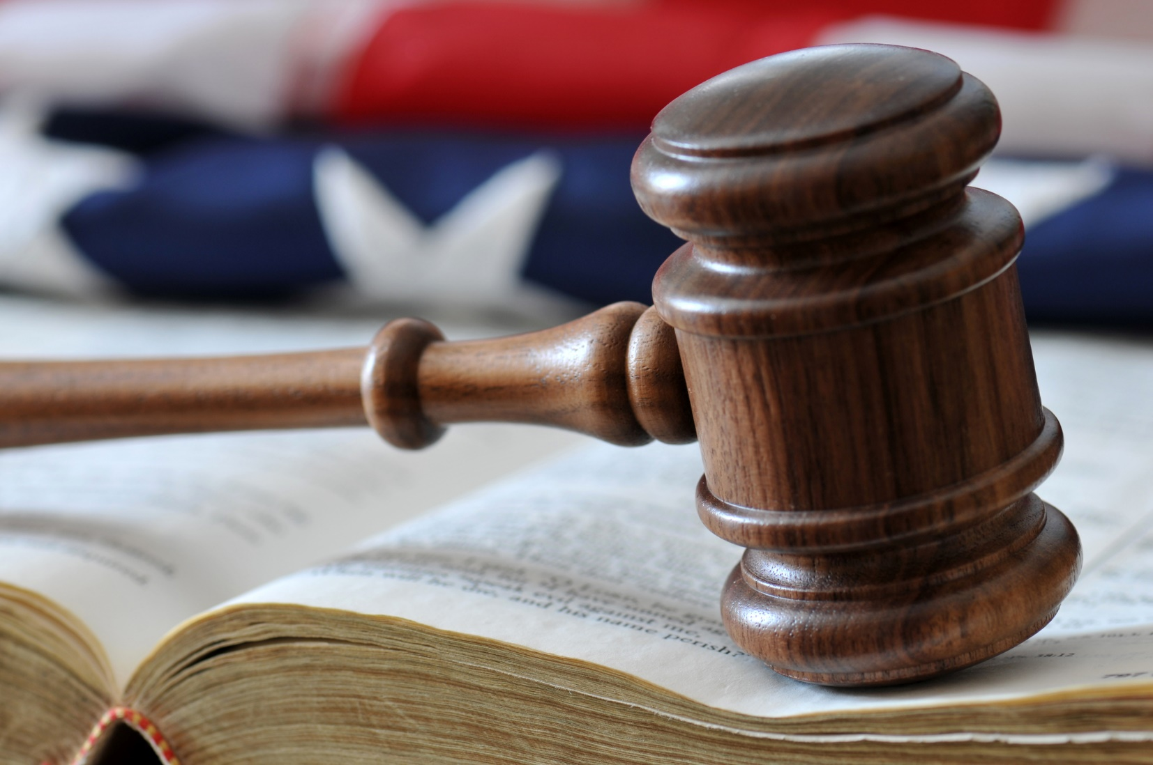
Interstate Compact Legislation
Courts, Parole Boards, Community Corrections & Other Executive Agencies:
Subject to the ICAOS Rules
Must enforce & effectuate the Compacts
Know your statute!!!
Notes:
It is a law in your state- know your statute

Slide 23
Statute Explained
1
Requires Rules to be Promulgated & Applied
Adhering to the Core Purpose of the Compact
Efficiently & Effectively
Outlines Commission’s Duties
Establish By-laws, Council, Policy, etc.
Reporting to State Officials
Monitor Compliance/Establish Measures
2
3
Defines Commissioner Appointment Process (which varies state to state)
Notes:
‘I can’t get stakeholders to do xyz’
1 speaks to if you are following the rules, but not in line with purposes of the compact, then it’s probably not the right way to do it. For example, if the rules require a warrant be issued ‘upon receipt’ for an absconder and your court takes 3 months, they aren’t adhering to the purposes of the compact or being efficient
2 speaks to the commission itself made of all the states. These elements are necessary to make the compact successful
3 speaks to the appointment process of why an individual is the commissioner for ICAOS over someone else. Or why the commissioner votes on rules rather than the DCA. States have the ability to manage this via their statute, for example, move commissioner to probation from parole.

Slide 24
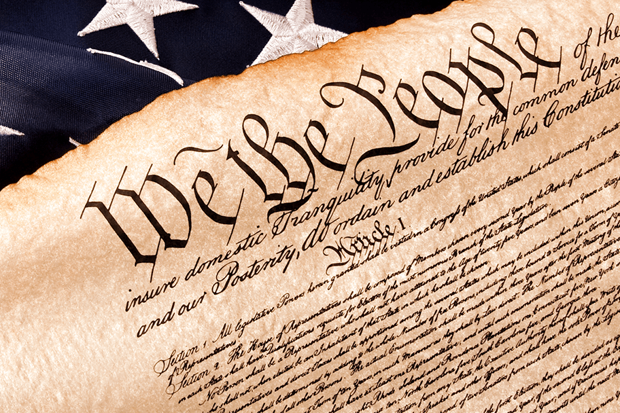
Authority of an Interstate Compact
Authorized
Binding
Supersedes
The Compact is authorized by US Constitution & Crime Control Act
The Compact is binding upon all state authorities & citizens
The Compact rules supersedes conflicting state law
Notes:
Basic legal slide that is important in this conversation.
Enforcing the Interstate Compact in your own state
The Interstate Compact Agreement in legal terms
Understand the authority of the interstate compact
Authorized, binding, and supersedes

Slide 25
Implications of Non-Compliance
It is incumbent upon prosecutors, judges and other state officials to understand the requirements of the Compact and its rules, as well as the consequences of non-compliance.
Failure of state judicial or executive branch officials to comply with the Compact and its rules results in the state defaulting on its obligations under the Compact and could lead the Commission to take corrective or punitive action, including suit in federal court for injunctive relief.
5
Notes:
Explaining the consequences is important for stakeholder resisting compliance with compact requirements

Slide 26
Know what needs Improvement
Review the Rules & Self-Assess
Know what rules pose challenges for your state and keep the conversation on it.
Take initiative/action
Notes:
Review the rules- what is working and what are areas for improvement in your state

Slide 27
Information & Communication are Key!
Educate your Commissioner
Provide info, updates
Identify issues
Develop a plan
Know what information is important and relevant to each stakeholder
Speak in terms they understand
Provide quick references to get buy in
Incorporate State Council members
Notes:
Information and communication are the key
Work with your Commissioner- does your Commissioner know IC? if not, provide info, updates, and identify issues- develop a plan
What information is important and relevant to each stakeholder
Speak and provide cheat sheets in terms they understand and get buy in
Incorporate State Council members

Slide 28
Effect Change in Your State
Think Outside the Box to implement:
Policies
Procedures
Strategies
Notes:
You have the knowledge and power to effect change in your state
Think outside of the box
Implement policies/strategies
Provide examples: Changed Commissioner from Parole to Probation, conduct our own retakings, developed IC hold process in CT DOC, improved state council meetings, walk warrants through court
Examples from other states?

Slide 29
Examples
Commissioner
Retaking
Warrants
Moved appointment from Parole to Probation
Streamline process/self conduct
Develop hold process
Walk through with court
Improve/develop tracking
State Council Meeting
Courts
Policy/Legislation
Collaborative agenda
Pre-Sentence processes
NE’s Supreme Court ruling on custodial sanctions & Parole’s response to client behavior policy
Notes:
Provide examples: Changed Commissioner from Parole to Probation (for most states this would require statute change, conduct our own retakings, developed IC hold process in CT DOC, improved state council meetings, walk warrants through court
Examples from other states?

Slide 30
Choose the top 3 areas your state can improve.

Slide 31
Resources to Assist
Notes:
Suzanne
Discussing the various resources that could be utilized to assist in having difficult conversations with stakeholders to help assure compliance
Regional DCA meetings
Highlight the importance of these meetings especially during COVID 19
Was beneficial to understand what states were experiencing in reference to transfers and extraditions and restrictions imposed
Provided an avenue for DCAs to discuss the overall status of COVID 19 in their states and how it was impacting field operations (i.e. Staff being restricted from field work)
Brought DCAs together to talk through how they could work together while adhering to state imposed restrictions while maintaining public safety and complying with compact rules and regulations
Allows DCA to get a better understanding of the challenges and successes within their regions
Creates opportunity for relationship building between DCAs that engage with one another on a regular basis
Empowers DCAs, in the absence of Commissioners, during regional meetings, to make decisions and strengthen communication
State Council
By statute, every Compact member state is required to establish a state council
Membership shall include at least one member of the judicial, legislative, and executive branch of government, as well as a victim representative, other community interest groups, and the compact administrator
Describe the benefits of having a diverse State Council
Ability to connect the compact office to various state organizations (Sheriffs, Prosecuting Attorneys/District Attorneys, Judiciary, Probation and Parole, Legislative, etc.)
Utilize as both an ally and an advocate within your state as well as at the commission level
Advocate for seeking resources, improving operations, resolving disputes, and conducting training
Provides the opportunity to receive feedback from various perspectives involved in the interstate compact process
Especially beneficial during rule making years
Discuss the importance of regularly scheduled meetings
Schedules will vary from state to state
Beneficial to meet regularly to keep council members engaged
Don’t focus solely on negative issues within your state
Utilize the opportunity to highlight positive topics (compliance, specific departments/officers that are doing exceptionally well, difficult cases that states were able to work together on)
Opportunity to discuss the work that states have done recently to work together due to COVID-19
They are there to assist you too. Ask how you can get on the agenda at their meetings, trainings, etc.
Dashboard reports
More than 35 dashboards are available covering activity due dates, compliance performance, administrative oversight, and compact activity history
Can be beneficial to show both the positives and negatives within your state when addressing external stakeholders/State Council members
Allows data to be exported to excel which allows you to sort information
For example- Can be beneficial if a certain officer/supervisor is struggling with adhering to specific timeframes which can assist the DCA in identifying a training need
Highlight the dashboard training that will be presented during the ABM
DCA Mentorship Program
To provide new DCAs information related to their duties and responsibilities or to assist a DCA with a specific goal as requested by their commissioner
Referral process
Request for formal mentoring of DCA by Commissioner (through DCA Liaison Committee)
New DCA requests mentoring
DCA Liaison Committee/Region Chairs will work with the participant and assign a DCA mentor
Mentorship will include:
Identify goals, issues, and interests of the participant
Review the role, expectations and responsibilities of the DCA on a regional and national level
Review the role, expectations and responsibilities of the Compact office
Review the role, expectations and responsibilities of their individual state compact office
Review ICAOS rules, advisory opinions and dispute resolution process
Review training opportunities and tools made available by the National Office
Review role of ICAOS committees, officers, region chairs, and National Office staff.
Encourage active participation in regional meetings
Provide a point of contact to consult with on difficult and/or unique cases
Act as an advisor on issues or questions
The mentor and participant will develop a schedule for meeting via phone/video through the year of their mentorship
This will provide an opportunity for the mentor to monitor the progress of the participant and provide continued guidance, feedback, and support
National Office
Utilizing National Office staff as a resource and ally
Can assist with navigating and interpreting dashboard reports
Can assist with training opportunities and training assistance within your state
Can assist in identifying problem areas and help states develop strategies and/or best practices to address deficiencies
Can assist with problem solving between states

Slide 32
Regional DCA Meetings
∙
COVID-19 highlighted importance:
Learned how restrictions impacted business in each state while keeping the focus on working together to maintain public safety
∙
Identify best practices:
In addition to learning each other’s challenges, share best practices
∙
Build relationships:
Learn from each other. Opens opportunity for ongoing engagement and relationship building
A lot was learned during COVID-19:
Learned how restrictions impacted business in each state while keeping the focus on working together to maintain public safety
∙
Empower each other:
In absence of Commissioners, DCAs can strengthen communication and discuss issues & decisions considered by the Commission
Notes:
Regional DCA meetings
Highlight the importance of these meetings especially during COVID 19
Was beneficial to understand what states were experiencing in reference to transfers and extraditions and restrictions imposed
Provided an avenue for DCAs to discuss the overall status of COVID 19 in their states and how it was impacting field operations (i.e. Staff being restricted from field work)
Brought DCAs together to talk through how they could work together while adhering to state imposed restrictions while maintaining public safety and complying with compact rules and regulations
Allows DCA to get a better understanding of the challenges and successes within their regions
Creates opportunity for relationship building between DCAs that engage with one another on a regular basis
Empowers DCAs, in the absence of Commissioners, during regional meetings, to make decisions and strengthen communication (give examples, Rule amendments, ICOTS enhancements, compliance,

Slide 33
Name 3 topics (one word each) you want DCA Region meetings to focus on in the upcoming year.

Slide 34
DCA Region Chairs

Slide 35
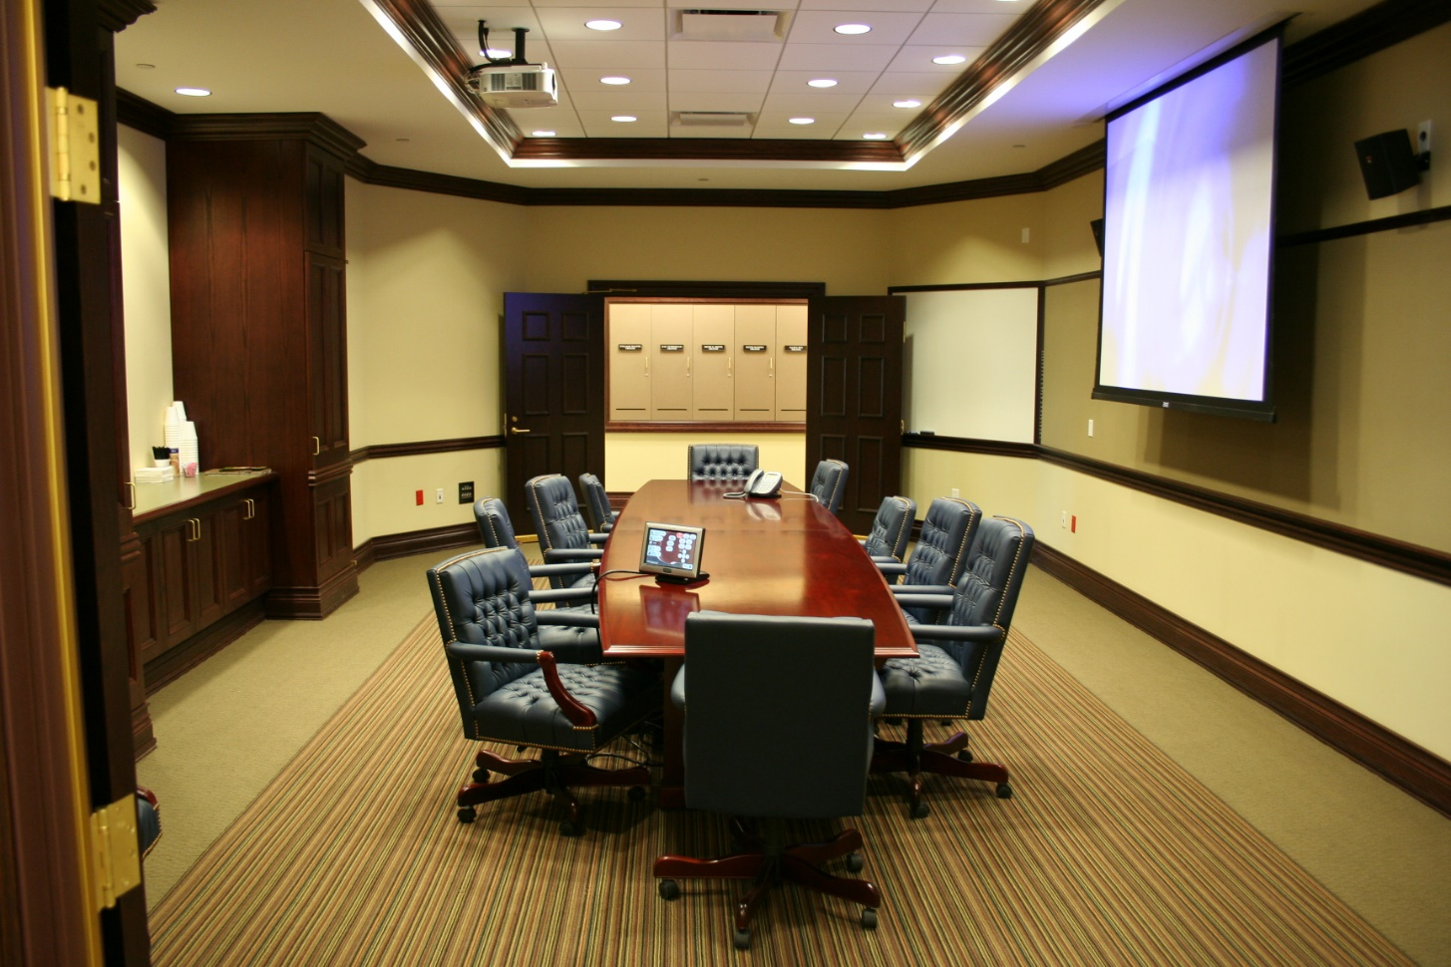
State Council
Diverse State Councils connect Interstate Compact with various state agencies:
Establishes allies & advocates for Interstate office
Provides opportunity for outside feedback & perspective
Regular meetings are key & should highlight positive topics over negative
Opens opportunity to provide training to stakeholders
Notes:
By statute, every Compact member state is required to establish a state council
Membership shall include at least one member of the judicial, legislative, and executive branch of government, as well as a victim representative, other community interest groups, and the compact administrator
Describe the benefits of having a diverse State Council
Ability to connect the compact office to various state organizations (Sheriffs, Prosecuting Attorneys/District Attorneys, Judiciary, Probation and Parole, Legislative, etc.)
Utilize as both an ally and an advocate within your state as well as at the commission level
Advocate for seeking resources, improving operations, resolving disputes, and conducting training
Provides the opportunity to receive feedback from various perspectives involved in the interstate compact process
Especially beneficial during rule making years
Discuss the importance of regularly scheduled meetings
Schedules will vary from state to state
Beneficial to meet regularly to keep council members engaged
Don’t focus solely on negative issues within your state
Utilize the opportunity to highlight positive topics (compliance, specific departments/officers that are doing exceptionally well, difficult cases that states were able to work together on)
Opportunity to discuss the work that states have done recently to work together due to COVID-19
They are there to assist you too. Ask how you can get on the agenda at their meetings, trainings, etc.

Slide 36
What topics were on your agenda at the last State Council meeting (not necessarily held in 2020)?

Slide 37
Did your state hold a state council meeting in 2020?

Slide 38
DCA Mentoring Program
1
2
3
4
Who Can Participate?
New DCAs
Any DCA referred by Commissioner for specific goal
Getting Started
DCA Liaison assesses needs and assigns mentor
Resources & worksheets on ICAOS support site
What is Learned?
Roles for DCA & Compact Office
Review Rules & legal publications
Roles of Commission
Point of Contact
Regular meetings
Consults with on difficult or unique cases
Advises on issues or questions
https://support.interstatecompact.org/hc/en-us/sections/207450728-ICAOS-Information-DCA-Mentoring-Program
Notes:
DCA Mentorship Program
To provide new DCAs information related to their duties and responsibilities or to assist a DCA with a specific goal as requested by their commissioner
Referral process
Request for formal mentoring of DCA by Commissioner (through DCA Liaison Committee)
New DCA requests mentoring
DCA Liaison Committee/Region Chairs will work with the participant and assign a DCA mentor
Mentorship will include:
Identify goals, issues, and interests of the participant
Review the role, expectations and responsibilities of the DCA on a regional and national level
Review the role, expectations and responsibilities of the Compact office
Review the role, expectations and responsibilities of their individual state compact office
Review ICAOS rules, advisory opinions and dispute resolution process
Review training opportunities and tools made available by the National Office
Review role of ICAOS committees, officers, region chairs, and National Office staff.
Encourage active participation in regional meetings
Provide a point of contact to consult with on difficult and/or unique cases
Act as an advisor on issues or questions
The mentor and participant will develop a schedule for meeting via phone/video through the year of their mentorship
This will provide an opportunity for the mentor to monitor the progress of the participant and provide continued guidance, feedback, and support

Slide 39
National Office Assistance
Technical
Training
Resource
ICOTS Support
Dashboards
Website & Directory
Communications
Compact Staff trainings
OnDemand trainings
TTA for stakeholders
PowerPoint templates
NEW Legal Training PPT!
Identifies problem areas
Strategy & best practice development
Problem solving
Publications
Notes:
National Office
Utilizing National Office staff as a resource and ally
Can assist with navigating and interpreting dashboard reports
Can assist with training opportunities and training assistance within your state
Can assist in identifying problem areas and help states develop strategies and/or best practices to address deficiencies
Can assist with problem solving between states
New Legal ppt for stakeholders

Slide 40
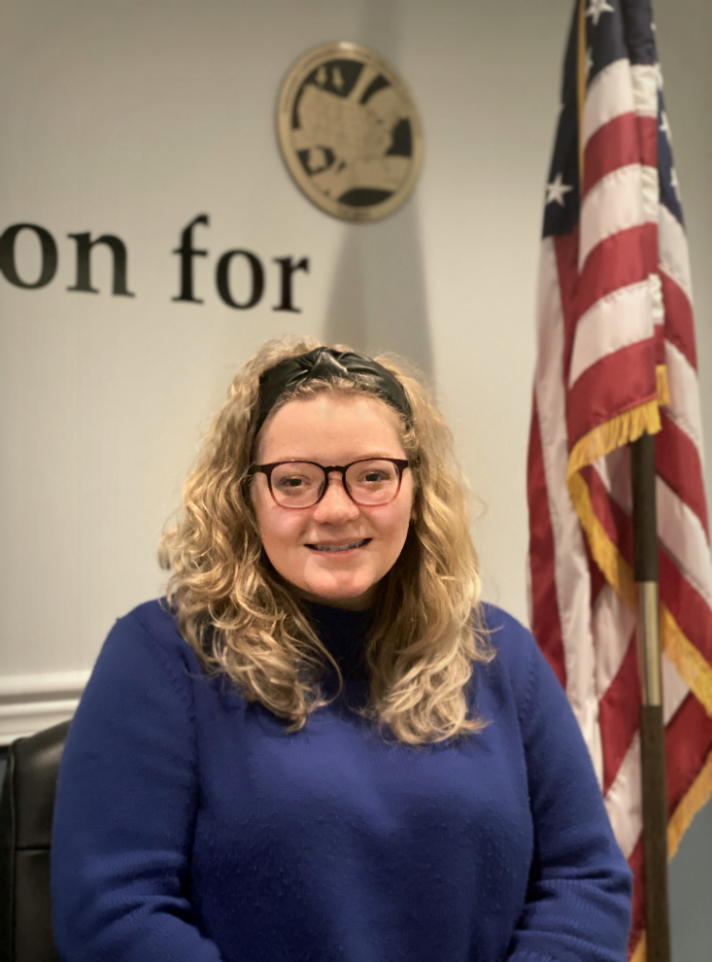
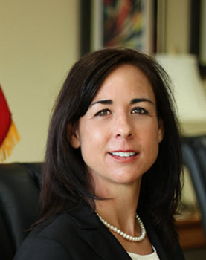
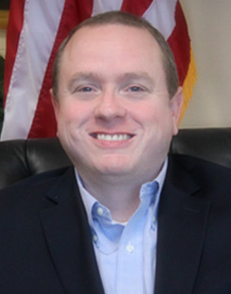
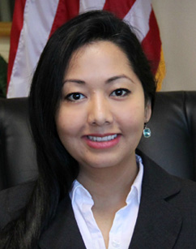
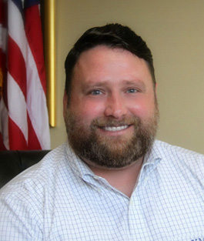
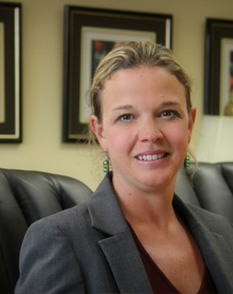
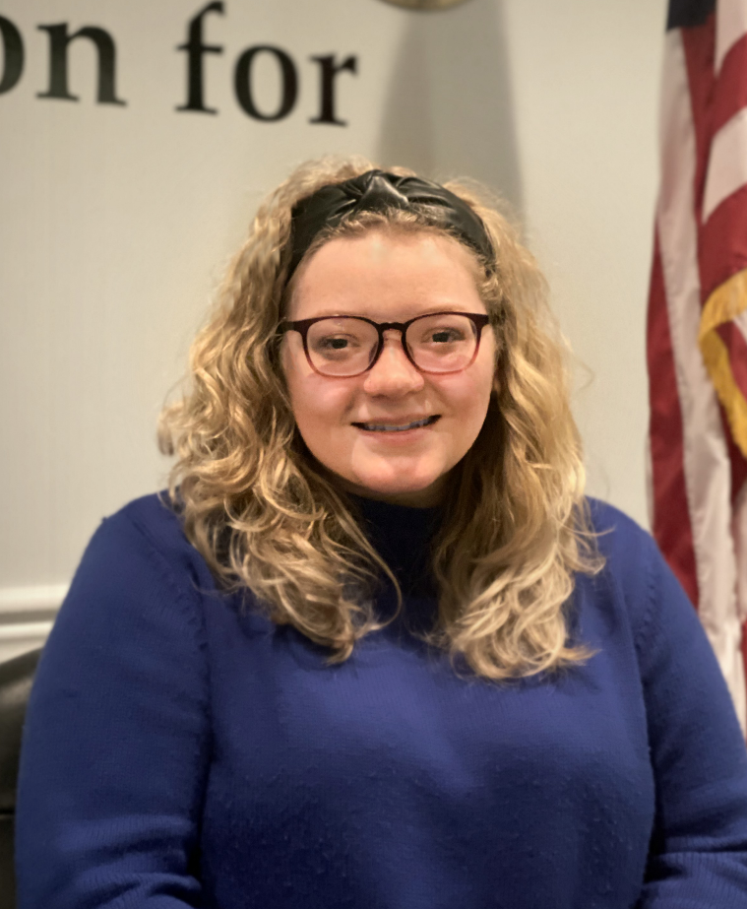
National Office Staff
We exist to support the Commission’s motivations, needs and expectations through innovation and education as the backbone and public face of the Commission. The National Office serves the Commission as a liaison by developing and providing resources for communication, organization and training. Our excellence, efficiency and professionalism benefit the Commission, victims, offenders, law enforcement agencies, and society as a whole.
Notes:
Ashley Lippert
Executive Director
Allen Eskridge
Policy and Operations Directo
Barno Saturday
Logistics and Administrative Coordinator
Xavier Donnelly
ICOTS Project Manager
Mindy Spring
Administrative and Training Coordinator
Kelsey Cole
Web Applications and Tech Support Manager

Slide 41
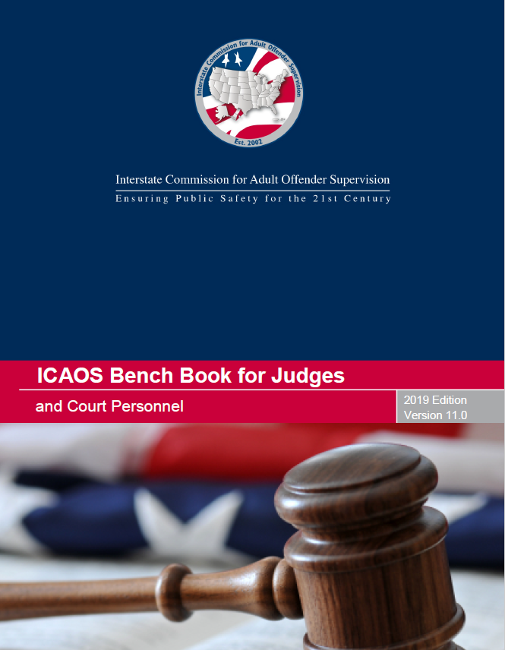
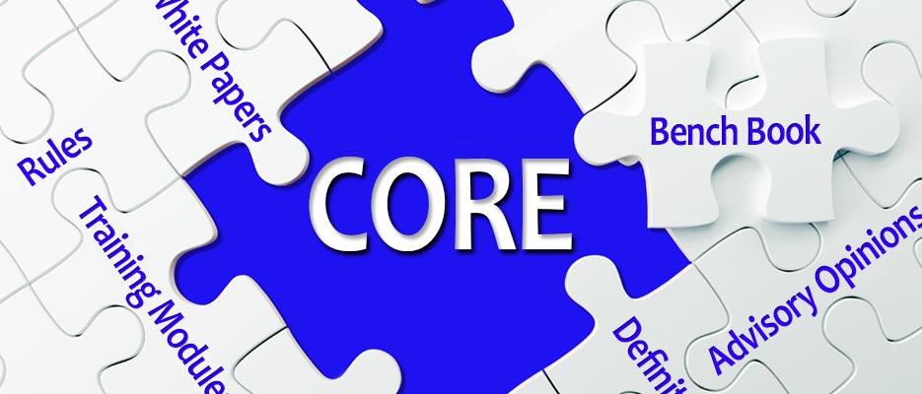
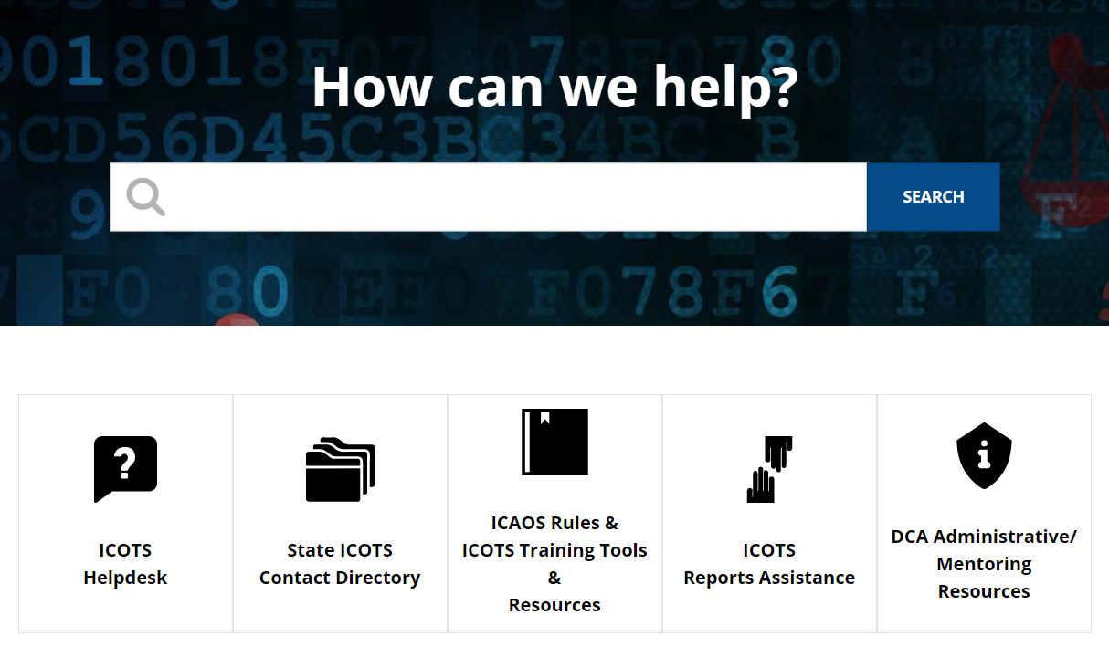
ICAOS Resources: www.interstatecompact.org
Compact Online Reference Encyclopedia
A cross-referenced guide on all ICAOS white papers, advisory opinions, training modules, rules. PC Hearing Officer Guide and the bench book.
Interstate Compact Offender Tracking System
The Commission’s national tracking system that administers the transfers for all compact offenders.
ICAOS Bench Book for Judges and Courts
The Commission’s judicial reference tool to assist judges and court personnel on the Compact.
Training Support
All of the Commission’s training material, resources and on-demand modules in one convenient location.
https://interstatecompact.org/core-search
https://interstatecompact.org/user/login?destination=/litmos-api
https://interstatecompact.org/user/login?destination=/zendesk-api
https://interstatecompact.org/bench-book
Notes:
Ashley: ICAOS has numerous resources for stakeholders involved in compact operations.
CORE,
ICAOS support site (training resources (including Ondemand), FAQ’s for ICOTS users, forums for state’s to share resources and dialogue)
ICOTS public webportal available to see a particular offender who may be transferred through the compact and contact info for each state
ICAOS Benchbook, comprehensive legal resource

Slide 42
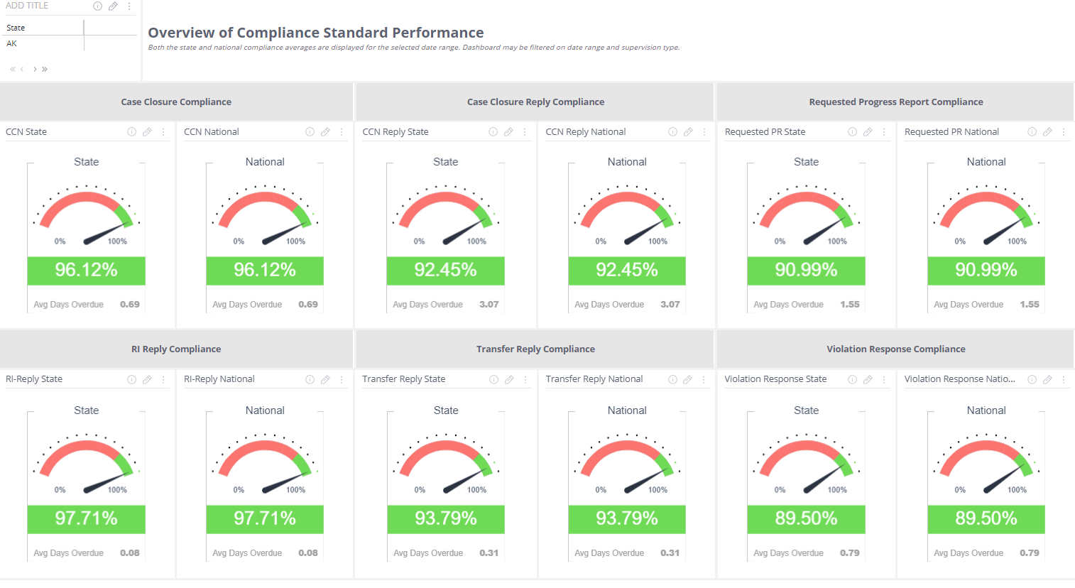
Dashboard Reports
More than 35 reports:
Due Date Management
Compliance Performance
ICOTS User Administration
Compact Activity History (stats)
Use to:
Report to Stakeholders
Analyze to identify problem areas/training needs
https://www.interstatecompact.org/icaos-dashboards
Notes:
Dashboard reports
More than 35 dashboards are available covering activity due dates, compliance performance, administrative oversight, and compact activity history
Can be beneficial to show both the positives and negatives within your state when addressing external stakeholders/State Council members
Allows data to be exported to excel which allows you to sort information
For example- Can be beneficial if a certain officer/supervisor is struggling with adhering to specific timeframes which can assist the DCA in identifying a training need
Highlight the dashboard training that will be presented during the ABM

Slide 43
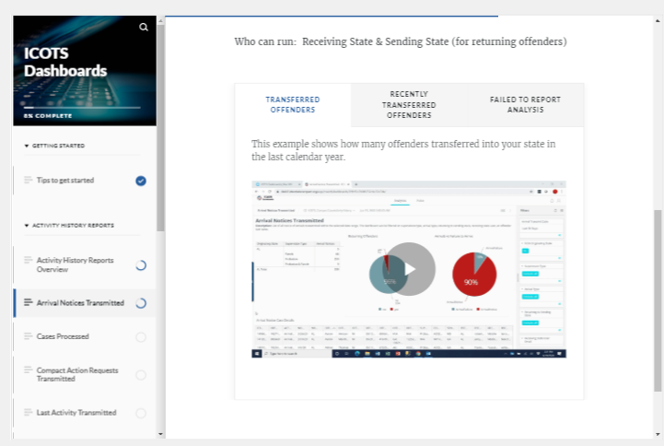
Dashboard Training
OnDemand training available to website users with access to Dashboards
Provides descriptions and demonstrations for various uses
More resources on support site
https://support.interstatecompact.org/hc/en-us/categories/203550447-Reports
Notes:
Access the training in the same place you log in to view dash
Boards
Commissioners DCAs automatically have access. Others in compact office can get access with request from Commissioner or DCA
Knowing basic database and spreadsheet (excel) knowledge is beneficial for navigating the reports.

Slide 44
What new skills do you plan to learn in the upcoming year to help you in your role?

Slide 45
Questions
Interstate Compacts for Adult Offender Supervision

Slide 46
Thank You
Interstate Compact for Adult Offender Supervision

