Slide 1

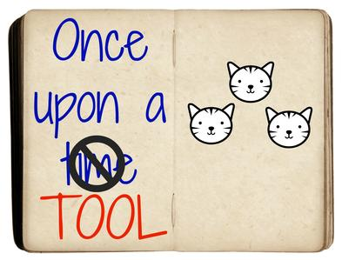

Who’s telling the story? Details, Accuracy and Due Process!

Slide 2
Summary of Topics
Latest Progress & Violation Report Stats
Identifying issues
  Training & DCA Calls
Supervision Documentation Overview
Compact Office Review-Ensuring Quality Documentation!
Addendum usage
Probable Cause

Slide 3
Progress Reports for a Purpose!
Notes:
Stack 2016-havecdecreased, but now quality and are being reviewed; work is reading quality, not volume
Update Sept. 1255 to date Have decreased, but quality is up

Slide 4
Violations Reported
(Comparison to CCN-marked reason-Retaken)
Notes:
Add Sept 2017 numbers; May 2017 still significant violations; bottom line

Slide 5
Training Issues Identified
Documentation
Implementation
Violation report requires retaking-MANDATORY
30 days of ‘determination’
Uniformity of documentation
Pending charges
Reporting jail time
PC, availability, location
  USE ADDENDUMS!
To be discussed in next session
Receiving state’s supervision responsibilities
Involving Stakeholders
Operationalizing the Rules
Goals, challenges and examples for resolution
Notes:
Training issues identified through last years’ training efforts and National office calls to DCAs

Slide 6
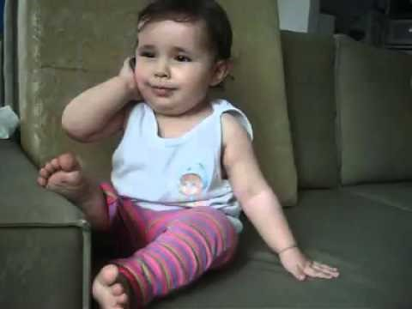
Congratulations! DCAs are the reason this is working!!!
Notes:
Don’t get frustrated…if something isn’t working out via ICOTS, PICK UP THE PHONE AND CALL THE OTHER STATE

Slide 7
Supervision Documentation
Progress Report
Violation Report REQUIRING RETAKING
Keeps the sending state informed of supervision practices; offender’s progress and behavior
Invokes requirement for sending state to retake offender
Communication!!!
Notes:
Two activities used to report offender compliance and non-compliance. The violation report to be used ONLY when requiring retaking due to DOCUMENTED

Slide 8
Considerations
Compact Office Review-It’s their job to ensure documentation is sufficient
How states address/respond to offender behavior varies across jurisdictions
  It’s about the details!
New pending charges?-Offender not REQUIRED to be retaken
  both states MAY agree due to public safety concern
Notes:
Pending charges, compact staff reviews but if something is questioned, your documentation is going to be what is investigated

Slide 9
What’s going on in the field?
Documentation disconnect when ICOTS user isn’t the supervising officer…
  Clerical staff
  Compact staff w/o field experience
  Before transmitting…Challenge your field DON’T wait to see if the other state challenges your office!
Notes:
States using clerical staff…do they understand your state’s supervision and how to apply them to compact
PA sent compact staff to field training, who else is getting familiar with the field?

Slide 10
Where’s the uniformity?
What’s Important
What’s NOT Important
Clear, concise, accurate..
Relevant attachments are included
YOUR Compact Office sets standards for YOUR field users
Questions/need clarification? ASK!
Format/placement
Where exactly the attachments are
Imposing your documentation standards on another state
What the ‘other’ state NEVER does….
No room for pettiness in compact business
Got an issue with what another state is doing/not doing??
Move up the chain of command!!
Notes:
Compact offices control what goes out of THEIR state….promote quality. Excuses from staff of this state does this and this state does that is not what the compact’s business is all about. If there’s a state that is truly deficient and continuously causing a headache, move it up the chain of command. Most DCAs will address issues with their staff to promote good business, if their not, Commissioners should be…As Jim Ingle would say, DCAs are really in the conflict resolution business.

Slide 11
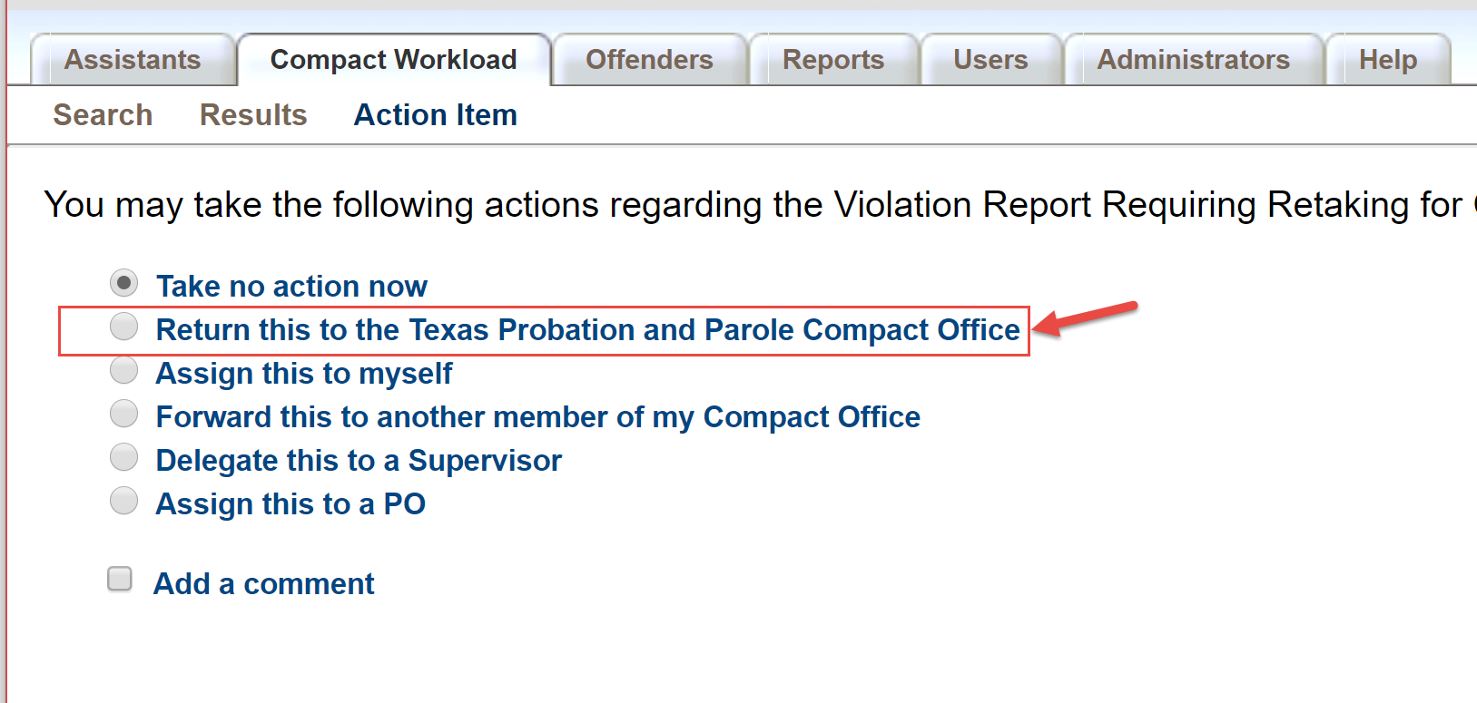
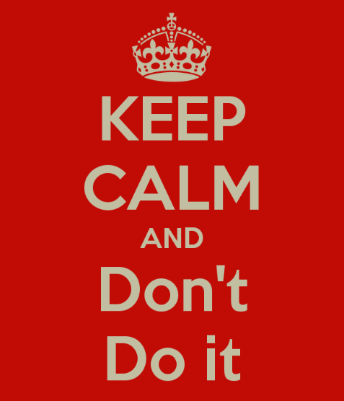
‘Send Back’ is Bad for Business!
NOT to be used to challenge
DOES NOT remove obligation to respond
but DOES remove your ability to respond
IS NOT a time saver
Causes CONFUSION/unnecessary workflow

Slide 12

Need Clarification?
Use the TOOLS!!
Addendums
  Minor clarifications
  Clerical error that can be addressed quickly
Withdraw
  Substantial issues
  Transmitted in error
Notes:
For TREQ’s and other activities, use CARs associated with activities

Slide 13
Behavior Requiring Retaking
“behavior would rise to level of revocation because…”
Non-Compliant Behavior
RECEIVING STATE would request revocation
RETAKING
DOCUMENTED
Unsuccessful Supervision
Non-Compliant Behavior
Sanctions would be applied to address behavior
Address behavior/Provide documentation via Progress Report
Rule 1.101 Behavior Requiring Retaking definition
Notes:
Be sure to distinguish reporting to the court and revocation. If there are avenues available to address the non-compliant behavior, violation report is not appropriate.

Slide 14

Options to address behavior have been EXHAUSTED!
Court/Parole Board in your jurisdiction actually revokes for similar behavior
RECEIVING STATE would request revocation
Revocation is NOT simply reporting a condition violation to the court
Revocation is likely
Revocation: Sentencing authority terminates supervised release and incarcerates the offender
Ensure your state’s definition of revocation is NOT really a sanction..
Notes:
Clarification slide for determining whether you WOULD request revocation in your state. Is this behavior requiring retaking. Every state fits in bubbles

Slide 15
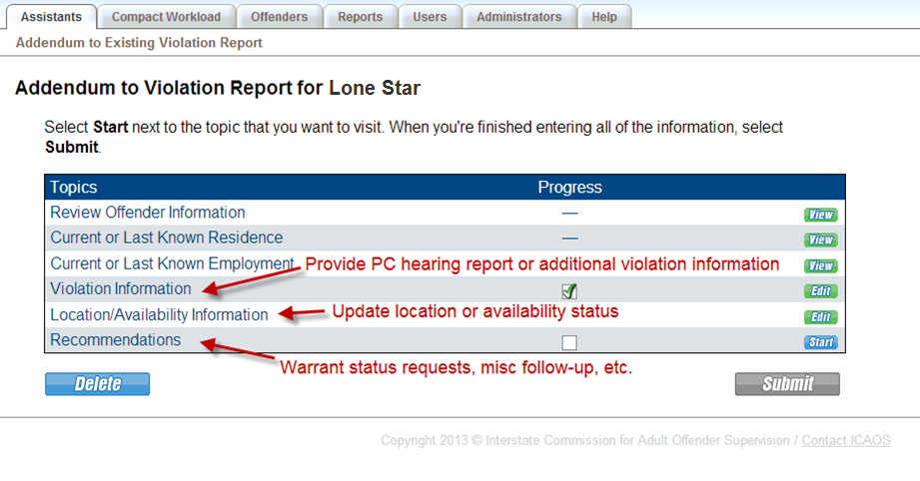
ICOTS Addendums…USE THEM!
PC, Location and Availability data relies on ACCURACY and ADDENDUM usage
Potential new ad hoc reports on hold ☹
Notes:
In developing new reports thousands of cases are not marked correctly….may need clean up effort and come back to these reports for publishing.

Slide 16
Probable Cause….
It’s a conversation we will continue to have….
Data is showing PC established on ONLY 12.5% of BRR since June 1st
  Of those 69% waivers; 31% hearings
Receiving states should EXPECT to conduct/offer a PC hearing in conjunction with Rule 5.108 prior to retake by the sending state
Sending state should ENSURE a PC is established prior to retaking if there is possibility of revocation of supervision for violations committed in receiving state
Notes:
Because currently data is not accurate, are states having issues with this?

Slide 17
Questions

Slide 19
Scenario

Slide 20
New Pending Charges….
FAQ #1: In my state, a new arrest of this nature would result in a request for revocation of supervision if an instate offender who would be held in custody pending outcome of the new charges. Shouldn’t these arrests be submitted on an offender violation report requiring retaking and simply marked ‘not available’ for retaking?
Notes:
Not necessarily and most of the time no. Remember the definition of ‘behavior requiring retaking’ is just a part of the decision whether a violation report should be used or whether a progress report should be used. Several considerations should be made.
For instate cases, is revocation also likely while charges are pending? Recommendation for revocation is simply not the supervising officer’s recommendation nor is it ‘reporting a violation to the court.’ When questionable (pending charges or any violating behavior,) compact staff should ensure they have a good understanding of the supervision practices and revocation procedures in that jurisdiction.
For instate cases, what other agencies are involved in getting to that decision of revocation? For instance, if courts or parole boards make decisions to sanction versus revoke, the sanctioning process (not just new pending charges, but any violating behavior) should be extended to include those agencies first. Once the determination is made that efforts have been exhausted, a violation report may be considered.
Is your state’s definition for ‘revocation’ a true permanent termination of supervised release? If instate offenders are going back into incarceration and released to the same terms after a pre-set amount of time, that may really be a sanction, not revocation as termed by the compact.
With the compact case, is there a current public safety concern? Remember submission of a violation report requiring retaking is requesting action (request of a warrant) by the sending state. Until the receiving state is asking for ‘action’ to be taken by the sending state, non-compliant behavior or new arrests should be reported on the progress report. It hasn’t been ‘determined’ to be ‘behavior requiring retaking.’ Otherwise, the receiving state still has the option to ask the sending state to ‘mutually agree to retake’ while the charges are pending under Rule 5.101-1.

Slide 21
New Pending Charges….
FAQ #2: If I don’t report the new arrest when it happens, how can my state be assured the offender will be retaken once ‘available?’ It will be passed the 30 days of when it was ‘discovered’ the new arrest occurred.
Notes:
Rule 4.109 states a violation report should be submitted when it is ‘discovered’ OR ‘determined’ the offender has engaged in behavior requiring retaking. In most cases and since in instances where new felony or violent crime charges exist, the offender is ‘not available,’ it is typically pre-mature to officially ‘determine’ the new arrest to truly be ‘behavior requiring retaking’ at this stage.
Until your state is expecting or request sending state action (request of a warrant,) these violations should be reported using a progress report
Most sending states and in most instances (unless charged with a serious violent crime) are not going to be able to address a new charge in a receiving state until the offender is afforded his or her due process and those charges are disposed of. Consider what is trying to be accomplished. If it truly is a clear public safety issue where action for the new charge is needed or requested by sending state, that needs to be clearly articulated in the violation report and advocated by the receiving state’s DCA and/or Commissioner.

Slide 22
New Pending Charges….
FAQ #3: For instate offenders charged with a new felony offense, our sentencing courts issue a warrant for violation of probation and hold the offender pending the new charges. When a compact offender is charged with a new felony offense in our state, that offender is typically afforded bail (even if a clear risk to public safety.) Since in our state there is no authority for an arrest w/o a warrant and we are unable to have one issued (our courts refuse to get involved in out of state matters,) is the sending state liable or is our state (as the supervising state?)
Notes:
ICAOS has no compliance matters as of yet for such a case, but this situation (which is common in several states) lends itself to the fact the receiving state is truly NOT supervising like they would their own. Receiving states are responsible for responding to behavior and new felony or violent crime charges BEFORE asking for action by the sending state.
This situation comes into play too for ‘zero tolerance’ violations where according to sanctioning guidelines of the receiving state requires the ‘sentencing court’ to make decisions on sanction/treatment v revoke. Examples: alcohol use, behavior mod, meth usage/new offense, sex offenders.
This discussion to continue this afternoon when we talk about stakeholder involvement as agencies making supervision decisions outside of revoke and sentence term, must be part of this process!

Slide 23
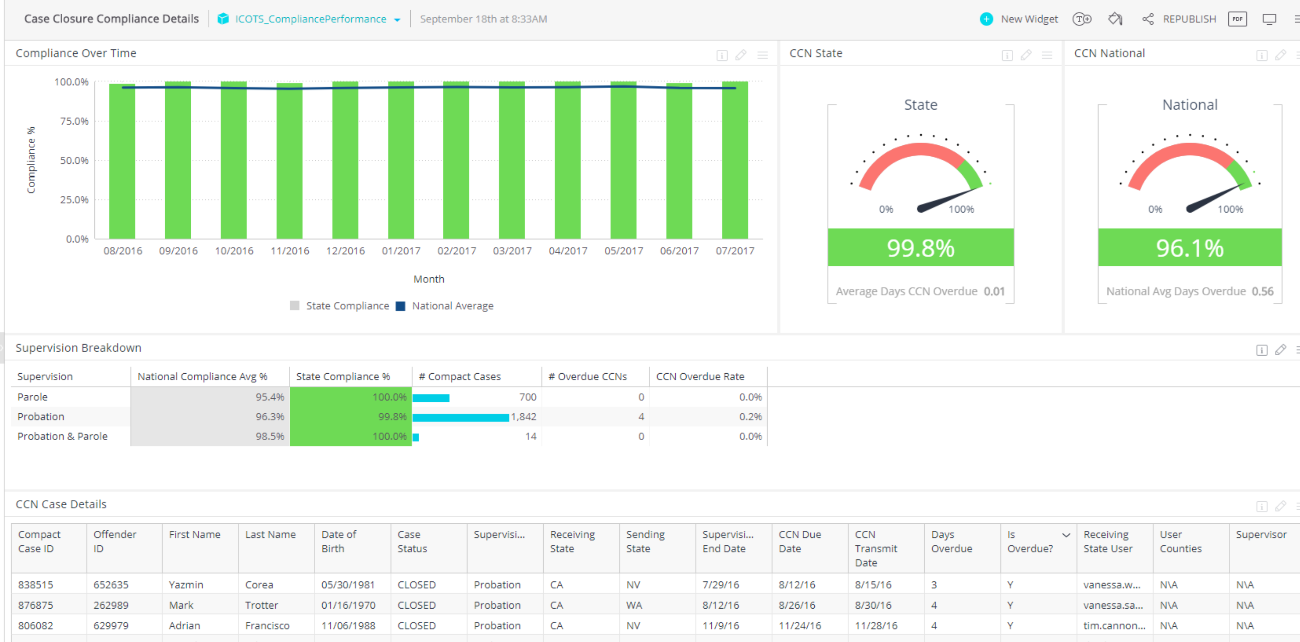
New Reports Coming Soon!
New Platform for Dashboard
New Management & Activity Reports
Notes:
Returning Offenders
Rejected Transfers
Violation Data Clean up Effort

Slide 24
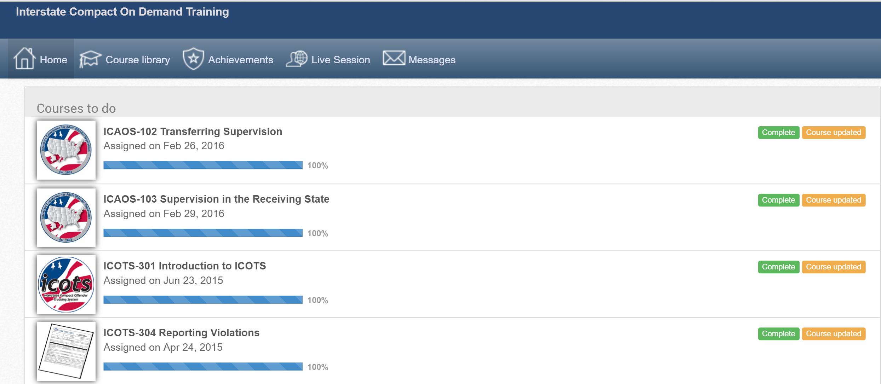
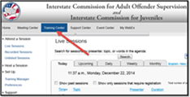
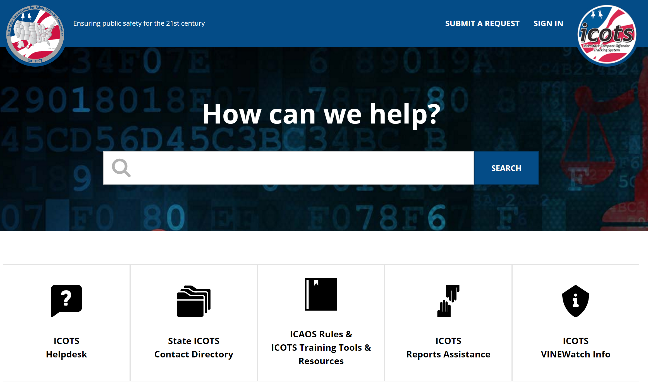
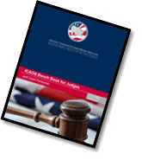

ICAOS Resources
Notes:
Note there is a module for parole board members, courts, and officers, PC hearings, etc. on ICAOS website among others

Slide 25
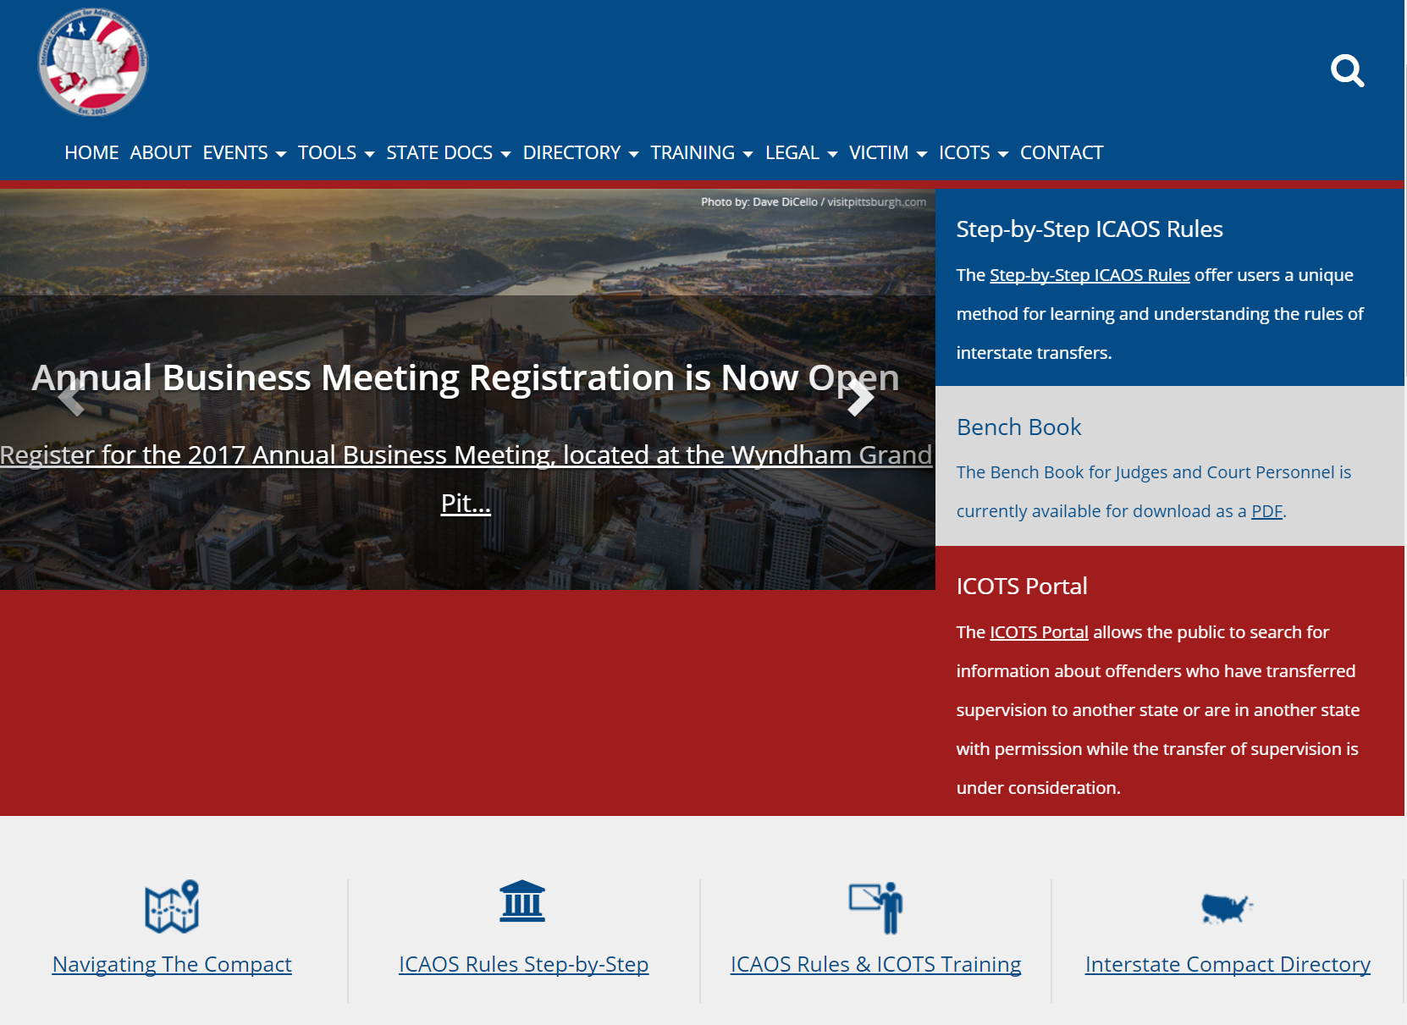
www.interstatecompact.org
REDESIGNED
WEBSITE!

Slide 26
FY 2018 Photo Audit
FY2017 PHOTO REVIEW assisted Tech Committee to establish photo standards
  In addition states were provided data on core demographics entered on ICOTS Profiles
New photo standards adopted April 2017
FY2018 Audit will review photos on records created July 1, 2017- December 31, 2017 for most states (those with more than 5% deemed ‘bad’ in FY2017 review
Notes:
FY2017, not an audit
If your state didn’t get a letter, you are not subject to review.

