Slide 1
Discretionary Assessment
Notes:
In FY2015, the states processed 10,496 discretionary transfers. The national acceptance rate for discretionary transfers is 57% (6,032). Included in the accepted cases are 745 cases (7%) which were initially rejected and the sending state resubmitted resulting in a subsequent acceptance. The national number of rejected cases was 4,464 (43%).

Slide 2
Reasons for Rejection
Discretionary Transfers FY2015

Slide 3
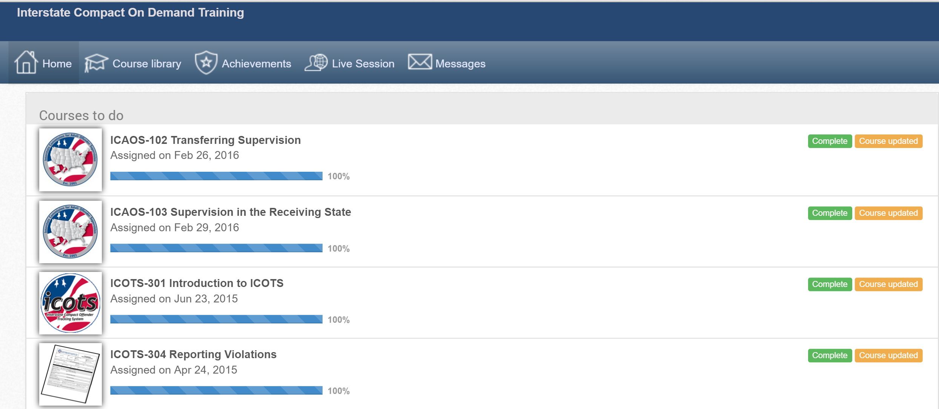
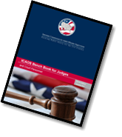
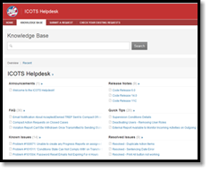
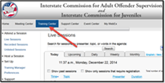
Resources
Notes:
Mindy

Slide 4
Questions

