Slide 1
2016 ICAOS
DCA Training Institute
Notes:
Anne & Tracy introduce training and trainers
Joe Beaman
Judy Mesick
Jim Ingle

Slide 2
ICAOS Compact Office Roles & Responsibilities
2016 DCA Training Institute
Notes:
Anne & Tracy introduce training and trainers
Joe Beaman
Judy Mesick
Jim Ingle

Slide 3
Training Objectives
Training Stakeholders
Applying the Rules w/Purpose of the Compact
Ensuring Quality Information
Best Practices/Shared Documents
DCA Mentoring Program
Resources

Slide 4
Stakeholders
Notes:
Educating on changes….can’t say can’t….make it happen

Slide 5
Work the Rules, Don’t Let the Rules Work You!!
Operationalize the rules when training stakeholders
Compact offices have a duty to communicate & cooperate with other state compact offices while supporting the field
Reinforce purpose and goals of the compact as well as the authority of the compact office
What’s best for public safety?
What’s best for the offender?
Notes:
Tangible examples---rules don’t provide direction…best thing to do…what makes sense
Presenters to give some examples…
Operationalizing the rules, getting back to what makes sense for public safety, offender rehabilitation, protecting our victims. The rules are not meant to cover each scenario so DCAs roles are so important in working out those tough issues with officers or other agencies to make sure the purposes of the compact are considered. Compact offices have to go above providing a copy of the ICAOS rules, but rather making sure stakeholders understand the rules and their specific obligations when dealing with interstate compact
Demonstrate how the rules fit into the purposes of the compact. Everyone’s number one goal in the compact office is to make sure the best interest of the offender and pubic safety are considered in every decision made at the compact office.

Slide 6
Purpose of ICAOS
Promote Public Safety
Communication & Cooperation
Protect the Rights of Victims
Effective Supervision/Rehabilitation
Control Movement of Offenders
Provide for Effective Tracking

Slide 7
Use the Rules as Your Guide
Rules are a framework….
Do not cover specific scenarios
Even Advisory Opinions are for specific cases
Statute language
The Interstate Commission…will promulgate rules to achieve the purpose of this compact
Notes:
If every single situation and every states’ supervision processes were considered, the rules would be never ending and no one would understand them. mandatory rules cover those common situations and for those discretionary decisions, the compact offices should emphasize increased communication and cooperation.
The statute quote which is included in most if not all of the compact states that it is the duty of the Commission to promulgate rules to achieve the purpose of this compact. Again, emphasizing the rules need to not only be written, but also applied with the purposes in mind.

Slide 8
Obligation to Review Activities
DO
DON’T
Review Outgoing & Incoming activities
READ through the entire activity
Ensure ‘quality’ ICOTS activities are going out of your state
Ask for more information
Communicate with other states using the ‘send back’
Use the rules against getting the offender where they need to be
Assume a state is ‘using a rule loophole’
Remember circumventing or using a rule against the purposes imposes liability just as failure to comply with a rule
Notes:
This is highlighting the compact offices responsibility to review and cooperate
ICOTS is designed to allow for variation of how information is uploaded into the system. Therefore, not every transfer request or violation report is going to look like a transfer request or violation report your state sends out.
It’s ok to ask for more information and know it’s the responsibility of the compact office to ensure your state is providing quality information not simply providing the minimum requirements Most compact offices are busy places and things can slip through unintendedly. Many times that simple call brings an issue to light and the other state can remedy that situation and provide any clarification if needed easily using CARs or withdrawing and resubmitting.
Jim-talk about reviewing PRs. This should not be limited to only managed activities. The national office can provide data to states
Don’t
Send back activities between states. Those comments are not meant to be a communication tool for arguing rules or rejecting cases.
Unless there is something blatantly conflicting with a rule and the situation is in the best interest of the offender and public safety, the rules should work for any situations. Anything that doesn’t fit into a mandatory situation, can always be worked out using a discretionary process. States should never use the rules to prevent an offender to get where they need to be. Call and work it out. Using so called ‘loopholes in the rule’ such as back to back 44 day travel permits or anything else which goes against public safety could be grounds for compliance enforcement. If you think another state is using a rule inappropriately, get more information first, involve your DCA and can always be escalated to your state’s commissioner if needed.

Slide 9
Transfer Review
Review the offenses between ICOTS and your in-house database
Open EACH attachment
Is the TR/RI reason legitimate under the rules?
Are they really a resident?
Is the application/waiver signed & populated?
When rejecting, Is the reason for the rejection legitimate?
Notes:
*Review the offenses between ICOTS and your in-house database to make sure the offenses are listed correctly and none have been missed.
*Open each attachment to make sure it pertains to the offender in question
*Is the TR/RI reason legitimate under the rules? Are they really a resident?
*Is the application/waver signed? Address/name/phone populated in paragraph #1?
*TR/RI rejections - is the reason for the rejection legitimate?

Slide 10
Other Activity Review
Violation Reports:
Does the VR in ICOTS match up with what your in-state matrix requires?
Does the VR tell the ‘story’ that supervision is unsuccessful
Case Closure Notices:
Is the reason for the closure legitimate?
DOES THIS MAKE SENSE?
Returning deficient items to YOUR field is a training opportunity
Do not return items transmitted from another state! Call!
Notes:
*On VRs, if your state uses a violation matrix which governs how violations are handled, does the VR in ICOTS match up with what your in-state matrix requires?
*CCNs - is the reason for the closure legitimate? Be wary of "moved to informal probation with the court" situations as these may still trigger the compact if there are conditions requiring monitoring still present.
*DOES THIS MAKE SENSE? Whatever the item is that you are processing in the compact workload, take everything you know about the rules and ask yourself, "Does what we are doing here make sense".
*Don't be afraid to return incorrect items to your state's officer who submitted them. While this may lead to a tense conversation and an opportunity to train with the officer, we are not doing them any favors by simply sending the incorrect item on to the other state who will just return it anyway. We help them by dealing with it now.

Slide 11
Communicate!
Notes:
Don’t get frustrated…if something isn’t working out via ICOTS, PICK UP THE PHONE AND CALL THE OTHER STATE

Slide 12
Best Practices & Shared Documents
No need to recreate the wheel!

Slide 13
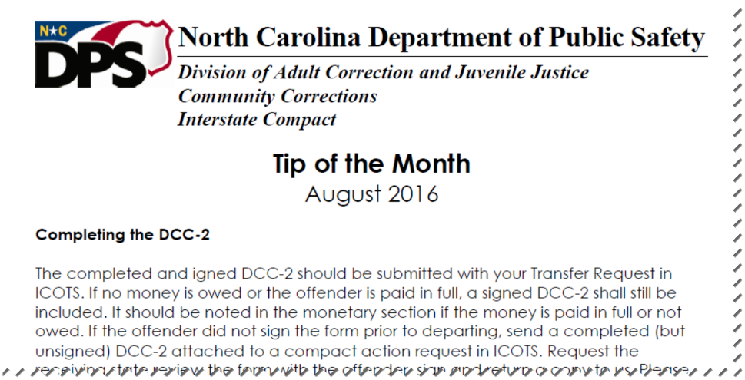
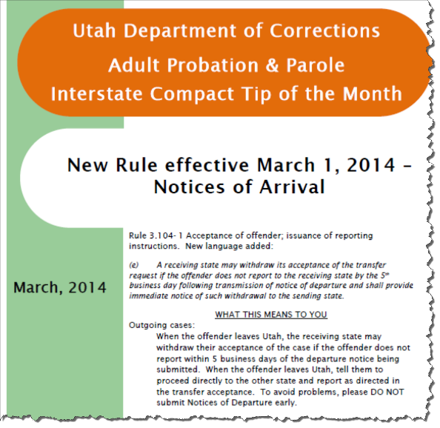
Tip of the Month!
Explain impact of new rule language
Show how in-state processes are incorporated into Interstate Business in your state
Notes:
Explains impact of new rule language and clarifies process Sending state responsible for collection of monies owed….this tip is an example of how the compact office manages that process for outgoing offenders.

Slide 14
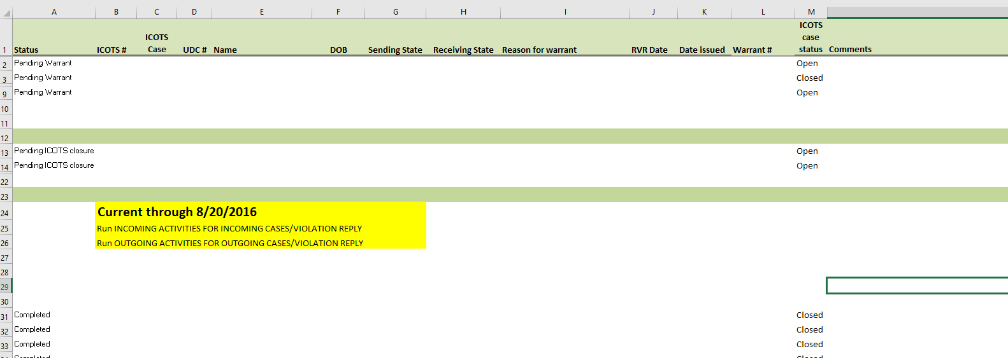
Warrant Tracking-Utah
Use Transmitted Activity Report-OVR Responses; Review Case Details
Notes:
Demo?

Slide 15
MOU’s in Bifurcated States
Agencies should work together in processing incoming dual supervision cases
Notes:
Bifurcated states should discuss and understand each other’s policies for incoming dual supervision cases…NE has an MOU

Slide 16
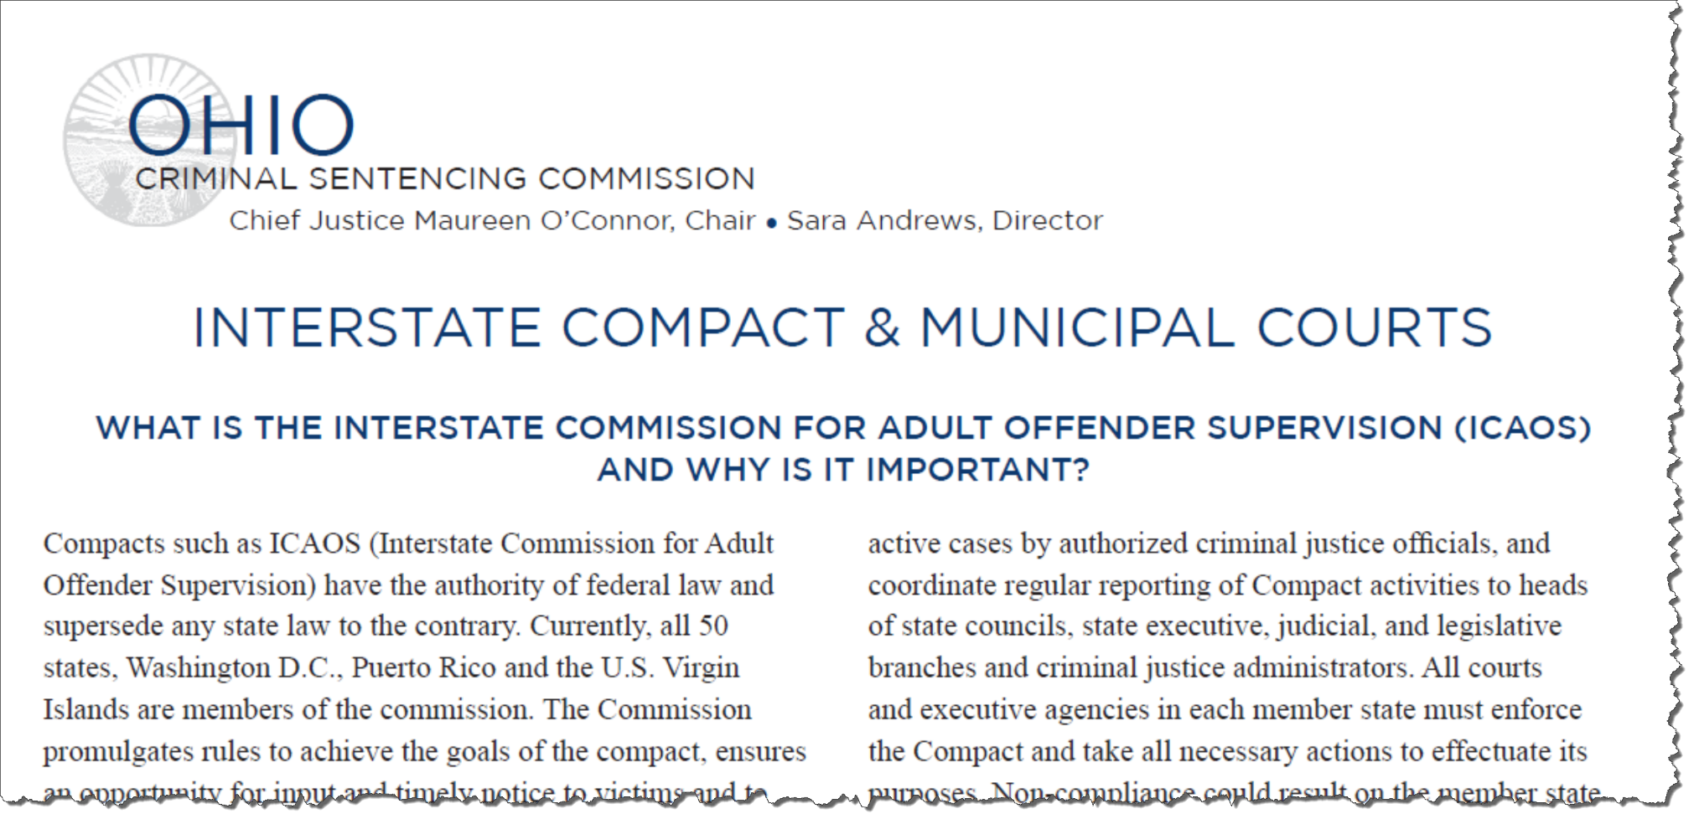
Quick References for Stakeholders
Interstate Guide for Courts, Jails, Parole Boards

Slide 17
Quick Reference for Offenders

Slide 18
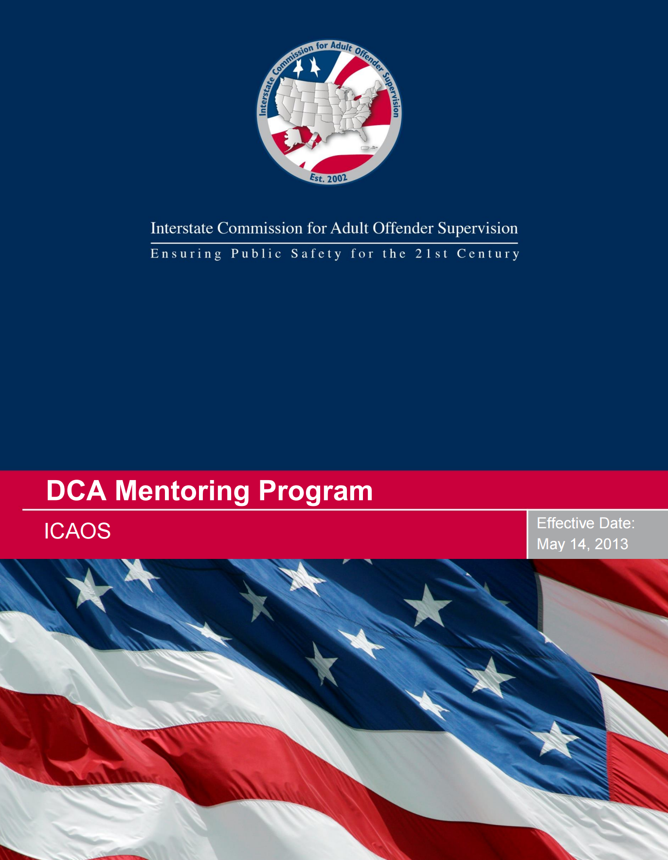
DCA Mentoring Program
New DCAs/ @ Commissioner request to resolve issues or technical & training assistance
New Proposal for online assessment streamlined process
Notes:
Identify goals on the front end

Slide 19
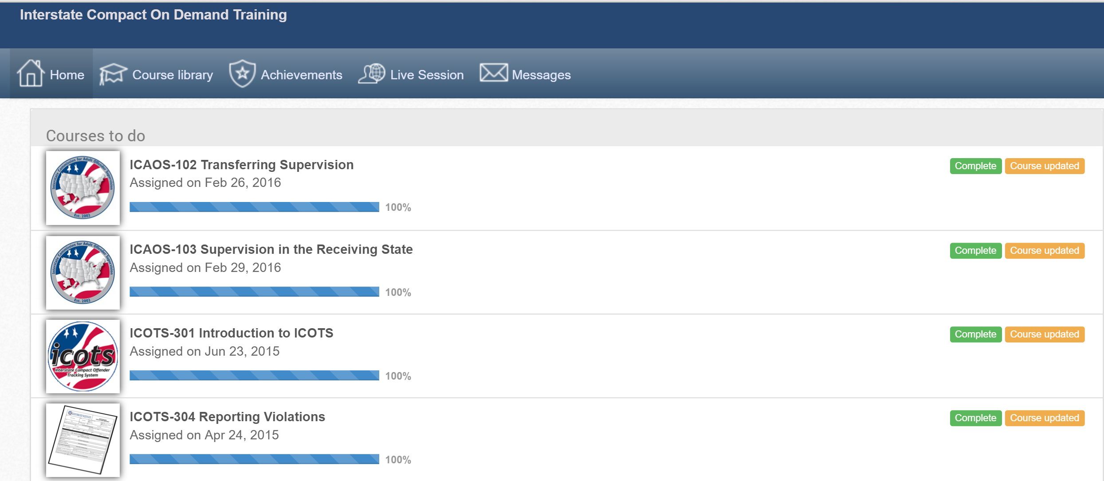
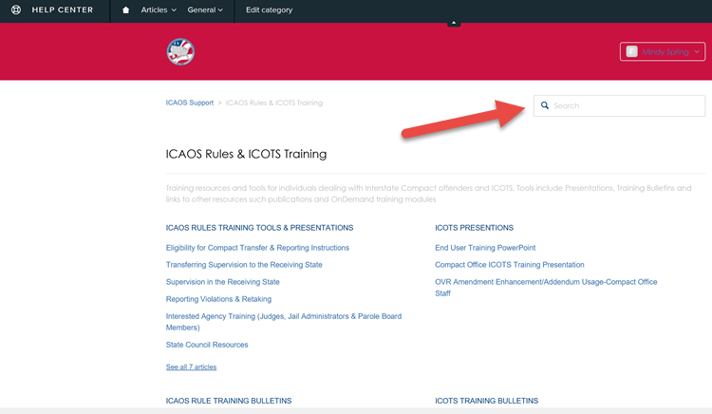
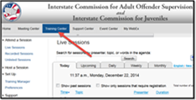
Resources
Notes:
Mindy

Slide 20
ICAOS Support
Notes:
Demo??

Slide 21
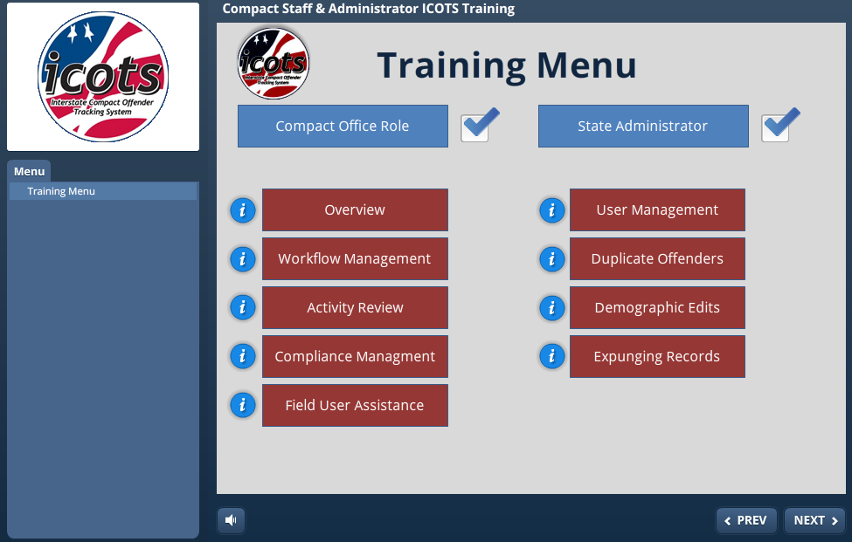
Compact Office Training Module
Notes:
9 topics so users can customize ICOTS training for compact offices and administrators

Slide 22
Questions

