Slide 1
2018 DCA Training Institute
Presented by: ICAOS DCA Liaison Committee &
Training, Education & Public Relations Committee

Slide 2


Slide 3
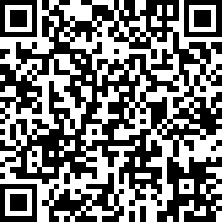
https://www.surveymonkey.com/r/DCA2018
Notes:
Log into survey monkey
Survey results, text analysis (word cloud)

Slide 4
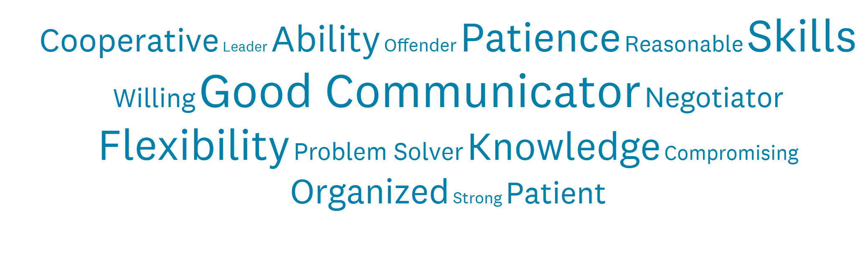
Insert Word Cloud

Slide 5
DCA Liaison Committee
Chair: Tracy Hudrlik (MN)
East Region Chair: Natalie Latulippe (CT)
South Region Chair: Julie Lohman (VA)
Midwest Region Chair: Matt Billinger (KS)
West Region Chair: Judy Mesick (ID)
Other Members: Margaret Thompson (PA); Simona Hammond (IA); Pat Odell (WY); Tim Strickland (FL)

Slide 6
DCA Liaison Committee
Mission:
Provide a mechanism for DCAs to communicate concerns or needs and act as a liaison to improve the communication and relationship between Commissioners and Deputy Compact Administrators.
2018 Goals:
Identify issues or concerns affecting DCAs and support effective discussion/action to find resolution.
Identify issues of relevance for referral to standing committees.

Slide 7
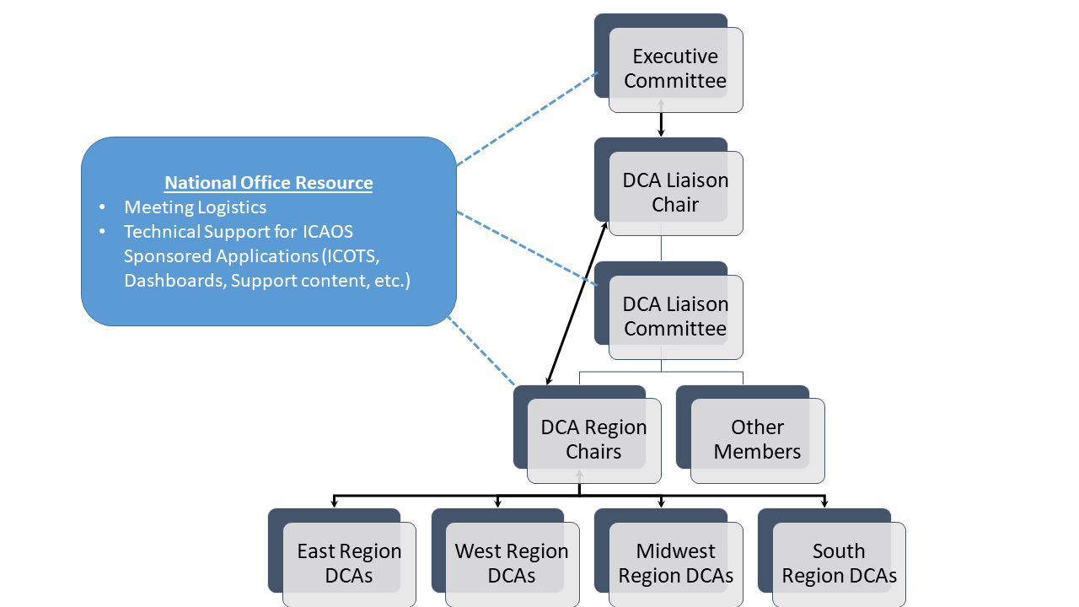
DCA Committee Restructure

Slide 8
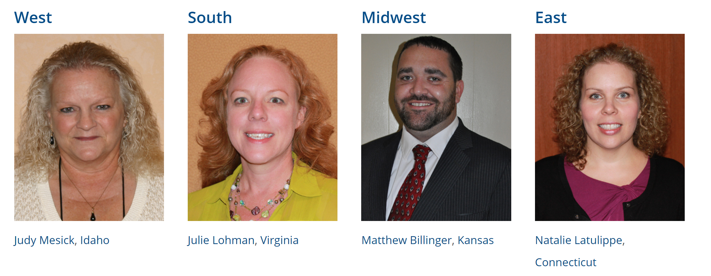
DCA Region Chairs

Slide 9
Training, Education & PR Committee
Chair: Anne Precythe (MO)
Chris Moore (GA)
Hope Cooper (KS)
Russ Marlan (MI)
Joseph Clocker (MD)
Roberta Cohen (NM)
James Parks (VA)
Dara Matson (IL)
Exofficio Members
Sally Reinhardt-Stewart (NE)
Tim Strickland (FL)
Mark Patterson (OR)

Slide 10
Training, Education & PR Committee
Mission:
Develop and enhance educational resources and training materials for use by affected member states and stakeholders. Enhance public safety through awareness and consistent administration.
2018 Goals:
Review and revise training modules and resources annually.
Create mobile friendly educational resources for stakeholders.
Support state compact offices’ responsibilities to train stakeholders in their state on ICAOS Rules, purpose and best operational practices.
Create dialogue that emphasizes the goals of the Compact: What’s in the best interest of public safety? What’s in the best interest of the offender?

Slide 11
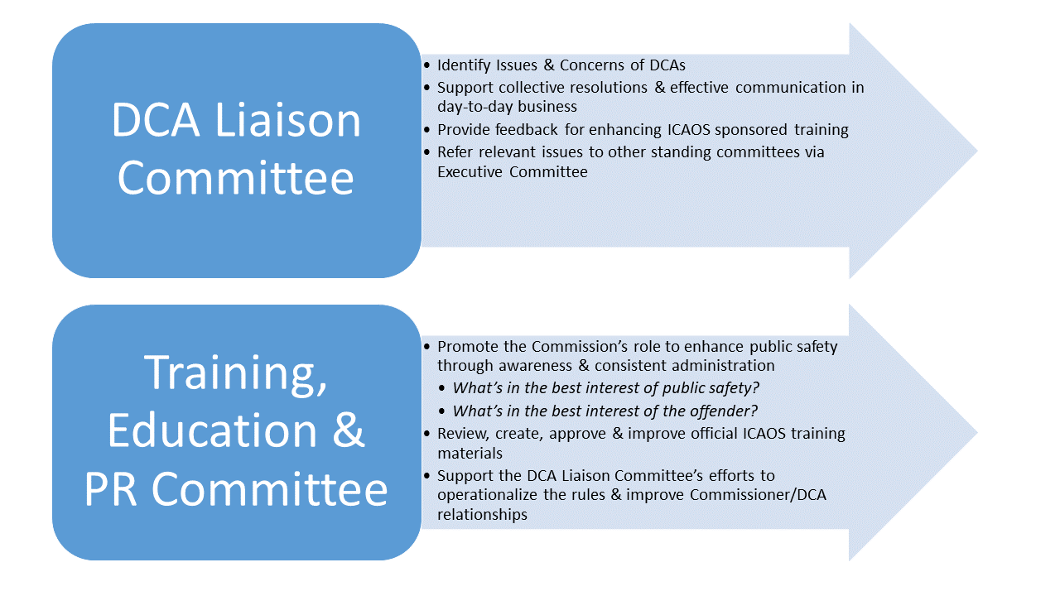
Notes:
Training issues or concerns should first be brought through DCA regions for discussion up through the DCA committee to request action or work from the TC.
What’s the COLLECTIVE SOLUTION, What is in the best interest of all member states.
State issues should also be elevated to Commissioner to be addressed through stakeholder involvements or input to bring to national commission to better understand issue. Pending charges, sentencing considerations, other things the compact rules do not necessarily impose on the states

Slide 12
2018 DCA Institute Agenda
Painting the Supervision Picture
Retaking required ‘Upon a request of the receiving state’
Warrant Tracking
Dealing with Pending Charges & Revocable Behavior
Probable Cause Hearing Requirements
Reacting to Out of State Subpoenas

Slide 13


Painting the Supervision Picture

Slide 14
Documentation Review Activity
20 minutes to review PR’s & OVR’s provided by DCAs
Does the report meet documentation standards for your state?
What’s good about the report?
What could be articulated better in the report?

Slide 15
Promote Quality!
What’s Important
What’s NOT Important
Clear, concise, accurate..
Relevant attachments are included
YOUR Compact Office sets standards for YOUR field users
Questions/need clarification? ASK!
Format/placement
Where exactly the attachments are
Imposing your documentation standards on another state
What the ‘other’ state NEVER does….

Slide 16
Supervision Goals
Keep supervision LOCAL!
  Offenders transfer for purposes of successful supervision
    Residents and/or supportive environment exists in the Receiving State
      Family, employment, etc.
  Use of Evidenced Based Practices (graduated response/sanctions/access to programs) should be the same for compact offenders
    Promote positive/compliant behavior

Slide 17
Supervision Goals
Provide sentencing state w/ clear picture of supervision practices and offender behavior
Ensure retaking is initiated ONLY when it MAKES SENSE!
  Retaking isn’t guaranteed to be permanent
  Retaking costs $$
  Documentation should support revocation at this point clearly demonstrating unsuccessful supervision

Slide 18
Supervision Documentation
Progress Report
Violation Report REQUIRING RETAKING
Keeps the sending state informed of supervision practices; offender’s progress and behavior
Invokes requirement for sending state to retake offender
Communication!!!
THINK: “What are you documenting in your own state’s case management?” Keep the Sending State INFORMED!
Notes:
Two activities used to report offender compliance and non-compliance. The violation report to be used ONLY when requiring retaking due to DOCUMENTED

Slide 19
Violation Requiring Retaking Reporting Considerations
The sending state is only going to know what you tell them
Use the same detail if reporting to your own authorities
Specifics on how the behavior was determined to be revocable
Has the option of working with the offender (e.g. intervention) been exhausted?

Slide 20
PRESENTED LAST YEAR 2017!!
Notes:
What was presented last year to show the change after June 1st rule change. Data showed retakings remain consistent, significant change however in number of violations being reported and more inline with retaking numbers

Slide 21
Definition Change Impact
Notes:
Actual data from FY2017 & 2018

Slide 22
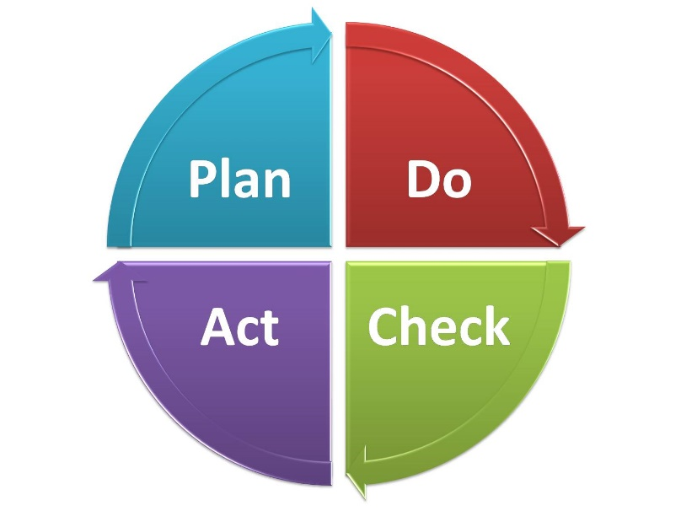
Good ISC Policies/Procedures are Key!
Relate Interstate Business to Instate Processes
Involve Stakeholders in Policy Development
Regularly Remind/Train on Policies
Review/Update Policies Regularly
Audit to Ensure Compliance
Notes:
Ask a few states with good policies to describe how they involve stakeholders. Nebraska for sure both Probation and Parole

Slide 23
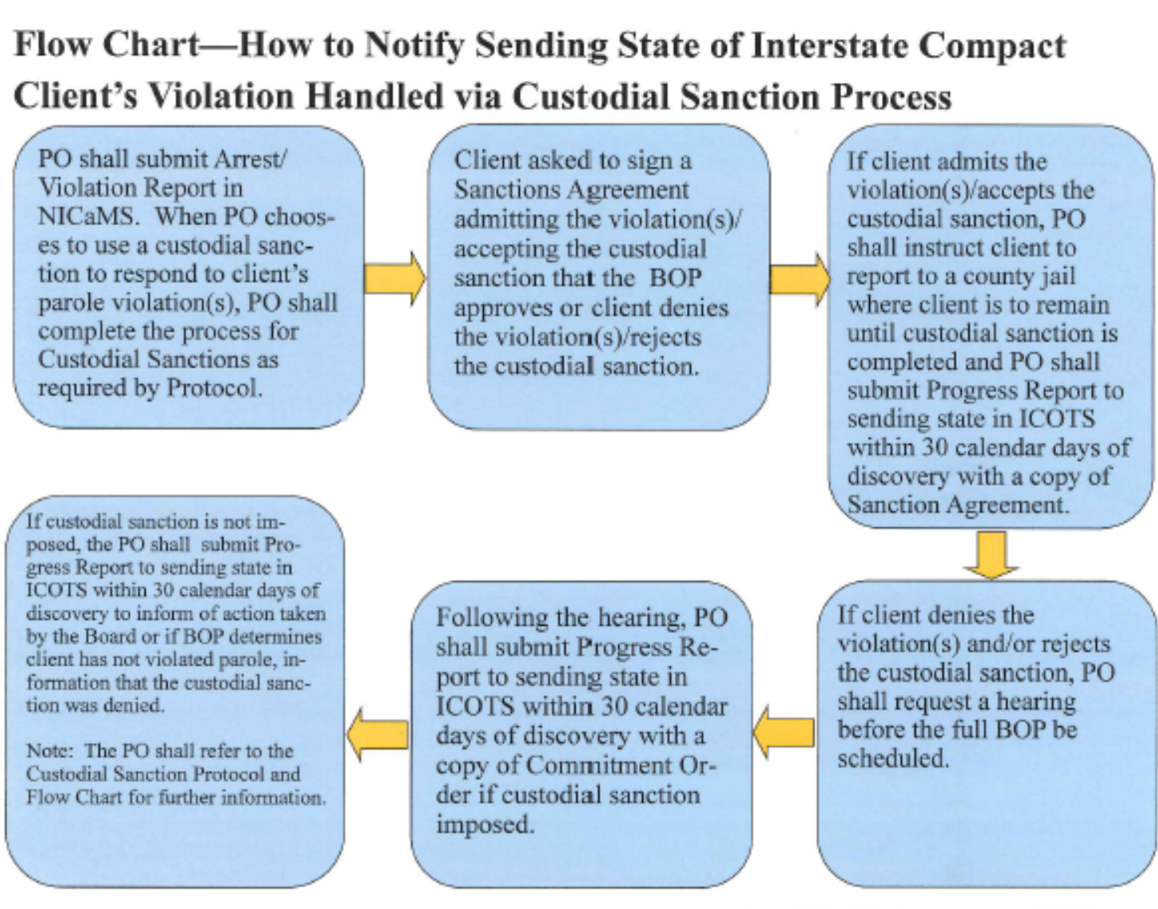

Nebraska-Response to Client Behavior Protocol
Notes:
I have had a chance to review #1 in your letter on Painting the supervision picture. Under a. Nebraska Parole has revised its Response to Client Behavior Protocol. The Protocol includes Flow Charts that were developed as a guide for when to submit Progress Reports, Violations Reports Requiring Retaking, etc. I have attached a copy of the Flow Charts for your reference. This has helped not only officers but supervisors and the Compact Office in handling activities in a consistent manner. Nebraska would be glad to share this with other states if you believe it would be beneficial.

Slide 24
Retaking is Required “Upon a Request…….”
ONCE
Presented by: Dori Littler Arizona Commissioner/DCA & Margaret Thompson Pennsylvania DCA

Slide 25
Mandatory Retake for a
New Felony or Violent Crime
Upon the request of the receiving state, the sending state shall issue a warrant and retake:
  after notice an “offender” has been convicted of a new felony offense OR “violent crime”
  Violation Report in ICOTS enforces the ICAOS Retaking Rules
Rule 5.102
Notes:
Stress the part of this rule that relies on a “conviction” for the retake to be mandatory and that the conviction can be either a misdemeanor or felony and that the “violent crime” will be determined by the receiving state and that this rule applies to all “offenders” who may be convicted of a violent crime, regardless of the instant offense conviction. Again, this rule relies on a “request from a receiving state” and not all circumstances will result in a request to retake. For example, an offender gets convicted of a violent crime while under supervision in the receiving state but receives probation supervision. The receiving state may determine that the offender should remain in the receiving state for the local supervision. The sending state can still be notified of the conviction but not asked to retake. Of course, the sending state can still decide to retake under Rule 5.101.

Slide 26
“Upon a Request of the Receiving State….”
Receiving State:
  Has exhausted options
  No longer a good “plan of supervision”
  Determined that invoking rule promotes public safety and victim safety
The receiving state may notify using a Progress Report when not asking for retake.
Notes:
Again, this rule relies on a “request from a receiving state” and not all circumstances will result in a request to retake. For example, an offender gets convicted of a violent crime while under supervision in the receiving state but receives probation supervision. The receiving state may determine that the offender should remain in the receiving state for the local supervision. The sending state can still be notified of the conviction but not asked to retake. Of course, the sending state can still decide to retake under Rule 5.101.

Slide 27
Retaking is NOT always the answer!
Offender’s resources solely in receiving state
  Mental/Medical treatment
  Caretaker for other family members
  Drug addicted offenders supervised for non-drug related crimes
Compliant with other aspects of supervision
  Employment, financial obligations, reporting, treatment, etc.
New probation sentence in receiving state
Offender subject to new lengthy sentence of incarceration in receiving state
Remember every violation situation is DIFFERENT! Review!
Notes:
In some instances couldn’t a lengthy sentence of incarceration in the RS also be a reason not to request retaking? If an offender is under probation supervision for a felony Forgery, with no other prior record, is convicted of a Robbery and receives a sentence of 5 to 10 years, does retaking make sense based on the initial offense? The sending state can always request retake if they want to, but most courts feel it would be overkill at that point.
Offender is a heroin addict under compact supervision for a Felony Theft.
Offender is doing well on supervision, is employed and supporting his family for a period of time.
Offender relapses, loses job and charged with a new felony theft in the RS.
RS submits PR with arrest information and imposes sanction of inpatient tx followed by outpatient tx (Opt).
Offender completes inpatient tx, is attending Opt, obtains employment, is supporting his family again and is in compliance with supervision.
Offender is convicted and sentenced to a period of probation.
The conviction information can be submitted on a PR because retaking would not be in the offender’s best interest.
Mental Health or other medical treatment (chemo or dialysis for example) in the receiving state- sometimes interruption of those services/treatments is detrimental to the offender’s health. Caretaker roles could be another since retaking could have devastating ripple effects on other family members.

Slide 28
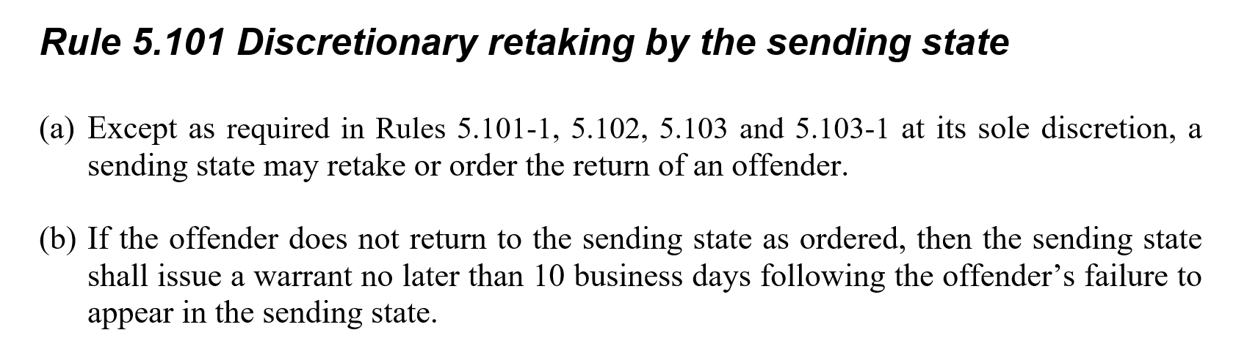
Reporting conviction on a Progress Report DOES NOT prevent the sending state from retaking

Slide 29
Warrant Tracking
Panel: Dori Littler Arizona Commissioner/DCA, Tracy Hudrlik Minnesota DCA, Matthew Charton New York DCA

Slide 30
Warrant Tracking
How does your state ensure warrants are Compact compliant?
How do you communicate with your external agencies regarding warrant issues?

Slide 31
Dealing w/ Pending Charges & Revocable Behavior
Presenters: Chris Moore Georgia Commissioner & Tim Strickland Florida DCA

Slide 32
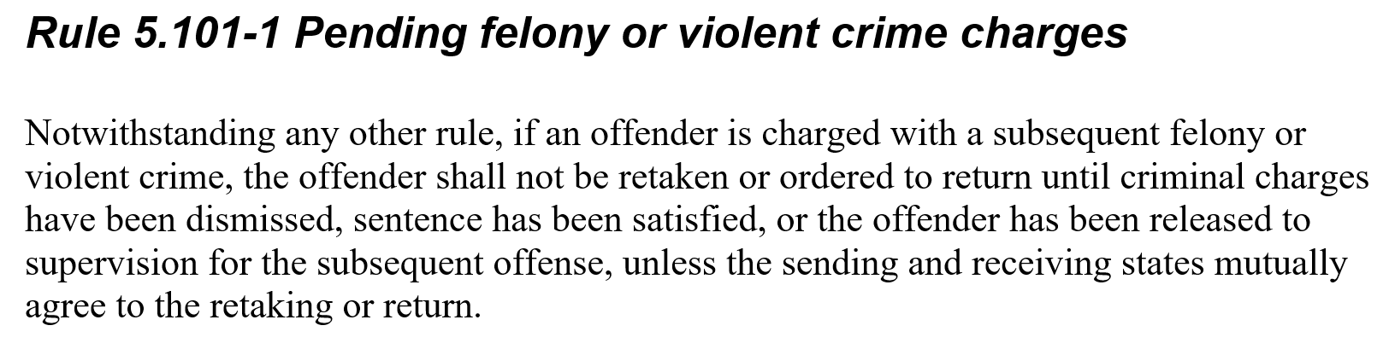

Slide 33
What are the issues?
Path to permanent revocation varies as does what revocation means in definition of ‘behavior requiring retaking’
For some, no authority to supervise offenders when pending charges exist
For some, compact offenders (because original sentence is from other state) are afforded bail when an instate offender would not
  New charges sometimes take years to resolve

Slide 34
Considerations…..
Rule 5.101-1 allows for states to mutually agree to retaking
What stakeholders are involved in the revocation process in your state?
Are the courts notified and educated on the retaking rules when these cases arise?
Is my state truly complying with Rule 4.101? (providing consistent supervision and imposition of incentives and sanctions)

Slide 35
Stakeholder Communication is KEY!
Elevate issues to Commissioner!
Is your legal department or Attorney General aware of your state’s limitations?
Has the issue been raised with State Council?
  Consider legislation/State Supreme Court ruling?
Are Compact Offices effectively communicating on these cases putting public safety #1?
  Using discretionary retaking or mutual agreement when it MAKES SENSE!

Slide 36
Probable Cause Hearings
Presenters: Jane Seigel Indiana Commissioner/ICAOS Rules Chair & Jacey Rader Nebraska Commissioner

Slide 37
US Supreme Court Decisions
Morrisey vs. Brewer 408 U.S. 471 (1972) (parole)
Gagnon vs. Scarpelli 411 U.S. 778 (1973) (probation)
Why is this important to Compact Offenders?
Geographical concerns (violations committed outside of Sending State)
Without PC, violations may be barred from consideration for revocation (Sending State)
  Offenders are ENTITLED when revocation is possible

Slide 38
Purpose of PC Hearing
Test Merit of Violation
  Provides evidence the offender likely violated his or her conditions of supervision
  Ensure violation meets definition of ‘Behavior Requiring Retaking’
    Receiving States should not arbitrarily revoke relocation once granted
Creates Record
  To be used in possible subsequent revocation hearing
  Who, What, When & Where??

Slide 39
When an Offender is not Entitled to a PC Hearing
No possibility violations committed in receiving state will be used in revocation proceedings in the sending state
  e.g. Offender simply returning to resume supervision in Sending State
New conviction
  Rule 5.102
  Conviction is conclusive proof of violation-including misd. conviction if reported as revocable behavior
Notes:
5.102 covers mandatory retake for felony conviction and violent crime convictions
New Rule 5.101-2 is not referencing a PC hearing, but rather a violation hearing for the new conviction. Allows for a discretionary process (based on the sending state’s capabilities) to address a violation of a new conviction and allow a new sentence imposed by the sending state to be satisfied or partially satisfied while incarcerated

Slide 40
PC Hearing Elements
Conducted by neutral and detached person
Close proximity to where alleged violations occurred
Administrative hearing
  Fact finding, no determination of guilt
  Level of due process is usually less than a revocation hearing; but may be more considering the results are intended to be used in a revocation hearing

Slide 41
Offender’s Rights at PC Hearing
What is an offender entitled to at a PC Hearing?
Disclosure of non-privileged/non-confidential evidence
Opportunity to be heard in person, present witnesses and evidence
The opportunity to confront and cross-examine adverse witnesses
  unless the hearing officer determines that a risk of harm to a witness exists

Slide 42
Hearing Report Requirements
Ensure reports meets local AND Rule 5.108 requirement!
Due to sending state within 10 business days after the hearing
Must include:
  Date, time, location of the hearing
  Who was present (who testified/who did not)
    Clear & concise WRITTEN summary of ALL testimony
  What evidence was used in decision?
  Specific statements as to which violations where PC found, not found and offender admitted to

Slide 43

Waiver of Probable Cause Hearing
Waiver acceptable when:
Offender is apprised of his or her rights to hearing
No contest to retaking and clearly aware of the facts supporting retaking
Signed admission to one or more violations
  IMPORTANT! Admission/Waiver must be of sufficient gravity to justify revocation in receiving state
Notes:
43
In place of a probable cause hearing a receiving state can offer the offender a PC waiver. The PC waiver needs to include an admission to at least one violation of conditions

Slide 44
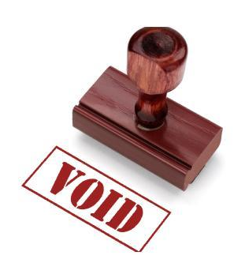
INVALID WAIVER Example
Sex offender’s OVR documents he violated curfew, had unauthorized contact with minors, viewed pornography, access social media, and tested positive for marijuana (which by itself is clearly NOT a revocable violation)
The offender admits guilt on a PC waiver only to the positive marijuana urine screen
PC must be established on REVOCABLE violations!

Slide 45
Rule 5.108 (c)
Misinterpretation
Sex offender’s OVR documents he violated curfew, had unauthorized contact with minors, viewed pornography, tested positive for drugs and is convicted in the RS of driving recklessly without insurance (misd conviction by itself is NOT revocable)
The offender’s conviction of reckless driving is NOT proof the offender engaged in BRR
PC must be established on REVOCABLE violations!

Slide 46
Don’t forget!
As the receiving state you WANT the sending state to revoke with the submission of a Violation Report
Retaking does not always prevent an offender from qualifying for re-transfer of supervision
Offender’s have a right to PC
Local procedures for PC vary and may or may not meet the requirements established by Supreme Court Rulings

Slide 47
Common Legal/Procedural Questions ISC Offices should know
What are the rules of evidence for PC hearings?
Can hearsay be admitted?
Can it be done proffer?
Can an affidavit be admitted or is the witness required to be present
What specifically is “evidence”? Is it transcripts or the exhibits?
Notes:
Know what your state requires for both establishing PC and in revocation hearings.

Slide 48
How Can Your State Improve?
Ensure ICOTS Users are using Addendums and providing PC records appropriately on ICOTS records
  Through Compact Workload Review
  Using ICOTS Dashboards
  Training Field Users
  Learn more about Field processes for PC and what may be needed in a revocation to better communicate
  Involve Legal for guidance

Slide 49
States Sharing PC Procedures/Policies
Texas
Tennessee
Arizona
Virginia
South Carolina
Notes:
States who shared via DCA region meetings

Slide 50
Reacting to Subpoenas
Presenters: Russ Marlan Michigan Commissioner & Hope Cooper Kansas Commissioner

Slide 51
Compact Rules
Do not impose a legal obligation for states to comply with out of state subpoenas
Cannot prevent out of state subpoenas

Slide 52
Step #1- Why???
Why is the subpoena issued?
Can the information or testimony sought in the subpoena be provided in another manner?
  Is it a matter of clarification?
  Is it a matter of understanding the compact?
  Is it an instance where the violation was not documented appropriately or lack of details?
  Is it lack of PC being established appropriately?

Slide 53

Legal Guidance is KEY!
Learn WHY the subpoena was issued
Involve your legal department or state attorney
Resolve with good communication btw compact offices & most importantly DIRECTION from legal department or state attorney
Notes:
From the DCA regions, ALL cases brought up were resolved through the involvement of legal/general counsel’s office

Slide 54
GAME

Slide 55
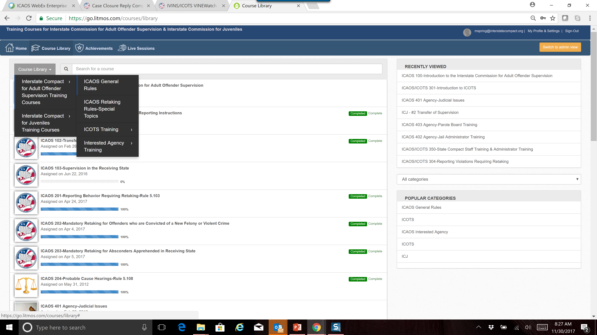
ICAOS OnDemand Training

Slide 56
Questions

