Slide 1

Presented by:
ICAOS State Councils
Interstate Compact for Adult Offender Supervision
Notes:
State Council

Slide 2
Presentation Objectives
In this training you will learn about:
Compact mechanisms, authority & implications
Purposes & functions of ICAOS
State Council Role & Responsibilities
Resources available
Notes:
Learn about how the compact’s function, what authority the compact rules have and implications for not complying with the compact requirements
What are the specific functions of ICAOS
who is required to be transferred through the compacts
high level look at states’ responsibilities and
what resources available to help answer questions regarding compact cases

Slide 3
ICAOS Functions
ICAOS regulates how supervised individuals are:
Transferred from one state to another
Supervised while on Compact Supervision
Returned to a sending state when supervision is not successful

Slide 4




Purpose of ICAOS
Protect the Rights of Victims
Promote Public Safety
Ensure Effective Supervision &
Rehabilitation
Control/Track Movement of Supervised Individuals
Notes:
Always important to highlight purposes of compact. No decisions or actions should be made that do not support these.
Promote Public Safety
Protect Victim’s rights
Ensure supervision techniques are consistent with instate supervised individuals and in line with best practices of the supervising state; this includes same access to supervision, sanctions, and services
Through databases supported by each national office, we are tracking and controlling movement of supervised individuals as they cross state lines

Slide 5
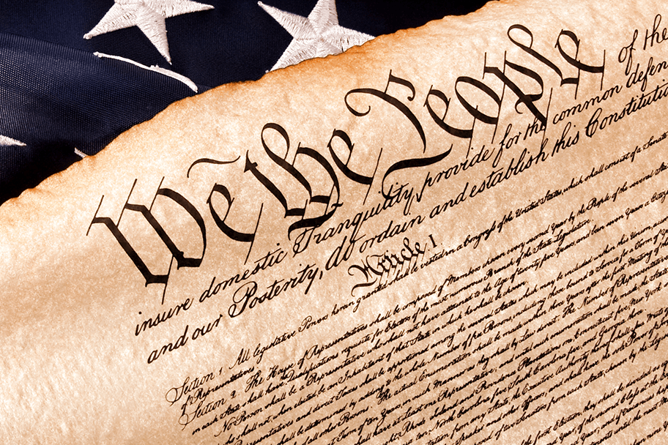


Authority of an Interstate Compact
Authorized
Binding
Supersedes
The Compact is authorized by US Constitution & Crime Control Act
The Compact is binding upon all state authorities & citizens
The Compact rules supersedes conflicting state law
Notes:
What authority

Slide 6

Interstate Compact Legislation
Courts, Parole Boards, Community Corrections & Other Executive Agencies:
Subject to the ICAOS Rules
Must enforce & effectuate the Compacts
[List Your State’s Statute]
Notes:
As each state passed like legislation to become a member of the Compacts, knowing this legislation is exists key to knowing each states’ obligations which requires the state to comply with rules and enforce and effectuate the compact business in each state. Mention state council role and ensuring resources exist for states to comply with compact obligations.

Slide 7

Authority to Regulate
There is no “right” of convicted persons to travel across state lines or to serve one’s sentence in a particular state. See, Jones v. Harris, 452 U.S. 412 (1981); Meachum v. Fano, 427 U.S. 215 (1976)
Convicted persons have no right to control where they live; the right is extinguished for the balance of their sentence. Williams v. Wisconsin, 336 F.3d 576 (7th Cir. 2003), Pelland v. RI,317 F. Supp. 2d 26 (2004)

Slide 8
National Governing Body
Members of the ICAOS:
  All 50 states
  District of Columbia
  US Virgin Islands
  Puerto Rico
Rule Making Authority
Compliance Enforcement
Notes:
Commission made up of the states, DC, US Virgin Islands and PR .The Commission has rule making authority and the authority to enforce compliance upon its members

Slide 9
Implications of Non-Compliance
It is incumbent upon prosecutors, judges and other state officials to understand the requirements of the Compact and its rules, as well as the consequences of non-compliance.
Failure of state judicial or executive branch officials to comply with the Compact and its rules results in the state defaulting on its obligations under the Compact and could lead the Commission to take corrective or punitive action, including suit in federal court for injunctive relief.
5
Notes:
The compact rules are binding on all state officials and states’ citizens.
The rules and by-laws adopted by states also address how noncompliance is handled.
Corrective actions could require states to complete a corrective action plan, require training and in some cases could lead to the Commission to file suit in federal court against a defaulting state.

Slide 10
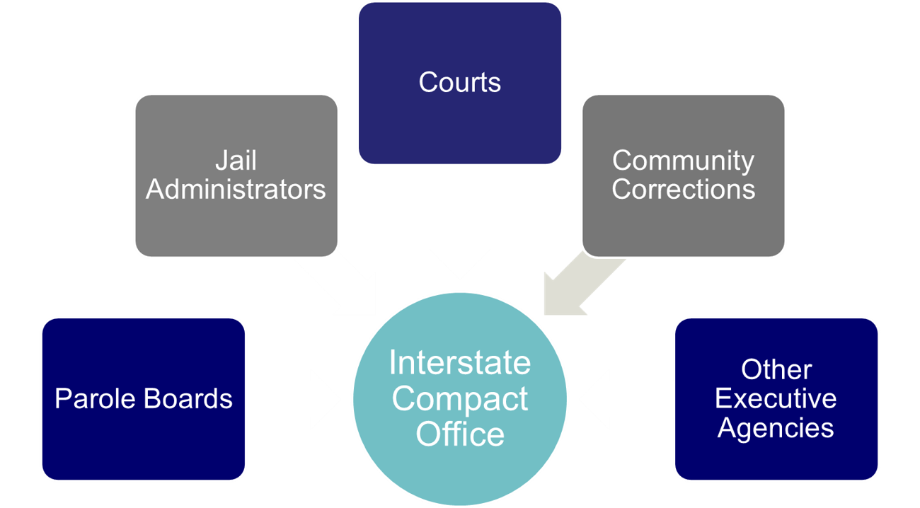
Interstate Compact Offices
Administers the Compact
Point of contact for case specific questions
Conducts training
Resolves issues with other states
Ensures rule compliance
Develops & recommends in-state ISC operating procedures to State Council
Interstate Compact Office
Notes:
Compact offices have an important role in ensuring compact success. They can also assist you in understanding compact implications in a case you may be dealing with.

Slide 11

What Triggers the ICAOS?
Pursuant to Rule 2.110, no state may allow a person covered by the Compact to relocate to another state except as provided by the Compact and its rules.
Therefore, a court cannot order or direct an eligible supervised individual to leave a state and relocate to another state unless such relocation occurs in accordance with the Compact and its rules.
Notes:
Pursuant to Rule 2.110, an offender, subject to supervision who is relocating to another state must request transfer of supervision through the interstate compact. Therefore, a court cannot order or direct a covered supervised individual to leave a state and relocate to another state unless such relocation is done in accordance with the Compact and its rules.
An individual who is not eligible for transfer under this Compact is not subject to these rules and remains subject to the laws and regulations of the state responsible for their supervision.

Slide 12
Key Definitions Determining Eligibility
Supervised
Individual
Supervision
Relocate
Adult who commits a criminal offense (all felonies & specific misdemeanants)
Subject to ‘supervision’; and
Released to the community under the jurisdiction of:
  Courts
  Paroling Authorities
  Corrections
  Other Criminal Justice Agencies
2 Distinct criteria:
  Oversight exercised by a controlling authority, which includes:
    Courts
    Paroling Authorities
    Corrections
    Other Criminal Justice Agencies
  Required to monitor regulations or conditions, other than monetary
Supervised individual intends to remain in another state for more than 45 consecutive days in any 12 month period.
+
+
Notes:
Note eligibility for deferred sentenced supervised individuals
Furloughed and preparole

Slide 13
Eligibility Criteria
1
2
3
4
Time Remaining on Supervision
>= 90 calendar days or an indefinite period of supervision remaining
Valid Plan
Terms & conditions of supervision
Residence
Employment/Means of Support
Substantial Compliance
No initiation of revocation proceedings by Sending State
Justification/Reason
Resident
Family
Employment
Military Orders
Discretionary/ Correctional Sense
Notes:
Other eligibility criteria for transfer must illustrate that relocating to another state is supervised individual’s best chance for success. supervised individuals must have a good plan, not be in violation status in the sending state and most have ties to the receiving state as being a resident (living in that state prior to committing their offense) or have family support.
As clearly stated in case law, no convicted person has a right to server his or her sentence in another state.
It’s imperative supervised individual’s understand this when allowed to transfer and that the compact is established to provide a legal mechanism for the supervised individual to live and be supervised in a receiving state, not be an obstacle.

Slide 14


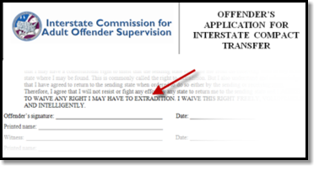
Compact Supervision Elements
Duration
Conditions
Waiver
Sentencing Authority in the Sending State determines duration of Supervision
Supervised individual agrees to conditions imposed by BOTH Sending & Receiving States
Supervised individual applying for transfer WAIVE rights for extradition
Notes:
As a precondition to transfer supervision, ALL supervised individuals must sign the supervised individual application for transfer agreeing to waive extradition from any state. This is EXTREMELY IMPORTANT as it replaces the need for an extradition hearing in the Receiving State and the need for a Governor's warrant by the Sending State in order to apprehend an supervised individual.
This form clearly states, “…I will not resist or fight any effort by any state to return me to the sending
state and I AGREE TO WAIVE ANY RIGHT I MAY HAVE TO EXTRADITION. I WAIVE THIS RIGHT FREELY,
VOLUNTARILY AND INTELLIGENTLY.”

Slide 15

Compact Supervision in a Receiving State
Supervision standard consistent with similar supervised individuals sentenced in the Receiving State
Same programs, incentives, sanctions/interventions
‘Participation in the ICAOS ensures not only the controlled movement of supervised individuals under community supervision, but also that out-of-state supervised individuals will be given the same resources and supervision provided to similar in-state supervised individuals including the use of incentives, corrective actions, graduated responses and other supervision techniques’
Notes:
Once allowed to transfer, receiving states have to provide supervision consistently in how they would supervised an supervised individual sentenced in the receiving state. Although most states fulfill this requirement well under the compact requirements, it can be a training issue for stakeholders involved in supervision decisions or rehabilitation programs.

Slide 16
State Council Role
Each state determines their state council membership. Membership must include at least one of the following:
Governor Representative
Legislative Representative
Judicial Representative
Victim’s Advocate
Provide mechanism for empowerment and awareness of Compact processes;
Determine state impact of Commission action(s) or potential action(s);
Assist in developing Compact policy;
Appoint Acting Commissioner in absence of appointed Commissioner

Slide 17
State Council
Empowerment
Each state is required by statute to establish a state council for overseeing its intrastate affairs dealing with the Compact.
An active State Council can have a positive influence on a state’s compact operation.
State councils can serve as an advocate when seeking resources, improving operations, resolving disputes and conducting training.

Slide 18
State Council
Appointment Considerations
Process can be lengthy & cumbersome.
Recommending suitable candidates for appointment who are willing to serve, may speed up the appointment process.
Factors to consider when recommending appointments include:
  Is the candidate willing to serve on the council?
  Does the candidate have a demonstrated interest in the compact process?
  Is the individual well known in the criminal justice community?
  Is the candidate influential?

Slide 19
State Council
Member’s Role
Understand the compact process
Be familiar with Commissioner appointment process
Assist in determining if Compact office has adequate staff for the operation of the Compact.
Assist Compact Administrator in developing a network within your state to improve processes & ensure compliance with rules.
Recommend other members that may assist in the Compact processes in your state.

Slide 20
State Council
Activities
Develop a dispute resolution policy and procedure
Assess compact office workload and needs
Recommend changes in Compact Office business process and procedures
Present on the Compact at conferences
Recommend legislative changes and lobby legislative groups
Recommend changes to the Compact rules

Slide 21
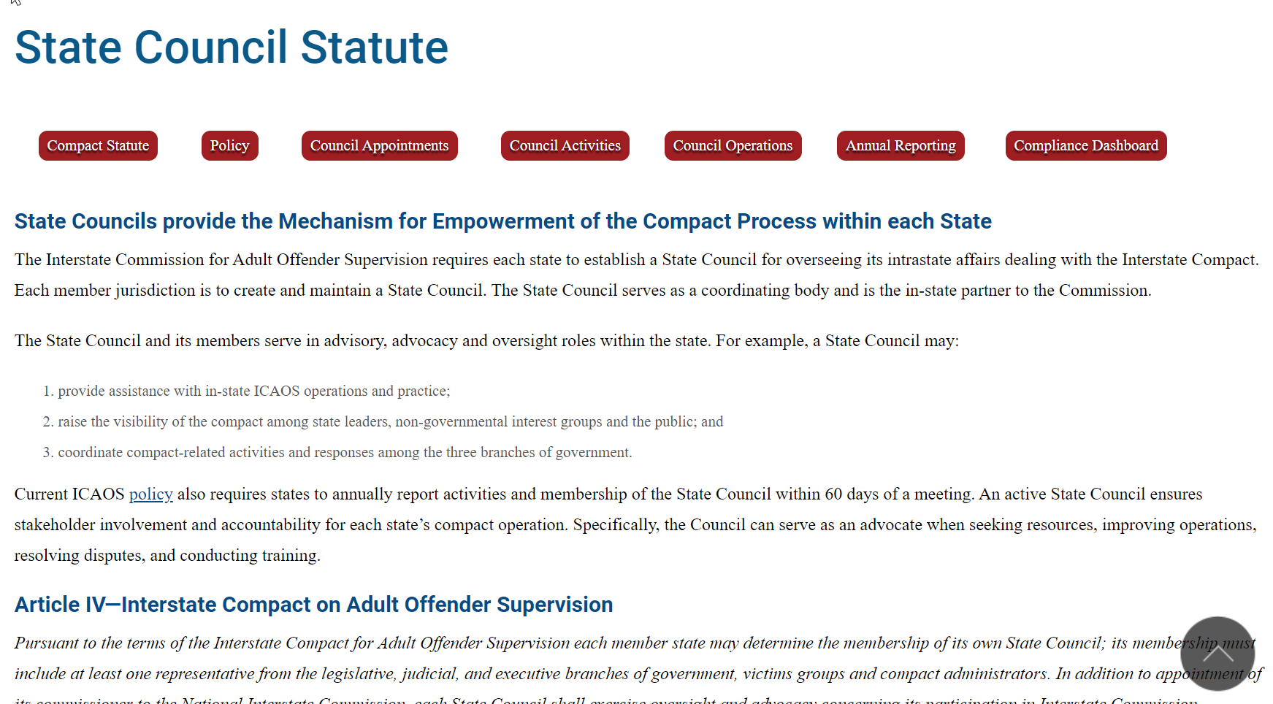
State Council Toolkit

Slide 22
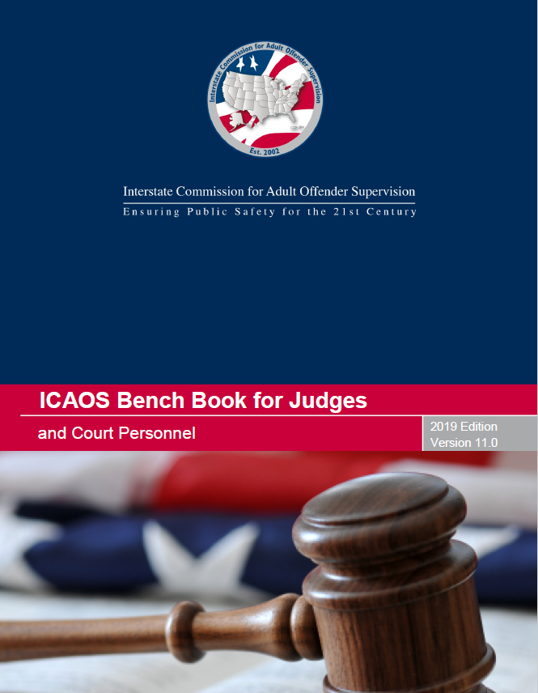
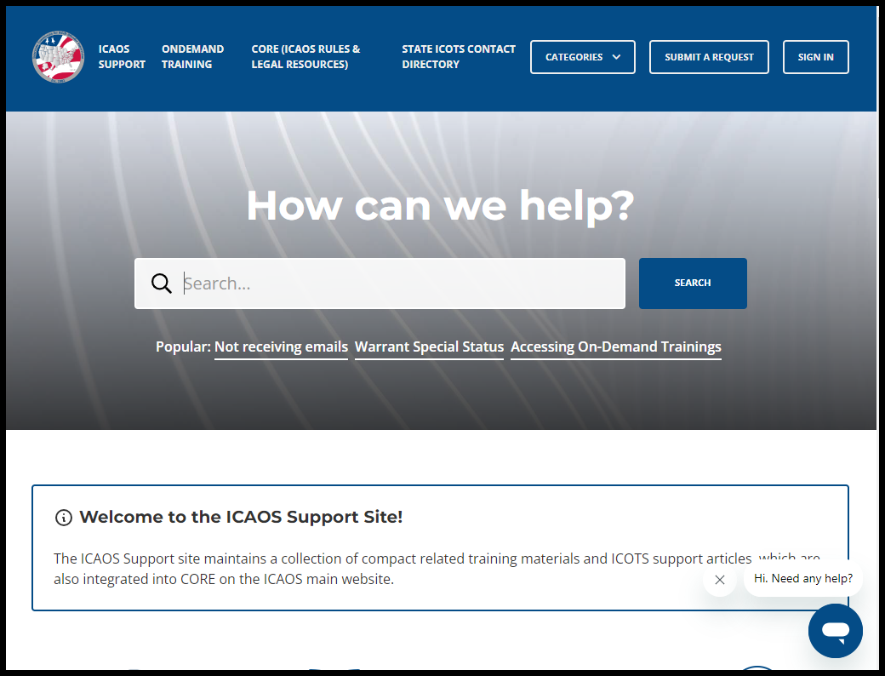


ICAOS Resources: www.interstatecompact.org
Compact Online Reference Encyclopedia
A cross-referenced guide on all ICAOS white papers, advisory opinions, training modules, rules. PC Hearing Officer Guide and the bench book.
Interstate Compact Offender Tracking System
The Commission’s national tracking system that administers the transfers for all compact supervised individuals.
ICAOS Bench Book for Judges and Courts
The Commission’s judicial reference tool to assist judges and court personnel on the Compact.
Training Support
All of the Commission’s training material, resources and on-demand modules in one convenient location.
https://interstatecompact.org/core-search
https://interstatecompact.org/user/login?destination=/litmos-api
https://interstatecompact.org/user/login?destination=/zendesk-api
https://interstatecompact.org/bench-book
Notes:
ICAOS has numerous resources for stakeholders involved in compact operations.
CORE,
ICAOS support site (training resources (including Ondemand), FAQ’s for ICOTS users, forums for state’s to share resources and dialogue)
ICOTS public webportal available to see a particular offender who may be transferred through the compact and contact info for each state
ICAOS Benchbook, comprehensive legal resource

Slide 23
Questions
Interstate Compacts for Adult Offender Supervision

Slide 24
Contact Us
Email
[Your Compact Office Email Address]
Phone
[Your Compact Office Phone]
Website
[Your Website]
www.interstatecompact.org
Offices
[Your Compact Office Address]

Slide 25
Thank You
Interstate Compact for Adult Offender Supervision

