Slide 1

ICAOS Rules Training
Interstate Compact for Adult Offender Supervision
Presented by:

Slide 2
Presentation Objectives
Today you will learn about:
Overview of the Compact
Eligibility for Transfer
Transfer Process/Investigation
Supervision in the Receiving State
Closing a Compact Case
Reporting Violations Requiring Retaking
Probable Cause Hearing Requirements
ICAOS Resources & Training Tools

Slide 3
Overview of the Compact
Purpose, Authority and Implications for Non-Compliance

Slide 4




Purpose of ICAOS
Protect the Rights of Victims
Promote Public Safety
Ensure Effective Supervision &
Rehabilitation
Control/Track Movement of Supervised Individuals
Notes:
Always important to highlight purposes of compact. No decisions or actions should be made that do not support these.
Promote Public Safety
Protect Victim’s rights
Ensure supervision techniques are consistent with instate supervised individuals and in line with best practices of the supervising state; this includes same access to supervision, sanctions, and services
Through databases supported by each national office, we are tracking and controlling movement of supervised individuals as they cross state lines

Slide 5
ICAOS Functions
ICAOS regulates how supervised individuals are:
Transferred from one state to another
Supervised while on Compact Supervision
Returned to a sending state when supervision is not successful

Slide 6



Authority of an Interstate Compact
Authorized
Binding
Supersedes
The Compact is authorized by US Constitution & Crime Control Act
The Compact is binding upon all state authorities & citizens
The Compact rules supersedes conflicting state law

Slide 7
Implications of Non-Compliance
It is incumbent upon prosecutors, judges and other state officials to understand the requirements of the Compact and its rules, as well as the consequences of non-compliance.
Failure of state judicial or executive branch officials to comply with the Compact and its rules results in the state defaulting on its obligations under the Compact and could lead the Commission to take corrective or punitive action, including suit in federal court for injunctive relief.
7
Notes:
Explaining the consequences is important for stakeholder resisting compliance with compact requirements

Slide 8
Eligibility for Transfer

Slide 9


Why supervised individuals Transfer
ALL Transfers Require:
  Valid plan of supervision;
  Justification; and
  Reason
Most supervised individuals are residents/have resident family-best chance for success!
Did you know?
113,000 active transferred individuals
60,000 cases transferring annually

Slide 10
ICAOS Creates Circumstances to
Promote Successful Supervision
Ensure Effective Supervision & Rehabilitation
Positive Relationships & Family Support
Life Stability
Means of Support & Employment
Resources/Programs
There is no “right” of convicted persons to travel across state lines or to serve one’s sentence in a particular state. See, Jones v. Harris, 452 U.S. 412 (1981); Meachum v. Fano, 427 U.S. 215 (1976)
Convicted persons have no right to control where they live; the right is extinguished for the balance of their sentence. Williams v. Wisconsin, 336 F.3d 576 (7th Cir. 2003), Pelland v. RI,317 F. Supp. 2d 26 (2004)
Notes:
Through ICAOS individuals on supervision provide opportunity for support and stability

Slide 11
Cycle of a Compact Case
Transfer Request
Notice of Arrival
Supervision in the Receiving state
Case Closure
Notice of Departure
Transfer Reply
1st Step: Determine Eligibility &
Reason for Transfer!

Slide 12
What Triggers the ICAOS?
Supervised
Individual
Supervision
Relocate
Adult who commits a criminal offense (all felonies & specific misdemeanants)
Subject to ‘supervision’; and
Released to the community under the jurisdiction of:
  Courts
  Paroling Authorities
  Corrections
  Other Criminal Justice Agencies
2 Distinct criteria:
  Oversight exercised by a controlling authority, which includes:
    Courts
    Paroling Authorities
    Corrections
    Other Criminal Justice Agencies
  Required to monitor regulations or conditions, other than monetary
Supervised individual intends to remain in another state for more than 45 consecutive days in any 12 month period.
+
+
Notes:
Note eligibility for deferred sentenced supervised individuals
Furloughed and preparole

Slide 13
Eligible Misdemeanants
Person incurred direct or threatened physical or psychological harm.
Sentence = 1+ years of supervision
AND
Instant Offense Includes
One or More
Use or possession of a firearm involved.
2nd or subsequent conviction of driving while impaired by drugs or alcohol
Sex offense requiring registration in the sending state

Slide 14
Transferring Supervision

Slide 15

What Requirements for Transfer?
1
2
3
4
Time Remaining on Supervision
>= 90 calendar days or an indefinite period of supervision remaining
Valid Plan
Terms & conditions of supervision
Residence
Employment/Means of Support
Substantial Compliance
No initiation of revocation proceedings by Sending State
Justification/Reason
Resident
Family
Employment
Military Orders
Discretionary/ Correctional Sense
Notes:
Other eligibility criteria for transfer must illustrate that relocating to another state is supervised individual’s best chance for success. supervised individuals must have a good plan, not be in violation status in the sending state and most have ties to the receiving state as being a resident (living in that state prior to committing their offense) or have family support.
As clearly stated in case law, no convicted person has a right to server his or her sentence in another state.
It’s imperative supervised individual’s understand this when allowed to transfer and that the compact is established to provide a legal mechanism for the supervised individual to live and be supervised in a receiving state, not be an obstacle.

Slide 16
Mandatory versus Discretionary Transfers
All Transfers should illustrate
Successful Completion of Supervision
Public Safety
Rehabilitation of supervised individuals
Protect Rights of Victims
Mandatory
Discretionary
Receiving State must accept supervision if:
Mandatory criteria transfer is met; and
Information is verified; and
Plan is valid; and
  Acceptable for in state supervised individual
Required documentation is provided
Receiving state may accept or reject supervision in a manner consistent with the purpose of the compact
Sending state must justify “WHY”
Rejections must include specific reasons for rejection

Slide 17
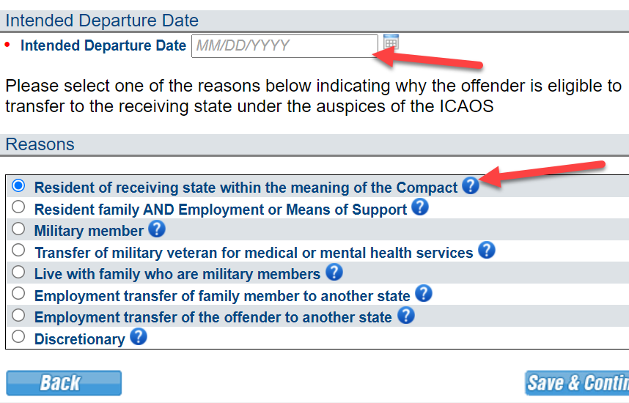
Reason for Transfer
Departure Date can be managed from the Offender’s profile.
Use the help points to ensure appropriate reason is selected and any additional documentation requirements

Slide 18

Top Reasons for Transfer
Resident of the Receiving State
Has supportive Resident Family
Lived in the receiving state for 1 year prior to either:
  Supervision start date; or
  Sentencing date
Parent, grandparent, aunt, uncle, adult child, adult sibling, spouse, legal guardian, or step-parent;
Lived in the receiving state for at least 180 days; and
Transfer must explain how family will support the supervised individual.

Slide 19
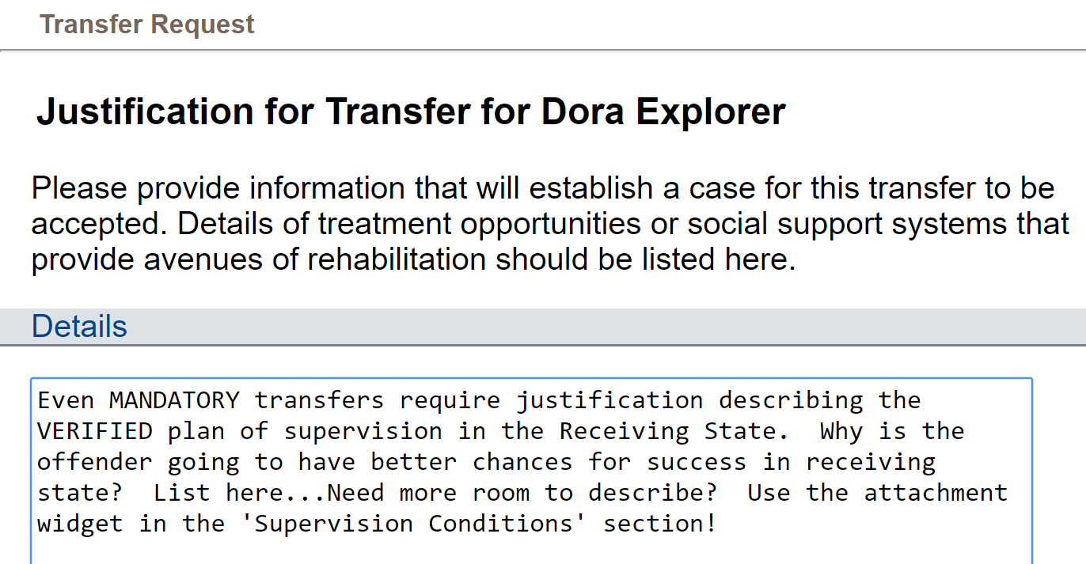

Justification for Transfer
Detailed VERIFIED justifications!!!
Why is the supervised individual going to be more successful in the Receiving State?
Describe support system
Means of support
Living situation
Use clear, concise language; no abbreviations

Slide 20
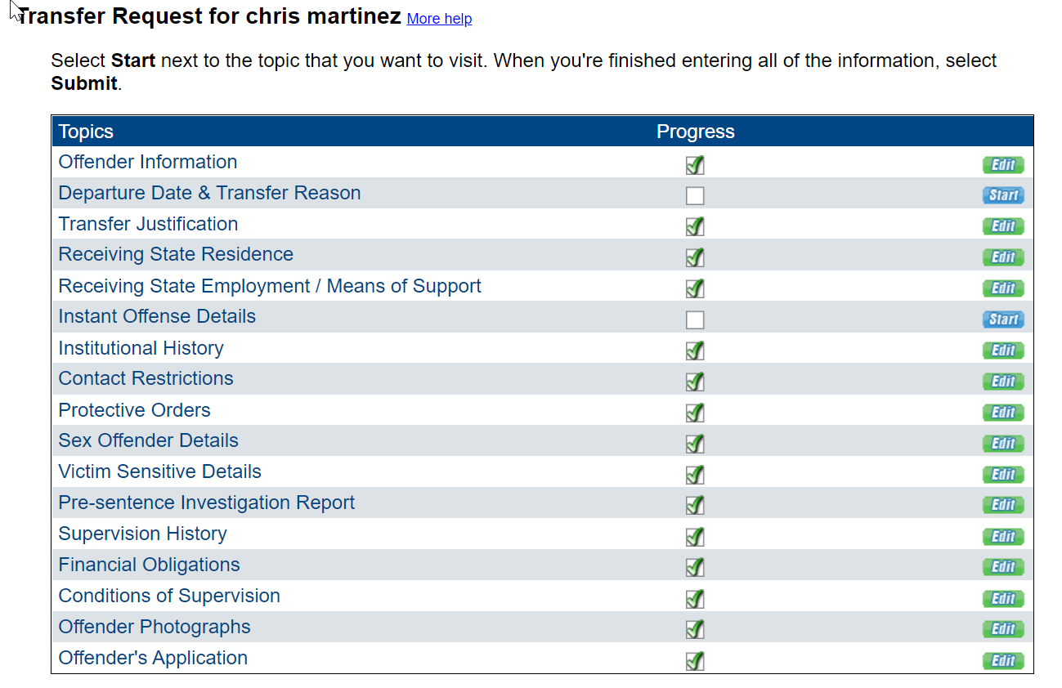
Required Attachments
Copy of signed Offender Application
Instant Offense DETAILS
Photo
Conditions of Supervision
Financial Obligations (order by Court)
Supervision history (only if currently on supervision for more than 30 calendar days)
PSI (if it exists or is not prohibited for distribution)
If Applicable: Sex offender registration requirements Orders of restriction Known protective orders Known gang affiliation Prison discipline and mental health history of last 2 years

Slide 21
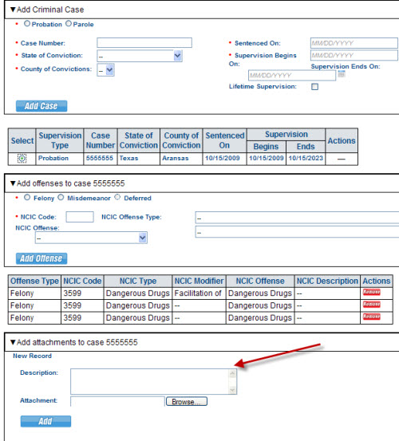
Offense Details
#1 Add criminal case information
#2 Add offenses to case Enter NCIC code or use drop-down
#3 Attach details of offense (Narrative, Police Report, etc.)

Slide 22
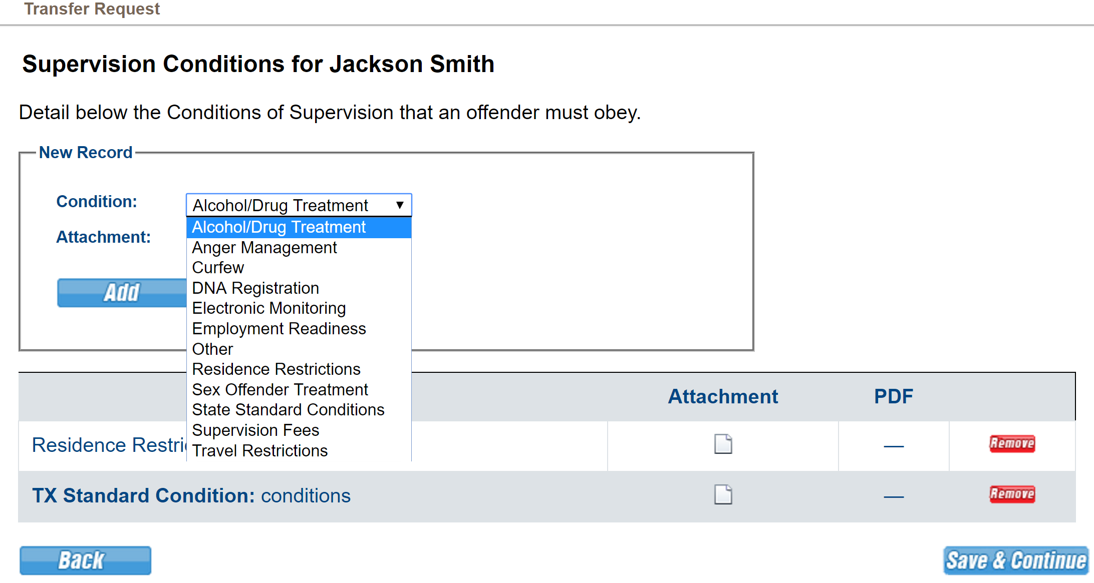
Conditions of Supervision

Slide 23
Sex Offenders
3 Types per ICAOS Definition
Additional Transfer Requirements
Following acceptance
If Available:
Assessment Information
Victim Information
  Demographics
  Statement
Supervision or Treatment plan - current or recommended
If requested (and available,) provide to the receiving state within 30 days
Risk Needs Score
Information related to PRIOR sex offenses
Other documents to assist in supervision
Registered in the sending state
Required to register in the sending state
Subject to sex offender terms and conditions in the sending state

Slide 24
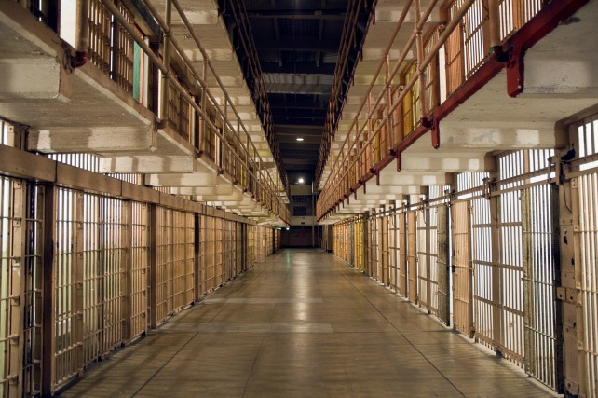
Submit request within 120 calendar days prior to release date
Sending state shall notify receiving state if:
Pre-Release Transfer
the planned release date changes, or
if release date has been withdrawn or denied

Slide 25
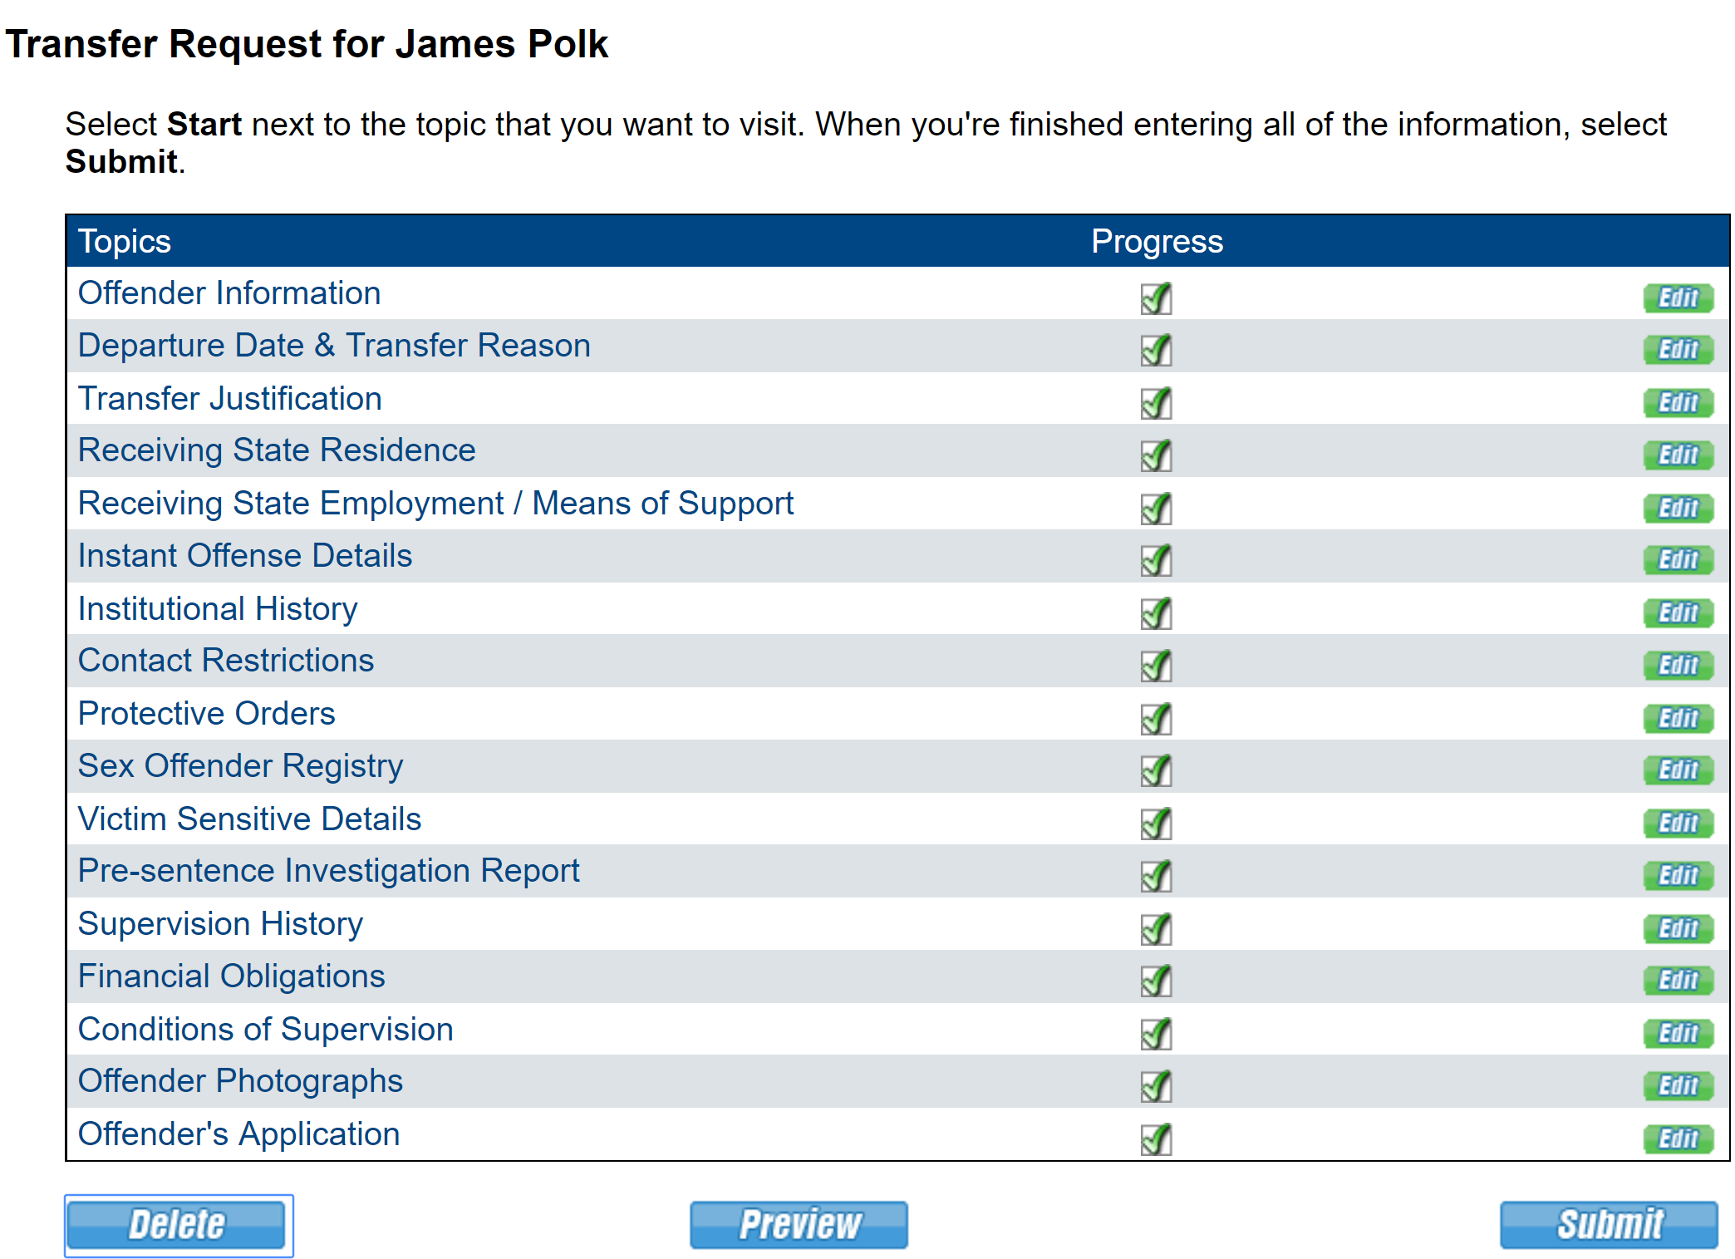
Submission of Transfer Request
Last Chance to Delete!

Slide 26
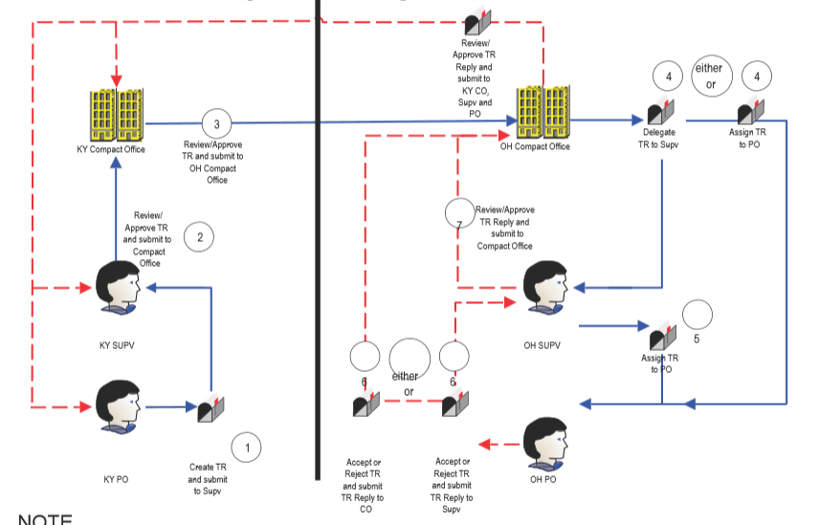

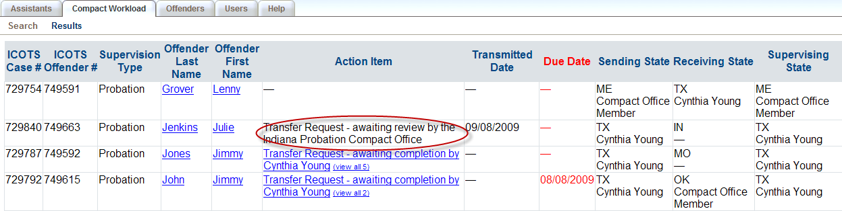
Check Status of Transfer Request
Compact Workload
Offender’s Profile (Action Items)

Slide 27

No Travel Prior to Acceptance
Investigation Period
Up to 45 days
Reporting Instructions Exceptions:
Living in Receiving State at the time of Sentencing
Military Members/Veterans Receiving Treatment/Employment Transfer
Other verified Emergency Situations (both states must agree)
OTHER: Daily travel (border) allowed for medical/employment ONLY must return daily and notify of travel via ICOTS
Notes:
Ris Provides temporary permission for supervised individual to be in a receiving state during the investigation.

Slide 28

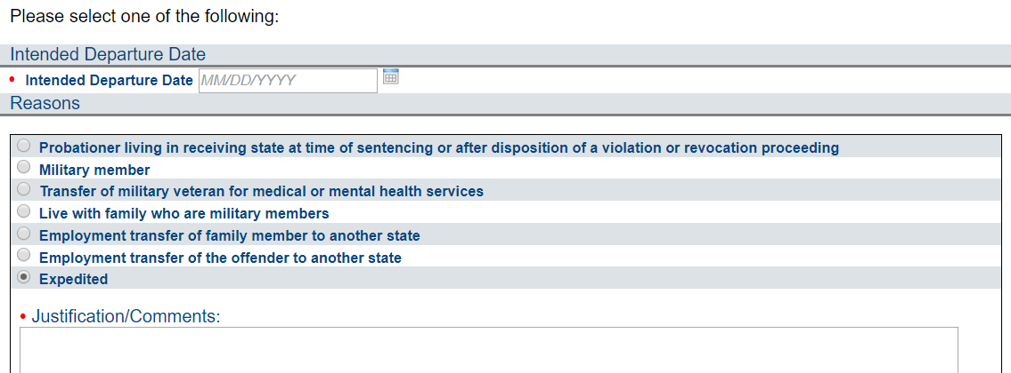
Reporting Instructions
Provides permission for supervised individual to be in the receiving state PRIOR to acceptance
Qualifying for mandatory reporting instructions does NOT automatically qualify as a mandatory transfer

Slide 29

Living in Receiving State vs. Compact Definition of Resident
Living in Receiving State
RI REASON
Resident
TRANSFER REASON
  Lives in the receiving state when sentenced to probation in the sending state and needs to go home after sentencing or sentenced remotely
Lived in receiving state for 1 year (continuously and immediately) prior to supervision start date or sentencing date

Slide 30
Reporting Instructions
Living in the Receiving State at the Time of Sentencing
Requests must be submitted within 7 days of:
Initial sentence to probation supervision, OR
release to probation supervision from incarceration (6 months of less,) OR
disposition of violation/revocation hearing
TIP: Submit Transfer Request prior to release. If approved, request for reporting instructions is not necessary
ONLY reason for reporting instructions in which a travel permit may be issued (non-sex offenders) prior to reply from a receiving state
        Be sure to inform supervised individual of the
        Reporting Instructions when received!!!

Slide 31
Reporting Instructions Documentation Requirements
Verify residency PRIOR to issuing a travel permit.
Military Orders
Approval/Referral
Employer documentation stating the transfer is directed by employer to maintain employment (NOT for new job opportunities/promotions)
Any other emergency reason. Both states MUST agree
ALWAYS JUSTIFY!
Sex Offender (All reasons) must include:
Offense details
Conditions of supervision
Contact Restrictions
Victim Information (Name, Sex, Age, Relationship)
Notes:
LIRS: Provide documentation

Slide 32

Reporting Instruction Timeframe Requirements
Receiving State
Sending State
  Respond to Reporting Instructions Requests
  2 business days
  Sex Offenders: 5 business days
  Send Transfer Request Timely!
  15 business days
  7 business days after approved expedited reporting instructions

Slide 33

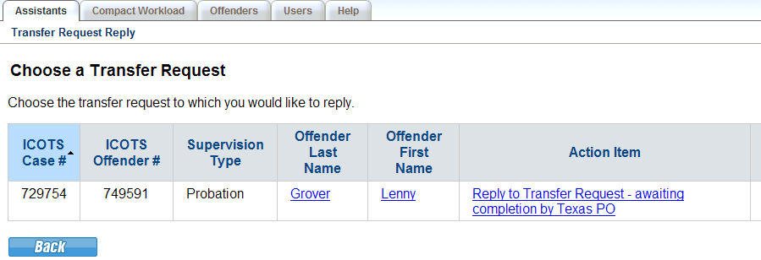
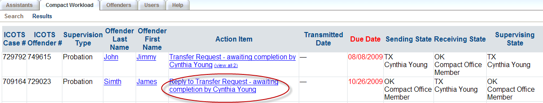
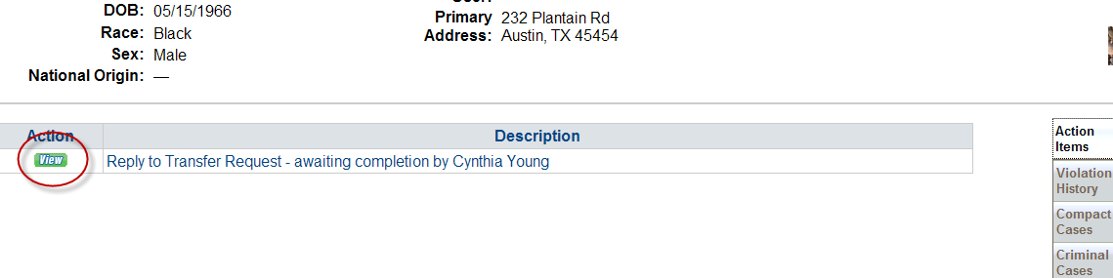
Transfer Reply
Email is sent to user assigned
Access activity from Assistants, Compact Workload or Offender Profile

Slide 34
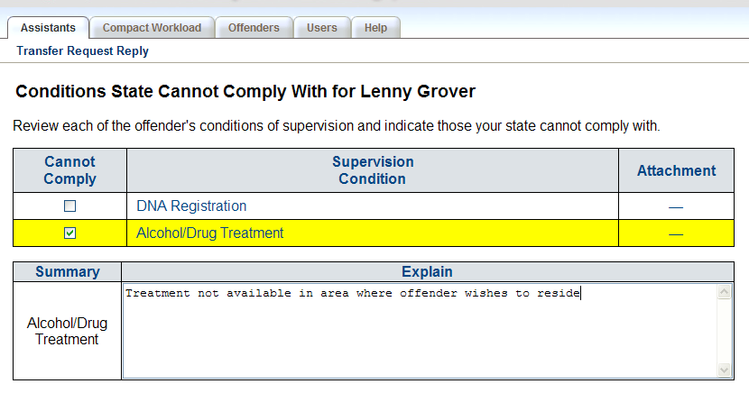
Transfer Reply
Provide details as to why a condition cannot be imposed
Inability to enforce a condition is NOT a valid reason for rejecting a transfer
Sending state authorities decide whether condition can be removed

Slide 35
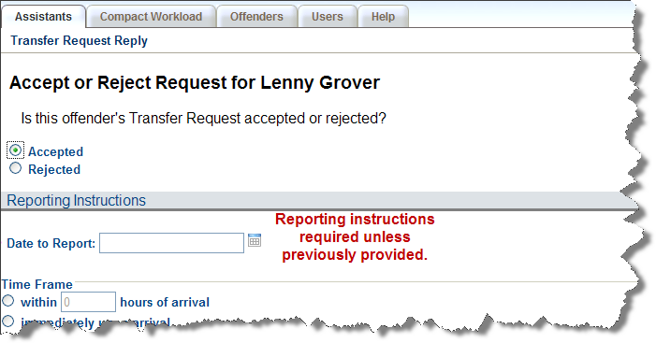
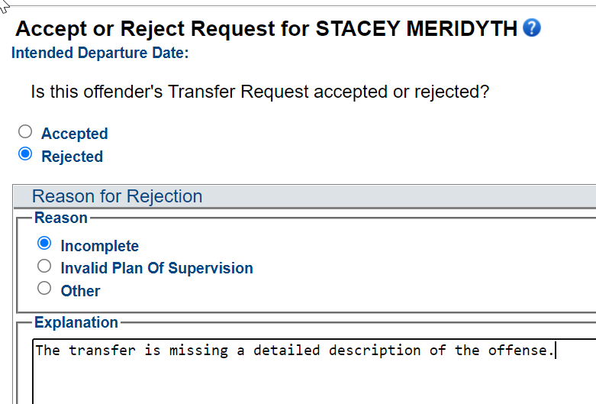
Transfer Reply
Acceptance
Valid for 120 Calendar Days
Rejection
Be specific: Reason for rejection must be consistent with the purpose of the compact articulating why plan would not be approved if convicted in your state

Slide 36

Invalid Transfer Rejections
Individuals with disabilities (Rule 2.108)
Individuals with pending charges (obtained before or during investigation period; AO 8-2005)
Undocumented immigrant (AO 13-2006)
Section 8 housing (AO 2-2007)
Discretionary Cases without addressing the justification (3.101-2)

Slide 37
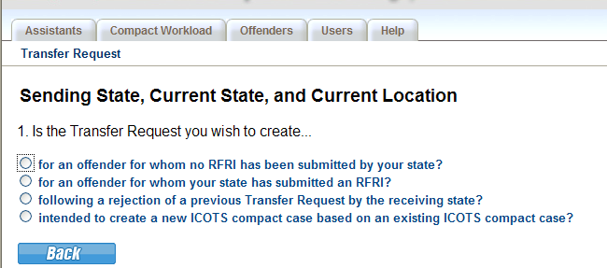
Resubmission AFTER Rejection
Supervised individuals in the receiving state with approved reporting instructions may remain there if a new Transfer Request is submitted within 15 business days

Slide 38
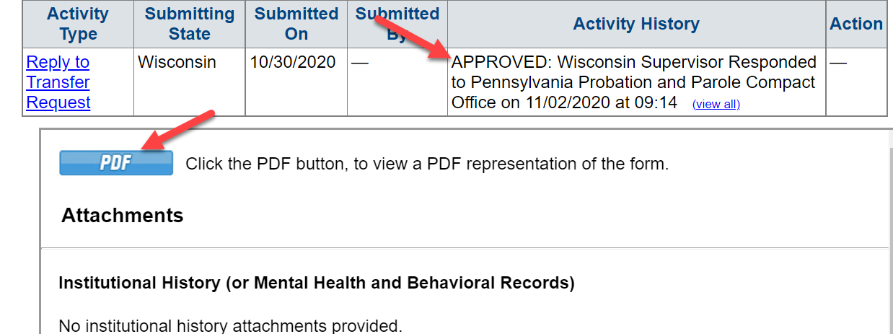
Transfer Approval
Receiving State’s Compact Office Transmits Reply
  Email is generated to sending state users
    Compact Office, PO Supervisor & PO
  Activity History (Offender Profile) reflects the decision of the Transfer Reply
  Sending state should be sure to review the pdf and attachments for details
After Approval, Receiving State may request (via transfer reply or compact action request) additional items needed for supervision.
Sending State must send within 30 calendar days.
See Rule 3.107

Slide 39
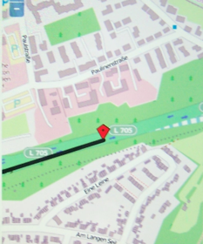
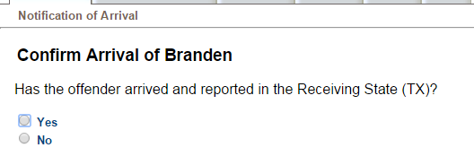
Tracking Movement-Notices of Departure/Arrival
Sending State
Receiving State
  Notice of Departure Due when supervised individual departs
  Failed to arrive as instructed? Warrant may be required
  (NOFA triggers warrant status needed notifications)
  Notice of Arrival when supervised individual arrives and reports as instructed
  (must be within 5 business days of departure)
  Officer becomes the ‘supervising user’ in ICOTS
Rules 3.104-1 & 4.105

Slide 40
Victim’s Rights
Victim’s Right to be Heard
Victim Notification
Victims can contact Sending State’s compact office
Victims have 15 business days after notification of transfer to give input
  Receiving state shall continue to investigate
Victim’s Comment ALWAYS Confidential
Victim notification shall be initiated:
In accordance with the sending state’s laws and procedures
Within 1 business day of either:
  Issuance of Reporting Instructions; or
  Acceptance of a Transfer Request

Slide 41
Supervision in the Receiving State

Slide 42


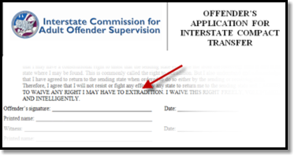
Compact Supervision Elements
Duration
Conditions
Waiver
Sentencing Authority in the Sending State determines duration of Supervision
Supervised individual agrees to conditions imposed by BOTH Sending & Receiving States
Supervised individual applying for transfer WAIVE rights for extradition
Notes:
As a precondition to transfer supervision, ALL supervised individuals must sign the supervised individual application for transfer agreeing to waive extradition from any state. This is EXTREMELY IMPORTANT as it replaces the need for an extradition hearing in the Receiving State and the need for a Governor's warrant by the Sending State in order to apprehend an supervised individual.
This form clearly states, “…I will not resist or fight any effort by any state to return me to the sending
state and I AGREE TO WAIVE ANY RIGHT I MAY HAVE TO EXTRADITION. I WAIVE THIS RIGHT FREELY,
VOLUNTARILY AND INTELLIGENTLY.”

Slide 43

Compact Supervision in a Receiving State
Supervision standard consistent with similar supervised individuals sentenced in the Receiving State
Same programs, incentives, sanctions/interventions
‘Participation in the ICAOS ensures not only the controlled movement of supervised individuals under community supervision, but also that out-of-state supervised individuals will be given the same resources and supervision provided to similar in-state supervised individuals including the use of incentives, corrective actions, graduated responses and other supervision techniques’
Notes:
Once allowed to transfer, receiving states have to provide supervision consistently in how they would supervised an supervised individual sentenced in the receiving state. Although most states fulfill this requirement well under the compact requirements, it can be a training issue for stakeholders involved in supervision decisions or rehabilitation programs.

Slide 44

Requirements during Supervision
Progress Reports
Registration
Fees
Regular supervision updates
  Requests for PR’s from sending state (via specialized CAR) must be sent within 30 calendar days
Notify when adding or updating conditions
Inform of compliant AND non-compliant behavior
Receiving states required to assist the sending state
  E.g., DNA Testing
Sending States
  May impose an application fee
  May NOT impose supervision fees after transfer
  Solely responsible for collection of financial obligations
    E.g., court fees, child support, restitution, etc.
Receiving States may impose supervision fees
  AFTER acceptance
  Consistent with fees paid by instate supervised individuals
https://www.interstatecompact.org/resources/fees

Slide 45
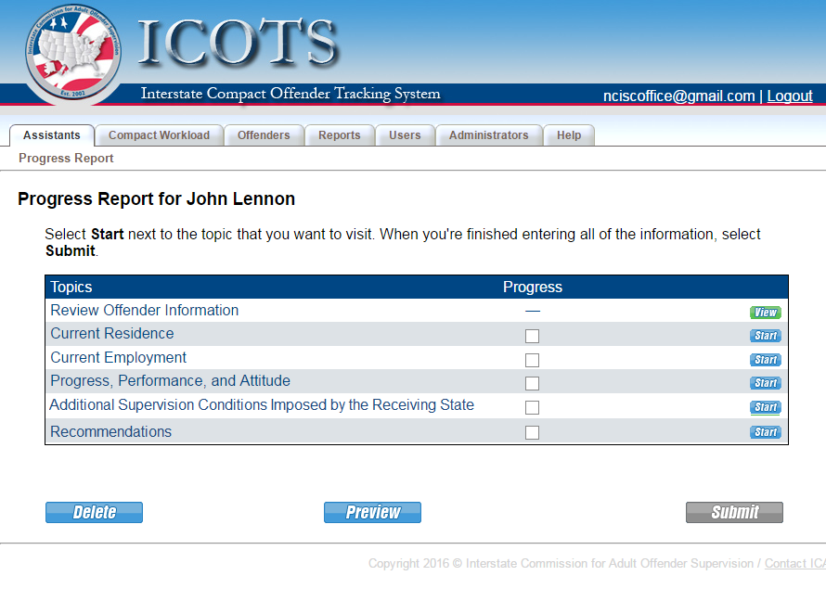
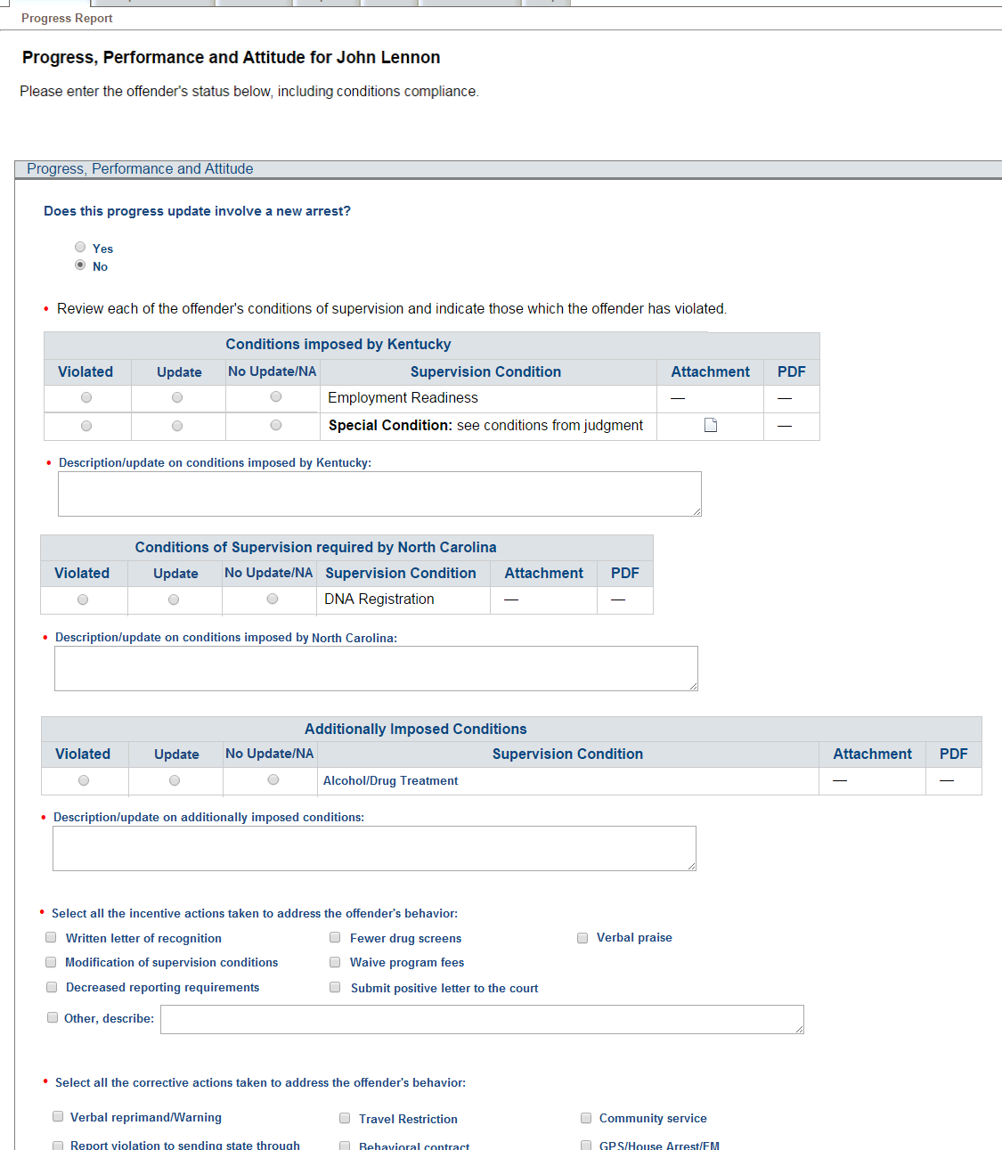
Progress Reports
Keep Sending State informed!
  Supervision Update
  Ability to add new conditions imposed
  Documentation on compliant & non-compliant behavior that DOES NOT require retaking
  Report New Arrest
Note: If reporting BOTH new arrest & violation of conditions, 2 progress reports may be needed

Slide 46
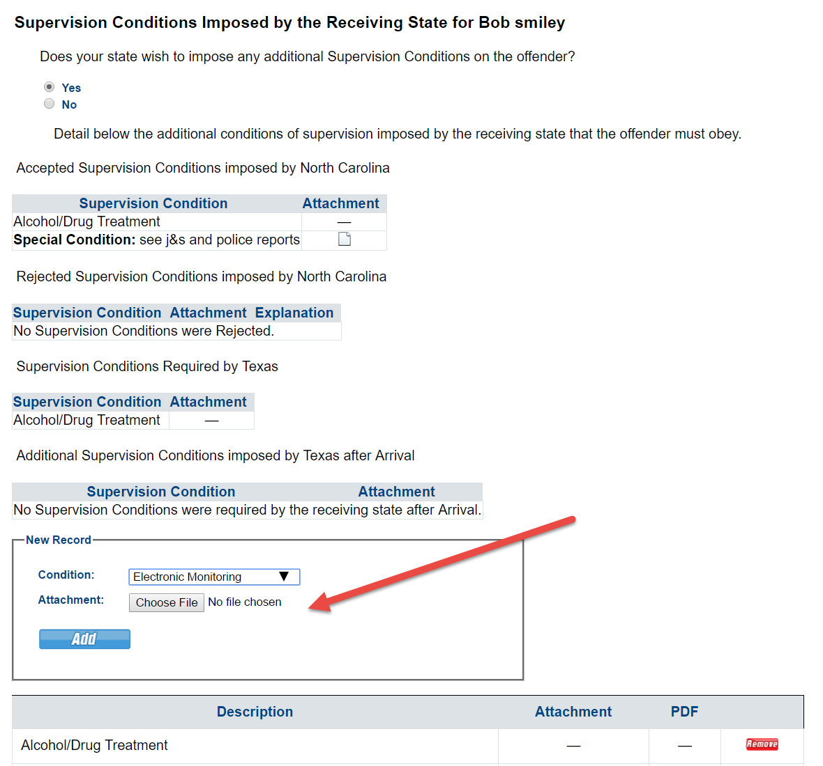
Progress Report Managing Conditions
View conditions of Supervision
Inform/Add New Conditions

Slide 47
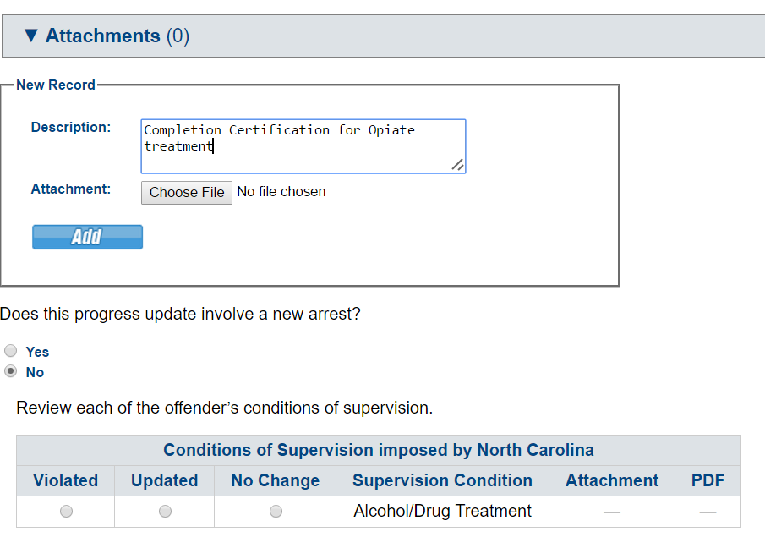
Progress Report Status of Conditions
Report compliance/non-compliance on conditions of supervision
Attach documentation

Slide 48
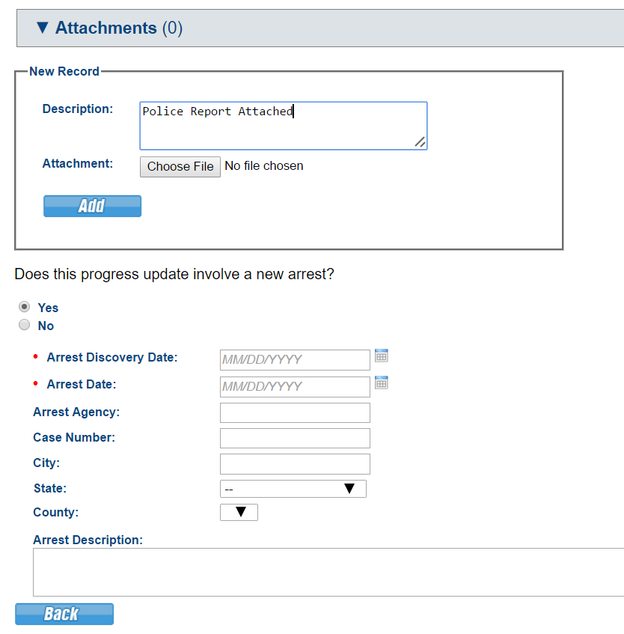
Report New Arrest
Notes:
If reporting on both send 2 progress reports

Slide 49
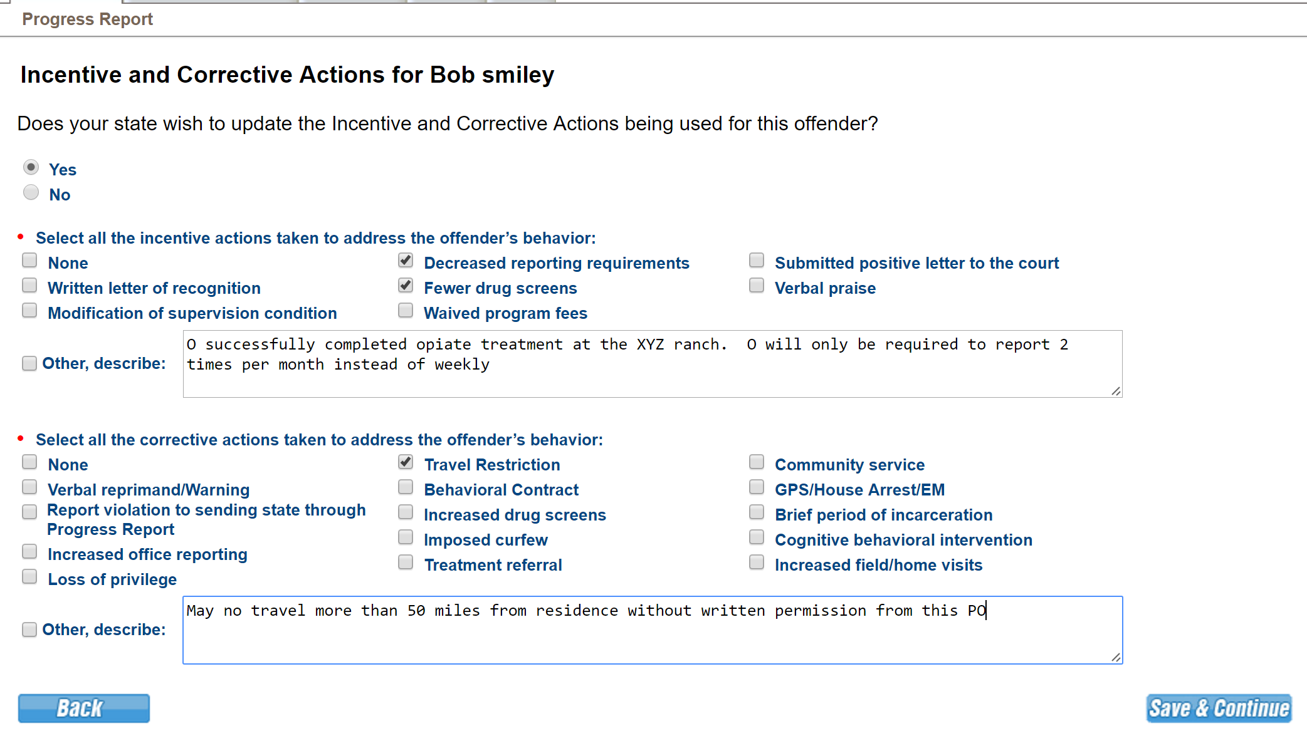
Progress Report Incentives & Sanctions
Don’t Forget to include OUTCOMES/RESPONSES for Corrective Actions Imposed!!

Slide 50
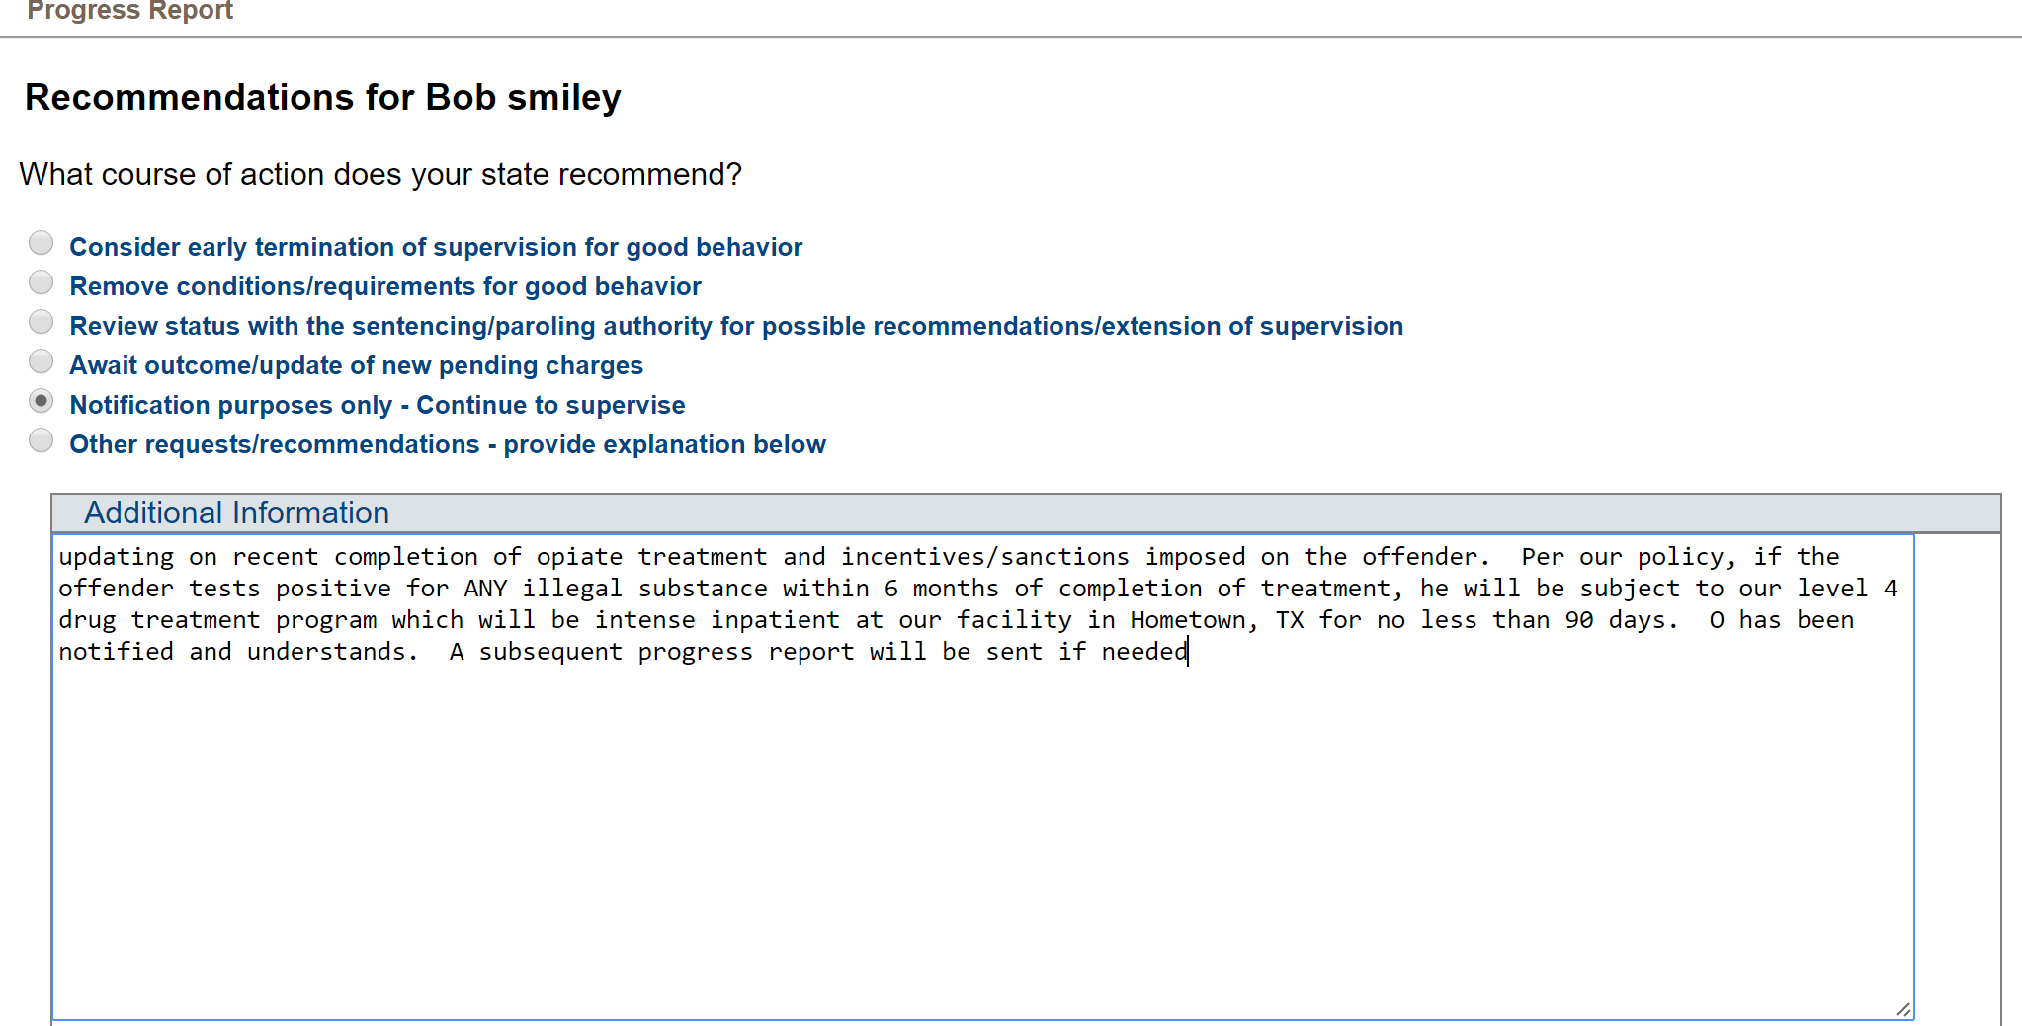
Progress Report Recommendations

Slide 51
Other Communication & Travel Permit Notifications
Use Compact Action Requests for other Communication
Generates an email notification to the other state
Does not appear on Compact Workload as pending action
Available to both the Sending State User & Receiving State User once assignments are made
Specialized: Travel Permit, Subsequent State Transfer, Link to Compact Activity & Request/Withdraw Request for Progress Report
REQUIRED (per Rule 3.110) when issuing a travel permit to the Sending State
  Intended to assist sending state w/ victim notification when supervised individual is traveling back to a sending state
  Notification is not required for known travel for employment or medical appointments

Slide 52

Returning to the Sending State
Requires Reporting Instructions Request for Transferred supervised individual Returning
ALWAYS provide Reason for Return
Transferee’s Request
After Rejection
In Lieu of Retaking
Applies to supervised individuals in receiving state with Reporting Instructions
DO NOT request return reporting instructions if appropriate for supervised individual to remain pending review of an alternate plan
ONLY allowed for:
  Discretionary return invoked by a sending state, OR
  Return in lieu of retaking for ‘behavior requiring retaking’ (Rule 5.103)
NOT allowed when retaking is required for a new crime!
This Photo by Unknown Author is licensed under CC BY-SA

Slide 53
Workflow for ALL Returns
Receiving State
Sending State
  Request RI’s: Provide Reason!
  NOD & CCN upon departure
  Supervisory Authority Ends
Respond to RI Request
(2 business Days)
NOA confirm arrival
Failed to arrive? Issue Warrant
CCN Response
CASE CLOSED

Slide 54
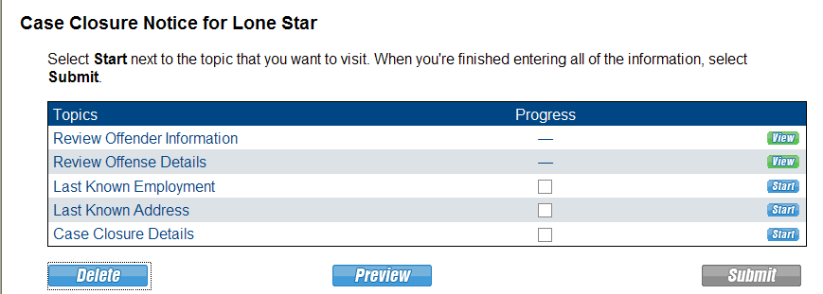
Case Closure
Date of discharge (termination) of supervision
Notice to sending state the supervised individual absconded the receiving state
  OVR must precede closure
Notice to sending state of incarceration for 180 calendar days or longer; include:
  Judgment and sentencing documents
  Information about the supervised individual’s location
Notification of death
Return to sending state
  Cannot close during retaking
  Rule 4.112
The sending state must submit a case closure reply within 10 business days of receipt

Slide 55
Warrants, Discretionary Retaking &
Reporting Violations Requiring Retaking
Violation Report = Mandatory Retaking!!!

Slide 56
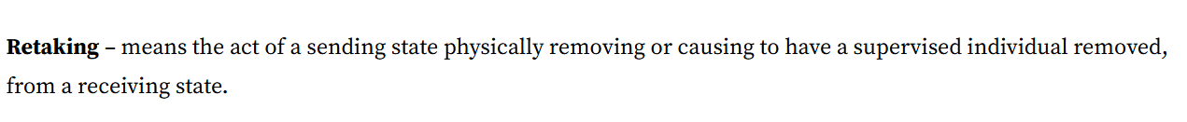
Retaking Definition
Sending State:
  Issue Compact compliant ‘warrant’
  Incur cost of Retaking Supervised Individual
Receiving State:
  Incur cost to incarcerate pending retake
  May require establishing PC
Supervised individuals subject to retaking shall not be entitled to bond/release conditions pending retaking Rule 5.111

Slide 57
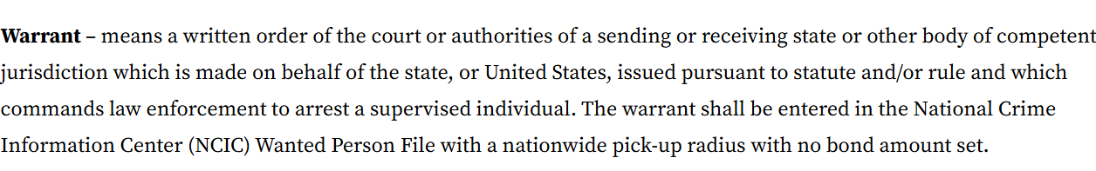
Warrant Definition
Warrants are required when:
Supervised individual fails to arrive as instructed
Receiving State requires retaking as supervision is no longer feasible and
  supervised individual is reported as an absconder; or
  supervised individual is subject to mandatory retaking for behavior requiring retaking (exception exists to allow return in lieu of retaking See Rule 5.103; or)
  supervised individual commits a new felony or violent crime
Sending State discretionarily retakes

Slide 58
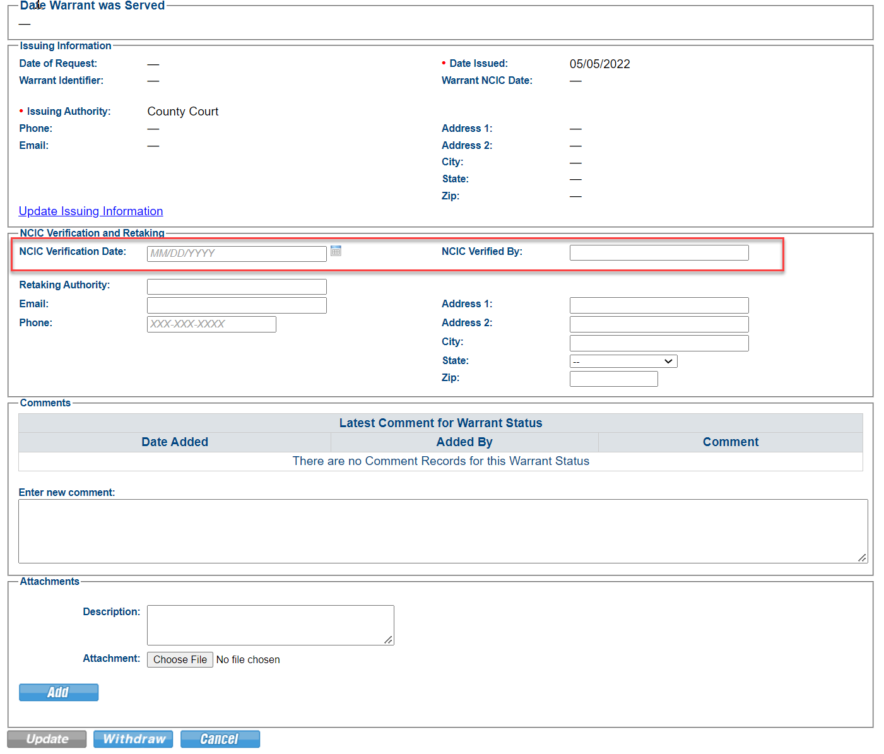
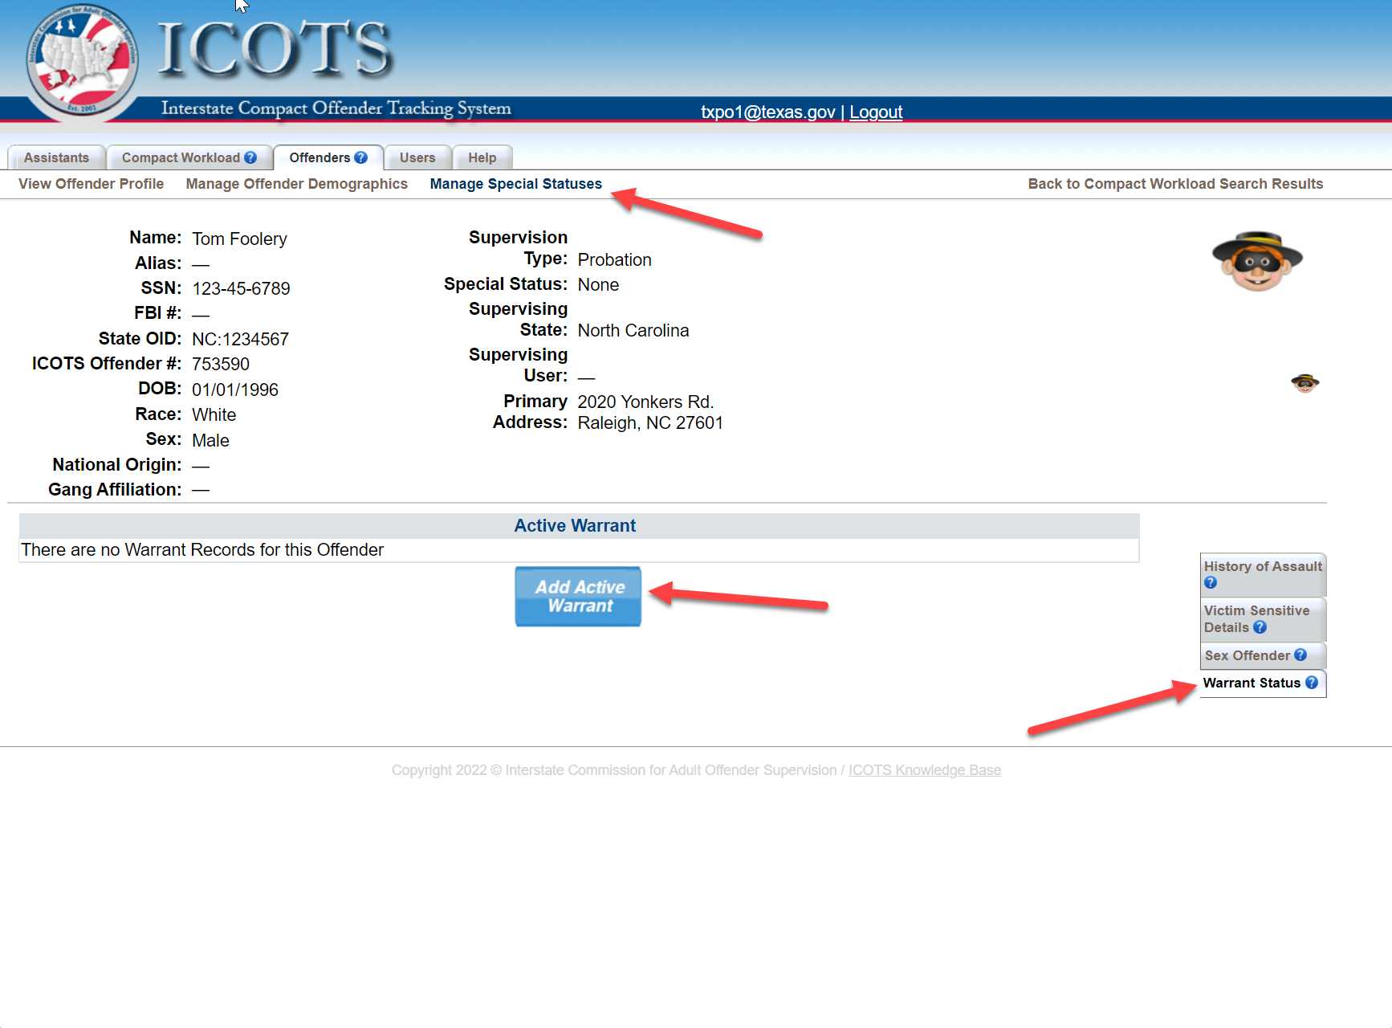
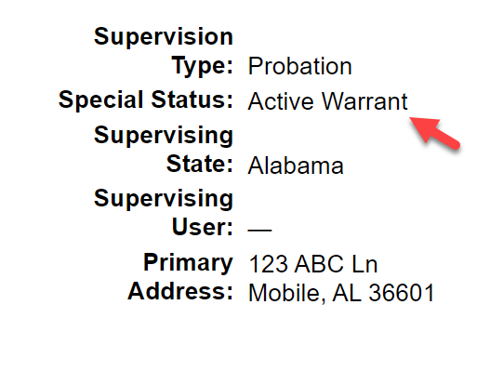
ICOTS Warrant Status
Enter verification date AFTER confirming warrant is compact compliant
No geographic limits
No bond
Entered into NCIC
All warrants issued by a sending state in accordance with ICAOS rules must be entered into ICOTS

Slide 59
Discretionary Retaking & Mandatory Retaking
Discretionary
Retaking
Mandatory
Retaking
Initiated by the SENDING STATE
  Typically sentencing officials such as Courts/Parole Boards
Requires Sending State Notification via Discretionary Retaking Activity
  ONLY retaking via Warrant
    Submit within 15 business days of warrant issuance
  Return in lieu of retaking? Request RI’s DO NOT USE Disc Retaking Activity
Warrant Entry into ICOTS
Invoked by the RECEIVING STATE for:
  Revocable behavior
  Commission of new felony/violent crime
  Absconder
Documentation illustrates all efforts to correct non-compliant behavior has been exhausted and receiving state would revoke supervision
  Probable cause (waiver or hearing) may be required unless violation is a new crime conviction

Slide 60
Behavior Requiring Retaking
“behavior would rise to level of revocation of supervision because…”
Utilize Violation Report
Utilize Progress Report
Act or pattern of Non-Compliant Behavior
Would Request Revocation of Supervision
RETAKING
Unsuccessful Supervision Documented
Non-Compliant Behavior
Would Apply Sanctions OR Corrective Actions
Address Behavior & Report to Sending State

Slide 61

Court/Parole Board in your jurisdiction revokes SUPERVISION for similar behavior
Extending/modifying supervision term is NOT revocation
RETAKING
Unsuccessful Supervision Documented
Exhausted options to address non-compliant behavior
Revocation of SUPERVISION would be likely for instate similar supervised individual
Revocation is NOT simply reporting a condition violation to the court.
Revocation: Sentencing authority terminates supervised release and incarcerates the supervised individual
Notes:
Absconder apprehended, but sending state could not pick up or transport-
Receiving state agreed to resume supervision until such a time as sending state could make arrangements

Slide 62
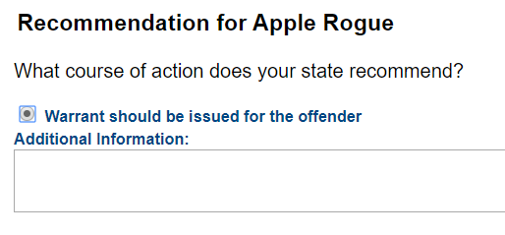
Use of Violation Report Requires Retaking
Reports “behavior requiring retaking”
Recommends revocation of supervision
Enforces retaking rules
Manages retaking
  All communication regarding violations via Violation Reports & Violation Addendums

Slide 63
Violation Reports Requiring Retaking
Receiving State
Sending State
Submit Violation Report within 30 calendar days of discovery or determination supervision is no longer a viable option
  Include Supporting Documentation
    Police reports
    Toxicology reports
    Preliminary findings
    Details/Status of infraction
  Incentives/Sanctions applied and responses
  Ensure ‘Availability’ Status is correct
Respond within 10 business days

Slide 64

Violation Report Considerations
1
2
3
4
The sending state is only going to know what you tell them.
Use the same detail if reporting to your own authorities.
Specifics on how the behavior would result in revocation of supervision.
State how and why the option of working with the individual (e.g. intervention)has been exhausted.
Violation reported is revocable behavior
“violation would rise to level of revocation because…”
Reported timely
Requiring return/retake
Availability status accurate
Ensure no pending charges exist
Supporting documentation included
“Story” provided on why supervision is not successful
Review supervised individual profile to ensure consistency/accuracy

Slide 65
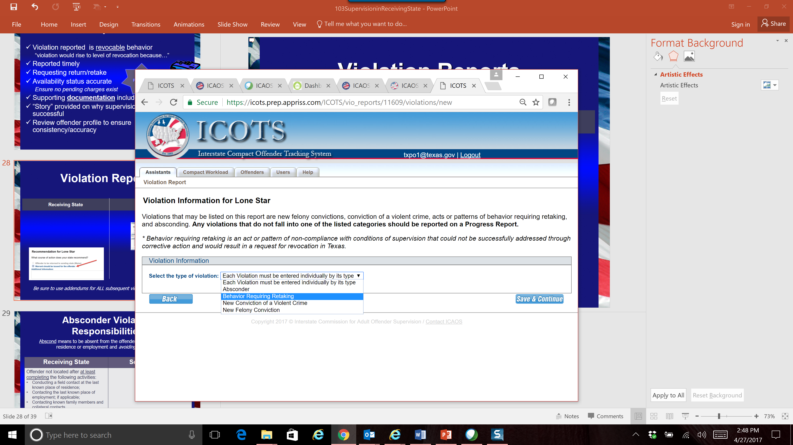
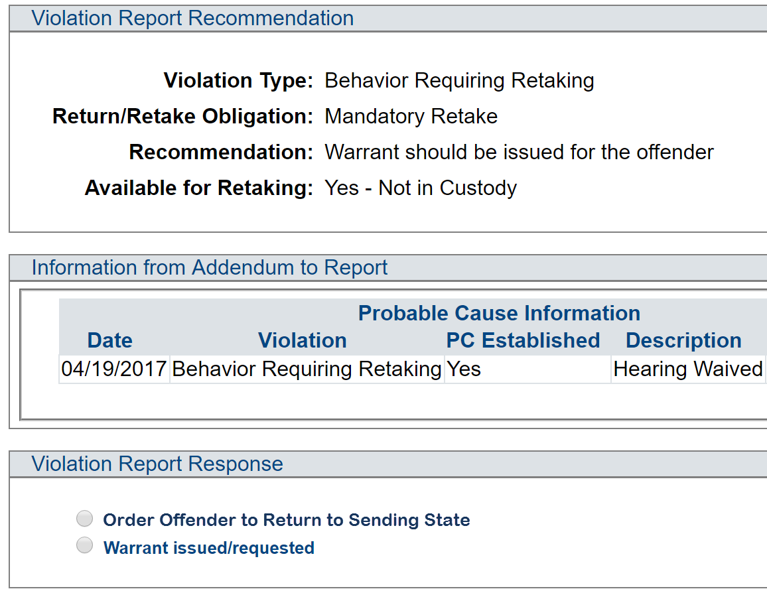
Violation Reports Requiring Retaking
Receiving State
Sending State
Be sure to use addendums for ALL subsequent violation correspondence

Slide 66
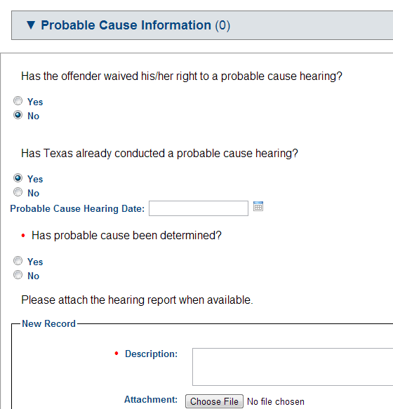
Violation Reports Probable Cause Status
Probable Cause Status
When there is a possibility of revocation of supervision once retaken/returned to the sending state, the supervised individual has a RIGHT to a PC hearing near where the alleged violations occurred prior to retaking
Not required if violation is new conviction
Although not required without request from sending state, establishing PC should be expected prior to retaking
Additional PC Training in next section
Waiver must include admission of a violation that would result in pursuance of revocation of supervision in YOUR STATE.
Hearing Reports must comply with Rule 5.108 and hearing officer must conclude there is probable cause of a violation that would result in pursuance of revocation of supervision in YOUR STATE.
Update/Add PC information anytime via Addendum to Violation Report

Slide 67
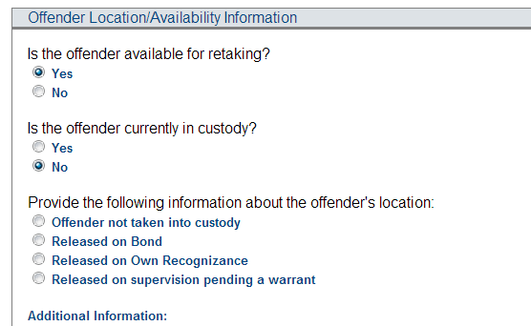

Violation Reports Location & Availability
Available for retaking?
Yes=there is nothing holding the supervised individual in the receiving state
supervised individual is NOT Available if there are pending Violent Crime or Felony Charges unless states (stakeholders) mutually agree
See Rule 5.101-1
Update Location information anytime via Addendum to Violation Report

Slide 68

Absconder Violation Reports
Abscond means to be absent from the supervised individual’s approved place of residence and employment; and failing to comply with reporting requirements.
Rule 1.101 Definitions
Receiving State
Sending State
Supervised individual not located after completing the following activities:
Document ALL communication attempts
Conduct a field contact at last known place of residence;
Contact last known place of employment; if applicable;
Contact known family members and collateral contacts (must include those identified in original transfer request.)
Submit Violation Report (DETAIL Activities )
Submit Case Closure
Issue Warrant within 15 business days
Enter Warrant Details on supervised individual Profile

Slide 69
Warrant Requirement
1
Violation Report Requiring Retaking
=
WARRANT
ONLY Exception: after report of ‘Behavior Requiring Retaking,’ Sending state can order the return of the supervised individual (via reporting instructions) in lieu of retaking
2
Warrant must be Compact Compliant (within 15 business days of OVR receipt)
No Bond
Nationwide
Entered into NCIC
3
Details of Warrant must be entered in ICOTS on the supervised individual’s Profile

Slide 70
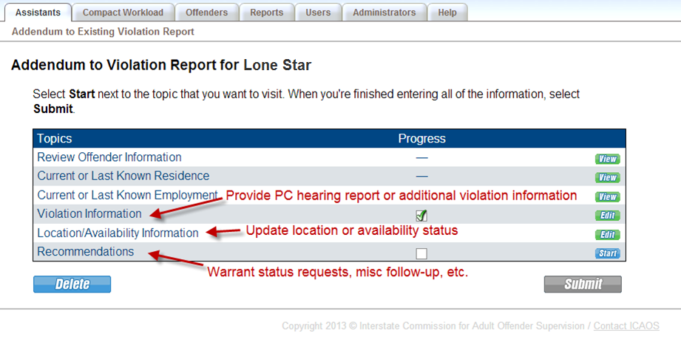
Manage Retaking via Violation Report Addendums
  Cases must remain open in ICOTS until retaking occurs!!
Previously reported absconder(subject to retaking) apprehended in the Receiving State? Reopen case to provide documentation and communication via addendums
E.g. location status, availability, etc.
Ensure accurate/updated information is provided timely

Slide 71
Probable Cause
Rule 5.108
Reference ICAOS Hearing Officer Guide https://www.interstatecompact.org/hearing-officers-guide

Slide 72
Probable Cause & Interstate Compact
US Supreme Court Cases & Rule 5.108
Morrisey vs. Brewer 408 U.S. 471 (1972) (parole)
Gagnon vs. Scarpelli 411 U.S. 778 (1973) (probation)
Why is this important to Compact supervised individuals?
Geographical concerns (violations committed outside of Sending State)
Without PC, violations may be barred from consideration for revocation (Sending State)
Supervised individuals are ENTITLED when revocation is possible (once transfer is granted, it cannot be arbitrarily rescinded)

Slide 73
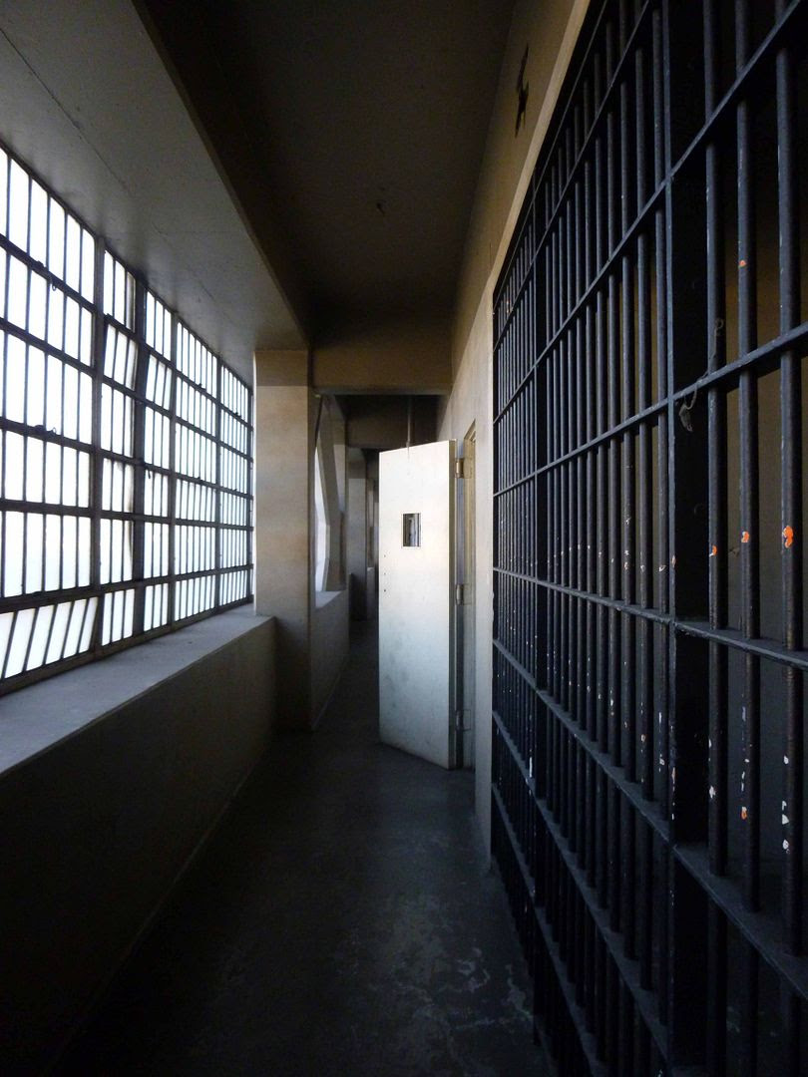
Revocation vs Retaking
Revocation
Retaking
  Sending State terminates supervised release and incarcerates the supervised individual
  Requires PC be established near where alleged violations occurred
  Process to remove or cause a supervised individual to be removed from the Receiving State
  Mandatory: Receiving State invokes based on ‘revocable’ non-compliant behavior
  Discretionary: Sending State may initiate retaking for ANY reason (unless pending felony or violent charges exist)
This Photo by Unknown Author is licensed under CC BY-NC-ND

Slide 74

Purpose of Probable Cause
Test Merit of Violation
Provides evidence the supervised individual likely violated his or her conditions of supervision
Ensure violation meets definition of ‘Behavior Requiring Retaking’
Receiving States should not arbitrarily revoke relocation once granted
Creates Record
To be used in possible subsequent revocation hearing
Who, What, When & Where??

Slide 75
When a Compact supervised individual is Entitled to a PC Hearing
NOT Entitled to a PC Hearing
Entitled to a PC Hearing
No possibility violations committed in receiving state will be used in revocation proceedings in the sending state
  e.g. supervised individual simply returning to resume supervision in Sending State
Violation is based on new conviction
  Conviction is proof the supervised individual committed the violation
  Rule 5.102
Custodial detention based on violations
  Initiated by either the receiving/sending state
  Justifies detention
Violations committed in receiving state may form basis for revocation of supervision
  PC creates record for sending state
  substantiates the violations
Absconder apprehended in the receiving state

Slide 76
Reasons Probable Cause is Required
Justify Custodial Detention
Violations to be used in revocation proceedings
Previously Reported Absconder
Preliminary hearing to justify detention
Sanctioning, not retaking or revocation
May or may not meet requirements of Rule 5.108 (varies state to state)
Retaking for violations
creates record for sending state
substantiates the violations
Ensures certain due process RIGHTS are afforded to the supervised individual prior to revocation hearing
Confirms validity of previous Violation Report
Warrant & Detainer must remain in place!
Reopen ICOTS case to provide PC documentation

Slide 77

Informing the supervised individual
Provide written notice of the alleged violation(s)
Supervised individual decides to
  require hearing; or
  waive his or her rights to a hearing so long as the waiver includes an admission to a ‘revocable’ violation
Probable Cause Hearing
Waive right to hearing

Slide 78
Probable Cause Hearing
Individual’s Rights
Elements of Hearing
Report Requirements
Disclosure of non-privileged/non-confidential evidence
Opportunity to be heard
in person, present witnesses, evidence, etc.
Opportunity to confront and cross-examine adverse witnesses
unless the hearing officer determines that a risk of harm to a witness exists
Conducted by neutral and detached person
Close proximity to where alleged violations occurred
Administrative hearing
Fact finding, no determination of guilt
Level of due process is usually less than a revocation hearing
Send within 10 business days after the hearing
Must include:
Date, time, location of the hearing
Who was present (who testified/who did not)
Clear & concise WRITTEN summary of ALL testimony
What evidence was used in decision?
Specific statements as to which violations where PC found, not found and supervised individual admitted to

Slide 79

Waiving PC Hearing
1
Supervised individual is apprised of his or her rights to hearing
2
Supervised individual does not contest retaking and aware of the facts supporting retaking
3
Signed admission to one or more revocable violations
Admission must be of sufficient gravity to justify revocation in receiving state

Slide 80
Upload PC Documentation
Upload Probable Cause documentation when reporting the violation or later via Addendum to Violation Report

Slide 81
After the PC Hearing….
PC Established
Receiving State | Sending State
May hold the individual in custody pending decision from the sending state | Confirm decision to retake within 15 business days of receipt of the report
 | SHALL retake individual within 30 calendar days once in custody solely held on the sending state’s warrant
PC NOT Established
Receiving State | Sending State
Notify the sending state to vacate the warrant | Vacate sending state’s warrant
Vacate the receiving state’s warrant
If in custody, release the individual back to supervision within 24 hours of the hearing
Continue Supervision

Slide 82


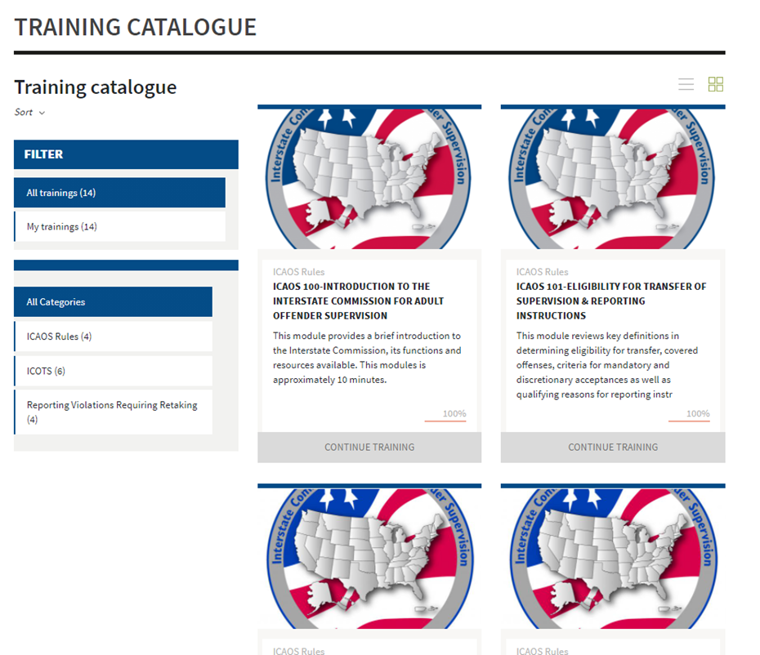
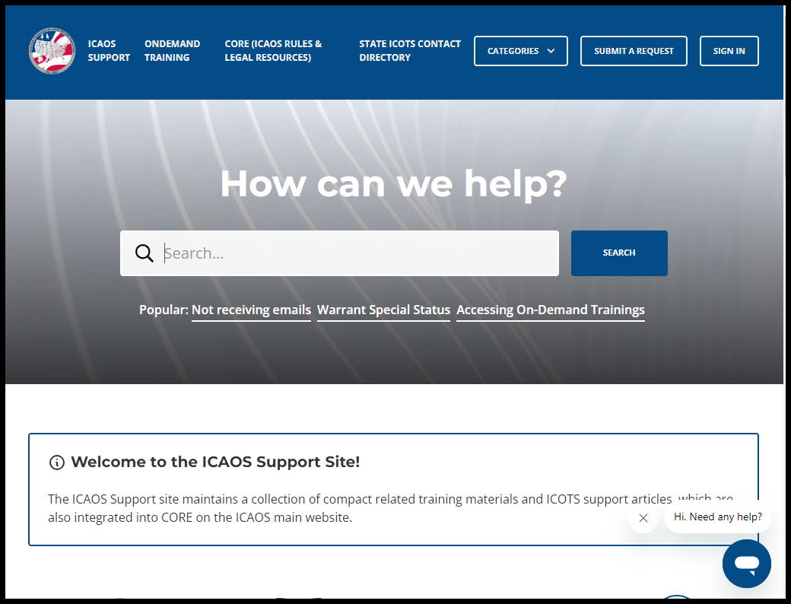
Contact the ICAOS National Office
Email
icaos@interstatecompact.org
Phone
859.721.1050
Website
www.interstatecompact.org
https://www.interstatecompact.org/core-search
https://www.interstatecompact.org/bench-book
https://support.interstatecompact.org/hc/en-us
Office
3070 Lake Crest Circle
Suite 400-264
Lexington, KY 40513

