Slide 1
ICOTS Helpdesk Training
Notes:
This presentation will give you a basic understanding of what the ICOTS Helpdesk is, its purpose, how to submit tickets and how to check the status of existing tickets.

Slide 2
Purpose
Beginning May 1, 2011 the national office is the sole provider of ICOTS helpdesk support for state compact offices
Notes:
As of May 1, 2011 the ICAOS national office will be the sole provider of ICOTS helpdesk support for state compact offices.

Slide 3
Benefits
Single point of contact for compact offices
Simplified ticket submission
Ticket tracking
No additional logins and passwords
Notes:
The designated ICOTS contact in each state compact office will no longer need to guess who to send their issue request to. All ICOTS issues will be sent to the ICOTS Helpdesk at the national office. Users do not need to change how they report issues with ICOTS as all tickets can be submitted and updated via email.
Users will also be able to check the status of their open tickets and review their past ticket submissions.
Additionally, users won’t need to memorize any additional usernames and passwords to login to the Helpdesk portal.

Slide 4
Who Can Submit Tickets?
Single designee from each compact office
End users will be directed to contact compact office
Other compact office users will need to go through designee
Notes:
Only designated ICOTS contacts in each compact office should submit tickets.
End users will still be directed to contact their state compact offices for assistance.
Other compact office users will be directed to go through their designee to submit a ticket.
We need to keep the ticket submission process as streamlined as possible and with limited resources in the national office, restricting who can submit a ticket ensures we will respond to each as efficiently as possible.
Directing tickets through a single point of contact in each compact office also ensures at least one person in each state is aware of all the ICOTS issues affecting their users, while reducing duplicate ticket submission and redundant work.

Slide 5
Submitting Tickets
Notes:
There are two methods to submit tickets to the helpdesk. Via email or the helpdesk portal.

Slide 6
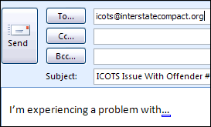
Submit Ticket Via Email
Send email to icots@interstatecompact.org
Notes:
The first method is submitting a ticket by email. Instead of sending an email directly to one of the national office staff, you will send it to icots@interstatecompact.org.

Slide 7
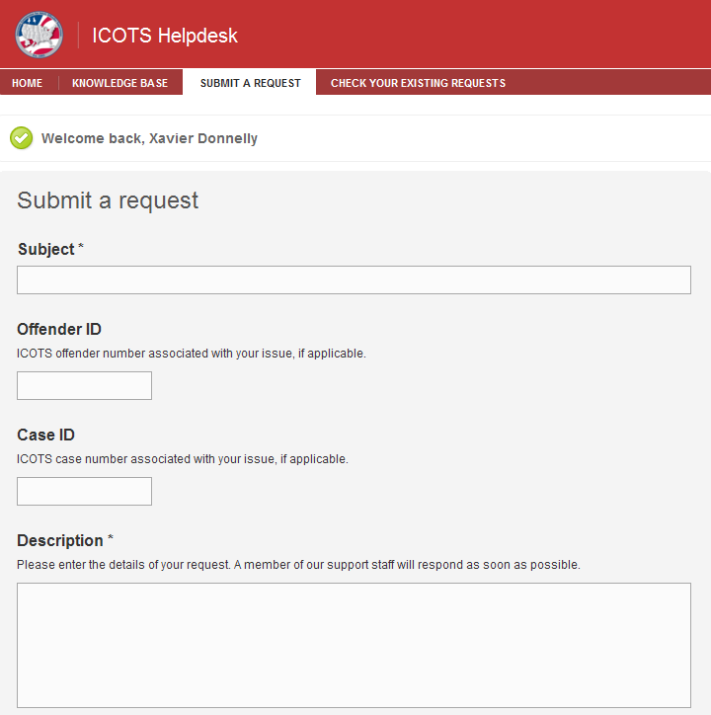
Submit Ticket Via Portal
Login to portal
Click ‘Submit a Request’ tab
Submit web form
Notes:
The second method is through submitting a web form on the helpdesk portal website.
Once logged into the portal, you will click the ‘Submit a Request’ tab at the top of the page. On the next screen, fill out the web form as completely as possible then click ‘Submit’.

Slide 8
Helpdesk Portal
http://support.interstatecompact.org
Notes:
The helpdesk portal is located at http://support.interstatecompact.org.
The portal is the central location for all ICOTS support. It contains the knowledge base and allows users to submit tickets and check the status of previously submitted tickets.

Slide 9
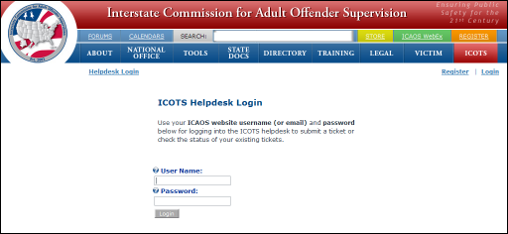
Helpdesk Portal Login
Login with ICAOS website account
Notes:
To login to the portal you just need to use your ICAOS website username and password.
Clicking the ‘Login’ link in the top right hand corner of the page on the helpdesk portal will take you to a screen that looks like the screenshot above. Once you enter your user name, password, and click the login button, you will be redirected back to the ICOTS helpdesk.

Slide 10
Helpdesk Portal
Submit tickets
Review existing tickets
Update tickets
Search knowledge base
Notes:
There are several functions available from the helpdesk portal.
We covered how you can submit a ticket through the portal on a previous slide.
Logged in users can review previously submitted tickets and update any open or pending tickets.
All users can search the knowledge base for ICOTS information including known issues and frequently asked questions.

Slide 11
Reviewing Tickets
Notes:
One of the benefits of the new helpdesk is the ability to review the status of existing tickets.

Slide 12
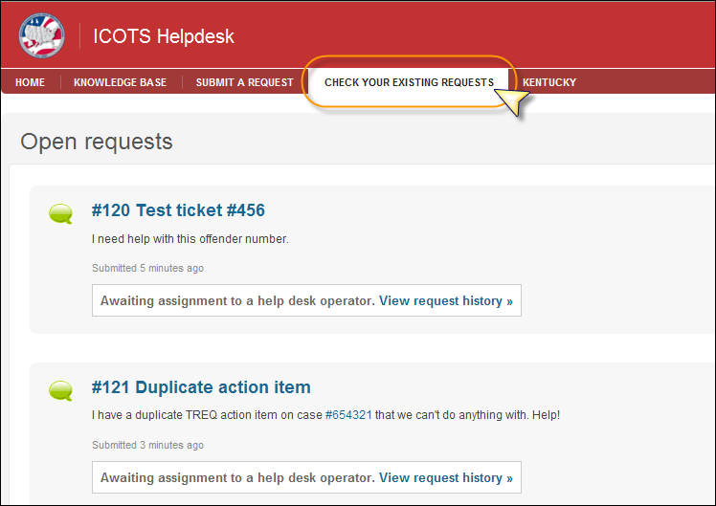
Review Open & Pending Tickets
Notes:
You can review your open and pending tickets by clicking the ‘Check Your Existing Request’ tab at the top of the screen.
A list of all your tickets that have not been solved or closed will be listed including your initial description of the problem.

Slide 13
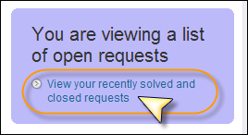
Review Solved & Closed Tickets
Notes:
On the right hand side of the same page, you will see a link to ‘View your recently solved and closed requests’. Clicking the link will bring up a list of all your previously solved and closed tickets.
Clicking the link will bring up a list of all your tickets that have been solved or closed.

Slide 14
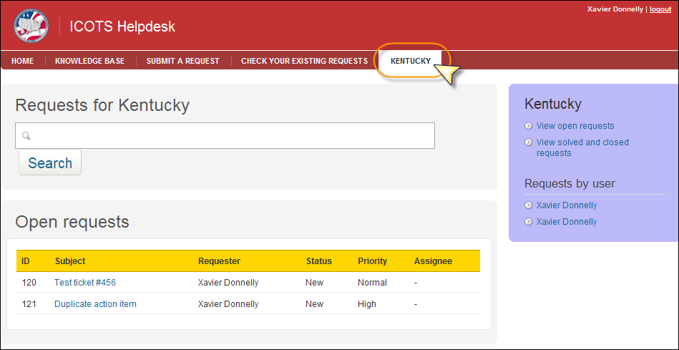
Review All State Tickets
Notes:
Compact office designees will also be able to view all tickets submitted by their state’s users.
You just need to click the state name tab at the top of the page. This will bring up a list of all open and pending tickets from your state.
You can also view all solved and closed tickets by clicking the link on the right hand side. In addition, the portal allows you to view tickets submitted by certain users. Those names will be listed on the right hand side of the page as well.

Slide 15
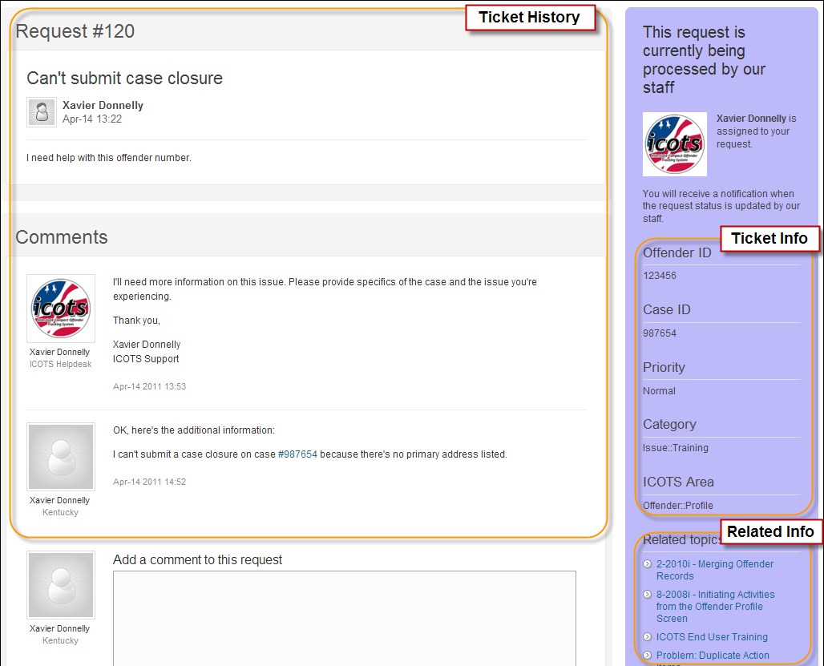
Anatomy of a Ticket
Notes:
When reviewing a list of tickets, clicking the name of the ticket will bring up it’s history and information.
The main part of the screen contains the ticket history with the original ticket description at the top. All comments and attachments will be tracked from oldest to newest down the page. This section of the ticket is also included in each email notification sent out.
On the right hand side of the page is the identifying ticket information, including offender number, case ID, priority, category and ICOTS area. Below that section is a list of related topics from the knowledge base. These articles may be able to address the issues you raised in the ticket.

Slide 16
Updating Tickets
Notes:
Updating a ticket is as easy as responding to an email or submitting a comment on a web page.

Slide 17
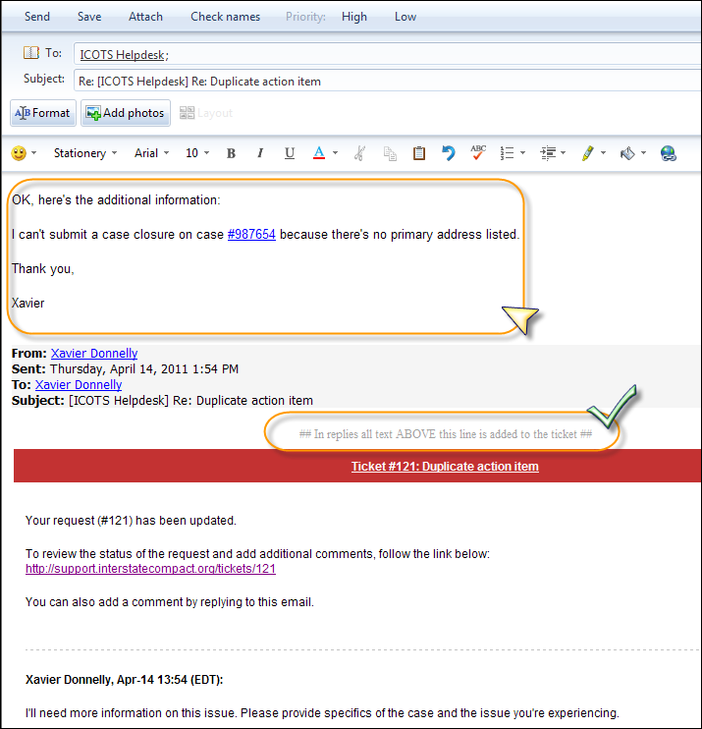
Update Tickets Via Email
Notes:
To update a ticket by email, you simply need to reply to the update notification you received.
You’ll notice the section that says “In replies all text ABOVE this line is added to the ticket”. As long as your response is above that section it will be added to the ticket. Any changes you make below that line will be ignored.
Any email attachments or embedded images will be added as attachments to the ticket.

Slide 18
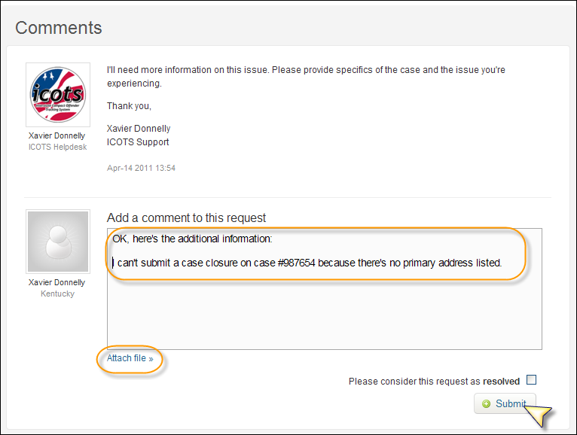
Update Tickets Via Portal
Notes:
Updating a ticket from the helpdesk portal is just as easy. Just enter your comments in the text box, attach any desired files, then click the submit button.

Slide 19
Knowledge Base
Notes:
One of the most useful parts of the new helpdesk portal is the knowledge base. It provides information on known issues and frequently asked questions in addition to training resources and quick tips.

Slide 20
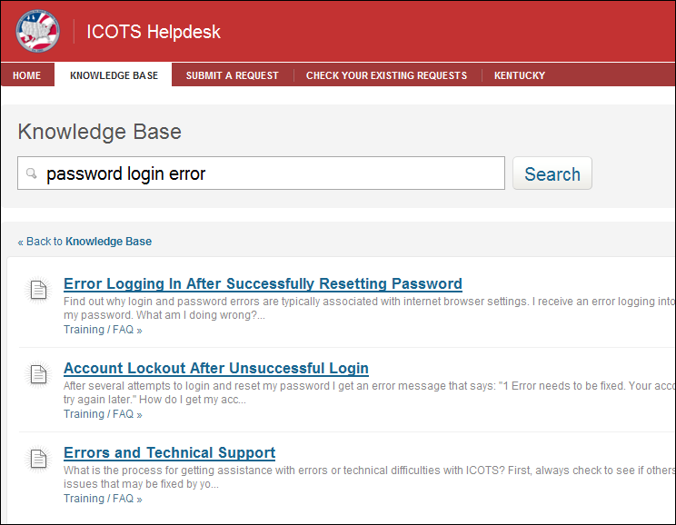
Search Knowledge Base
Notes:
We’ve moved all of the articles from the old knowledge base on the ICAOS website to the helpdesk portal. We’ve also added some new articles to cover more frequently asked questions and issues.
With all of this information in one place, the knowledge base should be the first stop for anyone thinking they have an issue with ICOTS.
As you can see above, the keyword search is very good at matching articles.

Slide 21
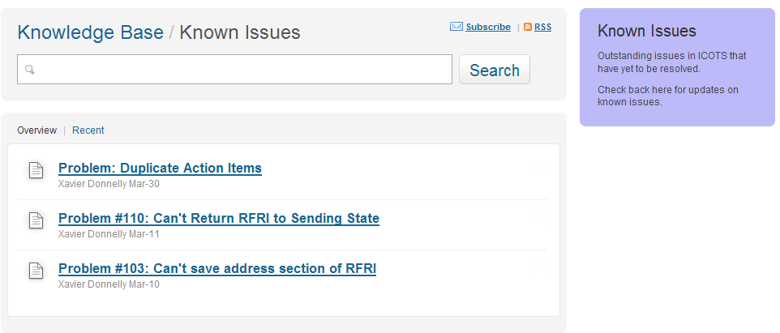
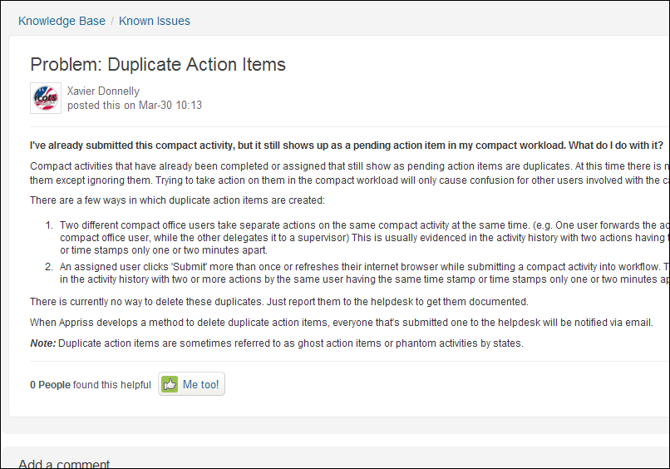
Known Issues
Notes:
We will start tracking all outstanding ICOTS problems in the Known Issues section of the knowledge base.
Any tickets that turn out to be new or outstanding issues in ICOTS will be assigned to a problem number and documented here. Any updates on these issues will also added to the articles.
Once an outstanding issue is resolved or addressed, each ticket assigned to that problem number will receive an email notification with a description of the resolution and changed to solved status.

Slide 22
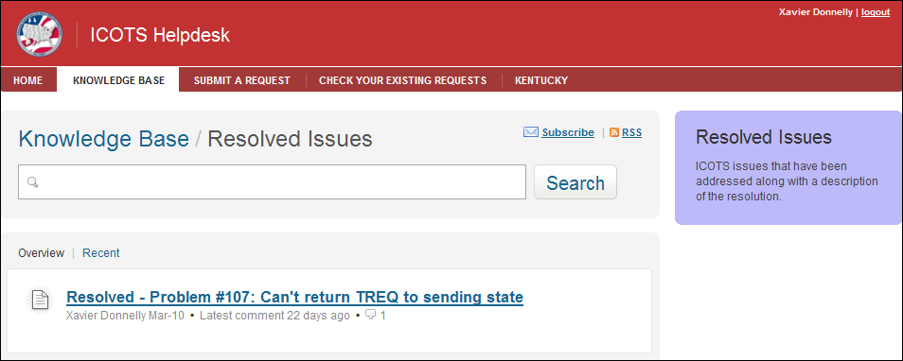
Resolved Issues
Notes:
Once outstanding issues are addressed, they will be moved to the resolved issues section of the knowledge base.

Slide 23
Review
Send all issues to icots@interstatecompact.org
Tickets should only come from designee
Login using ICAOS website account
Search knowledge base before submitting ticket
Notes:
To review the most important points:
If sending by email, all ICOTS issues should be sent to icots@interstatecompact.org instead of an individual at the national office.
Tickets should only be submitted by the compact office ICOTS designee.
When accessing the helpdesk portal to submit or review tickets, use your ICAOS website user name and password to login.
It’s always best to search the knowledge base before submitting a ticket as the answer will most likely be documented already. We’ll continuously add new articles so the most current information is available.

Slide 24
Questions?

