Slide 1
Warrant Execution Management
August 2023
Interstate Commission for Adult Offender Supervision

Slide 2
Agenda
DCA Liaison Committee Initiatives
FY24 DCA Dashboard Program Plans
New DCA Success Program
New DCA Toolkit
Warrant Management
New Training Bulletin 1-2023i
Best practices for Warrant Execution Management

Slide 3
Congrats for another DCA Region Chair 2 year term!
Simona Hammond
Tim Strickland
Midwest Region DCA Chair
South Region DCA Chair
Mark Patterson
Denis Clark
West Region DCA Chair
East Region DCA Chair

Slide 4
FY24 DCA Dashboard Program
Focus on Violations & Managing Retaking
Best Practices for Compact Staff Review Responsibilities
Compliance with Retaking Rules
Identifying User Trends & Training Issues
Violation Types
Assessing cases retaken & retransferred
Stay tuned for Details!
DCA Success Survey
Thank you to all who provided feedback this Spring!

Slide 5
New DCA Success Program
Sessions to Kick Off Fall 2023!
As survey revealed a widespread lack of stakeholder training, initial session will likely be a follow up on solution ideas shared at the Collaborative Solutions ABM Session
Participation will be limited with priority given to new DCAs and DCAs with stated goals for improving their state’s compact operations
Stay Tuned for Details!
Program Objectives
Employ a group mentoring strategy rather than one-on-one ‘mentoring’
Develop and share strategies to improve case management and compact office operations (intrastate and interstate processes)
Use coaching techniques as a training method versus ‘This is what I did or would do’ approach
Create New DCA Toolkit/training module
Improve compact management resources for DCAs

Slide 6
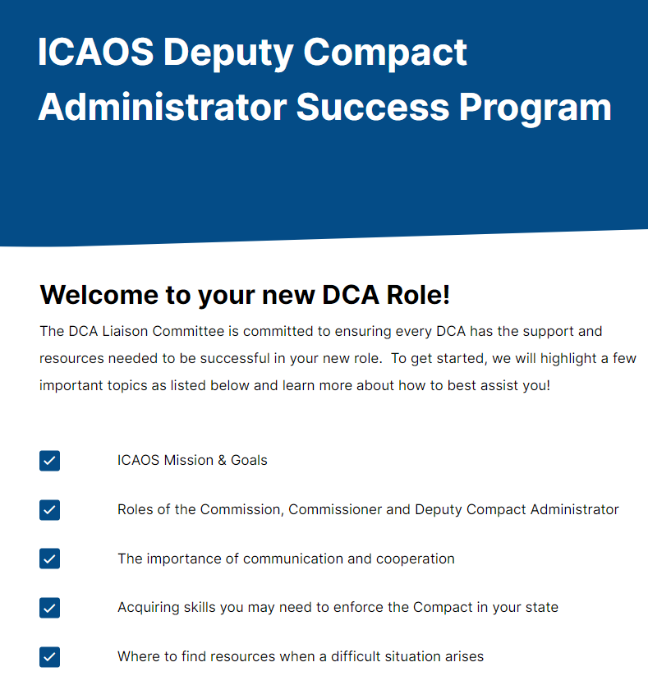
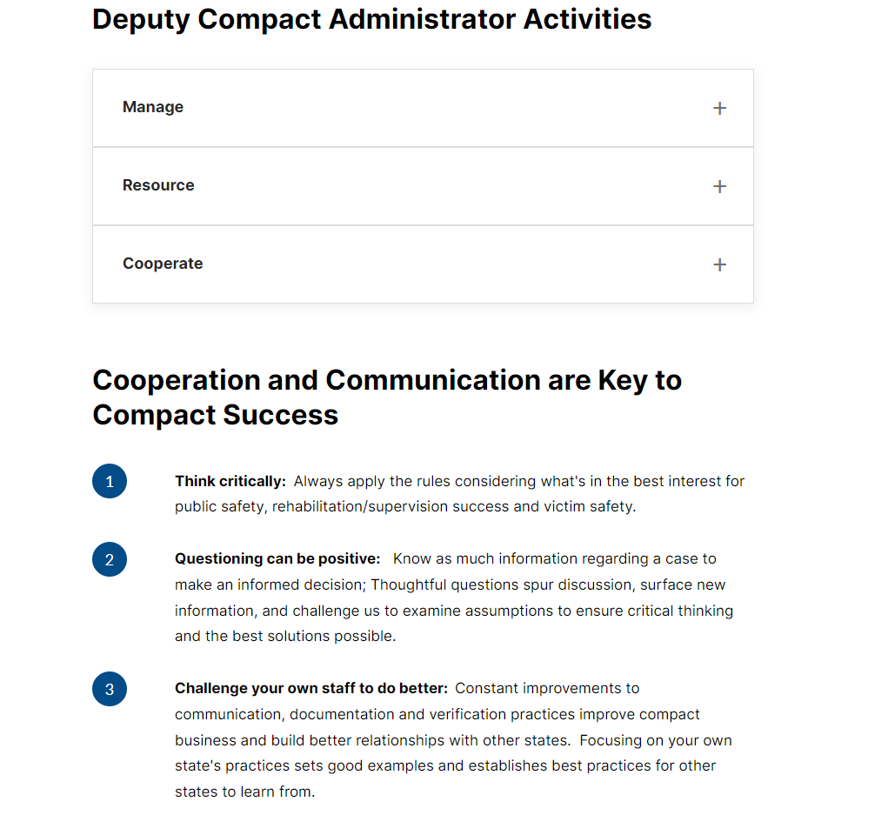
New
DCA Toolkit

Slide 7
Warrant Execution Management

Slide 8
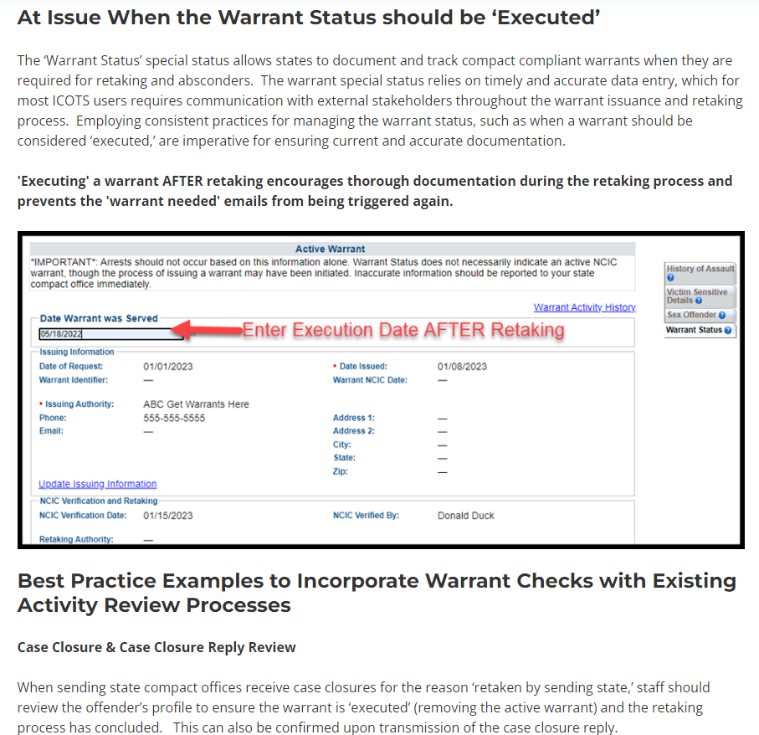
New
Training Bulletin
1-2023i

Slide 9
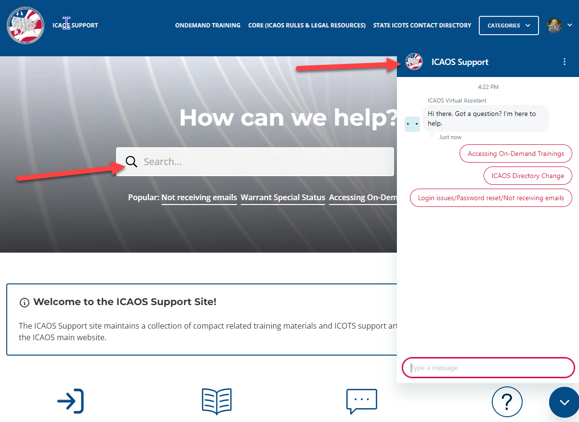
2023 Resource Improvement Project
DCA feedback via survey & direct contact
Training & DCA Liaison Committee Initiative
DCA Lead: Alyssa Miller (North Dakota)
New ICOTS Administrative & Dashboard Resources
Integrated with CORE
Save time! New auto-replies and Virtual Assistant (also available on the ICAOS Website!)

Slide 10
Collaborative Solutions!
Ensuring Compact Compliant Warrants
Improving Commissioner/DCA Relationship
Dealing with Compliance Issues
Applying Rule 3.103 to Ensure Seamless Supervision
What Ideas will Your State Share?

Slide 11
Interstate Commission for Adult Offender Supervision
www.interstatecompact.org

