Slide 1
Warrant Management Dashboard Training February 2023
Interstate Commission for Adult Offender Supervision

Slide 2
Presentation Objectives
Today you will learn about:
Warrant Status Functionality & FAQ’s
Warrant Management Dashboard
Complimenting Dashboards
Benefits of warrant tools

Slide 3
Warrant Status Support Site Links
Warrant Status-Special Status: Details technical specifications of the warrant status.
Screen shots
What fields are available (mandatory & non-mandatory)
Activity triggers
Email details & timeframes
Q & A
Warrant Tracking Dashboard: Provides description and details of dashboard.
Why warrant tracking is important
What data the dashboard provides (both at a glance & export details)
Complimenting reports available
https://support.interstatecompact.org/hc/en-us/articles/5722369894167-FY23-Warrant-Tracking-Dashboard-February-2023-
Notes:
Quick demo of support articles from search screen

Slide 4
Warrant Status/Tracking State Responsibilities
Develop & enforce internal procedures for warrant entries
Which users are authorized to use the feature
What fields are expected to be completed and in what timeframe(s)
Documentation expectations, including for information obtained from non-ICOTS users (for example, some states obtain NCIC verification through external partners such as sheriff's offices)
Perform regular audits (using Warrant Tracking Dashboard)
Conduct ‘Warrant checks’ ensuring previously issued warrants remain active thus ensuring ICOTS data is ACCURATE (don’t forget to document!)
Ensure warrant status tool is utilized appropriately
Notes:
As warrant issuance processes vary, states must develop specific procedures for users.

Slide 5
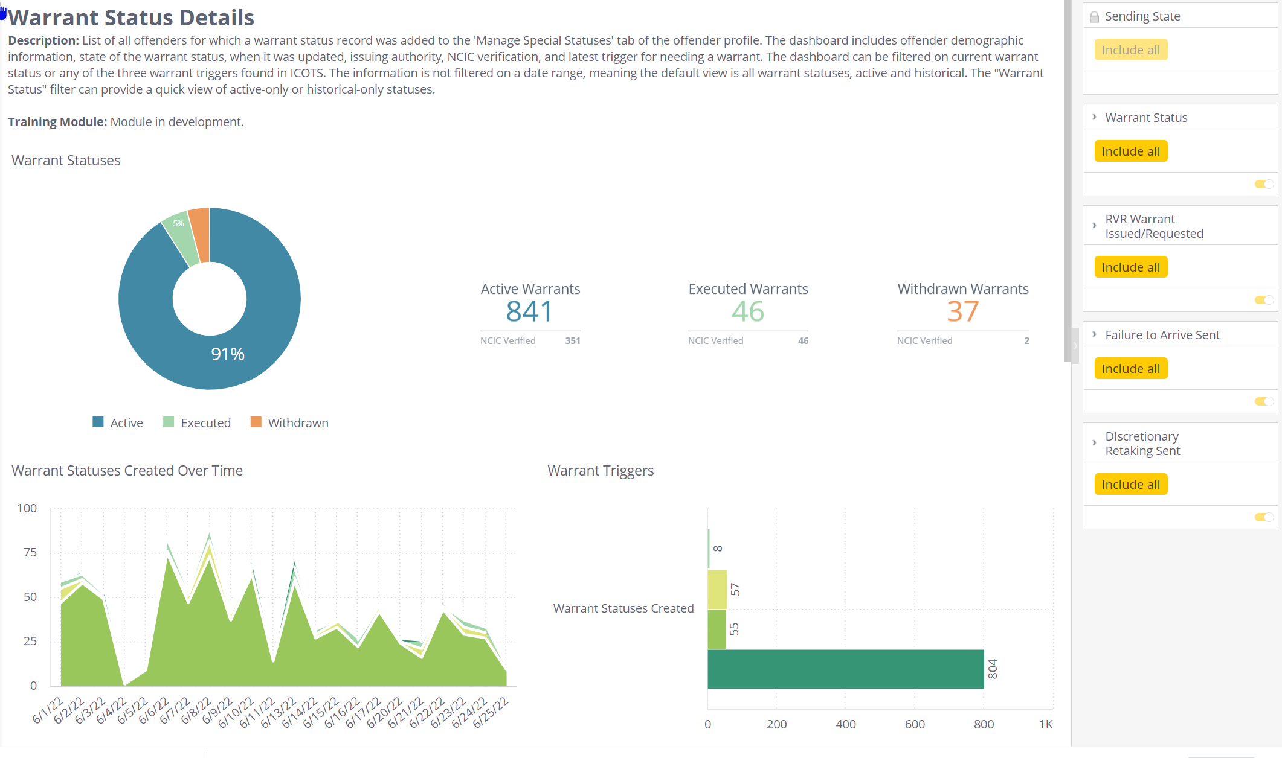
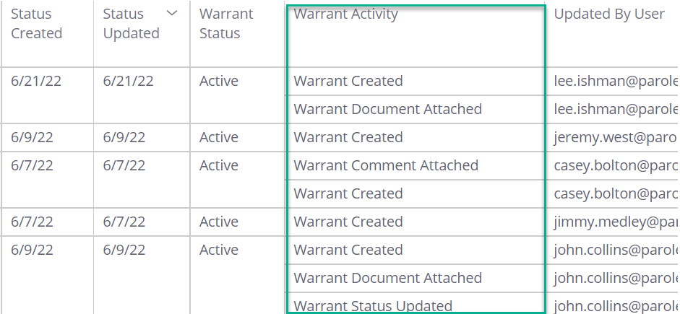
Warrant Management Dashboard
Shows records for ALL TIME
In screen filters allow filter by warrant status (active, withdrawn, executed) and initiating activity type
Export and filter for specific timeframe data
Warrant creation & update records
https://dash2.interstatecompact.org/app/main%23/dashboards/62b489d64ecdd92ae0ab27cf

Slide 6
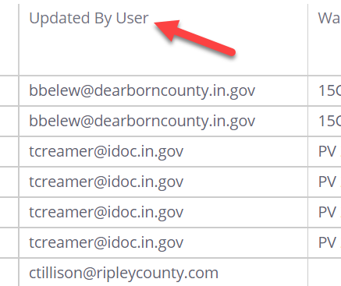
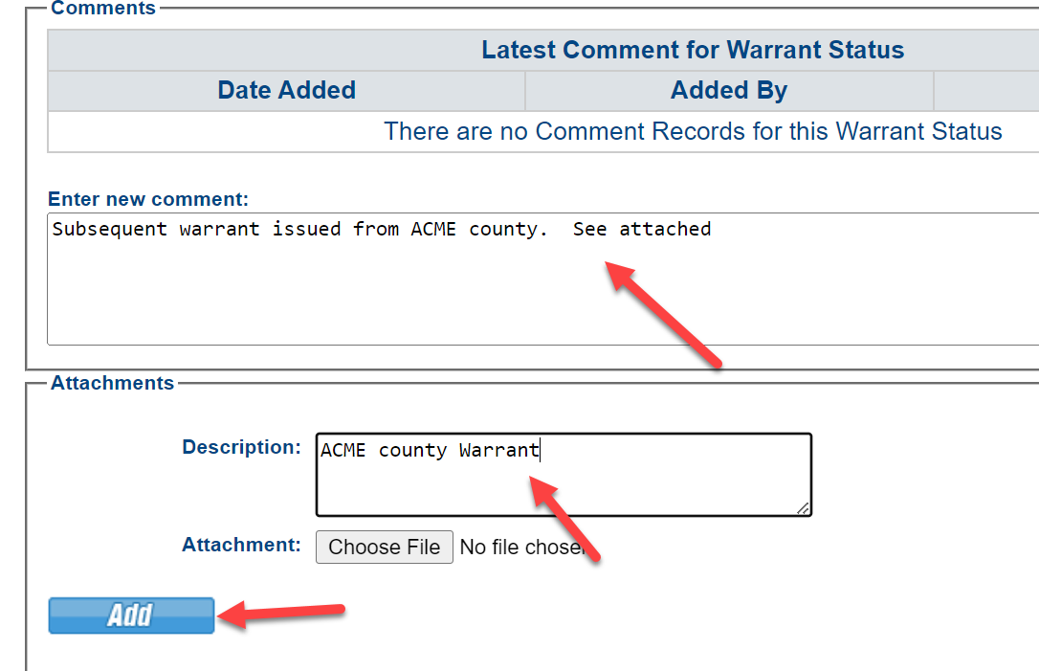
Warrant Report Limitations
∙
No ability to sort by supervision type
Export to filter by user email address
∙
Only 1 warrant record active at any given time
Note additional warrants in comments
Notes:
Supervision type is related to ICOTS cases, special status ICOTS offenders, not specific cases

Slide 7
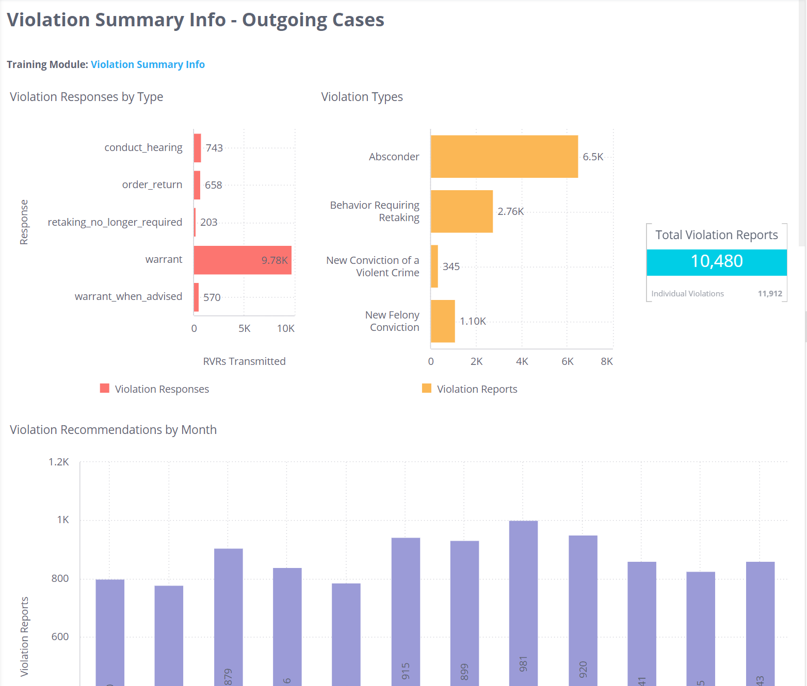
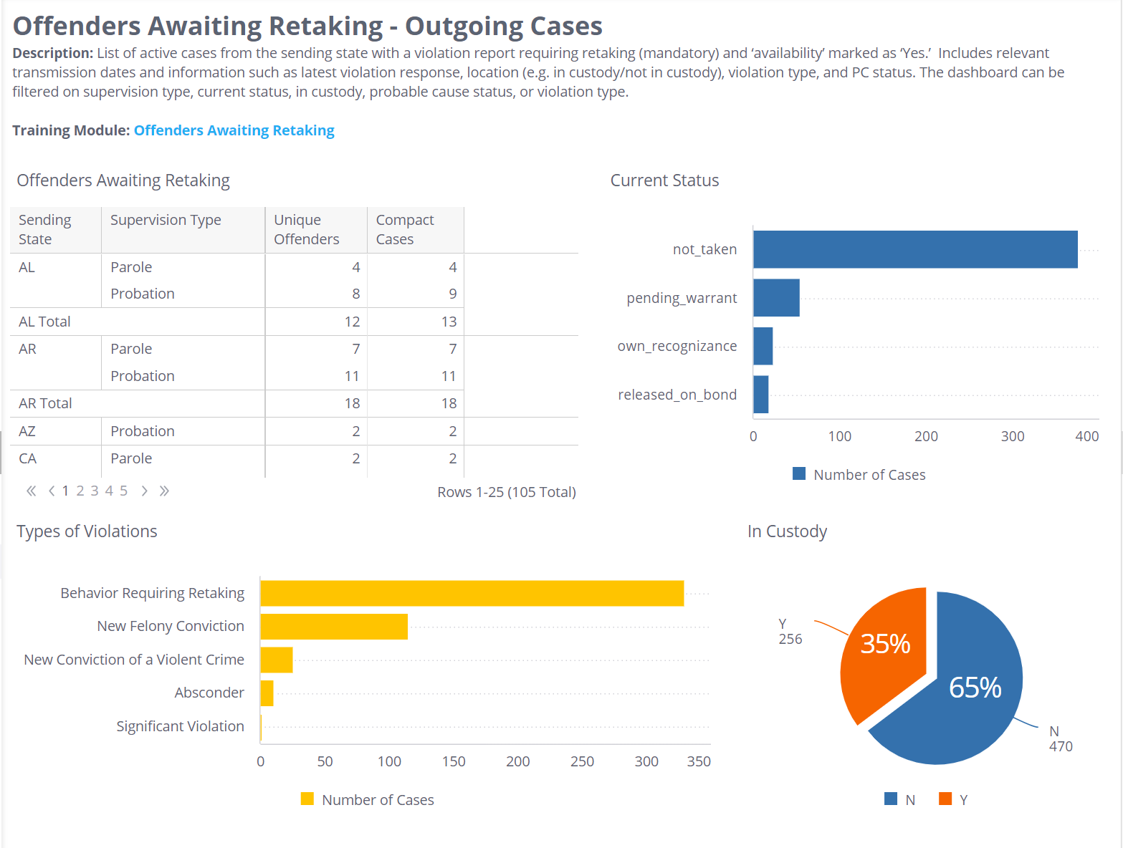
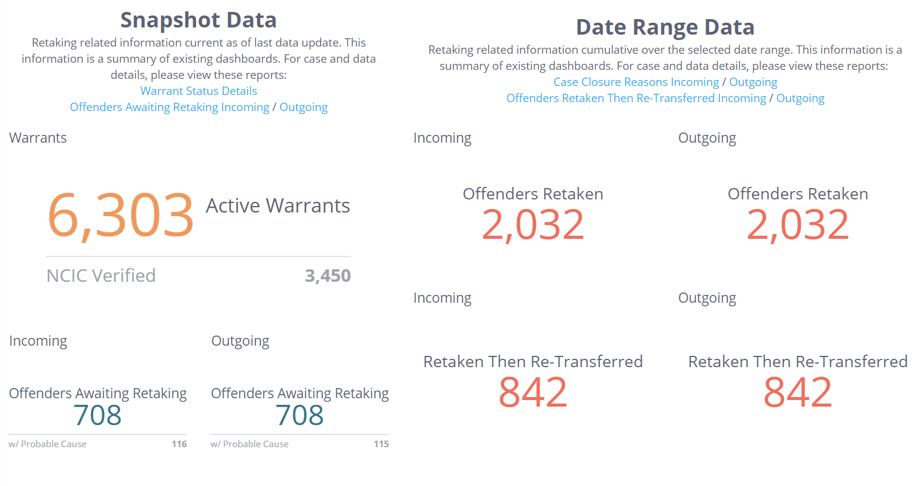
Complimenting Reports
Violation Summary
Awaiting Retaking
Retaking Management
Notes:
Violation Summary Info-Outgoing Cases: Identifies violation reports requiring retaking that trigger need for warrant submitted within a specified timeframe.
Offenders Awaiting Retaking-Outgoing Cases: Identifies which individuals are currently pending retaking via warrant [Availability =Yes & Latest Violation Response = 'Warrant Requested/Issued'
Retaking Management Dashboard: Also sent in biannual emails to Commissioners, this report provides a summary of retaking activity including a snapshot of current active warrants and number of individuals awaiting retaking. This report also provides number of individuals retaken (specifying also number retransferred) during a determined timeframe.

Slide 8
Thank You
Interstate Compact for Adult Offender Supervision

