Slide 1
ICOTS End User Training
Last updated Mar 2022
Notes:
The ICOTS application is offered by the Interstate Commission on Adult Offender Supervision (ICAOS), and Appriss. Appriss is also the provider of the Victim Information and Notification Everyday (VINE) service, MethCheck, and JusticeXchange

Slide 2
What is ICOTS?
ICOTS is a web-based application that allows member states to facilitate all compact business processes and other case based activities
https://icots.interstatecompact.org/ICOTS/login
Who Can Use ICOTS?
Each state determines who the users are and administrates their users.
Users are required to agree and adhere to the ICOTS Privacy Policy
Notes:
ICOTS is a web based application that facilitates the process of transferring the supervision of offenders from one state to another.
Other Compact cased based activities will be completed through the system.
Users approved by their state compact administrator can use ICOTS.
The data for ICOTS is stored at a central location and is accessible from any internet connected computer.
Workflow components such as notifications and requests are initiated within the application.

Slide 3
Logging In
Login is email address
Click “What is my password again?”
Enter email again
Go to Email Inbox, click on link to create password
Password example: Gsmith49#
Notes:
In order to demonstrate the initial stages of accessing ICOTS you will click on the demo link on the slide and a webpage will open in a new window.
Starting on the login page.
Describe the process of obtaining a user ID and login information.
Username is email address.
Contact agency administrator/state administrator
Briefly explain the hardware/software requirements.
Briefly explain the parameters for number of characters for password
Security methods require your password be a minimum of eight (8) characters and contain at
least:
• one upper case
• one lower case
• one numeral
• special character (Example: #, !, &)
Example: Gsmith49#
Additional requirements are:
• The password can not be the same as the User ID.
• You can not reuse any of your last 10 passwords.
• Passwords must be changed every 90 days.
• No spaces are allowed.
• Password can not be a dictionary word or proper name.
Note: Ten days before your password expires you will receive a warning message
reminding you to change your password.

Slide 4
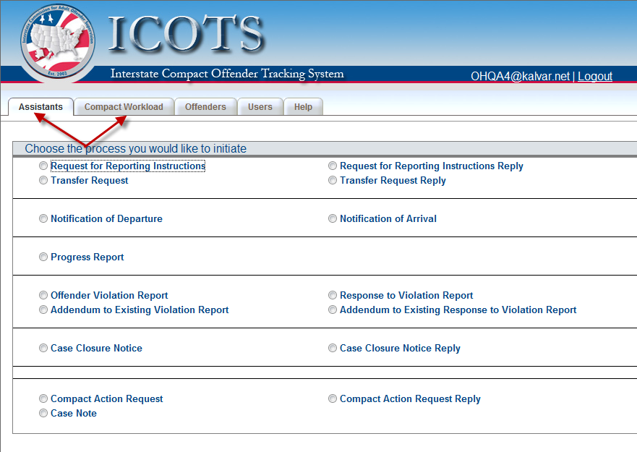
Main Portal Page
All processes can be initiated and continued once you login
Notes:
Demonstration and Talking Points:
You should highlight the fact that each of the processes are laid out on this page. This will be the default page you go to once you login.
These are the processes you can complete in ICOTS and the screen that pops up when you log in.

Slide 5
Preferences

Slide 6
Common ICOTS Tools
Adding an Attachment
The description can serve as the attachment
If you upload a document you MUST enter a description
Notes:
Talking Points:
Throughout the application users will be given the opportunity to attach files to an offender’s record. When attaching files users must provide a description for each file that they upload. If they cannot attach a file they can user the description field to input the required data.

Slide 7
Common ICOTS Tools
Dropdown Menu
Add multiple values (DOB, SSN, AKA)
Remove an added value
Select a date
Item has been saved
Notes:
Talking Points:
There are several icons and tools that users will observe in ICOTS. Briefly mention each of the listed items.

Slide 8
Common ICOTS Tools
Generates an ICAOS Form
Deletes the current selected activity
Attached document
Required field
Radio button
Notes:
Preview button – when a user clicks on the “Preview” button the system will generate the information on the current process into a standard ICAOS for printing
Delete button – Users will only be able to delete tasks which they have created. Once an item has been submitted it cannot be deleted by anyone. This button will only delete the currently loaded activity; it will not delete an offender or any other information on the offender’s record. For instance, if you are completing a Transfer Request Reply and decide that you need to start over completely you can click the “Delete” button to erase all of the information that you have entered. This will not effect the Transfer Request that you are replying to.

Slide 9
Process Flow
The processes that are completed using ICOTS can have several variations.
Your answer to one question will affect the next steps you need to complete or questions you need to answer.
Example: Selecting the reason for Transfer
Notes:
This slide shows a sample of a process that can have different results based on how a person reacts to certain questions.
Point out that answers to certain questions result in certain patterns. In a particular process, you will have to answer questions. Based on your answers certain other questions or requirements will be adjusted or added. As an instructor, you will need to be familiar with the process. You should talk about how some parts of the process must have other parts complete before they can continue. This chart should be explained at a high level to show that fact.
Another example is completing a process such as the NOD and NOA to allow for the ability to create supervision activities such as the violation report, progress report, etc.

Slide 10
Process Flow
Transfer Request
Transfer Reply
Notice of Departure
Supervision
Notice of Arrival
Case is closed
Notes:
Another example is completing a process such as the NOD and NOA to allow for the ability to create supervision activities such as the violation report, progress report, etc. ICOTS needs to know that first the request was approved, then allow for the NOD and offender departs. When ICOTS is notified the receiving state is supervising the offender via the Notice of Arrival, it will then allow for that state the ability to complete a Violation Report, Progress Report or Closure.

Slide 11
Workflow
POs
Create compact activities
Supervise offenders
PO Supervisors
Review and approve information
Have the ability to reassign cases from officer to officer
Notes:
2 field roles. Po sup may not necessarily is a supervisor over the PO or in their job. Only allows you to reassign and review information. Workflow is customizable. The PO supv role was established to allow for a review level or another user to reassign to and from other users.

Slide 12
Workflow
ICOTS provides a managed workflow that controls the flow of information
User roles are defined in the ICOTS workflow to allow for review, accountability and reassignment.
Notes:
User roles are defined in the ICOTS workflow to allow for review, accountability and reassignment.
The roles include:
PO: able to initiate Compact functions and submit for review to a PO Supervisor. This role also receives assignments through notification of the ICOTS system
PO Sup: reviews the entries of a PO for accuracy and completeness prior to submitting to a compact office for final submission to another state. This user also has the ability to reassign cases between PO users affiliated with them.
Compact Office: gatekeeper for all submissions received and going out of the state. This role may also reassign cases and perform functions in the absence of a PO or PO Sup.

Slide 13
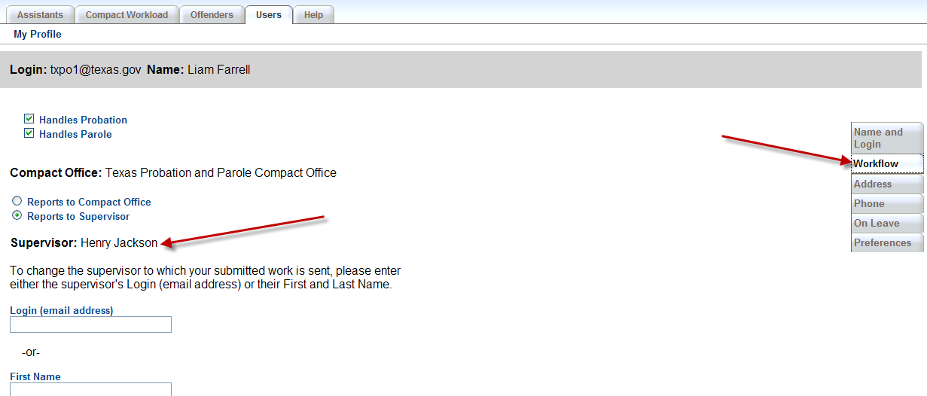
Workflow
Users Tab
Notes:
Each user defines and manages his or her workflow.
All users either reports to a supervisor to review all outgoing managed activities prior to submitting to the compact office or reports to the compact office.

Slide 14
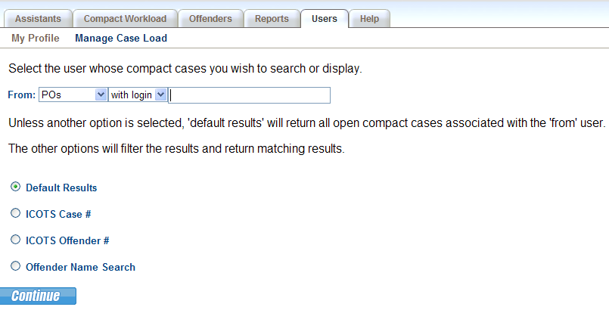
Manage Caseload
Used to Reassign Cases & Activities
Available to Compact Office and Supervisors
Notes:
CO from anyone to anyone
SUPV from any supv or Pos to any Supv or POs

Slide 15
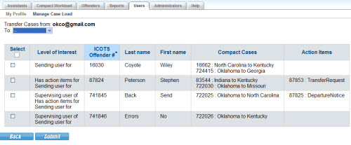
Level of Interest
Supervising User of = Responsible Officer
Sending User for = Assigned User in Sending State
Receiving User for = Assigned User in Receiving State
Has Action items for
Awaiting Completion
Awaiting Review
Notes:
Go over the Terms used in the level of Interest Column
Sending & Receiving User are the assigned users in the sending & receiving states respectively. When a request is initiated, the sending user is assigned this user is also the supervising user until the receiving user is assigned and the Notice of Departure and Notice of Arrival occur. Tracking component
Sending State user, typically who initiated the request
Receiving State user, typically who keyed the RI information either on a RFRI response (compact office user unless they reassigned) or TR reply.
Supervising User of, who is responsible for the body. During the transfer process, the Sending User retains this designation until the Notice of Arrival which indicates the receiving state has retained supervisory authority.
Has Action items for Pending activity associated with this user. May or may not be the assigned user. It could be the supervisor for the assigned user. Has an action to review the outgoing transfer request. What the action is is listed in the action items column.

Slide 16
Compact Workload
Depending on your user role, you can see offenders that might be assigned to others in your department.
Notes:
The Compact Workload provides a variety of searching options so that it is flexible enough to narrow your caseload to exactly the cases you wish to view.

Slide 17
Compact Workload
Case List/To-Do List
Has Action items for
Awaiting Completion
Awaiting Review
Notes:
Column sort
Name link
Action item
Mention Blue versus Black; view all
Submission and due dates to come

Slide 18
Action Items
Awaiting Review
Awaiting Completion
Notes:
Two types of action items
Awaiting Review; move through the workflow
Awaiting Completion, complete a pending activity

Slide 19
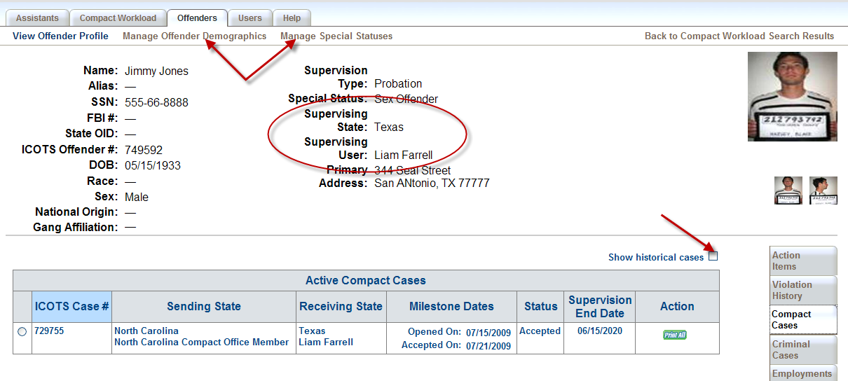
Offender Profile
Notes:
View and edit information about an offender
Address, Employment, Aliases, DOB, photographs, special statuses

Slide 20
Offender Profile
Notes:
This is where I would talk about initiating all other activities from here to avoid creating duplicate case numbers. More of the talking points from Slide 4 could go here…..
You can initiate other activities. Easiest to work from the offender profile to avoid creating duplicate cases. Can view all activities submitted from this screen as well

Slide 21
Offender Profile
Action Items
Notes:
Action Items also accessed from offender profile
View means the activities is for you, dash is a pending activity associated with the offender but for another user.

Slide 22
Offender Profile
Update Residence and Employment information
TIP! The ‘Supervising User’ should ensure the most current address exists on the profile. Getting an error submitting activities? Make sure a primary address exists on the record.

Slide 23
Transfer Request
Notes:
Talking points:
The processes and functions in ICOTS can all be accessed from the initial page. We will process the transfer request. Select transfer and continue.
Explain that the ICOTS system will prod the user with questions and will not allow progression to happen unless the questions are answered. Based on the criteria and answers given, you will be taken to the appropriate screens.
Continue through the request.

Slide 24
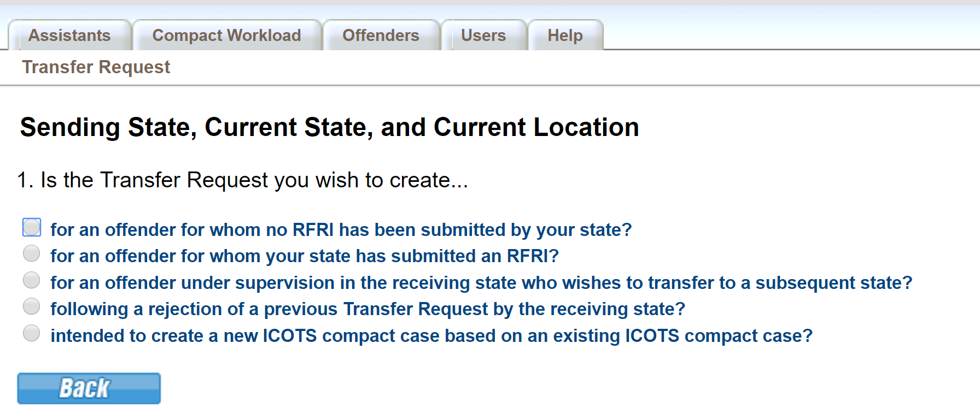
Transfer Request
Notes:
#1 will create a new ICOTS case
#2 will merge the TR to a case selected by the user
#3 3rd state transfers..requires that an active case exists with the offender in an inital receiving state
#4 will merge the TR to a case that has a previously rejected TR on it and retains most information from the previous TR
#5 will create a new ICOTS case copying an existing case already in ICOTS. Typically going to be used in dual supervision scenarios where the receiving state is bifurcated. Meaning two separate requests need to be sent to probation and parole. Rarely used.
Activities may also be initiated from the offender profile which it’s always best anytime the record already exists in ICOTS

Slide 25
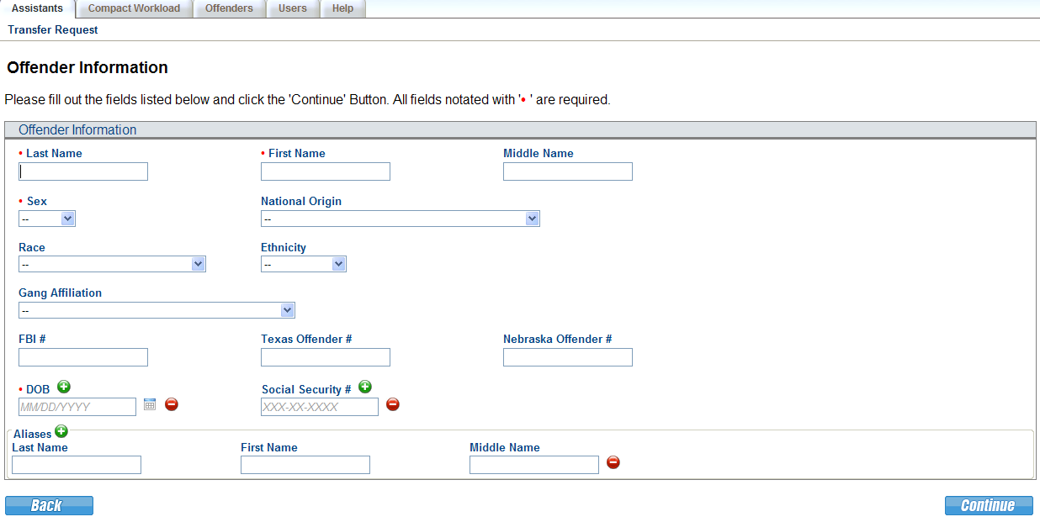
Transfer Request
Enter all known information. As with any entries into ICOTS, users should be providing as much detail as possible!
Notes:
Provide offender information. Put in as much information you have to retrieve better search results. Then ICOTS searches the system for matches

Slide 26
Transfer Request
Notes:
Talking Points:
If you don’t see the offender that you are searching for then you can create a new offender

Slide 27
Transfer Request
Notes:
If a match does locate your offender, select it from the list

Slide 28
Transfer Request
Notes:
Explain:
“Checkmark” saving feature – ICOTS saves your progress as you complete each task. You can resume partially completed previously entered activities.
The “grayed out” submit button – Ensures users fully complete the request before submitting it.
The Preview Button – Generates the information in the current Form format for printing

Slide 29
Transfer Request
Resident: inhabited at least one year prior to sentencing or supervision start date
Resident Family: Parent, grandparent, aunt, uncle, adult child, adult sibling, spouse, legal guardian, or step-parent: has resided in receiving state for at least 180 days and indicates willingness and ability to assist in plan of supervision.

Slide 30
Transfer Request
Notes:
Explain:
How the response to the question drives the next prompt
System helps to enforce the ICAOS rules by directing the user – Relationship Type dropdown
Employment OR Means of Support, not both.

Slide 31
Transfer Request
#1 Add criminal case information
#2 Add offenses to case
NCIC code or use drop-down
#3 Attach details of offense

Slide 32
Transfer Request
Notes:
Explain:
How the dropdowns work – Common conditions are listed need to choose all that apply, all others can be identified with “Other”

Slide 33
Transfer Request
Notes:
Explain:
That this is for reporting financial obligations, not tracking them.
There is no way to enter payments or subtraction from the total that is entered.

Slide 34
Transfer Request
Notes:
Explain :
If the offender is identified as a sex offender the user must provide additional details.
Sex offender
Meets “offender” definition
Subject to supervision
Meets eligibility requirements
3 Types of “Sex Offenders” per compact definition
Registered in the sending state
Required to register in the sending state
Offender who is under sex offender terms and conditions in the sending state

Slide 35
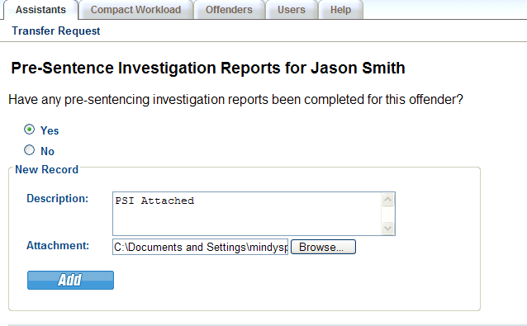
Transfer Request
Notes:
Explain:
The common construct that is seen on the remaining screens.
Yes/No Question
If yes, description/attachment construct
The PSI section is the catch all.

Slide 36
Transfer Request
Accepts png, jpg, gif and tif files
Main/front facing photo must be:
recognizable and visible;
displayed in ‘portrait’ view (height is greater than width);
In color, sharp with no visible pixels or printer dots;
Free of any distracting background
Notes:
Explain :
Only Front facing is required
Automatically resizes the image
Only accepts png, jpg, gif, and tif file types

Slide 37
Transfer Request
Notes:
The Application that must be signed can be printed (pre-populated with the offenders information) This is important to have signed prior to allowing the offender to leave. Waiver of extradition
You can scan and attach it for the receiving to review.
You must verify that it has been signed.
After each of these screens you will be taken back to the Transfer Request checklist.

Slide 38
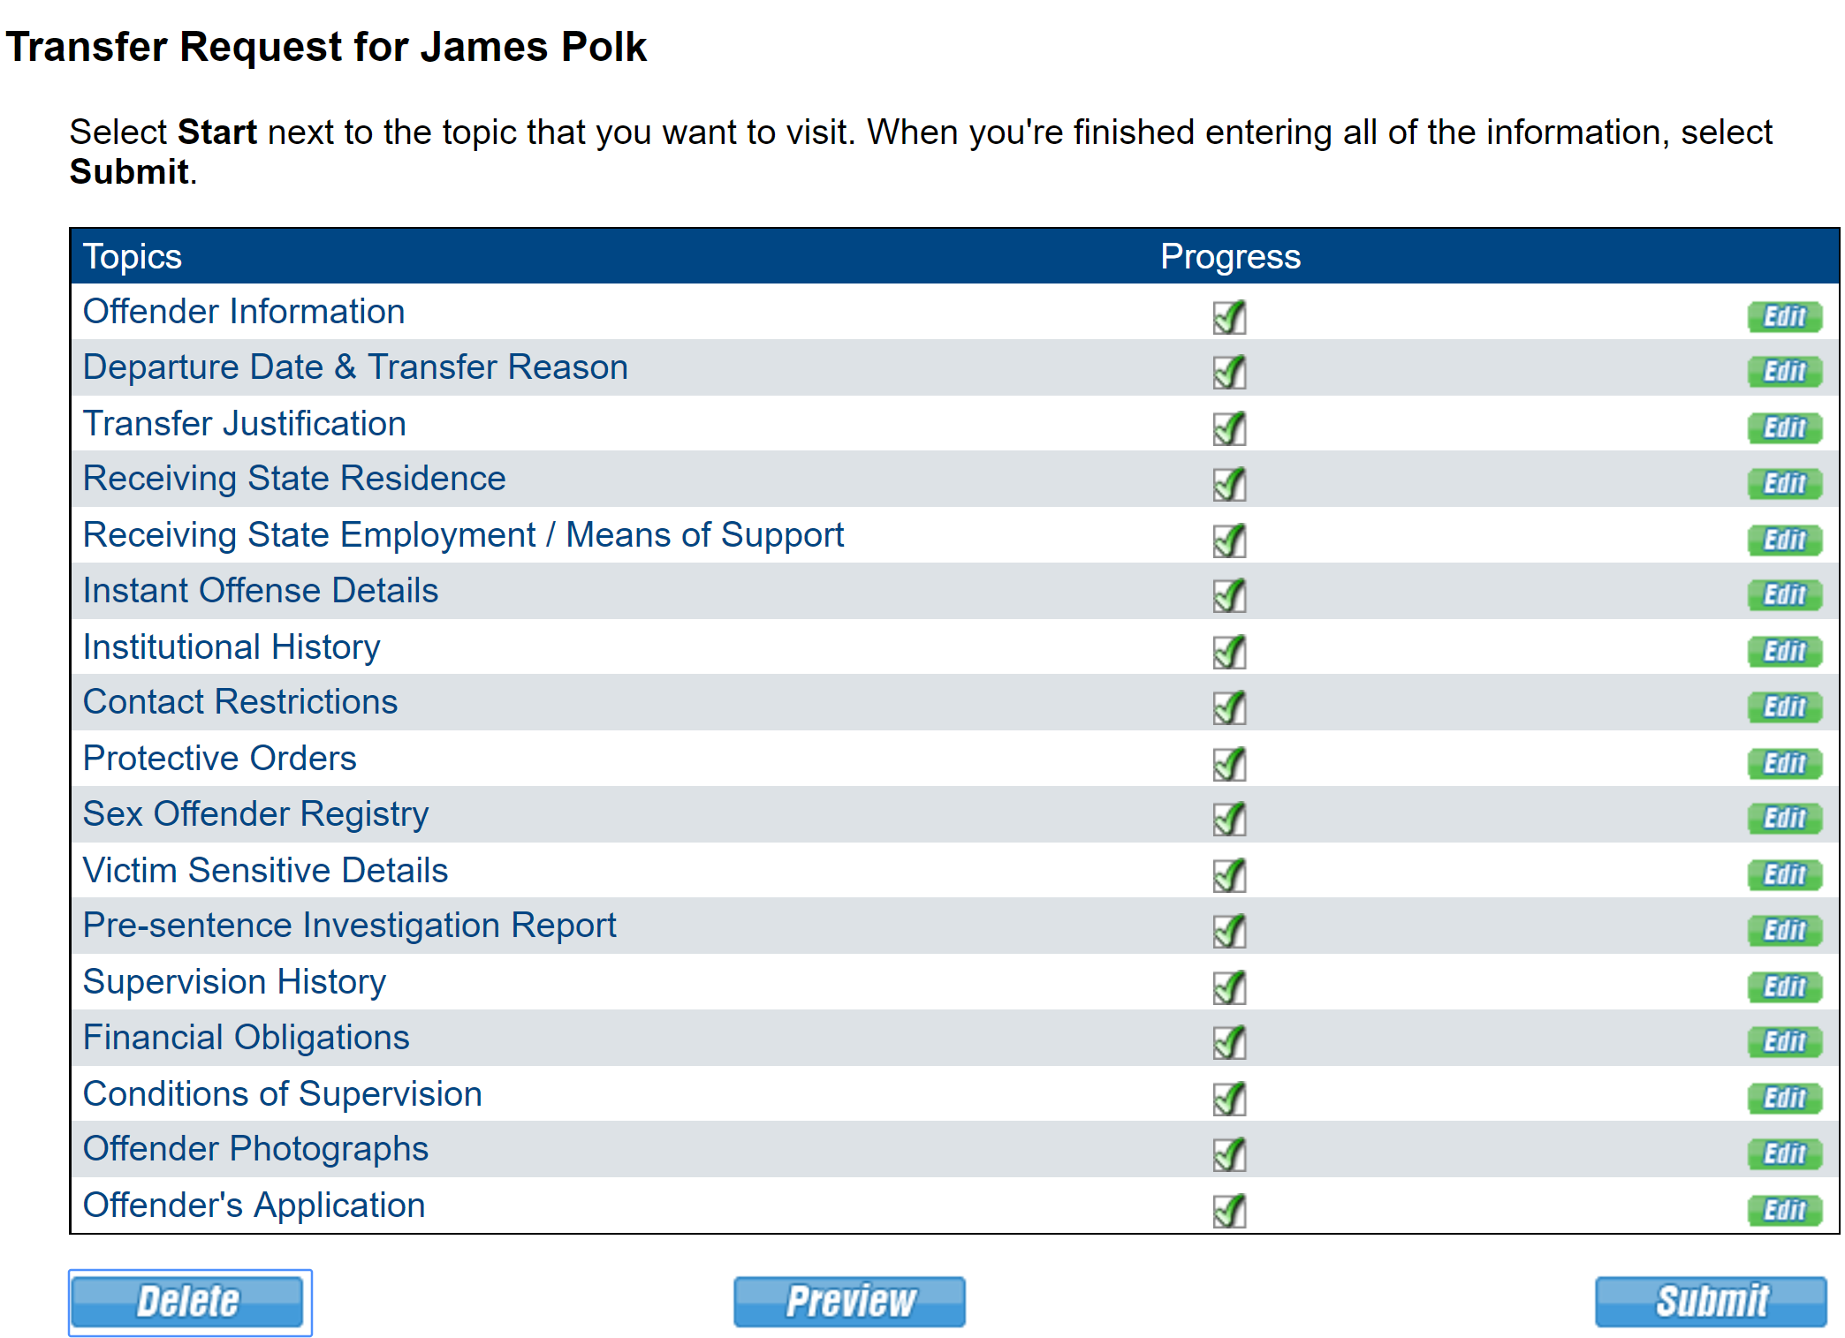
Transfer Request
Last Chance to Delete
Notes:
Explain :
Submit button is now active.
After submitted the request cannot be deleted.
Preview Button allows you to print the information in a format that is similar to today’s forms.
Forwards to your Supervisor/Compact office

Slide 39
Transfer Request
Email is sent to Supervisor for review
Notes:
Or to the CO workload depending on the workflow set up
If you are creating and moving activities and not getting emails. Check with your IT on any blocks

Slide 40
Transfer Request
Check activity status using the Compact Workload
Once assigned in the receiving state, the Transfer Request Reply is created
Per Rule 3.104 a Transfer Request must be responded to within 45 days
Notes:
The transfer request has been transmitted to the receiving state and awaiting the reply to be completed.

Slide 41
Reply
Once the response is sent, an email is generated notifying the sending state users (Compact Office, PO Supervisor & PO)
The Activity History (Offender Profile) also reflects the decision of the Transfer Reply
Notes:
View any comments provided in the Transfer Reply by selecting the Transfer Reply link
No pdf peeking!
If you’re the sending state, once approval, you can send the NOD at this time

Slide 42
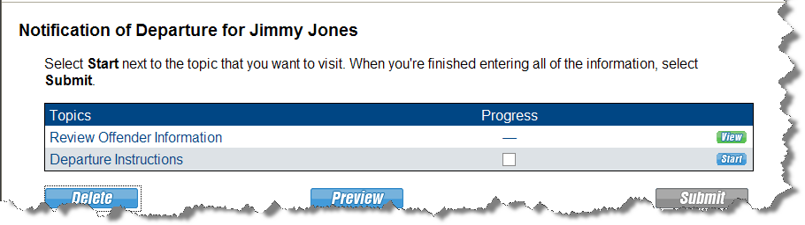
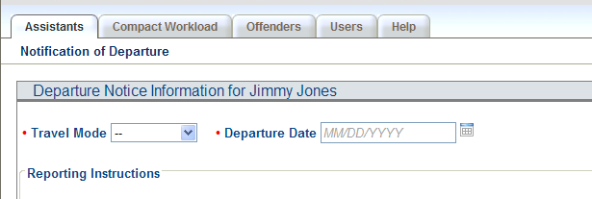
Notice of Departure

Slide 43
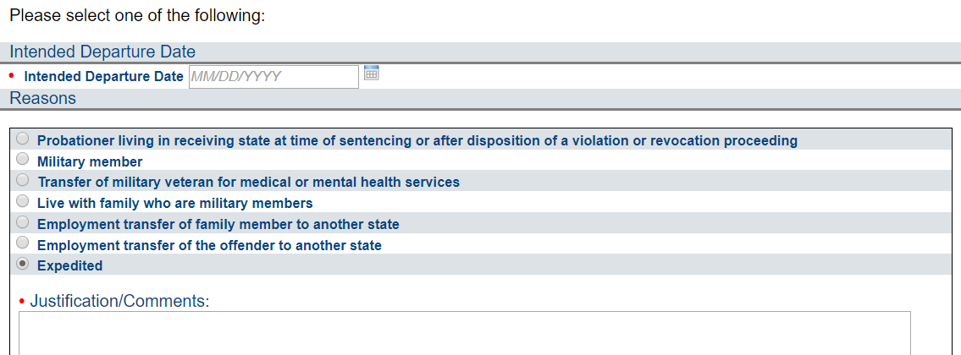
Offender must qualify for Reporting Instructions!!!!
Rule 3.101-1, 3.101-3, 3.103 & 3.106
Notes:
The sending state shall grant the request and provide reporting instructions no later than two business days
No travel pending approval or RIs with the exception of (living in the RS at sentencing, daily commuting for existing job, medical/treatment appts)-the 102 transferring supervision talks more about this

Slide 44
Request for Reporting Instructions
Notes:
Everything will populate from the TR expect for the reason for Ris
Complete all tasks before submit, last chance to delete. Cannot delete after submission
End of Sending state process

Slide 45
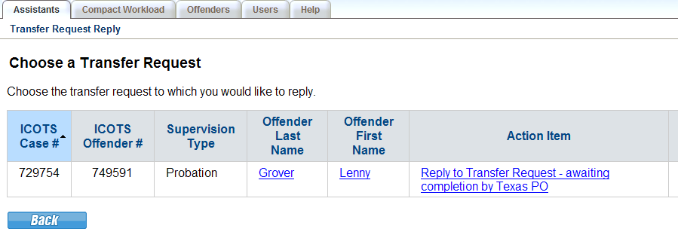
Transfer Request Reply
Email is sent to user assigned
Access activity from Assistants, Compact Workload or Offender Profile
Notes:
Shift to receiving state point of view. Incoming TR.

Slide 46
Transfer Request Reply
Offender Profile: Action Items

Slide 47
Transfer Request Reply
Notes:
Explain :
Works that same as the Transfer Request
Not all items require action, just the ones with the checkboxes
-- items are for informational purposes

Slide 48
Transfer Request Reply
Notes:
You are verifying the information and investigating the home plan. List others that weren’t listed on original TR sent by the sending state.

Slide 49
Transfer Request Reply
Notes:
Make sure Alcohol drug treatment wasn’t chosen in error. Look at attachement

Slide 50
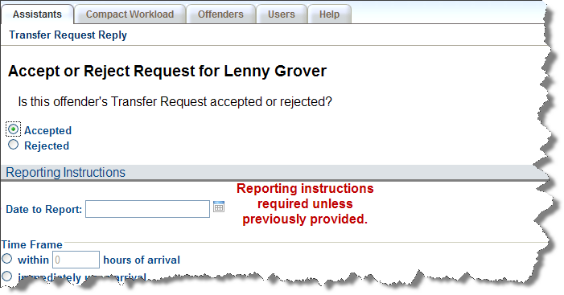
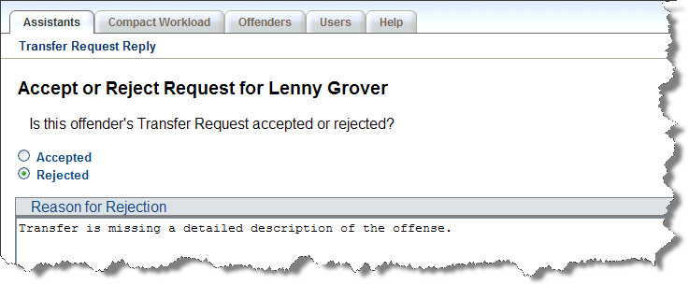
Transfer Request Reply
Accepted
-Valid for 120 calendar days
Rejected
-Be specific: Reason for rejection must be consistent with the purpose of the compact
Rule 3.104-1
Notes:
Rejections for incomplete Transfer Request state exactly what is missing.
When submitting a denial (ie residence, means of support, etc. ), remember you are denying the plan of supervision, not the offender. What is wrong with the residence, what is wrong with the support system or employment?
I
Rule 3.104-1

Slide 51
Transfer Request Reply
Notes:
Explain :
Submit is now active.

Slide 52
Transfer Request Reply
Notes:
Until the compact office reviews and transmits decision, the case remains pending

Slide 53
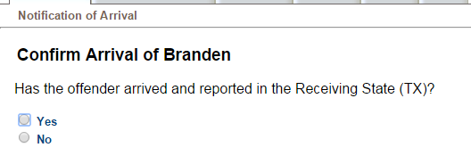
Notice of Arrival
Indicates the offender has arrived and reported
Receiving State assumes supervisory authority
Upon submission, the Receiving User becomes the Supervising User
Also can indicate an offender has failed to arrive or report
Notes:
Cannot do a NOA without a NOD
Indicate the offender has arrived and reported
Failed to report, indicate what you did to find an offender that failed to arrive or report

Slide 54
Receiving State Supervision
Transfer Request
Transfer Reply
Notice of Departure
Supervision
Notice of Arrival
Case is closed

Slide 55
Additional Activities
Violation Report Requiring Retaking & Addendum
OVR Reply & Addendum
Progress Report
Case Closure Notice
Closure Reply
Compact Action Request
Compact Action Reply
Case Note
Available after NOA & initiated by Receiving State
Available after Assignment is made in Receiving State
May indicate Case reassignment
Notes:
Know that offender is in the receiving state. ICOTS allow for activities

Slide 56
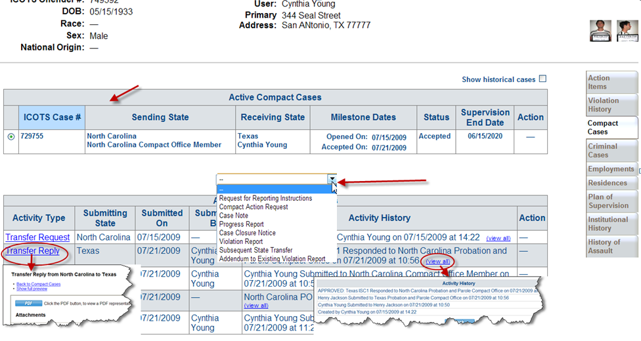
Receiving State Supervision

Slide 57
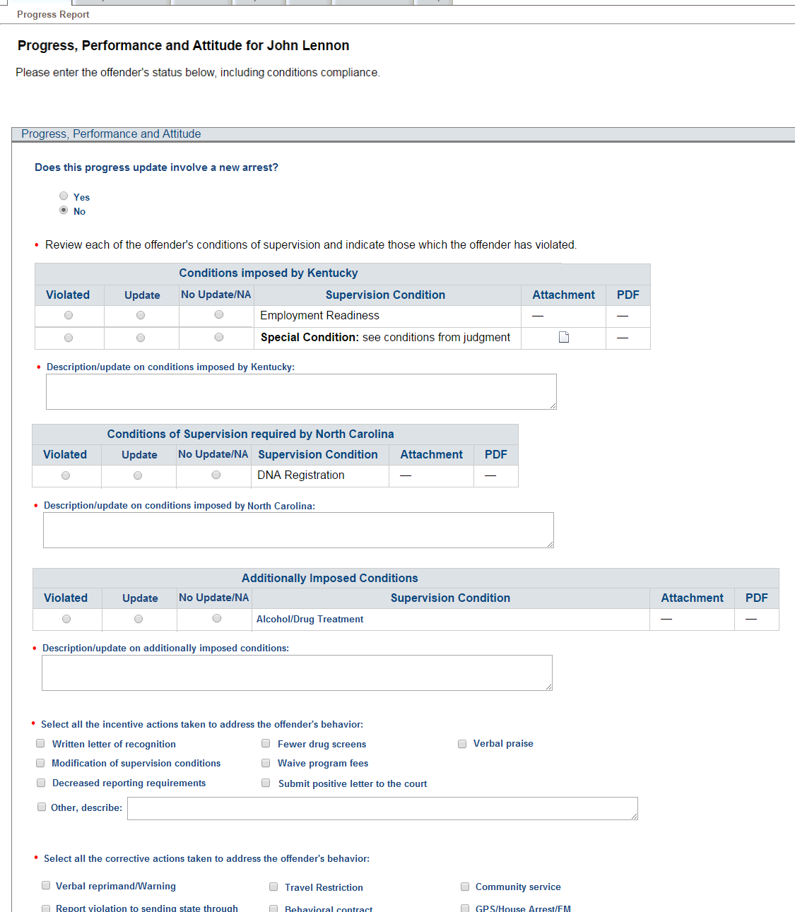
Progress Report
Supervision Update
Ability to add new conditions imposed
Documentation on compliant & non-compliant behavior that DOES NOT require retaking
Report New Arrest

Slide 58
Managing Conditions
View conditions imposed previously
Add new conditions of supervision

Slide 59
Report an Arrest
Notes:
If reporting on both send 2 progress reports

Slide 60
Report on Status of Conditions
Report compliance/non-compliance on conditions of supervision
Attach documentation
Notes:
If reporting on both send 2 progress reports

Slide 61
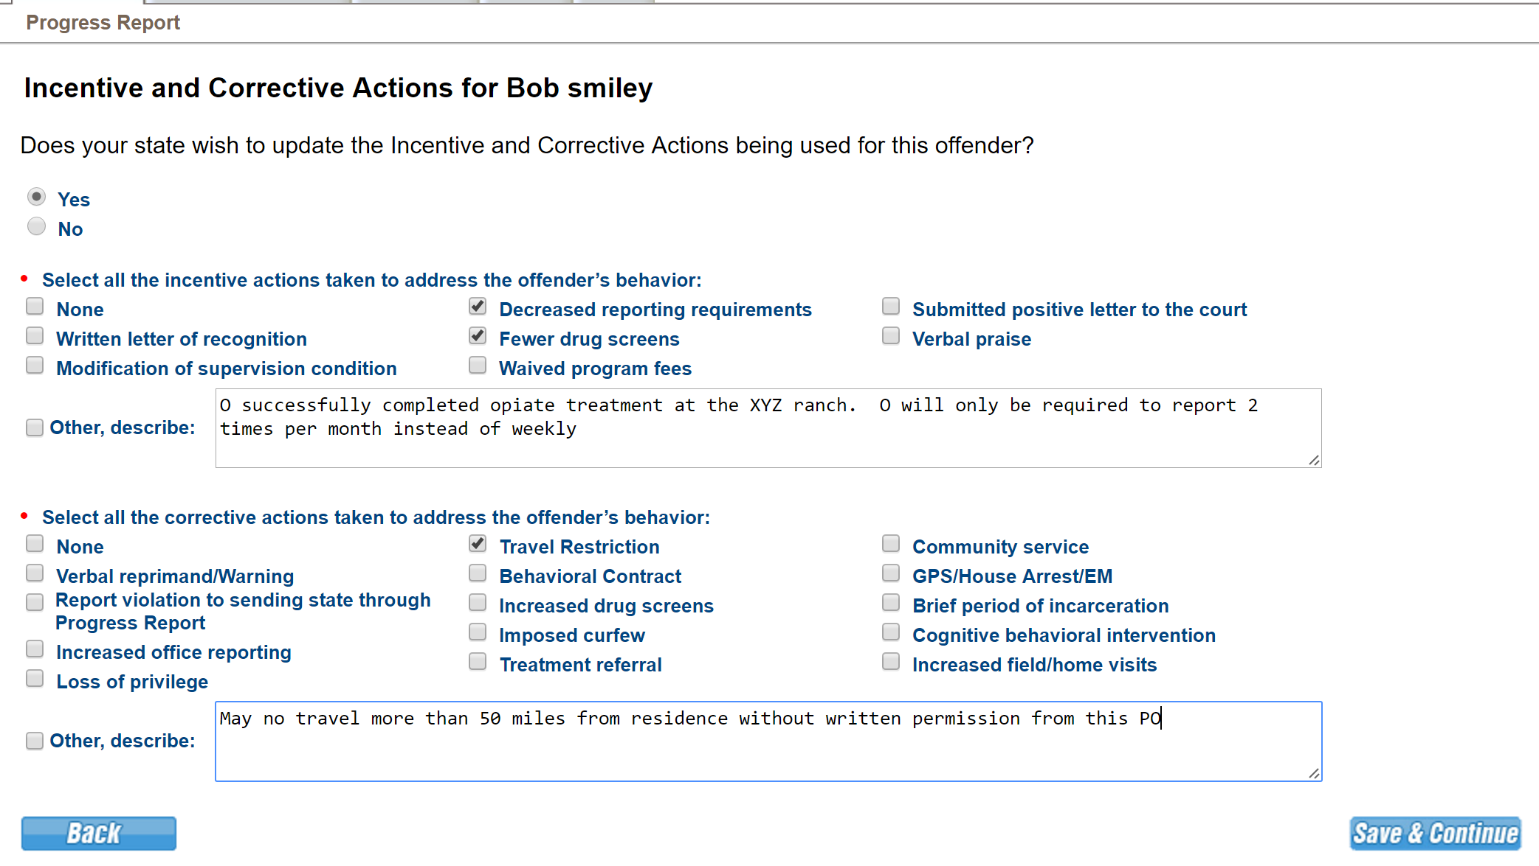
Incentives/Sanctions
Don’t forget to include OUTCOMES/RESPONSES for Corrective Actions Imposed!!

Slide 62
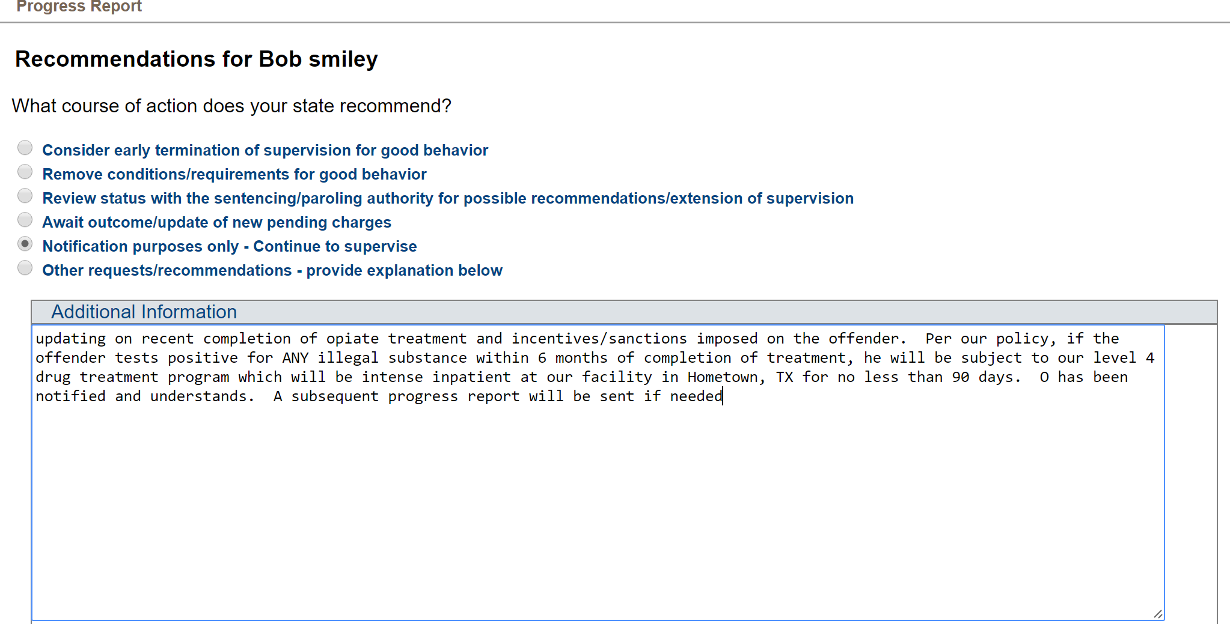
Recommendations

Slide 63
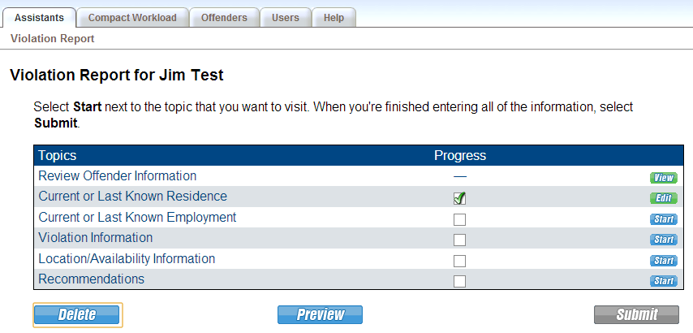
Violation Report Requiring Retaking
Submit within 30 days of determination/discovery ‘behavior requires retaking’
means an act or pattern of non-compliance with conditions of supervision that could not be successfully addressed through the use of documented corrective action or graduated responses and would result in a request for revocation of supervision in the receiving state.
Notes:
Non-compliant behavior that would likely not result in formal permanent revocation in your state should be reported on a progress report
States should instruct their users to provide at a minimum all documentation that would be provided on an offender in a revocation hearing, plus specific ICAOS requirements..Refer to state compact office

Slide 64
Violation Report Requiring Retaking
Document non-compliant behavior LEADING UP TO the behavior requiring retaking

Slide 65
Response to Violation
Allows you to respond to an Offender Violation Report
List of offenders to choose for response
Response is REQUIRED within 10 days of receipt in the Sending State
Notes:
Response to Violation Report – Allows you to respond to an Offender Violation Report
You will be given a choice of which offenders with violation reports for which you would like to initiate a response.

Slide 66
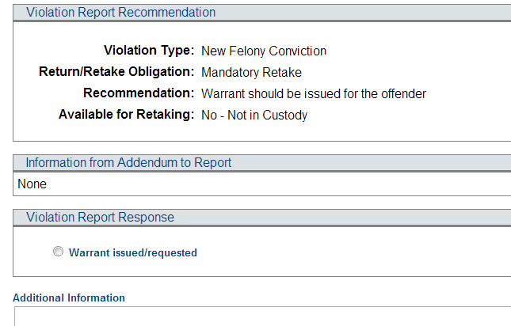
Response to Violation
Notes:
Response choices are based on return/retake obligation as well as whether or not PC has been determined. This example shows an offender initial significant violation in which the sending state has discretion whether to return or retake. If the violation obligates the sending state to retake or return their offender, the response selections will narrow to only appropriate responses.

Slide 67
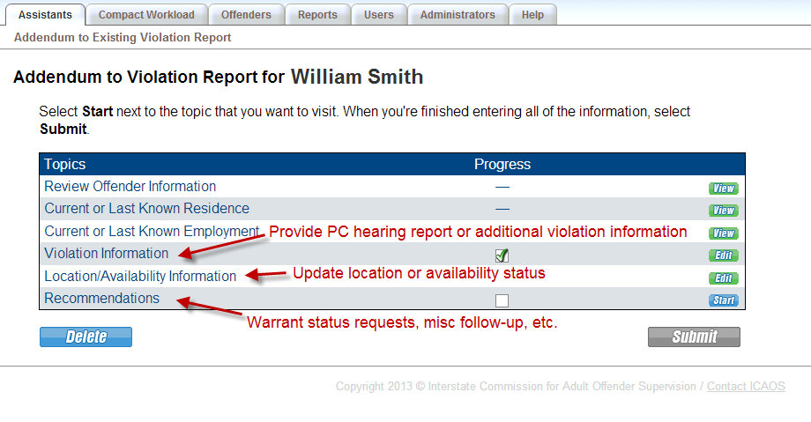
Addendum to OVR
IF NEEDED Receiving State uses to

Slide 68
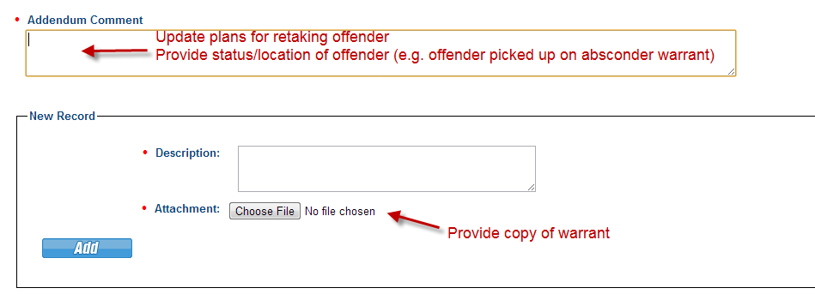
Addendum to OVR Response
IF NEEDED Sending State uses to

Slide 69
Case Closure Notice
Date of discharge (termination) of supervision
Notice to sending state of the absconding of the offender in the receiving state
OVR must precede closure
Notice to sending state of incarceration of offender for 180 days or longer; include:
Judgment and sentencing documents
Information about the offender’s location
Notification of death
Return to sending state
Cannot close during retaking

Slide 70
Closure Response
Allows the Sending State to agree and acknowledge a Case Closure
Due within 10 days of Case Closure
Upon transmission, case becomes historical & is removed from the Compact Workload
Can be accessed via the Offender’s Profile
Closed cases can be reopened by the Receiving State compact office

Slide 71
Compact Action Request & Replies
Generates an email notification to the other state
Does not appear on Compact Workload as pending action
Available to both the Sending State User & Receiving State User once assignments are made
Specialized: Subsequent State Transfer, Link to Compact Activity & Request/Withdraw Request for Progress Report

Slide 72
Case Notes
Should NOT be used for notification
If you want a response, send a CAR
Created automatically in ICOTS to document case reassignment.
Notes:
End of Activities

Slide 73
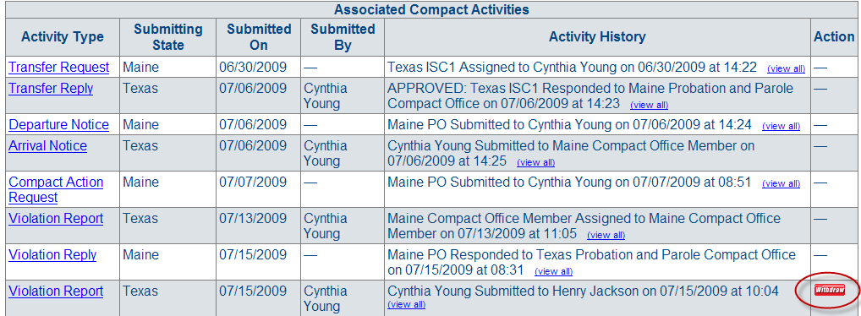
Withdrawing
Withdraw Activities from Offender Profile prior to a reply to that activity
Transfer Requests
Request for Reporting Instructions
Violation Reports
Case Closures
Notes:
It has to be a managed activities. Cannot withdraw progress reports, CAR

Slide 74
Withdrawing
Withdrawing Activities
Duplicate requests created by a User
Sent in error or Activity possesses an error
Incomplete Plan of Supervision provided
Transfer Replies to change a status from accepted to rejected
Failed to report within 120 days of acceptance
Failed to report within 5 days of the NOD
Rules 3.104-1 & 3.105
Notes:
Managing ICOTS and activities
What is meant by “replies to change a decision from accepted to rejected?” We need to be clear in this section on when states can withdraw their acceptance and only pursuant to Rule. (e.g. 3.104-1 & 3.105). They cannot withdraw for any other reason.
Withdrawing a Transfer reply that was accepted to change to rejected. ICOTS will not allow the sending state to complete a NOD

Slide 75
Withdrawing
Withdrawing a Transfer Reply changes a case from accepted status to rejected
Offender did not report as directed or within 120 days
Transfer was accepted in error

Slide 76
Withdrawing
Withdrawing Cases to remove from Compact Workload
Cancel Transfer (Rejected, no further request to be submitted)
Cases can be withdrawn up until the NOA is submitted
Notes:
Case Closure must be submitted after the NOA and withdraw is no longer available.

Slide 77
Register Interest
Allows an unassigned user to create an additional active case for an offender.
Dual Supervision cases from Split States
Multi-County/Multi User Cases
Subsequent obligation needs to be submitted for transfer
Notes:
3rd person handling the 3rd state transfer without taking possession of the original case.

Slide 78
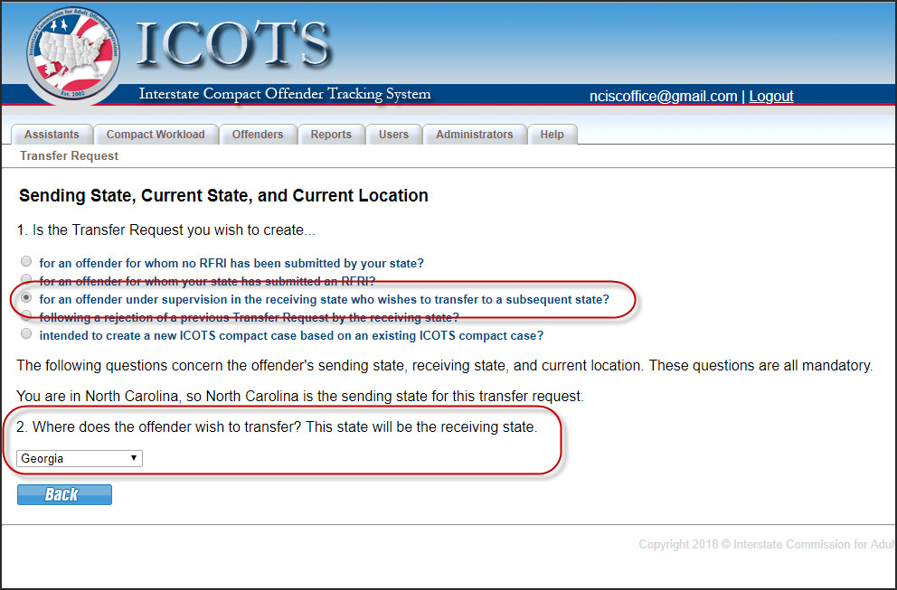
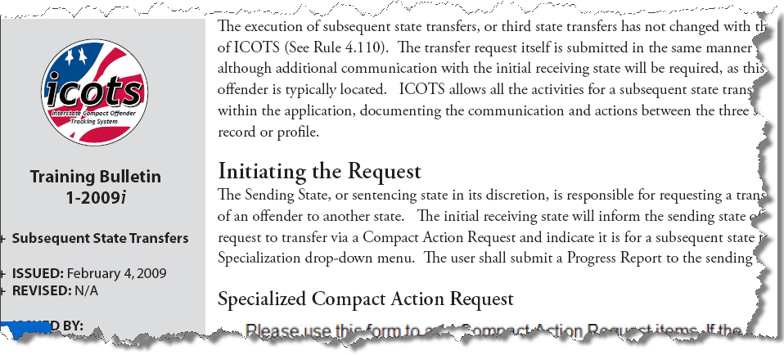
3rd State Transfers
TB 1-2009i www.interstatecompact.org
Initiated by original sending state
Receiving state can use specialized CAR for correspondence

Slide 79
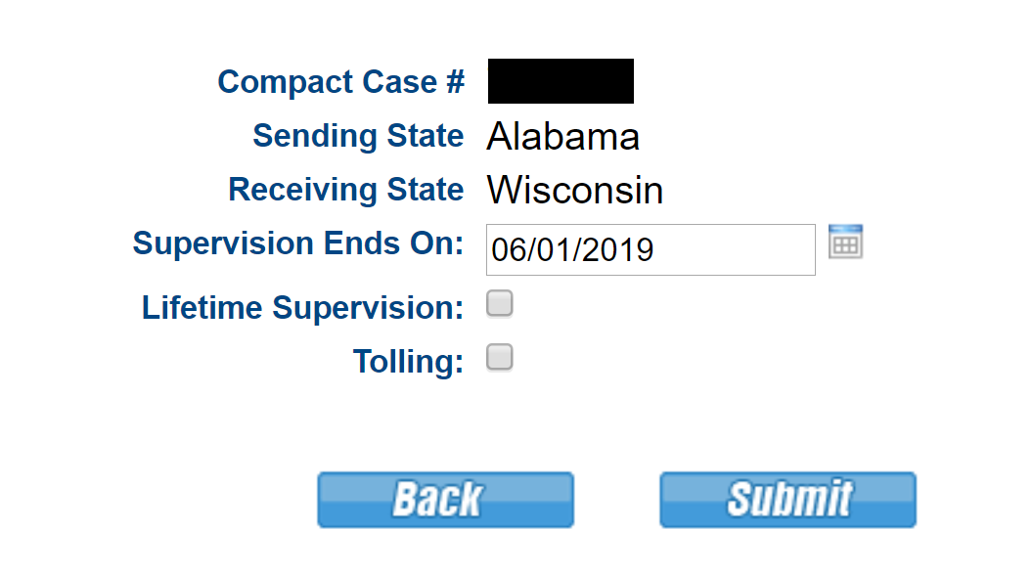
Supervision End Date
Case Closure Due date
Sending State PO manages from profile
Notes:
SED is the date the term of supervision ends for the compact case. Essentially the CCN due date.

Slide 80
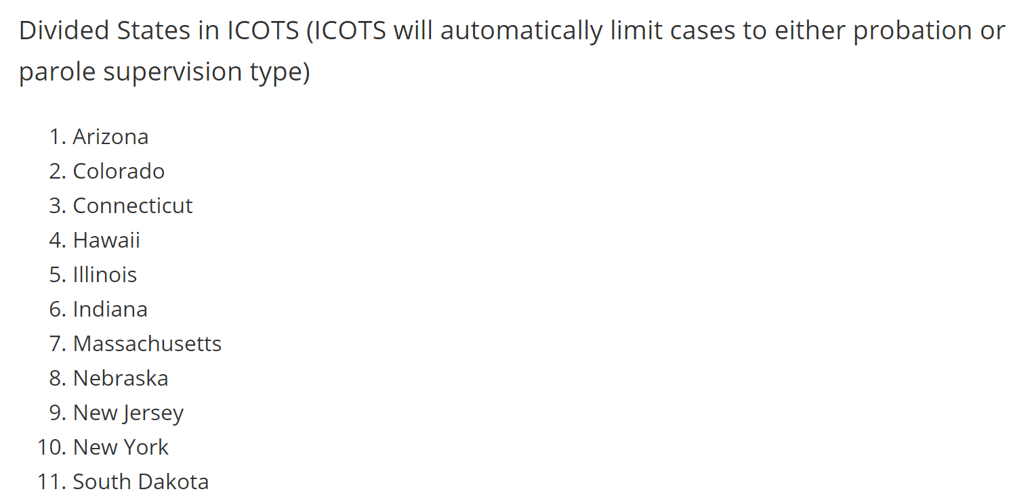
Split States
This configuration may or may not represent the state’s organizational structure outside of the ICOTS system.
Notes:
CO and TX also require two TR sent for dual supervision states.

Slide 81
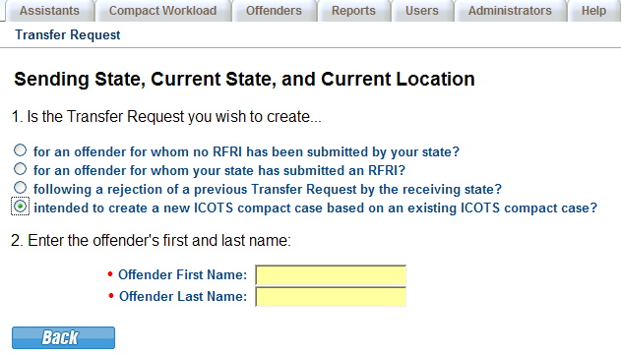
Split States
Several states have separate Compact Offices for probation and parole.
Dual Supervision criminal cases should be entered into ICOTS as separate cases
Notes:
Submit separate cases when supervision type is both probation and parole when transferring to a bifurcated state. This allows the other state to assign each case to separate users.

Slide 82
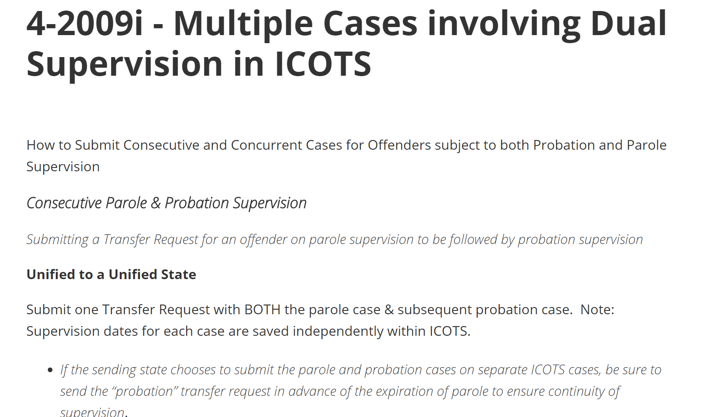
Consecutive vs Concurrent & Dual Supervision
TB 4-2009i www.support.interstatecompact.org
How to Submit Consecutive and Concurrent Cases for Offenders subject to both Probation and Parole Supervision to Unified and Bifurcated States via ICOTS

Slide 83
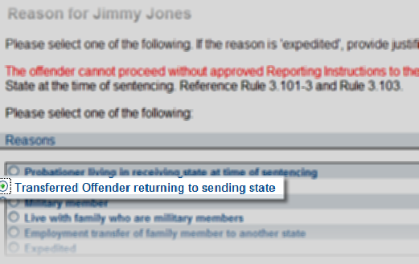
Returning Offenders
Request Reporting Instructions
Once approved submit NOD and Case Closure Notice
Notes:
Do not create a new case
Training tip: If returning address is unknown, be sure CCN is submitting with the NOD. See release and training notes on this 2019 enhancement on the support site.

Slide 84
Training & Help
In screen Integrated Training
ICAOS Support Site
Login Tips
Questions regarding workflow
Training Tools
ICAOS OnDemand
Rule & ICOTS training

Slide 85
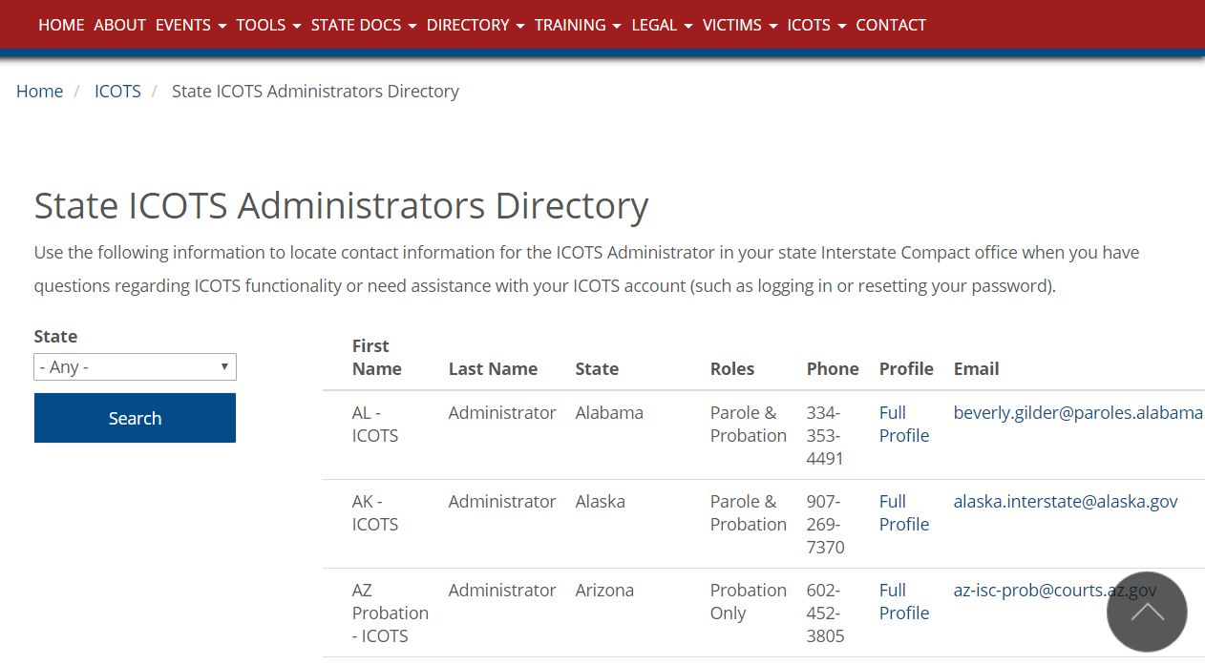
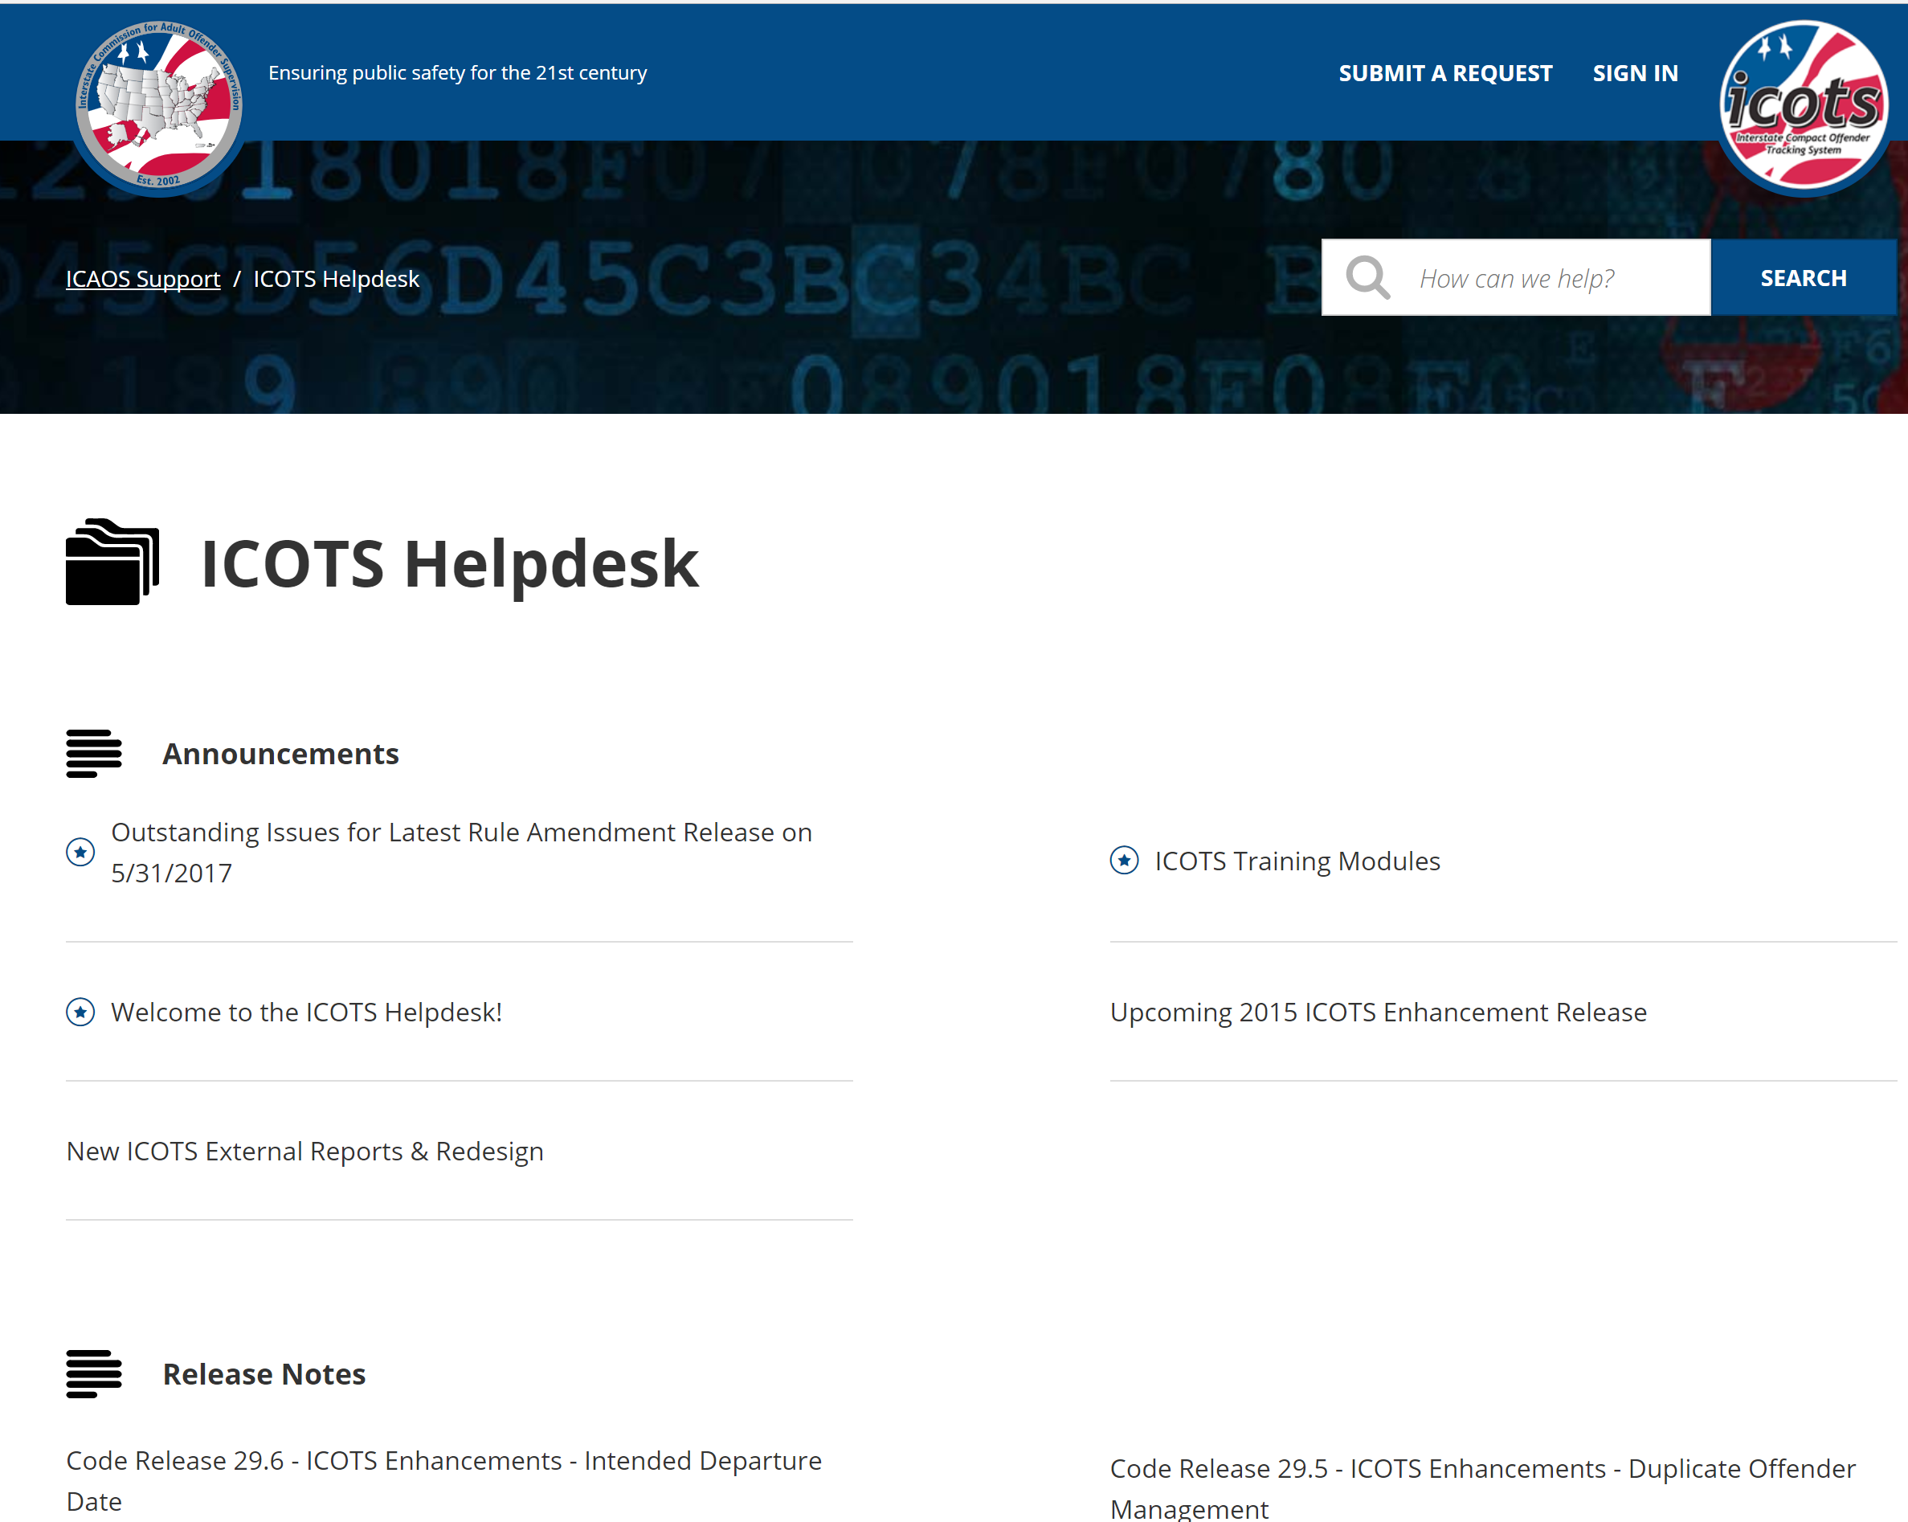
Training & Help
ICAOS Website
www.interstatecompact.org
https://support.interstatecompact.org
ICAOS Website
Includes directory for each state’s administrator
OnDemand Training
Support Site
FAQ
How-to’s
Notes:
Code Release Information
Training Updates
Short Tutorials
Quick Tips

Slide 86
Training & Help
https://support.interstatecompact.org

Slide 87
Questions??

