Slide 1

Presented by:
Crossing State Lines
Interstate Compact for Adult Offender Supervision
Notes:
For Parole Board Members

Slide 2
Presentation Objectives
In this training you will learn about:
Purposes & functions of ICAOS
  Eligibility & supervision responsibilities
Considerations for Parole Board Members
Resources available when compact cases arise
Notes:
Learn about how the compact’s function, what authority the compact rules have and implications for not complying with the compact requirements
What are the specific functions of ICAOS
who is required to be transferred through the compacts
high level look at states’ responsibilities and
what resources available to help answer questions regarding compact cases

Slide 3
Interstate Compact for Adult Offender Supervision
ICAOS regulates how offenders are:
Transferred from one state to another
Supervised while on Compact Supervision
Returned to a sending state when supervision is not successful
Notes:
ICAOS’s goals are to maintain supervision through a defined transfer process where it is recognized the best likelihood for success resides in another state:
family, treatment, work, education, etc.
Transfer does not allow a person to evade the conditions and expectations of the Court or Board of Parole; adult offenders must agree to any conditions imposed by the sentencing state and the state in which they are transferring to
Receiving states must treat compact offenders as they would their own upon the transfer of supervision responsibilities which under the compact.
ICAOS also creates a mechanism to return the person to the sending state if they violate the terms of their supervision and supervised release, probation or parole should be revoked

Slide 4




Purpose of ICAOS
Protect the Rights of Victims
Promote Public Safety
Ensure effective Supervision &
Rehabilitation.
Control/Track Movement of Offenders.
Notes:
Promote Public Safety
Protect Victim’s rights
Ensure supervision techniques are consistent with instate offenders and in line with best practices of the supervising state; this includes same access to supervision, sanctions, and services
Through databases supported by each national office, we are tracking and controlling movement of offenders as they cross state lines

Slide 5



Authority of an Interstate Compact
Authorized
Binding
Supersedes
The Compact is authorized by US Constitution & Crime Control Act
The Compact is binding upon all state authorities & citizens
The Compact rules supersedes conflicting state law
Notes:
What authority

Slide 6

Interstate Compact Legislation
Courts, Parole Boards, Community Corrections & Other Executive Agencies:
Subject to the ICAOS Rules
Must enforce & effectuate the Compacts
[List Your State’s Statute]
Notes:
As each state passed like legislation to become a member of the Compacts, knowing this legislation is exists key to knowing each states’ obligations which requires the state to comply with rules and enforce and effectuate the compact business in each state. Mention state council role and ensuring resources exist for states to comply with compact obligations.

Slide 7

Authority to Regulate
There is no “right” of convicted persons to travel across state lines or to serve one’s sentence in a particular state. See, Jones v. Harris, 452 U.S. 412 (1981); Meachum v. Fano, 427 U.S. 215 (1976)
Convicted persons have no right to control where they live; the right is extinguished for the balance of their sentence. Williams v. Wisconsin, 336 F.3d 576 (7th Cir. 2003), Pelland v. RI,317 F. Supp. 2d 26 (2004)

Slide 8
National Governing Body
Members of the ICAOS:
  All 50 states
  District of Columbia
  US Virgin Islands
  Puerto Rico
Rule Making Authority
Compliance Enforcement
Notes:
Commission made up of the states, DC, US Virgin Islands and PR .The Commission has rule making authority and the authority to enforce compliance upon its members

Slide 9
Implications of Non-Compliance
It is incumbent upon prosecutors, judges and other state officials to understand the requirements of the Compact and its rules, as well as the consequences of non-compliance.
Failure of state judicial or executive branch officials to comply with the Compact and its rules results in the state defaulting on its obligations under the Compact and could lead the Commission to take corrective or punitive action, including suit in federal court for injunctive relief.
5
Notes:
The compact rules are binding on all state officials and states’ citizens.
The rules and by-laws adopted by states also address how noncompliance is handled.
Corrective actions could require states to complete a corrective action plan, require training and in some cases could lead to the Commission to file suit in federal court against a defaulting state.

Slide 10
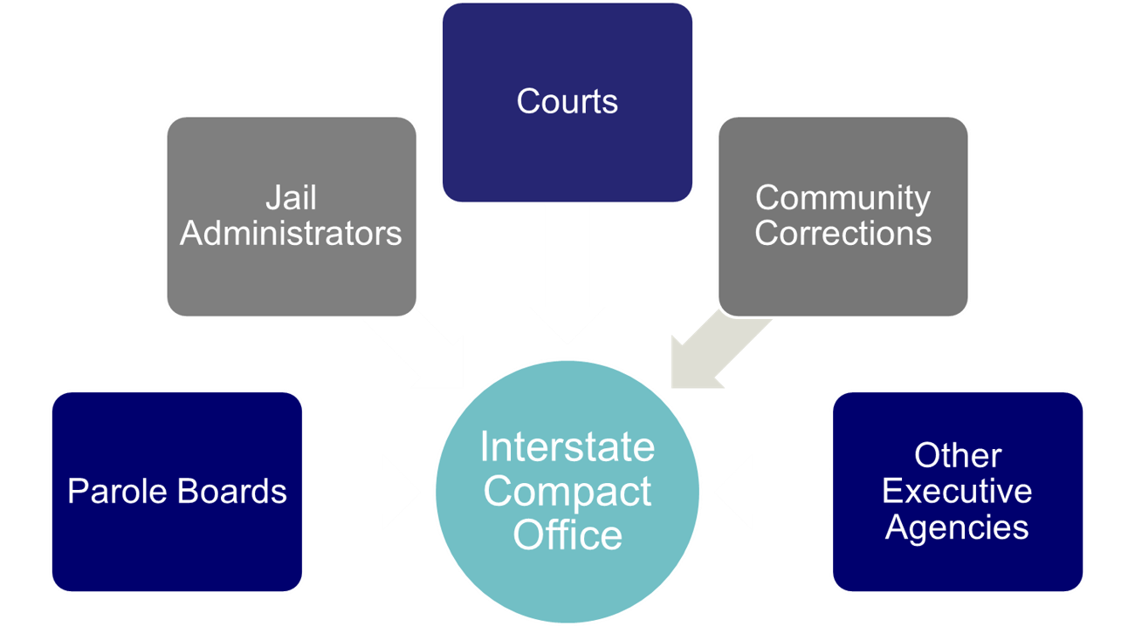
Interstate Compact Offices
Administers the Compact
Point of contact for case specific questions
Conducts training
Resolves issues with other states
Ensures rule compliance
Develops & recommends in-state ISC operating procedures to State Council
Interstate Compact Office
Notes:
Compact offices have an important role in ensuring compact success. They can also assist you in understanding compact implications in a case you may be dealing with.

Slide 11
What Triggers the ICAOS?
Offender
Supervision
Relocate
Adult who commits a criminal offense (all felonies & specific misdemeanants)
Subject to ‘supervision’; and
Released to the community under the jurisdiction of:
  Courts
  Paroling Authorities
  Corrections
  Other Criminal Justice Agencies
2 Distinct criteria:
  Oversight exercised by a controlling authority, which includes:
    Courts
    Paroling Authorities
    Corrections
    Other Criminal Justice Agencies
  Required to monitor regulations or conditions, other than monetary
Offender means to remain in another state for more than 45 consecutive days in any 12 month period.
+
+
Notes:
Note eligibility for deferred sentenced offenders
Furloughed and preparole

Slide 12


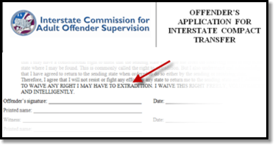
Compact Supervision Elements
Duration
Conditions
Waiver
Sentencing Authority in the Sending State determines duration of Supervision
Offender agrees to conditions imposed by BOTH Sending & Receiving States
Offender applying for transfer must WAIVE rights for extradition
Notes:
As a precondition to transfer supervision, ALL offenders must sign the offender application for transfer agreeing to waive extradition from any state. This is EXTREMELY IMPORTANT as it replaces the need for an extradition hearing in the Receiving State and the need for a Governor's warrant by the Sending State in order to apprehend an offender.
This form clearly states, “…I will not resist or fight any effort by any state to return me to the sending
state and I AGREE TO WAIVE ANY RIGHT I MAY HAVE TO EXTRADITION. I WAIVE THIS RIGHT FREELY,
VOLUNTARILY AND INTELLIGENTLY.”

Slide 13
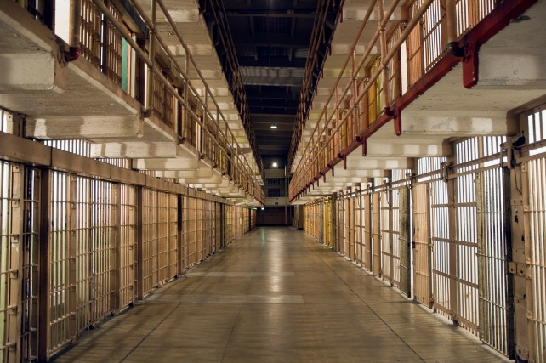
Submit request within 120 calendar days prior to release date
Sending state shall notify receiving state if:
Pre-Release Transfer
the planned release date changes, or
if release date has been withdrawn or denied

Slide 14

Compact Supervision in a Receiving State
Supervision standard consistent with similar offenders sentenced in the Receiving State
Same programs, incentives, sanctions/interventions
‘Participation in the ICAOS ensures not only the controlled movement of offenders under community supervision, but also that out-of-state offenders will be given the same resources and supervision provided to similar in-state offenders including the use of incentives, corrective actions, graduated responses and other supervision techniques’
Rule 4.101
Notes:
Once allowed to transfer, receiving states have to provide supervision consistently in how they would supervised an offender sentenced in the receiving state. Although most states fulfill this requirement well under the compact requirements, it can be a training issue for stakeholders involved in supervision decisions or rehabilitation programs.
Rule 4.101 requires a receiving state to supervise transferred offenders as it would in-state offenders. Receiving states shall subject the offender to any and all supervision techniques and behavior responses imposed on in-state offenders, with the exception of modifying the supervision term or revoking conditional release.

Slide 15

Supervision Goals
Less offenders returning to institution for formal revocation
  New strategies to address non-compliant behavior
  Exhaust alternatives to revocation while the offender is supervised in the receiving state
Ensure retaking is initiated ONLY when it MAKES SENSE!
  Retaking isn’t guaranteed to be permanent
  Retaking costs $$
  Documentation should support revocation
Notes:
Offenders usually live in the receiving state. If always resided in your state, they will always reside in your state. Violation doesn’t mean they won’t come back. Don’t you want offenders to have best opportunity to succeed in your community??
Ask who uses EBP…should be all
Offenders transfer for purposes of successful supervision
Residents and/or supportive environment exists in the Receiving State
Family, employment, etc.
Use of Evidenced Based Practices (graduated response/sanctions/access to programs) should be the same for compact offenders
Promote positive/compliant behavior

Slide 16
Retaking & Warrants
Retaking requires a Warrant
Warrants for interstate offenders shall be entered in the National Crime Information Center (NCIC)
Wanted Person File with a nationwide pick-up radius with no bond amount set within 15 business days.
1
3
4
Discretionary Retaking by Sending State
Requires notification to authorities in the receiving state
May order offender to return in lieu of retaking*
Sending State retains the authority to retake at anytime unless the offender has pending charges in the receiving state
Mandatory Retaking (initiated by a receiving state when corrective actions have been exhausted and documented and supervision is no longer viable)
Offender is convicted of new felony or violent crime;
Offender absconded;
Offender engaged in revocable behavior*

Slide 17

Retaking & Warrants
Retaking requires a Warrant
Warrants for interstate offenders shall be entered in the National Crime Information Center (NCIC)
Wanted Person File with a nationwide pick-up radius with no bond amount set within 15 business days.
1
3
4
Sending State Responsibilities:
Ensure probable cause is established/requested prior to retaking if revocation is possible
Retake within 30 days
Cost of retaking
Receiving State Responsibilities:
Conduct hearing/establish probable cause
Cost of incarceration pending retaking
No bail or other release conditions
New Pending Felony/Violent Crime Charges in the Receiving State?
Offender not available for retaking, unless key stakeholders in both states agree due to public safety concern
Resident/Family
The offender is a resident or has resident family and a willingness to assist the offender AND the offender can obtain employment or has a means of support

Slide 18
Common Challenges
Retaking Considerations
Differences in Supervision
States’ responses to behavior and path revocation vary across jurisdictions
Recognizing another state’s documentation
Stakeholder Involvement is Key
Ensure sanctions are exhausted before requiring retaking
  Actions and documentation must demonstrate noncompliance meets grounds for revocation in receiving state
  If offender is retaken, it intends that the sending state will revoke supervision
Ensure compliance: warrants, timeframes, costs
New pending charges = Offender not available for retaking (unless key stakeholders in both states agree due to public safety concerns)
Notes:
On the flip side, it is also a challenge for states recognizing another state’s documentation and the path to revocation may be different in a receiving state versus a sending state. The commission has published legal white papers on several issues related to these challenges. Many highlight the responsibility for states to educate its stakeholders and involve relevant stakeholders when decisions are made.
while numerous courts have held that convicted persons do not have a right to relocate from one state to another (as discussed in earlier slide,) courts have also
recognized that once relocation is granted states should not lightly or arbitrarily revoke the relocation.
Although retaking does not guarantee an offender will be revoked once retaken and back in the sending state, that is the intent if the level of noncompliance is reached while under supervision in the receiving state so states must ensure sufficient documentation and communication to ensure proper decisions and actions are made when responding to violation situations.
.

Slide 19
Be Part of the Solution!
State Councils
Sending State
Receiving State
Internal initiatives
Constant review of processes for improvement
Transfer Process
Retaking Process
Discretionary Retaking
Ensure supervision practices are consistent
Revocation alternatives for ISC offenders
Notes:
Tracy

Slide 20
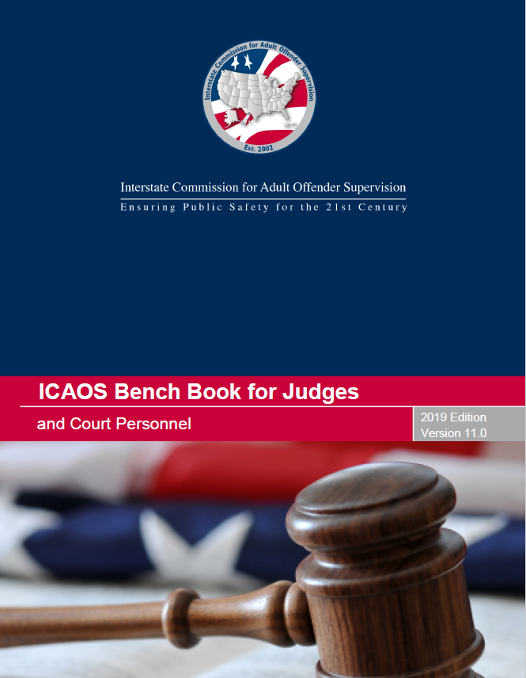


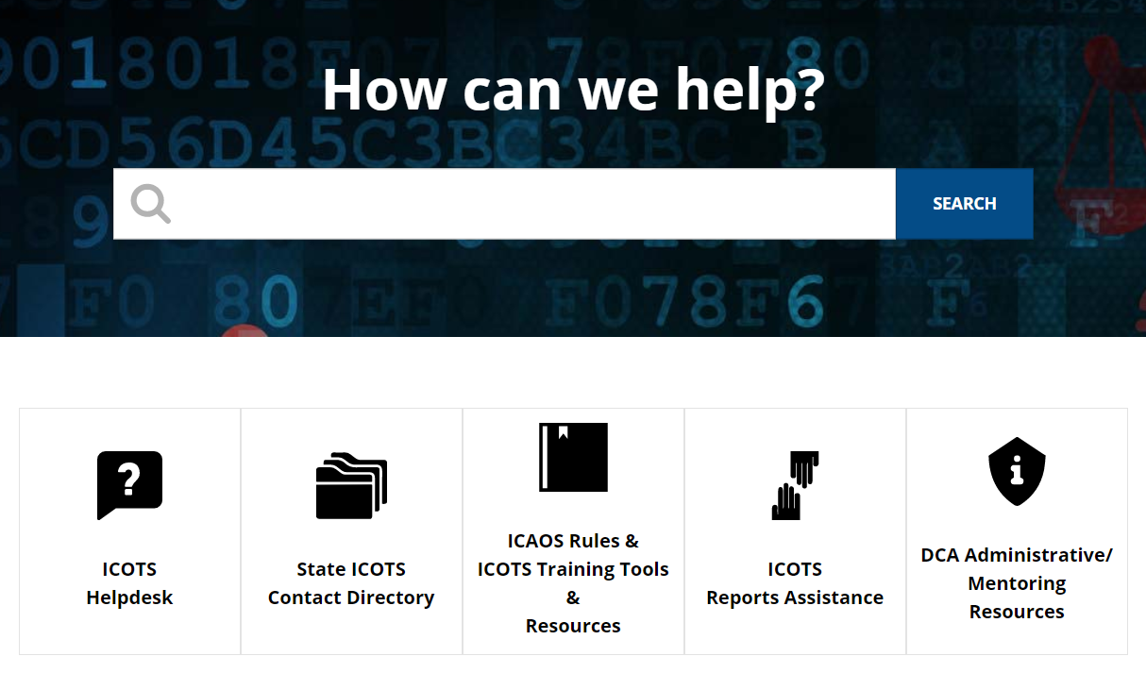
ICAOS Resources: www.interstatecompact.org
Compact Online Reference Encyclopedia
A cross-referenced guide on all ICAOS white papers, advisory opinions, training modules, rules. PC Hearing Officer Guide and the bench book.
Interstate Compact Offender Tracking System
The Commission’s national tracking system that administers the transfers for all compact offenders.
ICAOS Bench Book for Judges and Courts
The Commission’s judicial reference tool to assist judges and court personnel on the Compact.
Training Support
All of the Commission’s training material, resources and on-demand modules in one convenient location.
https://interstatecompact.org/core-search
https://interstatecompact.org/user/login?destination=/litmos-api
https://interstatecompact.org/user/login?destination=/zendesk-api
https://interstatecompact.org/bench-book
Notes:
ICAOS has numerous resources for stakeholders involved in compact operations.
CORE,
ICAOS support site (training resources (including Ondemand), FAQ’s for ICOTS users, forums for state’s to share resources and dialogue)
ICOTS public webportal available to see a particular offender who may be transferred through the compact and contact info for each state
ICAOS Benchbook, comprehensive legal resource

Slide 21
Questions
Interstate Compacts for Adult Offender Supervision

Slide 22
Contact Us
Email
[Your Compact Office Email Address]
Phone
[Your Compact Office Phone]
Website
[Your Website]
www.interstatecompact.org
Offices
[Your Compact Office Address]

Slide 23
Thank You
Interstate Compact for Adult Offender Supervision

