Slide 1

Presented by:
Crossing State Lines
Interstate Compact for Adult Offender Supervision
Notes:
For Legal Community

Slide 2
Presentation Objectives
In this training you will learn about:
Compact mechanisms, authority & implications
Purposes & functions of ICAOS
  Eligibility & supervision responsibilities
Judicial Considerations
Resources available when compact cases arise
Notes:
Learn about how the compact’s function, what authority the compact rules have and implications for not complying with the compact requirements
What are the specific functions of ICAOS
who is required to be transferred through the compacts
high level look at states’ responsibilities and
what resources available to help answer questions regarding compact cases

Slide 3

The Compact Mechanism
Simple, Versatile & Proven Tool
Provides effective, enforceable means of cooperatively addressing common problems
Even if state laws differ
Without relinquishing authority to the federal government
Notes:
What is a compact?

Slide 4
Compacts Explained
Advantages | Downsides
Flexible/Enforceable Means of Cooperation Uniformity Without Federal Intervention States Retain Shared Control | Lack of Familiarity of Compacts Loss of individual state sovereignty, States may not act unilaterally Delegation of state regulatory authority to interstate entities

Slide 5



Authority of an Interstate Compact
Authorized
Binding
Supersedes
The Compact is authorized by US Constitution & Crime Control Act
The Compact is binding upon all state authorities & citizens
The Compact rules supersedes conflicting state law
Notes:
What authority

Slide 6
Congressional Consent
Requirement
Implications
Art. I, Sec. 10 of the Compact Clause prohibits states from entering into compacts without the consent of Congress. Originally applied to all compacts – now only to those that:
  alter the political balance within the federal system; or
  affect a power delegated to the federal government
  -- Virginia v. Tennessee, 148 U.S. 503 (1893)
  May be express or implied; may be given before or after the compact is created.
  Equivalent of federal law under the “law of the union doctrine.”
  -Delaware River Comm’n v. Colburn, 310 U.S. 419, 439 (1940)
  -Cuyler v. Adams, 449 U.S. 433 (1981)
  -Texas v. New Mexico, 482 U.S. 124 (1987)
Places responsibility for interpretation and enforcement in the federal courts and finally the U.S. Supreme Court.
All courts must give effect to a compact even to the extent that state law (constitutional or statutory) must yield to its terms and conditions.
WMATA v. One Parcel of Land, 706 F.2d 1312 (4th Cir. 1983)

Slide 7




Purpose of ICAOS
Protect the Rights of Victims
Promote Public Safety
Ensure effective Supervision &
Rehabilitation.
Control/Track Movement of Offenders.
Notes:
Promote Public Safety
Protect Victim’s rights
Ensure supervision techniques are consistent with instate offenders and in line with best practices of the supervising state; this includes same access to supervision, sanctions, and services
Through databases supported by each national office, we are tracking and controlling movement of offenders as they cross state lines

Slide 8

Interstate Compact Legislation
Courts, Parole Boards, Community Corrections & Other Executive Agencies:
Subject to the ICAOS Rules
Must enforce & effectuate the Compacts
[List Your State’s Statute]
Notes:
As each state passed like legislation to become a member of the Compacts, knowing this legislation is exists key to knowing each states’ obligations which requires the state to comply with rules and enforce and effectuate the compact business in each state. Mention state council role and ensuring resources exist for states to comply with compact obligations.

Slide 9

Authority to Regulate
There is no “right” of convicted persons to travel across state lines or to serve one’s sentence in a particular state. See, Jones v. Harris, 452 U.S. 412 (1981); Meachum v. Fano, 427 U.S. 215 (1976)
Convicted persons have no right to control where they live; the right is extinguished for the balance of their sentence. Williams v. Wisconsin, 336 F.3d 576 (7th Cir. 2003), Pelland v. RI,317 F. Supp. 2d 26 (2004)

Slide 10
National Governing Body
Members of the ICAOS:
  All 50 states
  District of Columbia
  US Virgin Islands
  Puerto Rico
Rule Making Authority
Compliance Enforcement
Notes:
Commission made up of the states, DC, US Virgin Islands and PR .The Commission has rule making authority and the authority to enforce compliance upon its members

Slide 11
Interstate Compact for Adult Offender Supervision
ICAOS regulates how offenders are:
Transferred from one state to another
Supervised while on Compact Supervision
Returned to a sending state when supervision is not successful
Notes:
ICAOS’s goals are to maintain supervision through a defined transfer process where it is recognized the best likelihood for success resides in another state:
family, treatment, work, education, etc.
Transfer does not allow a person to evade the conditions and expectations of the Court or Board of Parole; adult offenders must agree to any conditions imposed by the sentencing state and the state in which they are transferring to
Receiving states must treat compact offenders as they would their own upon the transfer of supervision responsibilities which under the compact.
ICAOS also creates a mechanism to return the person to the sending state if they violate the terms of their supervision and supervised release, probation or parole should be revoked

Slide 12

What Triggers the ICAOS?
Pursuant to Rule 2.110, no state may allow a person covered by the Compact to relocate to another state except as provided by the Compact and its rules.
Therefore, a court cannot order or direct an eligible offender to leave a state and relocate to another state unless such relocation occurs in accordance with the Compact and its rules.
Notes:
Pursuant to Rule 2.110, an offender, subject to supervision who is relocating to another state must request transfer of supervision through the interstate compact. Therefore, a court cannot order or direct a covered offender to leave a state and relocate to another state unless such relocation is done in accordance with the Compact and its rules.
An offender who is not eligible for transfer under this Compact is not subject to these rules and remains subject to the laws and regulations of the state responsible for the offender’s supervision.

Slide 13
Key Definitions Determining Eligibility
Offender
Supervision
Relocate
Adult who commits a criminal offense (all felonies & specific misdemeanants)
Subject to ‘supervision’; and
Released to the community under the jurisdiction of:
  Courts
  Paroling Authorities
  Corrections
  Other Criminal Justice Agencies
2 Distinct criteria:
  Oversight exercised by a controlling authority, which includes:
    Courts
    Paroling Authorities
    Corrections
    Other Criminal Justice Agencies
  Required to monitor regulations or conditions, other than monetary
Offender means to remain in another state for more than 45 consecutive days in any 12 month period.
+
+
Notes:
Not all offender subject to community supervision (probation and parole) qualify, the qualifying criteria include those offenders who commit a felony or specific misd (Person to Person or threat of harm, DUI (2nd or subsequent), and Sex Offender) who intend to remain in another state for more than 45 consecutive days.
they must be subject to supervision which is defined as regulations or conditions imposed on the offender that require monitoring by some authority (which could include the courts.) Compact eligibility does not include those subject to merely monetary obligations
Deferred sentencing when an offender has given up right to trial and found guilty are eligible for transfer

Slide 14
Eligible Offenses: Misdemeanants
Sentence = 1+ years of supervision AND
Instant Offense includes one or more:
Person incurred direct or threatened physical or psychological harm. | 2nd or subsequent conviction of driving while impaired by drugs or alcohol
Use or possession of a firearm involved. | Sex offense requiring registration in the sending state
13
Notes:
Other misdemeanants can be transferred as discretionary transfers and acceptance is at discretion of the receiving state

Slide 15
What Makes an Offender Eligible for Transfer
1
2
3
4
Time Remaining on Supervision
The offender has more than 90 calendar days or an indefinite period of supervision remaining
Valid Plan
The Offender has a valid plan of supervision
Compliance
The offender is in substantial compliance with the terms of supervision
Resident/Family
The offender is a resident or has resident family and a willingness to assist the offender AND the offender can obtain employment or has a means of support
Notes:
Other eligibility criteria for transfer must illustrate that relocating to another state is offender’s best chance for success. Offenders must have a good plan, not be in violation status in the sending state and most have ties to the receiving state as being a resident (living in that state prior to committing their offense) or have family support.
As clearly stated in case law, no convicted person has a right to server his or her sentence in another state.
It’s imperative offender’s understand this when allowed to transfer and that the compact is established to provide a legal mechanism for the offender to live and be supervised in a receiving state, not be an obstacle.

Slide 16
Types of Transfers
Mandatory
Discretionary
Resident/Resident Family (88% of Compact Cases)
All Discretionary (12% of Compact Cases)
Military Member/Live with Military Family
Common Reasons: Treatment/School/New Employment opportunities; other verified means support
Military Veteran Receiving Treatment
Employment Transfers (at direction of employer)
Other Mandatory (<1% of Compact Cases)
Notes:
Resident – means a person who
has continuously inhabited a state for at least 1 year prior to the commission of the offense for which the offender is under supervision; and
intends that such state shall be the person’s principal place of residence; and
has not, unless incarcerated or on active military deployment, remained in another state or states for a continuous period of 6 months or more with the intent to establish a new principal place of residence.
Resident Family – means a parent, grandparent, aunt, uncle, adult child, adult sibling, spouse, legal guardian, or step-parent who
has resided in the receiving state for 180 calendar days or longer as of the date of the transfer request; and
indicates willingness and ability to assist the offender as specified in the plan of supervision.

Slide 17

No Travel Prior to Acceptance
Investigation Period
Up to 45 days
Reporting Instructions Exceptions:
Probationer Living in Receiving State at the time of Sentencing
Military Members/Veterans Receiving Treatment/Employment Transfer
Other verified Emergency Situations (both states must agree)
Notes:
Ris Provides temporary permission for offender to be in a receiving state during the investigation.

Slide 18
Victim’s Rights
Victim’s Right to be Heard
Victim Notification
Victims can contact Sending State’s compact office
Victims have 15 business days after notification of transfer to give input
  Receiving state shall continue to investigate
Victim’s Comment ALWAYS Confidential
Victim notification shall be initiated:
In accordance with the sending state’s laws and procedures
Within 1 business day of either:
  Issuance of Reporting Instructions; or
  Acceptance of a Transfer Request

Slide 19


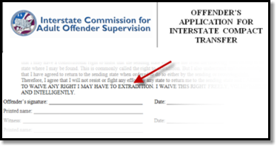
Compact Supervision Elements
Duration
Conditions
Waiver
Sentencing Authority in the Sending State determines duration of Supervision
Offender agrees to conditions imposed by BOTH Sending & Receiving States
Offender applying for transfer must WAIVE rights for extradition
Notes:
As a precondition to transfer supervision, ALL offenders must sign the offender application for transfer agreeing to waive extradition from any state. This is EXTREMELY IMPORTANT as it replaces the need for an extradition hearing in the Receiving State and the need for a Governor's warrant by the Sending State in order to apprehend an offender.
This form clearly states, “…I will not resist or fight any effort by any state to return me to the sending
state and I AGREE TO WAIVE ANY RIGHT I MAY HAVE TO EXTRADITION. I WAIVE THIS RIGHT FREELY,
VOLUNTARILY AND INTELLIGENTLY.”

Slide 20
Jurisdiction Considerations
Sending State
Receiving State
Retains jurisdiction for purposes of revocation of conditional release
May require reports of supervision progress from the receiving state at anytime
Has discretion to return/retake an offender unless required to retake due to documented revocable behavior (initiated by a request of the receiving state)
Has authority to impose additional conditions during supervision term
  Including limited terms of incarceration in lieu of revocation
  Must be consistent with conditions imposed on similar offenders and must be reported to the sending state
May initiate criminal proceedings if offender commits new crime
May require retaking when supervision is no longer successful

Slide 21

Force & Effect of Conditions
The sending state shall give the same force and effect to conditions imposed by a receiving state as if those conditions had been imposed by the sending state.

Slide 22

Compact Supervision in a Receiving State
Supervision standard consistent with similar offenders sentenced in the Receiving State
Same programs, incentives, sanctions/interventions
‘Participation in the ICAOS ensures not only the controlled movement of offenders under community supervision, but also that out-of-state offenders will be given the same resources and supervision provided to similar in-state offenders including the use of incentives, corrective actions, graduated responses and other supervision techniques’
Rule 4.101
Notes:
Once allowed to transfer, receiving states have to provide supervision consistently in how they would supervised an offender sentenced in the receiving state. Although most states fulfill this requirement well under the compact requirements, it can be a training issue for stakeholders involved in supervision decisions or rehabilitation programs.
Rule 4.101 requires a receiving state to supervise transferred offenders as it would in-state offenders. Receiving states shall subject the offender to any and all supervision techniques and behavior responses imposed on in-state offenders, with the exception of modifying the supervision term or revoking conditional release.

Slide 23
Retaking & Warrants
Retaking requires a Warrant
Warrants for interstate offenders shall be entered in the National Crime Information Center (NCIC)
Wanted Person File with a nationwide pick-up radius with no bond amount set.
1
3
4
Discretionary Retaking by Sending State
Requires notification to authorities in the receiving state
May order offender to return in lieu of retaking*
Sending State retains the authority to retake at anytime unless the offender has pending charges in the receiving state
Mandatory Retaking (initiated by a receiving state when corrective actions have been exhausted and documented and supervision is no longer viable)
Offender is convicted of new felony or violent crime;
Offender absconded;
Offender engaged in revocable behavior*

Slide 24

Retaking & Warrants
Retaking requires a Warrant
Warrants for interstate offenders shall be entered in the National Crime Information Center (NCIC)
Wanted Person File with a nationwide pick-up radius with no bond amount set within 15 business days.
1
3
4
Sending State Responsibilities:
Ensure probable cause is established/requested prior to retaking if revocation is possible
Retake within 30 days
Cost of retaking
Receiving State Responsibilities:
Conduct hearing/establish probable cause
Cost of incarceration pending retaking
No bail or other release conditions
New Pending Felony/Violent Crime Charges in the Receiving State?
Offender not available for retaking, unless key stakeholders in both states agree due to public safety concern
Resident/Family
The offender is a resident or has resident family and a willingness to assist the offender AND the offender can obtain employment or has a means of support

Slide 25
Common Challenges
Retaking Considerations
Differences in Supervision
States’ responses to behavior and path revocation vary across jurisdictions
Recognizing another state’s documentation
Stakeholder Involvement is Key
Ensure sanctions are exhausted before requiring retaking
  Actions and documentation must demonstrate noncompliance meets grounds for revocation in receiving state
  If offender is retaken, it intends that the sending state will revoke supervision
Ensure compliance: warrants, timeframes, costs
New pending charges = Offender not available for retaking (unless key stakeholders in both states agree due to public safety concerns)
Notes:
On the flip side, it is also a challenge for states recognizing another state’s documentation and the path to revocation may be different in a receiving state versus a sending state. The commission has published legal white papers on several issues related to these challenges. Many highlight the responsibility for states to educate its stakeholders and involve relevant stakeholders when decisions are made.
while numerous courts have held that convicted persons do not have a right to relocate from one state to another (as discussed in earlier slide,) courts have also
recognized that once relocation is granted states should not lightly or arbitrarily revoke the relocation.
Although retaking does not guarantee an offender will be revoked once retaken and back in the sending state, that is the intent if the level of noncompliance is reached while under supervision in the receiving state so states must ensure sufficient documentation and communication to ensure proper decisions and actions are made when responding to violation situations.
.

Slide 26
Implications of Non-Compliance
It is incumbent upon prosecutors, judges and other state officials to understand the requirements of the Compact and its rules, as well as the consequences of non-compliance.
Failure of state judicial or executive branch officials to comply with the Compact and its rules results in the state defaulting on its obligations under the Compact and could lead the Commission to take corrective or punitive action, including suit in federal court for injunctive relief.
5
Notes:
The compact rules are binding on all state officials and states’ citizens.
The rules and by-laws adopted by states also address how noncompliance is handled.
Corrective actions could require states to complete a corrective action plan, require training and in some cases could lead to the Commission to file suit in federal court against a defaulting state.

Slide 27
Compliance: Monitoring & Enforcement
∙
The Commission monitors compliance with the interstate compact and its rules, and intervenes address noncompliance.
∙
ICAOS conducts annual audits to ensure states’ compliance with the Compact and its rules.
∙
ICAOS resolves state filed complaints and assists with informal dispute resolution.
∙
The ICAOS has resolved more than 65 state filed complaints since 2005.
Notes:
The Commission monitors compliance and conducts annual audits to ensure states’ compliance with rules and timeframes.
Informal dispute procedures exist to assist with resolutions.

Slide 28
State Council Role
Each state determines their state council membership. Membership must include at least one of the following:
Governor Representative
Legislative Representative
Judicial Representative
Victim’s Advocate
Provide mechanism for empowerment and awareness of Compact processes;
Determine state impact of Commission action(s) or potential action(s);
Assist in developing Compact policy;
Appoint Acting Commissioner in absence of appointed Commissioner

Slide 29
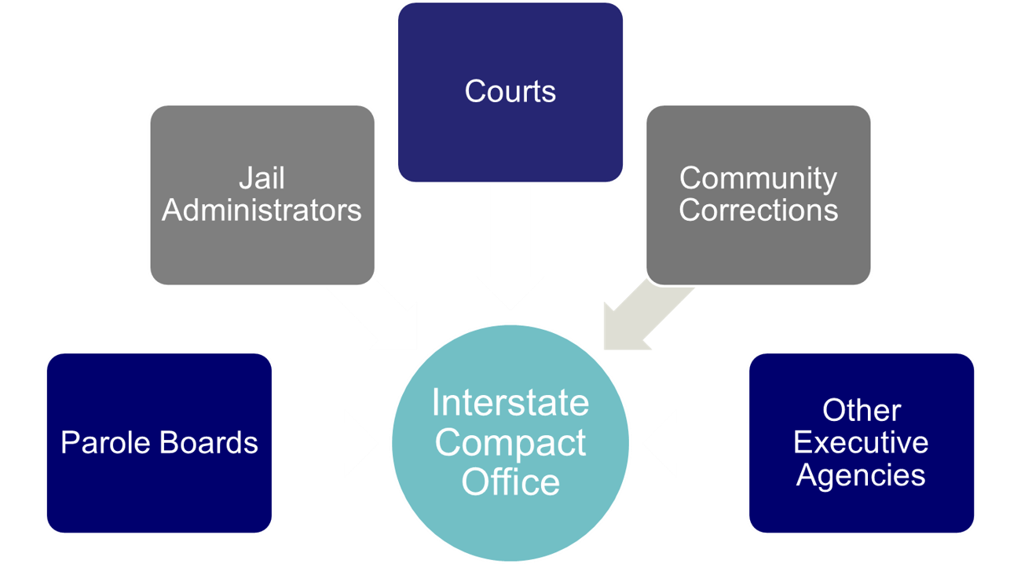
Interstate Compact Offices
Administers the Compact
Point of contact for case specific questions
Conducts training
Resolves issues with other states
Ensures rule compliance
Develops & recommends in-state ISC operating procedures to State Council
Interstate Compact Office
Notes:
Compact offices have an important role in ensuring compact success. They can also assist you in understanding compact implications in a case you may be dealing with.

Slide 30
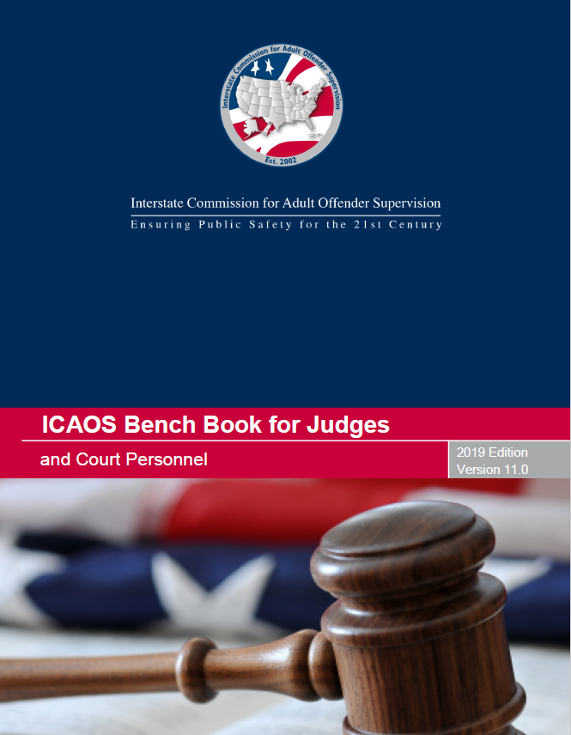


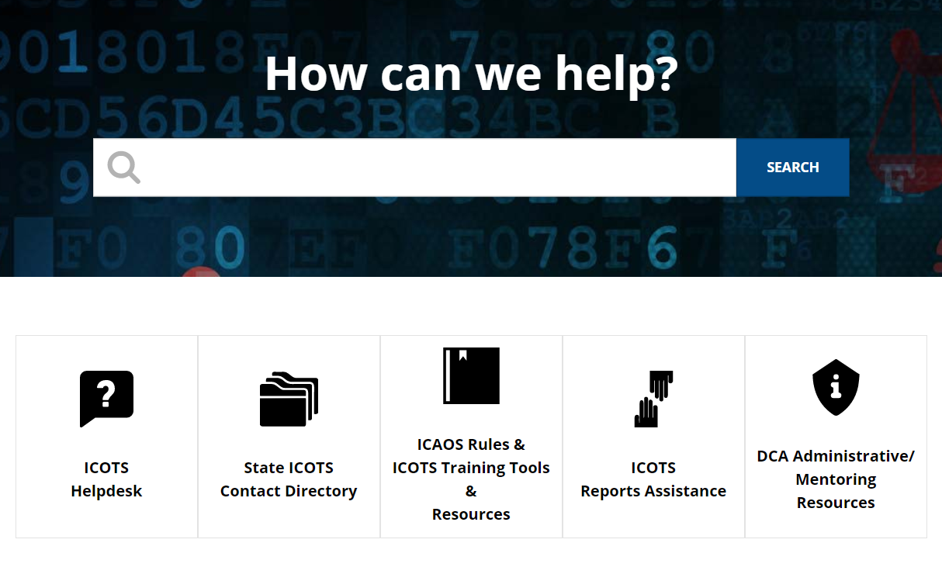
ICAOS Resources: www.interstatecompact.org
Compact Online Reference Encyclopedia
A cross-referenced guide on all ICAOS white papers, advisory opinions, training modules, rules. PC Hearing Officer Guide and the bench book.
Interstate Compact Offender Tracking System
The Commission’s national tracking system that administers the transfers for all compact offenders.
ICAOS Bench Book for Judges and Courts
The Commission’s judicial reference tool to assist judges and court personnel on the Compact.
Training Support
All of the Commission’s training material, resources and on-demand modules in one convenient location.
https://interstatecompact.org/core-search
https://interstatecompact.org/user/login?destination=/litmos-api
https://interstatecompact.org/user/login?destination=/zendesk-api
https://interstatecompact.org/bench-book
Notes:
Ashley: ICAOS has numerous resources for stakeholders involved in compact operations.
CORE,
ICAOS support site (training resources (including Ondemand), FAQ’s for ICOTS users, forums for state’s to share resources and dialogue)
ICOTS public webportal available to see a particular offender who may be transferred through the compact and contact info for each state
ICAOS Benchbook, comprehensive legal resource

Slide 31
Legal Resources
Right to Transfer
Eligibility
Warrants/Retaking
Bench Book: General Principals
Rule 2.110
Bench Book: Eligibility Criteria
Rules 3.101, 3.101-1 & 3.101-2
Bench Book: Chapter 4
Rules Chapter 5
Warrant Definition
Federal Lawsuits
Liability
PC Hearing
Compact Enforcement
  Bench Book: Chapter 5
  Whitepapers 2011 & 2013
  Hearing Officer’s Guide
  OnDemand Training
Search CORE for all ICAOS’ published white papers, advisory opinions, training modules, rules and the bench book

Slide 32
Questions
Interstate Compacts for Adult Offender Supervision

Slide 33
Contact Us
Email
[Your Compact Office Email Address]
Phone
[Your Compact Office Phone]
Website
[Your Website]
www.interstatecompact.org
Offices
[Your Compact Office Address]

Slide 34
Thank You
Interstate Compact for Adult Offender Supervision

