Slide 1

Interstate Compact Staff Training
February 2024

Slide 2
Agenda
Amendment to Rule 5.108(f) effective March 1, 2024
Language Change
New Learning Management Site (LMS)
  New ICOTS Modules
New Practitioner & Stakeholder Guides
New Support Resources

Slide 3
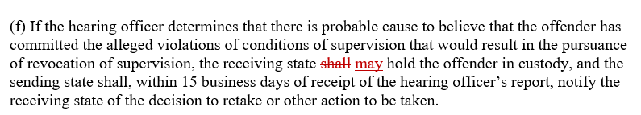
Rule 5.108 (f)-West Region
Probable Cause Hearing in the Receiving State
‘Shall’ requirement posed challenges when:
the sending state ordered the supervised individual’s return in lieu of issuing a warrant to retake;
the sending state needs probable cause established in order to obtain a warrant to retake; and
receiving states do not have warrantless arrest powers.
By changing the wording from "shall" to "may," states will still be able to hold a supervised individual in custody
Effective March 1, 2024
Notes:
Summary: Changing ‘shall’ to ‘may’ in subsection (f)
The "shall" requirement is not a requirement of the Supreme Court decision on which Rule 5.108 is based.
Rule 5.108 does not require an offender to be held in custody to conduct a probable cause hearing or to obtain a signed waiver, however current language requires the receiving state to take the offender in custody upon a finding of probable cause. This can pose challenges when:
the sending state may order the offender’s return in lieu of issuing a warrant to retake;
the sending state may need probable cause established in order to obtain a warrant to retake; and
when receiving states do not have warrantless arrest powers.
By changing the wording from "shall" to "may," states will still be able to hold an offender in custody.

Slide 4
Rule 5.108 (f)
Probable Cause Hearing in the Receiving State
Practical Impact
Provides flexibility to states without warrantless powers when the sending state has not issued a warrant pending PC or when the decision to retake versus order return for behavior requiring retaking has not been made.
Does not authorize jails to release supervised individuals pending retaking
Jails may not authorize an individual’s release without the compact office’s approval and acknowledgment, including when a sending state fails to pick up the individual within the thirty days required for retaking.
Effective March 1, 2024
Notes:
Provides flexibility to states without warrantless powers when the sending state has not issued a warrant pending PC or when the decision to retake versus order return for behavior requiring retaking has not been made.
The change still permits the receiving jurisdiction to issue a warrant for public safety concerns.
What are the holding requirements for the return of supervised individuals?
The receiving state must detain supervised individuals pending retaking. Jails may not authorize an individual’s release without the compact office’s approval and acknowledgment, including when a sending state fails to pick up the individual within the thirty days required for retaking.

Slide 5
Replacing the term ‘offender’ with ‘supervised individual’
No change to the Commission’s name or statute
No change to ICOTS’ name
States will not need to change their bylaws or statutes
No change to past Advisory Opinions
No change to sex-offender terminology
All current publications and materials will be updated by the national office. (Estimated 12 months to complete.)
The change will affect all documents going forward.
https://interstatecompact.org/sites/default/files/2023-12/Language_Chg_Press_Release.pdf
Notes:
In its ongoing commitment to creating a more inclusive and person-centric environment, the Commission has adopted a significant change in its terminology by replacing the term "offender" with "supervised individual." This transition reflects the Commission’s dedication to promoting dignity, respect, and a rehabilitative approach to those transferring through the Compact.
Why the Change?
The decision to replace "offender" with "supervised individual" aligns with evolving best practices in criminal justice and emphasizes the importance of recognizing the humanity and potential for positive change in each person we serve.
What Does This Mean for States?
Members of the Compact will notice a shift in the language used in our communications, documentation, and discussions. We encourage you to raise awareness of this change throughout our states to ensure its successful implementation.

Slide 6
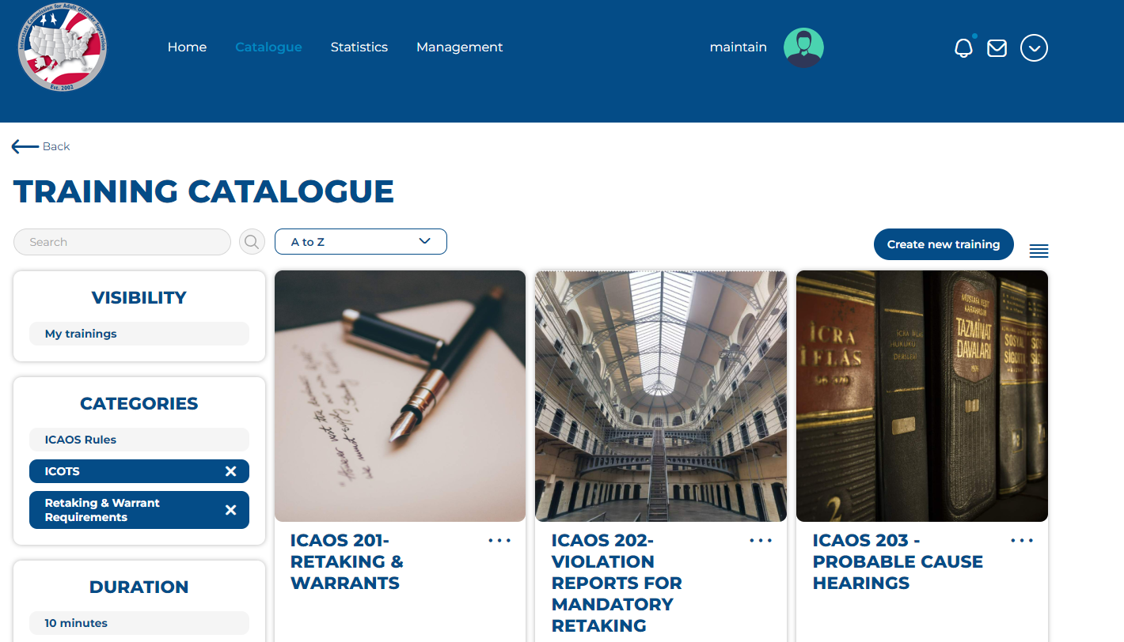
Upgrade!

Slide 7
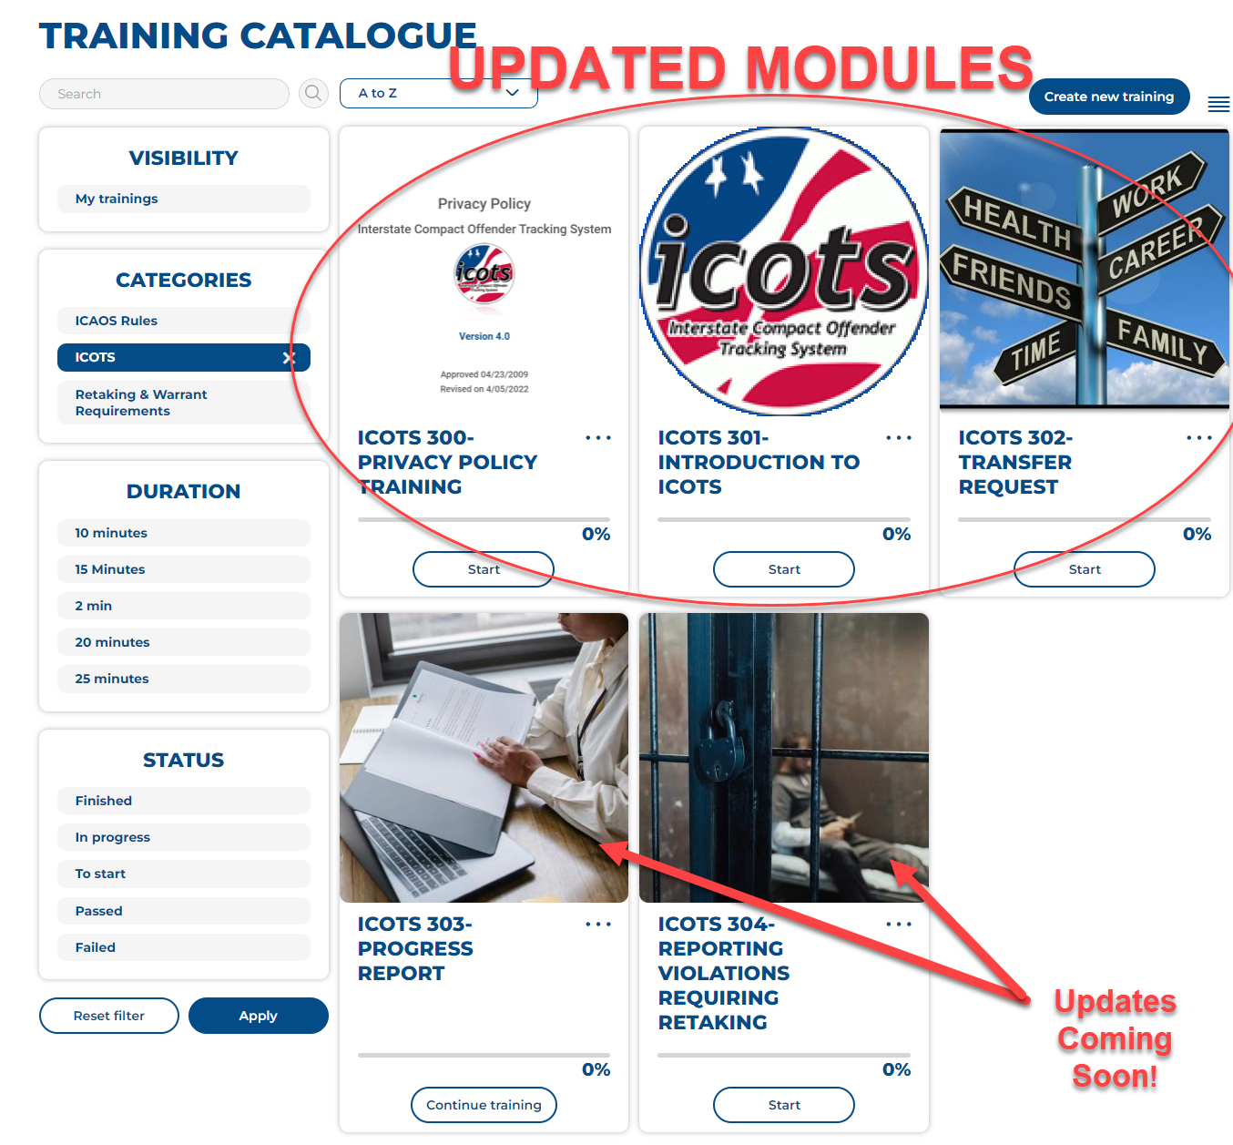

Slide 8

New Registration process:
  Accounts created directly on the training site rather than on the ICAOS
  Allows for immediate login
  ICAOS site only allows for commission log in
    New dashboard request process!
    Request LMS administrator access via helpdesk AFTER creating a training account

Slide 9
Prior achievements/certificates do not exist in the new training site
Rule Amendment for Rule 5.108 (ICAOS-203 Probable Cause Hearings)
Emails sent from training@interstatecompact.org
New Support Documentation!!
Accounts purged after 2 years of inactivity

Slide 10
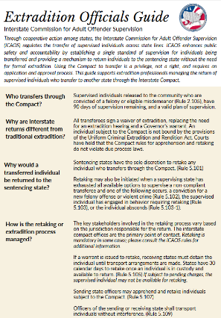
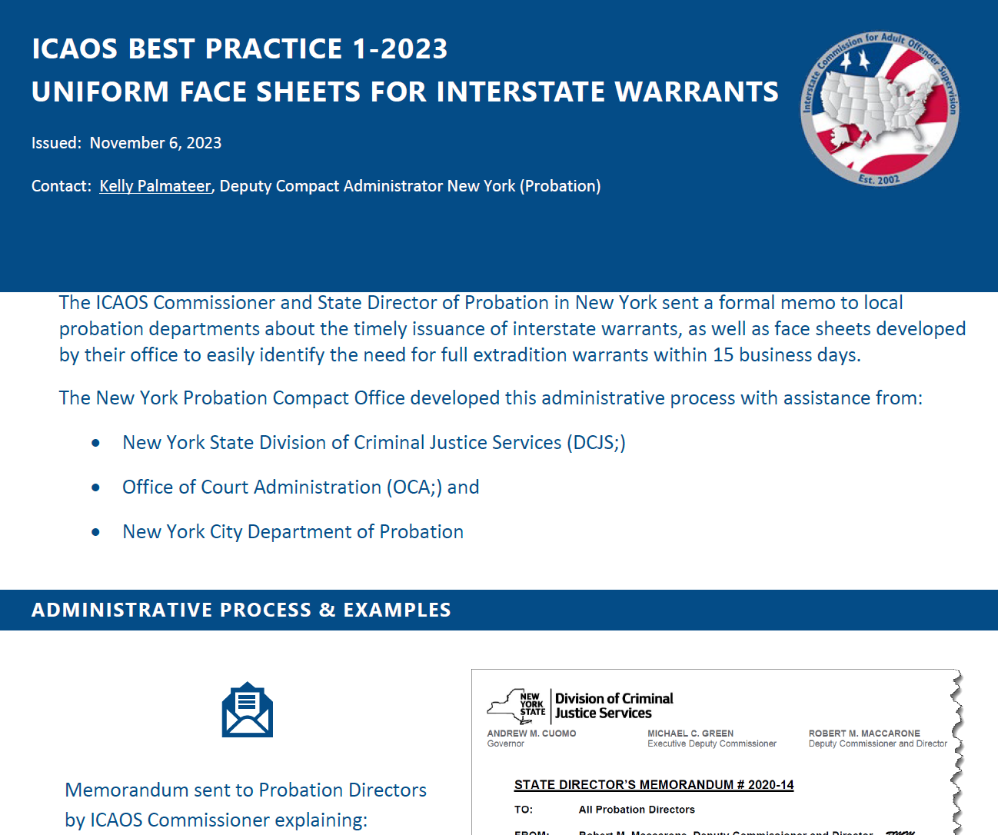
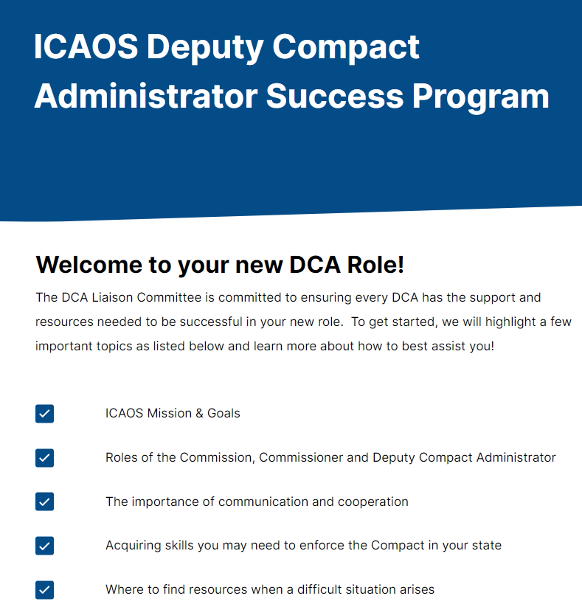
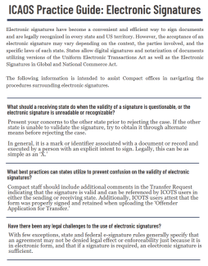
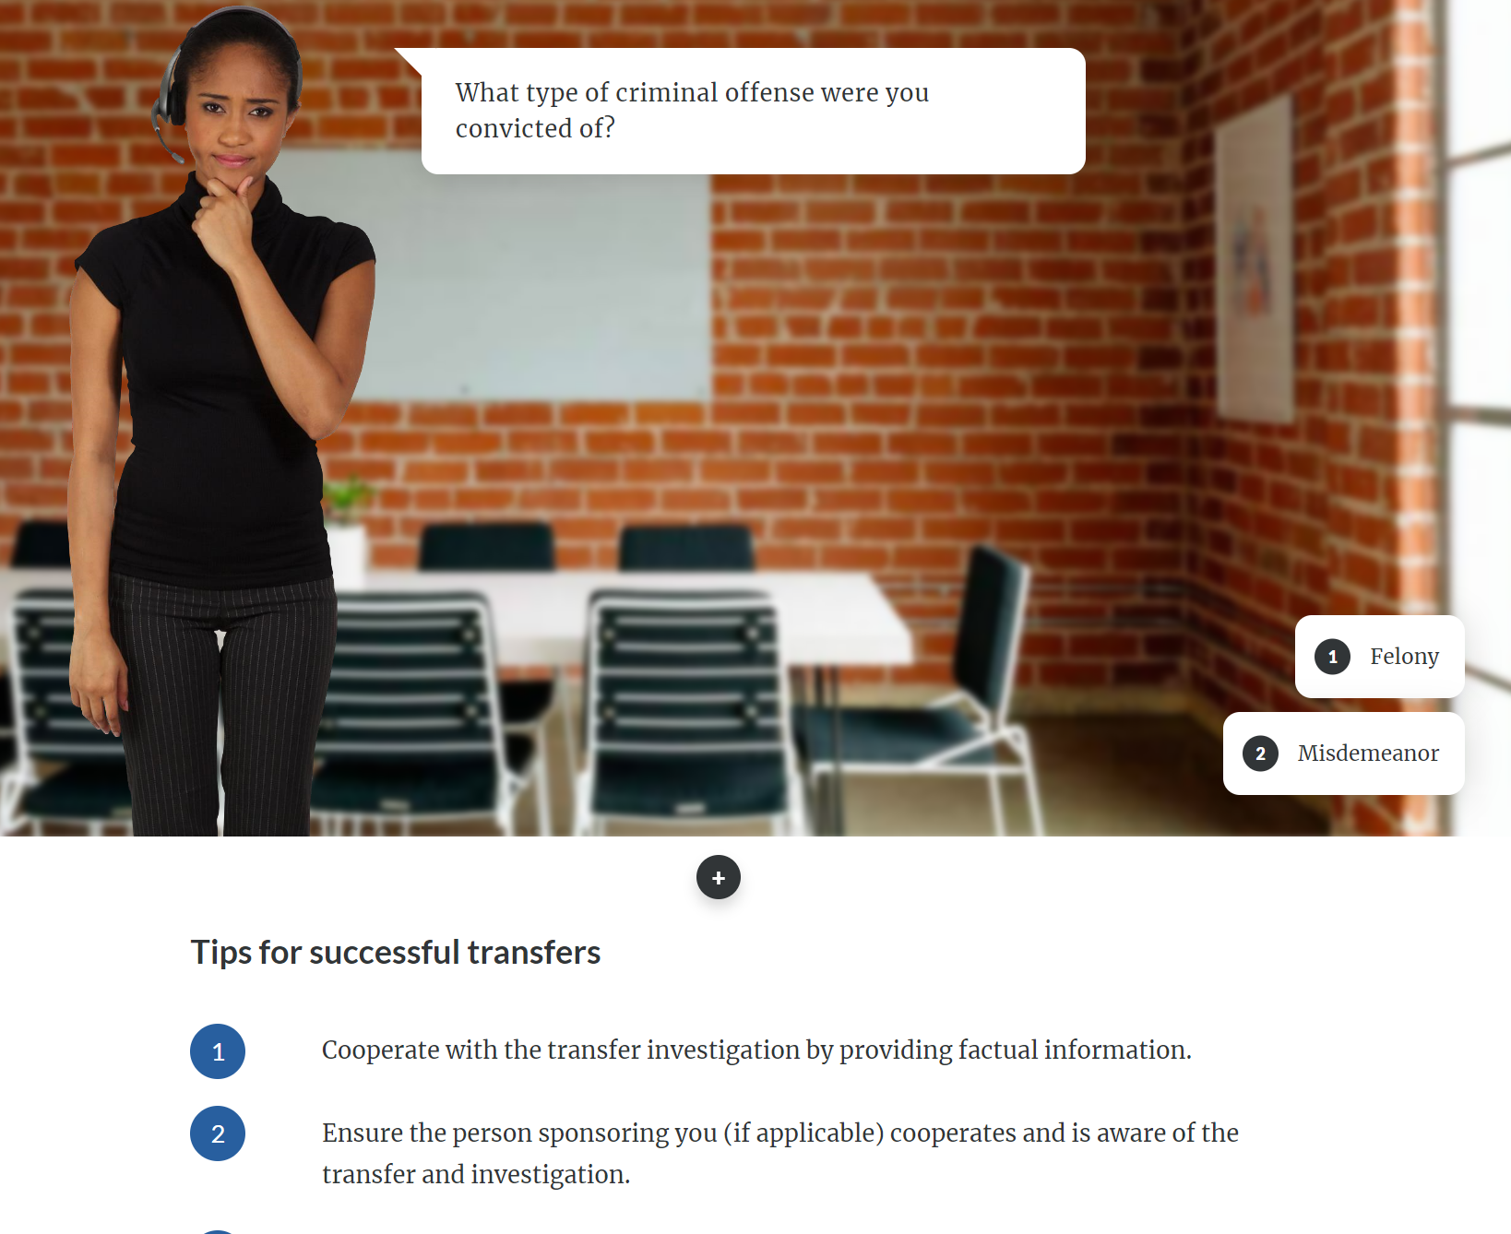
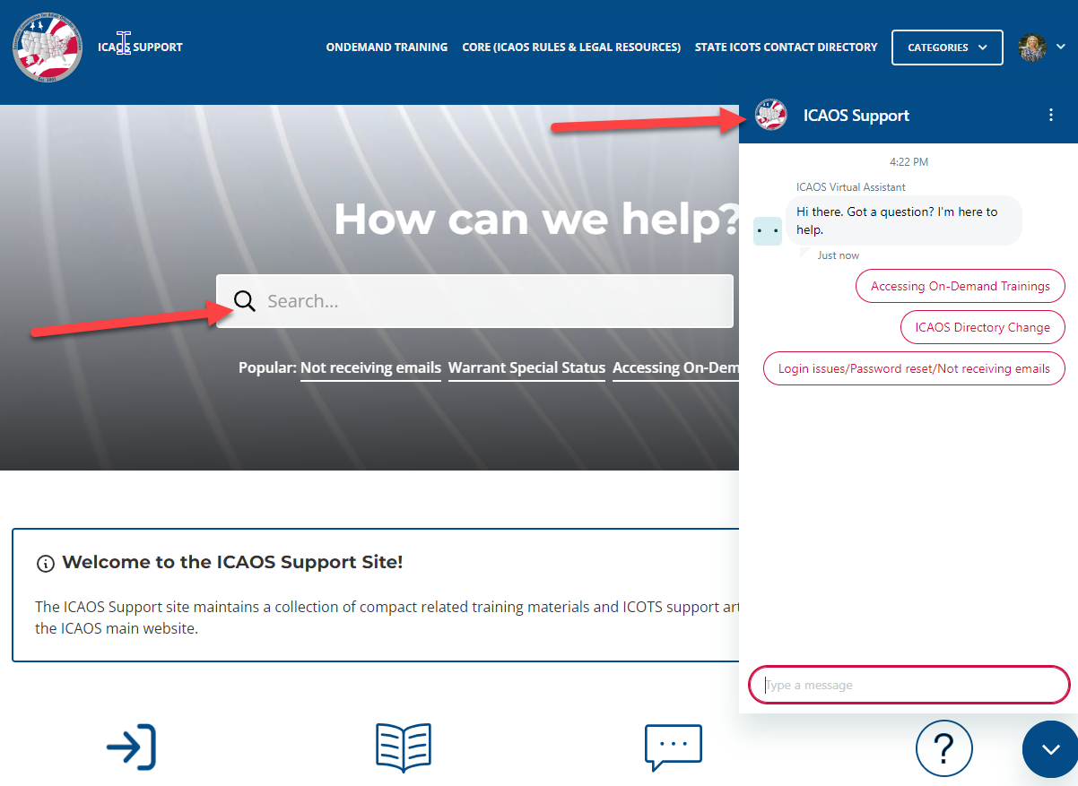

Slide 11
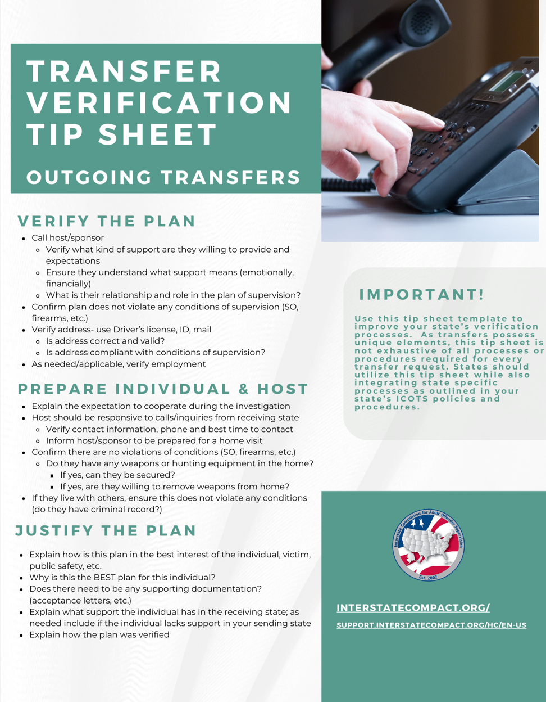
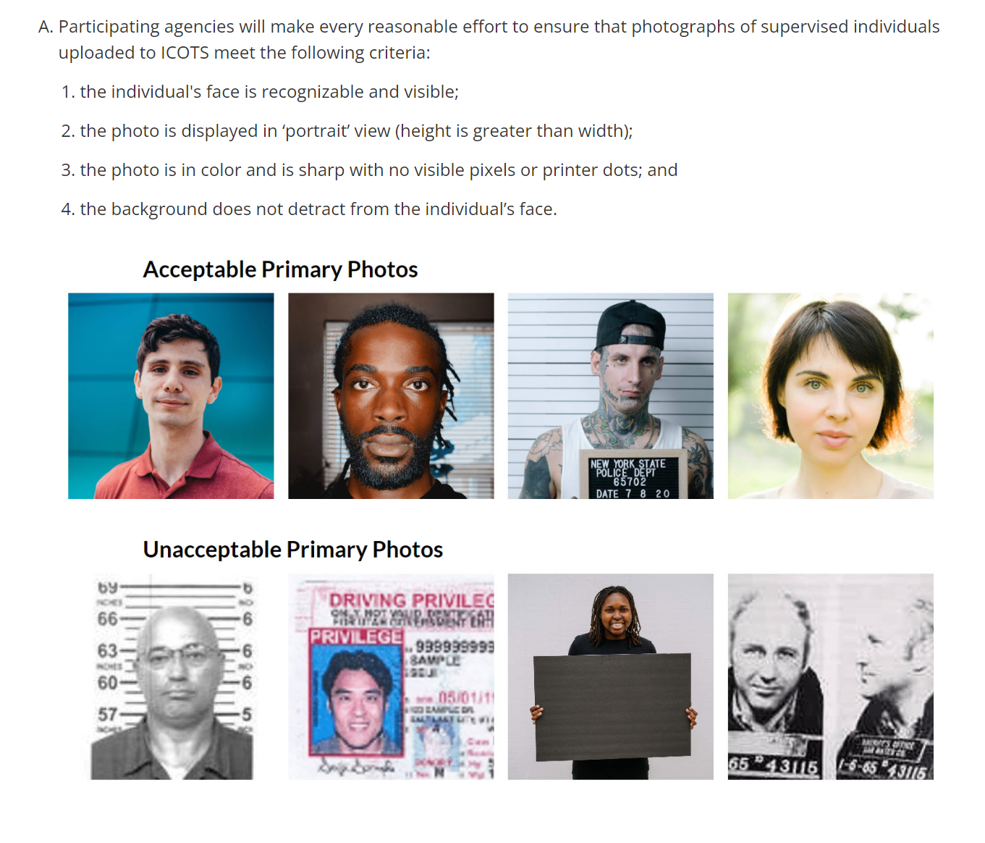
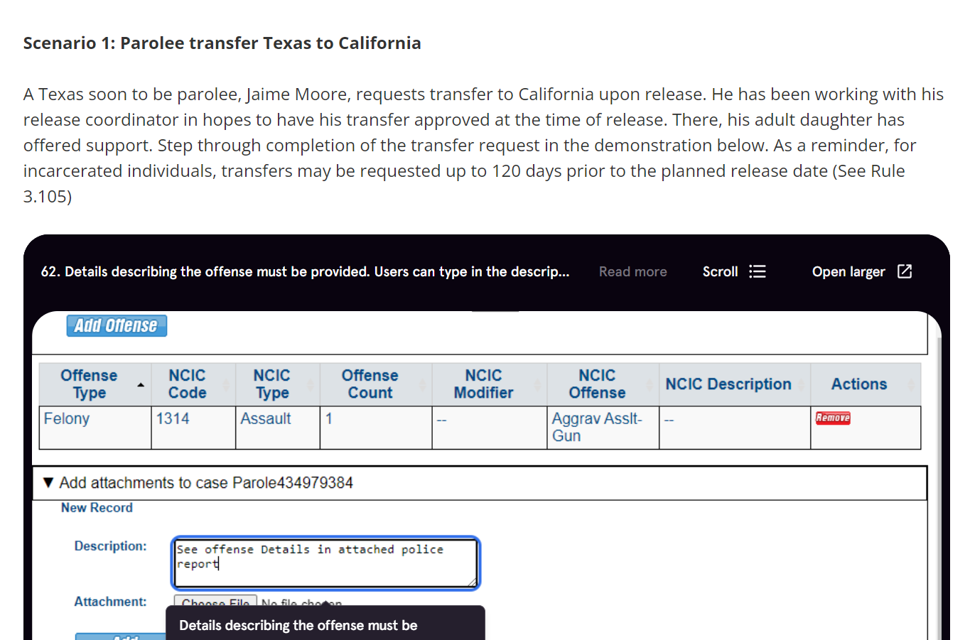
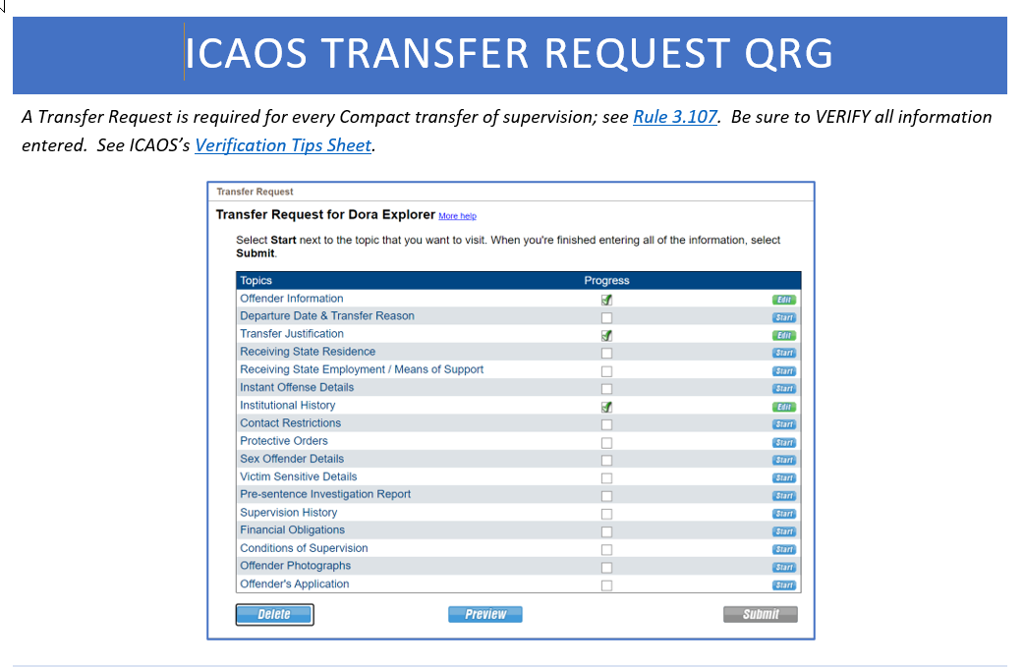
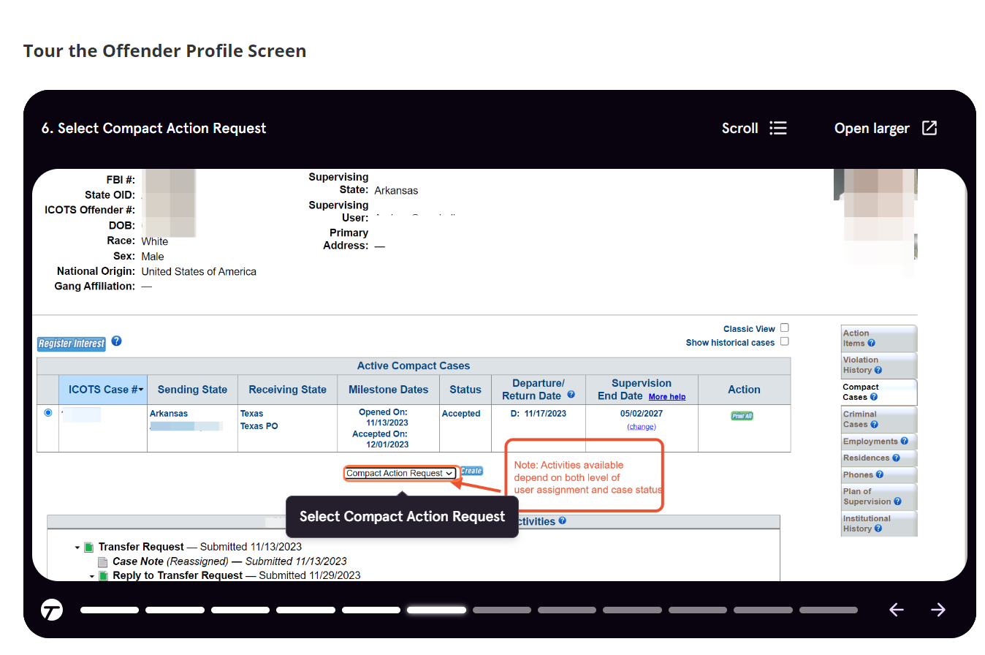
Notes:
Summary of ICOTS Activities
https://support.interstatecompact.org/hc/en-us/articles/19555090316823
Tour the Offender Profile (new training tools in ondemands)
https://support.interstatecompact.org/hc/en-us/articles/19591138374679
Primary Photo Requirements
https://support.interstatecompact.org/hc/en-us/articles/19612649919127
Transfer Verification Tips (Re-formatted)
https://support.interstatecompact.org/hc/en-us/articles/19777348391831
ICAOS Practice Guide: Electronic Signatures
https://support.interstatecompact.org/hc/en-us/articles/1500001939521
Transfer Request QRG
https://support.interstatecompact.org/hc/en-us/articles/20350660862103
RFRI QRG
https://support.interstatecompact.org/hc/en-us/articles/20630309169687
Stakeholder QRG
https://interstatecompact.org/quick-reference-guides
Summary of ICOTS Activities
https://support.interstatecompact.org/hc/en-us/articles/19555090316823
Tour the Offender Profile & Managing Demographic (new training tools in ondemands too)
https://support.interstatecompact.org/hc/en-us/articles/19591138374679
Primary Photo Requirements
https://support.interstatecompact.org/hc/en-us/articles/19612649919127
Transfer Verification Tips (Re-formatted)
https://support.interstatecompact.org/hc/en-us/articles/19777348391831
Transfer Request QRG
https://support.interstatecompact.org/hc/en-us/articles/20350660862103
RFRI QRG
https://support.interstatecompact.org/hc/en-us/articles/20630309169687
NOD & NOA (updated w step through)
https://support.interstatecompact.org/hc/en-us/articles/13584844476055-Notice-of-Departures-Arrivals
Transfer Training Scenarios
https://support.interstatecompact.org/hc/en-us/articles/20715029240855-Transfer-Request-Training-Scenarios
Transfer Reply
https://support.interstatecompact.org/hc/en-us/articles/20715111428119-Transfer-Reply
Transfer Status
https://support.interstatecompact.org/hc/en-us/articles/20715355501591-Reviewing-status-of-Transfer-Request-and-Transfer-Reply

Slide 12

Questions and/or Suggestions?

