Slide 1

Interstate Compact for the Parole Board Member
Interstate Compact for Adult Offender Supervision
Presented by:
Tracy Hudrlik, Minnesota Deputy Compact Administrator

Slide 2
Presentation Objectives
Today you will learn about:
Overview of the Compact Transfer Process
Supervision Expectations
New ideas for supervision/transfer
Strategies for Addressing Non-Compliant Behavior vs. Retaking
Notes:
Learn about how the compact’s function, what authority the compact rules have and implications for not complying with the compact requirements
What are the specific functions of ICAOS
who is required to be transferred through the compacts
high level look at states’ responsibilities and
I also want to hear from you and what questions you have regarding compact or any issues you’ve encountered that we can talk through.

Slide 3
Interstate Compact for Adult Offender Supervision
ICAOS regulates how offenders are:
Transferred from one state to another
Supervised while on Compact Supervision
Returned to a sending state when supervision is not successful
Notes:
A primary purpose of ICAOS is to continue a client's supervision during a defined transfer process in which it is recognized that a person's best chance of success is in a different state such as: family, treatment, employment, or school, for example.
While it is possible to transfer from one state to another, it does not remove one's responsibilities to the court or parole board. Adult offenders must comply with the terms of their original sentence as well as any new conditions imposed by the state they are moving to.
In the event that a person on supervised release violates the conditions of their release, the ICAOS provides a mechanism to return them to their home state.

Slide 4




Purpose of ICAOS
Protect the Rights of Victims
Promote Public Safety
Ensure Effective Supervision &
Rehabilitation
Control/Track Movement of Offenders
Notes:
It's always a good idea to point out the compact's primary functions. It is imperative that no decisions or actions be taken that do not respect these values.
Aim to Improve Public Safety and protect victims' rights.
Further, compact offenders should be given equal access to supervision as well as sanctions and assistance, in accordance with best practices in the supervising state. And through a nationally supported database we are able to tack offender movement and observe trends.

Slide 5
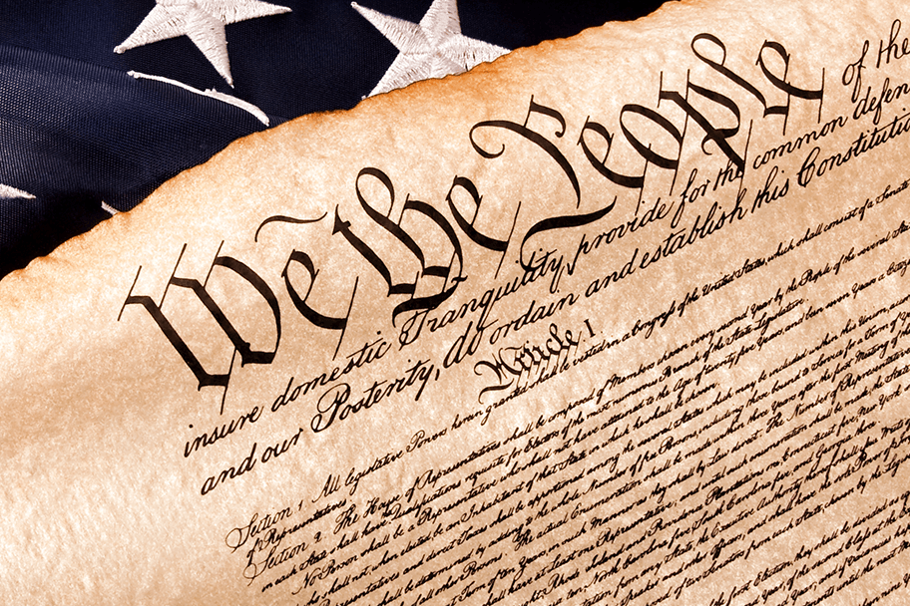


Authority of an Interstate Compact
Authorized
Binding
Supersedes
The Compact is authorized by US Constitution & Crime Control Act
The Compact is binding upon all state authorities & citizens
The Compact rules supersedes conflicting state law
Notes:
While not new, compacts are unique. Authorized by the US constitution and crime control act, they are binding on all member states. And in matters of dispute, the compact rules supersede conflicting state laws. Has anyone here experienced a conflict in your state with the rules of the compact?

Slide 6

Implications of Non-Compliance
Interstate compact rules have the same force and effect as federal law.
Compacting States must comply or could face corrective action/sanctions including monetary fines.
5
This Photo by Unknown Author is licensed under CC BY-NC
Notes:
It is critical to explain the repercussions to stakeholders who resist complying with the compact's terms.
As I mentioned the compact rules are binding on all state officials.
The rules and by-laws adopted by states address how noncompliance is handled, which is most often corrective action, training requirements, fines or fees, and in some more serious cases if a state fails to take corrective actions, the Commission may initiate a federal lawsuit against the state.

Slide 7
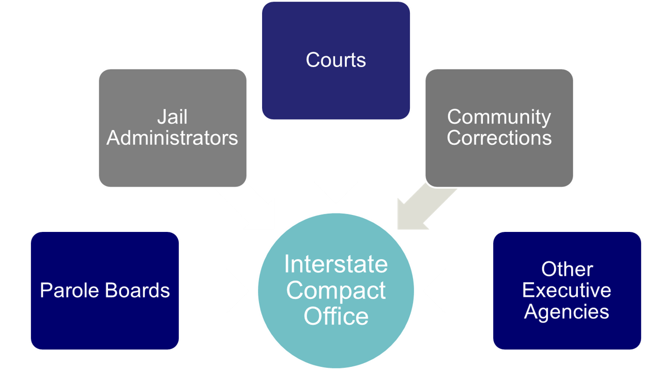
Interstate Compact Offices
Administers the Compact
Point of contact for case specific questions
Conducts training
Resolves issues with other states
Ensures rule compliance
Develops & recommends in-state ISC operating procedures to State Council
Interstate Compact Office
Notes:
Compact offices are a essential resource and play an important role in ensuring success. They can also assist you in locating information, finding solutions or understanding the implications of difficult cases. Who here is familiar with their compact office?

Slide 8
What Triggers the ICAOS?
Offender
Supervision
Relocate
Adult who commits a criminal offense (all felonies & specific misdemeanants)
Subject to ‘supervision’; and
Released to the community under the jurisdiction of:
  Courts
  Paroling Authorities
  Corrections
  Other Criminal Justice Agencies
2 Distinct criteria:
  Oversight exercised by a controlling authority, which includes:
    Courts
    Paroling Authorities
    Corrections
    Other Criminal Justice Agencies
  Required to monitor regulations or conditions, other than monetary
Offender means to remain in another state for more than 45 consecutive days in any 12 month period.
+
+
Notes:
So what triggers the ICAOS? First, the individual must meet the compact’s definition of offender.
They must also meet its criteria for supervision
And finally, they must plan to remain in the other state for more than 45 days. Less that than, they can apply for a travel permit if the state permits it.

Slide 9
What Makes an Offender Eligible for Transfer?
1
2
3
4
Time Remaining on Supervision
The offender has more than 90 calendar days or an indefinite period of supervision remaining
Valid Plan
The Offender has a valid plan of supervision
Compliance
The offender is in substantial compliance with the terms of supervision
Resident/Family
The offender is a resident or has resident family and a willingness to assist the offender AND the offender can obtain employment or has a means of support
There is no “right” of convicted persons to travel across state lines or to serve one’s sentence in a particular state. See, Jones v. Harris, 452 U.S. 412 (1981); Meachum v. Fano, 427 U.S. 215 (1976)
Convicted persons have no right to control where they live; the right is extinguished for the balance of their sentence. Williams v. Wisconsin, 336 F.3d 576 (7th Cir. 2003), Pelland v. RI,317 F. Supp. 2d 26 (2004)
Notes:
Other eligibility criteria for transfer must demonstrate that relocating to another state is offender’s best chance for success. To be successful, offenders must have a good supervision plan and not be in violation status in the sending state, but most importantly they should have ties to the receiving state as being a resident or having family support.
It’s important to remember, no convicted person has a right to server his or her sentence in another state.
This must be understood by offenders who are permitted to transfer, and that the compact is seen as a legal mechanism for them to live and be supervised in the receiving state, rather than as an impediment to their supervision.

Slide 10
Mandatory versus Discretionary Transfers
All Transfers should illustrate
Successful Completion of Supervision
Public Safety
Rehabilitation of Offenders
Protect Rights of Victims
Mandatory
Discretionary
Receiving State must accept supervision if:
Mandatory criteria transfer is met; and
Information is verified; and
Plan is valid; and
  Acceptable for in state offender
Required documentation is provided
Receiving state may accept or reject supervision in a manner consistent with the purpose of the compact
Sending state must justify “WHY”
Rejections must include specific reasons for rejection
Notes:
There are two types of Transfer. Mandatory transfer and discretionary?
The term mandatory does not express or imply that an offender has a constitutionally protected right to transfer. In this instance, the term simply means that they meet the eligibility criteria that compels a receiving state to accept supervision after an investigation determines the plan of supervision is valid in the receiving state.
If documentation and reason show the client meets mandatory criteria, the receiving state is required to accept supervision.
Alternatively, it doesn’t mean a receiving state can reject for any reason when it is a discretionary transfer.
Decisions must show they are made in line with the purposes of the compact and be detailed so they address the justification for transfer provided by the sending state

Slide 11
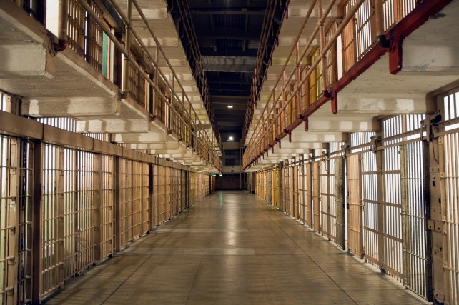
Submit request within 120 calendar days prior to release date
Sending state shall notify receiving state if:
Pre-Release Transfer
the planned release date changes, or
if release date has been withdrawn or denied
Notes:
Can you begin the process early? Yes.

Slide 12

Compact Supervision in a Receiving State
Supervision standard consistent with similar offenders sentenced in the Receiving State
Same programs, incentives, sanctions/interventions
‘Participation in the ICAOS ensures not only the controlled movement of offenders under community supervision, but also that out-of-state offenders will be given the same resources and supervision provided to similar in-state offenders including the use of incentives, corrective actions, graduated responses and other supervision techniques’
Notes:
Once allowed to transfer, receiving states must provide consistent supervision in the same way that they would supervise an offender sentenced in the receiving state. Although most states meet this requirement without problem, it can be a training issue for stakeholders involved in supervision decisions or rehabilitation programs.
Receiving states must subject the offender to all the supervision procedures and behavioral responses that are in place for in-state offenders, with the exception of modifying the supervision term or revoking conditional release, which can only be done by the sending state.

Slide 13

Supervision Goals
Less offenders returning to institution for formal revocation
  New strategies to address non-compliant behavior
  Exhaust alternatives to revocation while the offender is supervised in the receiving state
Ensure retaking is initiated ONLY when it MAKES SENSE!
  Retaking isn’t guaranteed to be permanent
  Retaking costs $$
  Documentation should support revocation
Notes:
Offenders usually live in the receiving state. Violation doesn’t mean they won’t come back. Don’t you want offenders to have best opportunity to succeed in your community??
Supervision goals should show that offenders are returning to institutions for formal revocation in smaller numbers and employ new approaches to dealing with non-compliant behavior.
While the offender is under supervision in the receiving state, explore all possible alternatives to revocation when violations occur. Make certain that retaking is only initiated when it MAKES SENSE! The results of retaking are not guaranteed to be permanent especially when you factor in the cost of retaking.
Use of Evidenced Based Practices such as graduated response, sanctions, or access to programs should be the same for compact offenders

Slide 14
Common Challenges
Compact Supervision in a Receiving State
Differences in Supervision
States’ responses to behavior and path revocation vary across jurisdictions
Recognizing another state’s documentation
Stakeholder Involvement
Ensure sanctions are exhausted before requiring retaking
  If offender is retaken, it means receiving state would revoke
Actions and documentation provided by another state
Ensure compliance: warrants, timeframes, costs
New pending charges = Offender not available for retaking (unless key stakeholders in both states agree due to public safety concerns)
Notes:
On the other hand, states recognizing another state's documentation face difficulties, and the path to revocation may differ in a receiving state versus a sending state. The commission has issued legal white papers on a number of these challenges. Many emphasize the responsibility of states to educate and involve their relevant stakeholders in decision-making.
While numerous courts have ruled that convicted individuals do not have the right to relocate from one state to another (as discussed earlier), courts have also ruled that once relocation is granted, states should not revoke it lightly or arbitrarily.
Retaking does not guarantee that an offender will be revoked once they return to the sending state, but if they are noncompliant while under supervision, that is the purpose of the retaking, thus states must maintain good documentation and communication in order to respond to violation situations properly.
.

Slide 15

Tools & Training
  ICAOS Quick Reference Guides: Relate to your own instate processes
    Courts
    Jails
    Transport/Extradition Teams
    Probationer/Parolee: Work WITH individuals transferring. Understanding of the process & cooperation promotes acceptances.
  Stakeholder Training: Keep Collaborative
    How can Compact assist?
    How can Stakeholder assist Compact?
Notes:
Tools and resources are essential for ensuring that compact requirements in our states are linked to existing processes. Is it necessary for everyone to be aware of every rule and requirement? No, we want to keep things simple and refer to what may already be out there.
Several states develop quick reference guides for stakeholders and individuals involved in the transfer process. We saw an increase in remote sentencing with COVID, which may be here to stay in many states due to the cost savings and logistics of them. That means that compact offenders may never physically be in the sending state and are already in the receiving state when sentenced.
Lets talk about some of the things states have done to improve their compact processes.

Slide 16

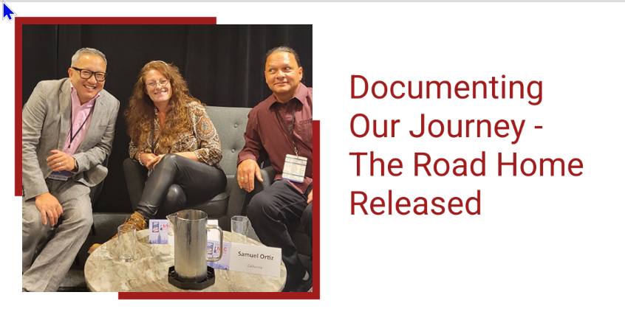
https://www.interstatecompact.org/documentary/the-road-home
Notes:
The Interstate Commission for Adult Offender Supervision (ICAOS) in collaboration with the National Institute of Corrections (NIC) presents a documentary on Compact history and real-life stories of adults navigating through the Compact
In a project that began over two years, ICAOS engaged the National Institute of Corrections to create a 60-minute documentary about adults on probation or parole as they navigate the interstate transfer process. The Commission wanted to see the compact through their eyes and engage audiences with an intimate look into their perspective as they use the Compact in the hopes of reuniting with their families in another state.
The film also demonstrates how ICAOS and NIC play critical roles in the American judicial system, including a historical primer and an examination of the pivotal 2002 Compact milestone from the standpoint of subject matter experts. It is a pleasure to finally present the finished film to the public.

Slide 17
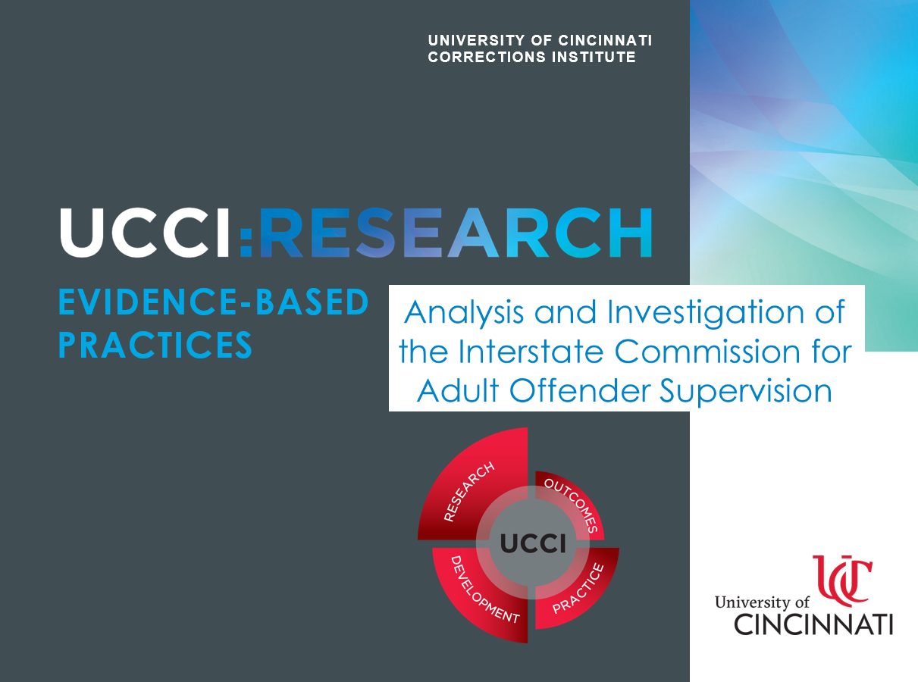
https://www.interstatecompact.org/sites/default/files/2022-09/UCCI_Final_Report_2022.pdf

Slide 18
Outcomes from Documentary & UCCI Study

Slide 19

Commission Improvement Considerations
ICOTS Improvements
  Look/usability
  Communication Tools
Risk Factors: Analyze rules & procedures to ensure alignment w/Evidence Based Practices.
  Eligibility for transfer
  Supervision expectations
Terminology Used
  Replacing the term ‘offender’

Slide 20

Compact Office/State Improvement Considerations
Improve Communication
  Improve quality & quantity w/ both Internal & External Agencies
Enhance stakeholder involvement
  Courts/Release agencies
  Supervising agencies
  Victims
  Extradition teams/jails
Highlight Core Correctional Practices in ISC Training
  Effective reinforcement,
  Effective disapproval, and
  Effective use of authority

Slide 21

Field Improvement Considerations
Enhance communication & correspondence
  When using ICOTS
  With stakeholders involved in compact cases
  With transferees and sponsors, particularly during the transfer process
Improve documentation
Learn how transferee’s needs are identified
Promote supervision success

Slide 22
State Initiative Examples
Promoting Successful Supervision
Notes:
Hit on the fact the pandemic changed the threshold for revocation and retaking.
NE- 90 days sanction time before pursuing revocation]
Pandemic changed threshold for custody/return to prison in many, if not all, states
GPS/electronic monitoring as a response to violations

Slide 23

Minnesota
Hearing & Release Unit using standardized Prehearing Worksheet (risk based)
  For incoming cases: Apply worksheet to compact cases to determine whether to resume supervision or pursue retaking
  For outgoing cases: When violation does not meet criteria for a revocation hearing, MN communicates with the receiving state to avoid retaking when no chance of return to institution is known
Notes:
MN uses a risk assessment prior to retaking to try and work with receiving state and stakeholders are important participants in that conversation
This has limited number of people going back to institution and imposed criteria so their responses to violations are consistent

Slide 24

Nebraska
Parole Board Member on NE’s State Council
  Promotes NE’s Authority over out of state cases in its Behavioral Management System
  Ensures NE exhausts/documents ALL efforts to bring offenders into compliance before requiring retake by sending state
    Including Board of Parole imposed custodial sanctions (up to 60 days) & other revocation alternatives
Notes:
Nebraska makes it a point to have a member of the parole board serve on their state council. This strengthens NE's authority over out-of-state cases in its Behavioral Management System, and it assures that NE documents ALL efforts to bring offenders into compliance before retaking. This includes any correctional sanctions issued by the parole board as well as any revocation alternatives.

Slide 25

South Dakota
Parole case staffing committee reviews revocation recommendations for BOTH instate and compact cases
  Ensures consistency and compliance w/ ICAOS Rules
  Technical violations rarely result in revocation in SD, so retaking is rarely initiated for interstate cases supervised in SD
Notes:
Revocation recommendations for both instate and compact cases are reviewed by the South Dakota parole case staffing committee. This ensures consistency and compliance with the ICAOS rules. SD has a low rate of revocation due to technical violations, which means that retaking is rarely required in interstate cases.

Slide 26

Missouri
Lead parole analyst works closely with interstate office
  Familiar w/ ICAOS Rules & Processes
  Anticipates questions from board members when dealing with retaking cases and out of state violation documentation
Notes:
In Missouri, the lead parole analyst collaborates closely with the interstate office. They are familiar with ICAOS rules and procedures and can anticipate questions from board members When dealing with retaking cases and out-of-state violation documentation.

Slide 27

Ohio
Utilization of violation matrix ensures considerations were made for compact cases
  Interstate Office has close relationship with Parole Board & Hearing Officers
  Hearing Officers qualify that supervising officer in Ohio has exhausted efforts and ensure retake for a compact offender = revocation level
Notes:
Ohio employs a violation matrix to ensure that considerations for compact cases were taken into account. Their Interstate Office maintains close contact with the Parole Board and Hearing Officers. Hearing Officers in Ohio determine whether the supervising officer has exhausted his or her efforts and whether or not a compact offender should be retaken.

Slide 28
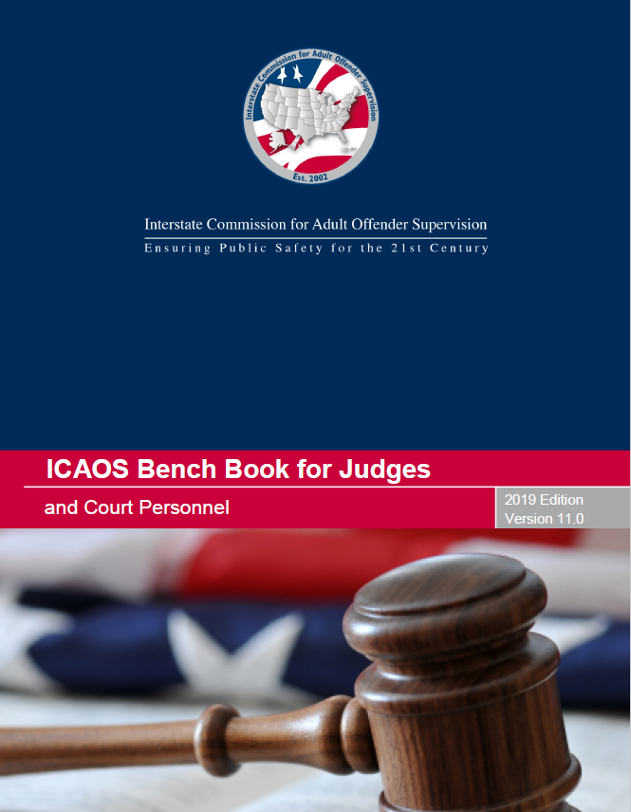

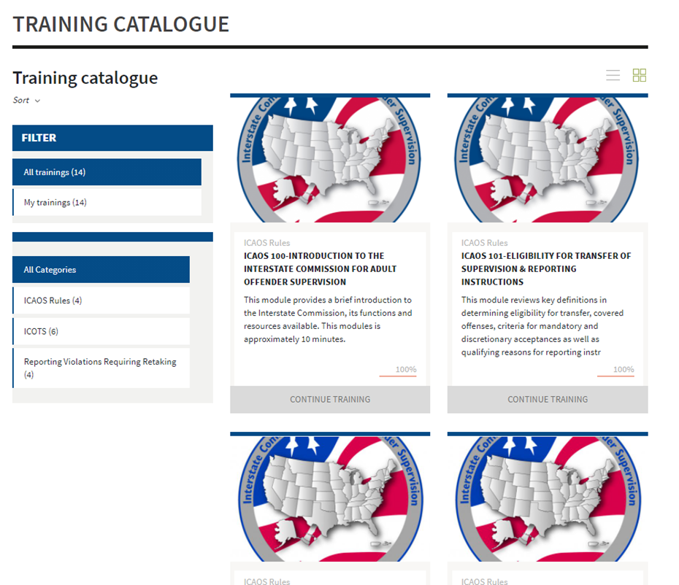
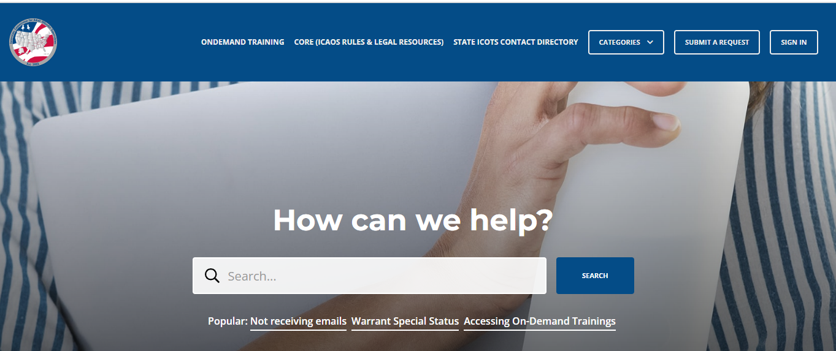
Contact the ICAOS National Office
Email
icaos@interstatecompact.org
Phone
859.721.1050
Website
www.interstatecompact.org
https://www.interstatecompact.org/core-search
https://www.interstatecompact.org/bench-book
https://support.interstatecompact.org/hc/en-us
Office
3070 Lake Crest Circle
Suite 400-264
Lexington, KY 40513

