Slide 1

Future of ICAOS
The Next 20 Years
Interstate Compact for Adult Offender Supervision
Presented by:
Katrina Ransom (OH), Commissioner
Suzanne Brooks (OH), DCA Liaison Committee Chair
Notes:
Who has been involved in a transfer? Who knows nothing about IC?

Slide 2
Presentation Objectives
Today you will learn about:
Overview of the Compact Process
New ICAOS Documentary: The Road Home
UCCI Study of ICAOS

Slide 3
Interstate Compact for Adult Offender Supervision
ICAOS regulates how offenders are:
Transferred from one state to another
Supervised while on Compact Supervision
Returned to a sending state when supervision is not successful
Notes:
The compact (formal agreement of all 50 state and 3 US territories including PR, District of Columbia and Virgin Islands) provides a mechanism for individuals on probation and parole to be supervised in another state other than the one they were sentenced in or served prison time.
The compact provides a transfer process, supervision expectations of the supervising state as well as recognizes successful supervision may not always occur so if the client violates to the extent supervision would be revoked in a receiving state, a process exists for returning a client to the sending state.
As we advance through the presentation, think about these 3 areas and how all of these topics are achieved through cooperation and communication between the two states.
What information would you need to approve or investigate a home plan?
What information is needed for supervision? And
When should a justice involved individual be reincarcerated for violations and what information is needed to go through such a process

Slide 4



Authority of an Interstate Compact
Authorized
Binding
Supersedes
The Compact is authorized by US Constitution & Crime Control Act
The Compact is binding upon all state authorities & citizens
The Compact rules supersedes conflicting state law
Notes:
ICAOS operates with Congressional consent that derives from the Crime Control Act from 1934
Each member state enacted the compact through legislation. And compact rules adopted by the commission supersede any conflicting state laws..

Slide 5
Implications of Non-Compliance
It is incumbent upon prosecutors, judges and other state officials to understand the requirements of the Compact and its rules, as well as the consequences of non-compliance.
Failure of state judicial or executive branch officials to comply with the Compact and its rules results in the state defaulting on its obligations under the Compact and could lead the Commission to take corrective or punitive action, including suit in federal court for injunctive relief.
5
Notes:
Despite that, states and the commission are regularly training its stakeholders on the interstate requirements as even courts are required to comply with the rules.
It is important to note that Failure of state judicial or executive branch officials to comply with the Compact and its rules results in the state defaulting on its obligations under the Compact and could lead the Commission to take corrective action.

Slide 6
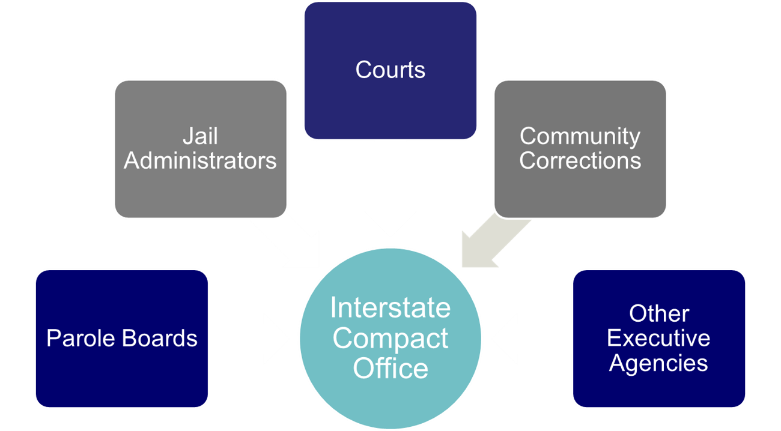
Interstate Compact Offices
Administers the Compact
Point of contact for case specific questions
Conducts training
Resolves issues with other states
Ensures rule compliance
Develops & recommends in-state ISC operating procedures to State Council
Interstate Compact Office
Notes:
Each state has a compact office that manages compact activities and is a training resource for your state. Anytime you have a question about compact or perhaps an issue with anything compact related, elevate to them. We provide a directory on the ICAOS website

Slide 7




Purpose of ICAOS
Protect the Rights of Victims
Promote Public Safety
Ensure Effective Supervision &
Rehabilitation
Control/Track Movement of Offenders
Notes:
Always important to highlight 4 major purposes of compact. No decisions or actions should be made that do not support these.
Promote Public Safety
Protect Victim’s rights
Ensure supervision techniques are consistent with instate offenders and in line with best practices of the supervising state; this includes same access to supervision, sanctions, and services
Through databases supported by each national office, we are tracking and controlling movement of offenders as they cross state lines

Slide 8
ICAOS Creates Circumstances to
Promote Successful Supervision
Ensure Effective Supervision & Rehabilitation
Positive Relationships & Family Support
Life Stability
Means of Support & Employment
Resources/Programs
Notes:
Today we are going to really focus on the goal and purpose of effective supervision and what provides the best chances for success.
We want to ensure justice involved individuals have access to positive relationships, resources, stability and means of support.
So in consideration of the compact, these elements are in another state so documenting and explaining how these elements exist more in another state, we will later show how the explanations are so important to ensure a transfer is accepted and accepted more efficiently.

Slide 9
What Triggers the ICAOS?
Offender
Supervision
Relocate
Adult who commits a criminal offense (all felonies & specific misdemeanants)
Subject to ‘supervision’; and
Released to the community under the jurisdiction of:
  Courts
  Paroling Authorities
  Corrections
  Other Criminal Justice Agencies
2 Distinct criteria:
  Oversight exercised by a controlling authority, which includes:
    Courts
    Paroling Authorities
    Corrections
    Other Criminal Justice Agencies
  Required to monitor regulations or conditions, other than monetary
means to remain in another state for more than 45 consecutive days in any 12 month period.
+
+
Notes:
Eligibility as not everyone on probation or parole is required to transfer
1st has to be guilty of a criminal offense, subject to supervision which is defined as being subject to non(monetary) conditions requiring monitoring. In addition, the compact rules do not govern temporary travel but any transfer in which the individual intends to be in the other state for at least 45 days

Slide 10

What Requirements for Transfer?
1
2
3
4
Time Remaining on Supervision
>= 90 calendar days or an indefinite period of supervision remaining
Valid Plan
Terms & conditions of supervision
Residence
Employment/Means of Support
Substantial Compliance
No initiation of revocation proceedings by Sending State
Justification/Reason
Resident
Family
Employment
Military Orders
Discretionary/ Correctional Sense
Notes:
Other eligibility criteria for transfer must illustrate that relocating to another state is offender’s best chance for success. Offenders must have at least 90 days remaining on supervision term, a good plan, not be in violation status in the sending state and most have ties to the receiving state as being a resident (living in that state prior to committing their offense) or have family support. But any transfer can be accepted under a discretionary reason so long as the transfer makes sense.
As clearly stated in case law, no convicted person has a right to server his or her sentence in another state so this all starts with the sending state verifying the best chances for success exist in another state. I also want to stress it’s imperative clients understand this when allowed to transfer and are expected to cooperate with the investigation process.

Slide 11

Compact Supervision in a Receiving State
Supervision standard consistent with similar offenders sentenced in the Receiving State
Same programs, incentives, sanctions/interventions
‘Participation in the ICAOS ensures not only the controlled movement of offenders under community supervision, but also that out-of-state offenders will be given the same resources and supervision provided to similar in-state offenders including the use of incentives, corrective actions, graduated responses and other supervision techniques’
Notes:
Shifting to after the transfer is accepted, what are the expectations of the receiving state as a supervising agent.
Once allowed to transfer, receiving states have to provide supervision consistently in how they would supervised an offender sentenced in the receiving state. Although most states fulfill this requirement well under the compact requirements, it can be a training issue for stakeholders involved in supervision decisions or rehabilitation programs.

Slide 12

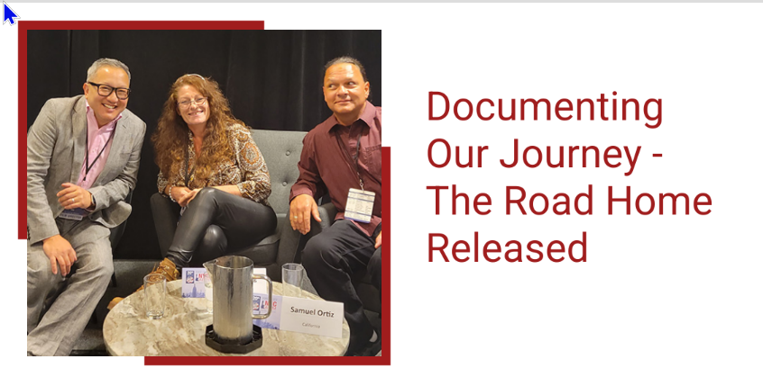
https://www.interstatecompact.org/documentary/the-road-home
Notes:
The Interstate Commission for Adult Offender Supervision (ICAOS) in collaboration with the National Institute of Corrections (NIC) presents a documentary on Compact history and real-life stories of adults navigating through the Compact
In a project that began over two years, ICAOS engaged the National Institute of Corrections to create a 60-minute documentary about adults on probation or parole as they navigate the interstate transfer process. The Commission wanted to see the compact through their eyes and engage audiences with an intimate look into their perspective as they use the Compact in the hopes of reuniting with their families in another state.
The film also demonstrates how ICAOS and NIC play critical roles in the American judicial system, including a historical primer and an examination of the pivotal 2002 Compact milestone from the standpoint of subject matter experts. It is a pleasure to finally present the finished film to the public.

Slide 13
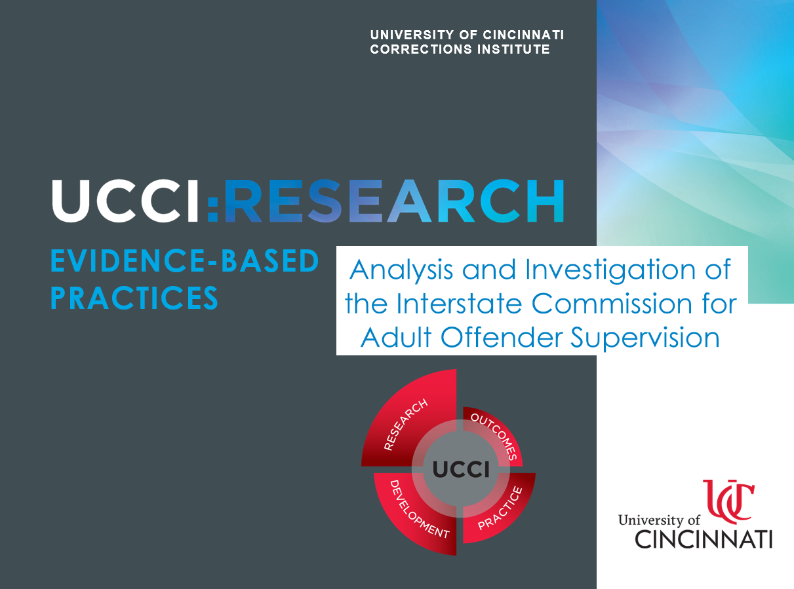
https://www.interstatecompact.org/sites/default/files/2022-09/UCCI_Final_Report_2022.pdf

Slide 14

Officers’ perceptions of the Compact from UCCI Study

Slide 15
Outcomes from Documentary & UCCI Study

Slide 16

Commission Improvement Considerations
ICOTS Improvements
  Look/usability
  Communication Tools
Risk Factors: Analyze rules & procedures to ensure alignment w/Evidence Based Practices.
  Eligibility for transfer
  Supervision expectations
Terminology Used
  Replacing the term ‘offender’

Slide 17

Compact Office/State Improvement Considerations
Improve Communication
  Improve quality & quantity w/ both Internal & External Agencies
Enhance stakeholder involvement
  Courts/Release agencies
  Supervising agencies
  Victims
  Extradition teams/jails
Highlight Core Correctional Practices in ISC Training
  Effective reinforcement,
  Effective disapproval, and
  Effective use of authority

Slide 18

Field Improvement Considerations
Enhance communication & correspondence
  When using ICOTS
  With stakeholders involved in compact cases
  With transferees and sponsors, particularly during the transfer process
Improve documentation
Learn how transferee’s needs are identified
Promote supervision success

Slide 19
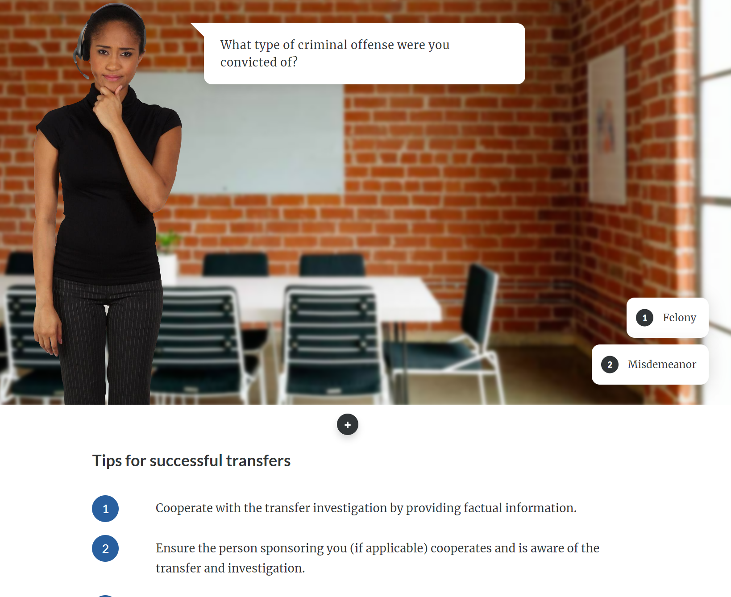
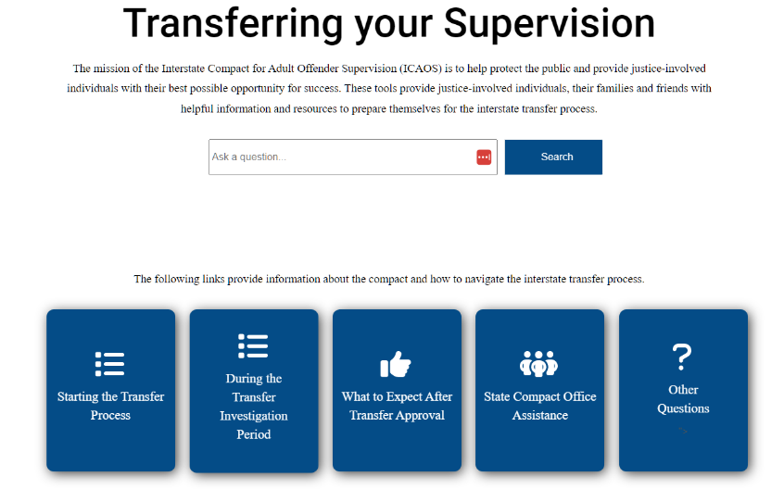
New Navigating the Compact Tool
https://www.interstatecompact.org/resources/transferring-your-supervision
Notes:
These tools provide justice-involved individuals, their families and friends with helpful information and resources to prepare themselves for the interstate transfer process.

Slide 20
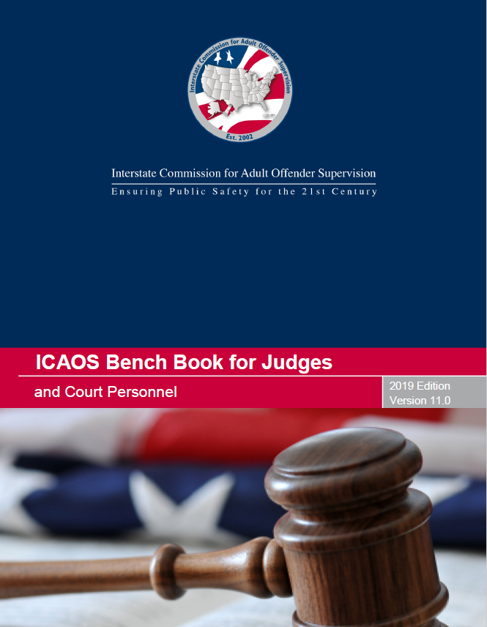

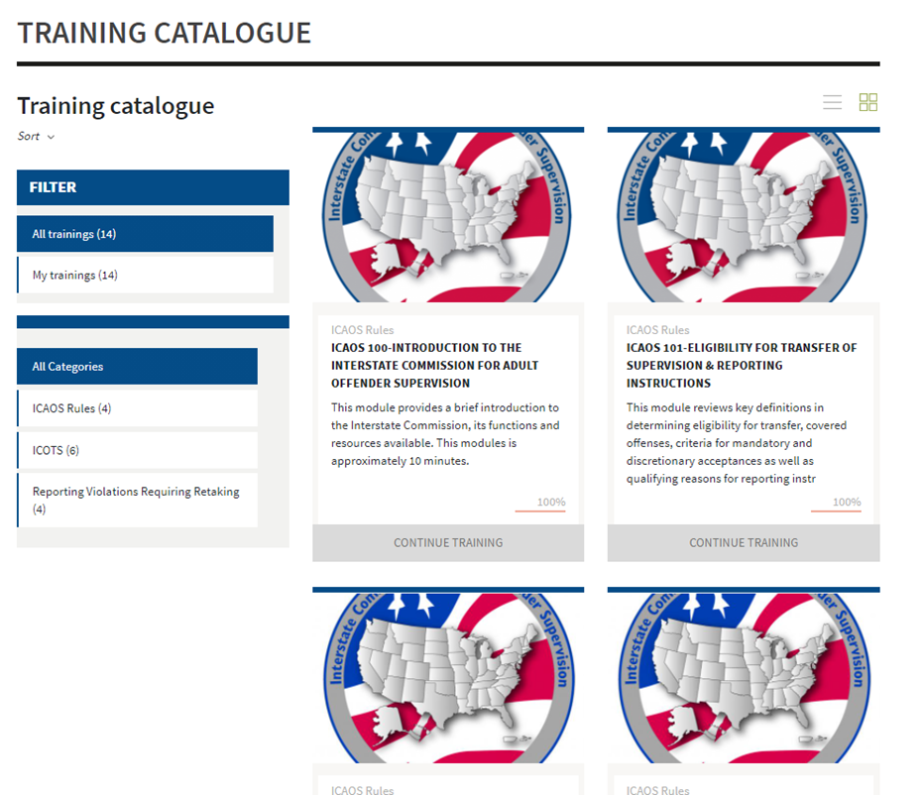
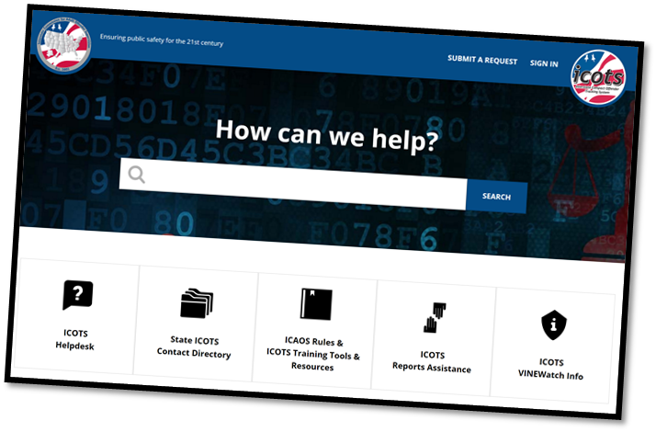
Contact the ICAOS National Office
Email
icaos@interstatecompact.org
Phone
859.721.1050
Website
www.interstatecompact.org
https://www.interstatecompact.org/core-search
https://www.interstatecompact.org/bench-book
https://support.interstatecompact.org/hc/en-us
Office
3070 Lake Crest Circle
Suite 400-264
Lexington, KY 40513

Slide 21

Questions and/or Suggestions?

